Slide 1


Slide 2
What is dbt?
dbt (data build tool) is the open-source standard for transforming data in the warehouse using SQL.
Helps teams apply software engineering best practices like version control, modular design, CI/CD, and documentation to analytics code.
Allows you to build, test, document, and deploy data models collaboratively and safely.
dbt compiles SQL models and runs them on your data platform, making your transformations production-ready.
Enables a single source of truth for metrics and definitions, improving data consistency and collaboration.
Built-in testing and documentation features reduce errors and provide early warnings when data logic breaks.
Notes:
dbt is a tool designed to help with data transformation directly within your data warehouse.dbt follows an ELT architecture where it focuses on the 'T' — Transformation. It uses SQL (and optionally Python) to define transformations as modular, version-controlled code. Using dbt makes data transformation more maintainable and reliable. With testing, documentation, and versioning built-in, teams can collaborate better and avoid data quality issues.

Slide 3
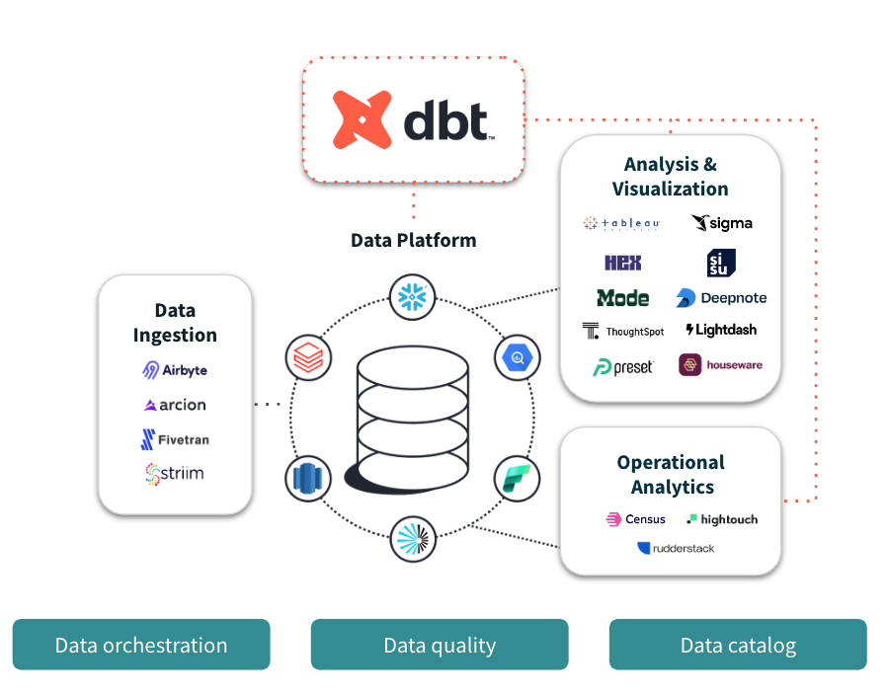
Notes:
dbt compiles and runs your analytics code against your data platform, enabling you and your team to collaborate on a single source of truth for metrics, insights, and business definitions. This single source of truth, combined with the ability to define tests for your data, reduces errors when logic changes, and alerts you when issues arise.

Slide 4
dbt Products
dbt Cloud is a fully managed, web-based platform to develop, test, schedule, and monitor dbt workflows—ideal for teams seeking speed and simplicity.
dbt Core is the open-source, command-line version of dbt for users who prefer manual setup and full control of their dbt environment.
Notes:
dbt comes in two main forms — dbt Core, the open-source CLI tool for transforming data with SQL and Python, and dbt Cloud, a managed platform that builds on Core by adding features like a web IDE, scheduling, logging, and easy collaboration. While Core is great for local development, Cloud is ideal for teams and production workflows.

Slide 5
dbt Core
Command-line interface for building and running dbt projects.
Free and flexible, ideal for local development and CI/CD workflows.
Supports SQL and Python models.
Integrates with version control systems like Git.
Requires external orchestration and hosting.
Notes:
dbt Core is the engine behind all dbt executions. It's open-source and ideal for developers who want full control of their environments using local tools and scripts.

Slide 6
dbt Cloud
Web-based IDE and hosted scheduler for dbt projects.
Includes job scheduling, logging, and notifications.
Provides visual lineage and documentation.
Supports role-based access and job history.
Integrates easily with GitHub, GitLab, BigQuery, Snowflake, and more.
Notes:
dbt Cloud offers a managed experience with additional enterprise features like a browser-based IDE, built-in scheduling, and easier Git integration, making team collaboration smoother.

Slide 7
dbt Cloud – Key Features
All-in-one platform: Develop, test, schedule, document, and monitor data models via a user-friendly browser interface.
Flexible deployment: Run dbt workflows from the browser (IDE) or local command line (CLI).
CI/CD & job scheduling: Automate jobs with schedules or triggers using APIs or webhooks.
Multi-environment setup: Isolate development and production environments for safe testing.
Integrated notifications: Get alerts on job successes, failures, or cancellations via email or Slack.

Slide 8
dbt Core vs dbt Cloud
dbt Core: Free, local execution, flexible, requires orchestration setup.
dbt Cloud: Paid plans, browser IDE, scheduler included, team-friendly.
Core is best for solo developers or CI environments.
Cloud is best for organizations needing collaboration and scheduling.
Both use the same underlying dbt logic and project structure.
Notes:
Choose dbt Core if you're starting small or want full control. Choose dbt Cloud for easier team use and scheduling. You can start with Core and later upgrade to Cloud if needed.

Slide 9
dbt Cloud Architecture (Overview)
Component-based design:
Static components run the web app and essential services continuously.
Dynamic components spin up on demand for tasks like jobs and Cloud IDE sessions.
Infrastructure:
Backed by PostgreSQL, S3-compatible storage, and Kubernetes for dynamic storage volumes.
Available globally in multi-tenant and single-tenant (AWS, Azure) setups.
Secure communication:
All traffic uses HTTPS with TLS 1.2 encryption, protecting data in transit—even on public networks.
Minimal data retention:
dbt Cloud processes but does not persist customer data from warehouse queries—data stays in memory temporarily.
Platform integrations:
Supports GitHub, GitLab, Azure DevOps, and OAuth/SSO auth providers with role-based access control (RBAC).
Security standards:
dbt Labs is certified for SOC 2 Type II, ISO27001:2013, and is GDPR compliant.
Notes:
dbt Cloud follows a component-based architecture with static services running the UI and dynamic components like job runners spinning up on demand. It's built on PostgreSQL, S3-compatible storage, and Kubernetes. All data transmission is secured with TLS encryption, and dbt Cloud doesn’t persist warehouse data—ensuring strong privacy. It also integrates with Git platforms and meets enterprise-grade security standards like SOC 2 and GDPR compliance

Slide 10
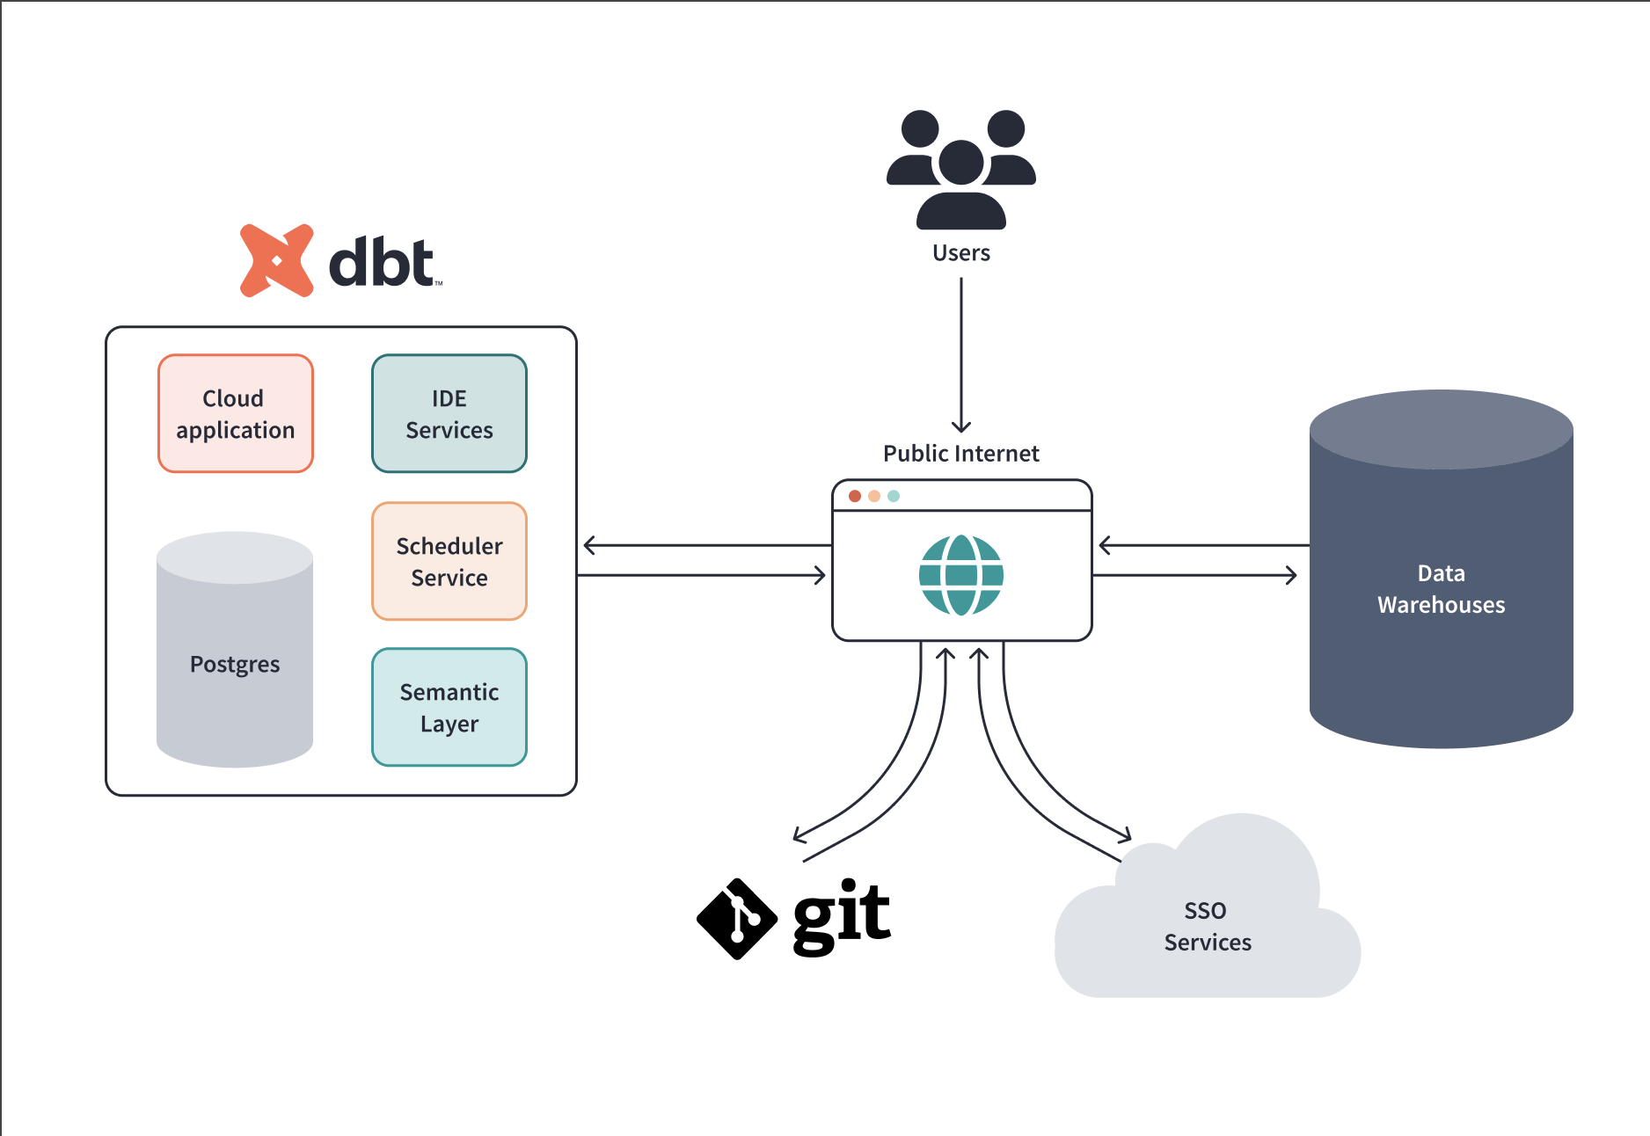
Notes:
Advanced guide to dbt architecture - Link

Slide 11
Supported Data Platforms for dbt
dbt supports a wide range of SQL-based data warehouses and query engines.
Popular cloud platforms:
Snowflake
BigQuery
Amazon Redshift
Databricks
Open-source and local options:
PostgreSQL
DuckDB
Spark (via dbt-spark adapter)
Notes:
dbt supports a wide range of modern cloud data platforms like Snowflake, BigQuery, Redshift, Databricks, and more. This flexibility allows teams to build and deploy transformation workflows directly in their existing data warehouses—keeping the data in place and ensuring performance and scalability

Slide 12
Developing in dbt Cloud
dbt Cloud CLI:
Allows you to develop and run dbt commands from your local command line or code editor connected to dbt Cloud.Link
dbt Cloud IDE:
Browser-based tool to compile code into SQL and manage your project changes efficiently with an intuitive interface.Link
dbt Canvas (Beta):
A drag-and-drop interface for analysts to quickly create and visualize dbt models, streamlining the development process.Link
Notes:
In dbt Cloud, you can develop using the dbt IDE, a browser-based editor that supports version control and collaboration. The dbt Canvas (in beta) offers a visual way to explore and organize your DAG. For more technical workflows, dbt CLI remains a powerful tool for local development and automation.

Slide 13
About dbt Projects
A dbt project informs dbt about the context and how to transform your data.
dbt enforces the top-level structure of a project (e.g., dbt_project.yml file, models directory, snapshots directory).
You can organize your project inside the top-level directories to suit the needs of your organization.
Minimum requirement: The project must include the dbt_project.yml file.
Notes:
A dbt project is the core structure where all your models, tests, and configurations live. It's organized using folders and YAML files, helping teams standardize their data transformations and maintain consistency across environments. If you want to explore dbt projects more in-depth, you can clone dbt Lab’s Jaffle shop on GitHub. It's a runnable project that contains sample configurations and helpful notes.

Slide 14
Project Configuration: dbt_project.yml
Key configuration options in dbt_project.yml:
name: The project’s name in snake case.
version: Version of the project.
require-dbt-version: Restrict to a specific range of dbt Core versions.
profile: The profile dbt uses to connect to the data platform.
model-paths: Directories where model files live.
seed-paths: Directories for seed files.
test-paths: Directories for test files.
analysis-paths: Directories for analysis files.
macro-paths: Directories for macro files.
snapshot-paths: Directories for snapshot files.
docs-paths: Directories for doc files.
vars: Project variables for data compilation.
Notes:
Every dbt project includes a project configuration file called dbt_project.yml. It defines the directory of the dbt project and other project configurations.

Slide 15
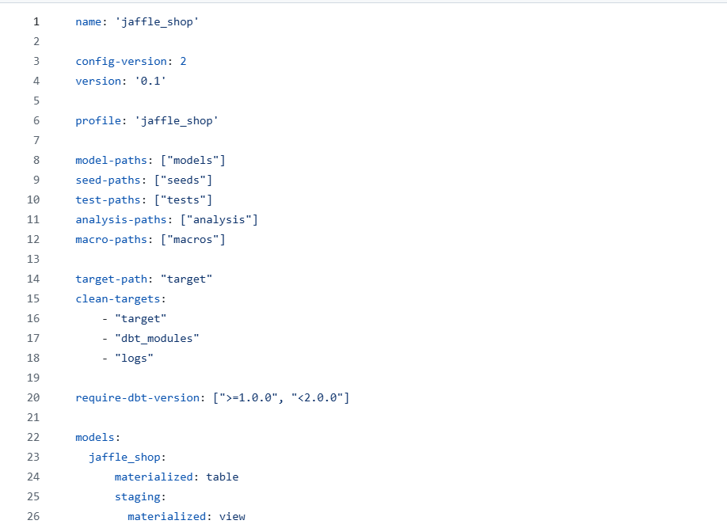
Project Configuration: dbt_project.yml

Slide 16
Commonly used dbt commands
dbt run — Runs the models you defined in your project
dbt build — Builds and tests your selected resources such as models, seeds, snapshots, and tests
dbt test — Executes the tests you defined for your project
dbt seed — Loads static CSV files into the warehouse (used for reference data, mappings, etc.).
Other dbt commands – dbt-commands
Notes:
dbt commands are used to run, test, build, and document your data models. Some commonly used commands include dbt run, dbt test, dbt build, dbt docs generate, and dbt seed. These commands streamline the development workflow and help enforce data quality.
Use dbt run when you specifically want to execute your data transformations.
Use dbt build when you want a more holistic approach that includes building, testing, and managing other dbt resources like snapshots and seeds in a coordinated way, especially when data quality is paramount.

Slide 17
About dbt models
Models are the core of dbt, where SQL or Python code transforms raw data directly within your data warehouse — the "T" in ELT.
Each model is a .sql or .py file containing a final SELECT statement (or logic in Python) that defines how a dataset should be built.
Developers spend most of their time working with models, writing and refining them as business logic, data needs, and efficiency goals evolve.
Python models (supported from dbt v1.3+) allow for more advanced use cases like machine learning, complex transformations, or custom library usage.
Projects are made up of multiple models, which can reference each other to build layered, modular transformations across your data pipeline.
Notes:
dbt models are SQL or Python files where transformations happen. These models define how raw data is transformed into business-relevant metrics and insights. Models are the backbone of your dbt project, and they can be used to build tables, views, or materializations in your data warehouse

Slide 18
About dbt models - schema.yml
The schema.yml file is used to define metadata for models, such as descriptions, tests, and tags.
You can add descriptions to models and columns to document their purpose and improve understanding for data consumers.
The file allows you to define tests on columns (e.g., unique, not_null, accepted_values, relationships) to ensure data quality.
You can assign tags and meta properties for categorization, tracking, or integration with external tools.
dbt uses this metadata when running commands like dbt docs generate to build searchable, interactive documentation.
The schema.yml is kept in the same folder as your model files for modularity and better project organization.
Notes:
The schema.yml file in dbt is where you document models, add descriptions, define tests, and manage metadata. It's placed alongside your model .sql files and helps maintain clarity, governance, and testability within your data models. Sample File - LINK

Slide 19
About dbt models - SQL models
dbt's Python capabilities extend its core functionality beyond SQL models.
A SQL model in dbt is simply a SELECT statement stored in a .sql file.
Each .sql file contains one model, and the model name must match the filename exactly — including case sensitivity.
Use underscores (e.g., my_model.sql) instead of dots (e.g., my.model.sql) in filenames to avoid issues with configurations and metadata.
Models can be nested in subdirectories within the models/ folder for better organization.
When you run dbt run, dbt wraps the SQL in CREATE VIEW AS or CREATE TABLE AS statements to build the model in your data warehouse.
Notes:
By default dbt will:
Create models as views
Build models in a target schema you define
Use your file name as the view or table
name in the database

Slide 20
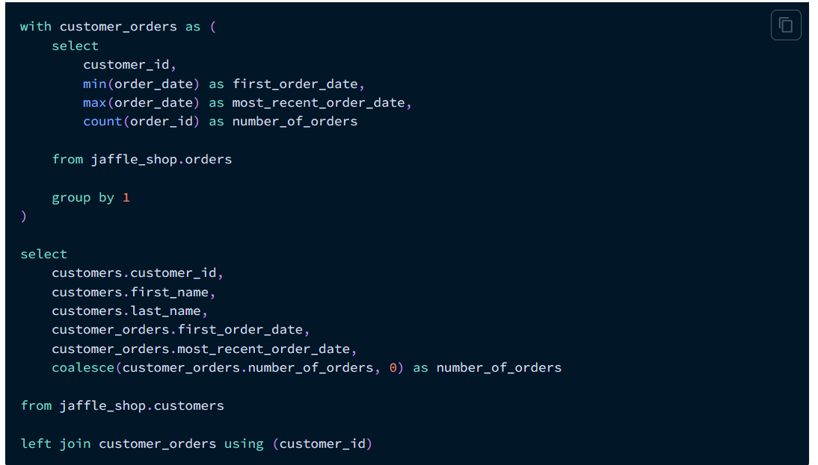
Notes:
Consider a customer.sql model being created

Slide 21
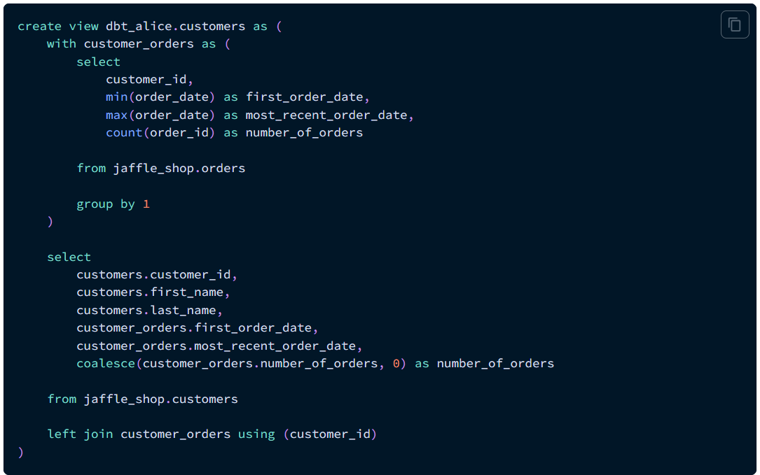
Notes:
When you execute “dbt run”, dbt will build this as a view named “customers” in your target schema.

Slide 22
About dbt models - Configuring dbt models
Configurations are "model settings" that you can set in your dbt_project.yml file, and in your model file using a config block. Some example configurations include:
Changing the materialization that a model uses — a materialization determines the SQL that dbt uses to create the model in your warehouse.
Build models into separate schemas.
Apply tags to a model.

Slide 23
About dbt models - Configuring dbt models
Materializations control how dbt builds your models in the data warehouse, such as creating tables, views, or running scripts.
The four main built-in materializations are:
view: Creates a SQL view in your warehouse. Fast to build, but not ideal for large datasets.
table: Creates a physical table. Slower to build, but useful for performance and when querying large volumes of data.
incremental: Only updates or adds new data since the last run, great for large datasets where full refreshes are costly.
ephemeral: The model is not persisted in the database; instead, its SQL is inlined in dependent models during compilation.
You set a model’s materialization in dbt_project.yml or within the model file using the config() block.
Notes:
In dbt, materializations define how models are stored in the data warehouse. They determine whether a model is stored as a view, table, incremental model, or ephemeral model. Materializations are crucial for optimizing performance and managing how data is updated in your warehouse.

Slide 24
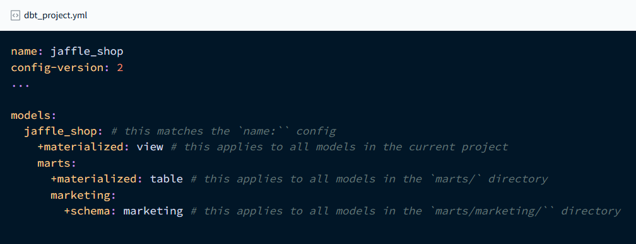
About dbt models - Configuring dbt models
Notes:
In the dbt_project.yml file, you can configure how your models are materialized, such as defining them as tables, views, or incremental models. The materialized option determines how dbt builds and stores the model in the data warehouse. Additionally, you can specify the schema where the model will reside using the schema configuration, which allows you to organize your models efficiently within your project.

Slide 25
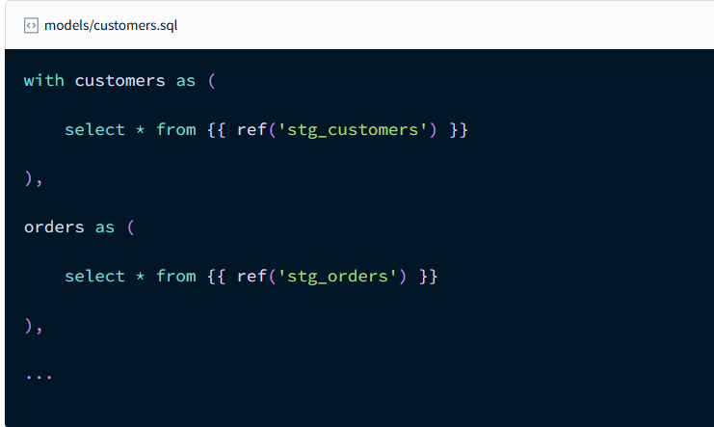
Building models dependencies
Notes:
You can build dependencies between models by using the ref function in place of table names in a query. Use the name of another model as the argument for ref.

Slide 26
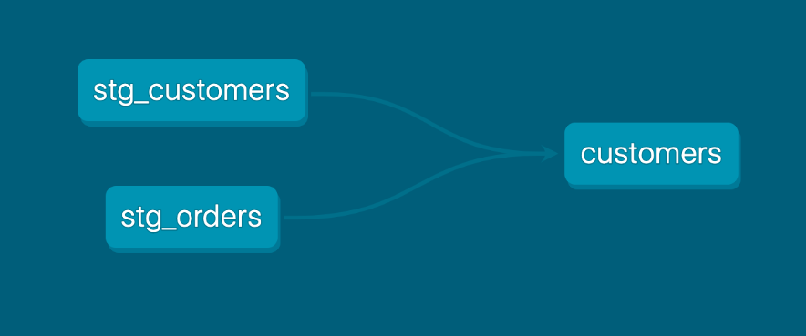
Building models dependencies

Slide 27
About dbt models - Python models
A dbt Python model is a Python function that reads from dbt sources or models, applies transformations using DataFrame operations, and returns a final transformed DataFrame.
Python models work similarly to SQL models — upstream data is referenced, transformed step-by-step, and the result is materialized into a table in the data warehouse.
Instead of a final SELECT statement (as in SQL models), a Python model ends by returning a single DataFrame.
During development, you can preview data using methods like .show() or .head(); when run, dbt saves the full DataFrame result as a table.
Python models live in .py files in the models/ directory and must define a model() function with two parameters:
dbt: Gives access to project context and configurations.
session: Connects to the data platform and handles reading/writing DataFrames.
To execute a Python model, use:
dbt run --select python_model
Notes:
dbt Python (dbt-py) models can help you solve use cases that can't be solved with SQL. Python transformations defined in dbt are models in your project with all the same capabilities around testing, documentation, and lineage.Link

Slide 28
dbt tests
Data tests are assertions made about models, sources, seeds, and snapshots to validate data quality and integrity in your dbt project.
Running dbt test checks whether each defined test passes or fails by returning any records that violate the assertion.
dbt provides built-in generic tests to check for:
Non-null values
Uniqueness
Referential integrity (e.g., foreign key constraints)
Membership in a specific list of allowed values
Notes:
dbt tests help ensure data quality by validating assumptions about your data—like checking for nulls, uniqueness, or valid relationships between tables. You can use built-in generic tests or write custom SQL-based singular tests to catch data issues early in the pipeline. This makes your transformation layer more reliable and easier to maintain.

Slide 29
dbt tests
Tests are SQL queries that return “failing” records — for example, selecting duplicates for a uniqueness test or nulls for a not-null test. A test passes if zero failing rows are returned.
Singular tests are custom SQL queries saved in .sql files in the tests/ directory, designed for specific, one-off validations.
Generic tests are reusable and parameterized test blocks (similar to macros), defined once and referenced in .yml files on models, columns, or sources.
Generic tests are more common due to their flexibility and reusability, making them ideal for large-scale and consistent testing across models.
Using tests helps catch regressions, confirm assumptions about data structure and content, and maintain trustworthy pipelines as your code evolves.
Notes:
There are two main types of dbt tests: generic tests and singular tests. Generic tests are reusable checks defined in YAML, like ensuring a column is not null or unique. Singular tests are custom SQL queries written to capture more complex validation logic specific to your data.

Slide 30
dbt tests - Singular tests
Singular tests are custom SQL queries written to assert a specific condition by returning failing records — typically for one-off validations.
Each test is defined in a .sql file placed in the tests/ directory (as specified by the test-paths configuration).
A singular test file contains one SELECT statement, which identifies rows that violate the assertion — if any rows are returned, the test fails.
You can use Jinja functions like ref() and source() in these SQL files to dynamically reference models and sources.
The test name is derived from the filename — for example, tests/assert_total_payment_amount_is_positive.sql creates a test named assert_total_payment_amount_is_positive.
Avoid using semicolons (;) at the end of SQL statements in test files, as they can cause execution issues.
Singular tests run automatically when you execute dbt test, as long as they're located in the correct test directory.
Do not reference singular tests in .yml files under tests: blocks — they are not macros or generic tests and will cause errors if treated as such.
You can document a singular test by adding a schema.yml file in the same directory with a data_tests: section to provide a name and description.
Notes:
The simplest way to define a data test is by writing the exact SQL that will return failing records. We call these "singular" data tests, because they're one-off assertions usable for a single purpose.

Slide 31
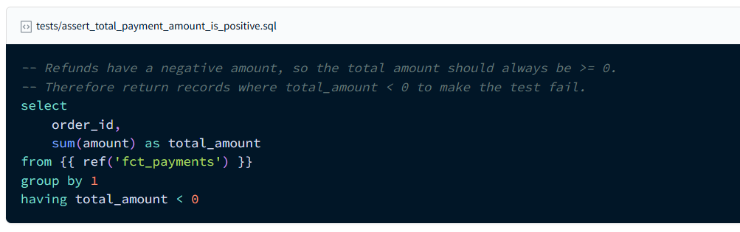
dbt tests - Singular tests
Notes:
Singular tests are placed in the tests directory are automatically executed when running dbt test. Don't reference singular tests in model_name.yml, as they are not treated as generic tests or macros, and doing so will result in an error.

Slide 32
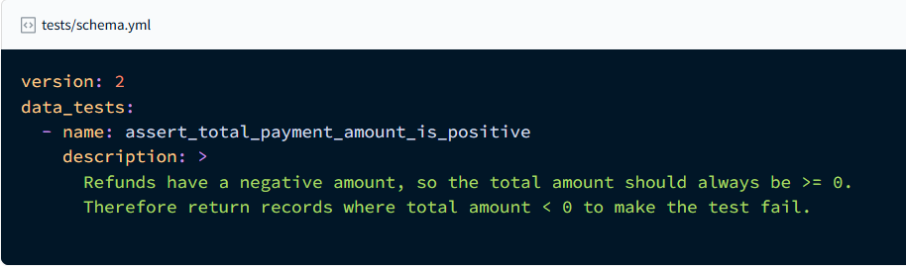
dbt tests - Singular tests
Notes:
To add a description to a singular test in your project, add a .yml file to your tests directory, for example, tests/schema.yml

Slide 33
dbt tests - Generic tests
Generic tests are reusable, parameterized tests defined once and applied across multiple models, columns, sources, or seeds.
These tests are referenced in .yml files (usually model or schema YAML files), using the tests: keyword under fields like columns, models, or sources.
Generic tests are powered by Jinja macros that accept arguments, allowing for flexible test logic across different resources.
dbt ships with four built-in generic tests:
not_null: checks that a column has no null values.
unique: ensures values in a column are unique.
relationships: validates referential integrity across models.
accepted_values: verifies that column values fall within an expected set.
You can also create custom generic tests by defining a test block (like a macro) in a .sql file in the macros/ directory.
Generic tests return failing rows like singular tests — if no rows are returned by the SELECT query, the test passes.
Notes:
Generic tests in dbt are predefined, reusable validations like not_null, unique, accepted_values, and relationships. They’re configured in YAML files and applied directly to models or columns. These tests help ensure your data meets basic quality standards consistently across your project.

Slide 34
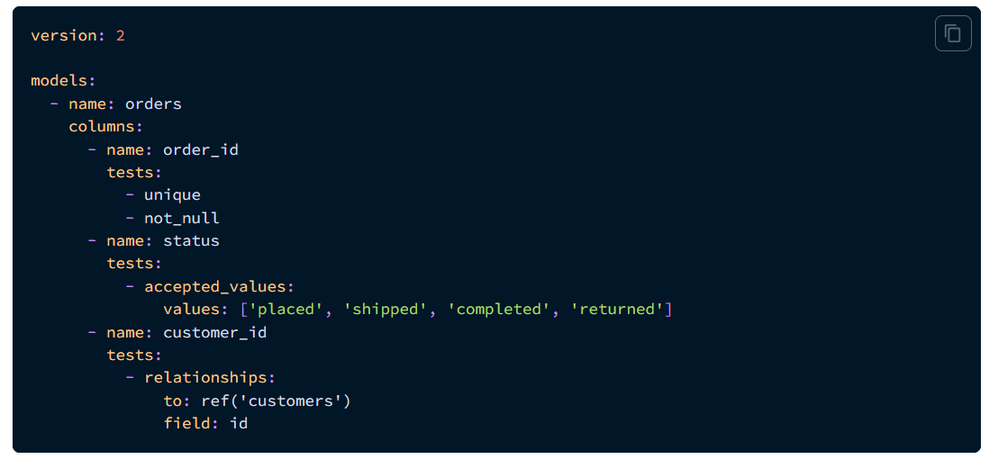
dbt tests - Generic tests
Notes:
Generic tests like unique, not null, etc can be added directly to the schema.yml file.Link

Slide 35
Adding descriptions to dbt project
Descriptions provide context for models, columns, sources, and tests
Defined inside .yml files (usually in the models/ or tests/ directory)
Helps teams understand what each part of the project does
Improves visibility when generating documentation (dbt docs)
Use description: under model, column, or source definitions
Supports Markdown formatting for better readability
Notes:
In dbt, adding descriptions helps document your models and columns, making your data more understandable for both developers and stakeholders. You define these descriptions in the schema.yml file, and they appear in the dbt Docs site when you generate documentation. It’s a best practice to describe what each model represents and the meaning of important columns.

Slide 36
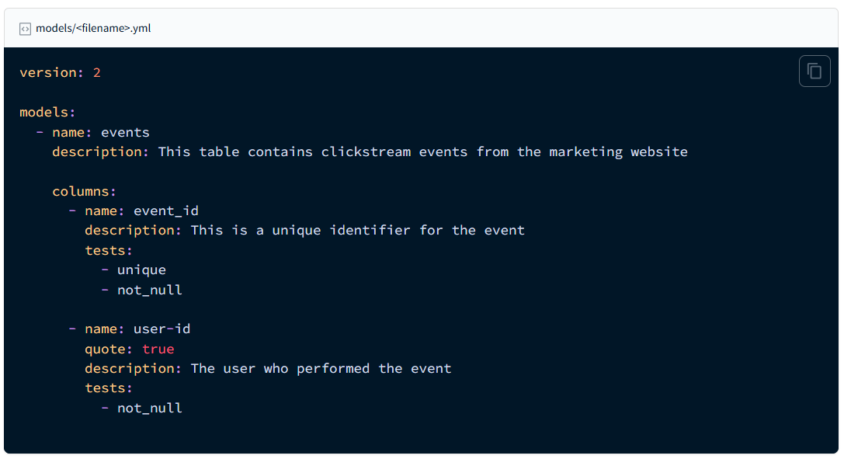
Adding descriptions to dbt project

Slide 37
dbt documentation
dbt docs generate builds a browsable HTML documentation site
Captures lineage, descriptions, columns, data types, and tests
Use dbt docs serve to view docs locally in a browser
Shows upstream/downstream dependencies through lineage graphs
Great for onboarding, collaboration, and auditing
Reflects everything defined in .yml and model files
Notes:
In dbt, documentation is created using schema.yml files where you describe models, columns, sources, and tests. You can generate a browsable site with dbt docs generate and view it using dbt docs serve, which helps teams explore and understand the data lineage and context behind your transformations.

Slide 38
dbt seeds
Seeds are CSV files placed in the data/ directory of your dbt project that can be loaded into your data warehouse as tables.
They are useful for static or reference data, like country codes, status mappings, or small lookup tables.
You run the command dbt seed to load these CSV files into your warehouse.
Each CSV becomes a table in your warehouse with the same name as the file (excluding the .csv extension).
You can apply configurations like schema, database, and column_types to your seeds in the dbt_project.yml file.
They can be used in models just like any other table by referencing them with ref('seed_name').
Notes:
dbt seeds allow you to load static CSV files into your data warehouse as tables. They're great for reference data like lookup tables or small datasets used in joins or tests. You place your CSVs in the data/ directory and load them using the dbt seed command.

Slide 39
Jinja templating
Jinja is a templating language for Python, used in dbt to add logic inside SQL files.
It lets you dynamically insert variables, loops, conditionals, and macros into your SQL models.
This makes your dbt code more reusable, dynamic, and easier to maintain.
Expressions {{ ... }}: Expressions are used when you want to output a string. You can use expressions to reference variables and call macros.
Statements {% ... %}: Statements don't output a string. They are used for control flow, for example, to set up for loops and if statements, to set or modify variables, or to define macros.
Comments {# ... #}: Jinja comments are used to prevent the text within the comment from executing or outputing a string. Don't use -- for comment.
Notes:
dbt uses Jinja templating to make your SQL dynamic and reusable. With Jinja, you can include logic like if statements, loops, and macros in your models. It’s a powerful way to reduce repetition and make your transformations more flexible and maintainable.

Slide 40
Benefits of Jinja in dbt
Promotes DRY (Don't Repeat Yourself) code.
Enables environment-specific logic (e.g., different behavior in dev vs prod).
Useful for automation, parameterization, and consistency in large projects.

Slide 41
Jinja templating example
{% set payment_methods = ["bank_transfer", "credit_card", "gift_card"] %}
select
order_id,
{% for payment_method in payment_methods %}
sum(case when payment_method = '{{payment_method}}' then amount end) as {{payment_method}}_amount,
{% endfor %}
sum(amount) as total_amount
from app_data.payments
group by 1
Notes:
Consider the example where we want to show the total payment amounts for each of the payment methods grouped by the order_id.

Slide 42
Jinja templating example - Interpretation by dbt
select
order_id,
sum(case when payment_method = 'bank_transfer' then amount end) as bank_transfer_amount,
sum(case when payment_method = 'credit_card' then amount end) as credit_card_amount,
sum(case when payment_method = 'gift_card' then amount end) as gift_card_amount,
sum(amount) as total_amount
from app_data.payments
group by 1

Slide 43
Macros
Macros are reusable code blocks written in Jinja (a templating language) that help you avoid repeating logic in your dbt project.
Think of them as functions in Python or Excel — you define them once and use them wherever needed.
They are stored in .sql files inside the macros/ folder in your dbt project.
Notes:
Macros in dbt are reusable SQL snippets or functions written in Jinja, allowing you to encapsulate logic and reuse it across multiple models or tests. This promotes DRY (Don't Repeat Yourself) principles and ensures consistency throughout your dbt project.

Slide 44
Why use macros in dbt?
Avoid duplication by reusing logic across models, tests, and snapshots.
Make code dynamic by passing variables into macros.
Helps you abstract complex logic (like conditional logic, formatting, or naming conventions).
Makes large dbt projects easier to maintain and scale.

Slide 45
Creating a macro
Create a macros/cents_to_dollars.sql file -
{% macro cents_to_dollars(column_name, scale=2) %}
({{ column_name }} / 100)::numeric(16, {{ scale }})
{% endmacro %}
Notes:
Macros are defined in .sql files, typically in your macros directory

Slide 46
Using the macro in the model
select
id as payment_id,
{{ cents_to_dollars('amount') }} as amount_usd,
...
from app_data.payments
Notes:
A model which uses this macro might look like -

Slide 47
Macros - dbt interpretation
select
id as payment_id,
(amount / 100)::numeric(16, 2) as amount_usd,
...
from app_data.payments

Slide 48
dbt snapshots
Track Slowly Changing Data: Snapshots let you capture changes in data over time — great for tracking history (e.g., customer status, price changes).
Works on Source Tables: You snapshot a table (usually raw data from your warehouse) to create a historical log of its changes.
Built-in Strategies: dbt supports two types: timestamp (tracks changes based on a datetime column) and check (tracks any column changes).
Snapshot Block: You define snapshots in .sql files using {% snapshot %} blocks, similar to models and macros.
Stored in Schema: Snapshots are materialized as tables in a schema you configure, separate from your normal models.
One Record Per Change: Every time a change is detected, a new row is added with dbt_valid_from and dbt_valid_to fields.
Great for Audit Trails: Useful for audits, regulatory reporting, or analyzing how a record changed over time.
Notes:
dbt snapshots help us track how records change over time — like a time machine for your data. They’re perfect for capturing historical states of slowly changing tables, such as customer statuses or pricing. dbt handles the logic for comparing old and new records, and adds rows whenever a change is detected, making it super useful for audits or analytics based on change history

Slide 49
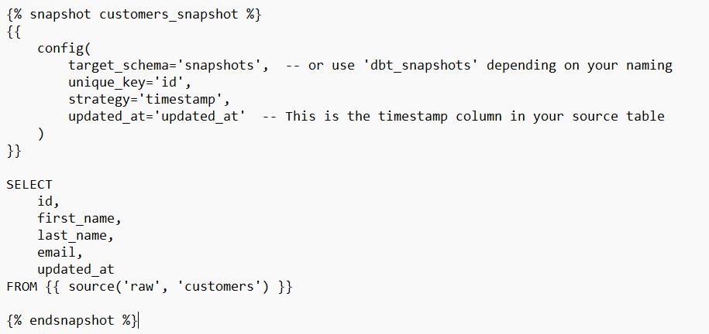
dbt snapshots
Notes:
This snapshot tracks changes in the customers table using a timestamp strategy. The updated_at column tells dbt when a record was last modified. If dbt sees that timestamp change, it stores a new version of the row. It also automatically adds two helpful columns — dbt_valid_from and dbt_valid_to — which show the time range when that version of the record was valid. This is a great way to build an audit trail or analyze how data evolved.

Slide 50
dbt MetricFlow
MetricFlow is part of dbt’s Semantic Layer that helps you centrally define business metrics in one place.
It lets you write metrics once using YAML in your dbt project, avoiding repeated SQL logic across reports or dashboards.
It uses semantic models and metrics to organize and define calculations in a standardized way.
You can query and test metrics using MetricFlow commands from the CLI, dbt Cloud IDE, or Core — depending on your setup.
Supports consistent reporting by making sure all teams use the same definitions for metrics like revenue, churn, or active users.
Integrates with downstream tools (like BI platforms) for dynamic querying via the universal Semantic Layer (Team/Enterprise only).
It boosts data governance by centralizing and controlling how metrics are created, used, and shared across your company.
Notes:
Use MetricFlow in dbt to centrally define your metrics. As a key component of the Semantic Layer, MetricFlow is responsible for SQL query construction and defining specifications for dbt semantic models and metrics. It uses familiar constructs like semantic models and metrics to avoid duplicative coding, optimize your development workflow, ensure data governance for company metrics, and guarantee consistency for data consumers.

Slide 51
Understanding Semantic Models in dbt
Semantic models are YAML-based configurations that describe how your data should be understood — they serve as the foundation for defining metrics in dbt MetricFlow.
These models enable MetricFlow to generate SQL queries based on the logical structure you define, without manually rewriting joins or metric logic.
Each semantic model corresponds 1:1 with a dbt model (either SQL or Python) — meaning you define the structure separately from the transformation logic.

Slide 52
Semantic model components
A semantic model contains several key components:
Entities: Represent business objects like customer, order, or product.
There’s usually one primary or natural entity.
Other entities may be foreign keys or unique identifiers that define relationships with other semantic models.
Dimensions: Attributes like country, order_date, or product_category that you can slice your metrics by.
Measures: Aggregations like sum(revenue) or count(orders) that form the basis for metrics.
Metrics: Business-level metrics (e.g., total_revenue, average_order_value) that are defined using measures and reused across tools.
Notes:
In dbt, semantic models are central to defining and organizing metrics. They consist of entities, measures, dimensions, and metrics, allowing you to construct queries for metrics in a standardized way. These models connect various data points and ensure consistent and accurate reporting across your organization.

Slide 53
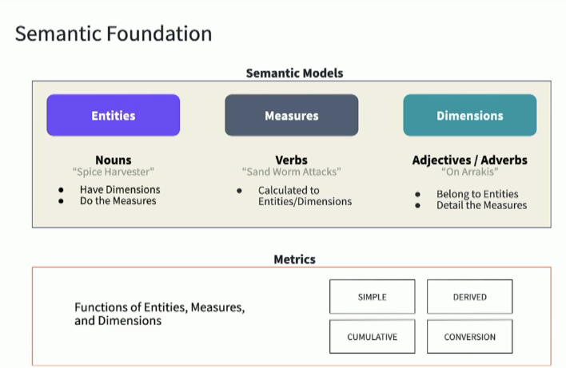

Slide 54
Semantic models components
semantic_models:
- name: the_name_of_the_semantic_model ## Required
description: same as always ## Optional
model: ref('some_model') ## Required
defaults: ## Required
agg_time_dimension: dimension_name ## Required if the model contains measures
entities: ## Required
- see more information in entities
measures: ## Optional
- see more information in the measures section
dimensions: ## Required
- see more information in the dimensions section
primary_entity: >-
if the semantic model has no primary entity, then this property is required. #Optional if a primary entity exists, otherwise Required
Notes:
Link

Slide 55
Semantic models - Example
semantic_models:
- name: customer_revenue
description: >
This semantic model defines the revenue metrics for each customer.
entities:
- name: customer
description: The customer entity represents individual customers.
primary_key: customer_id
foreign_entities:
- name: orders
description: The orders made by customers.
foreign_key: customer_id
dimensions:
- name: customer_name
description: The name of the customer.
measures:
- name: total_revenue
description: The total revenue from all orders by a customer.
calculation: sum(order_total)
- name: order_count
description: The total number of orders placed by a customer.
calculation: count(order_id)
Notes:
Entities: The customer is the primary entity, and orders is a foreign entity connected via customer_id. The primary entity represents the main subject of the metric, while foreign entities provide the context or relations.
Dimensions: These are attributes or properties of the entities that you can use to slice your metrics, like customer_name and country.
Measures: These are the raw calculations of your data, like total_revenue (sum of all orders) and order_count (count of all orders).
Metrics: These are higher-level business definitions that combine measures. For example, average_order_value combines total_revenue and order_count.
Time Spine: The order_date defines a consistent time frame for aggregating data, and in this case, it is set to a daily granularity for reporting.

Slide 56
Semantic models - Example
metrics:
- name: average_order_value
description: The average value of an order for a customer.
calculation: total_revenue / order_count
time_spine:
- name: order_date
description: The date when the order was placed.
type: date
granularity: day
Notes:
Full code –
semantic_models:
- name: customer_revenue
description: >
This semantic model defines the revenue metrics for each customer.
entities:
- name: customer
description: The customer entity represents individual customers.
primary_key: customer_id
foreign_entities:
- name: orders
description: The orders made by customers.
foreign_key: customer_id
dimensions:
- name: customer_name
description: The name of the customer.
measures:
- name: total_revenue
description: The total revenue from all orders by a customer.
calculation: sum(order_total)
- name: order_count
description: The total number of orders placed by a customer.
calculation: count(order_id)
metrics:
- name: average_order_value
description: The average value of an order for a customer.
calculation: total_revenue / order_count
time_spine:
- name: order_date
description: The date when the order was placed.
type: date
granularity: day

Slide 57
Metrics
Metrics are business definitions: Metrics represent key business calculations like revenue, customer count, or conversion rate that teams want to track.
Defined once, used everywhere: In MetricFlow, you define a metric in your dbt project once, and it can be used across dashboards, reports, and tools consistently.
Built on top of measures: A metric usually references one or more measures, which are raw aggregations (e.g., sum of sales, count of orders).
Supports filters and dimensions: You can define filters (e.g., country = 'US') or breakdowns (e.g., by product or date) within metrics for better analysis.
Helps avoid duplication: Central metric definitions reduce repeated SQL logic across teams, making data work more efficient and less error-prone.
Queryable via the Semantic Layer: Metrics defined using MetricFlow can be dynamically queried using metricflow query or through BI tools that integrate with dbt Cloud's Semantic Layer.
Encourages governance and consistency: Defining metrics in code allows teams to track changes, review logic, and ensure metric definitions remain consistent over time.
Notes:
dbt Metrics allow us to define key business KPIs—like revenue, conversion rate, or user count—directly in our dbt project. These metrics are centrally managed, version-controlled, and reusable, which ensures consistent definitions across all reporting tools and teams. Using MetricFlow, dbt constructs SQL on-demand to query these metrics reliably and dynamically

Slide 58
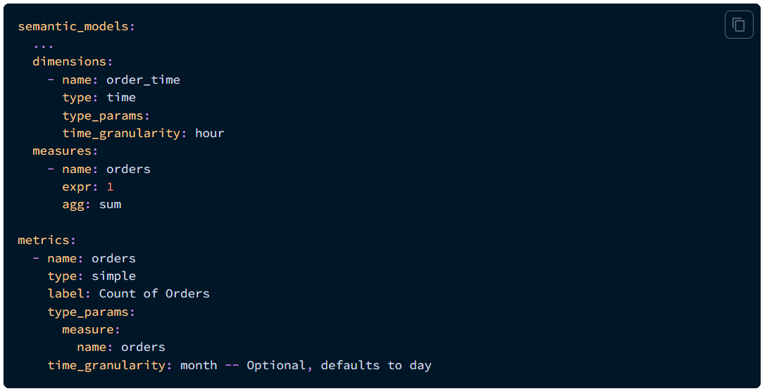
Metrics

Slide 59
Metric types
Simple Metrics
Cumulative Metrics
Ratio Metrics
Derived Metrics
Conversion Metrics
Notes:
dbt supports different types of metrics to suit your business needs:
Simple metrics: Basic aggregations like sum, count, or average.
Cumulative metrics: Metrics that build up over time, like total sales year-to-date.
Derived metrics: Built using other metrics—for example, profit margin derived from revenue and cost.
Ratio metrics: Comparisons like conversion rate or churn rate.
Conversion metrics: Used to track specific actions in funnels, such as a user signing up after visiting a page.

Slide 60
Simple Metrics
Basic aggregations like sum, count, average, or min/max.
Defined on top of a single measure in a semantic model.
Example: total_sales = sum(order_amount).

Slide 61
Cumulative Metrics
Track the running total of a metric over time.
Useful for metrics like Monthly Active Users (MAU) or cumulative revenue.
Require a time dimension to compute the running total.
Example: Cumulative revenue over months.

Slide 62
Ratio Metrics
Express the relationship between two metrics (numerator/denominator).
Useful for calculating conversion rates, averages, or percentages.
Example: conversion_rate = total_orders / total_visits.

Slide 63
Derived Metrics
Metrics built from other existing metrics.
Help avoid duplication and promote reuse.
Example: profit_margin = (revenue - cost) / revenue.

Slide 64
Conversion Metrics
A special form of ratio metric that tracks conversions through a funnel.
Common in marketing or product analytics.
Example: Signups that convert to paying customers.

Slide 65
Incremental models
Incremental models only process new or updated data instead of rebuilding the entire table every time you run dbt run.
They are useful when working with large datasets that don’t change frequently, helping to save time and warehouse resources.
Inside the model, you can use the special is_incremental() function to write logic that runs only during incremental updates
During the first run, dbt creates the table with all rows. On subsequent runs, it appends or merges data based on your logic.
You can combine incremental models with partitioning or deduplication to handle more complex update strategies.
Incremental models work best when there’s a reliable timestamp or unique key column to track changes.
Notes:
Incremental models in dbt are great for handling large datasets efficiently. Instead of rebuilding the entire model every time, they only process new or updated records. This approach speeds up builds and reduces strain on your data warehouse—especially helpful in production pipelines.

Slide 66
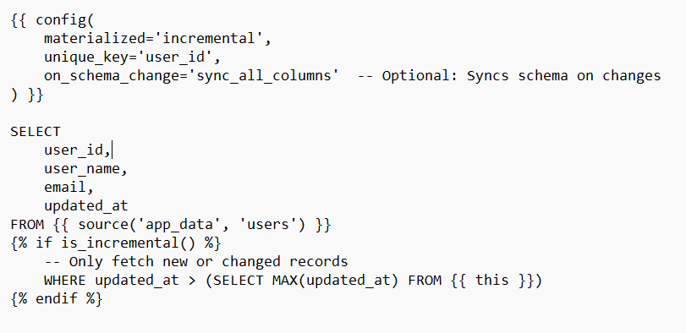
Incremental models
Notes:
materialized='incremental': Tells dbt to treat this model as incremental.
unique_key='user_id': dbt uses this key to detect duplicates or update rows.
is_incremental(): Ensures the WHERE clause is applied only during incremental runs.
this: A special dbt variable that refers to the model's current location in the database (e.g., schema.table_name).

Slide 67
dbt Job scheduler
Automated Execution: The dbt job scheduler automates the process of running dbt models, ensuring that transformations occur on a scheduled basis without manual intervention.
Integration with Orchestration Tools: dbt integrates with popular orchestration tools like Airflow, Prefect, and dbt Cloud’s built-in scheduler, enabling complex job workflows.
Scheduling Flexibility: You can schedule dbt jobs to run at specific intervals, such as hourly, daily, or weekly, depending on the business requirements.
Job Monitoring: It allows you to monitor the status of each dbt job run, providing feedback on success, failure, and logs for debugging.
Data Freshness: Scheduling ensures that data models are up-to-date, improving the freshness of reports and analytics, and maintaining accuracy across dashboards.
Parallel Execution: Depending on the scheduler, dbt can execute jobs in parallel to optimize the processing time and improve efficiency.
Customizable Triggers: Jobs can be triggered based on certain conditions, such as when new data arrives in the warehouse or when specific models need to be refreshed.
Notes:
The job scheduler is the backbone of running jobs in dbt Cloud, bringing power and simplicity to building data pipelines in both continuous integration and production contexts. The scheduler frees teams from having to build and maintain their own infrastructure, and ensures the timeliness and reliability of data transformations.

Slide 68
dbt Explorer
DBT Explorer is a powerful UI tool within dbt Cloud that provides a visual interface to explore and manage your dbt project. It helps you track your models, examine their relationships, view metadata, and navigate through your entire dbt workflow efficiently. It provides insights into your data models, dependencies, and the transformation processes.
Visualize Models: DBT Explorer allows you to visualize the relationships and dependencies between different models in your project.
Metadata Insights: Provides detailed metadata such as descriptions, tests, and sources associated with each model.
Easily Navigate Projects: You can easily navigate through your project’s models, sources, and tests without digging into the code.
Track Job Runs: Offers an overview of your dbt job runs, their status, and any errors that occurred during execution.
Quick Access to Documentation: Direct access to documentation and descriptions linked to models, sources, and tests.
Model Dependencies: It provides an interactive graph showing model dependencies, helping to understand the impact of changes on other models.
Data Lineage: Tracks and visualizes the data lineage from source to target, giving you a complete view of how data flows through the transformation process.
Notes:
dbt Explorer is a part of the dbt Cloud platform that enhances the user experience by giving you a visual representation of your project. It’s a great tool for quickly understanding your dbt project’s structure, dependencies, and job statuses. It also allows you to explore metadata, descriptions, and tests, making it easier to manage and maintain your data transformations without constantly switching between different interfaces. With DBT Explorer, you can optimize your development workflow and maintain better data governance.

