Slide 1
Prefect: Modern Workflow Orchestration

Slide 2
What is Workflow Orchestration?
Automation of data and task pipelines
Coordinate dependencies and execution order
Common in ETL, ML, and data engineering
Helps with retries, logging, scheduling
Examples: Airflow, Prefect, Luigi
Notes:
Workflow orchestration is the automation of a series of tasks that have dependencies, like running data pipelines or scheduled jobs. It ensures tasks run in the correct order, handles failures, and provides visibility into the process. Tools like Prefect, Airflow, and Luigi help developers manage this complexity effectively.

Slide 3
What is Prefect?
Open-source data workflow orchestration tool.
Used to define, schedule, and monitor data pipelines.
Written in Python with intuitive API design.
Workflows are defined as Python functions using decorators.
Helps manage retries, failures, logging, and alerts.
Notes:
Prefect is a modern alternative to traditional ETL workflow tools. It allows developers to write workflows in pure Python, which are then orchestrated and monitored. The intuitive design and flexible architecture make it beginner-friendly.

Slide 4
What is Prefect?
https://www.youtube.com/watch?v=D5DhwVNHWeU&t=44s
Notes:
Prefect is a modern alternative to traditional ETL workflow tools. It allows developers to write workflows in pure Python, which are then orchestrated and monitored. The intuitive design and flexible architecture make it beginner-friendly.

Slide 5
Intro to Workflow Orchestration with Prefect
https://www.youtube.com/watch?v=XL4wgLUp-VA&t=266s

Slide 6
Core Features of Prefect (Open Source)
Flows: A set of tasks with dependencies
Tasks: Units of work (functions)
Blocks: Configuration like credentials
Orchestration: Managing retries, state, scheduling
Deployment: Triggering and monitoring runs
Notes:
In this slide, introduce the foundational building blocks of Prefect: Flows are the overall workflow containers, while Tasks are individual units of work. Blocks store external config like credentials. Prefect handles orchestration, retries, and scheduling automatically. This structure helps developers write workflows as clean, testable Python code.

Slide 7
Why Use Prefect?
Pythonic syntax makes it easy to learn.
Flexible and modular architecture.
Good for both small scripts and large pipelines.
Integrated logging and alerting.
Easier debugging and testing compared to traditional ETL tools.
Notes:
Prefect is designed to solve the 'negative engineering' problem by reducing the overhead involved in writing safe and reliable data workflows. It is suitable for teams and individuals who want clear control over their dataflows.

Slide 8
Use Cases for Prefect
Data extraction and ETL jobs
Automating ML training pipelines
Scheduled API calls or reports
Data validation & quality checks
Workflow monitoring dashboards
Notes:
In this slide, we'll look at practical scenarios where Prefect shines. It's ideal for automating data workflows like ETL pipelines, model training, or even simple reporting tasks. Prefect's flexibility makes it easy to integrate with cloud services or databases and monitor workflows through its UI. These use cases help anchor Prefect in real-world relevance.

Slide 9
Prefect vs Airflow and Other Tools
Notes:
Prefect is cloud-native and integrates easily with modern tools like S3, Docker, and Kubernetes using its agent model. It’s built for flexibility and works well across environments—local to production. Airflow is more mature in large enterprise settings but may require more setup and plugin management. Prefect scales more naturally in dynamic, Python-based workflows.

Slide 10
Prefect vs Airflow: Key Differences
Prefect uses Python functions; Airflow uses DAG objects.
No need for a scheduler in open-source Prefect (Orion built-in).
Prefect handles task states as first-class concepts.
Airflow has a steeper learning curve and older architecture.
Prefect provides real-time observability out of the box.
Notes:
Airflow is a mature tool, but it can be complex for beginners. Prefect simplifies many of the pain points that developers face in Airflow, such as dependency management and testing.

Slide 11
Prefect vs Airflow: Key Differences
Airflow: DAG-first, UI-centric, config-heavy
Prefect: Code-first, Python-native, minimal config
Airflow uses Jinja templating, Prefect uses functions
Prefect encourages modular, testable code
Airflow has a steeper learning curve
Notes:
Airflow is a mature tool, but it can be complex for beginners. Prefect simplifies many of the pain points that developers face in Airflow, such as dependency management and testing.

Slide 12
Airflow Vs. Prefect
https://www.youtube.com/watch?v=XrZegcm1ftw

Slide 13
Prefect vs Luigi vs Dagster
Luigi: Focused on batch processing; lacks modern UI.
Dagster: Strong on type systems and data asset tracking.
Prefect: Easier setup, strong observability, modern UI.
Prefect has a lower entry barrier for new developers.
Community and ecosystem around Prefect is growing fast.
Notes:
Each tool has its strengths. Luigi is older and less flexible, Dagster is more structured but more complex, and Prefect strikes a balance between usability and functionality, especially for newcomers.

Slide 14
When to Choose Prefect
You want a lightweight, modern workflow tool.
You prefer Python-native tools with decorator patterns.
You don’t want to manage external schedulers.
You need visual monitoring and debugging tools.
You're building pipelines that need retries and alerts.
Notes:
Prefect is ideal when you want to iterate quickly, avoid steep DevOps setup, and gain visibility into your pipeline runs without complex configuration.

Slide 15
Installation and Configuration

Slide 16
Prerequisites for Installation
Python 3.7 or later installed on your system
pip (Python package manager) installed on your system
A compatible operating system (Windows, macOS, or Linux)
A code editor or IDE (Integrated Development Environment) of your choice
Notes:
Before we begin with the installation, make sure you have the following prerequisites installed on your system.

Slide 17
Installing Prefect using pip
Open a terminal or command prompt on your system
Type the above command to install Prefect using pip
Press Enter to execute the command
Notes:
To install Prefect, we will use pip, the Python package manager. Simply type the above command in your terminal or command prompt and press Enter.

Slide 18
Configuring Prefect
Create a Prefect configuration file using prefect config init
Configure your Prefect API key using prefect config set api_key <your_api_key>
Configure your Prefect backend using prefect config set backend <your_backend>
Notes:
After installation, we need to configure Prefect. We will cover the basic configuration steps in this slide

Slide 19
Creating a Prefect Configuration File
Open a terminal or command prompt on your system
Type the above command to create a Prefect configuration file
Press Enter to execute the command
Notes:
To create a Prefect configuration file, we use the prefect config init command. This will create a default configuration file in your home directory.

Slide 20
Setting up a Prefect Cloud Account

Slide 21
Introduction to Prefect Cloud
Prefect Cloud = Prefect’s orchestration UI & backend
Free tier available with basic orchestration features
Helps you monitor & manage flows from the web
No need to manage backend infra
We’ll register, explore the UI, and set up a workspace
Notes:
Prefect Cloud is a managed orchestration platform. It provides a visual interface to manage flows, tasks, and logs. With the free tier, we can orchestrate multiple flows without running a server.

Slide 22
Create Your Prefect Cloud Account
Go to https://www.prefect.io/
Click on “Get Started Free”
Sign up using GitHub or Email
Choose the Cloud (Serverless) option
Create a new workspace (e.g., training-lab)
Notes:
Prefect Cloud is a managed orchestration platform. It provides a visual interface to manage flows, tasks, and logs. With the free tier, we can orchestrate multiple flows without running a server.

Slide 23
Key Prefect Cloud Concepts
Workspace: Logical grouping of flows
Work Pool: Connects Cloud to workers
Blocks: Secure storage for credentials/config
Deployments: Package + schedule + parameters
Agents/Workers: Run your flow locally
Notes:
Think of this as the “architecture vocabulary” of Prefect Cloud. All flows need to be deployed and linked to a work pool to run.

Slide 24
Generate a Prefect API Key
Go to "Settings" > "API Keys"
Click “+ New API Key”
Name it: local-dev-key
Copy and store it securely
Notes:
This key is essential to connect your local development to Prefect Cloud. Treat it like a password. It links your CLI to your cloud workspace.

Slide 25
Flows, Tasks, and Parameters

Slide 26
Introduction to Prefect Flows
Prefect flows represent a collection of tasks and their execution order.
Flows are used to define and manage the logic of workflows.
Flows can be composed of multiple tasks that depend on each other.
Flows are used to define how tasks are executed within a Prefect environment.
Notes:
A flow is essentially the "big picture" that determines the sequence of tasks to run.
Every Prefect workflow begins with defining a flow, and tasks are added to it.
Flows encapsulate dependencies, error handling, retries, etc.

Slide 27
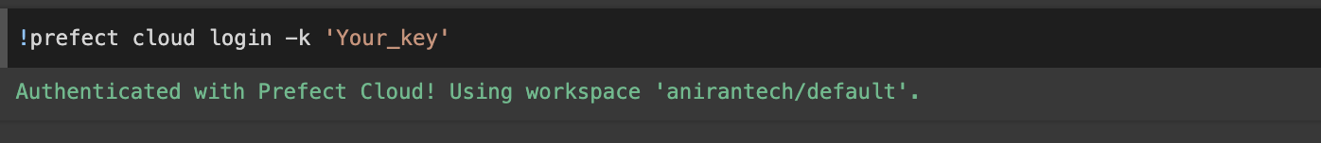
Authenticate to your Workspace
Login to Prefect Account
Create Workspace
Create API Key
Authenticate

Slide 28
What is a Task?
A Task is a unit of work in Prefect, which can be an operation like API calls, database queries, etc.
Tasks are reusable and can be connected into a flow.
Tasks are defined using the @task decorator.
Notes:
Tasks are the smallest unit of execution, typically encapsulating a single operation.
Tasks can run in parallel or sequentially based on the flow definition.

Slide 29
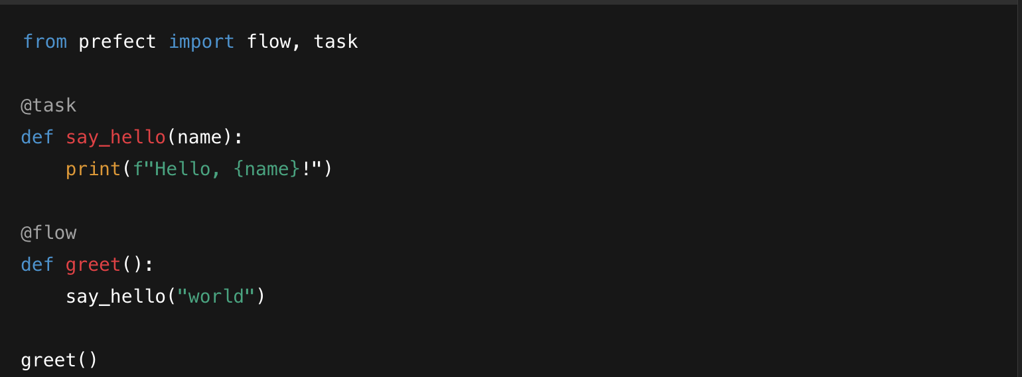
Hands-on: Your First Flow, Task
Install Prefect (pip install prefect)
Create a task & flow using decorators
Register and run locally
Observe results in UI
Add retry and logging
Notes:
In this slide, we will walk through creating a simple Prefect flow from scratch. Start by installing Prefect using pip install prefect. Then, create a task using the @task decorator and define a flow with the @flow decorator. We'll execute the flow locally, observe the output in the terminal, and explore the Prefect UI for monitoring. This exercise will help participants understand how easy it is to define and run workflows with Prefect.

Slide 30
Passing Data Between Tasks
Prefect allows passing data between tasks using flow parameters or direct task outputs.
Tasks can share data, which enables complex workflows.
Use return values of tasks as inputs for the next task.
Notes:
You can chain tasks by having one task return a value and another task consume that value as input.

Slide 31
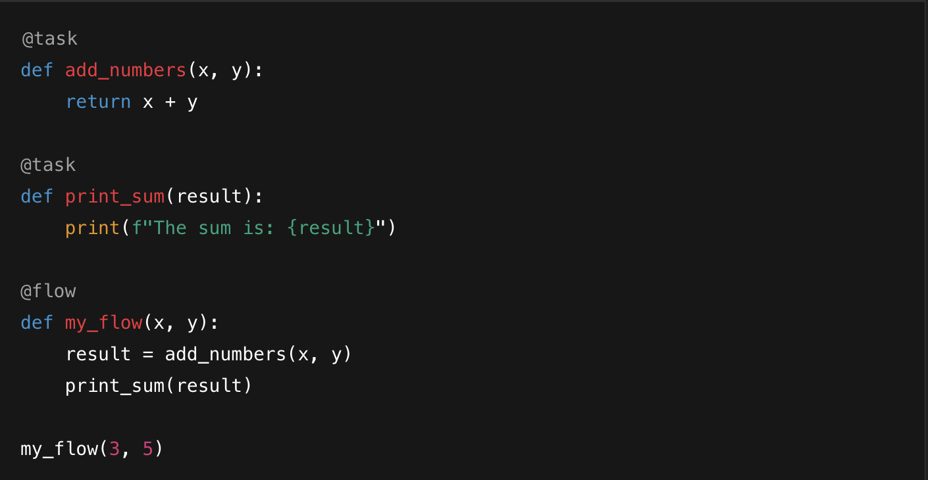
Hands-on: Passing Data Between Tasks

Slide 32
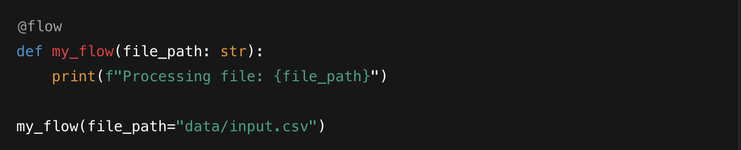
What are Parameters?
Parameters are values that allow you to dynamically pass data to tasks.
Parameters are defined in the flow and can be provided at runtime.
Parameters make your tasks more flexible and reusable.
Notes:
Parameters help in defining dynamic values for task execution.
For instance, if you're working with a dataset, parameters can specify the input file.

Slide 33
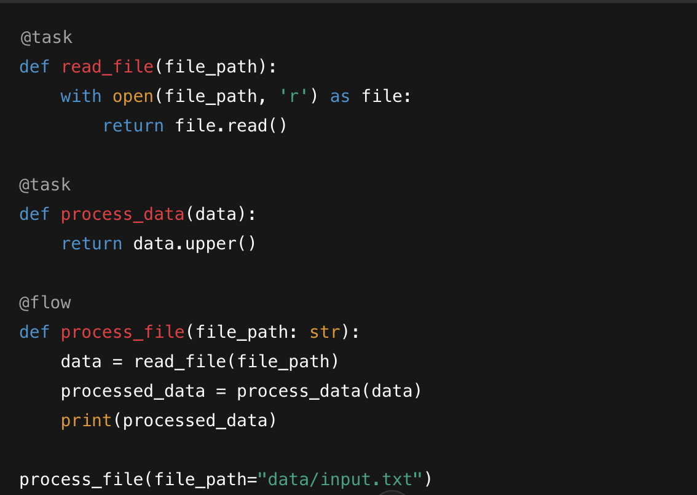
Combining Tasks, Flows, and Parameters
Notes:
You can combine tasks and parameters to form powerful, reusable workflows.

Slide 34
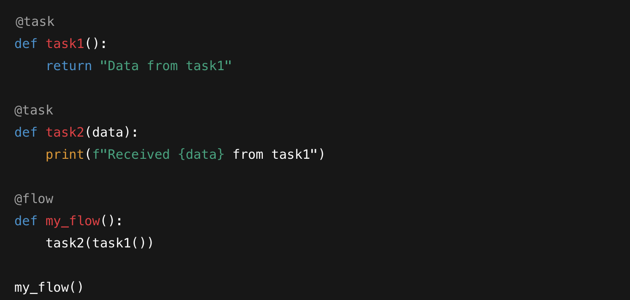
Task and Flow Dependencies
You can manage dependencies with upstream_tasks and downstream_tasks.
Notes:
You can combine tasks and parameters to form powerful, reusable workflows.

Slide 35
Connecting Local Environment to Prefect Cloud

Slide 36
Login to Prefect Cloud via CLI
Use your API key to log in:
Select your workspace
Verify:
Notes:
prefect cloud login writes a config file in ~/.prefect/config.toml linking your CLI to your Cloud workspace.

Slide 37
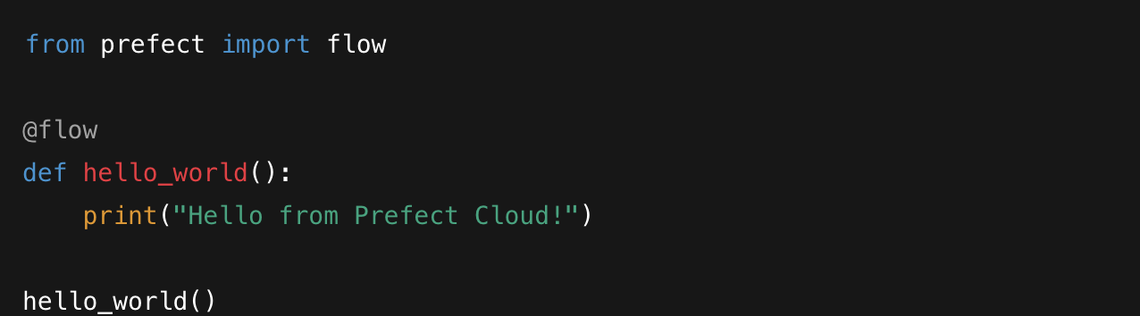
Create a Simple Flow
Notes:
This is a simple flow. It can run locally, but now it’s linked to your Cloud account via CLI login. Prefect Cloud can see this run's logs if deployed properly.

Slide 38
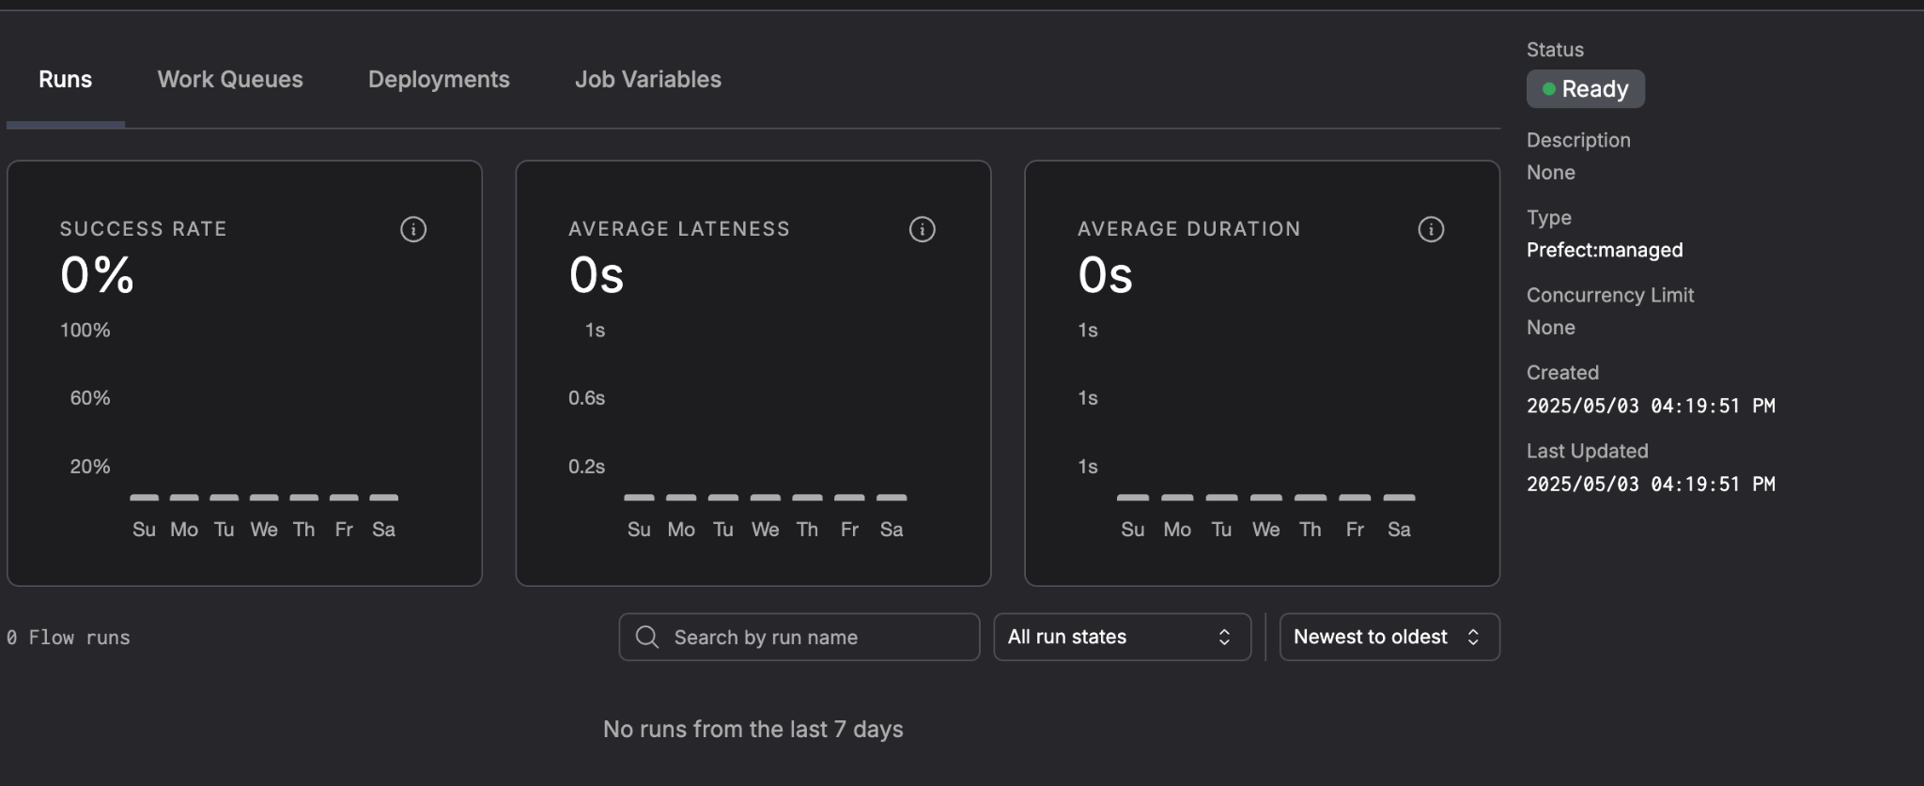
Create a Work Pool
Go to “Work Pools”
Click “+ Create Work Pool”
Choose “Prefect-managed” type
Name: local-pool
Notes:
Work Pools define how your workers communicate with Prefect Cloud. "Prefect-managed" pool type is suitable for local dev.

Slide 39
Start a Worker Locally
Run a local worker:
This polls the cloud for work
Keep this terminal running
Notes:
The worker runs in your terminal and polls the cloud. Without a worker, Prefect Cloud deployments won’t run.

Slide 40
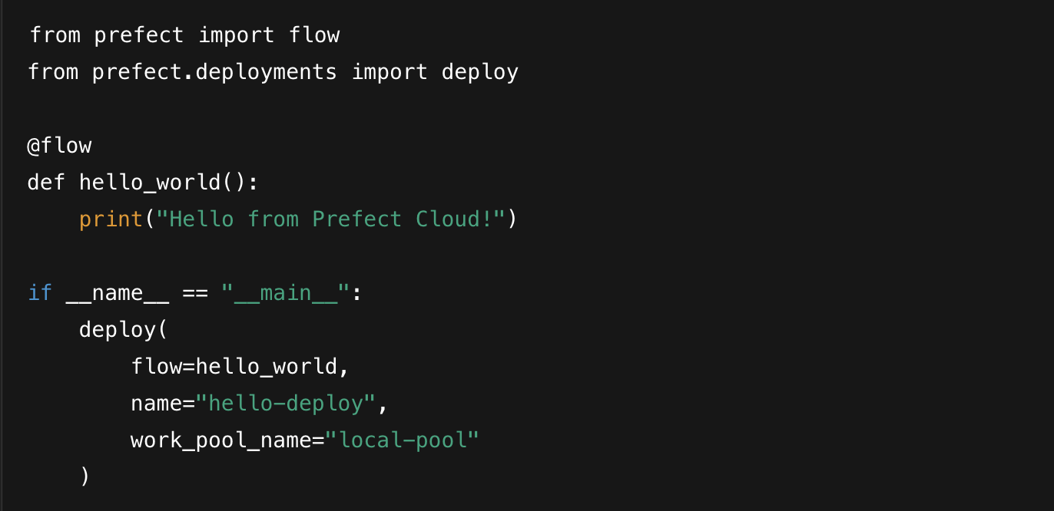
Deploy Your Flow
Add deployment to your flow:
Notes:
The worker runs in your terminal and polls the cloud. Without a worker, Prefect Cloud deployments won’t run.

Slide 41
Deploy Your Flow
Add deployment to your flow:
Notes:
deploy() creates a deployment in your workspace. It doesn’t run the flow yet—it just registers it for orchestration.

Slide 42
Run from Prefect Cloud
Go to “Deployments” in UI
Click “hello-deploy”
Click “Run” > Set parameters (if any)
Monitor Logs
Notes:
Once deployed, you can trigger runs from Cloud or via CLI. The logs and status will appear in the Cloud UI. Your local worker executes the run.

Slide 43
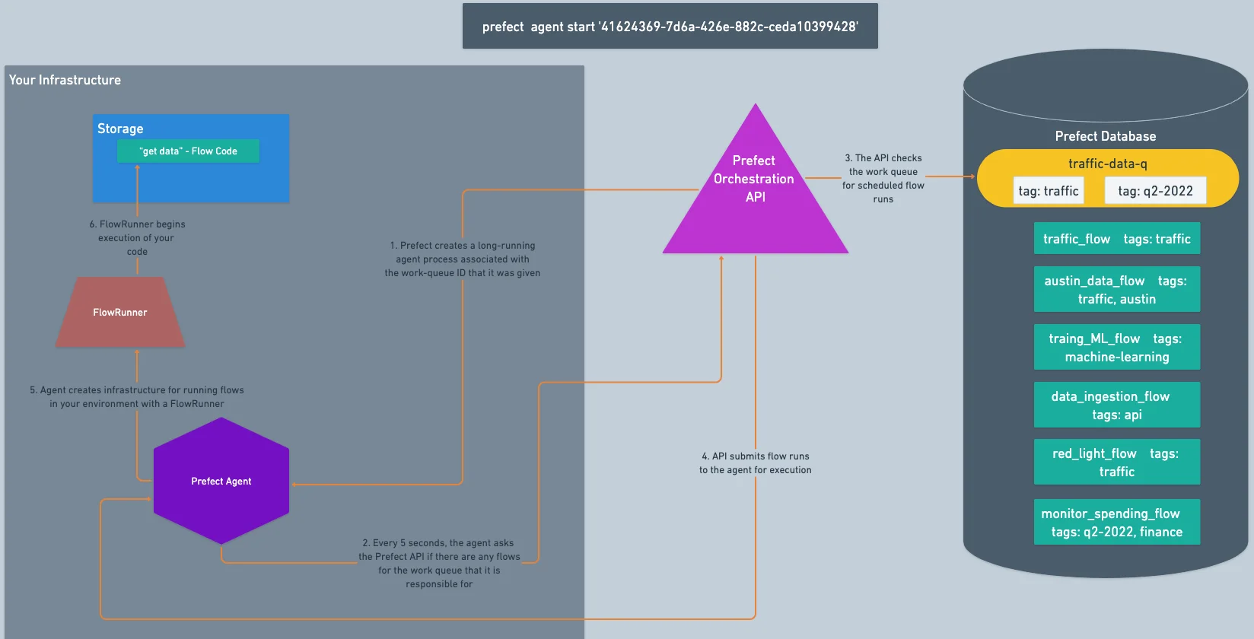
Prefect Orchestration Architecture
Notes:
Prefect is cloud-native and integrates easily with modern tools like S3, Docker, and Kubernetes using its agent model. It’s built for flexibility and works well across environments—local to production. Airflow is more mature in large enterprise settings but may require more setup and plugin management. Prefect scales more naturally in dynamic, Python-based workflows.

Slide 44
Prefect Architecture Overview
Prefect Core: responsible for workflow execution and monitoring
Prefect API: provides interface for interacting with Prefect
Prefect UI: provides visualization and monitoring of workflows
Prefect Agent: responsible for executing workflows
Prefect Storage: provides storage for workflow data and metadata
Notes:
"Prefect architecture consists of several components that work together to provide a robust workflow management system."

Slide 45
Prefect Core
Workflow Definition: defines the workflow structure and tasks
Task Execution: executes tasks and handles dependencies
State Management: manages the state of workflows and tasks
Error Handling: handles errors and exceptions during workflow execution
Logging and Auditing: provides logging and auditing capabilities for workflows
Notes:
"Prefect Core is responsible for executing and monitoring workflows. It defines the workflow structure, executes tasks, and manages the state of workflows."

Slide 46
Prefect API
REST API: provides interface for interacting with Prefect
Python Client: provides a Python interface for interacting with Prefect
API Endpoints: provides endpoints for workflow creation, execution, and monitoring
API Authentication: provides authentication mechanisms for API access
API Rate Limiting: provides rate limiting mechanisms for API access
Notes:
"Prefect API provides an interface for interacting with Prefect. It allows users to create, execute, and monitor workflows programmatically."

Slide 47
Prefect UI
Workflow Visualization: provides visualization of workflows and tasks
Workflow Monitoring: provides real-time monitoring of workflows
Task Monitoring: provides detailed monitoring of tasks
Error Handling: provides error handling and notification mechanisms
User Management: provides user management and access control mechanisms
Notes:
Prefect UI provides visualization and monitoring of workflows. It allows users to visualize and monitor workflows in real-time.

Slide 48
Prefect Agent
Workflow Execution: executes workflows and tasks
Resource Management: manages resources for workflow execution
Error Handling: handles errors and exceptions during workflow execution
Logging and Auditing: provides logging and auditing capabilities for workflows
Agent Configuration: provides configuration options for the agent
Notes:
Prefect Agent is responsible for executing workflows and tasks. It manages resources and handles errors during execution.

Slide 49
Prefect Storage
Database Storage: provides storage for workflow data and metadata
File System Storage: provides storage for workflow files and artifacts
Cloud Storage: provides storage for workflow data and metadata in the cloud
Storage Configuration: provides configuration options for storage
Data Encryption: provides data encryption mechanisms for storage
Notes:
Prefect Storage provides storage for workflow data and metadata. It allows users to store and retrieve workflow data and metadata

Slide 50
Prefect Security
Authentication: provides authentication mechanisms for API access
Authorization: provides authorization mechanisms for API access
Data Encryption: provides data encryption mechanisms for storage and transmission
Network Security: provides network security mechanisms for API access
Security Best Practices: provides security best practices for Prefect deployment and usage
Notes:
Prefect Security provides security features and best practices for Prefect deployment and usage. It allows users to secure their workflows and data

Slide 51
Handson: Write and run Workflows
As a data engineer, you want to automate the task of fetching the daily weather forecast for a specific city and saving it to a local file for further analysis. Doing this manually every day is time-consuming and error-prone.
You need to write a Prefect workflow (flow) that:
Takes a city name as a parameter.
Fetches the current weather data using a free public API.
Saves the weather data into a local file named weather_<city>.json.

Slide 52
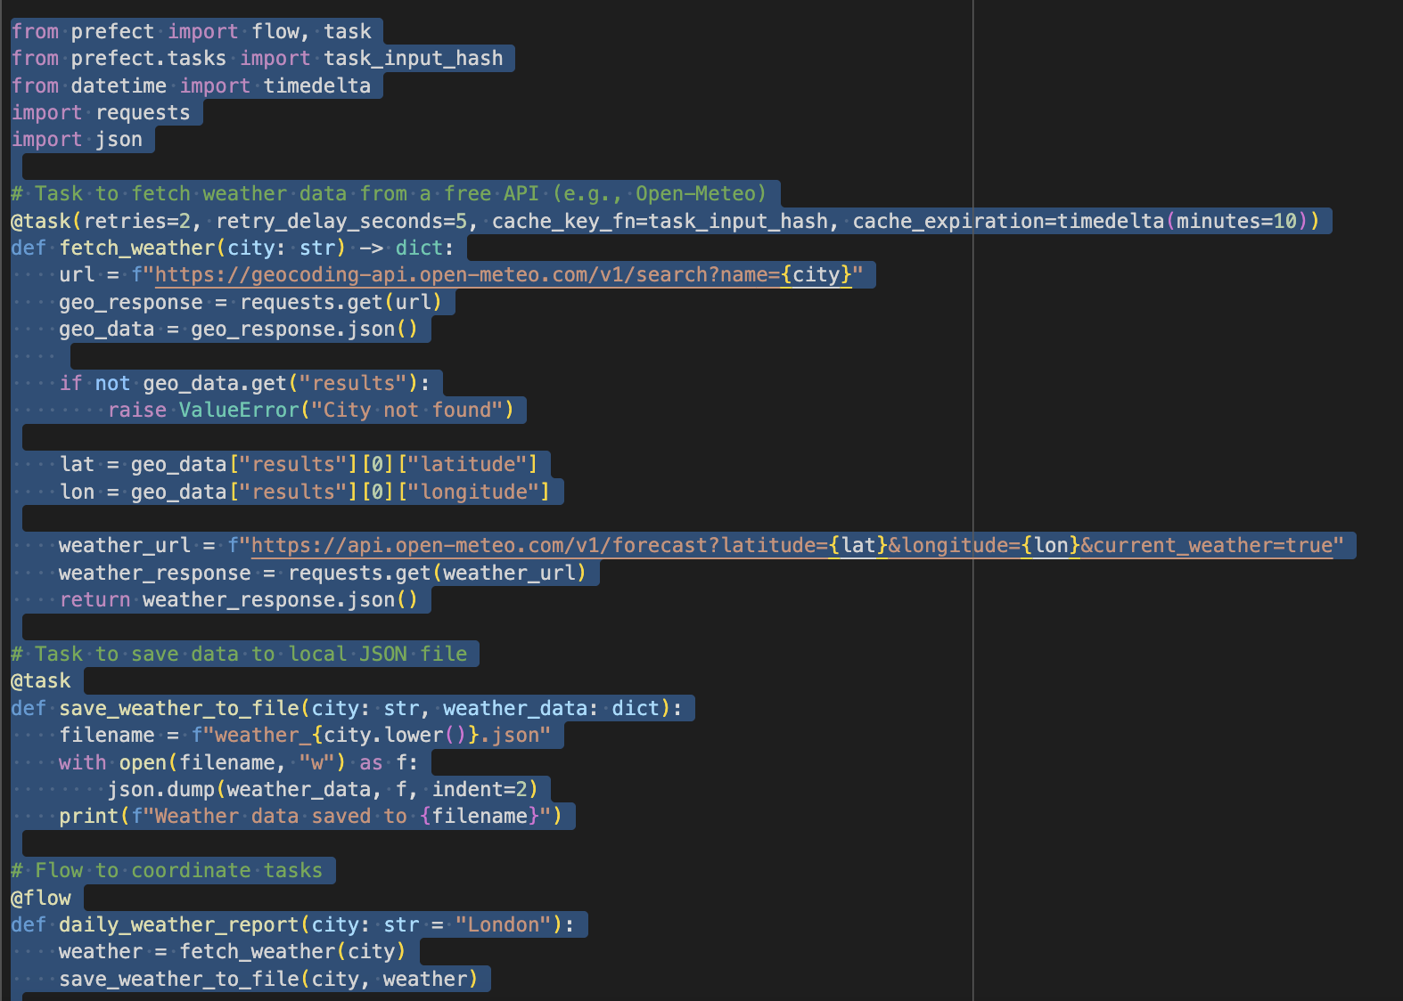
Handson: Write and run Workflows

Slide 53
Build, Schedule, & Automate Workflows
https://www.youtube.com/watch?v=EYs5xotSOT0

Slide 54
Defining Task Order with Dependencies in Prefect

Slide 55
Task Dependencies
Prefect uses the Data Dependency Model
Tasks run in parallel unless specified otherwise
Dependencies defined using:
.submit() order
wait_for argument
Flow runs tasks as soon as dependencies are ready
Notes:
Prefect checks if all inputs or conditions are satisfied. Use a diagram (optional) to show Task A → Task B → Task C.

Slide 56
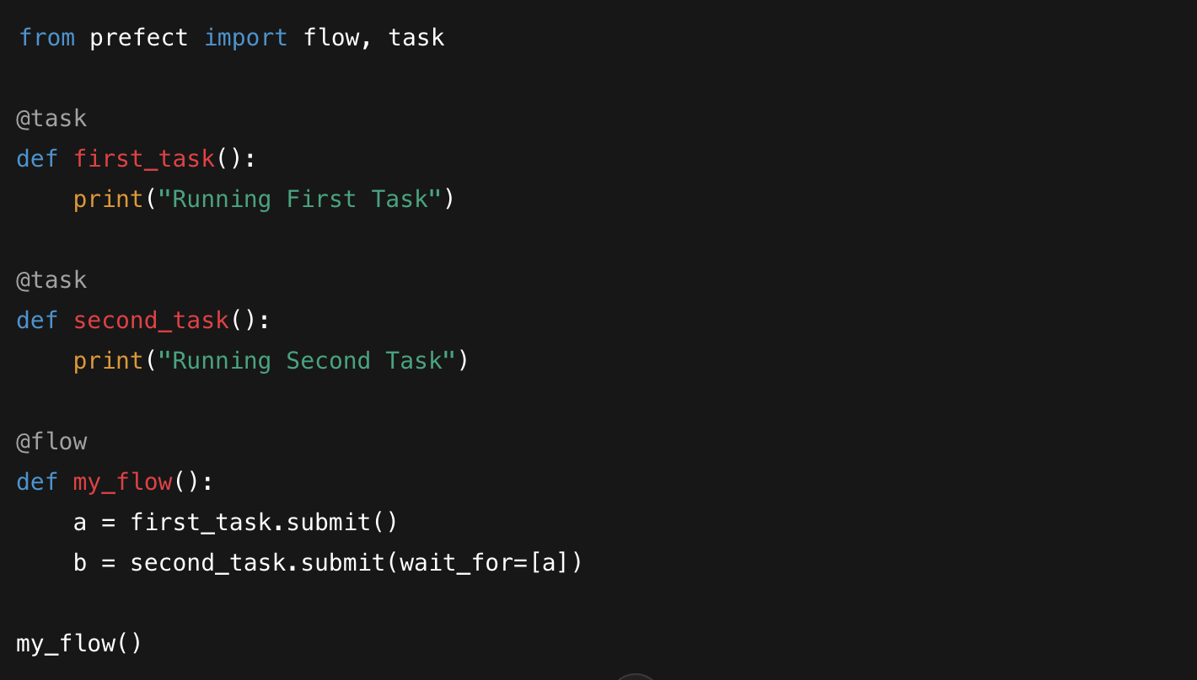
Task Order Using .submit()
Notes:
.submit() is used to schedule tasks for execution
wait_for makes a task wait for another
Tasks without wait_for can run in parallel

Slide 57
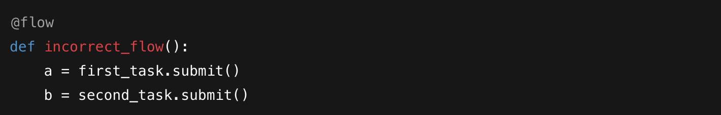
Task Chaining Without wait_for
No dependency here: both tasks may run at the same time
Order of appearance in code doesn’t determine execution order
Notes:
.submit() is used to schedule tasks for execution
wait_for makes a task wait for another
Tasks without wait_for can run in parallel

Slide 58
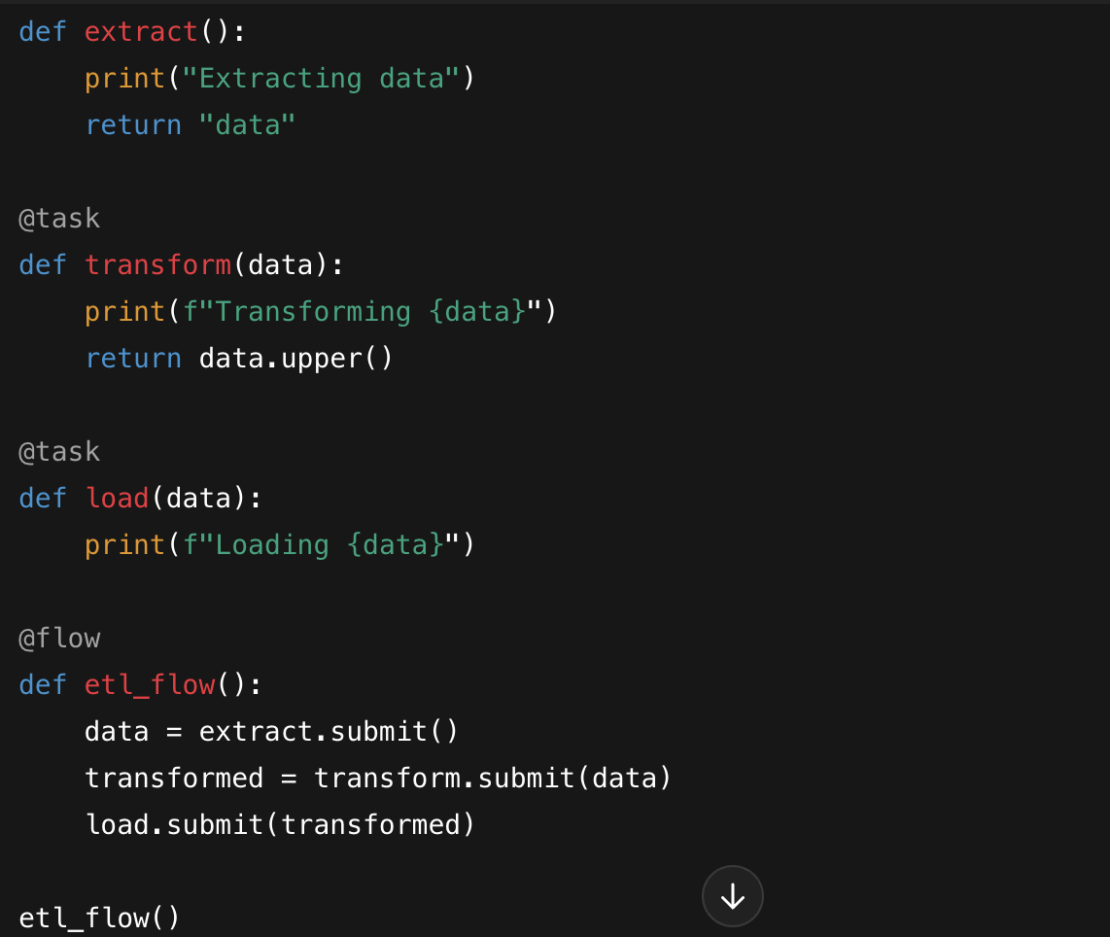
Complex Dependencies Example
Notes:
.submit() is used to schedule tasks for execution
wait_for makes a task wait for another
Tasks without wait_for can run in parallel

Slide 59
Advanced Task Handling

Slide 60
Retrying Failed Tasks – What and Why
Tasks can fail due to temporary issues (e.g., network errors)
Retrying gives tasks another chance to succeed
Avoids restarting entire flow for transient issues
Controlled with retries and retry_delay_seconds
Useful for API calls, flaky services, etc.
Notes:
In real-world data flows, failures are common—especially for tasks like API calls or database queries. Instead of giving up on the first failure, we can configure Prefect to automatically retry failed tasks a few times.

Slide 61
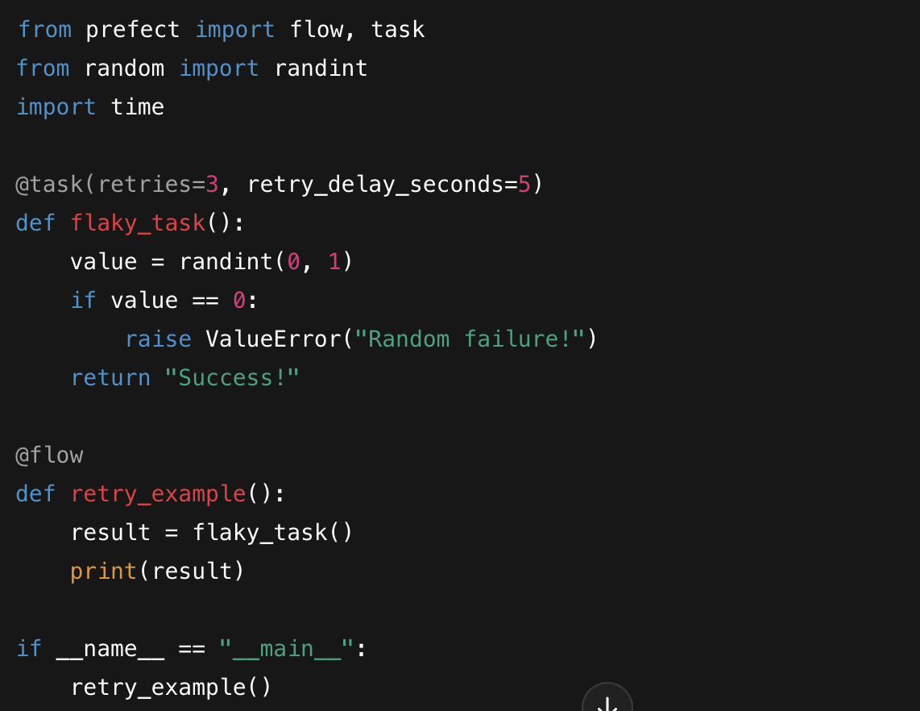
Retrying Failed Tasks – What and Why
Notes:
Retries up to 3 times
Waits 5 seconds between attempts
Handles random failures gracefully
No manual error handling needed

Slide 62
Task Timeouts – What and Why
Tasks might hang due to external issues (e.g., API stalls)
Timeouts ensure a task doesn't block the whole flow
Use timeout_seconds parameter
Task is cancelled after timeout
Combine with retries for better resilience
Notes:
Sometimes, a task may hang indefinitely. A timeout puts a limit on how long we’ll wait. Combined with retries, it lets us fail fast and try again, without freezing the entire flow.

Slide 63
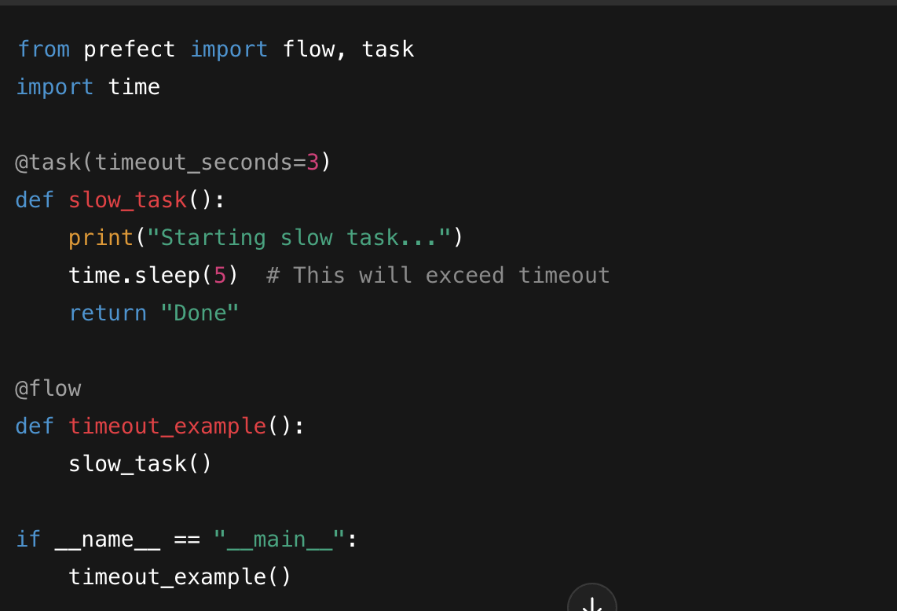
Task Timeouts – Code Example
Notes:
Task exceeds timeout and is stopped
Timeout is set to 3 seconds
Ensures flow doesn't hang forever
Useful for external API/database calls

Slide 64
Using Caching – What and Why
Avoid rerunning tasks with the same input
Useful for expensive computations or slow queries
Prefect supports input-based caching
Use cache_key_fn and cache_expiration
Works locally in open-source version
Notes:
If your task runs the same inputs repeatedly—like querying static data or transforming a fixed file—you can cache the result. That saves time and resources. Prefect allows input-based caching with expiration control.

Slide 65
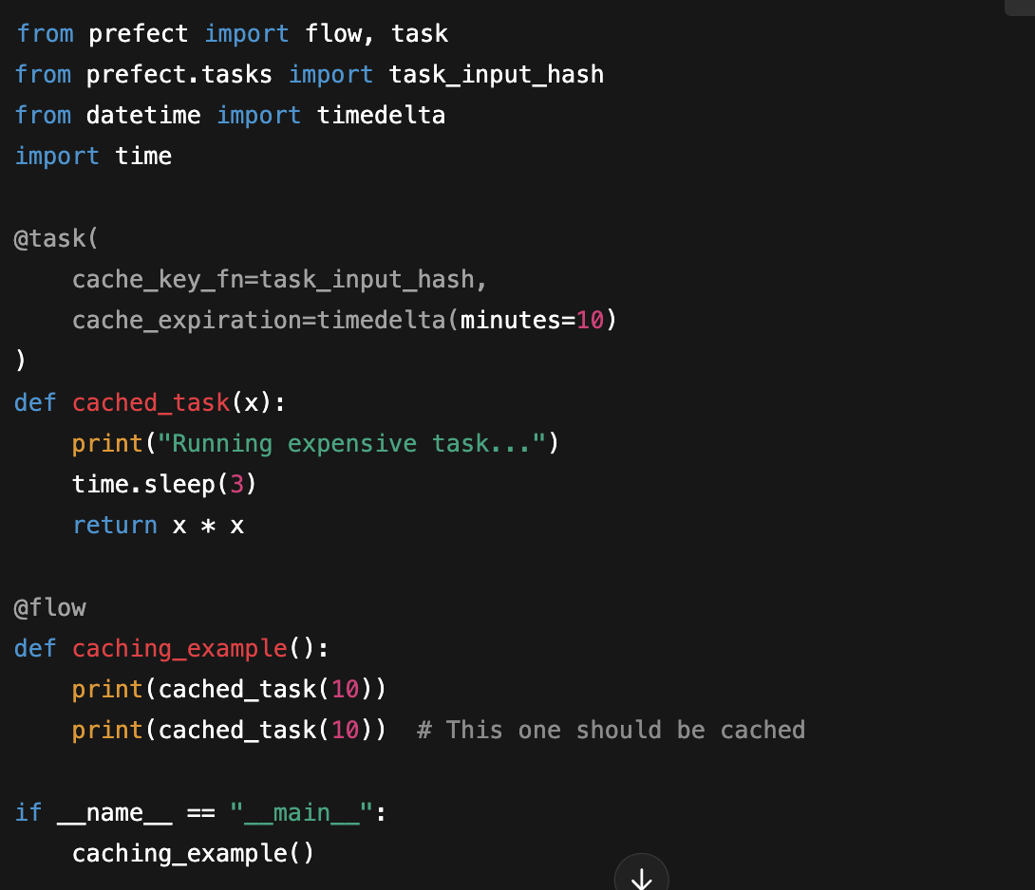
Task Caching – Code Example
Notes:
Only first call runs the task
Second call returns cached result
Saves time on repeated inputs
Expiration after 10 minutes

Slide 66
Logging and Monitoring

Slide 67
Logging in Prefect (Basics)
Prefect uses Python's built-in logging module.
Logs are attached to task and flow runs automatically.
Default logging level is INFO.
Use get_run_logger() to log from within tasks/flows.
Logging helps in debugging and performance monitoring.
Notes:
Prefect provides automatic logging integration, meaning any log you write inside a task or flow using get_run_logger() is automatically visible in the Prefect UI. This is extremely useful for understanding what happened during a run—especially when things go wrong.

Slide 68
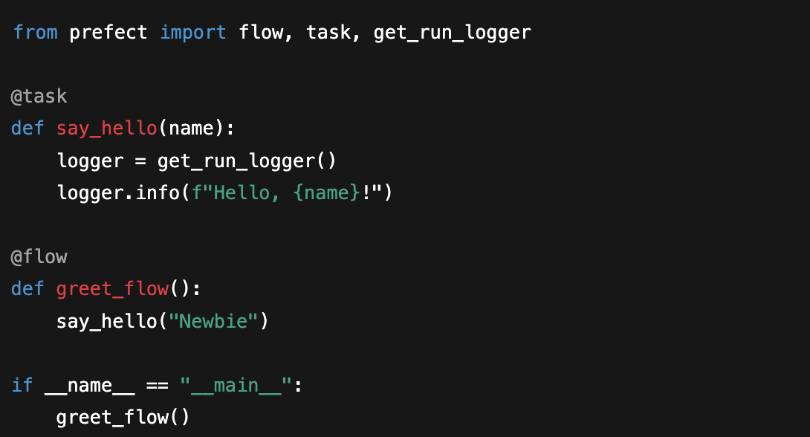
Logging in Prefect (Basics)
Notes:
Prefect provides automatic logging integration, meaning any log you write inside a task or flow using get_run_logger() is automatically visible in the Prefect UI. This is extremely useful for understanding what happened during a run—especially when things go wrong.

Slide 69
Where to See Logs in the UI
Prefect UI shows logs for each flow run and task run.
Navigate to "Flow Runs" > Select a Run > Logs tab.
Logs are timestamped and color-coded by level (INFO, ERROR).
You can filter by task and log level.
Notes:
When you run a flow, Prefect stores logs and exposes them in the UI. You can explore individual flow and task logs via the web interface. This is crucial for understanding the execution sequence and locating errors or slowdowns.

Slide 70
Understanding Flow and Task Run States
Each task/flow run has a state: Scheduled, Running, Completed, Failed, etc.
States are color-coded in the UI.
State transitions trigger logs and events.
Failed states often include stack traces.
Useful for debugging retry logic, failures, and timeouts.
Notes:
Prefect doesn’t just run things—it tracks what happens. Knowing how to read state transitions in the UI is just as important as writing good tasks. Use the UI’s visual cues (colors, tooltips, logs) to quickly assess what happened in each run.

Slide 71
Monitoring Your Flows in the Prefect UI
Dashboard shows latest flow/task runs and statuses.
You can see retry counts, durations, and outcomes.
Click on any flow run to view a task map (DAG).
View logs inline or per task.
Helps with real-time monitoring and troubleshooting.
Notes:
The Prefect UI gives a visual and interactive way to monitor your workflows. For example, if a task fails, you’ll immediately see it in red. Click through to see the log trail. For long-running flows, you can monitor progress in real time.

Slide 72
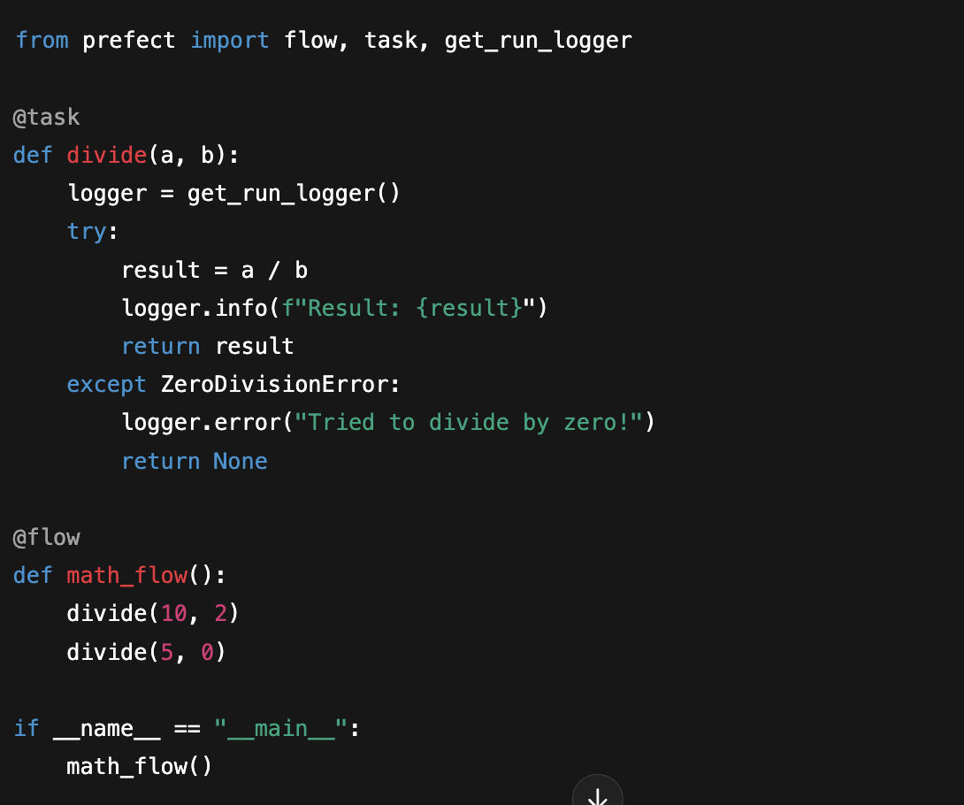
Example: Logging for Debugging
Notes:
This example shows how to use logging and error handling together. If something goes wrong, you’ll see the logs in the UI immediately. For instance, dividing by zero logs an error, helping you identify the problem fast.

