Slide 1
Contributing to LibreOffice – Talk 3

Slide 2
Selection of bugs for fixing
Easy hack/Non easy hack
Adds better value to the LO user
Are long standing and unattended.
On LO's MAB list
Matches your field of interest
Usually bugs that would take a week of effort

Slide 3
Negative selection of bugs
Not bugs we think will be picked up by others
Not bugs that have a monetary reward
Have not thought through it
It might be someone's livelihood
Not our commercial activity

Slide 4
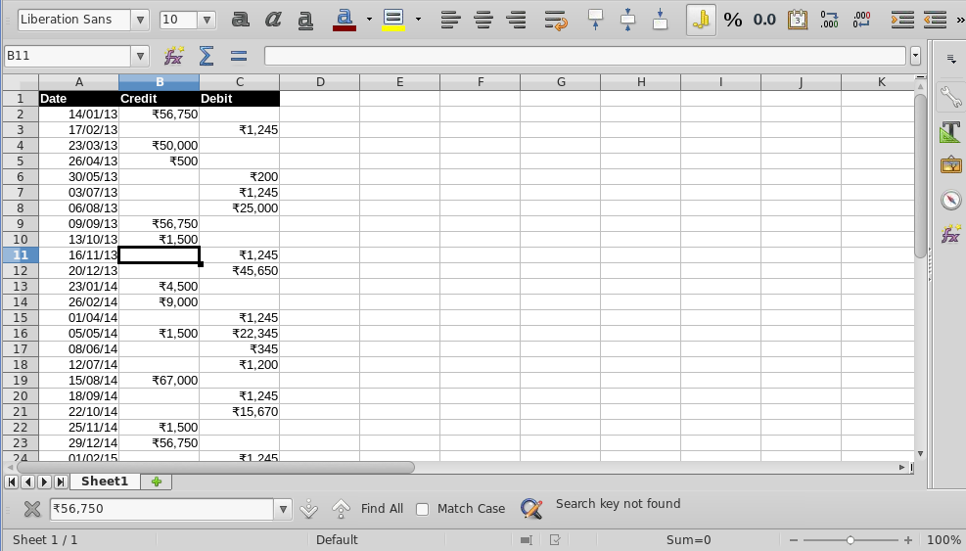
tdf # 48456
Cannot search for a number with formatting

Slide 5
Using opengrok and few runs in gdb, was able to localize the code of our interest :
In sc/source/core/data/table6.cxx ScTable::SearchCell()
bool ScTable::SearchCell(const SvxSearchItem& rSearchItem, SCCOL nCol, SCROW nRow,
const ScMarkData& rMark, OUString& rUndoStr, ScDocument* pUndoDoc)
{
if (!ValidColRow( nCol, nRow))
return false;
bool bFound = false;
bool bDoSearch = true;
bool bDoBack = rSearchItem.GetBackward();
OUString aString;
ScRefCellValue aCell;
...
aCell = aCol[nCol].GetCellValue(nRow);
if (aCell.isEmpty())
return false;
bool bMultiLine = false;
CellType eCellType = aCell.meType;
switch (rSearchItem.GetCellType())
{
case SvxSearchCellType::FORMULA:
{
if ( eCellType == CELLTYPE_FORMULA )
aCell.mpFormula->GetFormula(aString, pDocument->GetGrammar());
else if ( eCellType == CELLTYPE_EDIT )
bMultiLine = lcl_GetTextWithBreaks(*aCell.mpEditText, pDocument, aString);
else
{
aCol[nCol].GetInputString( nRow, aString );
}
}
break;
case SvxSearchCellType::VALUE:
if ( eCellType == CELLTYPE_EDIT )
bMultiLine = lcl_GetTextWithBreaks(*aCell.mpEditText, pDocument, aString);
else
{
aCol[nCol].GetInputString( nRow, aString );
}
break;
case SvxSearchCellType::NOTE:
break; // don't search this case here
default:
break;
}
rSearchItem has the search string.
These extract the string form of the cell's true value (without formatting) to aString variable.
aString is then compared to the search string for ocurrences.
aCol[nCol] returns a ScColumn typed object. Fortunately ScColumn already has a method to get the formatted string of a cell. It it called GetString()

Slide 6
The first try was to search both the formatted as well as the non-formatted string automatically.

Slide 7
But performance goes down for every regular search.
Felt more when the sheet is big.
It will take approx. double the time to search.

Slide 8
LO devs suggested the use of a checkbox
Do search on the formatted cell content only if the check box is checked.

Slide 9
Search can happen three ways
From Calc Find bar
From Find and Replace dialog box.
From LO API

Slide 10
For Checkbox addition follow the already existing checkboxes as examples.

Slide 11
In Find & Replace dialog there is a checkbox called “Match Case”. Doing a search on opengrok points to
svx/uiconfig/ui/findreplacedialog.ui
<child>
<object class="GtkCheckButton" id="matchcase">
<property name="label" translatable="yes">Ma_tch case</property>
<property name="visible">True</property>
<property name="can_focus">True</property>
<property name="receives_default">False</property>
<property name="use_underline">True</property>
<property name="xalign">0</property>
<property name="draw_indicator">True</property>
</object>
<packing>
<property name="left_attach">0</property>
<property name="top_attach">0</property>
</packing>
</child>
Now search in opengrok where this file is sourced.
It is sourced in svx/source/dialog/srchdlg.cxx in SvxSearchDialog class.

Slide 12
Here is the checkbox widget
corresponding to the “Match Case”
option in the UI.
115 class SvxSearchDialog : public SfxModelessDialog
116 {
121 public:
122 SvxSearchDialog( vcl::Window* pParent, SfxChildWindow* pChildWin, SfxBindings& rBind );
123 virtual ~SvxSearchDialog();
124 virtual void dispose() override;
………………………………
……………………………...
149 private:
150 VclPtr<vcl::Window> mpDocWin;
151 bool mbSuccess;
152
153 VclPtr<VclFrame> m_pSearchFrame;
154 VclPtr<ComboBox> m_pSearchLB;
155 VclPtr<ListBox> m_pSearchTmplLB;
156 VclPtr<FixedText> m_pSearchAttrText;
157 VclPtr<FixedText> m_pSearchLabel;
158
159 VclPtr<VclFrame> m_pReplaceFrame;
160 VclPtr<ComboBox> m_pReplaceLB;
161 VclPtr<ListBox> m_pReplaceTmplLB;
162 VclPtr<FixedText> m_pReplaceAttrText;
163
164 VclPtr<PushButton> m_pSearchBtn;
165 VclPtr<PushButton> m_pSearchAllBtn;
166 VclPtr<PushButton> m_pReplaceBtn;
167 VclPtr<PushButton> m_pReplaceAllBtn;
168
169 VclPtr<VclFrame> m_pComponentFrame;
170 VclPtr<PushButton> m_pSearchComponent1PB;
171 VclPtr<PushButton> m_pSearchComponent2PB;
172
173 VclPtr<CheckBox> m_pMatchCaseCB;
174 VclPtr<CheckBox> m_pSearchFormattedCB;
175 VclPtr<CheckBox> m_pWordBtn;

Slide 13
Now need to understand the class members code how this checkbox is accessed

Slide 14
After many followups on “MatchCase”
We finally get the new checkbox info to table6.cxx ScTable::SearchCell()

Slide 15
54 bool ScTable::SearchCell(const SvxSearchItem& rSearchItem, SCCOL nCol, SCROW nRow,
55 const ScMarkData& rMark, OUString& rUndoStr, ScDocument* pUndoDoc)
56 {
57 if (!ValidColRow( nCol, nRow))
58 return false;
59
60 bool bFound = false;
61 bool bDoSearch = true;
62 bool bDoBack = rSearchItem.GetBackward();
63 bool bSearchFormatted = rSearchItem.IsSearchFormatted();
64
65 OUString aString;
66 ScRefCellValue aCell;
73 aCell = aCol[nCol].GetCellValue(nRow);
74 if (aCell.isEmpty())
75 return false;
76
77 bool bMultiLine = false;
78 CellType eCellType = aCell.meType;
79 switch (rSearchItem.GetCellType())
80 {
81 case SvxSearchCellType::FORMULA:
82 {
83 if ( eCellType == CELLTYPE_FORMULA )
84 aCell.mpFormula->GetFormula(aString, pDocument->GetGrammar());
85 else if ( eCellType == CELLTYPE_EDIT )
86 bMultiLine = lcl_GetTextWithBreaks(*aCell.mpEditText, pDocument, aString);
87 else
88 {
89 if( !bSearchFormatted )
90 aCol[nCol].GetInputString( nRow, aString );
91 else
92 aCol[nCol].GetString( nRow, aString );
93 }
94 }
95 break;
96 case SvxSearchCellType::VALUE:
97 if ( eCellType == CELLTYPE_EDIT )
98 bMultiLine = lcl_GetTextWithBreaks(*aCell.mpEditText, pDocument, aString);
99 else
100 {
101 if( !bSearchFormatted )
102 aCol[nCol].GetInputString( nRow, aString );
103 else
104 aCol[nCol].GetString( nRow, aString );
105 }
106 break;
107 case SvxSearchCellType::NOTE:
108 break; // don't search this case here
109 default:
110 break;
111 }
Here is the new checkbox data
If the checkbox was checked use GetString() else use GetInputString()

Slide 16
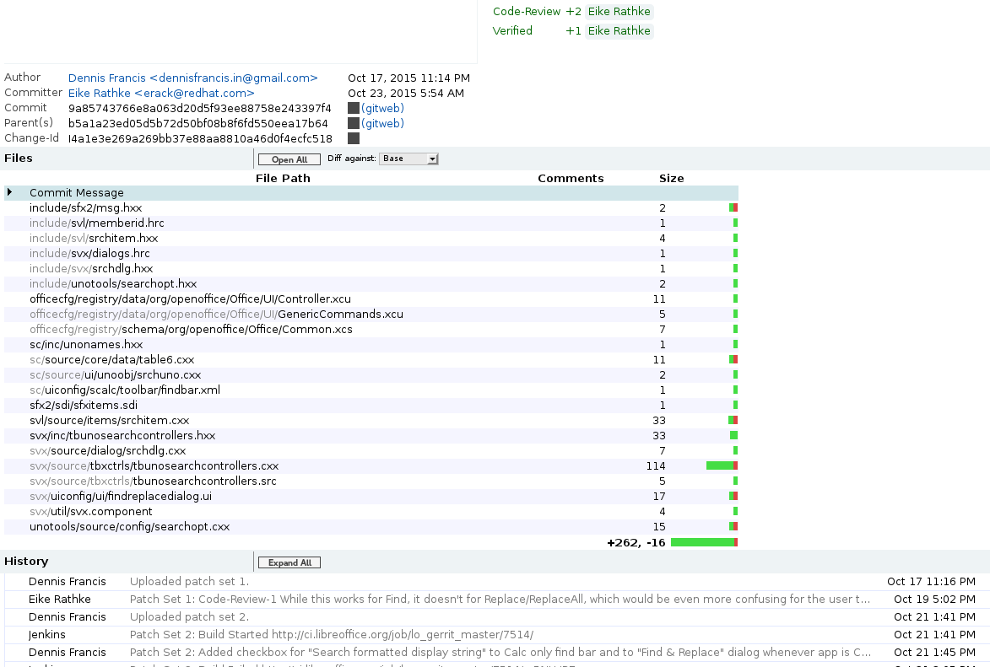
Gerrit(code review) URL : https://gerrit.libreoffice.org/#/c/19420/

Slide 17
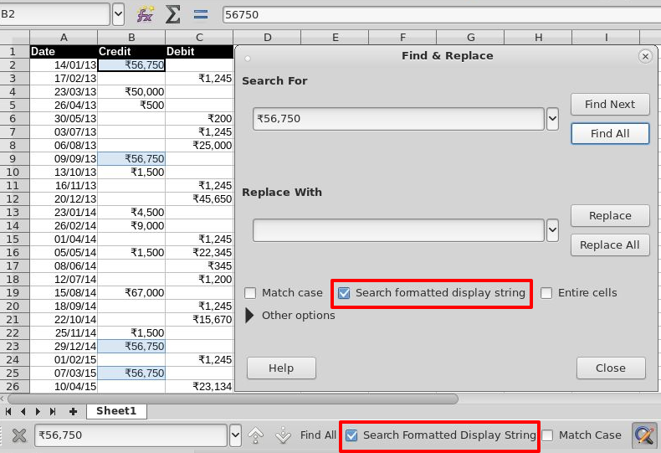
UI after the patch

