Slide 1
Contributing to LibreOffice – Ilugc Talk 4

Slide 2
Feature addition : ability of deleting borders of cell from adjacent cell tdf#34449

Slide 3
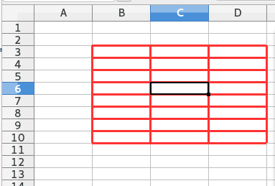
Why we need this ?
Select any region and apply borders to all cells using “Format Cells” dialog.
Now select any inner cell having border, and try to remove the border
no visible change occurs ! The red border around the cell remains.
This is clearly non-intuitive for a new user.

Slide 4
Not a bug !
Here C6's border gets removed correctly, but what we perceive as C6's border are in fact the adjacent borders of C5, D6, C7 and B6.
This patch adds a check-box in format cells dialog to delete the borders from adjacent cells as well

Slide 5
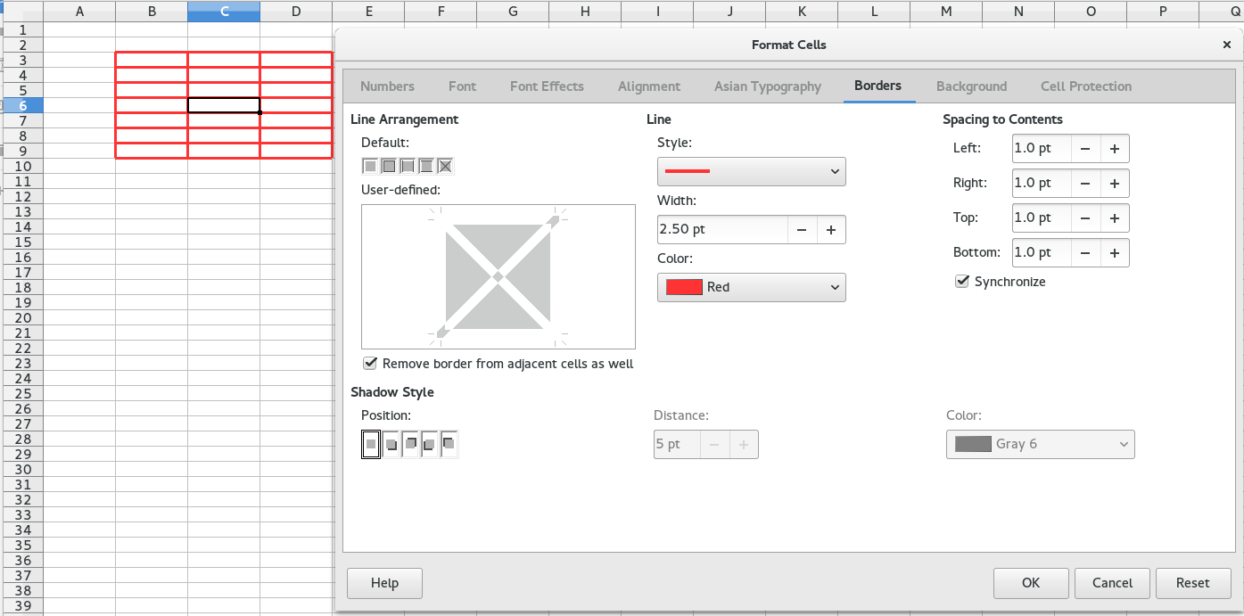
With the patch applied

Slide 6
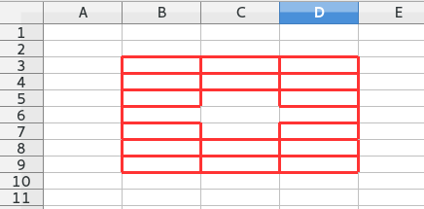
With the patch applied
This deletes borders of C6 as well as
bottom border of C5,
top border of C7,
left border of B6 and
right border of D6

Slide 7
Complications
The patch should work not just for a single cell selection, but also for all kinds of selections !
The selection could be
Single rectangle selection
Multiple rectangle selection (aka MultiSelection )

Slide 8
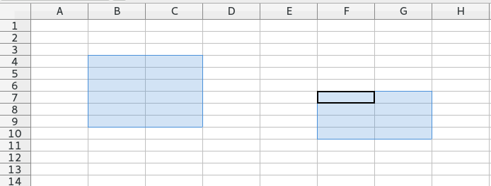
Selection Cover
Cover or envelope is the set of cells surrounding the user's selection.
In this example(multi selection)
Top cover is the set {B3, C3, F6, G6}
Bottom cover is the set {B10, C10, F11, G11}
Left cover is the set {A4, A5, A6, A7, A8, A9, E7, E8, E9, E10}
Right cover is the set {D4, D5, D6, D7, D8, D9, H7, H8, H9, H10}

Slide 9
Brief outline of the patch
Compute top, bottom, left and right cover sets for the current user selection. (this is the hard part esp. for multi selection)
If the user selects the new checkbox :
If user wants to remove top border of the selection, then remove bottom border of all cells in top cover as well.
If user wants to remove bottom border of the selection, then remove top border of all cells in bottom cover as well.
If user wants to remove left border of the selection, then remove right border of all cells in left cover as well.
If user wants to remove right border of the selection, then remove left border of all cells in right cover as well.

Slide 10
Selection Cover computation
For fast computation of selection cover for multi selection, the patch uses a data structure called flat segment tree (FST).
Kohei Yoshida et al. already implemented Flat segment tree data structure in C++, so we use this. See http://kohei.us/files/mdds/doc/

Slide 11
FST
FST lets you map from non overlapping range of integers to any data of your choice, efficiently.
A Hash table could be made to do this, but less efficient as it is a generic data structure. FST is made for this.

Slide 12
FST API simplified...
Fst.setValue(rangeStart, rangeEnd, val) :
ex : Fst.setValue(0, 100, 5) sets the value 5 for the range of numbers from 0(inclusive) to 100(excluded)
val = Fst.getValue(queryPoint)
ex : getValue(50) when run after setValue(0, 100, 5) would return the value 5.
range = Fst.getRangeData(querypoint) // returns the range where the querypoint is in
range has three members : start, end, value.
Fst.setValue(0, 100, 5)
Fst.getValue(10) // returns 5
Fst.setValue(50,75, 10)
Fst.getValue(10) // still returns 5
Fst.getValue(80) // returns 5
Fst.getValue(60) // returns 10
range = Fst.getRangeData(20) // range.start = 0, range.end = 49, range.value = 5

Slide 13
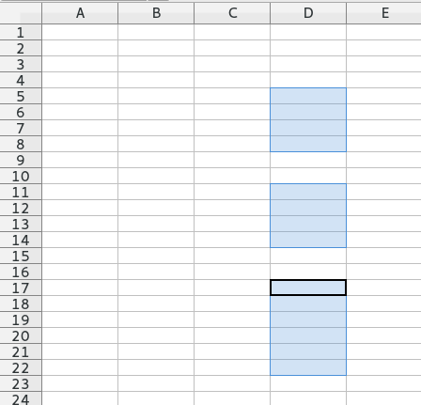
FST in the context of Selection Cover
FST is used to keep track of row selections in a column.
To represent the selections in column D, we can use :
Fst.setValue(0, MAXROWS, false) // Initialize FST indicating no selections.
Fst.setValue(5, 9, true) // D5 to D8 are selected
Fst.setValue(11, 15, true) // D11 to D14 are selected
Fst.setValue(17, 23, true) // D17 to D22 are selected

Slide 14
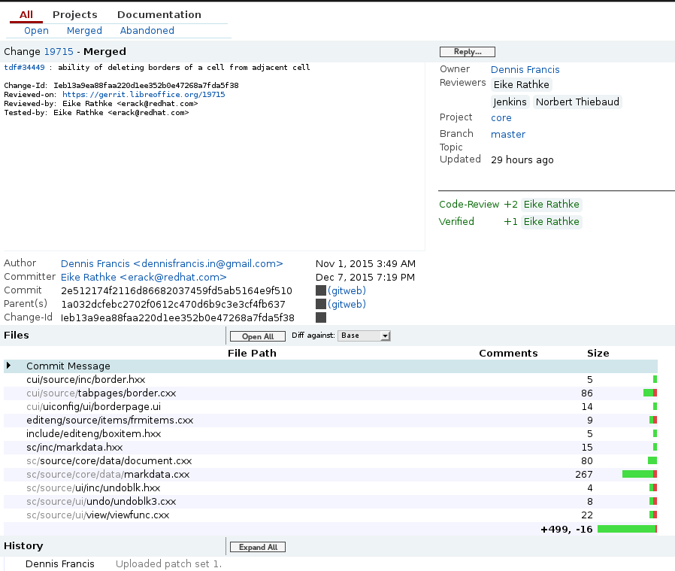
See Patch @ https://gerrit.libreoffice.org/#/c/19715/

