Slide 1

Contributing to LibreOffice
Bugs Focused in this Talk
  Bug tdf#96822
  Bug tdf#91065
  Bug tdf#94865
Libre Data Consultancy Services (www.ldcs.co.in)

Slide 2
Agenda
Steps to Contribute to LibreOffice
Introduction to Bugs & possible solution
  Bug tdf#96822 (Yogesh Desai)
  Bug tdf#91065 (Arul Michael)
  Bug tdf#94865 (Kumar Thangavel)
Question & Answers
Libre Data Consultancy Services (www.ldcs.co.in)

Slide 3
Steps to Contribute to LibreOffice
Steps to Contribute :
Clone LO code
Select a Bug from LO-Bugzilla
Make changes to LO code
Use LO Opengrok to Navigate code
Change your code as per
Suggestions
Get Code Review & Suggestions
Submit your Patch through gerrit
One Bug Solved
Libre Data Consultancy Services (www.ldcs.co.in)

Slide 4
Bug tdf#96822
Bug Description :
  Cell With Numeric Values Formatted As "TEXT" Should Align Left
Steps to reproduce:
  Open Calc & Type 123 in cell A1
  Set cell format of “A1” to “Text”
Expected : Cell contents should be “Left-Aligned” as Format is “Text”
Actual : Cell contents are Right-Aligned
Libre Data Consultancy Services (www.ldcs.co.in)

Slide 5
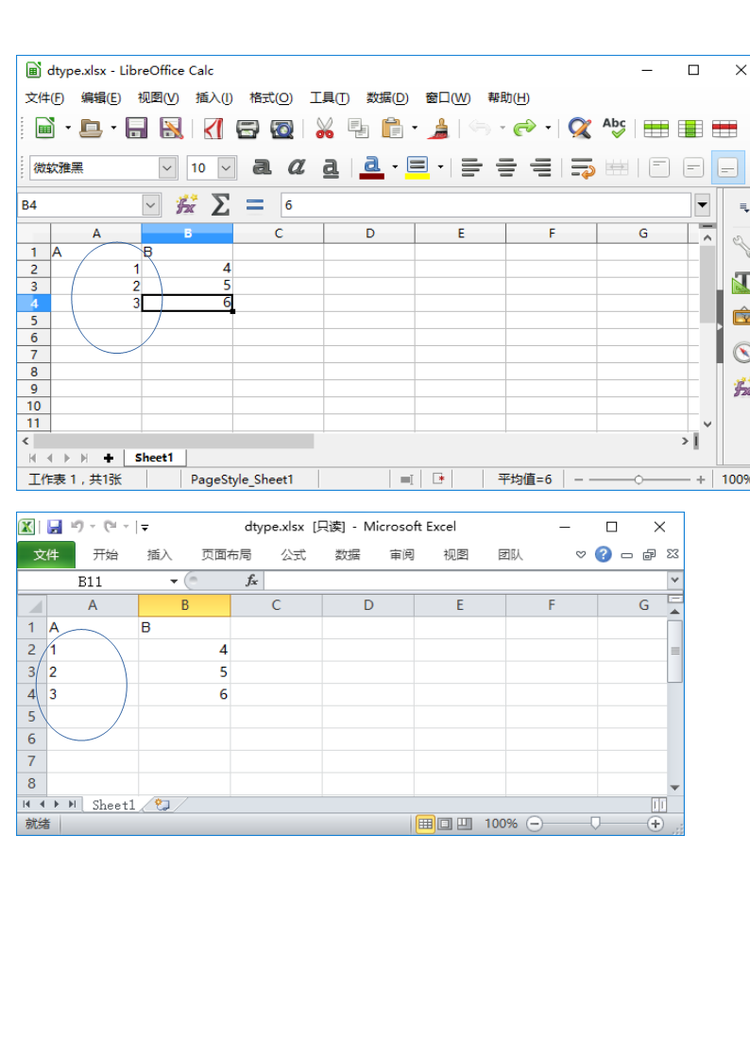
You may add additional text here ...
Libre Data Consultancy Services (www.ldcs.co.in)

Slide 6
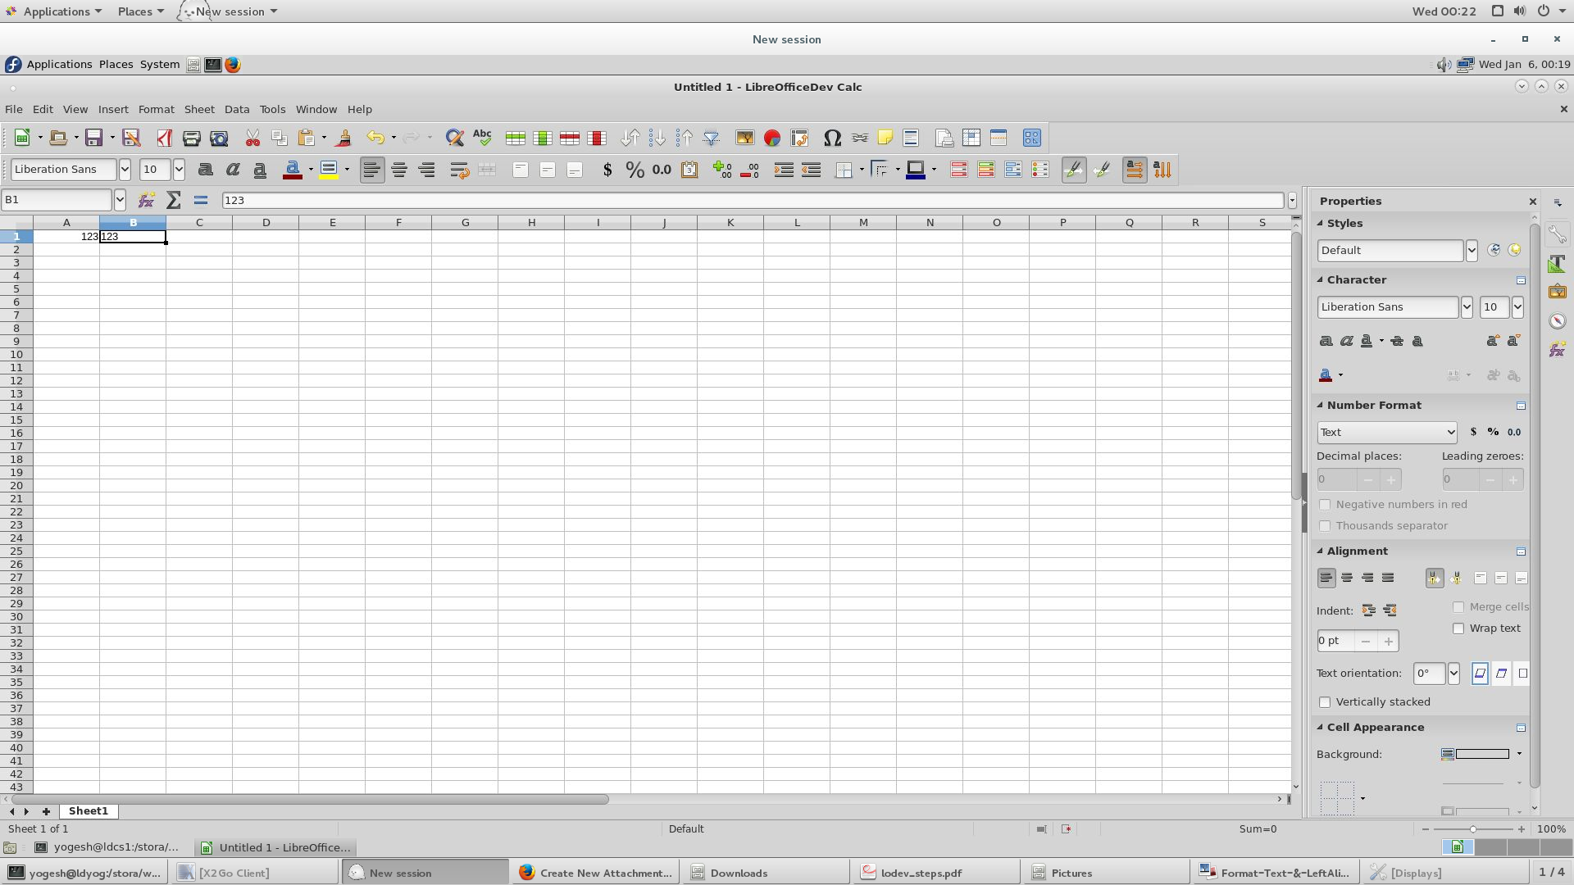
Patch Submitted & Accepted
Libre Data Consultancy Services (www.ldcs.co.in)

Slide 7
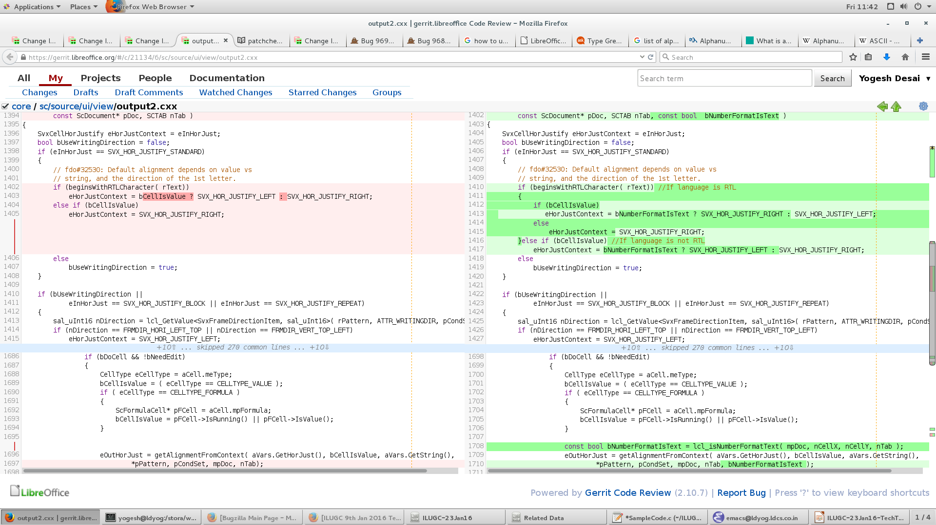
Code Changes
Libre Data Consultancy Services (www.ldcs.co.in)

Slide 8
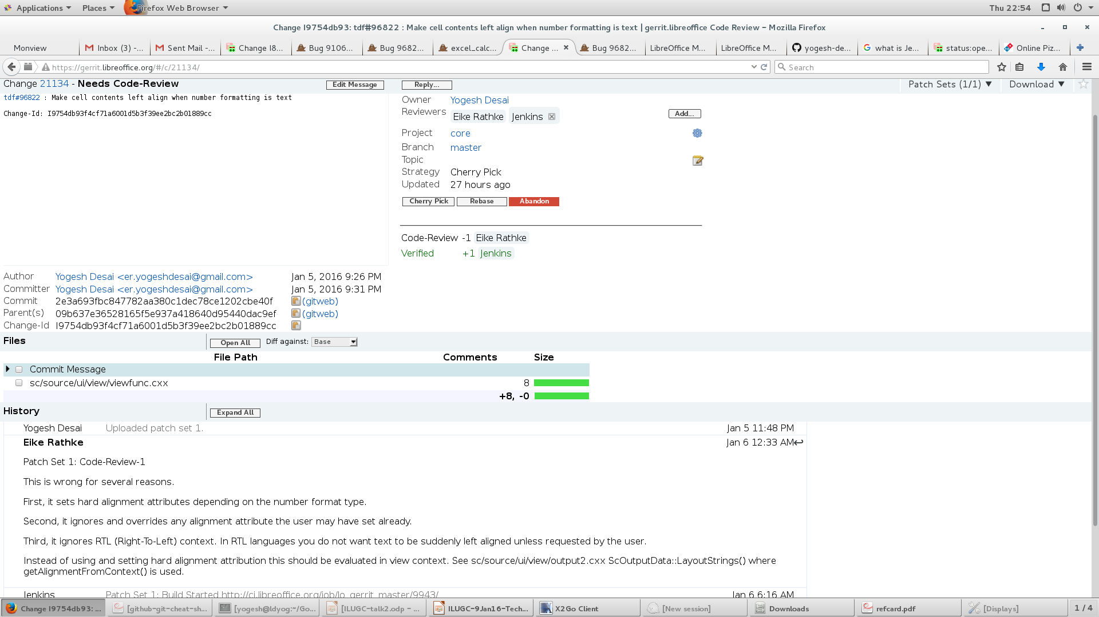
Code Review
Libre Data Consultancy Services (www.ldcs.co.in)

Slide 9
Code Review
Libre Data Consultancy Services (www.ldcs.co.in)

Slide 10
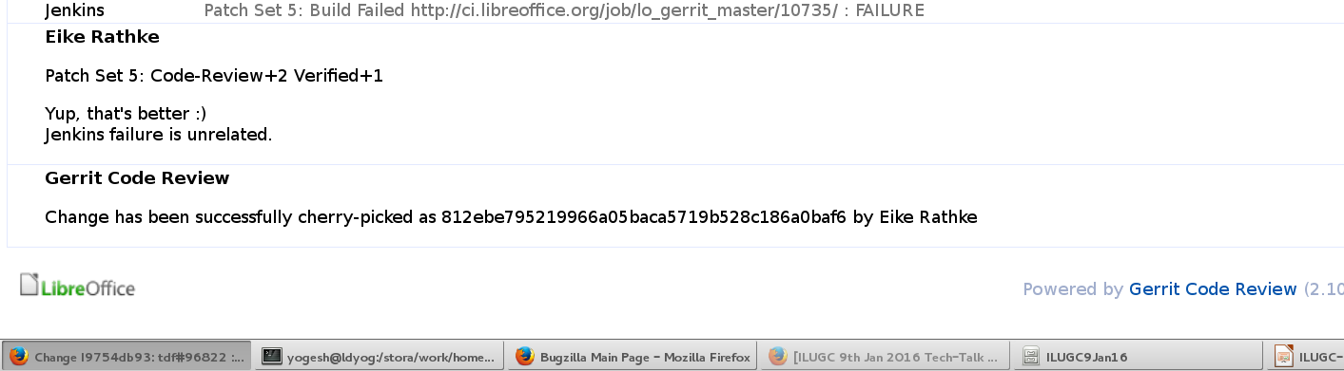
Code Review
Libre Data Consultancy Services (www.ldcs.co.in)

Slide 11
Bug tdf#91065
Description
Title of Document Properties dialog cannot be localized adequately
Dialog Title = <Title read from config file> + <filename>
Change Required
  The config file value will have a placeholder to substitute the filename.
  Example:
  <property name="title" translatable="yes">Properties of %1</property>
  “%1” will be the place holder to substitute the file name
Libre Data Consultancy Services (www.ldcs.co.in)

Slide 12
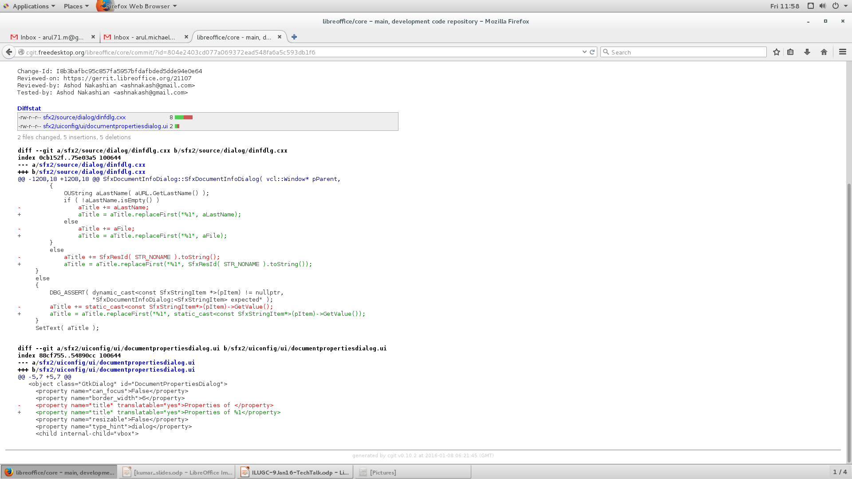
Changes
Identify the config file which is used by the dialog
sfx2/uiconfig/ui/documentpropertiesdialog.ui
Libre Data Consultancy Services (www.ldcs.co.in)

Slide 13
Changes
The code that sets the dialog title
/sfx2/source/dialog/dinfdlg.cxx
SfxDocumentInfoDialog::SfxDocumentInfoDialog(....)
Libre Data Consultancy Services (www.ldcs.co.in)

Slide 14
Bug tdf#94865
Bug Description :
MENU : Duplicate accelerators in en_US version
Steps to reproduce :
Open writer document
Press Alt + F
Press D
Again press D
Libre Data Consultancy Services (www.ldcs.co.in)

Slide 15
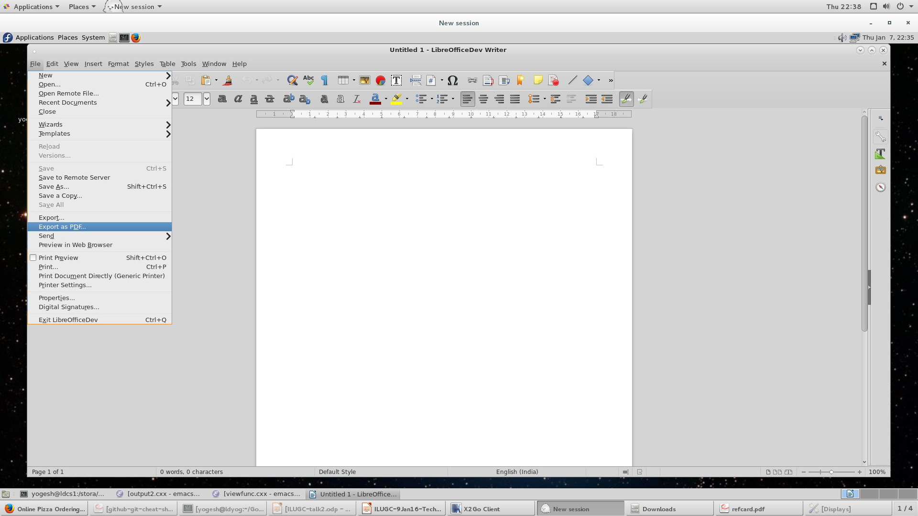
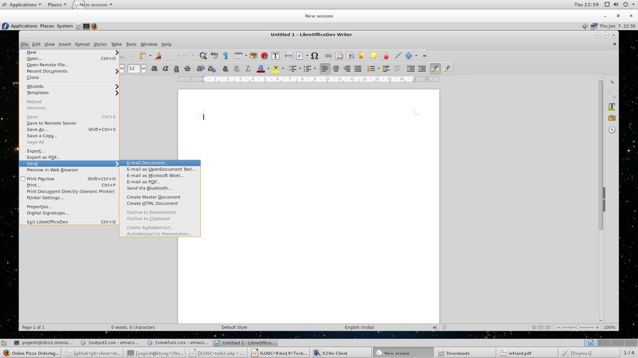
Libre Data Consultancy Services (www.ldcs.co.in)

Slide 16
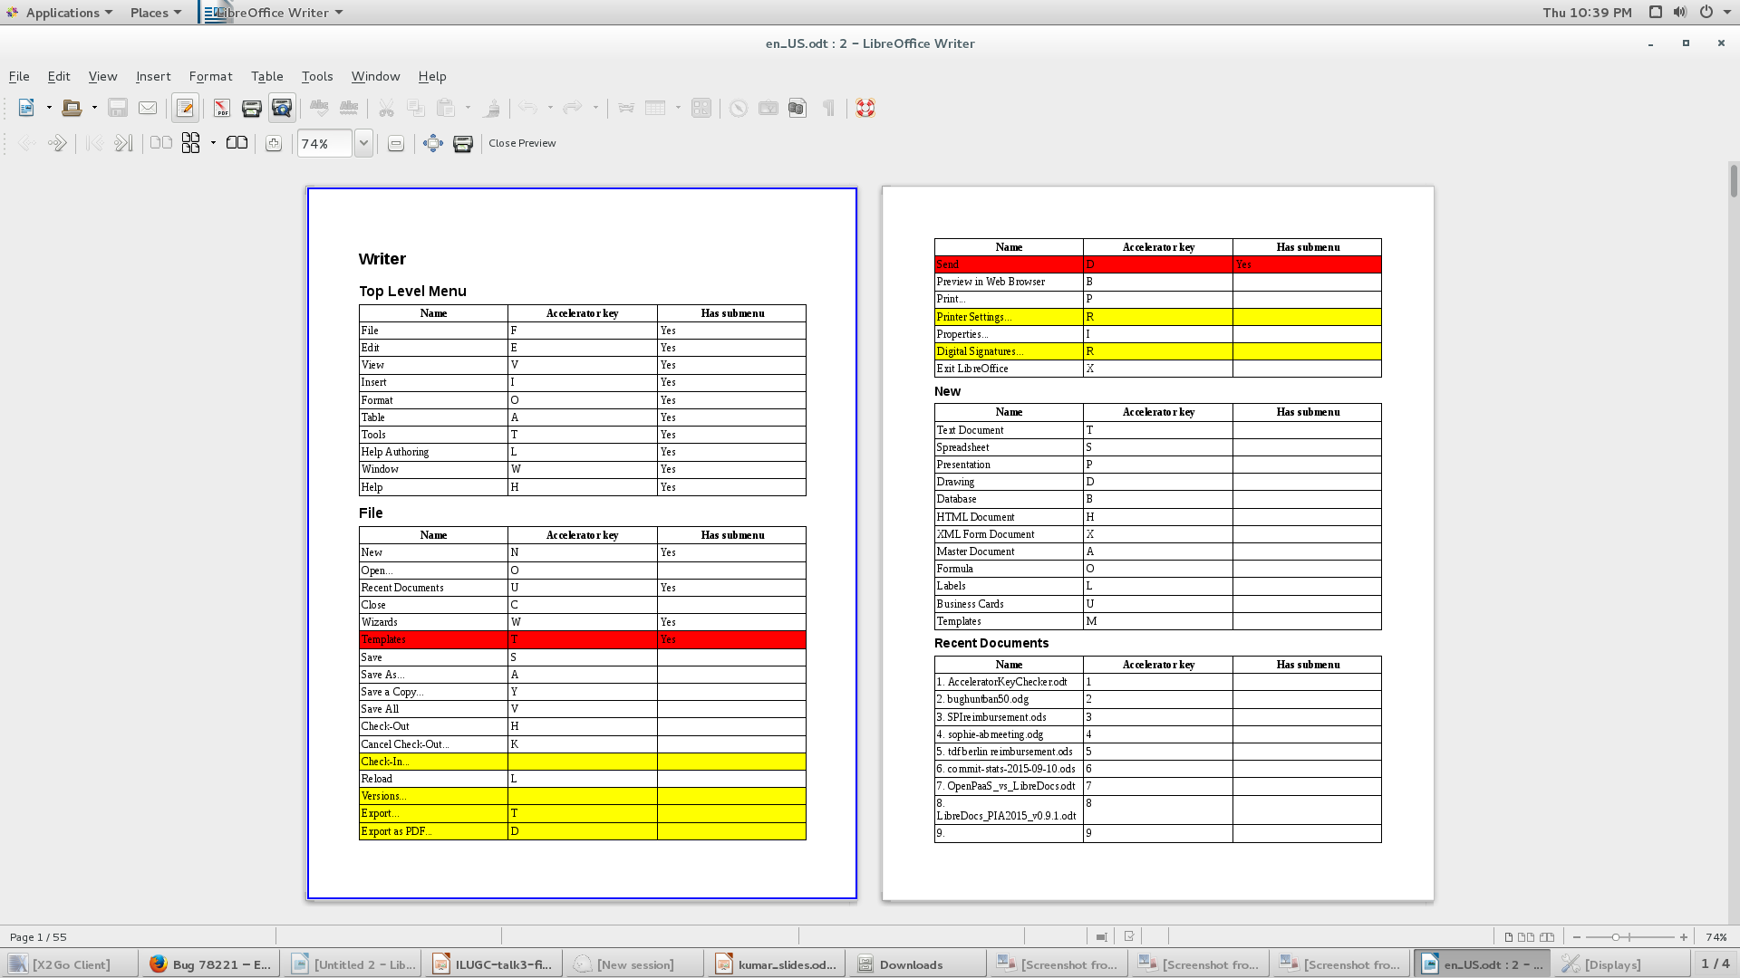
Libre Data Consultancy Services (www.ldcs.co.in)

Slide 17
Steps to solve
Use Opengrok to pick the code pointers
Choose duplicate accelerators to fix
Analyze and pick accelerators to replace it
It should not affect other accelerators
Don't pick “.” (Dot) or special characters as a accelerators
Libre Data Consultancy Services (www.ldcs.co.in)

Slide 18
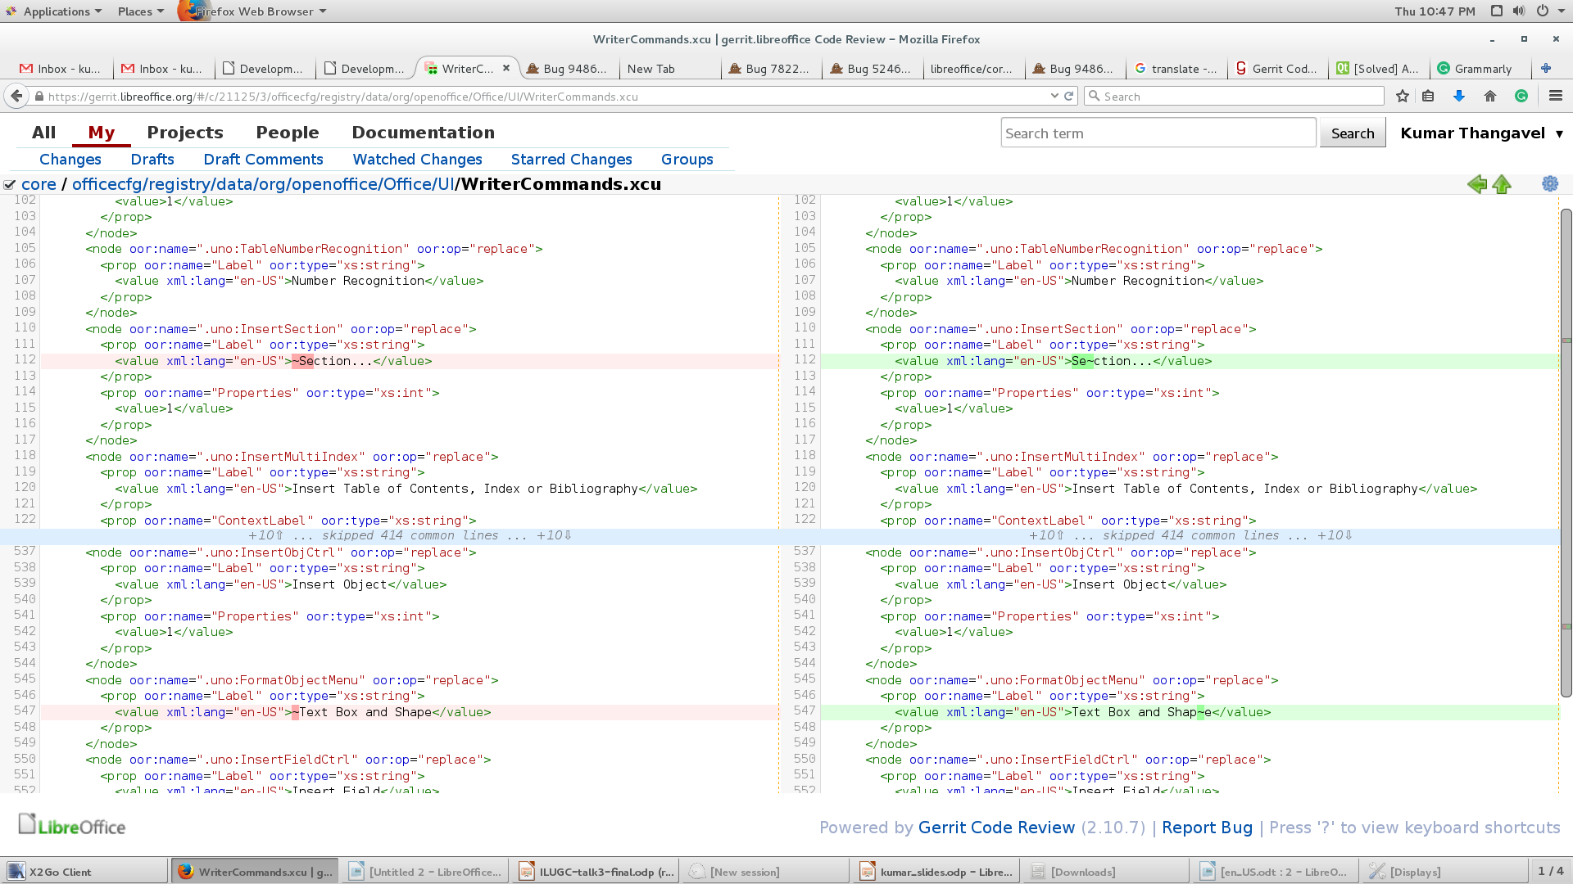
Before | After
Export as PDF, send | Export as PDF, send
Shape, Section | Shape, Section
Field, Document | Field, Document
Image, Asian phonetic guide | Image, Asian phonetic guide
Row, Arrange | Row, Arrange
Form, Flip | Form, Flip
Shapes, Split | Shapes, Split
Libre Data Consultancy Services (www.ldcs.co.in)

Slide 19
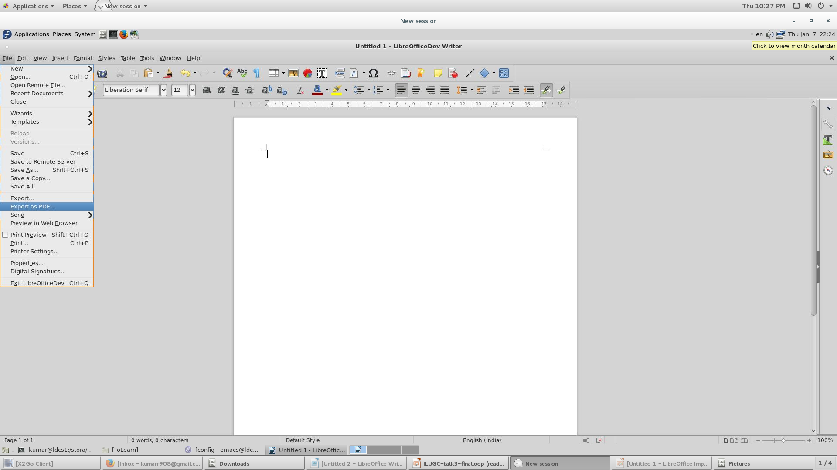
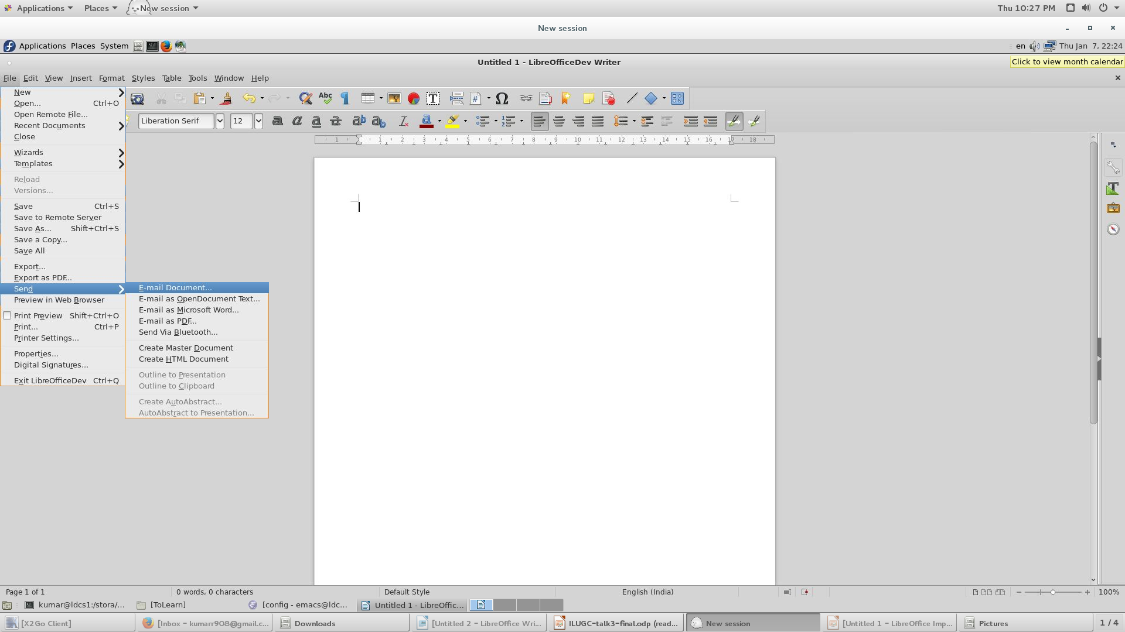
Libre Data Consultancy Services (www.ldcs.co.in)

Slide 20
Any Questions ???
Libre Data Consultancy Services (www.ldcs.co.in)

Slide 21
Thank you …
Libre Data Consultancy Services (www.ldcs.co.in)

