Slide 1

Contributing to LibreOffice
Bugs Focused in this Talk
  Bug tdf#89140 (Arul Michael)
  Bug tdf#96910 (Yogesh Desai)
Libre Data Consultancy Services (www.ldcs.co.in)

Slide 2
Steps to Contribute to LibreOffice
Steps to Contribute :
Clone LO code
Select a Bug from LO-Bugzilla
Make changes to LO code
Use LO Opengrok to Navigate code
Change your code as per
Suggestions
Get Code Review & Suggestions
Submit your Patch through gerrit
One Bug Solved
Libre Data Consultancy Services (www.ldcs.co.in)

Slide 3
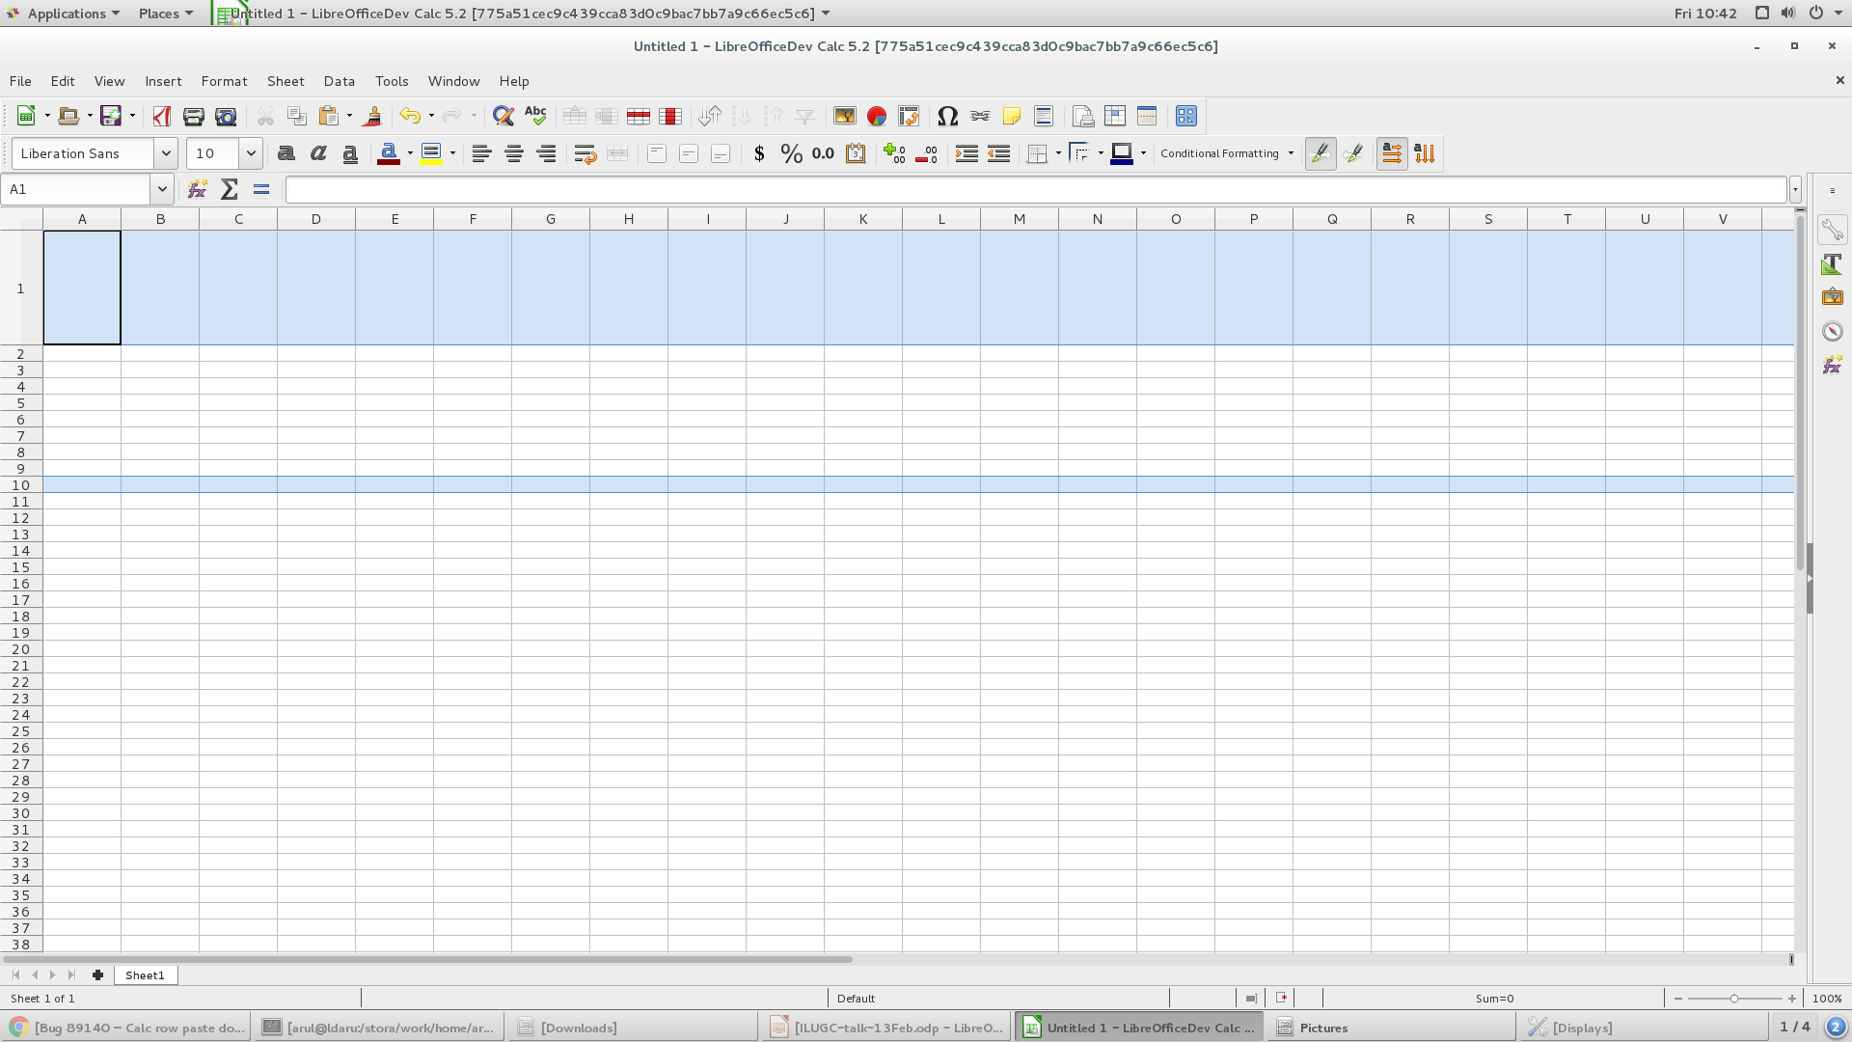
Bug tdf#89140
Calc row paste doesn't keep row height
Libre Data Consultancy Services (www.ldcs.co.in)

Slide 4
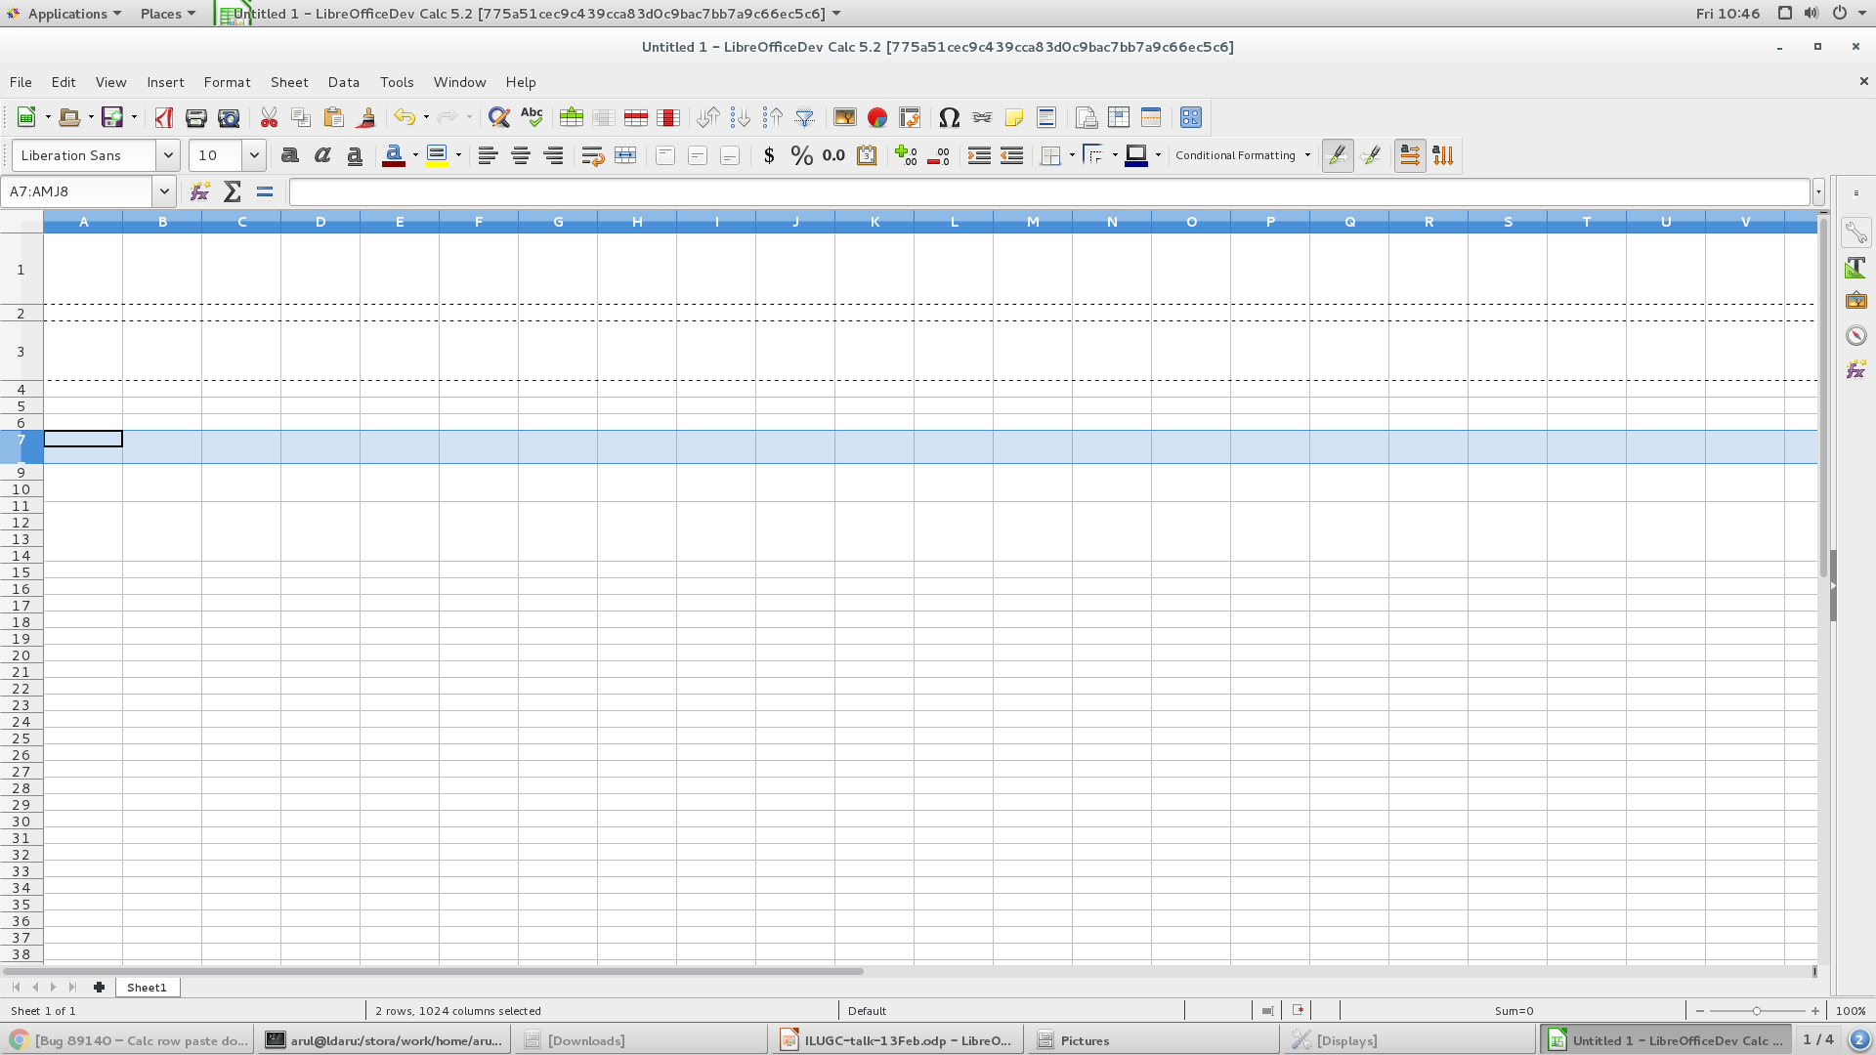
Issue 2 - Redraw
Issue 3 - Undo was not working
Libre Data Consultancy Services (www.ldcs.co.in)

Slide 5
Calc Architecture
Class ScDocument
{
…
typedef std::vector<ScTable*> TableContainer;
...
}
Class ScTable
{
ScColumn aCol[MAXCOLCOUNT]; // currently count = 1024 will change soon
….
...
std::unique_ptr<ScFlatUInt16RowSegments> mpRowHeights;
}
Libre Data Consultancy Services (www.ldcs.co.in)

Slide 6
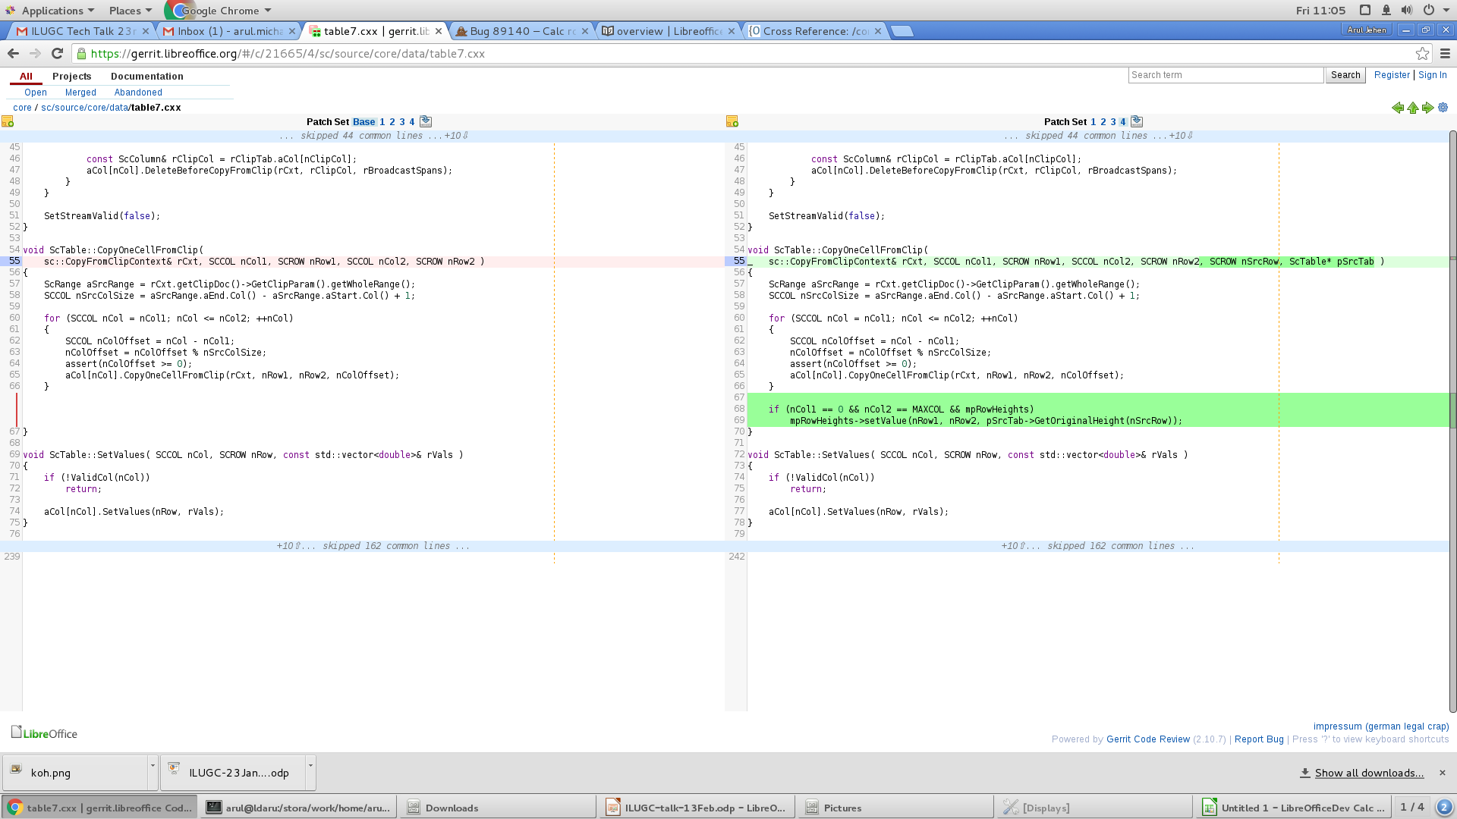
Code change for fixing row height
Libre Data Consultancy Services (www.ldcs.co.in)

Slide 7
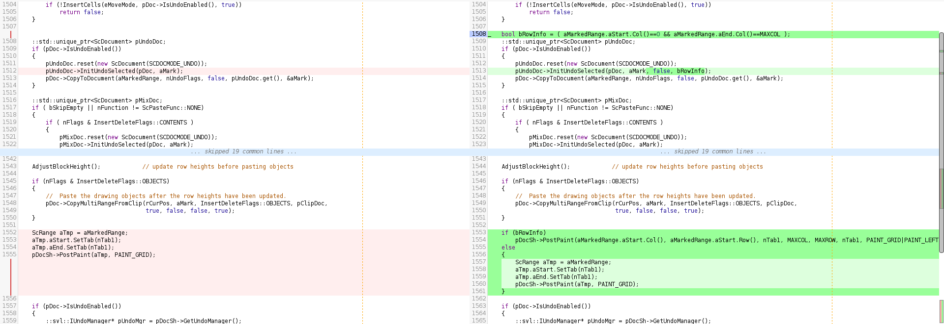
Code change for redraw and undo issue
Libre Data Consultancy Services (www.ldcs.co.in)

Slide 8
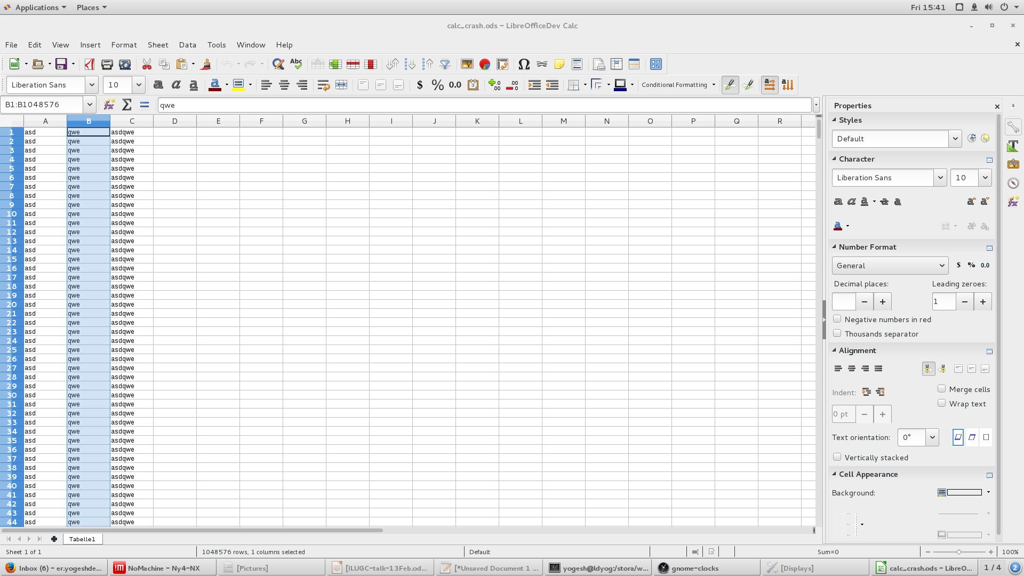
Bug tdf#96910
EDITING - Crash using "insert column left" for large documents with concatenation
Libre Data Consultancy Services (www.ldcs.co.in)

Slide 9
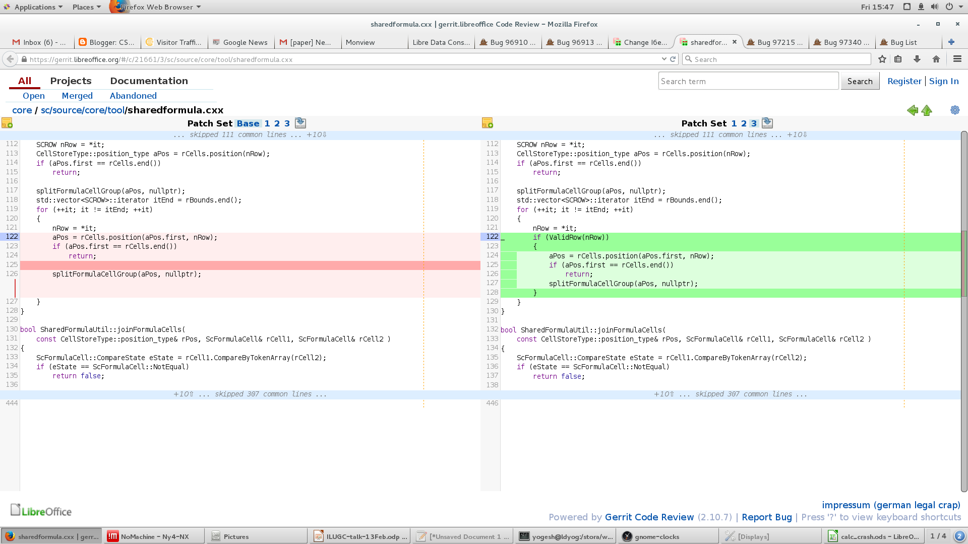
Code change to fix the Bug
core/sc/inc/address.hxx
Gerrit Code Review Status: Accepted
Code changes will be available in LO version 5.0.6, 5.1.1 & 5.2.0
Libre Data Consultancy Services (www.ldcs.co.in)

Slide 10
Any Questions ???
Libre Data Consultancy Services (www.ldcs.co.in)

Slide 11
Thank you …
Libre Data Consultancy Services (www.ldcs.co.in)

