Slide 1
Optimizing the patrolling route
Dongdong Lu

Slide 2
Motivation
An experiment done by Minneapolis PD patrolling 55 crime hotspots have shown the “treatment group” sees a significant decline in crimes and public disorders compared with the “control group”. In addition, British research has shown that targeted foot patrol can also improve public confidence in the police, perceptions of crime, and feelings of safety.
So the question naturally arises, how to design the optimized patrolling route to maximize the positive effects of this practice?

Slide 3
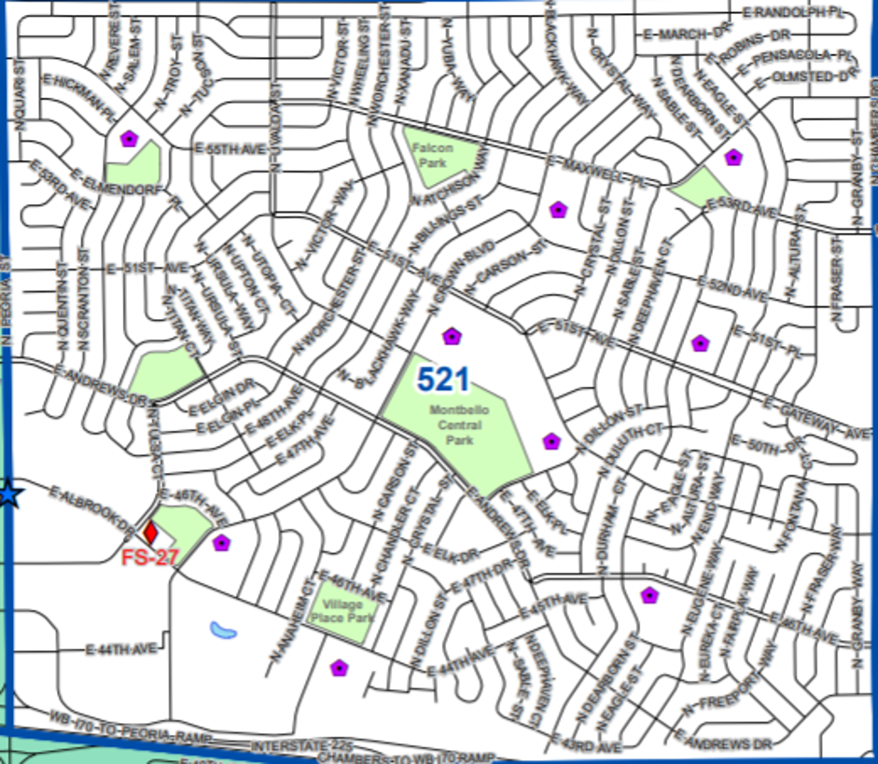
Question
How to design better patrolling route within those precincts, i.e. 521?

Slide 4
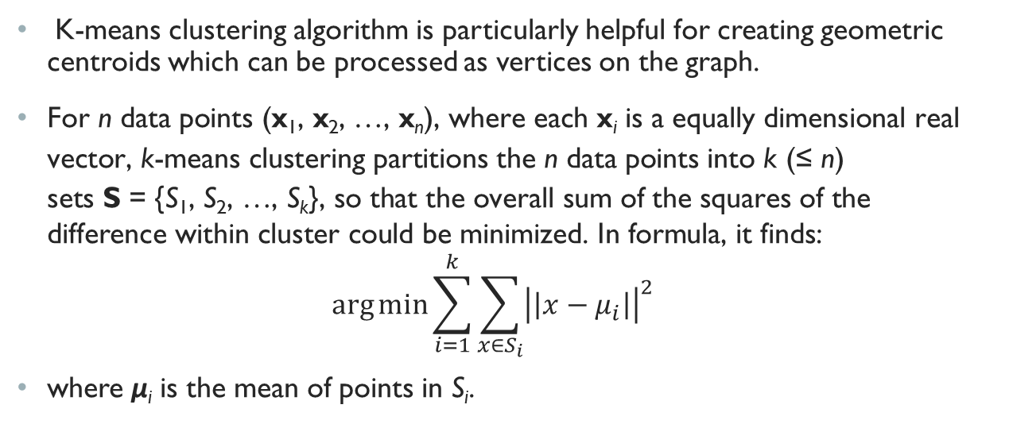
Method
K-means clustering algorithm is particularly helpful for creating geometric centroids which can be processed as vertices on the graph.
$\text{For} \text{n} \text{data} \text{points}\text{ (}\text{x}\text{1}\text{, }\text{x}\text{2}\text{, …, }\text{x}\text{n}\text{), }\text{where} \text{each} \text{x}\text{i} \text{is} \text{a} \text{equally} \text{dimensional} \text{real} \text{vector}\text{, }\text{k}\text{-}\text{means} \text{clustering} \text{partitions} \text{the} \text{n} \text{data} \text{points} \text{into} \text{k}\text{ (≤ }\text{n}\text{) }\text{sets} \text{S}\text{ = \{}\text{S}\text{1}\text{, }\text{S}\text{2}\text{, …, }\text{S}\text{k}\text{\}, }\text{so} \text{that} \text{the} \text{overall} \text{sum} \text{of} \text{the} \text{squares} \text{of} \text{the} \text{difference} \text{within} \text{cluster} \text{could} \text{be} \text{minimized}\text{. }\text{In} \text{formula}\text{, }\text{it} \text{finds}\text{:}$
$$\arg{min\sum_{i=1}^{k}{\sum_{x∈S_{i}}{{\left|\left|x−μ_{i}\right|\right|}^{2}}}{}}$$
where μ_{i} is the mean of points in S_{i}.

Slide 5
Illustration of K-means clustering

Slide 6
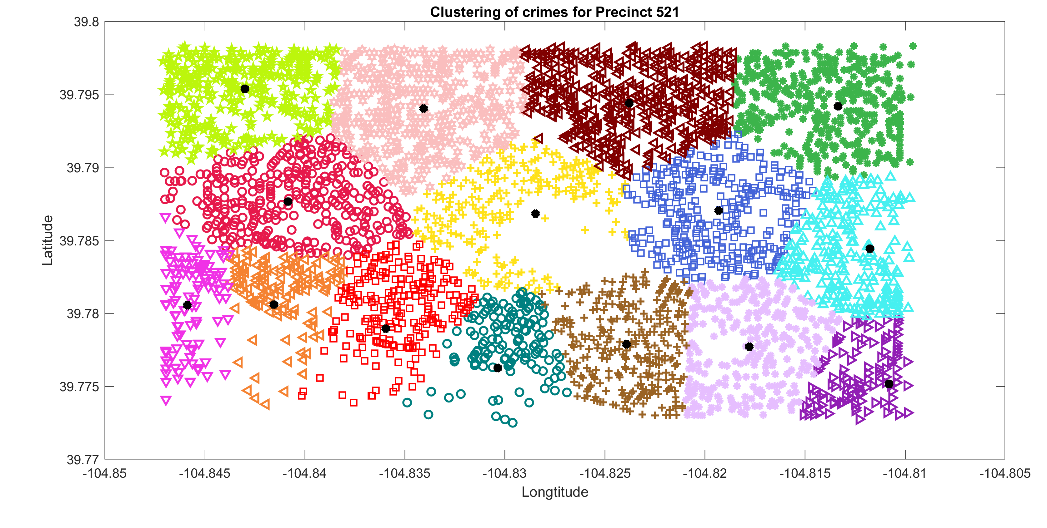
After K-means clustering

Slide 7
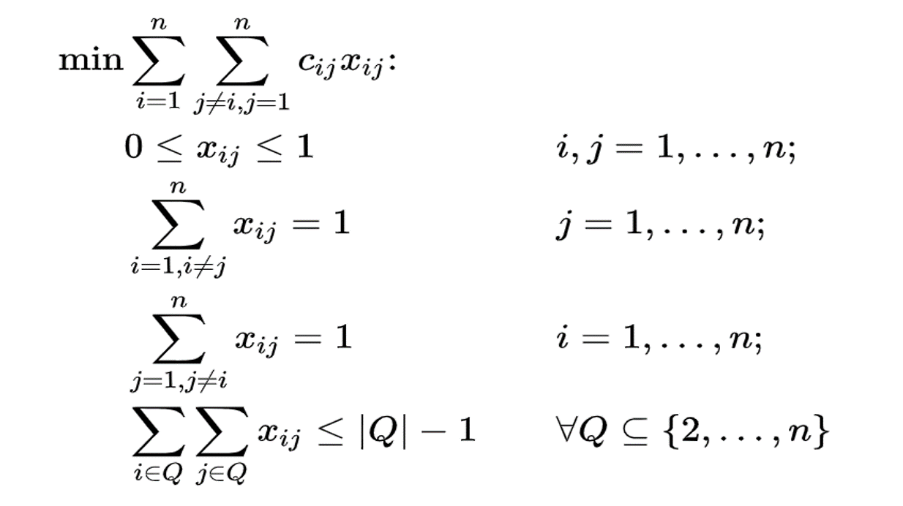

Solving the tsp: Miller-Tucker-Zemlin formulation
Denote $c_{ij}$ to be the distance from node i to node j and introduce $μ_{i}$ as a dummy variable. Then we can formulate the TSP as the rightside integer linear programming problem:

Slide 8
Why does the subtour elimination work?

Slide 9
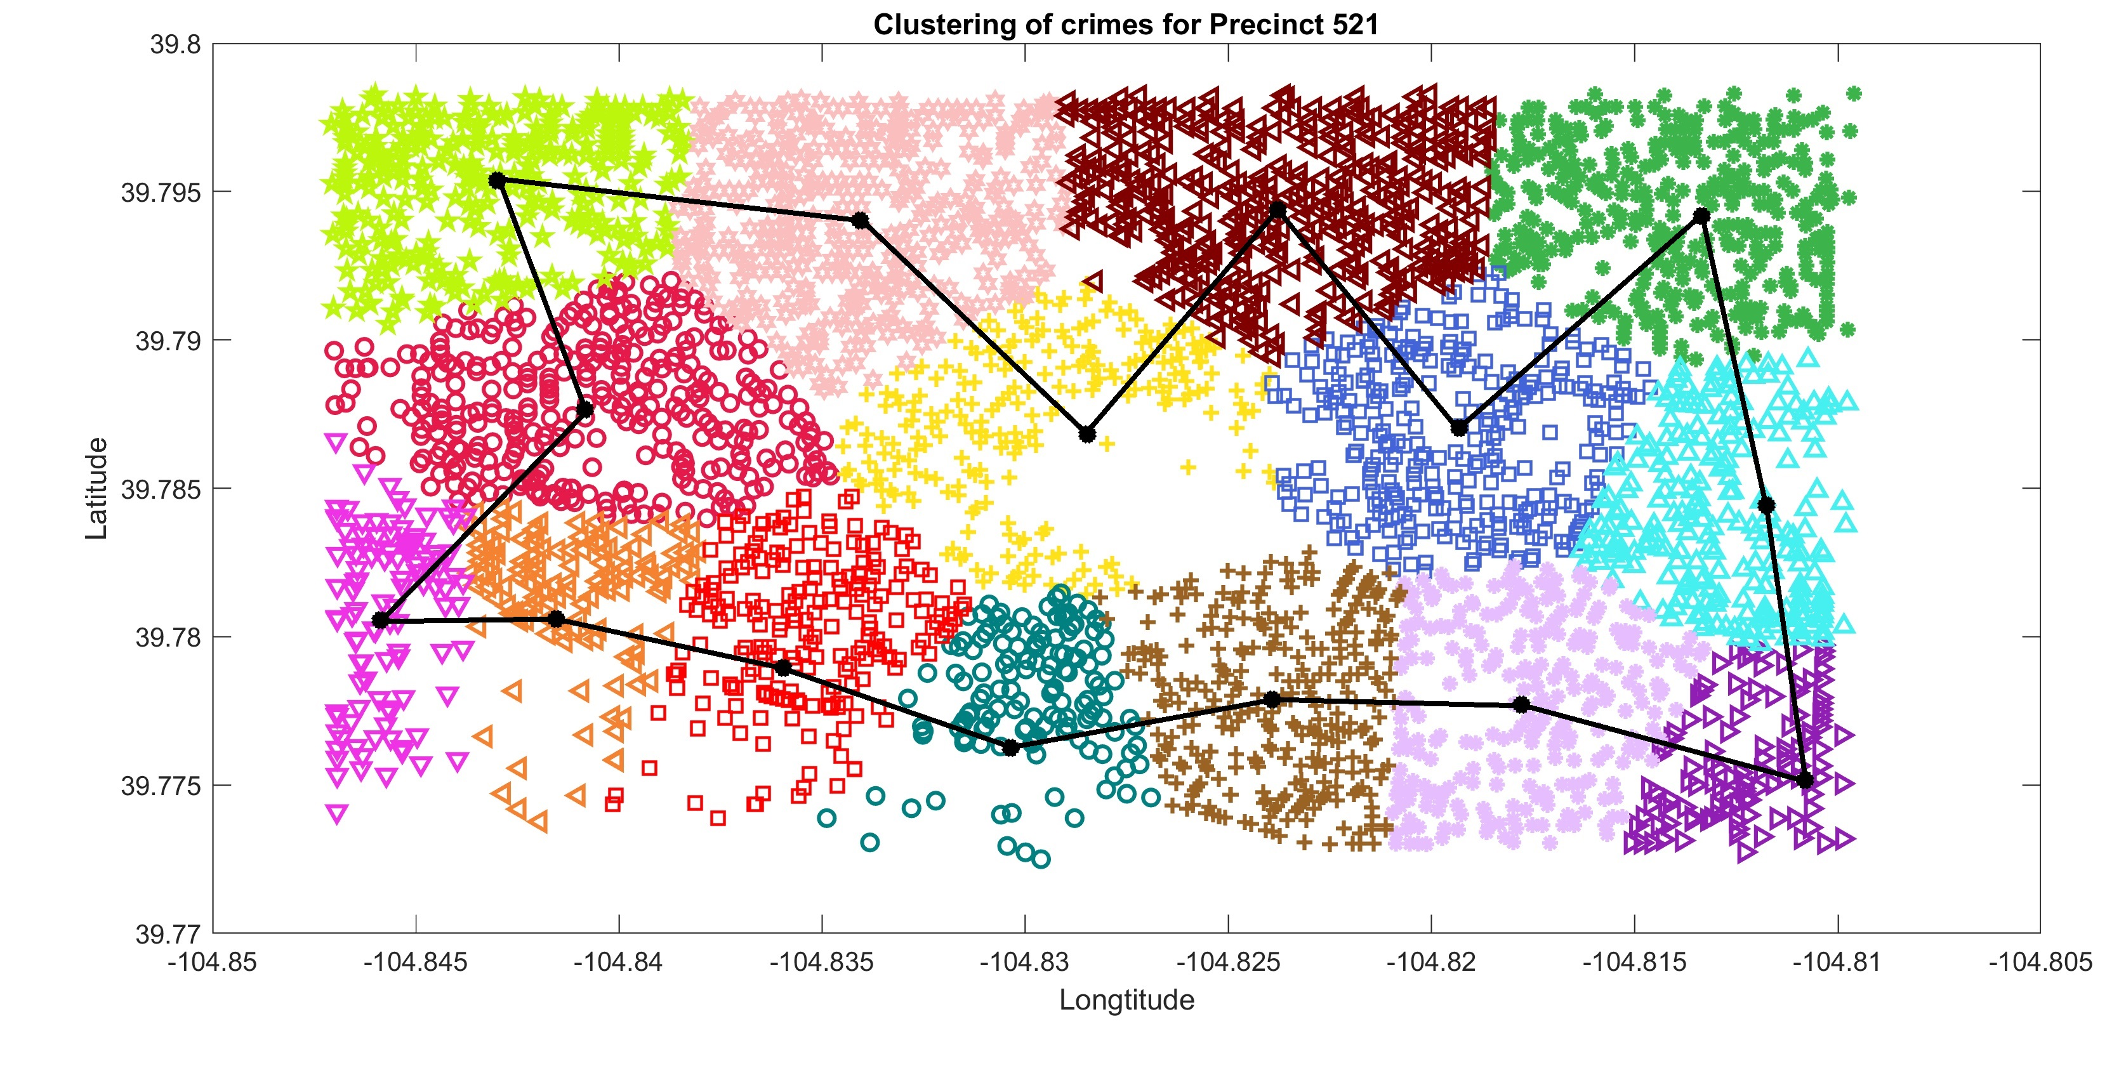
The optimized path

Slide 10
Additional thinking: Design better precincts
For a more efficient policing, we can use the K-means clustering technique to construct to precincts. Further improvements can be archived by incorporating more accurate transportation information from Google Map and the capacity of each police station.

Slide 11
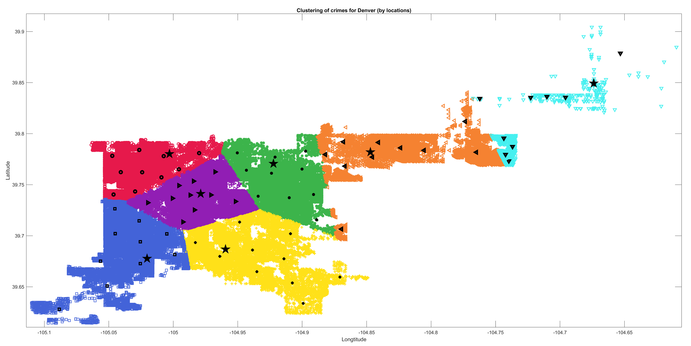
A PRELIMINARY RESULT

Slide 12
SUMMARY & FURTHER THINKINGS
Among those precincts, the above procedures would help design better patrolling routes. Since the crime data varies from period to period, for the practical purpose, a program which can automatically generate patrolling routes for every precinct by retrieving the data from the database and performing the above analysis would be applicable and more attractive.
Divide the crime data into day time crimes and nighttime crimes and types with different sensitivity to police patrolling, the above procedures may produce different patrolling routes and reveal new information on the distribution patterns of certain types of crimes.

Slide 13
Thank you!

