Slide 1
SBI in Arctic Wintertime Radiosonde Data Analysis Results
Defeng Lu

Slide 2
Site Investigated: 71082 Alert UA, NU, CA Latitude: 82.493 Longitude: -62.344 00UTC = 8PM local 12UTC = 8AM local →Close to theoretical max SBI time of 6AM
Parameter investigated:
SBI Frequency, Strength, Depth, Intensity/Lapse rate
Trends for above indices
Inversion top height and temperature
Temperature Trend vs pressure
Diurnal Frequency, Strength, Depth (12UTC-00UTC)
SBI Impact

Slide 3
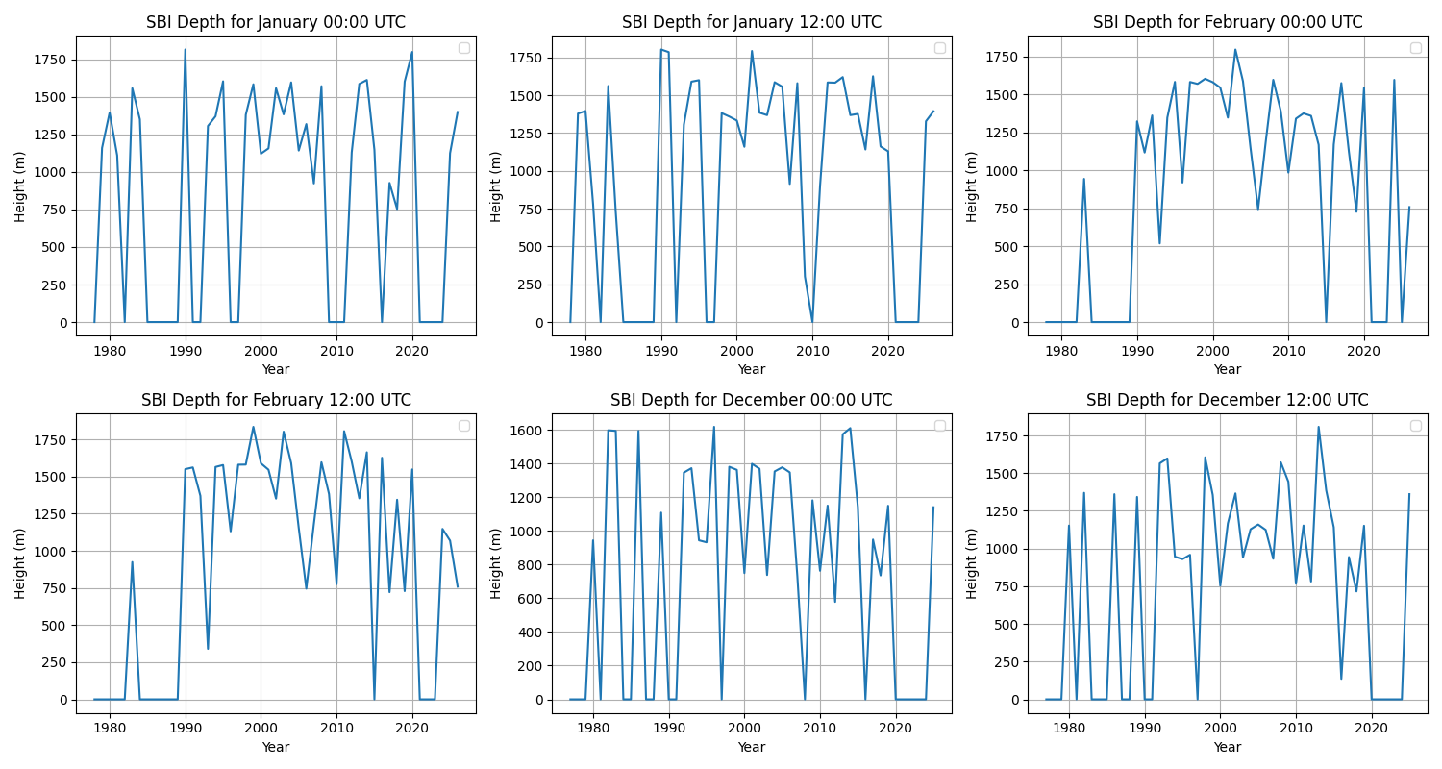
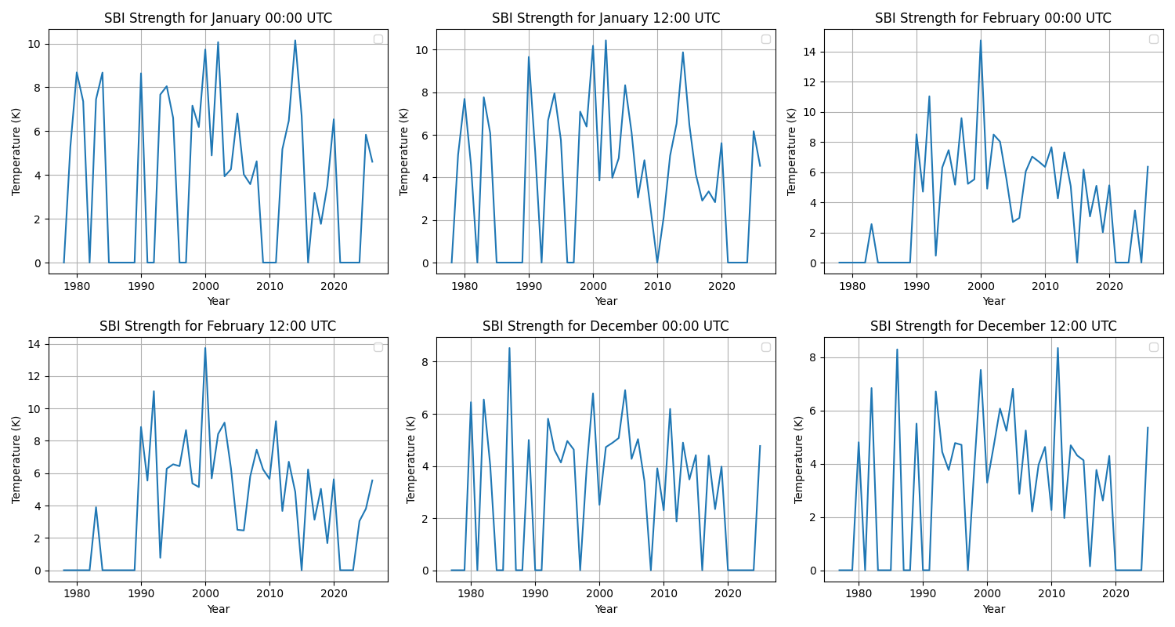
SBI Main Parameters 1
Depth: Lots of high SBI depth going to 1.5km
Strength: On average in the 2-8K except for some specific years where their JAN and FEB have SBI_{strength} going up to 10K and 15K

Slide 4
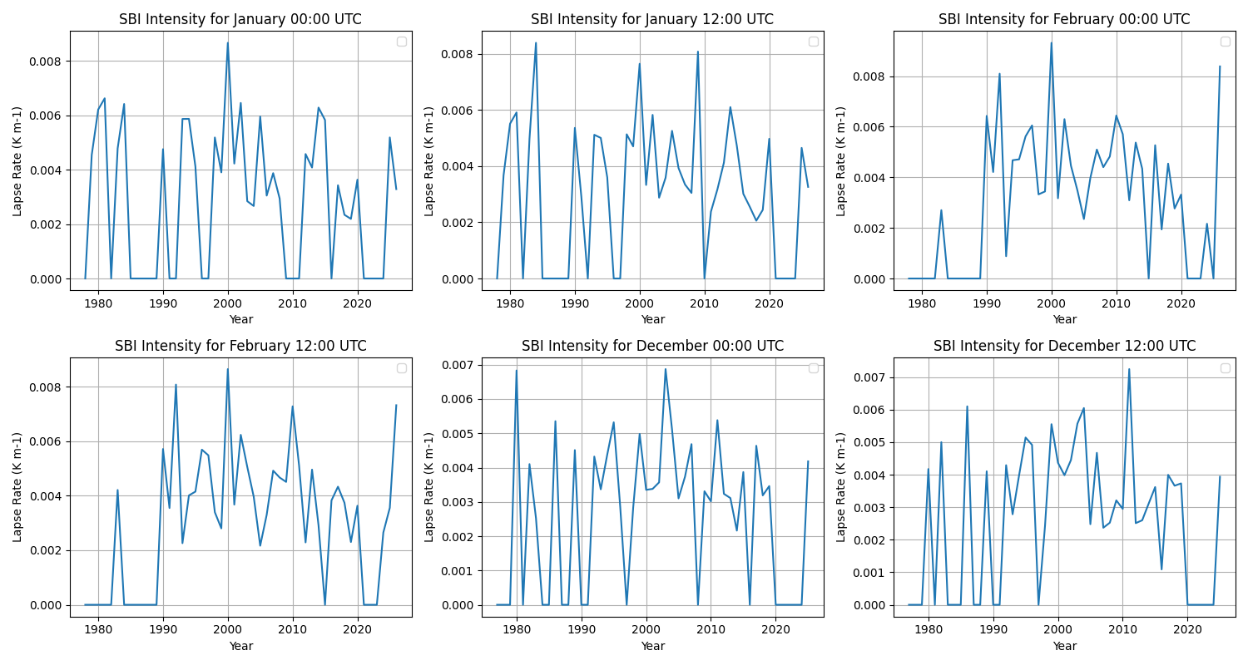
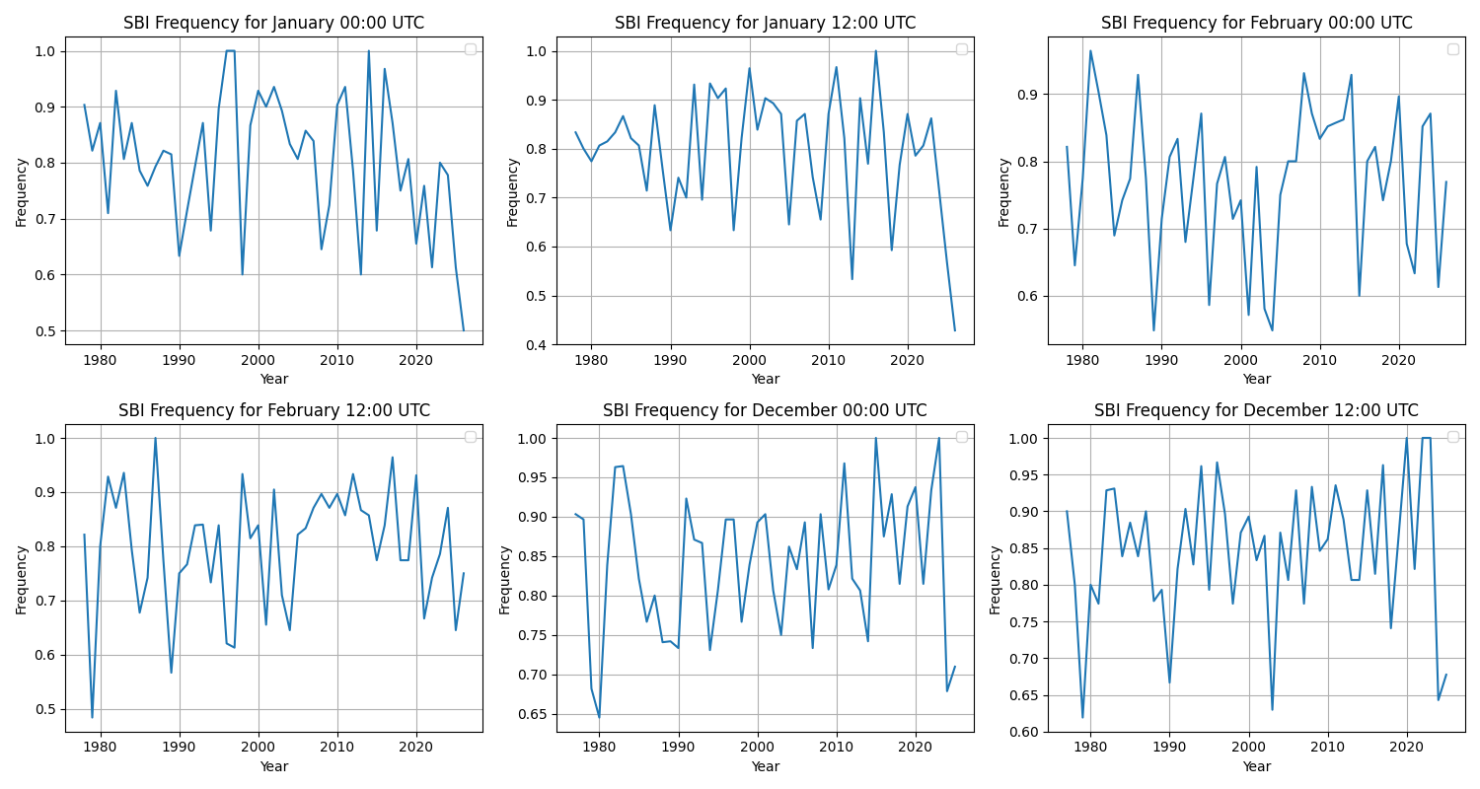
SBI Main Parameters 2
Intensity: On average below Environmental Lapse Rate (ELR = 0.0065 k/m) at around 0.003-0.006k/m so we have rather weak inversions ?
Frequency: On average we have around 0.7-0.8 SBI frequency which translates to about 21-24days/per month except for DEC12 where it looks more like 0.85 so there’s SBI most of the time in the Winter months

Slide 5
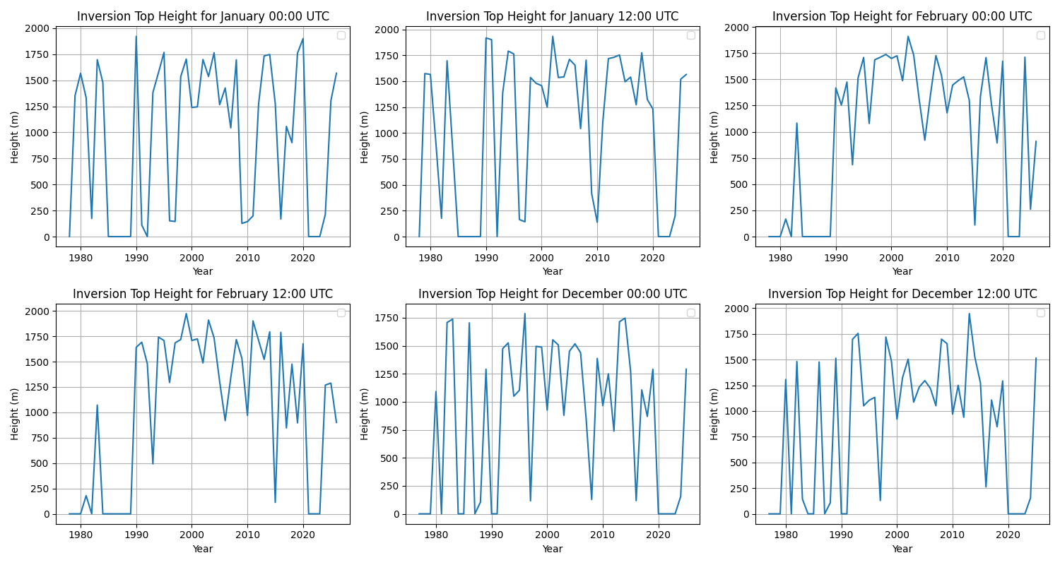
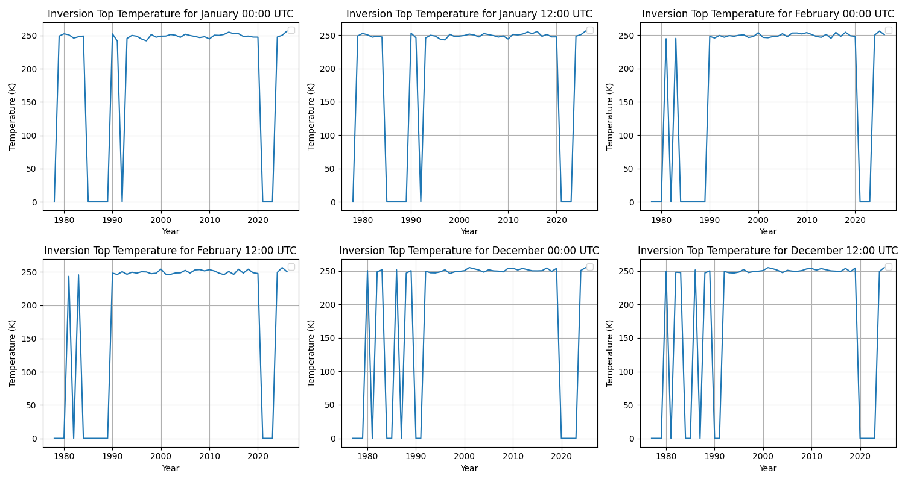
SBI Main Parameters 3
Top height: Vary a lot but there are some high ones > 1.5km
Top Temp: On average we have around 250 K or around -25 C

Slide 6
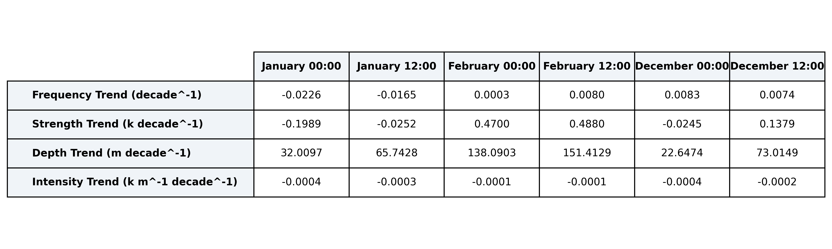
SBI parameter trends
General trend: Depth(Z), Frequency(F), Strength(T) are increasing in FEB for both times and DEC at 12UTC and decreasing in the other ones
Largest decrease in F and Z is JAN00
Largest (and in the higher end) increase in F,Z,T is FEB12 →

Slide 7
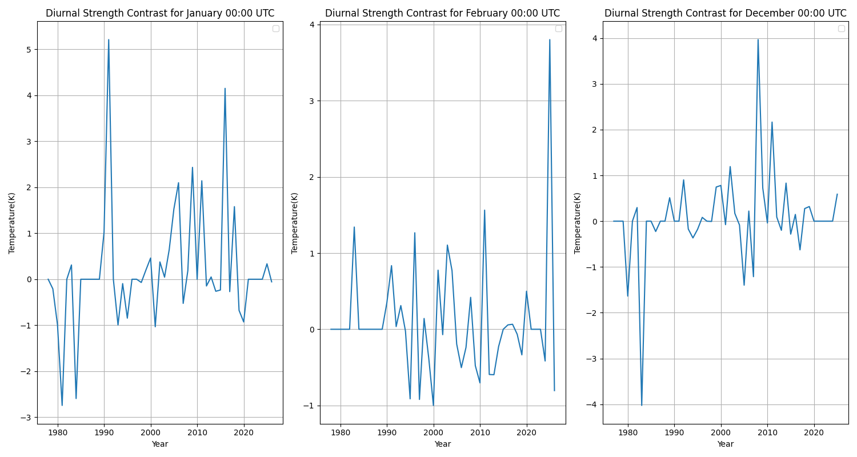
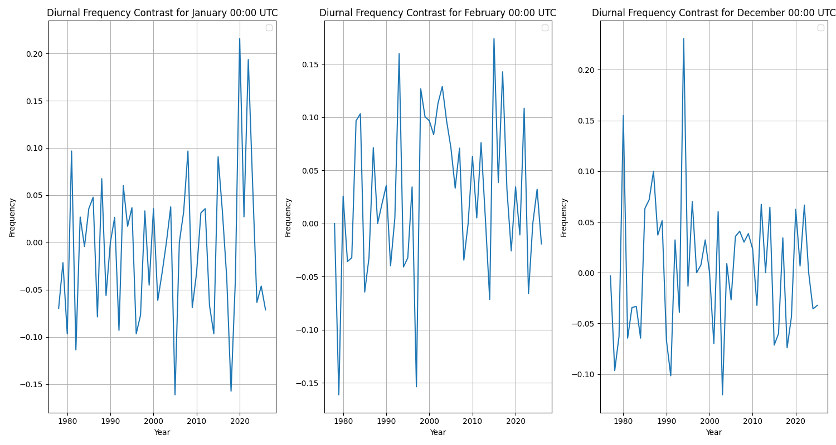
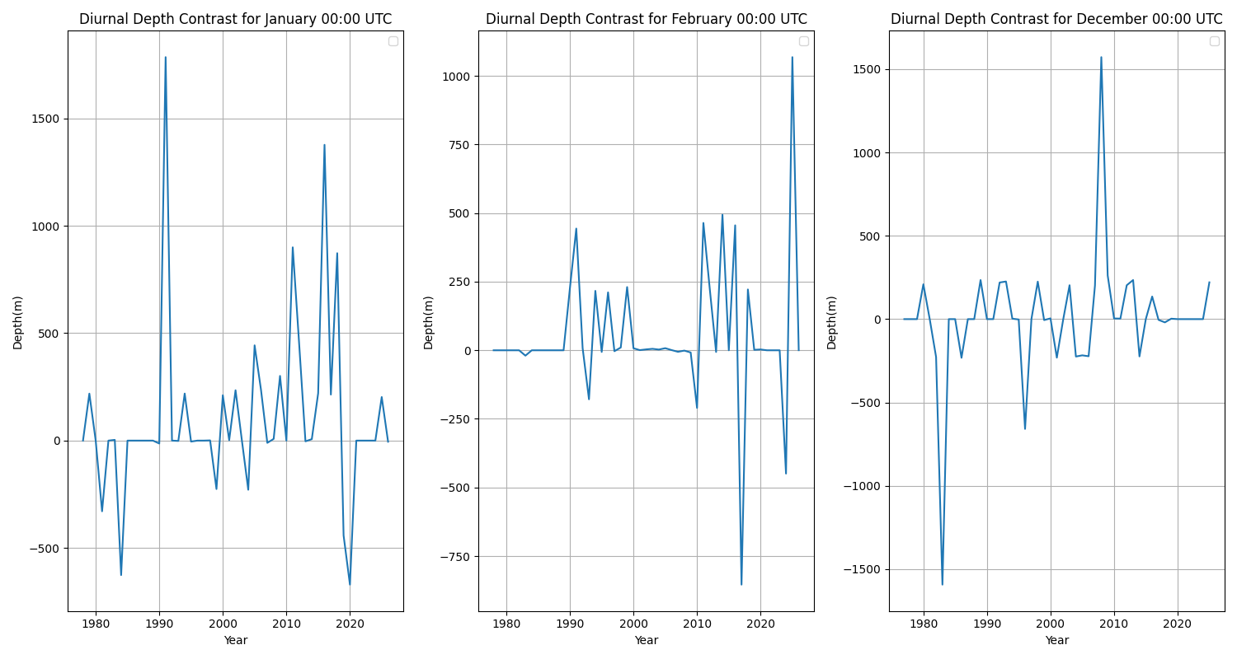
Diurnal diagnostic
Strength: Generally >0 so Strength at 12UTC is larger
Depth: Generally >0 so Depth at 12UTC is larger
Frequency: Oscillating but more biased for >0, so generally more SBI at 12UTC than 00UTC

Slide 8
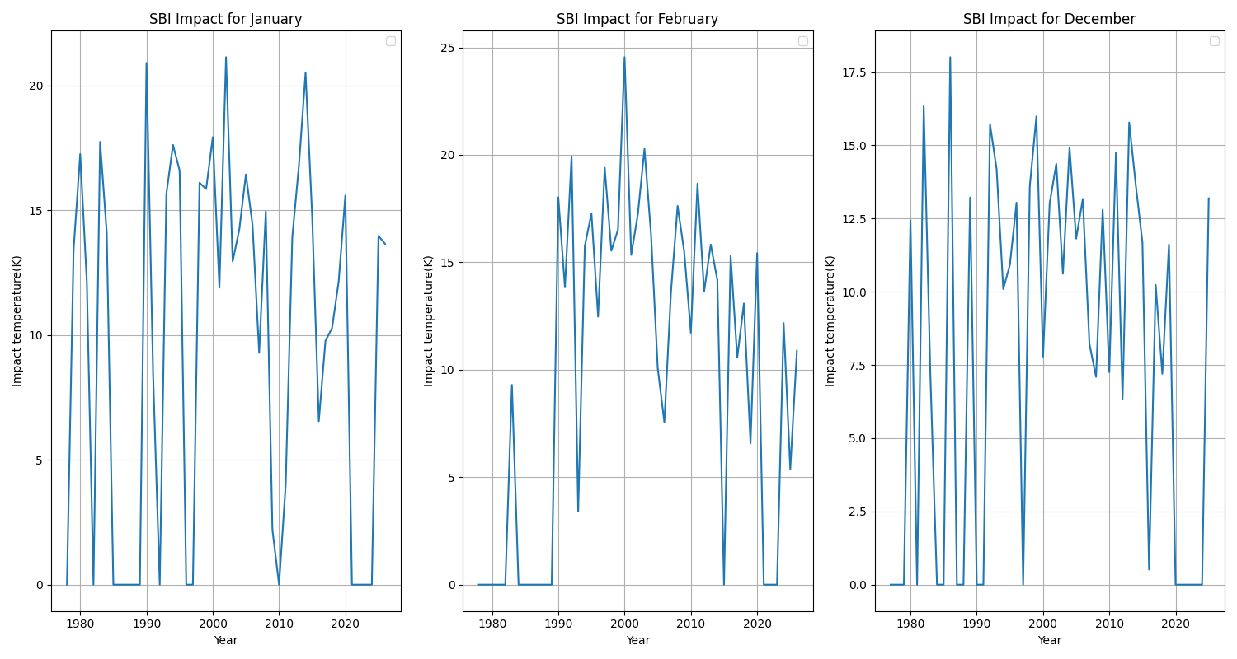
SBI Impact
Definition from Noad et Al 2023
Projected Surface Air Temperature (SAT) = SBI_{depth} x ELR
SBI_{Magnitude} = Projected SAT + SBI_{strength}
SBI_{Impact =} (SBI_{Magnitude} (pm) x SBI_{frequency} (pm)+ SBI_{Magnitude} (am) x SBI_{frequency} (am))/2
SBI impact = impact on Mean Annual Air Temperature
See that this composite index is the strongest in FEB
then JAN, DEC

Slide 9
Future Investigations
Obtain results for other high arctic radiosonde sites (Currently have results for 2 other sites, just need to download the raw data for the other sites of interest)
Compare with ERA5 reanalysis results for each site (location = average radiosonde lat x lon from each site) to assess reliability of ERA5 data for SBI
If time allows, look into CMIP6 models to try to explain the results
Temperature profile per pressure: avg temp at each pressure levels
Could average per month → 00UTC and 12UTC together for better idea of monthly average
So that we go from 6-> graphs, can also do mean for winter months

