Slide 1


KSE2026
ALQAC 2026
Agentic Retrieval and
Claim-consensus Weighted Decision
for Vietnamese Civil Judgment Prediction
UTEHY-NLU
Duong-Hieu Le,
Guided by: Assoc. Prof. Dr. Minh-Tien Nguyen
Hanoi, Vietnam | September 28, 2026
Notes:
Hello everyone. My name is LDH. Today I present my system for ALQAC 2026: predicting who wins a Vietnamese civil case. It uses agentic retrieval and a voting rule called CCWD.

Slide 2
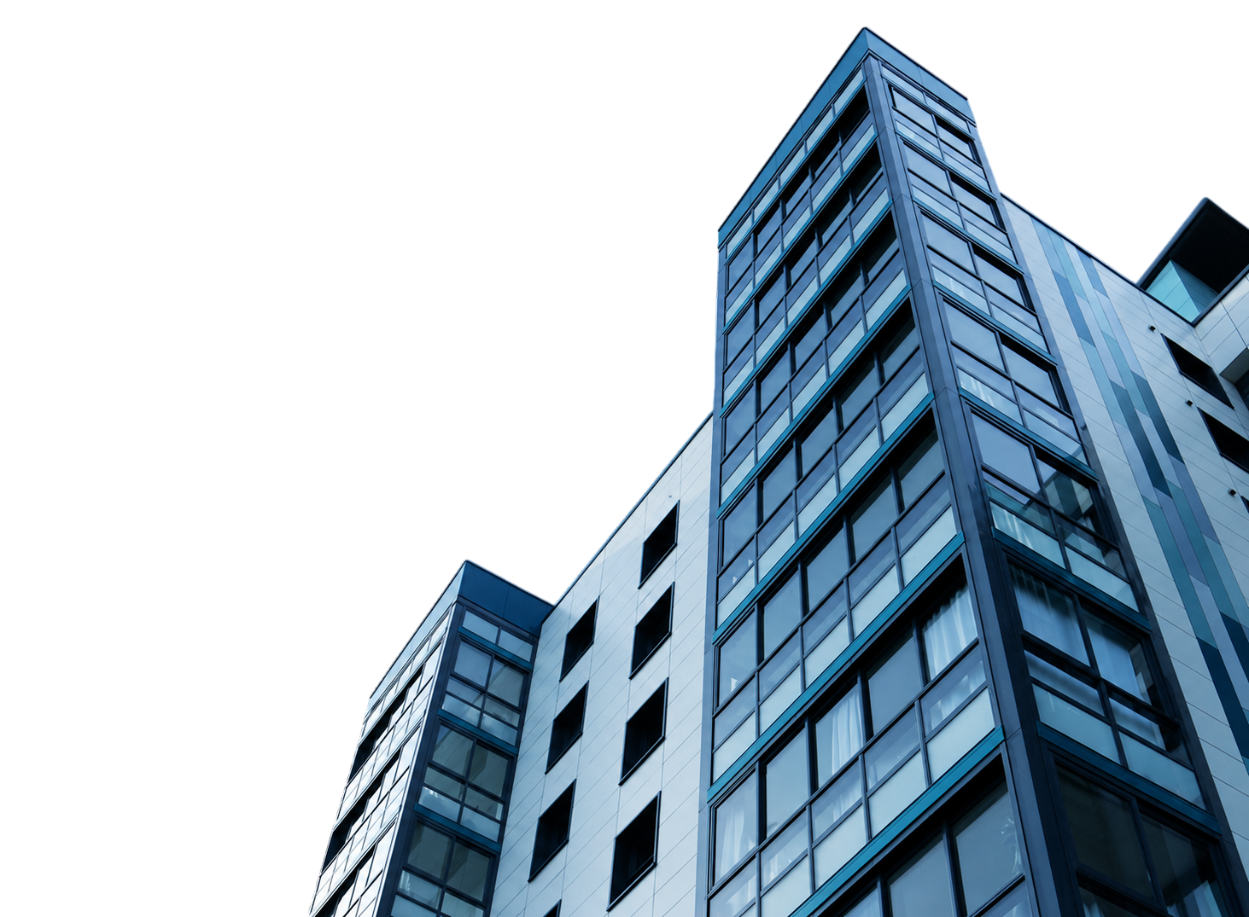
TABLE OF CONTENTS
01
Introduce the problem
02
Methodology
03
Experiments & Results
04
Conclusion
Notes:
My talk has four parts: the problem, the method, the results, and the conclusion.

Slide 3

01
Introduce the problem
KSE2026
Notes:
First, the problem.

Slide 4




The task: who wins a civil case?
More cases, more laws
Vietnam issues many legal documents. Checking them by hand is slow.
LLMs can reason
Vietnamese is under-studied
Most case-outcome work is on English and other rich-resource languages.
The task
More cases, more laws
INPUT
OUTPUT
q: a short case query.
Plaintiff A asks for some relief from defendant B
verdict ŷ,
case evidence E*, law articles L
Hanoi, Vietnam | September 28, 2026
Notes:
In a civil case, plaintiff A asks the court for something from defendant B. Who wins, and how much? Checking by hand is slow, and most research is on English, not Vietnamese. My input is a short case query. My output is the verdict, the case evidence, and the law articles.

Slide 5


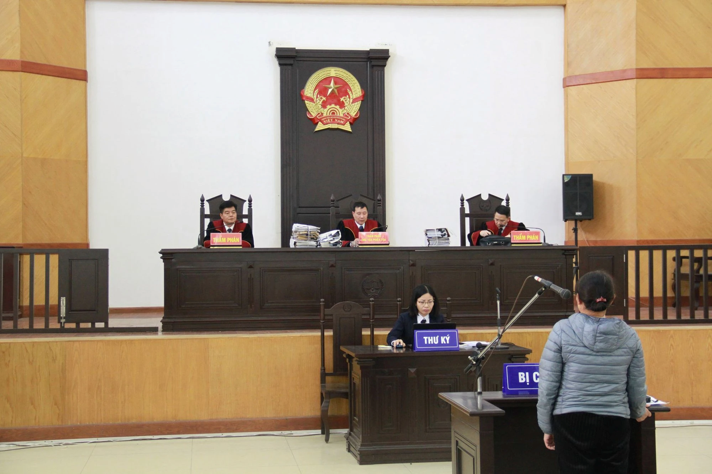
Where the field stands
High-resource languages
Find similar past cases, then let an LLM decide
Break the facts down, then reason
Predict from evidence that the parties submit
Find cases by generating legal elements
Legal AI for Vietnamese
Law-specific models: VNLawBERT, ViLegalLLM
Better legal search with question–context–answer data
Benchmarks: ALQAC 2025, VLSP Legal SLM
VLegalBench: includes court-decision prediction
Notes:
For rich-resource languages, work finds similar cases, breaks facts down, or uses evidence from the parties. For Vietnamese, work builds legal models, better search, and benchmarks like ALQAC. In the work I reviewed, none does outcome prediction and evidence retrieval together. ALQAC 2026 asks for both.

Slide 6

02
Methodology
KSE2026
Notes:
Now, my method.

Slide 7









System overview
Grounding
Case Query
Evidence Agent
01
case facts
Hybrid Retrieval
02
what happened, what A wants
finds the facts behind the case
finds the 14 relevant law articles
facts + 14 laws
Verdict
Decision
04
votes
Multi-Judges
04
claims
Issue Mapper
03
who wins, how much
combines votes into one verdict
vote on every claim
splits the case into claims
Decision
Notes:
Two phases, five stages. Grounding: Stage 1 finds case evidence, Stage 2 finds 14 law articles. Decision, which is CCWD: Stage 3 splits the case into claims, Stage 4 has three judges vote, Stage 5 computes the verdict. First build the context, then reason.

Slide 8
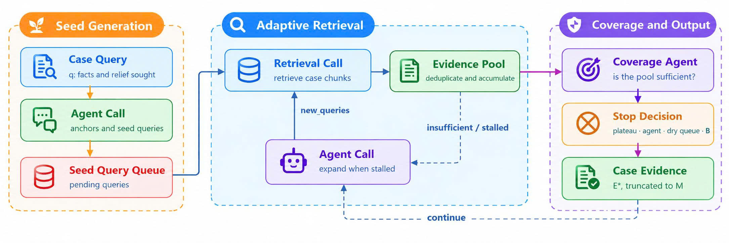
Adaptive case-evidence retrieval
Notes:
The query is short, so i need more facts. One agent call makes the first search queries. Then search runs by itself, and each new piece of evidence gives new queries. The model is called again only when search stalls. Search stops at the first of four conditions: plateau, the agent says enough, a dry queue, or 50 calls used. i keep up to 8,000 characters as the case evidence.

Slide 9

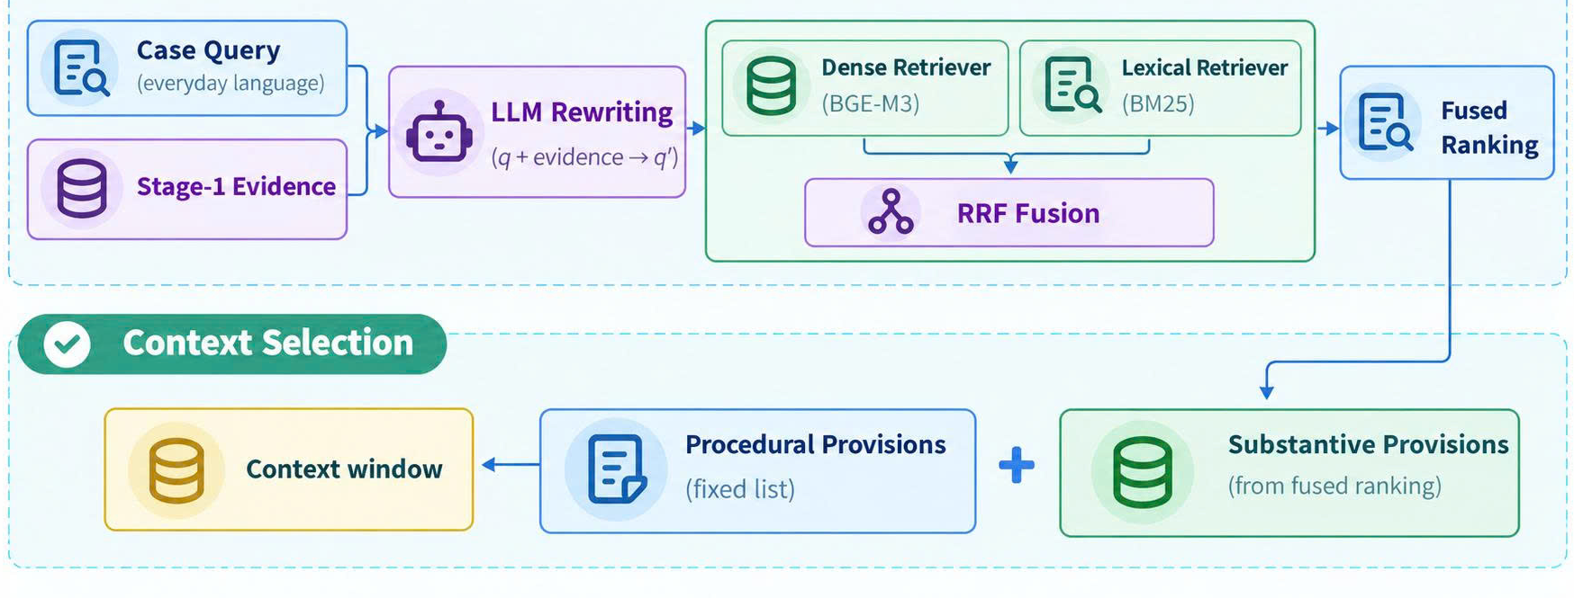


Legal-query rewriting & hybrid retrieval
$$s_{RRF}\left(a∣\overline{q}\right)=\frac{1}{k_{0}+τ_{d}\left(a∣\overline{q}\right)}+\frac{1}{k_{0}+τ_{b}\left(a∣\overline{q}\right)}$$
Context L = 6 + 8 = 14 articles
6 substantive:
top of the fused ranking
8 procedural:
one fixed list, kept out of the search pool
Why fixed?
Notes:
Queries use everyday words, but laws use legal words. So i rewrite the query into legal language. Then i search with BGE-M3 and BM25, and merge the two rankings with RRF. The context has 14 articles: 6 substantive from the ranking, and 8 procedural from a fixed list. Why fixed? Fee and jurisdiction rules appear in almost every case, but they do not decide who wins.

Slide 10







Claim-Consensus Weighted Decision
3. Issue Mapping
Mapper Prompt
Case Query
3. Issue Mapper
Claim Set
facts, reliefs
one LLM call
claims
type + importance
4. Multi-Judge
claims
Context
4. Legal Judges
Judgments
q , E*, L
context
V independent LLM calls
V per claim
Judge Prompt
5. Decision
5. Decision
combines V judgments into a verdict, Eq. (2)–(4)
Notes:
CCWD has three steps. The Issue Mapper and the Judges are LLM calls. The Decision step is only computation, so the label is computed, not guessed by the model.

Slide 11


Claims & judges
ISSUE MAPPER
LEGAL JUDGES
Claims with type and weight
3 independent votes
A CLAIM
All 3 judges get the same input: q, E*, L and the claim set C. Only the random seed differs.
= the words in q that ask for one relief (up to 8 per case)
TYPE = KIND OF RELIEF.
It says if a court can split it (an estate: yes; a contract: no)
Each judge picks one outcome per claim:
WEIGHT
FULL_ACCEPT
PARTIAL_A_LEAN
= material or secondary. Material counts 2×
ONLY CLAIMS
can show a partial win; one label cannot
PARTIAL_B_LEAN
REJECT
CHECK EVERY CLAIM
A vote is dropped if:
Exact copy of words in q → accept
Reworded → needs ≥ 80% of its words in q, an action verb, and more than a description
The outcome is not one of the four above
The claim id did not come from stage 3
The claim was already answered (it would count twice)
Notes:
The Issue Mapper splits the query into claims. A claim is the words that ask for one relief. Each claim has a type (can a court split it?) and a weight (material counts twice). i check that each claim stays close to the query words. Then three judges get the same input and differ only in the random seed. Each picks one of four outcomes per claim. Invalid, unknown, or repeated answers are dropped. So we judge each request alone, and this lets us show partial wins.

Slide 12


Claims & judges
ōᵢ
= majority vote on claim i
S_A
= Σ w(mᵢ)·a(ōᵢ) / Σ w(mᵢ)
material claim
= 2 x secondary
a(ōᵢ) · SHARE OF THE DISPUTED VALUE THAT A WINS
REJECT
PARTIAL_B_LEAN
PARTIAL_A_LEAN
FULL_ACCEPT
a
0
0.35
0.65
1
THRESHOLDS — S_A FALLS INTO ONE OF FOUR BANDS
B_WIN
PARTIAL_B_WIN
PARTIAL_A_WIN
A_WIN
0
τ₁ = 0.30
τ₂ = 0.55
τ₃ = 0.85
1
EXAMPLE (MADE UP)
A (material) FULL_ACCEPT · B (material) REJECT · C (secondary) FULL_ACCEPT
S_A = (2×1 + 2×0 + 1×1) / 5 = 0.60 → PARTIAL_A_WIN
Notes:
Each claim gets a value: how much of the disputed value A wins. REJECT is 0, PARTIAL_B_LEAN 0.35, PARTIAL_A_LEAN 0.65, FULL_ACCEPT 1.
The case score S_A is the weighted average of these values. Material counts twice.
Three thresholds, 0.30, 0.55 and 0.85, cut S_A into four bands: B_WIN, PARTIAL_B_WIN, PARTIAL_A_WIN, A_WIN.
A one-claim case keeps its own label, and this limits where each threshold can be. i chose the exact values after seeing the 50 public cases, so they may be tuned to that set.

Slide 13

03
Experiments & Results
KSE2026
Notes:
Now, the experiments and results

Slide 14
Setup
FIXED PIPELINE CONFIGURATION
Stage | Parameter | Value
Evidence agent | Call budget B | 50
 | Query-refuel budget R | 5
 | Duplicate window W | 10
 | Duplicate-ratio threshold ρ | 0.75
 | Coverage threshold _{K} | 0.50
 | Coverage-agent gate t₀ | 20
 | Evidence character limit M | 8,000
Statute retrieval | Candidates per retriever N_{cand} | 50
 | RRF rank constant k₀ | 60
 | Substantive provisions | 6
 | Procedural provisions | 8
 | Characters per provision | 6,000
Decision | Maximum claims per case | 8
 | Judge votes V | 3
Engine | Context window / input cap | 40,960 / 24,000
 | Qwen2.5-7B-Instruct | 32,768 / 24,000
 | Precision | bfloat16
 | Seed | 2026
Hanoi, Vietnam | September 28, 2026
Notes:
These settings were fixed in all runs. i used four open models under 10B parameters, on one A100 GPU. The public set has 50 cases. Always guessing the most common label gives only 0.38 accuracy, so every method must beat that. i compare CCWD with a baseline that predicts the verdict in one call.

Slide 15
Statute retrieval
PUBLIC-SET STATUTE RETRIEVAL PERFORMANCE
Input | Retrieval | Recall@10 | Hit@10 | Prec.@10
Query | Semantic | 4.05 | 38.00 | 5.20
Query + agr. query | Hybrid | 26.62 | 88.00 | 29.60
Query + arg. fact | Semantic | 11.37 | 38.00 | 5.60
Query + agr. query + arg. fact | Hybrid | 26.52 | 90.00 | 29.20
Hit@10: 38% → 88–90%
Case facts add little
Better articles ≠ better verdicts
Notes:
For law retrieval, Hit@10 is 38 percent with the plain query. With the rewritten query and hybrid search, it is 88 to 90 percent. Adding case facts adds little. But better retrieval did not give better verdicts: mean accuracy is 0.371 for hybrid and 0.395 for semantic. The gap is about one case, so it did not help, not that it hurt.

Slide 16
Verdict prediction
VERDICT PREDICTION PERFORMANCE ACROSS INPUTS, RETRIEVERS, METHODS, AND MODELS
Input | Retriever | Method | Qwen3-4B | Qwen2.5-7B | DS-R1-8B | Qwen3.5-9B | Mean score
Query | Semantic | Baseline | 0.300 / 0.1870 | 0.320 / 0.1812 | 0.420 / 0.3320 | 0.320 / 0.2366 | 0.340 / 0.2342
 |  | CCWD | 0.400 / 0.2265 | 0.400 / 0.2769 | 0.380 / 0.2188 | 0.340 / 0.1718 | 0.380 / 0.2235
 | Hybrid | Baseline | 0.260 / 0.1231 | 0.360 / 0.1882 | 0.280 / 0.2170 | 0.280 / 0.2144 | 0.295 / 0.1857
 |  | CCWD | 0.440 / 0.2361 | 0.380 / 0.2526 | 0.340 / 0.2787 | 0.400 / 0.1846 | 0.390 / 0.2380
Query + Arg.Query + Arg. Fact | Semantic | Baseline | 0.420 / 0.3432 | 0.320 / 0.1621 | 0.400 / 0.3255 | 0.580 / 0.4574 | 0.430 / 0.3221
 |  | CCWD | 0.360 / 0.2671 | 0.360 / 0.2210 | 0.500 / 0.3984 | 0.500 / 0.4426 | 0.430 / 0.3323
 | Hybrid | Baseline | 0.320 / 0.2602 | 0.300 / 0.1840 | 0.460 / 0.4358 | 0.520 / 0.4165 | 0.400 / 0.3241
 |  | CCWD | 0.320 / 0.2695 | 0.300 / 0.1946 | 0.400 / 0.3175 | 0.580 / 0.5995 | 0.400 / 0.3453
Notes:
Look at the bold last row. Three points. One: richer input helps most, with baseline accuracy going from 0.318 to 0.415. Two: CCWD raises mean accuracy a little, from 0.366 to 0.400. Three: in my submitted setting only Qwen3.5-9B gains, and it also finds the most claims, 2.16 per case. Our best result is Qwen3.5-9B with CCWD and hybrid retrieval: 0.58 accuracy and 0.5995 macro-F1, against 0.52 and 0.4165 for the baseline.

Slide 17
Private test result and errors
ALQAC 2026 PRIVATE TEST RANKING
Rank | Team | Score
1 | UTEHY-NLU† | 0.5317
2 | DL100 | 0.5195
3 | K35-DL-DDTQ | 0.4880
4 | HocTot | 0.4796
5 | The Heptad | 0.4713
6 | DeepSix | 0.4648
7 | 6 Con Sâu | 0.4638
8 | NOWJ | 0.4579
9 | K35-DL-NDQH | 0.4559
10 | KHTN-K26 | 0.4545
11 | Pegasus | 0.4270
12 | URAx | 0.4103
13 | HoclaiSau | 0.3932
14 | HCMUS-DivingTeam | 0.3920
15 | No Name | 0.3817
16 | Five Neurons | 0.3267
17 | DL999 | 0.3206
18 | K23 | 0.2946
19 | Loading | 0.2374
HOW THE SCORE IS MADE?
Law-evidence micro-F1
Case-evidence
recall (penalized)
Verdict accuracy
21 OF 50 PUBLIC CASES WRONG
Wrong winner:
no threshold can fix this
9
12
A_WIN mixed with PARTIAL_A_WIN:
the query rarely shows which money part the court cut
Notes:
i ranked first of 19 teams with 0.5317, which is 0.0122 ahead of the second. The score is 70% verdict accuracy, 20% case-evidence recall, 10% law F1. On the public set, 21 of 50 cases are wrong. Nine mix A_WIN with PARTIAL_A_WIN, because the query rarely shows which money part was cut. Twelve have the wrong winner, and no threshold can fix that.

Slide 18

04
Conclusion
KSE2026
Notes:
Finally, the conclusion

Slide 19



Conclusion & future work
CONTRIBUTIONS
Grounding: adaptive evidence agent + hybrid retrieval (BGE-M3 + BM25 + RRF)
CCWD: weighted claims → 3 judges → majority vote → computed verdict
Partial wins expressed at claim level
Small LLMs (<10B), one A100
1st of 19 teams, private score 0.5317
Key insight: evidence matters more than the decision rule
FUTURE WORK
Validate thresholds on a fresh split
Fix the citation bug (applied_laws)
Element-aware retrieval for the deciding element
Cheaper evidence agent
Hanoi, Vietnam | September 28, 2026
Notes:
I ground the case, split it into weighted claims, and compute the verdict from the votes. With models under 10B, i ranked first. Two lessons: richer evidence helps more than the decision rule, and claims let us express partial wins. Future work: test the thresholds on new data, fix the citation bug, and improve retrieval.

Slide 20

THANK YOU
Questions
UTEHY-NLU
KSE2026
Notes:
Thank you. Questions are welcome.

