Slide 1



4-Bit CPU Datapath
Architecture, Module Breakdown, and Verification Strategy
Presentation Roadmap
Project Overview
Architecture
Block diagram & datapath flow
PROJECT NAME
Slide 2
4-Bit RISC Pipelined Processor
Modules
STUDENT NAME
Verilog implementation (PC to ALU)
[HOÀNG NGỌC LONG]
Slides 3-8
STUDENT ID
Verification
[SE204586]
Testbench & simulation strategy
Slide 9
Results
STATUS
Design & Simulation Phase Complete
Cycle-by-cycle truth table analysis
Slide 10

Slide 2
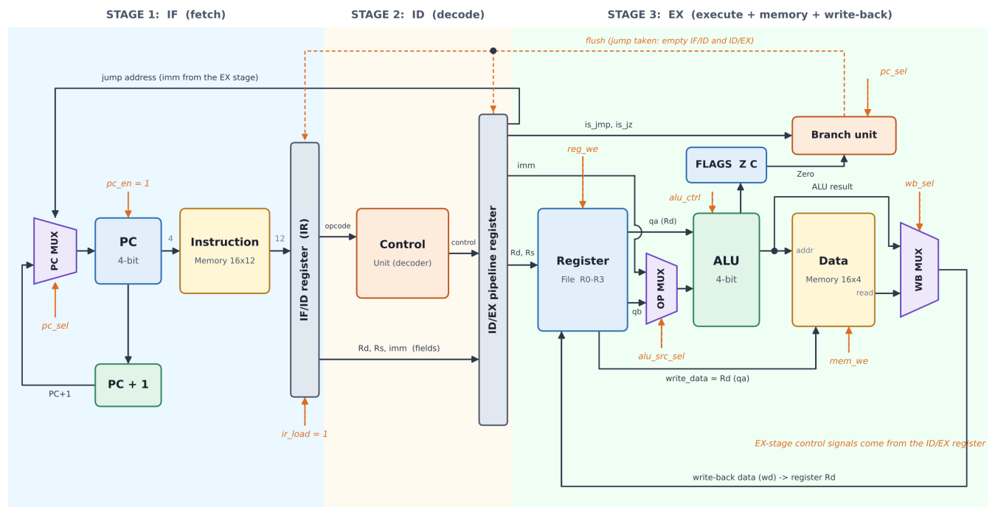
DATAPATH PIPELINING
Overall System Architecture and Mechanism
Synchronized clocking coordinates execution across unified memory, control, and datapath units.

Slide 3
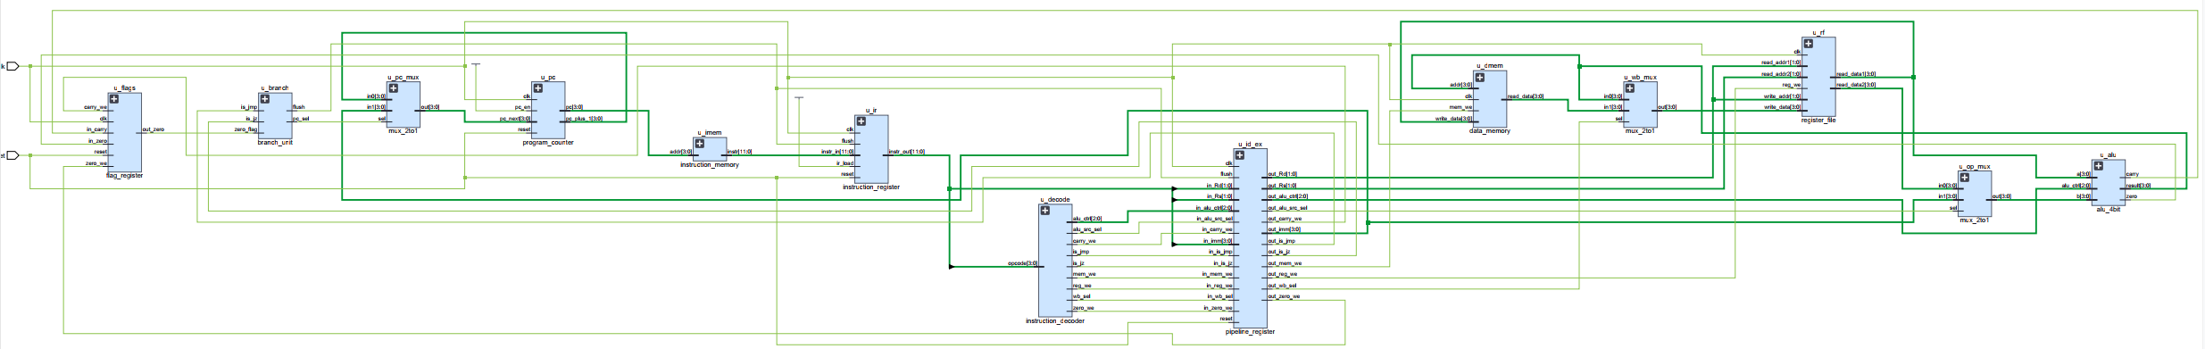
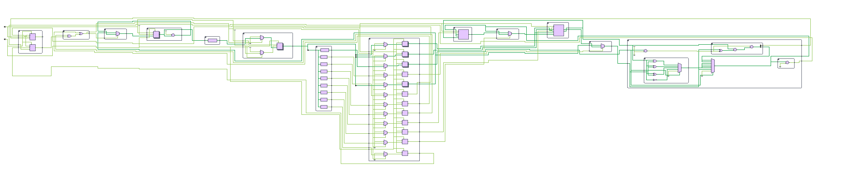
DATAPATH PIPELINING
Overall System Architecture and Mechanism
13 cells 2 I/O ports 98 nets
Synchronized clocking coordinates execution across unified memory, control, and datapath units.

Slide 4
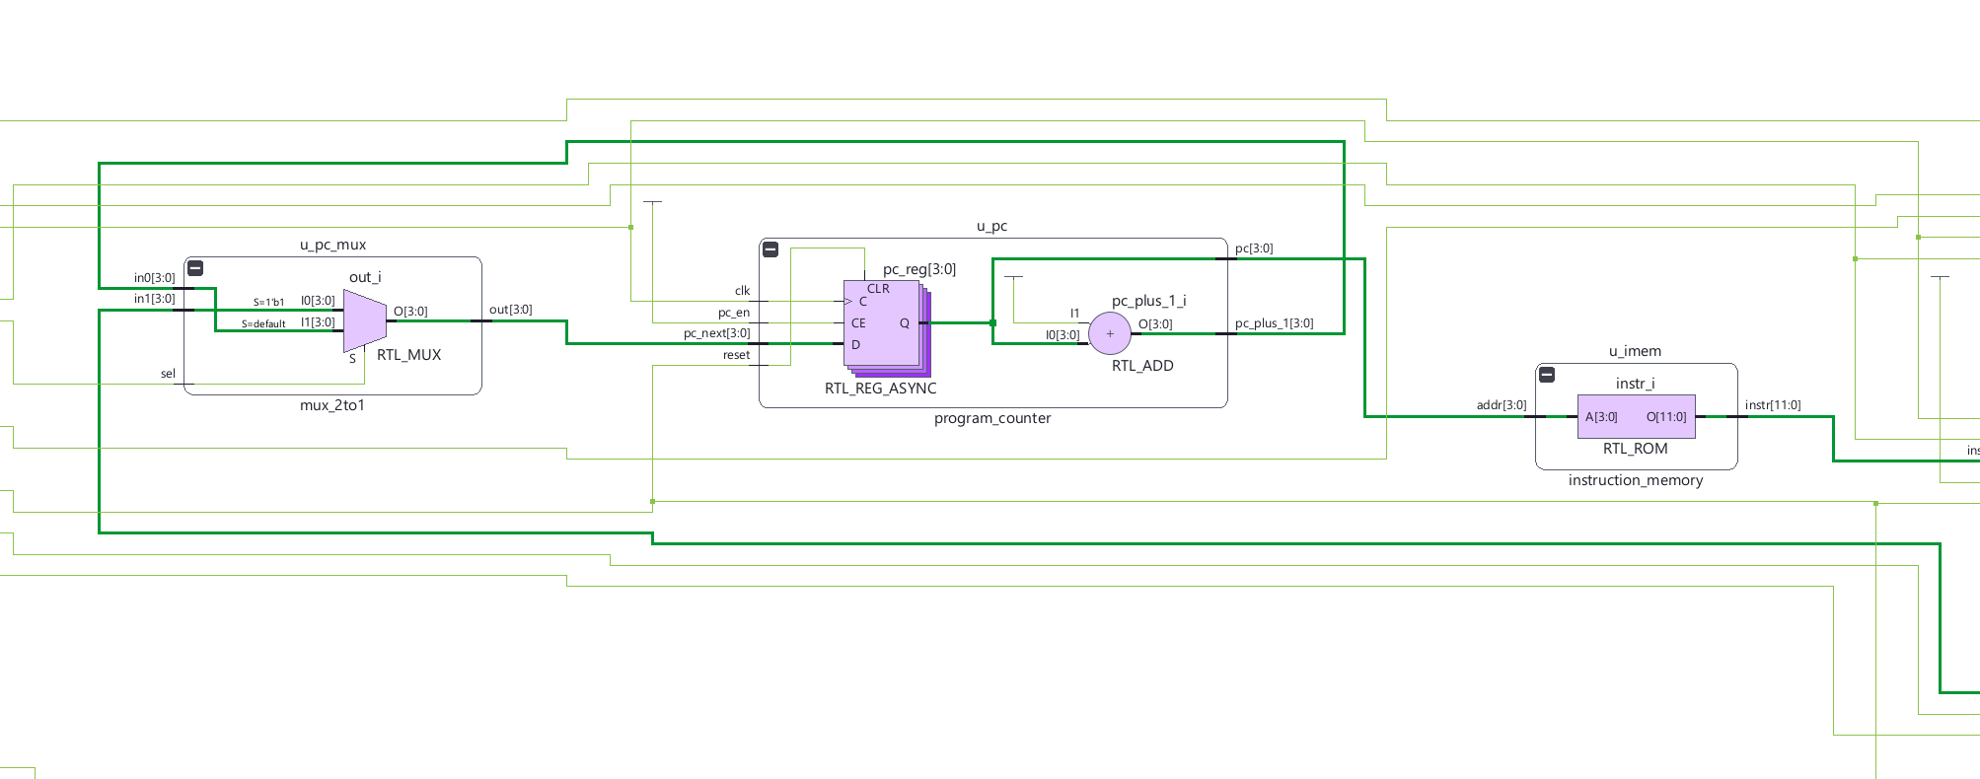

FLOW CONTROL
INSTRUTION FETCH (IF)
Addressing & Routing
STAGE 1

Slide 5
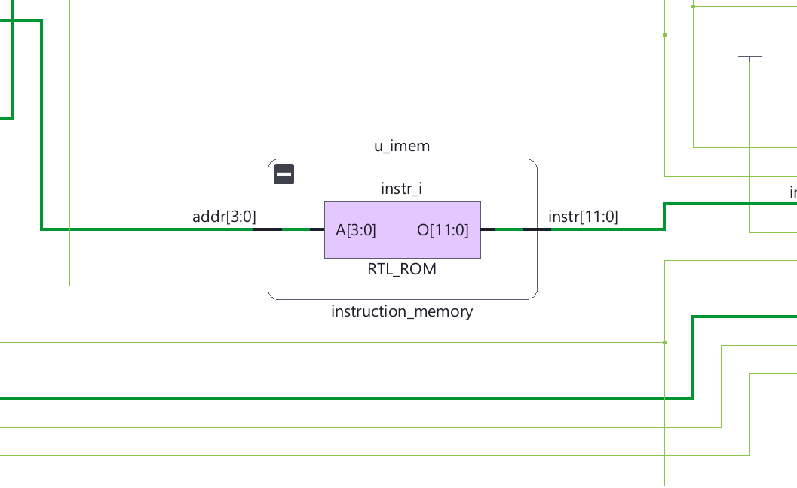
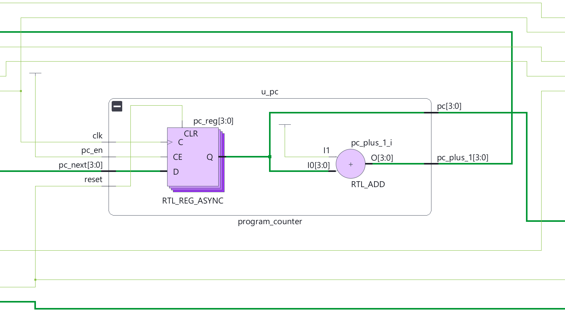
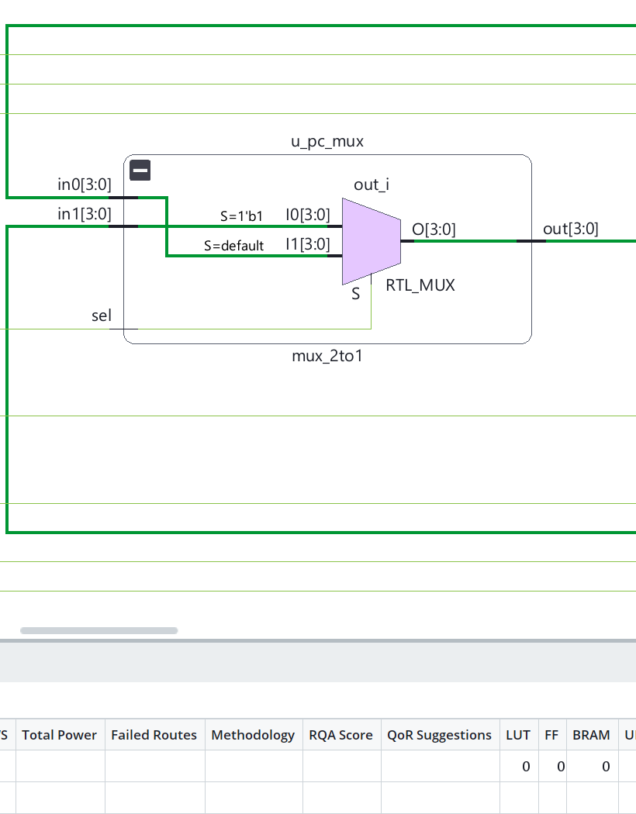


FLOW CONTROL
Program Counter and Instruction Memory
Addressing & Routing
Program Counter
PC MUX
Instruction Memory
Sequentially tracks and updates 4-bit instruction memory addresses.
Acts as a switch to select between PC+1 or Jump Address
Routes branch targets versus sequential PC addresses based on control flags.

Slide 6
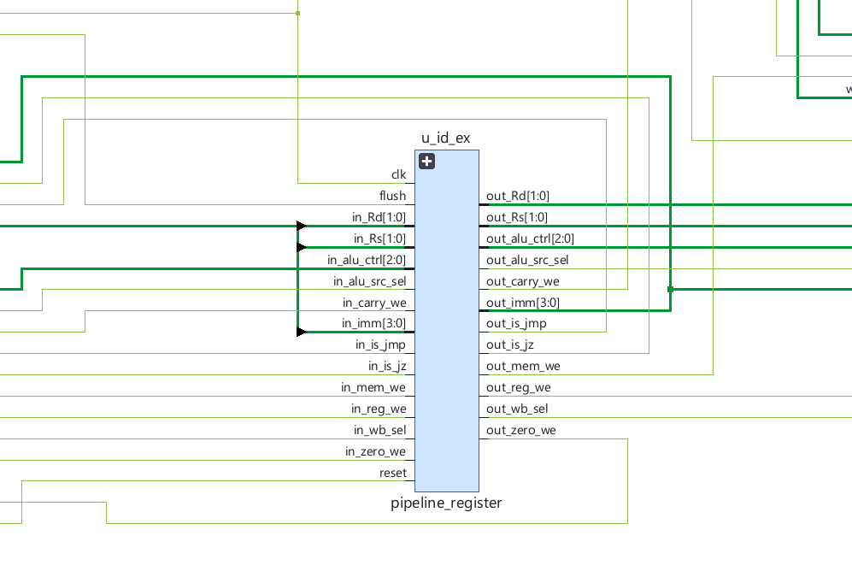

TIMING & SYNCHRONIZATION
Pipeline Register Buffering Strategy
Stage Isolation
Purpose
Mechanism
Act as data waiting rooms between pipeline stages.
Catch and hold signals steady at every clock edge to prevent data collision.

Slide 7
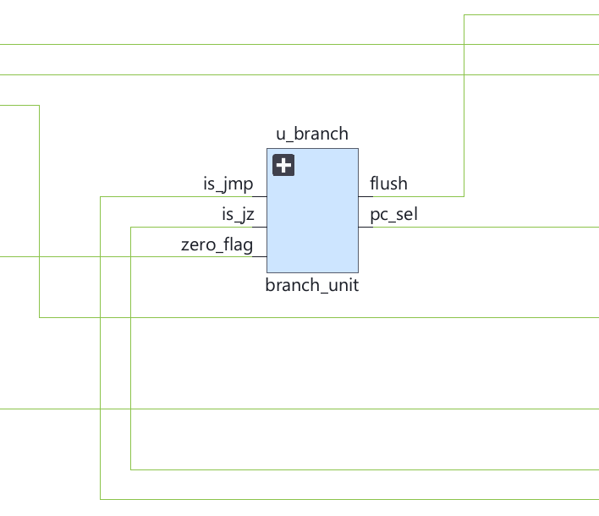
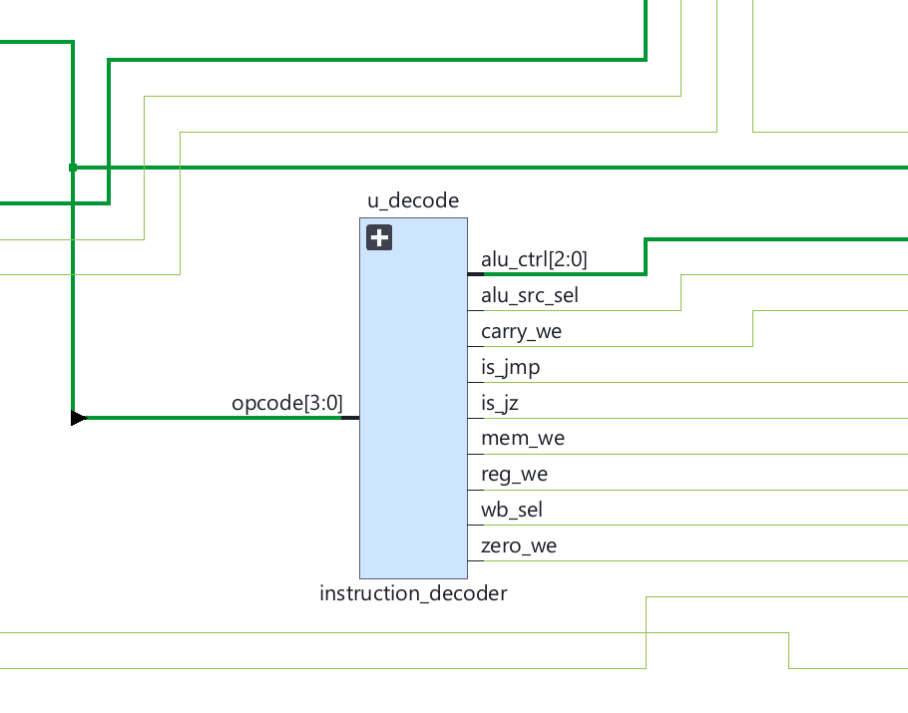
COMMAND INFRASTRUCTURE
INSTRUCTION DECODE (ID)
Stage Isolation
STAGE 2

Slide 8
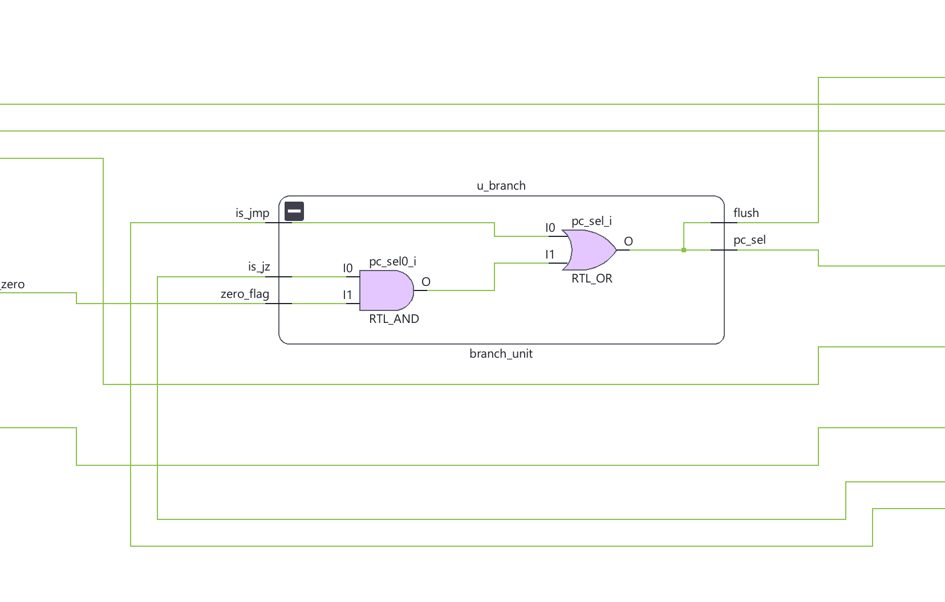
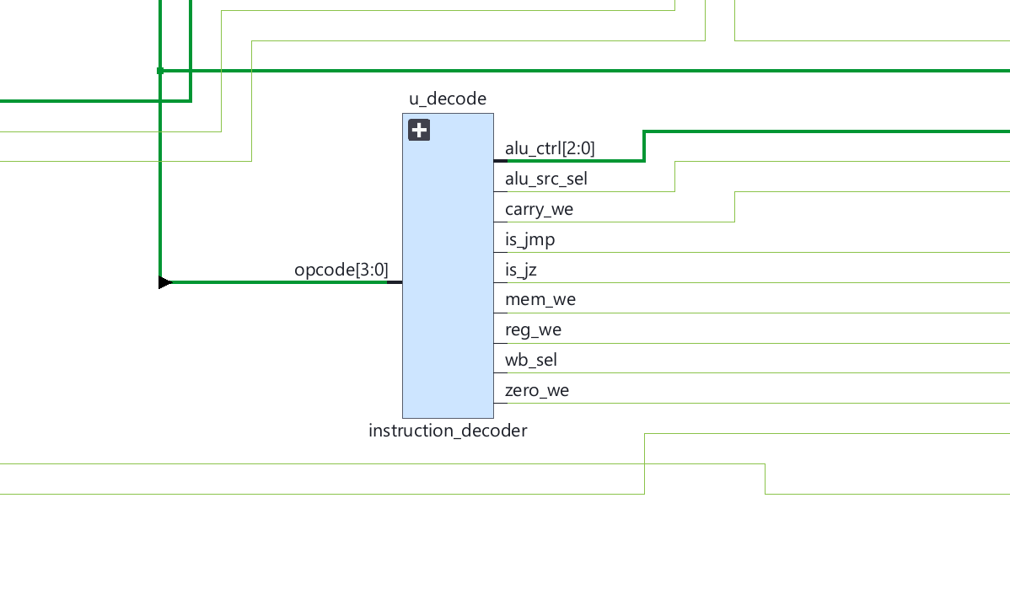


COMMAND INFRASTRUCTURE
Control Unit and Instruction Decoding
Central Decoder
Purpose
Output
Translates incoming machine instructions into synchronized datapath control lines.
Generates hardware control signals (e.g., Reg_WE, ALU_Src) for the Execute stage.

Slide 9
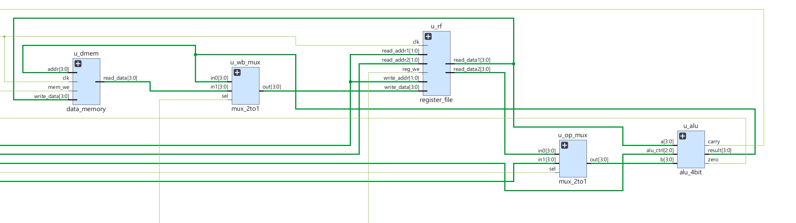
ARCHITECTURAL STATE
Memory Register file & ALU (Execute)
Stage Isolation
STAGE 3

Slide 10
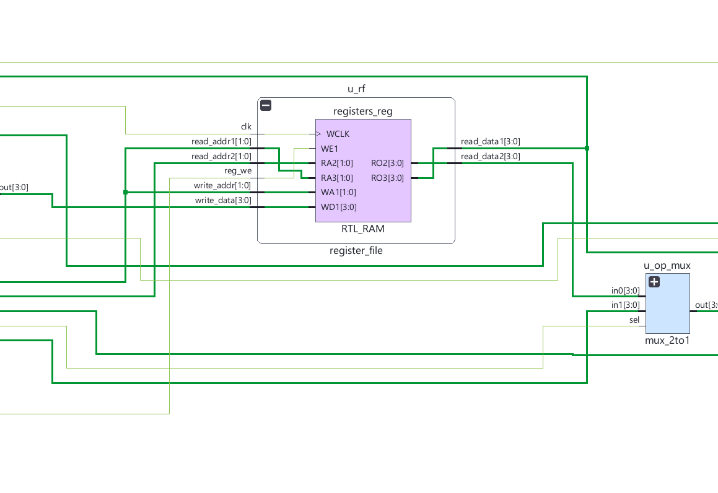
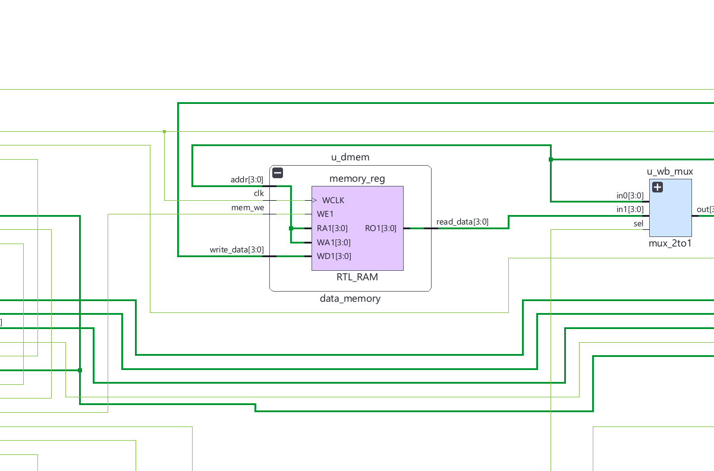


ARCHITECTURAL STATE
Register File and Data memory
Internal State
Register File (R0-R3)
Data Memory (RAM)
4-bit fast temporary storage.
-Read: Asynchronous (Instant access).
-Write: Synchronous (Waits for clock edge).
4-bit memory for long-term variables (Controlled by Mem_WE).

Slide 11

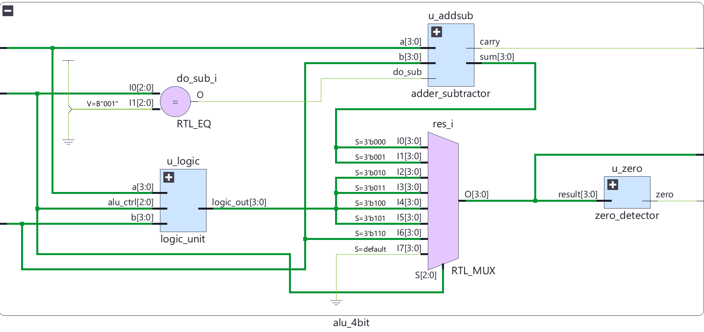
COMPUTATION ENGINE
4-Bit ALU Arithmetic Operations
Execution Core
Arithmetic
Logic Functions
Flag Feedback
Computes 4-bit addition (Add) and subtraction (Sub).
Evaluates bitwise Boolean primitives (AND, OR, XOR).
Dynamically asserts active carry-out and zero-detect indicators.

Slide 12
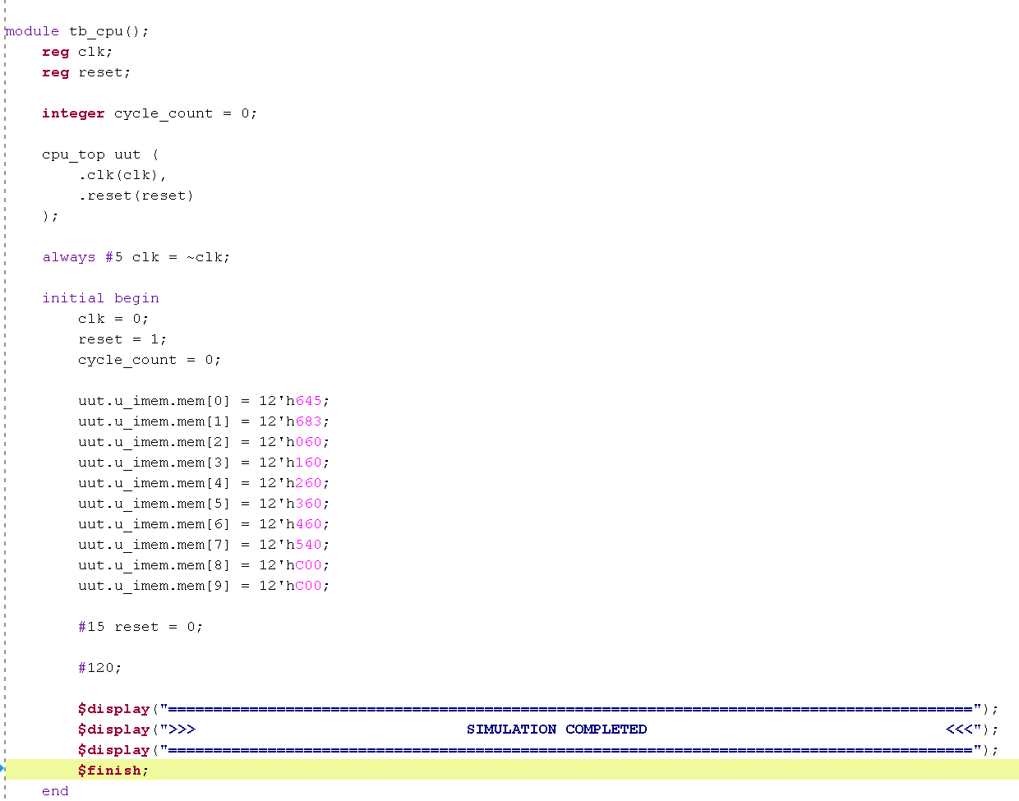
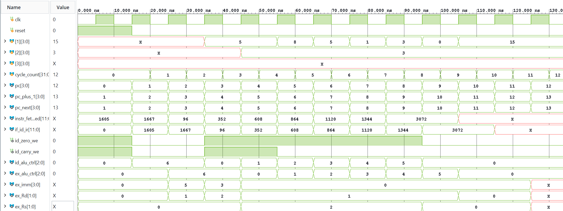

QUALITY ASSURANCE
Testbench strategy
Simulation Harness
Automated Stimulus
Signal Tracing
Drives system clock, reset sequences, and assembled instruction streams.
Continuously monitors internal buses against architectural specification models.

Slide 13
EMPIRICAL VALIDATION
Simulation Results and Truth Table Analysis
Cycle | PC | Hex | Assembly | ALU Out / WB | R1 | R2 | Zero | Carry
1 | 1 | 683 | LDI R2, 3 | X | X | X | 0 | 0
2 | 2 | 060 | ADD R1, R2 | 5 | X | X | X | X
3 | 3 | 160 | SUB R1, R2 | 3 | 5 | X | X | X
4 | 4 | 260 | AND R1, R2 | 8 | 5 | 3 | X | X
5 | 5 | 360 | OR R1, R2 | 5 | 8 | 3 | 0 | 0
6 | 6 | 460 | XOR R1, R2 | 1 | 5 | 3 | 0 | 1
7 | 7 | 540 | NOT R1 | 3 | 1 | 3 | 0 | 1
8 | 8 | c00 | NOP | 0 | 3 | 3 | 0 | 1
9 | 9 | c00 | NOP | 15 | 0 | 3 | 1 | 1
10 | 10 | XXX | - | X | 15 | 3 | 0 | 1
Confirms cycle-by-cycle correctness across PC advancement, datapath computations, and flag assertion.

