Slide 1




Virtual Congress July 29 – August 1, 2020
PREVALENCE-INDUCED CONCEPT CHANGE IN OLDER ADULTS
Sean Devine, Concordia University
@cognitivesciencesociety
@cogsci_ soc
# CogSci2020
cognitivesciencesociety.org

Slide 2
“The more things change, the more they stay the same”
— Jean-Baptiste Alphonse Karr and, later, Jon Bon Jovi

Slide 3
“The more things change, the more they stay the same”
— Jean-Baptiste Alphonse Karr and, later, Jon Bon Jovi

Slide 4
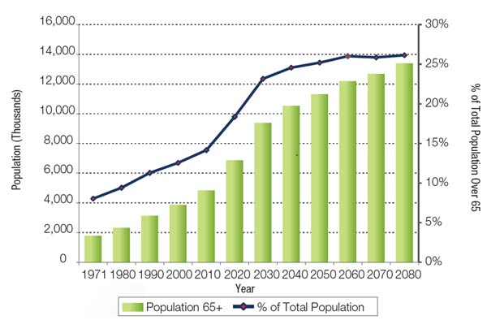
An Ageing Population
Ageing affects many elements of cognition
Executive functioning ²
Processing speed ³
Memory ⁴
Judgement and decision-making ⁵
1. Government of Canada, 2014; 2. Mayr et al., 2000; 3. Kerchner et al., 2012, 4. Lezak et al., 2012, 5. Bolenz et al., 2019

Slide 5
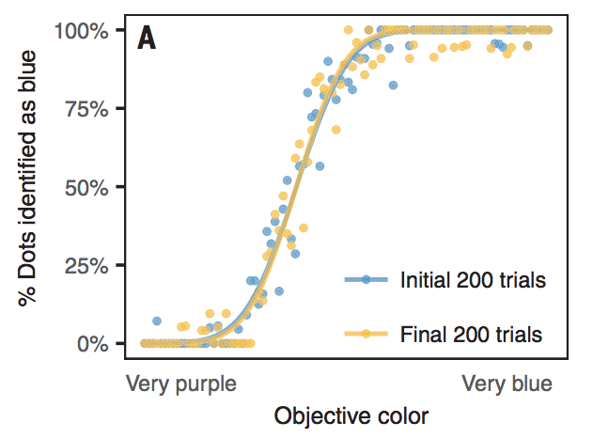
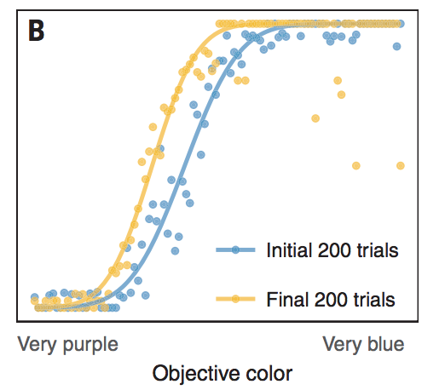
Prevalence-induced concept change
First described by Levari et al. (2018).
Occurs across perceptual, social, and ethical domains

Slide 6
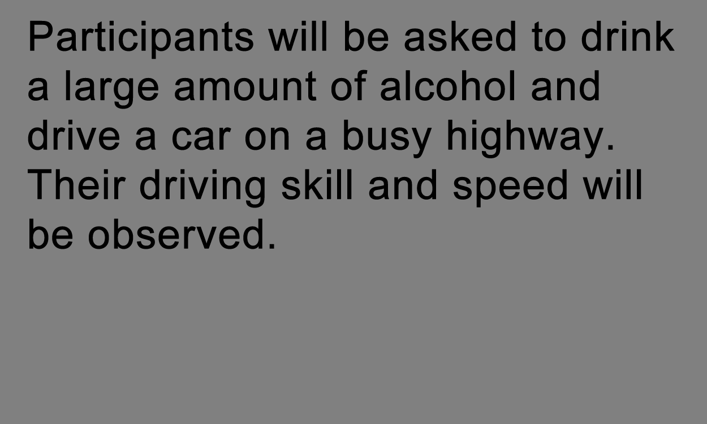
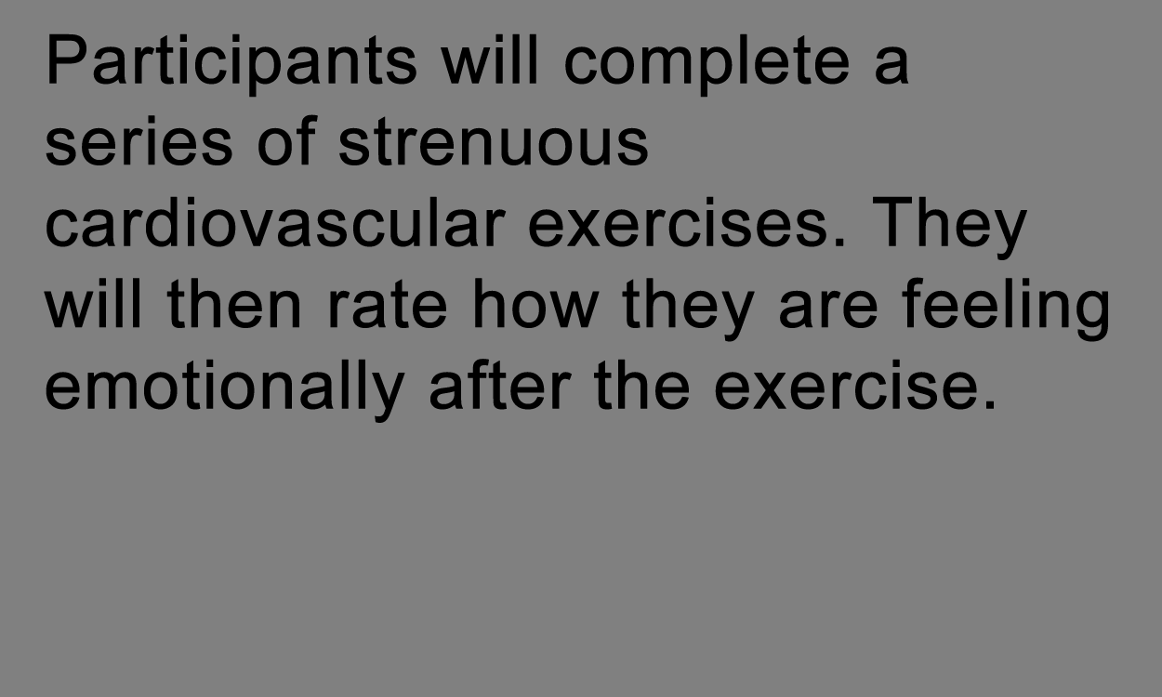
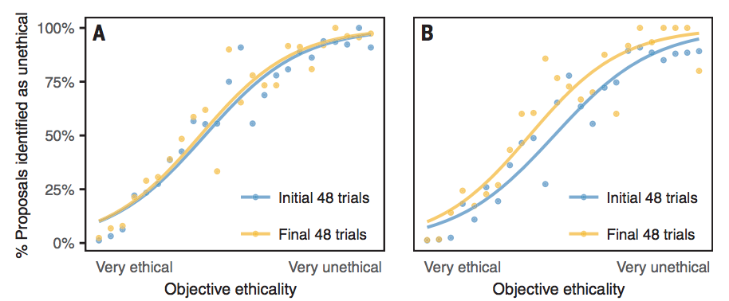
Prevalence-induced concept change
First described by Levari et al. (2018) across 7 experiments.
Found to occur in perceptual, social, and ethical decision-making about categories.
Unethical
Ethical

Slide 7
Prevalence-induced concept change
Levari et al. (2018) focused on young adults
But older adults ≠ young adults
More sensitive? Less sensitive?
Implications for decision-making in both cases
more sensitive, less consistent → social pessimism?
less sensitive, more consistent → conceptual conservatism? Is this beneficial?

Slide 8
Study 1

Slide 9
Are older adults more, less, or equally susceptible to PICC?
H1. OA less susceptible to PICC than YA
Difficulty learning from uncertain outcomes ⁷
Perseverative behaviour ⁸
Perseverative behaviour drives PICC down ⁹
H2. OA more susceptible to PICC than YA
Less able to converge on a representation of the current concept ¹⁰
Rely more heavily on the environment (outsource control) ¹¹
Heavy reliance on stimuli shown to increase PICC ⁹
H0. OA equally susceptible to PICC than OA
7. Nassar et al., 2016; 8. Bruckner et al., in prep; 9. Wilson, 2018; 10. Hämmerer et al., 2018; 11. Lindenberger & Mayr, 2014

Slide 10
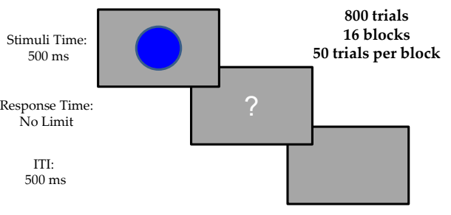
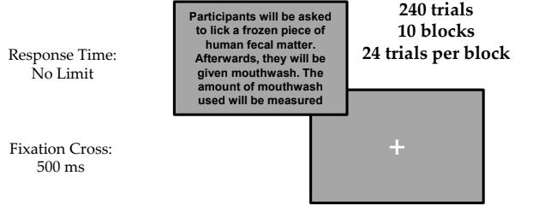
Methodology
Participants will make a list of the cities they would most like to visit around the world, and write about what they would do in each one
Participants will be given a plant and told that it is a natural remedy for itching. In reality, it will cause itching. Their reaction will be recorded
Participants will be asked to lick a frozen piece of human fecal matter. Afterwards, they will be given mouthwash. The amount of mouthwash used will be measured

Slide 11
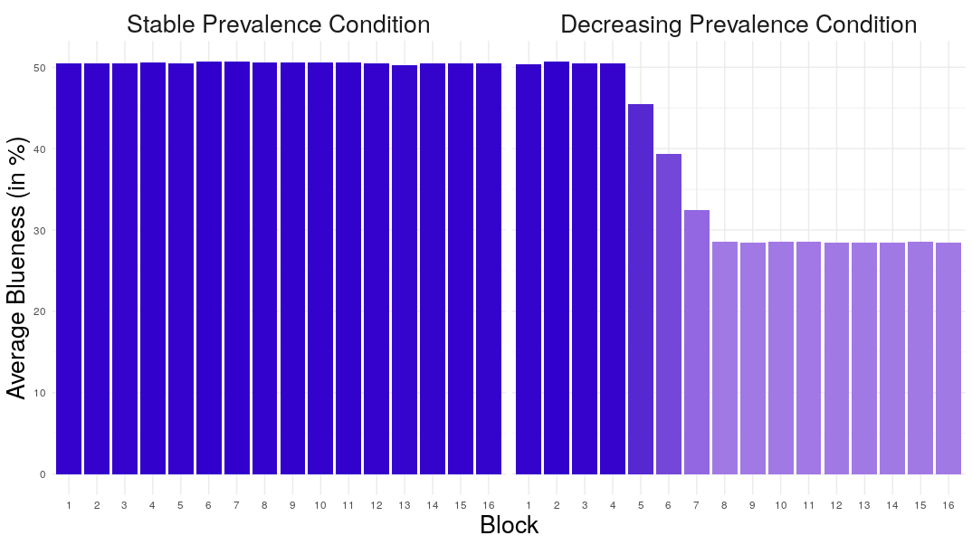

Slide 12
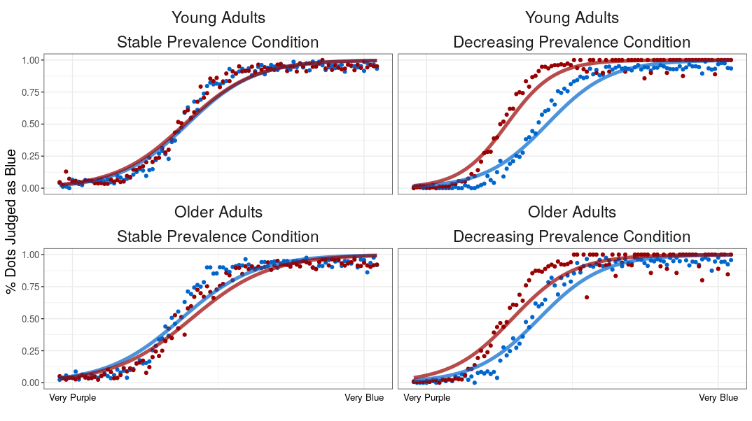
Results: Dots task
80 OA (60-84; m_{age} = 70.10)
80 YA (18-28; m_{age} = 21.85)
First 200 trials
Last 200 trials

Slide 13
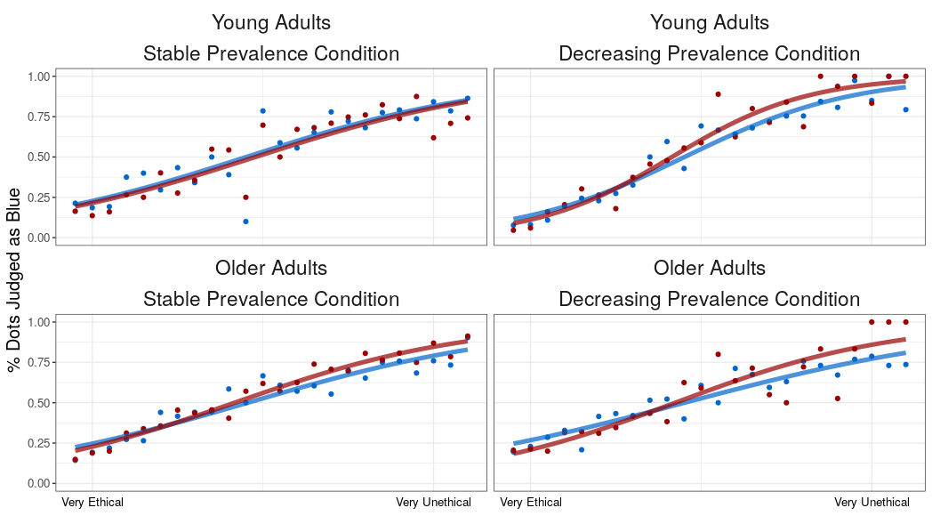
Results: Ethics task
80 OA (60-84; m_{age} = 70.10)
80 YA (18-28; m_{age} = 21.85)
First 48 trials
Last 48 trials

Slide 14
Summary and discussion
Older adults were significantly less sensitive to prevalence-induced concept change than young adults in the Dots task
Older adults weren’t significantly affected by prevalence-induced concept change in the Ethics task, but young adults were
H1 supported
Older adults' concepts are more resilient when faced with a changing world
Why?

Slide 15
Why?
One approach: computational ⁹
Higher perseverance → reduced prevalence-induced concept change
(Recall! Older adults have been shown to perseverate in other tasks before too)
If this explains our effects, we should expect to find age differences in estimated model parameters
i.e., more perseverant parameters should fit old adults’ data better
Did it work?
9. Wilson, 2018

Slide 16
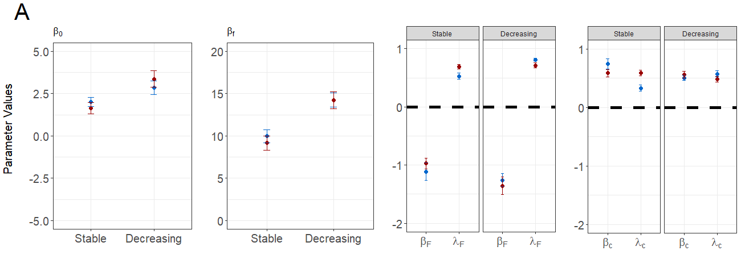
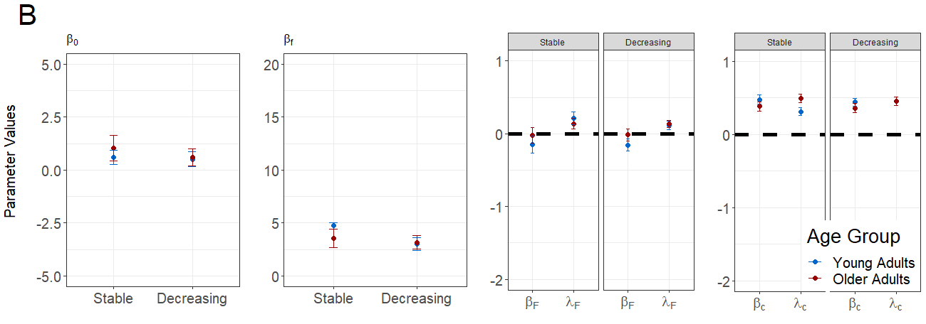
Notes:
No meaningful age differences in estimated parameters

Slide 17
So what now?
Estimated parameters in the computational model didn’t meaningfully differ between young and old adults
So what’s driving the difference in sensitivity to prevalence-induced concept change
Exploratory response time analysis

Slide 18
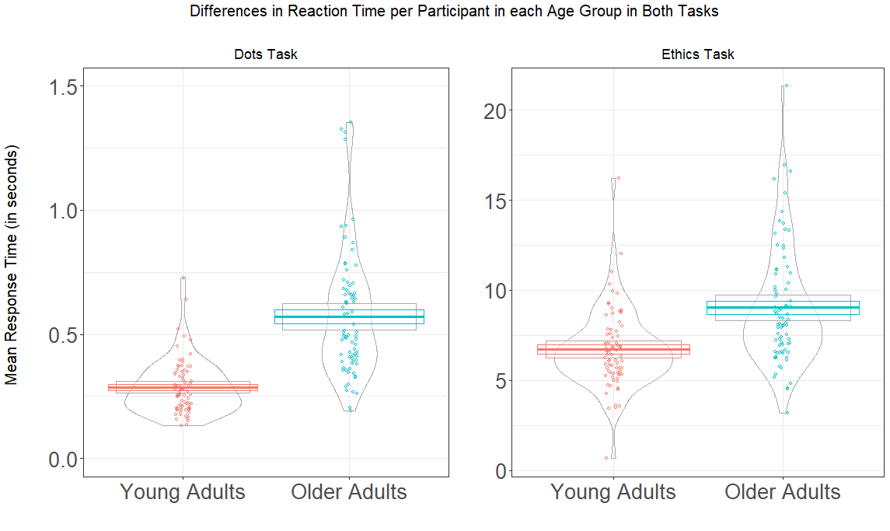

Slide 19
Older adults are slower
Older adults respond more slowly than young adults in both tasks
But why would this even matter? Is there any reason to think this should affect prevalence-induced concept change?
Modify recent computational model⁹ to account for RT, simulate data, and see what happens
9. Wilson, 2018

Slide 20
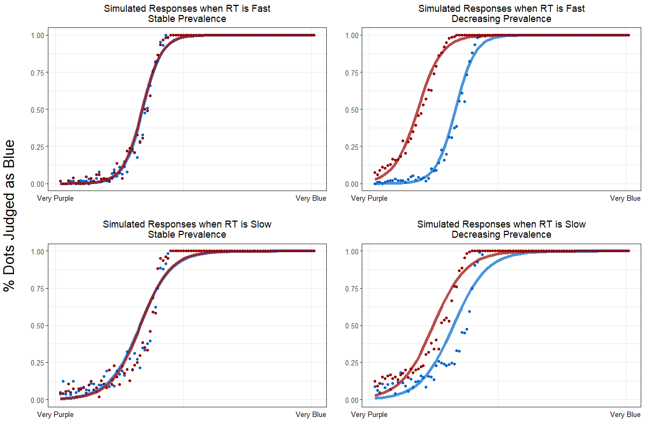

Slide 21
Seems promising
Unclear on where this slow down comes from and what it’s doing
Could be due to:
general slowing ⁸ and/or
a speed-accuracy trade-off ⁹
8. Verhaeghen & Cerella, 2002
9. Starns & Ratcliffe, 2010

Slide 22
Study 2 & 3

Slide 23
Study 2: General slowing
Older adults might just be responding slower overall
This might increase the space between stimuli, which may drive down concept change
Test this in a new group of young adults (n = 36; m_{age} = 20.89)
i.e., a group who were fast and highly affected by prevalence change

Slide 24
Methodology for Study 2
2000 ms
n = 36 young adults

Slide 25
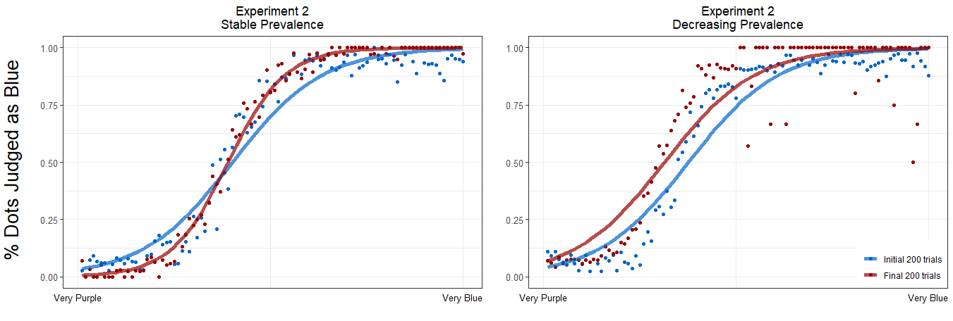
Reduced concept change when longer ITI

Slide 26
Study 3: Speed-accuracy trade-off
Young adults show reduced concept change when the space between stimuli is increased
Older adults may show a similar decrease because they respond more slowly (thus increasing the space between stimuli)
But why are they slower?
Perhaps they are slowing down to become more accurate
Speed-accuracy trade-off
In other words, does motivation matter?

Slide 27
Methodology for Study 3
…
You made 10 mistakes
You have 3.4 credits left
n = 50 young adults

Slide 28
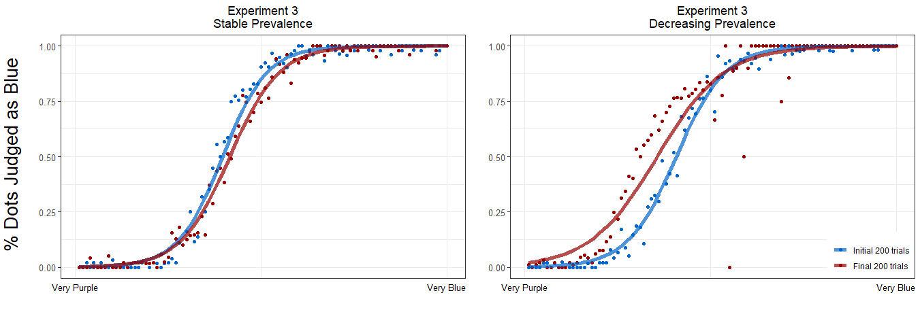
Reduced concept change when incentivised

Slide 29
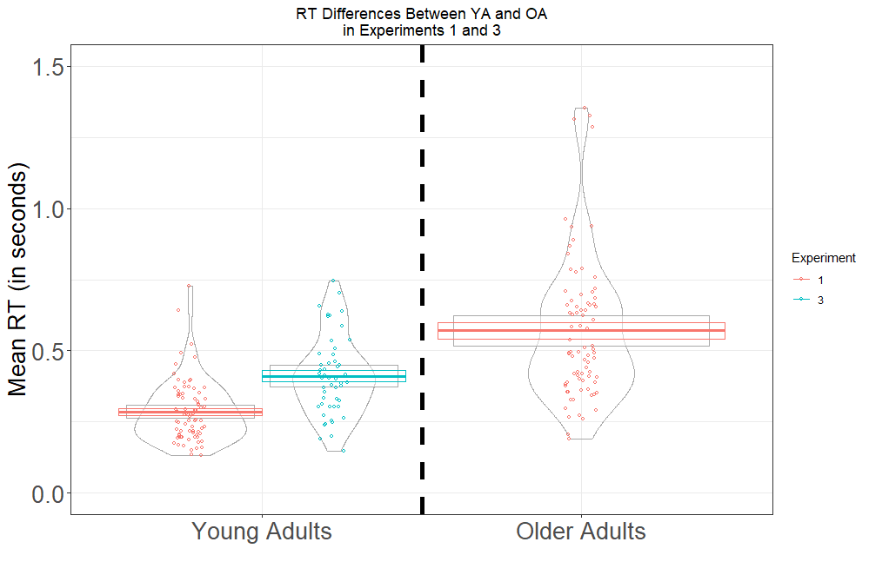
Slower responses when incentivised

Slide 30
Conclusions

Slide 31
Takeaways
Older adults are less sensitive to prevalence-induced concept change
Their concepts are more rigid, their decision-making more conservative and less susceptible to update
Might arise due to limitations, but can be beneficial in some cases
This might be due
Responding more slowly
Concept change occurs most quickly when information is presented rapidly
Trading speed for accuracy
Concept change can be reduced if people are sufficiently motivated
Older adults seem to be motivated to do so without the need for external motivation

Slide 32
“The more things change, the more they stay the same”
— Jean-Baptiste Alphonse Karr and, later, Jon Bon Jovi

Slide 33

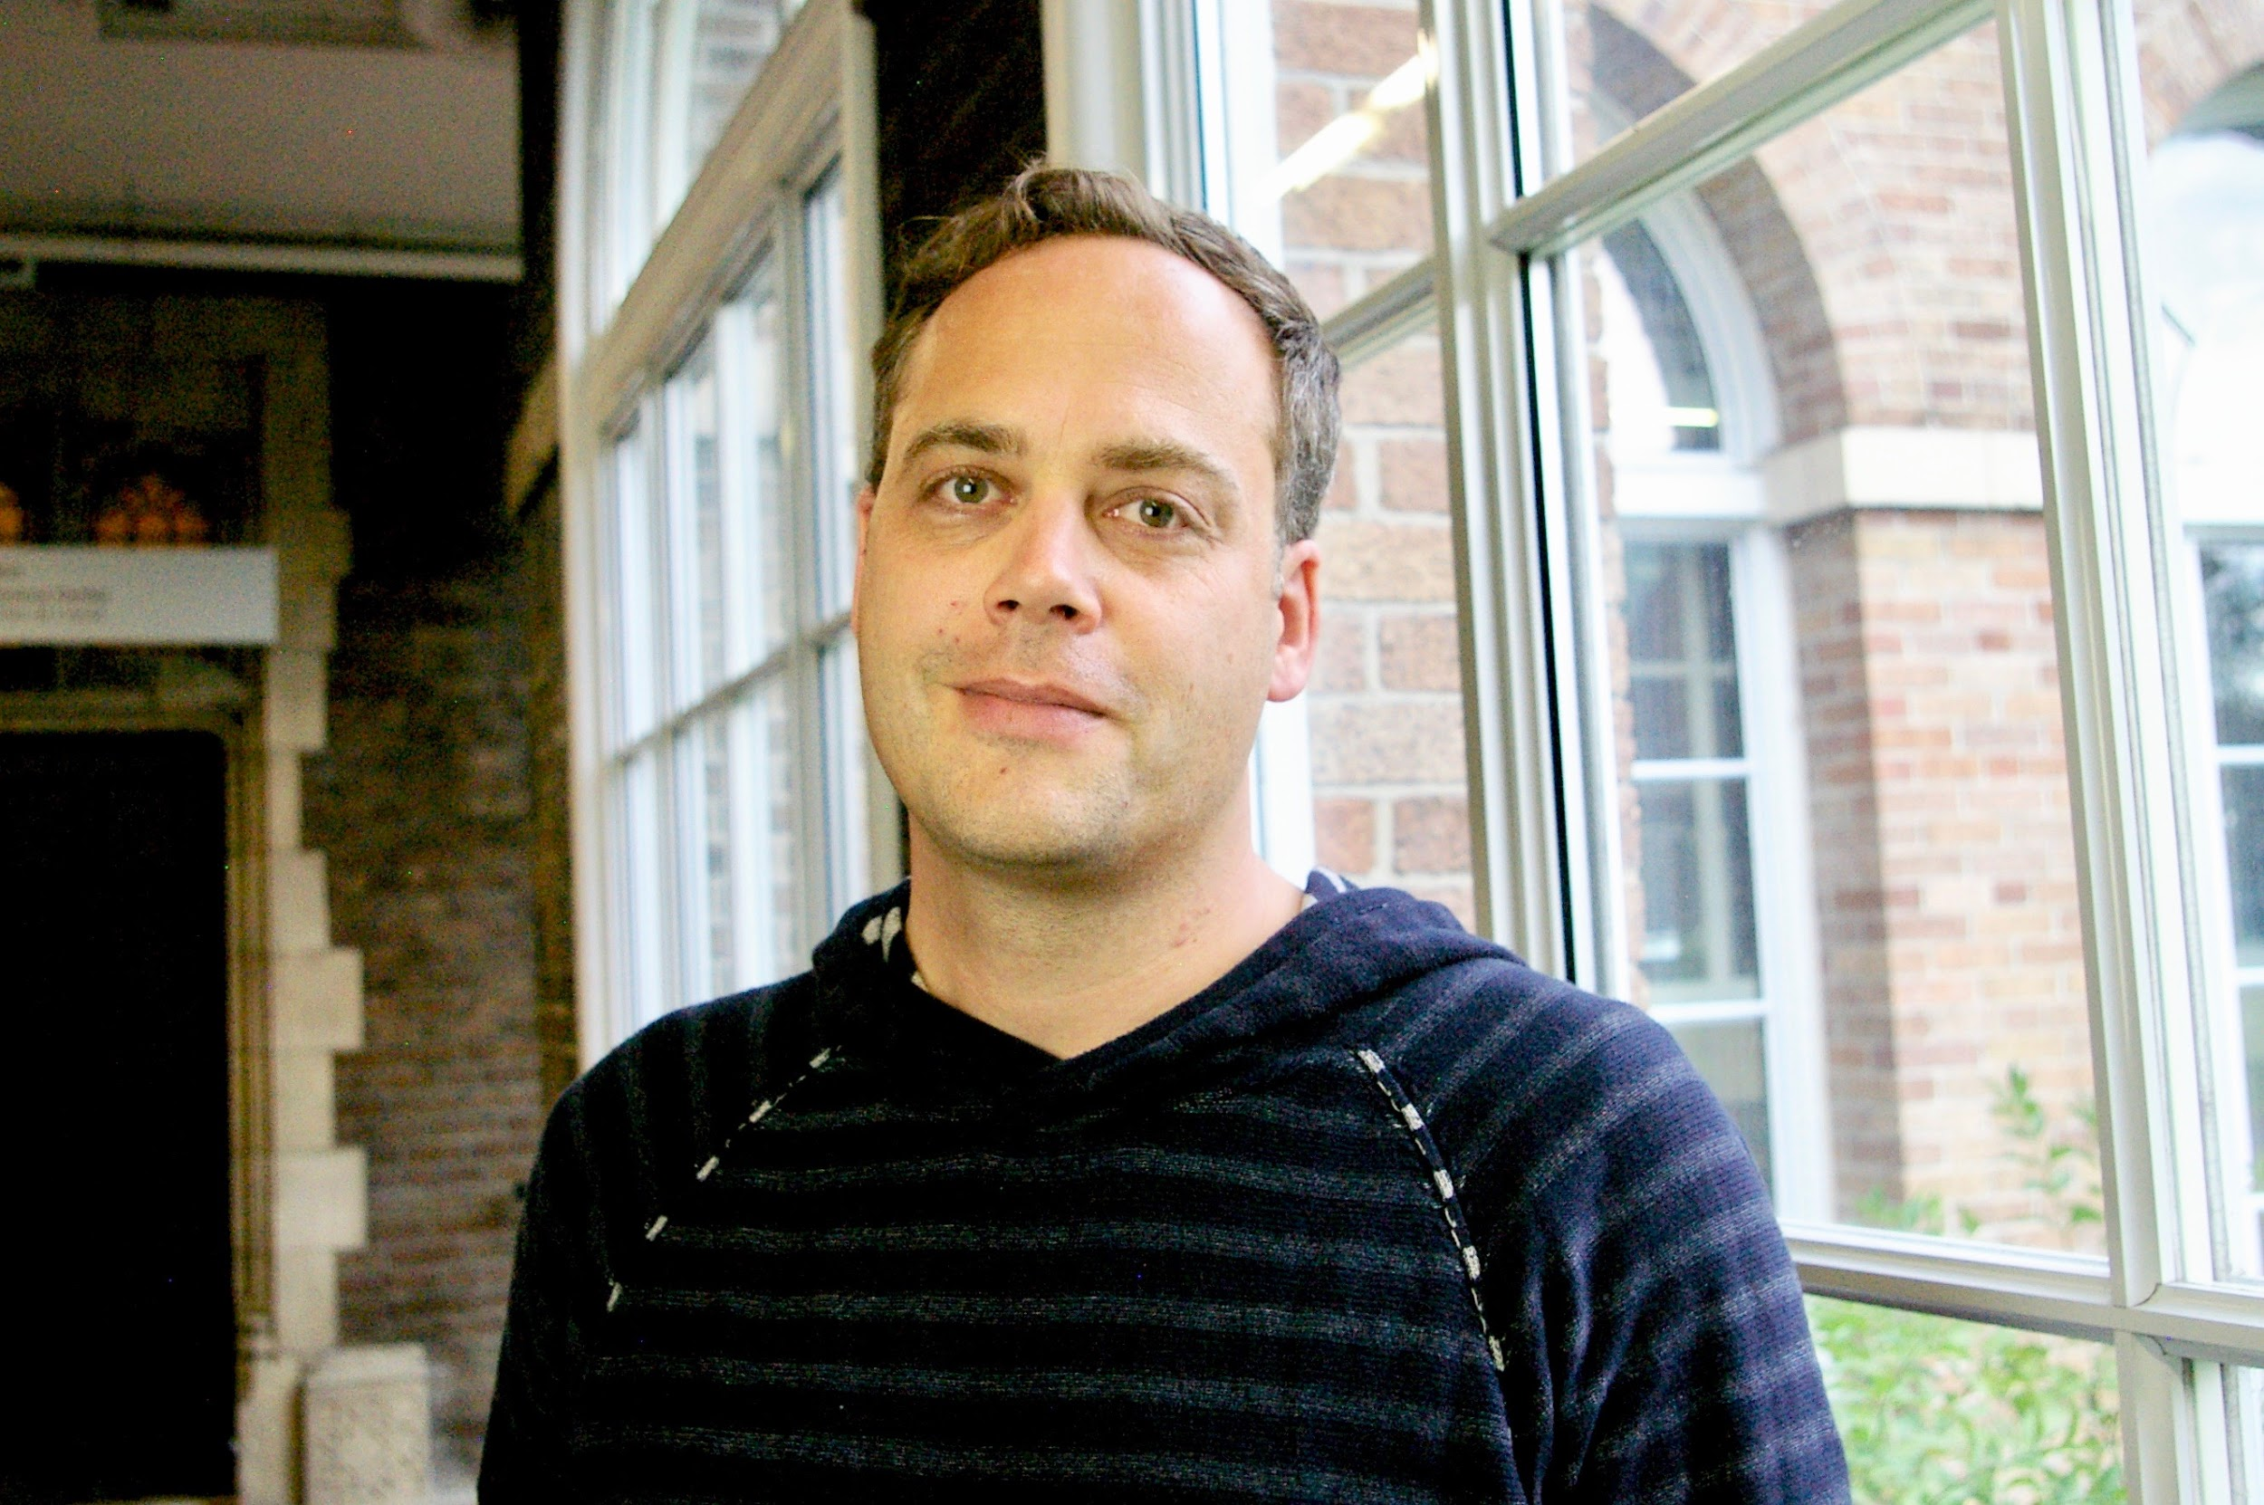
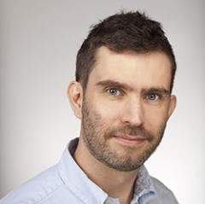

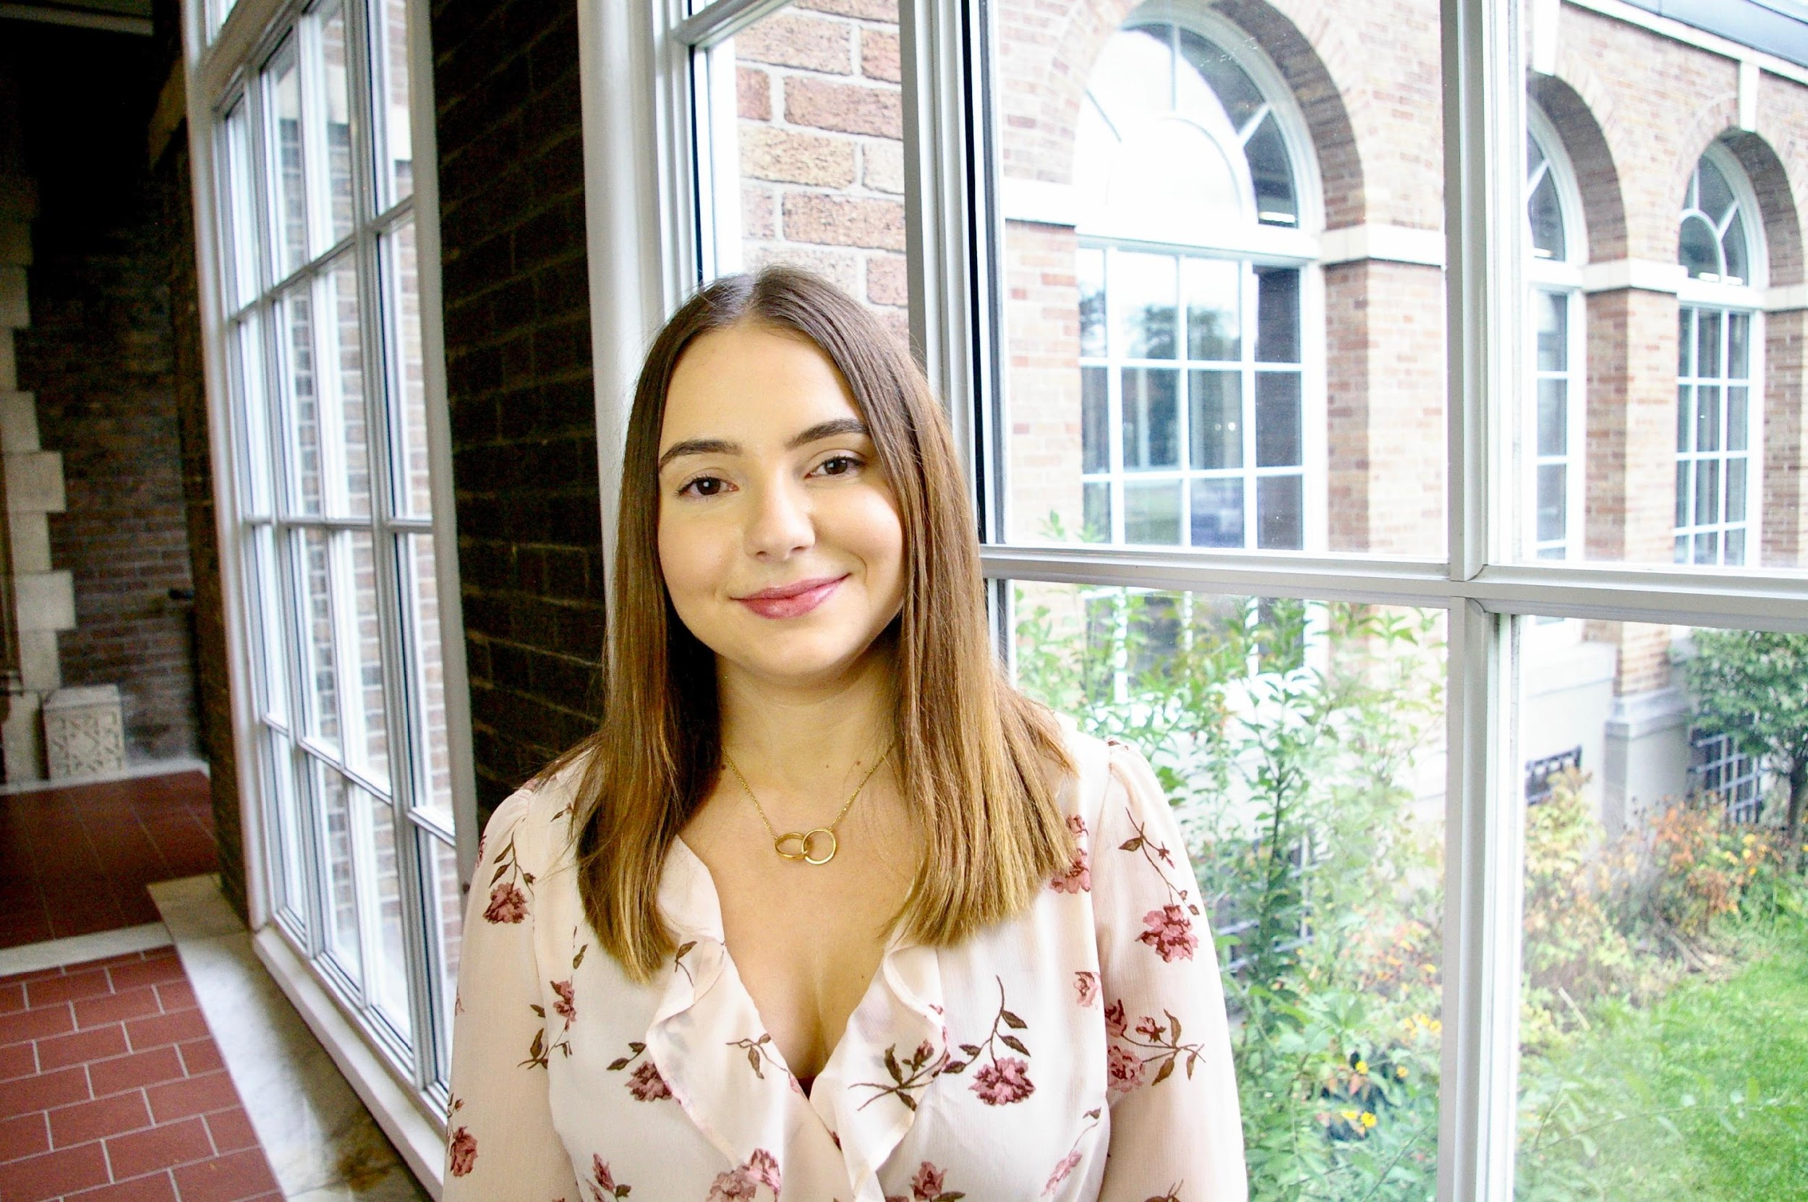

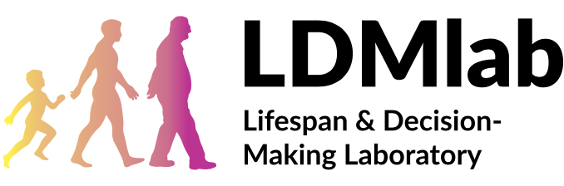

Thank you to these people
Robert Wilson,
Neuroscience of Reinforcement
Learning Lab Director,
University of Arizona
Ben Eppinger,
LDM Lab Director,
Concordia University
David Levari,
Postdoctoral Research Associate
Harvard University
Cassandra Neumann,
MA Candidate,
Concordia University

Slide 34
If you are interested in this research, contact me
seandamiandevine@gmail.com

