Slide 1
Buffer Management and Heap Files
Project #2
Slides based on “Database Management Systems” book by Johannes Gehrke and Raghu Ramakrishnan

Slide 2
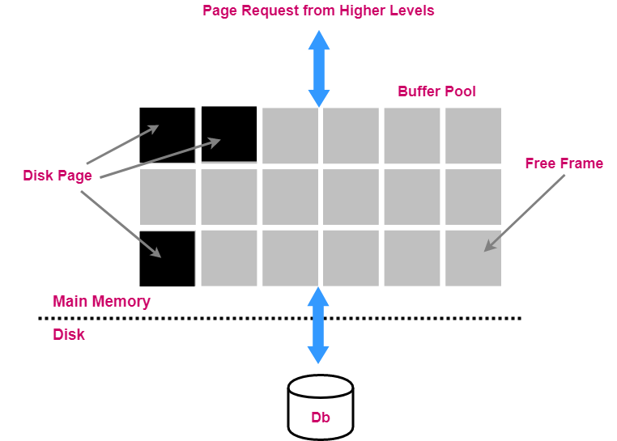
Buffer Management in a DBMS
Data must be in memory for DBMS to operate on it
Table of <frame#, pageid> pair is maintained.
Bookkeeping information (per frame):
pin count
dirty bit
Choice of the frame is dictated by replacement policy.

Slide 3
When a Page is requested …
If requested page is not in pool and the pool is full:
Choose a frame for replacement.
If frame is dirty, write it to disk.
Read requested page into chosen frame.
Pin the page and return its address.
If request can be predicted (e.g., sequential scans), pages can be pre-fetched (several pages at the same time)

Slide 4
More on Buffer Management
Requestor of page must unpin it and indicate whether page has been modified:
dirty bit is used for this
Page in pool may be requested many times:
A pin count is used.
A page is candidate for replacement
iff pin count == 0.
CC & Recovery may entail additional I/O when frame is chosen for replacement (Write-Ahead Log Protocol).

Slide 5
Buffer Replacement Policy
Frame is chosen for replacement by a replacement policy:
FIFO, Least-Recently-Used (LRU), Clock, MRU, etc.
Policy can have a big impact on # of I/O’s; depends on the access pattern.
Sequential Flooding. Nasty situation caused by LRU + repeated sequential scans.
# buffer frames < # pages in file
means each page request causes an I/O. MRU much better in this situation (but not in all situations, of course).

Slide 6
DBMS vs OS File System
OS does disk space & buffer management: why not let OS manage these tasks?
Differences in OS support: portability issues
Some limitations, e.g., files can't span disks.
Buffer management in DBMS requires ability to:
pin a page in buffer pool, force a page to disk (important for implementing CC & recovery),
adjust replacement policy, and prefetch pages based on access patterns in typical DB operations.

Slide 7
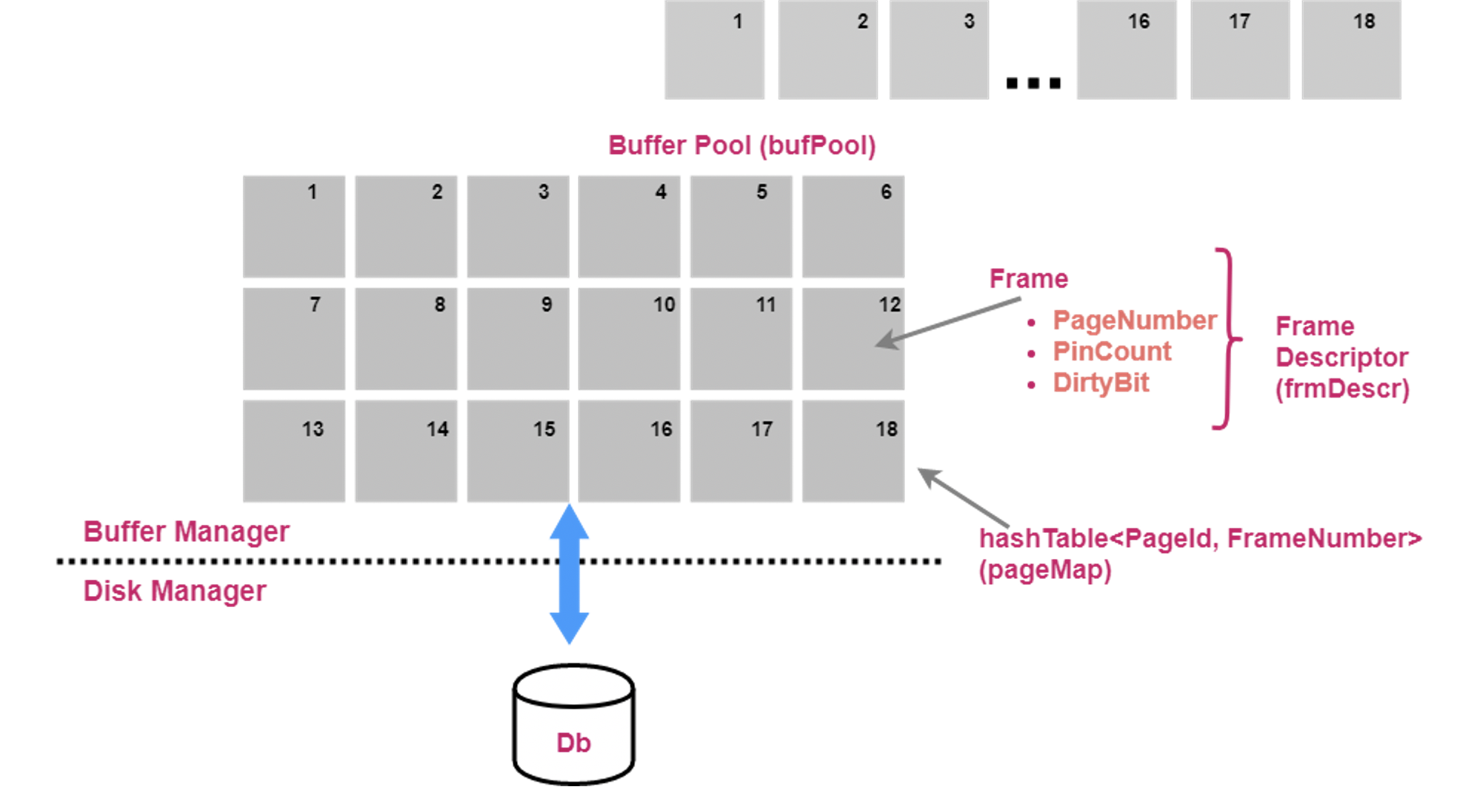
Project #2

Slide 8
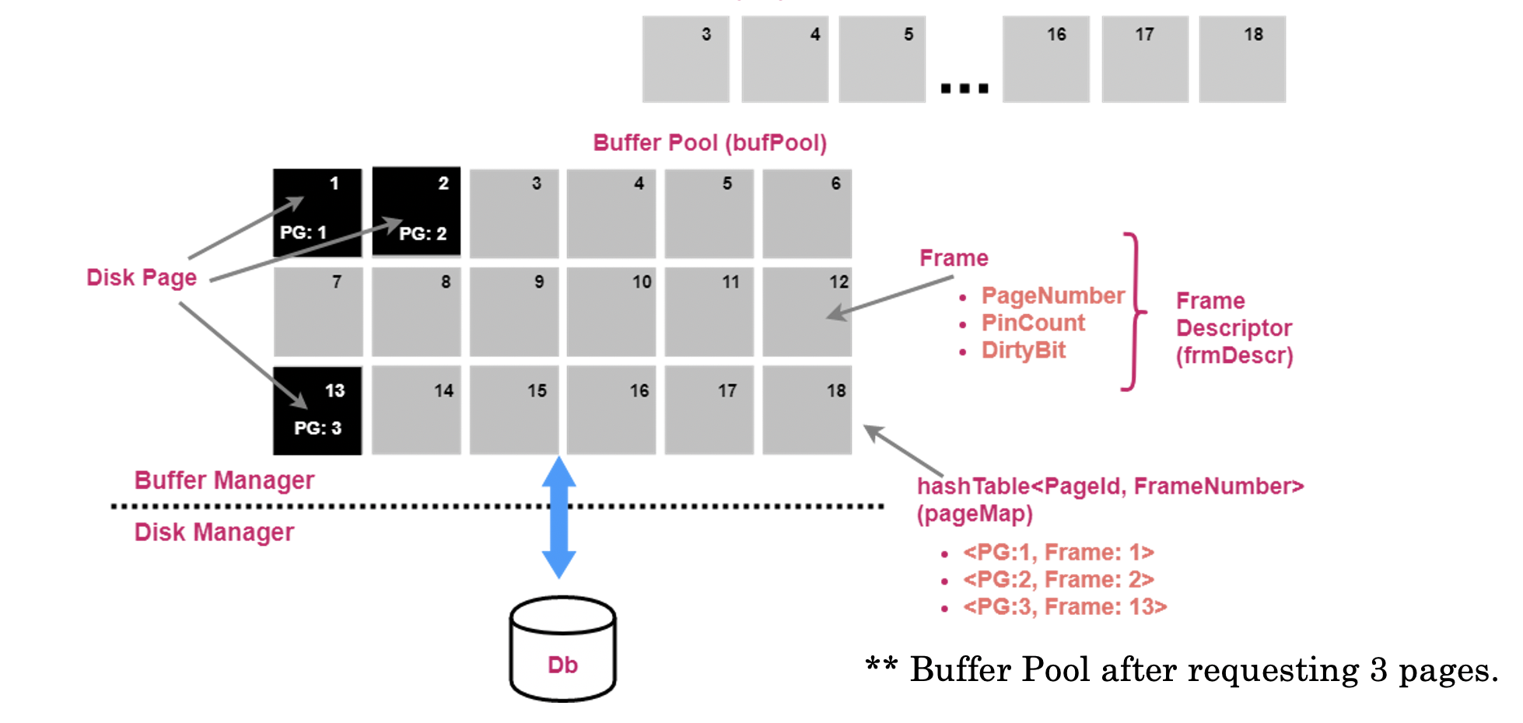
Project #2

Slide 9
Methods to Implement
void pinPage
Attempts to pin the requested page.
void unpinPage
Attempts to unpin the requested page.
PageId newPage
Attempts to allocate ‘x’ pages in memory.
void freePage
Attempts to the case when we need to remove a page completely from disk.

Slide 10
Heap Files
Many choices exist for file structure, each good for some situations, and not so good in others:
–Heap Files: Suitable when typical access is a file scan retrieving all records.
–Sorted Files: Best for retrieval in search key order, or only a `range’ of records is needed.
–Hashed Files: Good for equality selections. [Will be handy in a future project].

Slide 11
Project 2 Requirements
The major methods of HeapFile.java that you will implement include:
public HeapFile(String name) protected void finalize() throws Throwable public void deleteFile() public RID insertRecord(byte[] record) public byte[] selectRecord(RID rid) public void updateRecord(RID rid, byte[] newRecord) public void deleteRecord(RID rid) public int getRecCnt() public HeapScan openScan()

Slide 12
Things you will need from other layers
Minibase.DiskManager.get_file_entry(name)
Minibase.BufferManager.newPage( )
Minibase.DiskManager.add_file_entry(str, Page)
Minibase.DiskManager.get_file_entry(str, Page)
Pin/Unpin
HFPage.getData, HFPage.setData

Slide 13
Some Hints
1. Use two arrays/lists to store Pages and PIDs for a Heap File (or you can also use HFPage)
2. Carefully first figure out the sequence of things you want to do in the HeapFile constructor
There can be 3 cases:
If the file name is passed exist (just check if name is null or not)
If a name is passed but the file is not in memory (rather on disk)
If a name is passed and the file is already in memory
No name is passed

Slide 14
Make sure to see what HFPage does and can help
HFPage is a wrapper for Page class that gives a lot of funtionality to get records, set current page in a heap file, go to next records etc.
Whenever working on a Heap File, use HFPage to read in the data in the Page objects to HFPages
You can use nextRecord() and getNextPage() of HFPage to iterate through records and pages of a Heap File
HFPage can also return free space etc. meta information that can help in insertRecord() etc.

