Slide 1

Edinburgh Napier University Personal Development Tutor Refresher Training Website
By Fraser Yuill, Jamie Kearney, Liam Duff, Jake Johnston, Sean Mullen and Marcin Kazmierkiewicz

Slide 2
Aims
A requirements analysis detailing the information to be included. This will be done via a focus group and interviews with students. Then create a report based on this feedback that details the user experience of the PDT system and its effectiveness.
A visually appealing and easy to use website, using university branding, providing staff with refresher training on their PDT role.

Slide 3
Approach

Slide 4
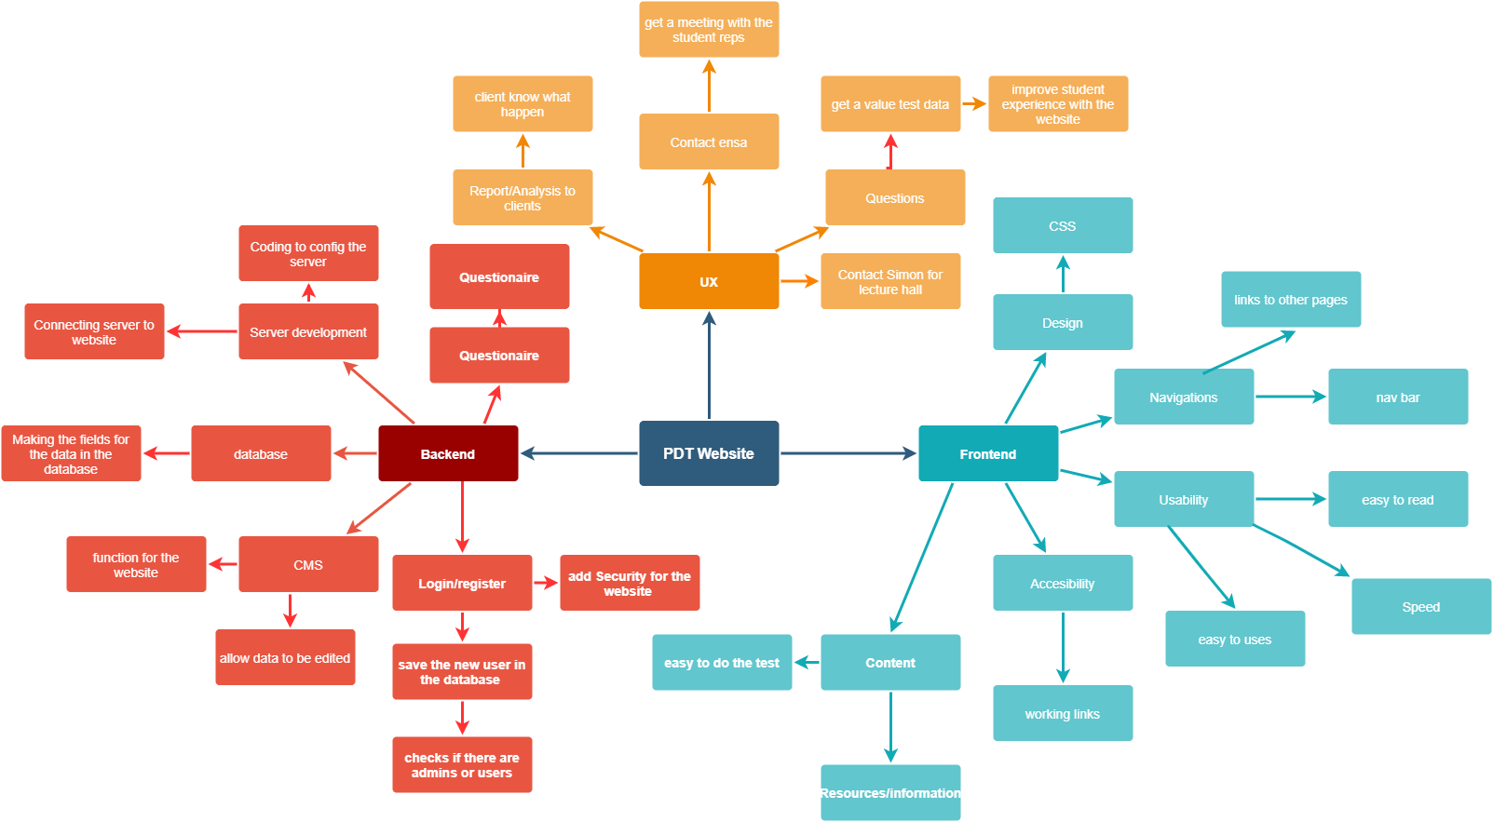
Prototypes and Designs
Configuration Map:

Slide 5
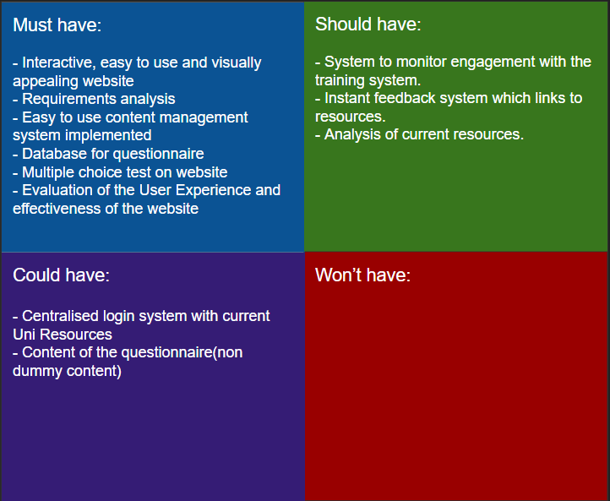
Prototypes and Designs
MOSCOW:

Slide 6
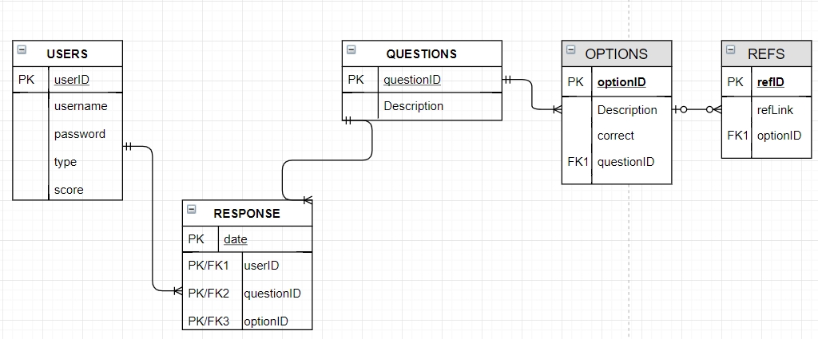
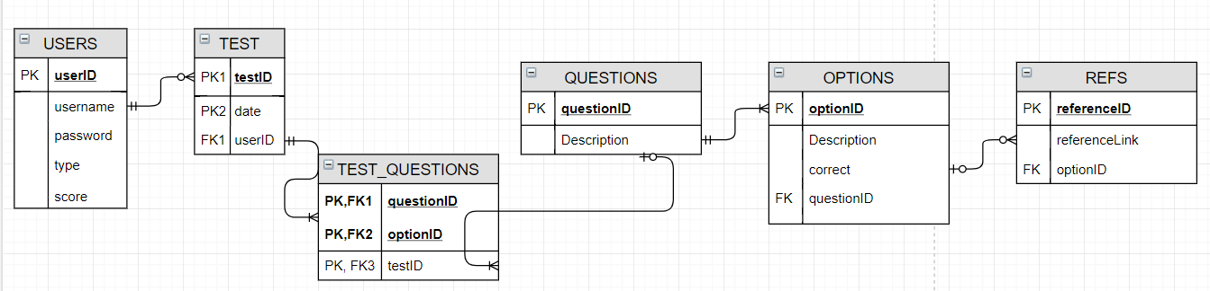
Prototypes and Designs
Database Design:

