Slide 1
Hello World: Running a LEAP Program
Michael Adler Elliott Fleming
Hsin-jung Yang Felix Winterstein

Slide 2
Getting Started

Slide 3
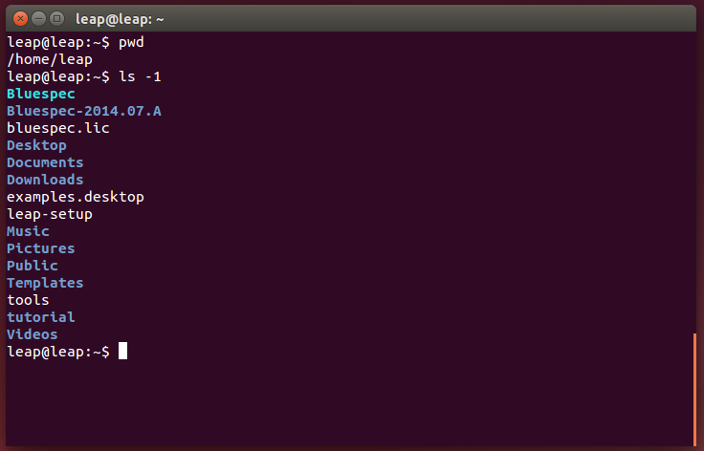
Getting Started
Logging in:
User: leap
Password: leap
Environment
Bluespec installation
Environment setup script
Tutorial AWB workspace

Slide 4
Hello World in LEAP

Slide 5
Hello World in C
int main (int argc, char* argv[]) { printf(“Hello, world!\n”); return 0; }
What actions are taken by the system when compiling/executing this code?

Slide 6
Hello World in LEAP
hello-world.bsv
module [CONNECTED_MODULE] mkConnectedApplication ();
STDIO#(Bit#(32)) stdio <- mkStdIO();
let msg <- getGlobalStringUID("Hello, World!\n");
Reg#(STATE) state <- mkReg(STATE_start);
rule hello (state == STATE_start); stdio.printf(msg, List::nil);
state <= STATE_finish; endrule
endmodule
This code is a complete LEAP program

Slide 7
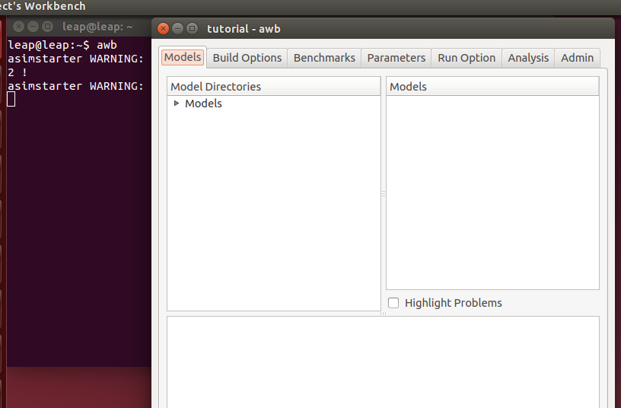
Running AWB
LEAP uses AWB to construct build scripts
Start by executing the commands:
cd tutorial export EDITOR=emacs awb
We’ll use AWB for the tutorial
GUI-less build option leap-make is a new, class-friendly feature

Slide 8
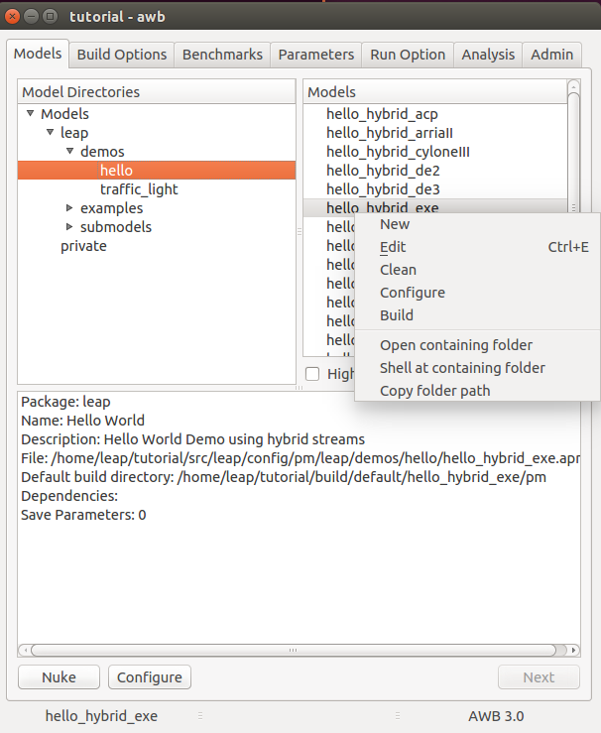
Hello World in LEAP: Accessing the Code
LEAP uses AWB as a code management-facility
AWB is not essential to using LEAP’s core functionalities
AWB ‘models’ are FPGA program/target pairings
Use edit to see the code included in the FPGA program
More AWB Examples: https://github.com/AWB-Tools/awb/wiki/AWB-example-build-GUI

Slide 9
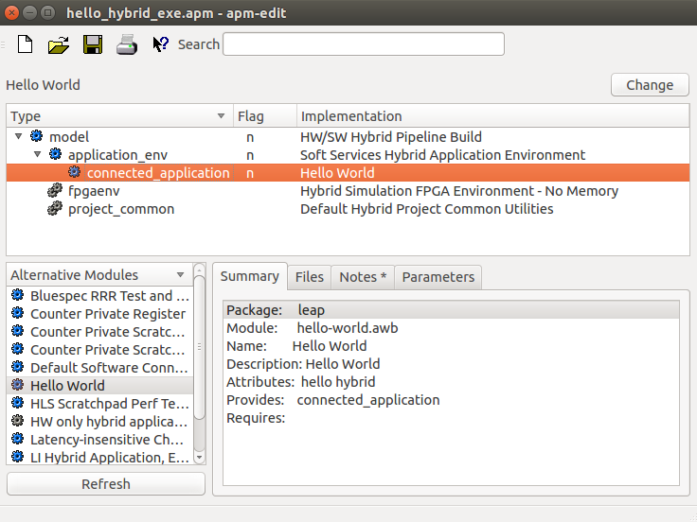
Hello World in LEAP: A view of the code
Here, we see the complete nest of code needed to run a basic LEAP program
Only the Hello World module is the user program, everything else is LEAP OS.
Notes:
Operations – replace module in tree, edit module, open shell in module’s source directory.

Slide 10
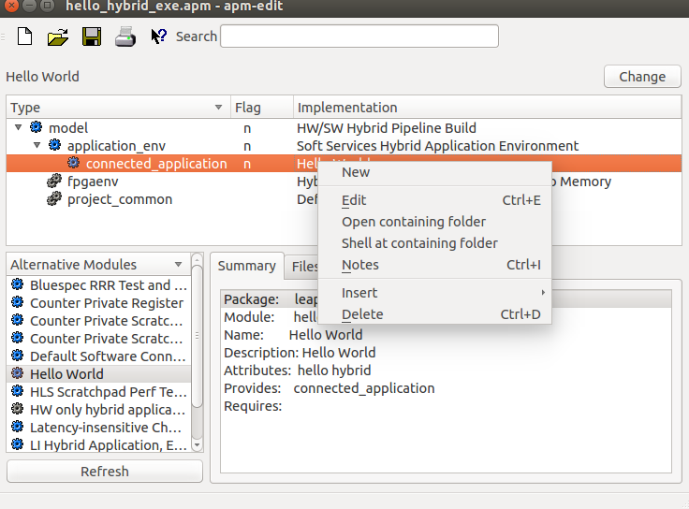
Hello World in LEAP: Opening the Code
Right clicking Hello World gives the option to edit the source code
For the next few slides we’ll consider hello.bsv
Often, a README will be included along with the code
Notes:
Operations – replace module in tree, edit module, open shell in module’s source directory.

Slide 11
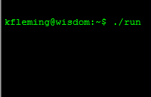
Hello World in LEAP: Expected Behavior
What do we expect when running Hello World?
A print to screen…
Like software, this print should happen no matter what our execution target:
Simulation
Single FPGA
Multiple FPGA
LEAP’s operating system and compilation facilities enable this expected behavior
module [CONNECTED_MODULE] mkConnectedApplication ();
STDIO#(Bit#(32)) stdio <- mkStdIO();
let msg <- getGlobalStringUID("Hello, World!\n");
Reg#(STATE) state <- mkReg(STATE_start);
rule hello (state == STATE_start); stdio.printf(msg, List::nil);
state <= STATE_finish; endrule
endmodule
Hello, World!

Slide 12
Hello World in LEAP: Latency-insensitive Modules
LEAP programs are composed of latency-insensitive modules
These modules communicate externally using latency-insensitive channels
mkConnectedApplication is a latency insensitive module, and is similar in function to C’s main
Sub-modules like stdio can have arbitrary interfaces, including LI channels.
Three kinds of modules:
LI Modules (channel interface only)
Non-LI Modules (non-channel only)
Hybrid (Both channel and non-channel interfaces)
LI modules can have non-latency-insensitive components like registers, wires, and arbitrary logic
Hidden LI
Interface
Arbitrary Wire Interface
module [CONNECTED_MODULE] mkConnectedApplication ();
STDIO#(Bit#(32)) stdio <- mkStdIO();
let msg <- getGlobalStringUID("Hello, World!\n");
Reg#(STATE) state <- mkReg(STATE_start);
rule hello (state == STATE_start); stdio.printf(msg, List::nil);
state <= STATE_finish; endrule
endmodule

Slide 13
Hello World in LEAP: Where are the Channels?
mkConnectedApplication is a latency-insensitive module
But where are the interface latency-insensitive channels?
The LEAP compiler uses SoftServices to manage special kinds of interfaces like memory and communication.
Denoted with the [CONNECTED_MODULE] syntax
mkConnectedApplication inherits the channels of STDIO
The STDIO client uses a “chain”, the latency-insensitive broadcast primitive to talk to the STDIO server
module [CONNECTED_MODULE] mkConnectedApplication ();
STDIO#(Bit#(32)) stdio <- mkStdIO();
let msg <- getGlobalStringUID("Hello, World!\n");
Reg#(STATE) state <- mkReg(STATE_start);
rule hello (state == STATE_start); stdio.printf(msg, List::nil);
state <= STATE_finish; endrule
endmodule
module [CONNECTED_MODULE] mkSTDIO (); . . . Chain#(Bit#(64)) stdioNetwork <- mkChain(“STDIO”); . . . endmodule

Slide 14
Hello World in LEAP: Handling Strings
Hello World prints a string
Strings are difficult to manage in hardware
We borrow from software and use pointers
SoftServices gives each string a unique ID at compile time
Here, msg is a pointer to the string “Hello, World!”
These string IDs are exported to software as a table, just like in C
At run time, STDIO calls like printf pass the string pointer
module [CONNECTED_MODULE] mkConnectedApplication ();
STDIO#(Bit#(32)) stdio <- mkStdIO();
let msg <- getGlobalStringUID("Hello, World!\n");
Reg#(STATE) state <- mkReg(STATE_start);
rule hello (state == STATE_start); stdio.printf(msg, List::nil);
state <= STATE_finish; endrule
endmodule

Slide 15
Hello World in LEAP: The Anatomy of a Service
module [CONNECTED_MODULE] mkConnectedApplication ();
STDIO#(Bit#(32)) stdio <- mkStdIO();
let msg <- getGlobalStringUID("Hello, World!\n");
Reg#(STATE) state <- mkReg(STATE_start);
rule hello (state == STATE_start); stdio.printf(msg, List::nil);
state <= STATE_finish; endrule
endmodule
LEAP provides many useful services, which simplfy common programming tasks
STDIO, locks, barriers, statistics, assertions, etc.
Services take a client-server architecture
Similar to SW operating system services
User programs instantiate clients, like mkStdIO
LEAP’s driver code instantiates a server which handles requests from clients
Client are connected to the server by latency-insensitive channels
Servers are often connected to SW by latency-insensitive channels.
STDIO Server (HW)
FPGA
CPU
STDIO Server (SW)
Non-LI Ifc.
LI Ifc.
Hybrid Ifc.

Slide 16
Building on abstractions: STDIO Service
stdio.printf(msg,List::nil);
User
Module
STDIO
Client
User
Module
printf()
User
Module
STDIO
Client
STDIO
Client
LI Network
STDIO Server
STDIO Server
Marshalling
Marshalling
Virtual Channel Multiplexing
Virtual Channel Multiplexing
FPGA Physical Drivers
Kernel Driver
FPGA
CPU

Slide 17
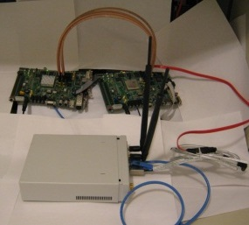
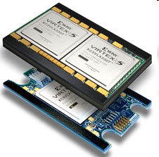
Service Portability: Abstraction Across Different Platforms
stdio.printf(msg,List::nil);
User
Module
STDIO
Client
User
Module
printf()
User
Module
STDIO
Client
STDIO
Client
STDIO Service
STDIO Service
Marshaling
Marshaling
Virtual Channel Multiplexing
Virtual Channel Multplexing
ACP Physical Devices
Simulation Driver
XUPV5 Kernel Driver
XUPV5 Physical Devices
ACP Kernel Driver
Simulation Physical Devices
FPGA
CPU
Simulator
void channelToHost(long long data);

Slide 18
Building Hello World for Simulation (GUI)

Slide 19
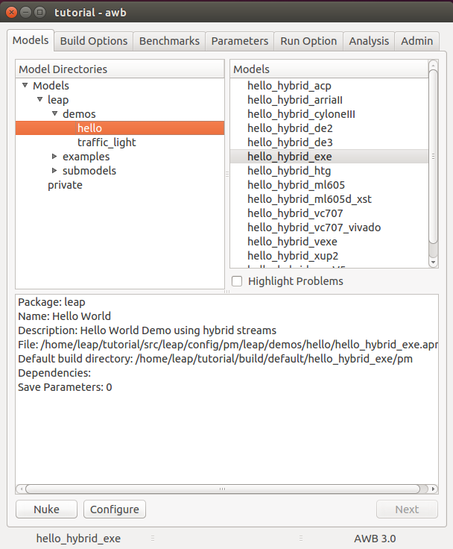
Hello World: Setting up the Build
The ‘configure’ button in the ‘Models’ tab sets up a series of SCons scripts which will be used to construct the application. hello_hybrid_exe targets simulation, hello_hybrid_vc707 targets the VC707, etc.

Slide 20
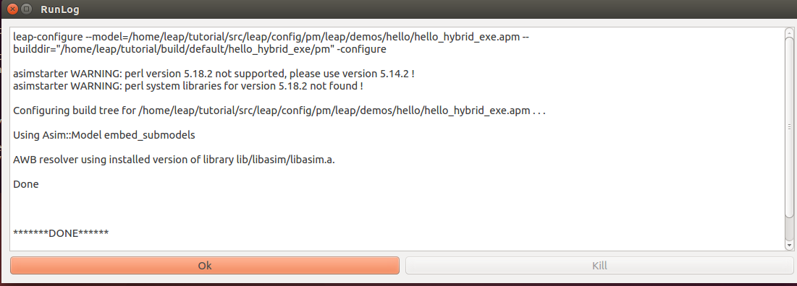
Hello World: Setting Up the Build
Runlog shows the command line tool invoked. The leap-configure tool creates a build directory for the program.

Slide 21
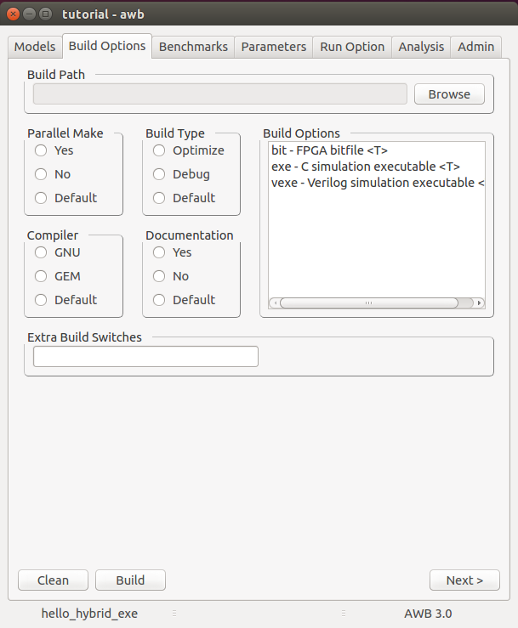
Hello World: Building the Code
The ‘build’ button in the build option tab invokes ‘scons’ in the build tree created by the configure script.

Slide 22
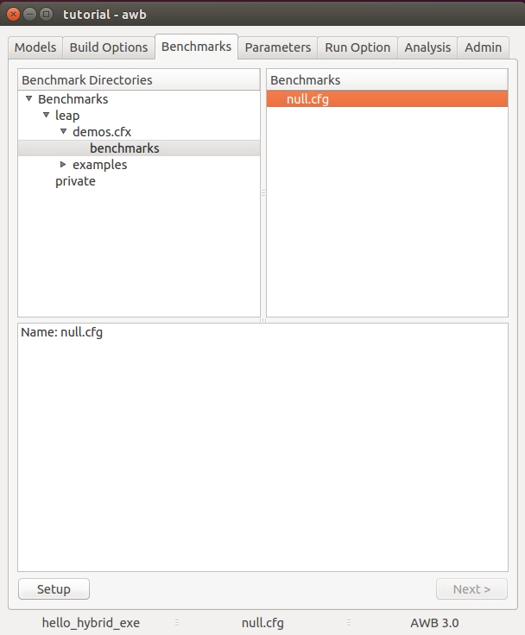
Hello World: Setting Up a Run
The ‘setup’ button in the ‘benchmarks’ tab invokes the proper benchmark setup tool as determined by the model type. (See apm-edit for details)

Slide 23
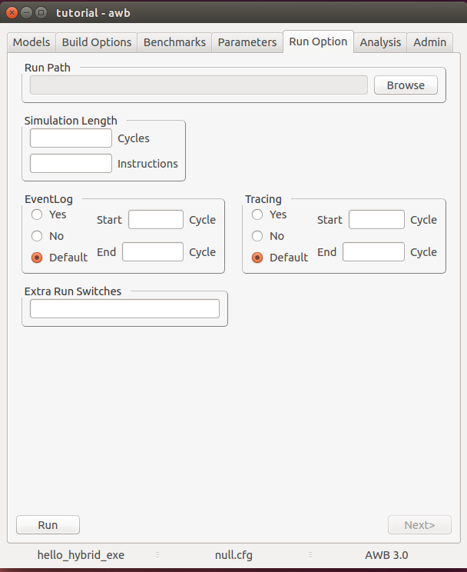
Hello World: Running Hello World
The ‘run’ button in the ‘Run Options’ tab invokes the ./run script in the benchmark directory created by the benchmark setup script. The run script manages loading the program targets (FPGAs, sw, etc)

Slide 24
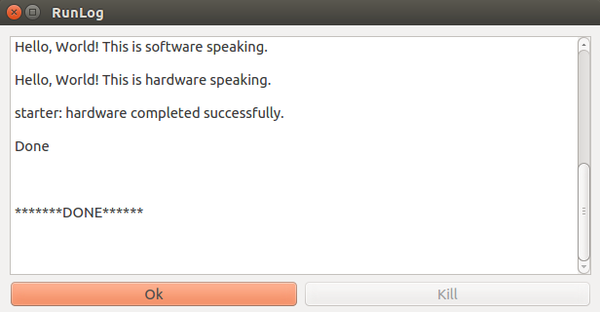
Hello World: Running Hello World
https://github.com/AWB-Tools/awb/wiki/AWB-example-build-GUI

Slide 25
Building Hello World for Simulation (Command Line)

Slide 26
Getting Started
Sometimes it’s just nicer to build from the command line
Start from tutorial home directory
Tutorial AWB workspace (start here)

Slide 27
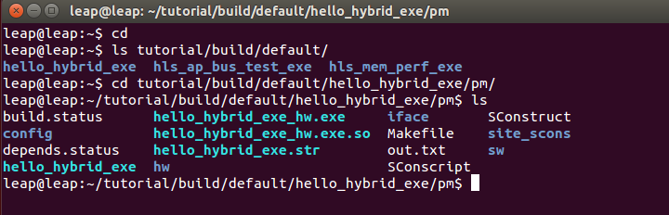
Finding the simulation build directory
This directory is constructed when you ‘configure’ in AWB
Each FPGA program will have its own directory
AWB Workspace build configuration directory
LEAP program build directories
Generated LEAP build script

Slide 28
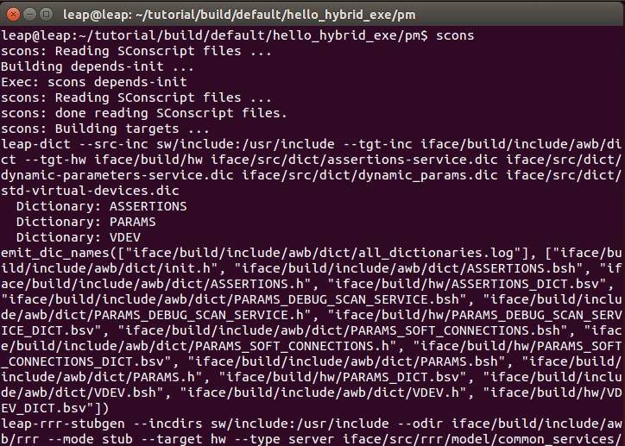
Building from Command Line
AWB builds programs in the ‘pm’ directory
LEAP uses scons as its build infrastructure

Slide 29
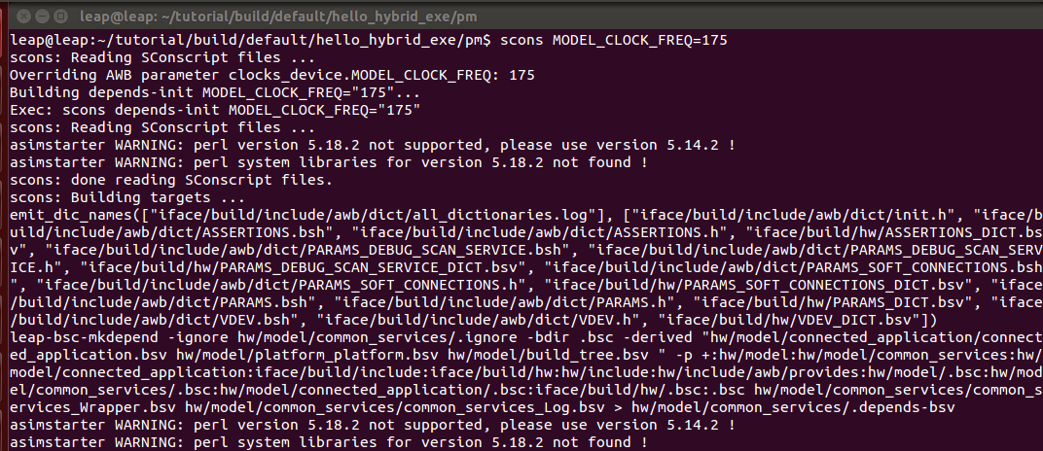
Building from command line
Typing scons builds the design
Parameters can be set by typing them on the command line, as in “MODEL_CLOCK_FREQ=175”

Slide 30
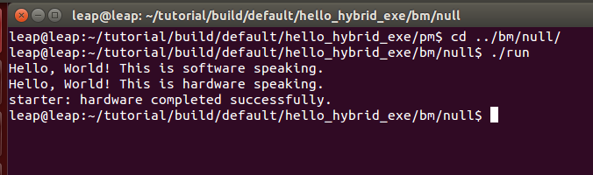
Simulating The Design
AWB builds a simulation wrapper in the ‘bm’ directory
Executing the ‘run’ command will invoke the hardware simulator and software side of the LEAP program.

Slide 31
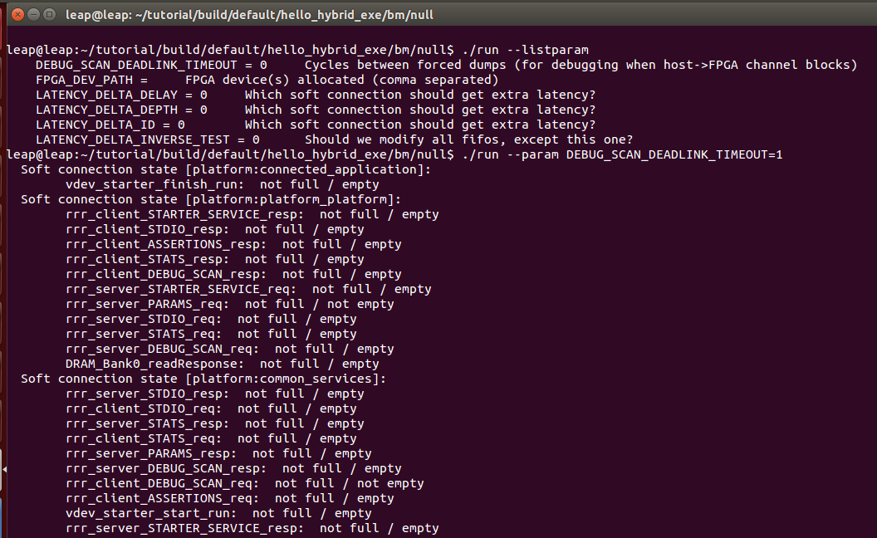
Setting Dynamic Parameters
Hardware parameters can be set from the command line
In this case, we force LEAP to dump debug information

Slide 32
Questions?

