Slide 1
Hello World: Running a basic program on two FPGAs
Kermin Fleming
Michael Adler
Joel Emer

Slide 2
Hello World in LEAP

Slide 3
Hello World in C
int main (int argc, char* argv[])
{
printf(“Hello, world!\n”);
return 0;
}
What actions are taken by the system when compiling/executing this code?

Slide 4
Hello World in LEAP
hello-world.bsv
module [CONNECTED_MODULE] mkConnectedApplication ();
Connection_Receive#(Bool) linkStarterStartRun <-
mkConnectionRecv("vdev_starter_start_run");
Connection_Send#(Bit#(8)) linkStarterFinishRun <-
mkConnectionSend("vdev_starter_finish_run");
STDIO#(Bit#(32)) stdio <- mkStdIO(); let msg <- getGlobalStringUID("Hello, world!\n”); rule hello(True); linkStarterStartRun.deq();
stdio.printf(msg, List::nil);
linkStarterFinishRun.send(0); endrule
endmodule
This code is a complete LEAP program

Slide 5
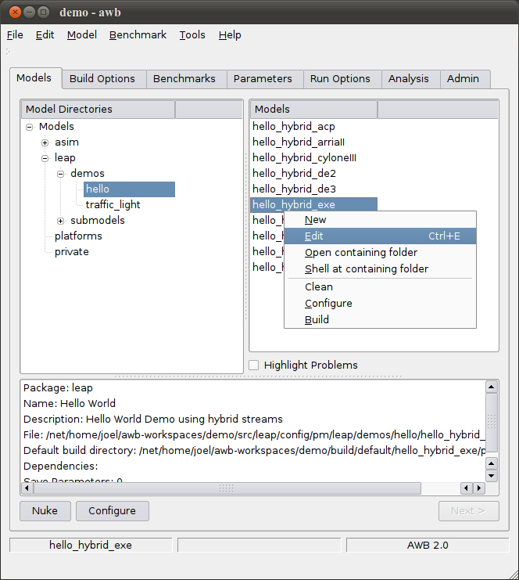
Hello World in LEAP: Accessing the Code
LEAP uses AWB as a code management-facility
AWB is not essential to using LEAP’s core functionalities
Collage and ACE, which resemble AWB in many ways, can also be used as a frontend
AWB is used in DCG to build architectural models of processors
AWB ‘Models’ are FPGA program/target pairings
Use edit to see the code included in the FPGA program.
More AWB Examples: http://asim.csail.mit.edu/redmine/projects/awb/wiki/AWB_example_build_GUI

Slide 6
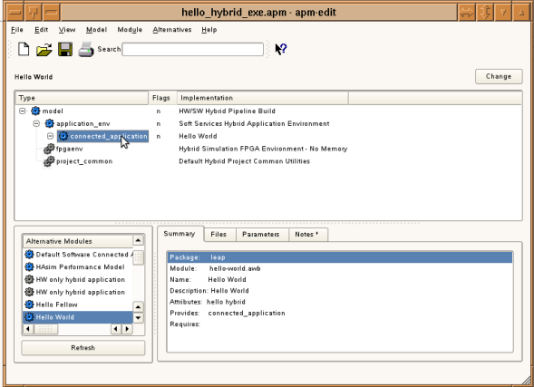
Hello World in LEAP: A view of the code
Here, we see the complete nest of code needed to run a basic LEAP program
Only the Hello World component is the user program, everything else is the LEAP OS.
Notes:
Operations – replace module in tree, edit module, open shell in module’s source directory.

Slide 7
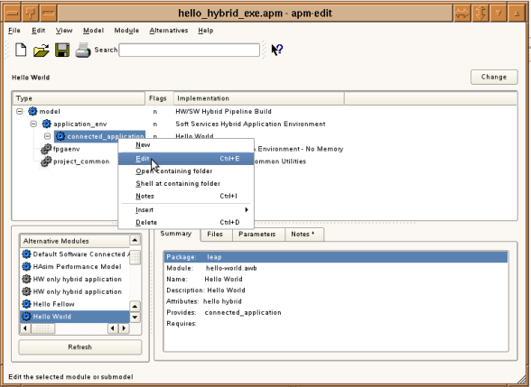
Hello World in LEAP: Opening the Code
Right clicking Hello World gives the option to open the source code for the module
For the next few slides we’ll consider hello.bsv
Often, a README will be included along with the code
Notes:
Operations – replace module in tree, edit module, open shell in module’s source directory.

Slide 8
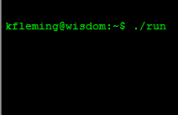
Hello World in LEAP: Expected Behavior
What do we expect when running Hello World?
A print to screen…
The code does this by using the STDIO service and the starter service, which sends a single start message to the program
Like software, this print should happen no matter what our execution target.
Simulation
Single FPGA
Multiple FPGA
LEAP’s operating system and compilation facilities enable this expected behavior
module [CONNECTED_MODULE] mkConnectedApplication ();
Connection_Receive#(Bool) linkStarterStartRun <-
mkConnectionRecv("vdev_starter_start_run");
Connection_Send#(Bit#(8)) linkStarterFinishRun <-
mkConnectionSend("vdev_starter_finish_run");
STDIO#(Bit#(32)) stdio <- mkStdIO(); let msg <- getGlobalStringUID("Hello, world!\n”); rule hello(True); linkStarterStartRun.deq();
stdio.printf(msg, List::nil);
linkStarterFinishRun.send(0); endrule
endmodule
Hello, World!

Slide 9
Hello World in LEAP: Latency-insensitive Modules
LEAP programs are composed of latency-insensitive modules
These modules communicate externally using latency-insensitive channels
mkConnectedApplication is a latency insensitive module, and is similar in function to C’s main
Sub-modules like stdio can have arbitrary interfaces, including LI channels.
Three kinds of modules:
LI Modules (channel interface only)
Non-LI Modules (non-channel only)
Hybrid (Both channel and non-channel interfaces)
LI modules can have non-latency-insensitive components like Registers, wires, and arbitrary logic
Hidden LI
Interface
Arbitrary Wire Interface
module [CONNECTED_MODULE] mkConnectedApplication ();
Connection_Receive#(Bool) linkStarterStartRun <-
mkConnectionRecv("vdev_starter_start_run");
Connection_Send#(Bit#(8)) linkStarterFinishRun <-
mkConnectionSend("vdev_starter_finish_run");
STDIO#(Bit#(32)) stdio <- mkStdIO(); let msg <- getGlobalStringUID("Hello, world!\n”); rule hello(True); linkStarterStartRun.deq();
stdio.printf(msg, List::nil);
linkStarterFinishRun.send(0); endrule
endmodule

Slide 10
Hello World in LEAP: Where are the Channels?
module [CONNECTED_MODULE] mkConnectedApplication ();
Connection_Receive#(Bool) linkStarterStartRun <-
mkConnectionRecv("vdev_starter_start_run");
Connection_Send#(Bit#(8)) linkStarterFinishRun <-
mkConnectionSend("vdev_starter_finish_run");
STDIO#(Bit#(32)) stdio <- mkStdIO(); let msg <- getGlobalStringUID("Hello, world!\n”); rule hello(True); linkStarterStartRun.deq();
stdio.printf(msg, List::nil);
linkStarterFinishRun.send(0); endrule
endmodule
We said mkConnected Application was a latency-insensitive module
But where are the interface latency-insensitive channels?
Channels are hidden by the SoftServices interface
The LEAP compiler uses SoftServices to manage special kinds of interfaces like memory and communication.
SoftServices modules are denoted with the [CONNECTED_MODULE] syntax
mkConnectedApplication inherits the channels of STDIO
The STDIO client uses a “chain”, the latency-insensitive broadcast primitive to talk to the STDIO server
module [CONNECTED_MODULE] mkSTDIO (); Chain#(Bit#(64)) stdioNetwork <- mkChain(“STDIO”);
endmodule

Slide 11
Hello World in LEAP: Handling Strings
Hello World prints a string to terminal
Strings are difficult to manage in hardware
So we borrow from software and use pointers
SoftServices gives each string a unique ID at compile time
Here, msg is a pointer to the string “Hello, World!”
These string IDs are exported to software as a table, just like in C
At run time, STDIO calls like printf pass the string pointer
module [CONNECTED_MODULE] mkConnectedApplication ();
Connection_Receive#(Bool) linkStarterStartRun <-
mkConnectionRecv("vdev_starter_start_run");
Connection_Send#(Bit#(8)) linkStarterFinishRun <-
mkConnectionSend("vdev_starter_finish_run");
STDIO#(Bit#(32)) stdio <- mkStdIO(); let msg <- getGlobalStringUID("Hello, world!\n”); rule hello(True); linkStarterStartRun.deq();
stdio.printf(msg, List::nil);
linkStarterFinishRun.send(0); endrule
endmodule

Slide 12
Hello World in LEAP: The Anatomy of a Service
module [CONNECTED_MODULE] mkConnectedApplication ();
Connection_Receive#(Bool) linkStarterStartRun <-
mkConnectionRecv("vdev_starter_start_run");
Connection_Send#(Bit#(8)) linkStarterFinishRun <-
mkConnectionSend("vdev_starter_finish_run");
STDIO#(Bit#(32)) stdio <- mkStdIO(); let msg <- getGlobalStringUID("Hello, world!\n”); rule hello(True); linkStarterStartRun.deq();
stdio.printf(msg, List::nil);
linkStarterFinishRun.send(0); endrule
endmodule
LEAP provides many useful services, which simplfy common programming tasks
STDIO, locks, barriers, statistics, assertions, etc.
Services take a client-server architecture
Similar to SW operating system services
User programs instantiate clients, like mkStdIO
LEAP’s driver code instantiates a server which handles requests from clients
Client are connected to the server by latency-insensitive channels
Servers are often connected to SW by latency-insensitive channels.
STDIO Server (HW)
FPGA
CPU
STDIO Server (SW)
Non-LI Ifc
L! Ifc.
Hybrid Ifc.

Slide 13
Building on abstractions: STDIO Service
stdio.printf(msg,List::nil);
User
Module
STDIO
Client
User
Module
printf()
User
Module
STDIO
Client
STDIO
Client
LI Network
STDIO Server
STDIO Server
Marshalling
Marshalling
Virtual Channel Multiplexing
Virtual Channel Multiplexing
FPGA Physical Drivers
Kernel Driver
FPGA
CPU

Slide 14
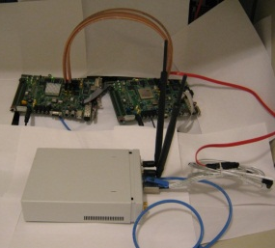
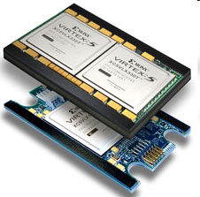
Service Portability: Abstraction Across Different Platforms
stdio.printf(msg,List::nil);
User
Module
STDIO
Client
User
Module
printf()
User
Module
STDIO
Client
STDIO
Client
STDIO Service
STDIO Service
Marshaling
Marshaling
Virtual Channel Multiplexing
Virtual Channel Multplexing
Simulation Physical Devices
ACP Physical Devices
Simulation Driver
XUPV5 Kernel Driver
XUPV5 Physical Devices
ACP Kernel Driver
FPGA
CPU
Simulator
void channelToHost(long long data);

Slide 15
Building Hello World for One FPGA

Slide 16
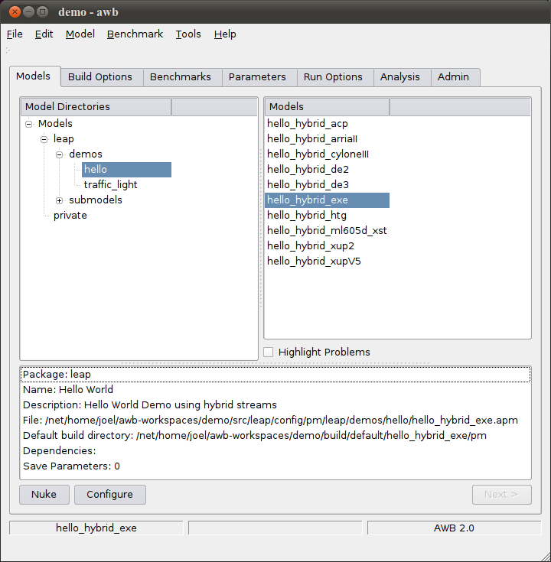
Hello World: Setting up the Build
The ‘configure’ button in the ‘Models’ tab sets up a series of SCons scripts which will be used to construct the application. hello_hybrid_exe targets simulation, hello_hybrid_vc707 targets the VC707, etc.

Slide 17
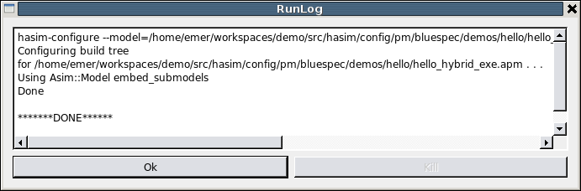
Hello World: Setting Up the Build
Runlog shows the command line tool invoked. Should have been leap-configure, which creates a build directory.

Slide 18
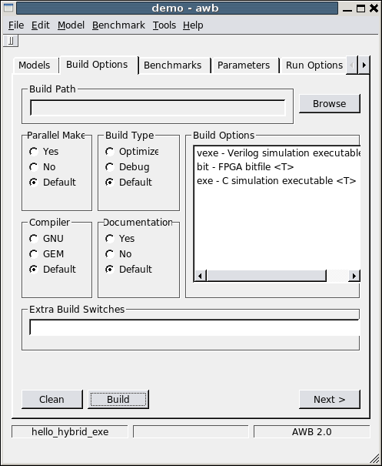
Hello World: Building the Code
The ‘build’ button in the build option tab invokes ‘scons’ in the build tree created by the configure script.

Slide 19
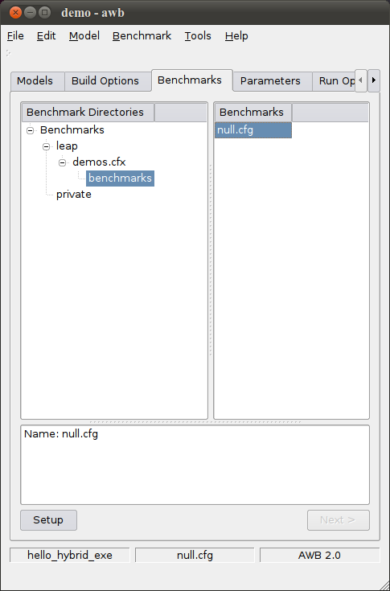
Hello World: Setting Up a Run
The ‘setup’ button in the ‘benchmarks’ tab invokes the proper benchmark setup tool as determined by the model type. (See apm-edit for details)

Slide 20
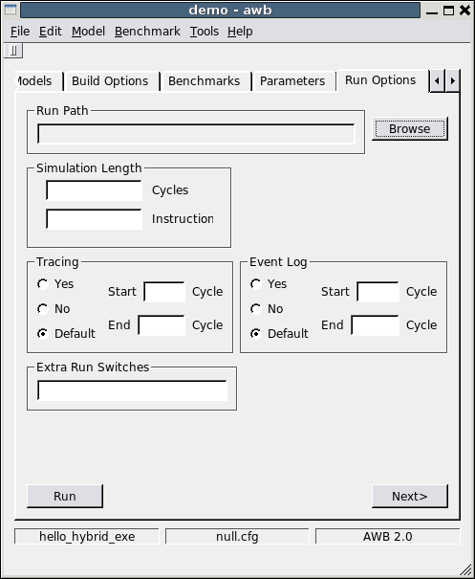
Hello World: Running Hello World
The ‘run’ button in the ‘Run Options’ tab invokes the ./run script in the benchmark directory created by the benchmark setup script. The run script manages loading the program targets (FPGAs, sw, etc)

Slide 21
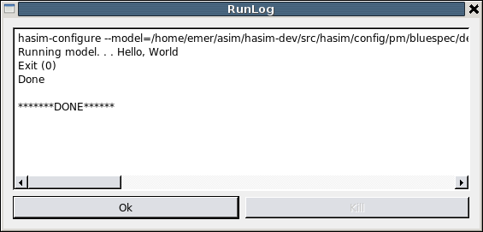
Hello World: Running Hello World
http://asim.csail.mit.edu/redmine/projects/awb/wiki/AWB_example_build_GUI

Slide 22
Building Hello World for Multiple FPGAs

Slide 23
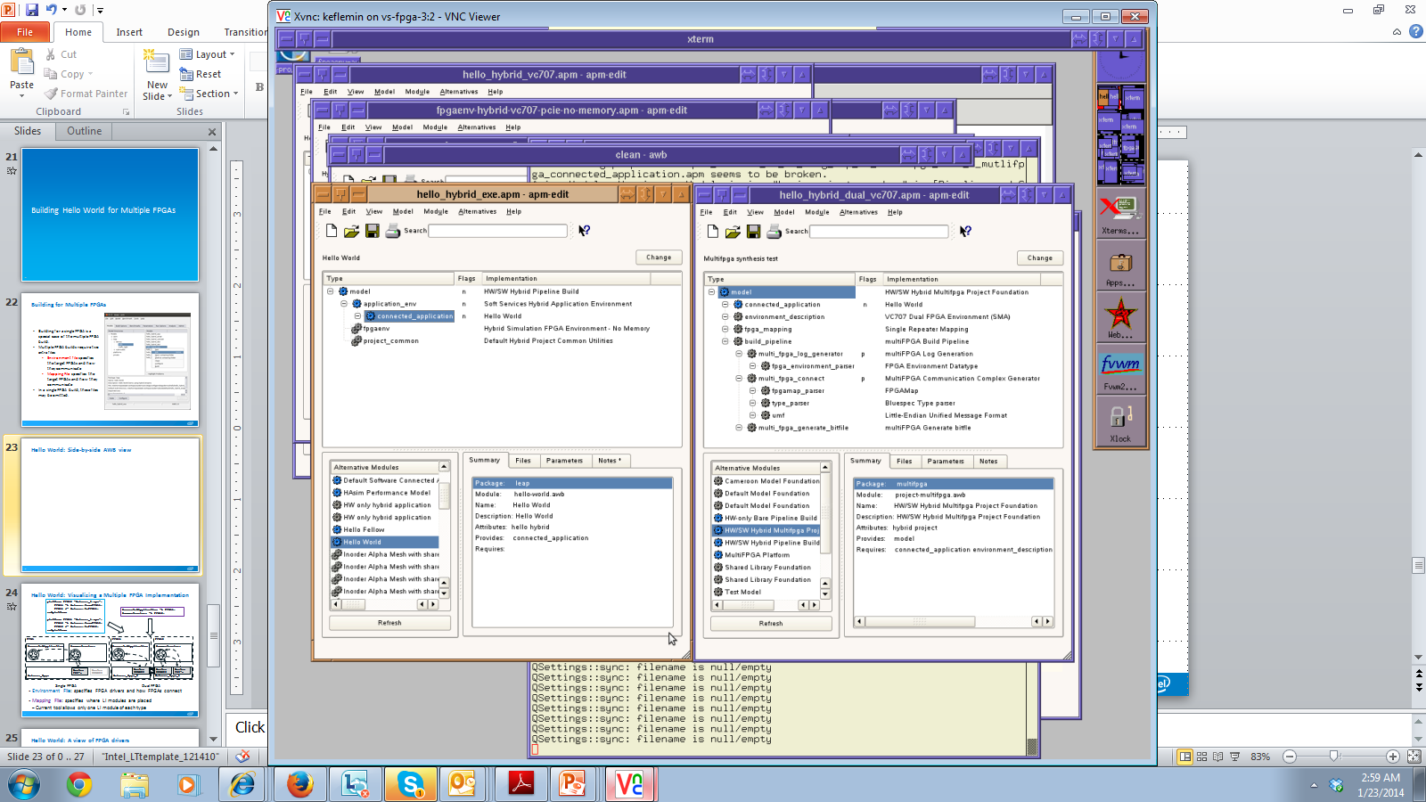
Building for Multiple FPGAs
Building for a single FPGA is a special case of the multiple FPGA build.
Multiple FPGA builds require two extra files
Environment file specifies the target FPGA platforms and how they communicate
Mapping File specifies how latency-insensitive modules map to the platforms
In a single FPGA build, these files may be omitted.

Slide 24
Hello World: Side-by-side AWB view
In a multiple FPGA build, the user code remains the same, but the nest code changes

Slide 25
Hello World: Visualizing a Multiple FPGA Implementation
platform FPGA0 “drivers_0.apm”;
FPGA1 -> drivers.fromFPGA1;
FPGA1 <- drivers.toFPGA1;
endplatform
platform FPGA1 “drivers_1.apm”;
FPGA0 -> drivers.fromFPGA0;
FPGA0 <- drivers.toFPGA0;
endplatform
connected_application -> FPGA1;
common_services -> FPGA0;
FPGA
FPGA1
FPGA0
connected_application
common_services
connected_application
common_services
drivers_fpga
drivers_fpga_0
drivers_fpga_1
Router
PCI-e
Router
SERDES
Router
SERDES
Router
SERDES
Router
PCI-e
Single FPGA
Dual FPGA
Environment File: specifies FPGA drivers and how FPGAs connect
Mapping File: specifies where LI modules are placed
Current tool allows only one LI module of each type
Notes:
Cut down FPGA

Slide 26
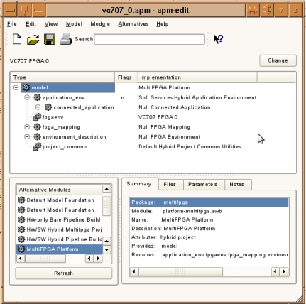
Hello World: A view of FPGA drivers
Each platform in the environment file has an associated apm
This apm resembles the single FPGA apm, but with null application code
At compile time, the application code will be filled in by the compiler
This apm includes a pointer to the driver code apm

Slide 27
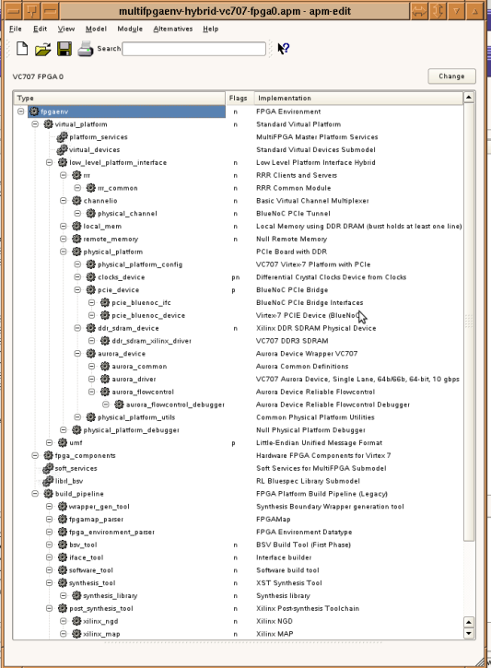
Hello World: A view of FPGA drivers
Each platform in the environment file has an associated apm describing its drivers
Physical Devices
LEAP Services
Build Code
LEAP hides most of this complexity from the user code

Slide 28
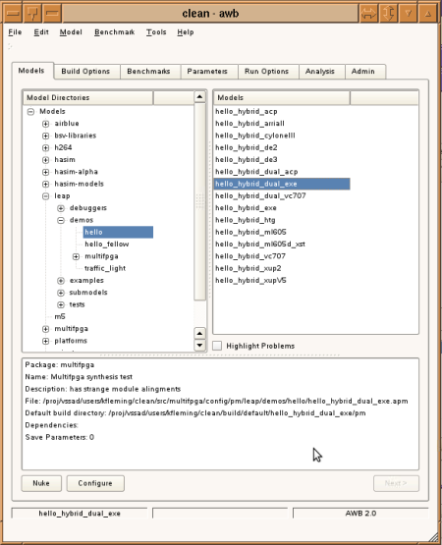
Hello World: Building for Multiple FPGAs
Multiple FPGA configure/build/run are the same as for single FPGA/simulation.
Simply pick a different target
No user code changes between targets or between single/multiple FPGA builds

Slide 29
Hello World: Area Usage
LEAP is an operating system
All operating systems add some degree of overhead to a program
LEAP’s overhead tends to scale with the number of features used by the target program
The following table summarizes LEAP’s overhead for Hello World
Hello World itself uses almost no area.
Using multiple FPGAs incurs overhead for inter-chip communications
Target | LUTs | Registers | BRAM
VC707 | 1.1% | 3.0% | 0.3%
VC707 (0) | 2.9% | 4.2% | 0.9%
VC707 (1) | 1.1% | 1.5% | 0.9%

Slide 30
Questions?

