Slide 1
LEAP Tutorial: FPGA Memory Abstractions
Michael Adler†, Kermin E. Fleming†,
Hsin-Jung Yang‡, and Felix Winterstein§
† Intel Corporation
‡ Massachusetts Institute of Technology
§ European Space Agency
September 1st, FPL 2015

Slide 2
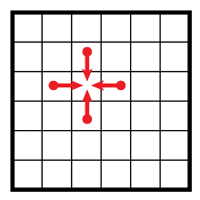
Memory Abstraction
General Purpose Processors
2D Heat Transfer
#define U(t, x, y) array[2*(M*(y)+(x)) + (t)&1]
// memory allocation
int * array = (int*)malloc(M*N*2*sizeof(int));
// computation
for(int t = 0; t < T; t++)
for (int y = 0; y < N; y++)
for (int x = 0; x < M; x++)
U(t+1,x,y) = C0*U(t,x,y)
+ Cx*(U(t,x-1,y)+U(t,x+1,y))
+ Cy*(U(t,x,y-1)+U(t,x,y+1));
N
M
Memory allocation, read/write operations are easy
Complicated memory management is hidden behind the memory abstraction

Slide 3
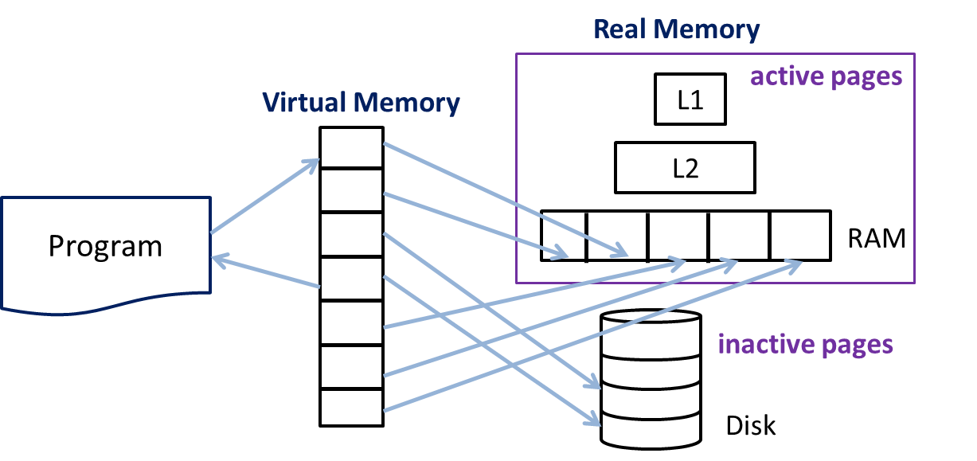
Memory Abstraction
General Purpose Processors
int * array = (int*)malloc(M*N*2*sizeof(int));
d1 = array[a1];
array[a2] = d2;
How about FPGAs?
Simple Program
Complex Memory Management
Ex: cache hierarchy, address translation,
page swapping….

Slide 4
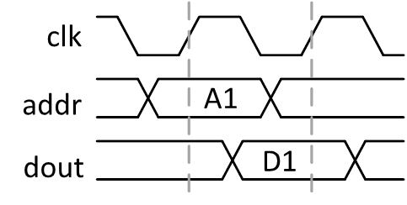
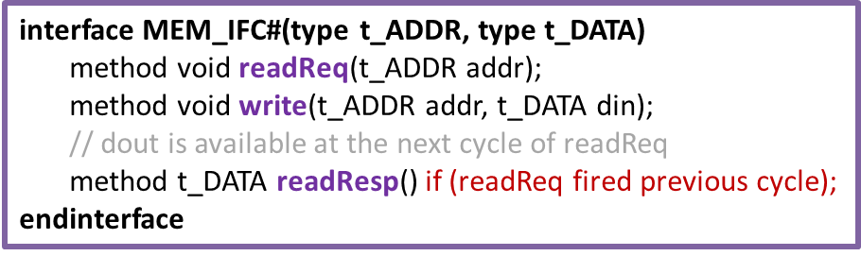
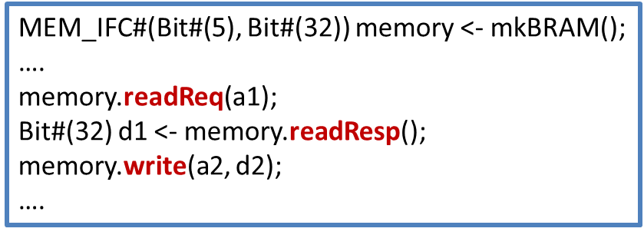
FPGA Memory: Block RAMs
2D Heat Transfer
Engine
addr
din
dout
N
Interface
wen
Block RAM
M
Difficulty:
Problem size cannot fit in block RAMs
for(int t = 0; t < T; t++)
for (int y = 0; y < N; y++)
for (int x = 0; x < M; x++)
U(t+1,x,y) = C0*U(t,x,y)
+ Cx*(U(t,x-1,y)+U(t,x+1,y))
+ Cy*(U(t,x,y-1)+U(t,x,y+1));

Slide 5
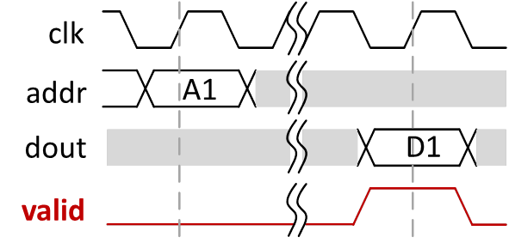
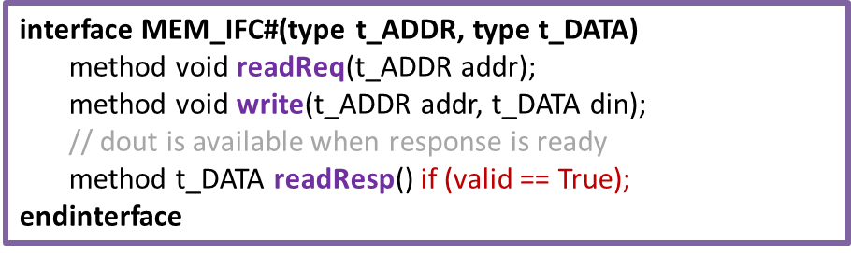
FPGA Memory Abstraction
2D Heat Transfer
Engine
addr
din
dout
N
Interface
wen
valid
Block RAM
M
Become Latency Insensitive
Difficulty:
Problem size cannot fit in block RAMs

Slide 6
FPGA Memory Abstraction: LEAP Scratchpad
2D Heat Transfer
Engine
N
Interface
LEAP Scratchpad
Same memory interface
Arbitrary data size
Private address space
“Unlimited” storage
Automatic caching
LEAP
Scratchpad
M
interface MEM_IFC#(type t_ADDR, type t_DATA)
method void readReq(t_ADDR addr);
method void write(t_ADDR addr, t_DATA din);
method t_DATA readResp();
endinterface
M. Adler et al., “LEAP Scratchpads,” in FPGA, 2011.

Slide 7
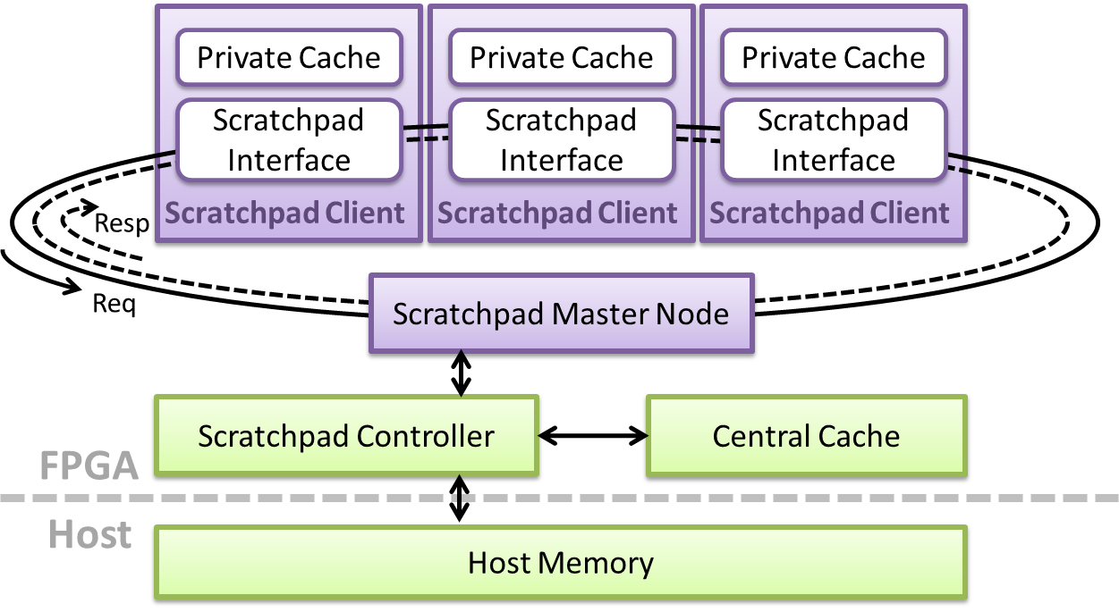
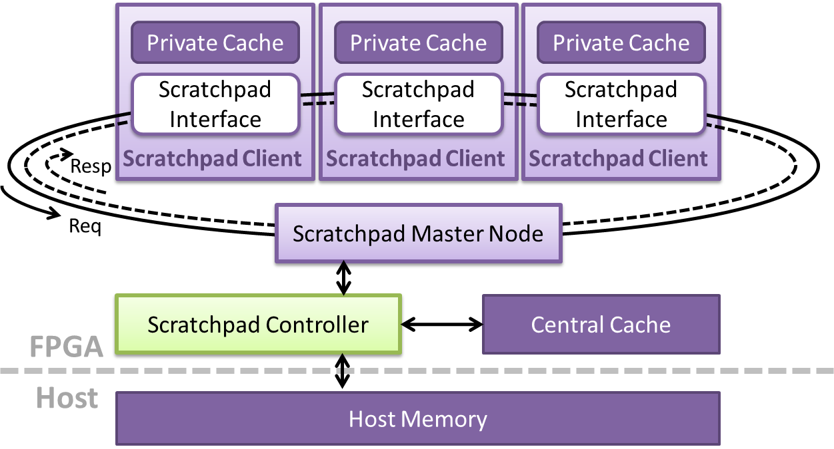
LEAP Scratchpad Hierarchy
Scratchpads
Processor
Client
Client
Client
Application
Interface
on-chip SRAM
L1 Cache
on-board DRAM
L2 Cache
Memory

Slide 8
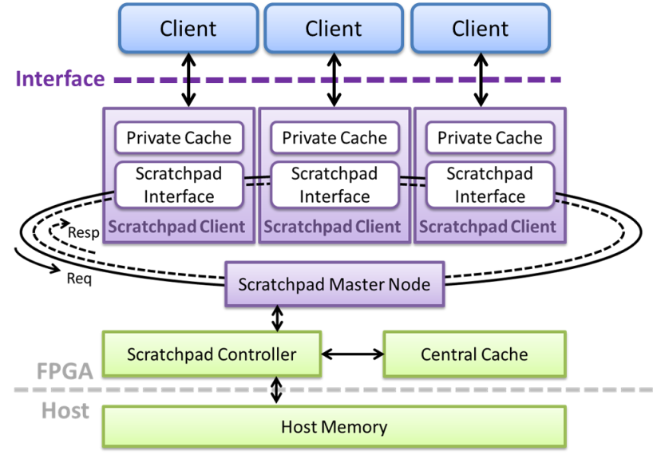
LEAP Scratchpad Usage
data size
In C program:
int * array;
array = (int*)malloc((1<<28)*sizeof(int));
….
d1 = array[a1];
array[a2] = d2;
…
address space
In LEAP program:
MEMORY_IFC(Bit#(28), Bit#(32)) memory <- mkScratchpad(scratchpadID, config);
….
memory.readReq(a1);
Bit#(32) d1 <- memory.readResp();
memory.write(a2, d2);
….
data size
address space

Slide 9
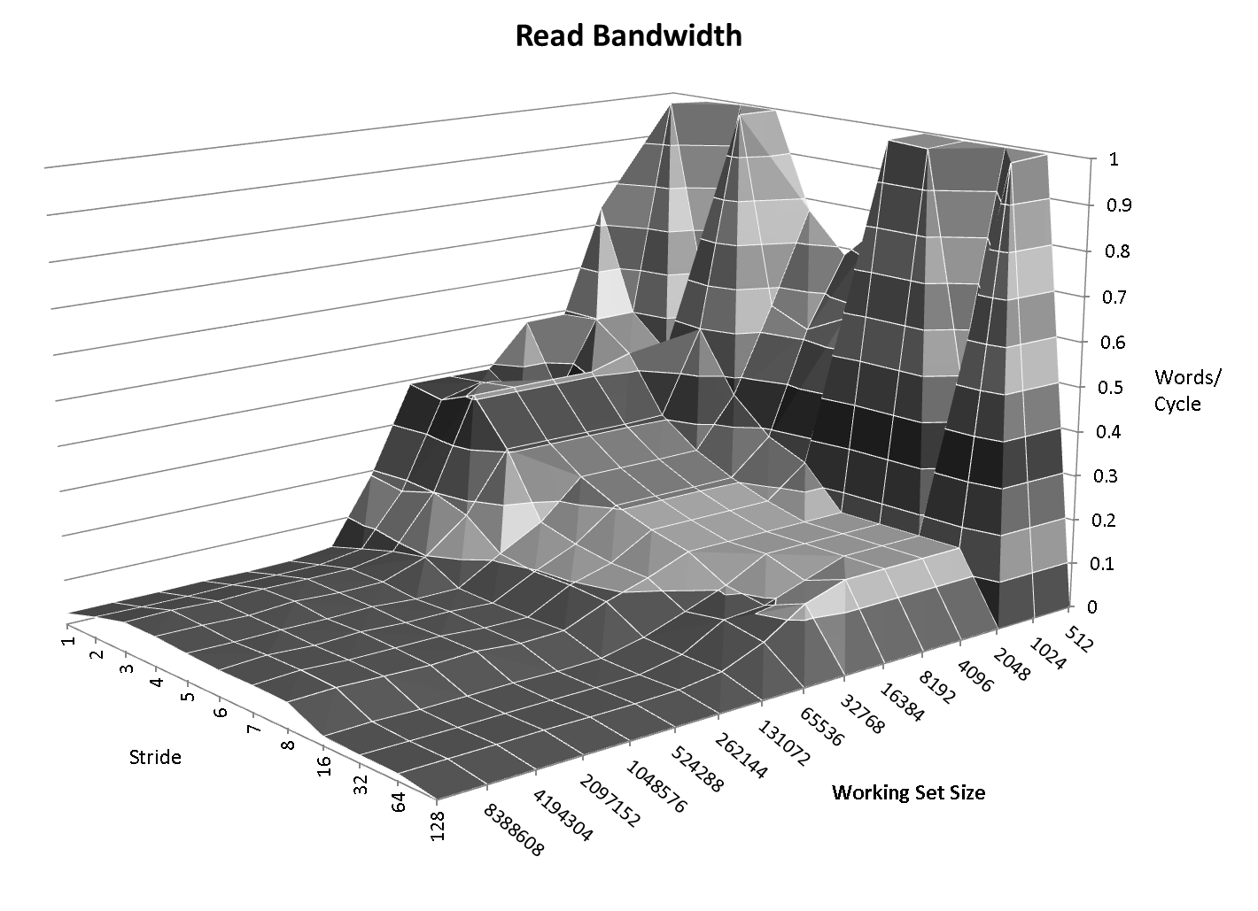
LEAP Scratchpad Performance
Local Cache
Central Cache
Host Memory

Slide 10
Scratchpad Optimization
Abstraction Enables Optimization
Reduce scratchpad latency
-> Automatic speed up memory-using programs
Leverage unused resources
Learn from optimization techniques in processors
Larger caches, greater associativity
Better cache policies
Cache prefetching

Slide 11
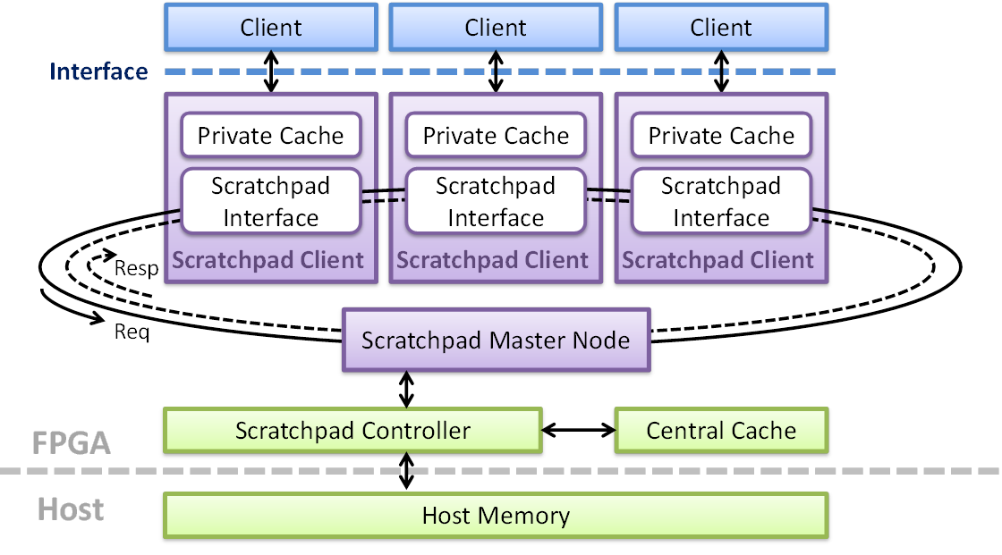
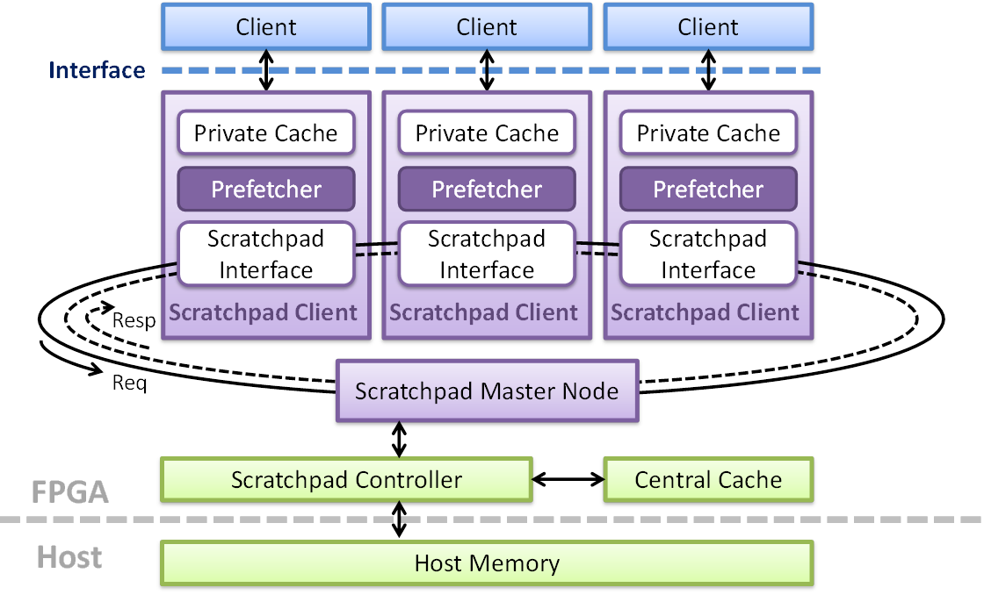
Optimization: Scratchpad Prefetcher
H. Yang et al., “Optimizing under Abstraction: Using Prefetching to Improve FPGA Performance,” in FPL, 2013

Slide 12
Prefetching on FPGAs
Easier:
Cleaner streaming memory accesses
No need for PC as a filter to separate streams
Fixed (usually plenty of) resources
Harder:
Back-to-back memory accesses
Inefficient to implement CAM
Scratchpad prefetcher uses address-based stride prefetching with a larger set of direct-mapped learners

Slide 13
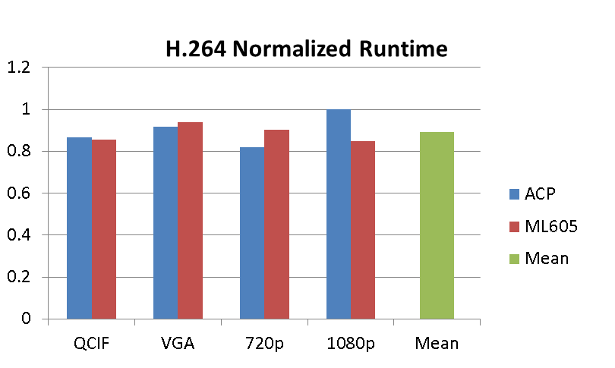
Prefetch Performance
automatic speedup!
Area requirements of FPGA prefetching are small.
less than 0.5% of total chip area on the ML605 board
K. Fleming et al., “H.264 Decoder: A Case Study in Multiple Design Points,” in MEMOCODE, 2008

Slide 14
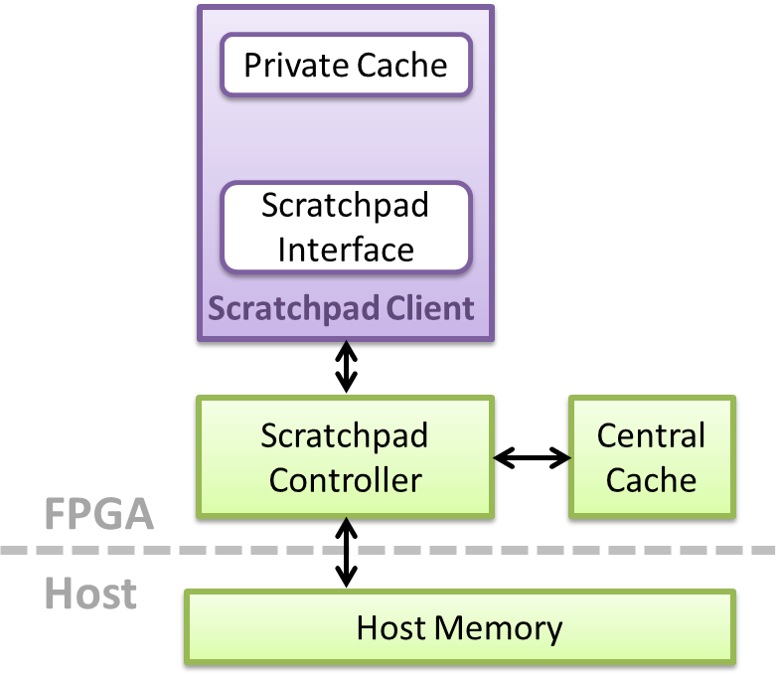
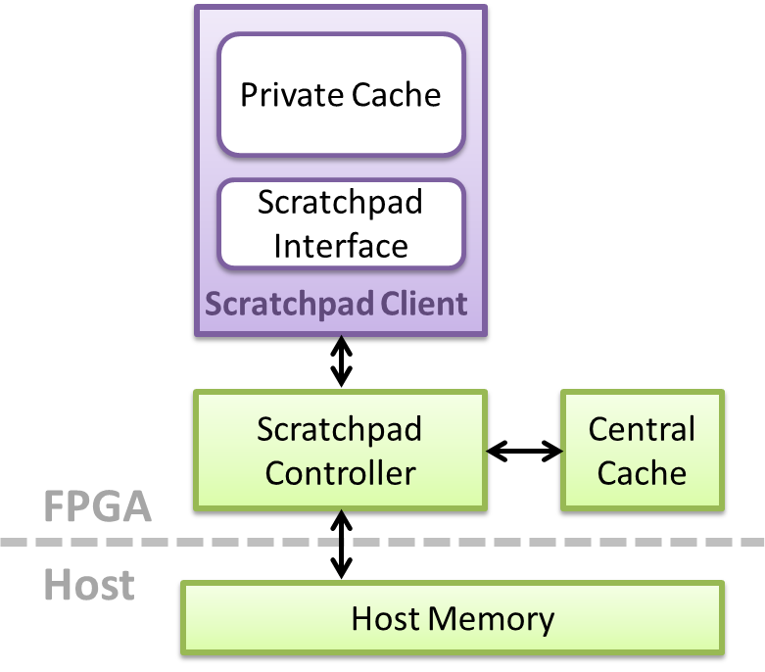
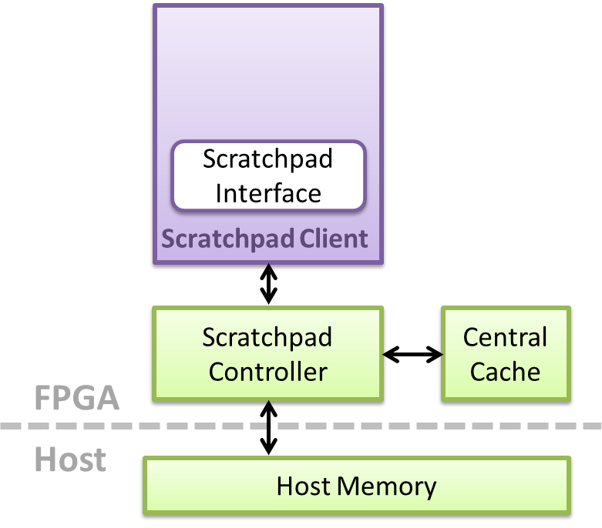
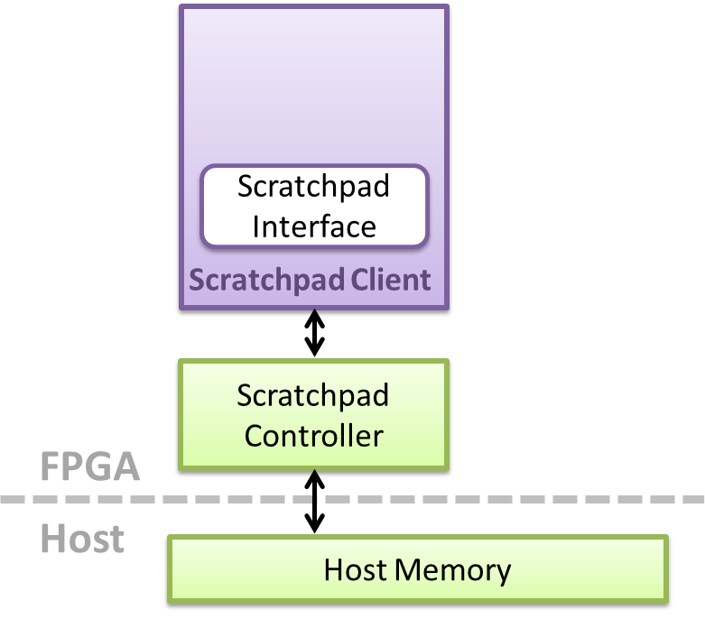

Scratchpad Configurability
Client
Interface
Whether to instantiate a prefetcher
Private cache size
Whether to have a private cache
Whether to have the whole cache hierarchy

Slide 15
LEAP Shared Memories

Slide 16
Parallel Programming on FPGA
Goal: simplifying parallel programming on FPGAs
2D Heat Transfer Equation
for(int t = 0; t < T; t++){
#pragma omp parallel num_threads(4){
int thread_id = omp_get_thread_num();
int bid_x = thread_id%2;
int bid_y = thread_id/2;
for (int y = bid_y*(N/2); y < (1+bid_y)*(N/2); y++)
for (int x = bid_x*(M/2); x < (1+bid_x)*(M/2); x++)
U[t+1,x,y] = C0*U[t,x,y]
+ Cx*(U[t,x-1,y]+U[t,x+1,y])
+ Cy*(U[t,x,y-1]+U[t,x,y+1]);
}
}
N
M
operation on the shared array
implicit barrier synchronization

Slide 17
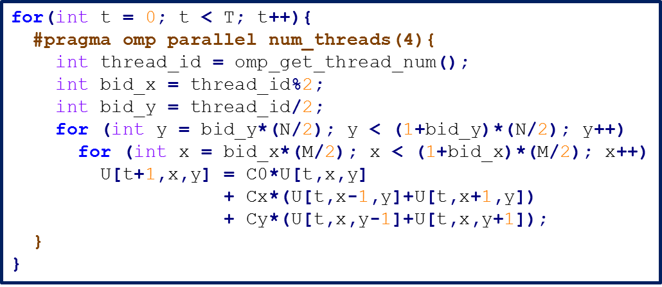
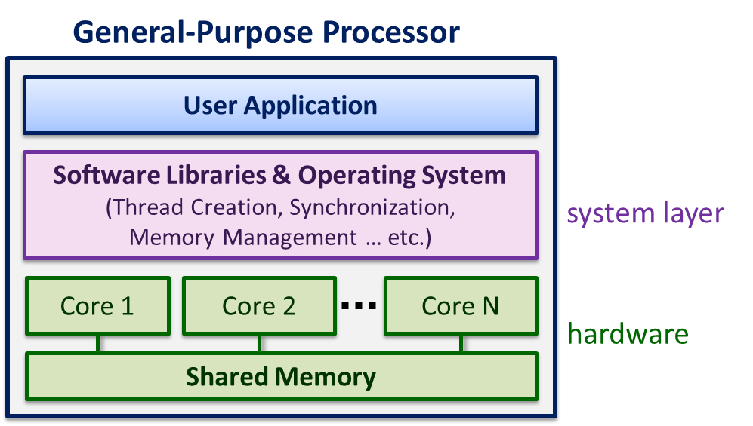
Parallel Programming on FPGA
Goal: simplifying parallel programming on FPGAs
2D Heat Transfer Equation
N
How to implement on FPGAs?
M

Slide 18
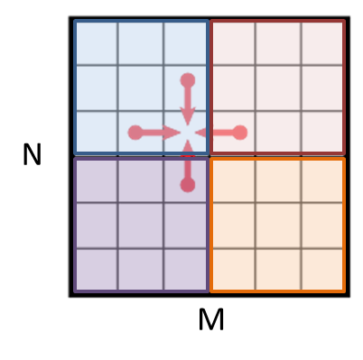
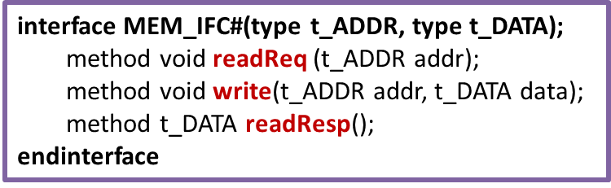
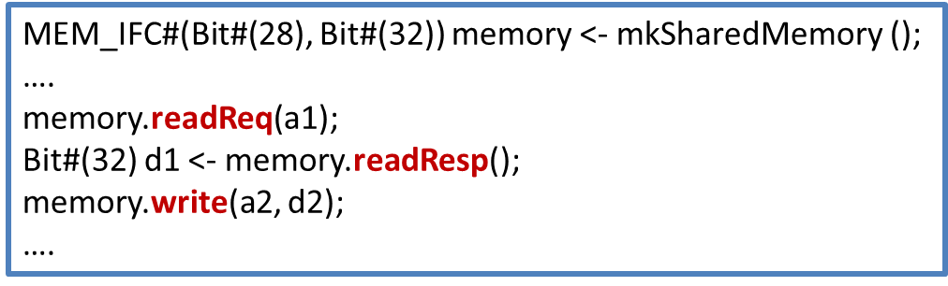
Parallel Programming on FPGA
2D Heat Transfer Equation
Engine1
Engine2
Engine3
Engine4
Interface
Shared Memory
Shared Memory
Shared Memory
Shared Memory
Coherence, Consistency, Synchronization
unlimited address space
arbitrary data size
Engine

Slide 19

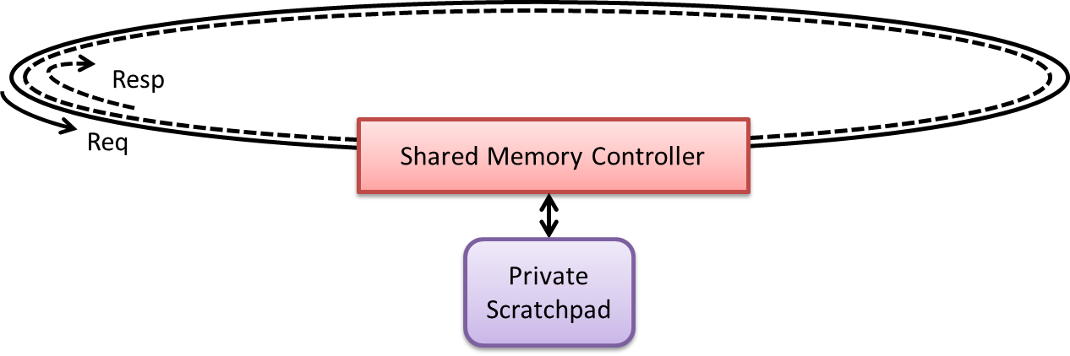
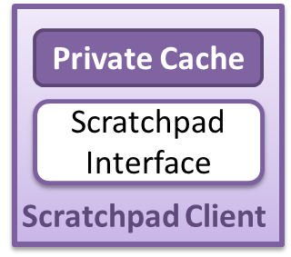
Parallel Programming on FPGA
2D Heat Transfer Equation
Engine 1
Engine 2
Engine 3
Engine 4
N
Interface
Remote Access
M
Difficulty: Performance is limited
Serialized requests
Long latency if across FPGAs

Slide 20
Parallel Programming on FPGA
2D Heat Transfer Equation
Engine 1
Engine 2
Engine 3
Engine 4
N
Interface
Cache
Cache
Cache
Cache
M
Need cache coherence!

Slide 21
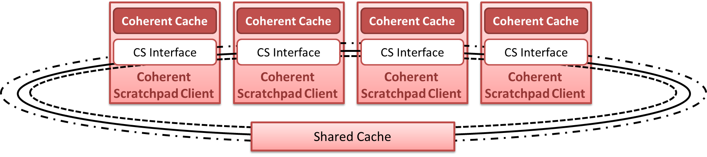
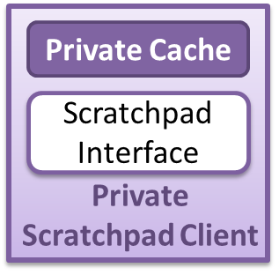
LEAP Shared Memory Services: Coherent Scratchpad (CS)
Engine
Engine
Engine
Engine
Interface
Coherent Scratchpad Controller
Shared Cache
Ring-based snoopy protocol
pre-order request
Modified MOSI protocol
ordered request
response
Ordering point
Store data
Store owner-bit information
Ordering point
Store data
Shared data ca
Store owner-bit information for every address
owner bit
data
H. Yang, “LEAP Shared Memories: Automating the Construction of FPGA Coherent Memories,” in FCCM, 2014.

Slide 22
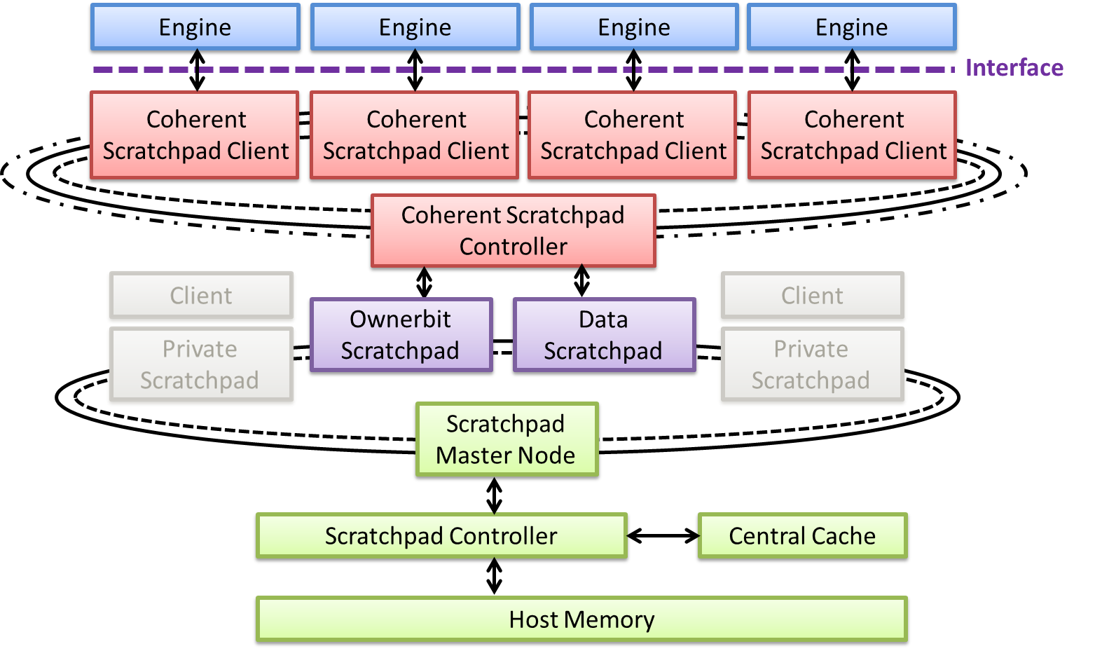
LEAP Shared Memory Services: Coherent Scratchpad

Slide 23
Parallel Programming on FPGA
2D Heat Transfer Equation
for(int t = 0; t < T; t++){
#pragma omp parallel num_threads(4){
int thread_id = omp_get_thread_num();
int bid_x = thread_id%2;
int bid_y = thread_id/2;
for (int y = bid_y*(N/2); y < (1+bid_y)*(N/2); y++)
for (int x = bid_x*(M/2); x < (1+bid_x)*(M/2); x++)
U[t+1,x,y] = C0*U[t,x,y]
+ Cx*(U[t,x-1,y]+U[t,x+1,y])
+ Cy*(U[t,x,y-1]+U[t,x,y+1]);
}
}
N
M
operation on the shared array
implicit barrier synchronization
Finish the inner loop operations
Computations complete
Memory operations complete
Wait until all threads are finished

Slide 24
LEAP Shared Memory Services: Memory Consistency
Block RAM/Private Scratchpad Interface
Coherent Scratchpad Interface
interface MEM_IFC#(type t_ADDR, type t_DATA);
method void readReq (t_ADDR addr);
method void write(t_ADDR addr, t_DATA data);
method t_DATA readResp();
endinterface
interface MEM_IFC#(type t_ADDR, type t_DATA);
method void readReq (t_ADDR addr);
method void write(t_ADDR addr, t_DATA data);
method t_DATA readResp();
// t_REQ r := {READ, WRITE, FULL}
method Bool requestPending(t_REQ r);
endinterface
Fence support (memory consistency)

Slide 25
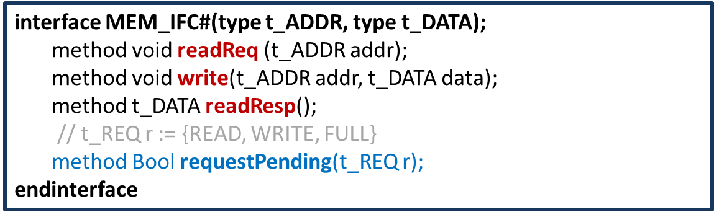
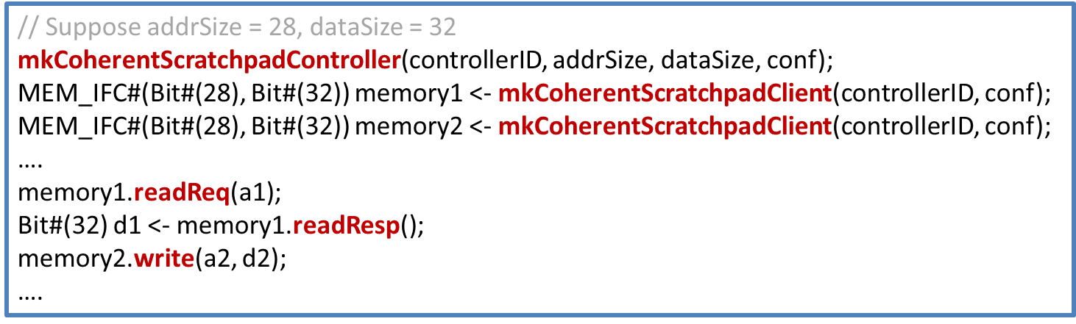
Coherent Scratchpad Usage
Coherence Controller

Slide 26
Parallel Programming on FPGA
2D Heat Transfer Equation
for(int t = 0; t < T; t++){
#pragma omp parallel num_threads(4){
int thread_id = omp_get_thread_num();
int bid_x = thread_id%2;
int bid_y = thread_id/2;
for (int y = bid_y*(N/2); y < (1+bid_y)*(N/2); y++)
for (int x = bid_x*(M/2); x < (1+bid_x)*(M/2); x++)
U[t+1,x,y] = C0*U[t,x,y]
+ Cx*(U[t,x-1,y]+U[t,x+1,y])
+ Cy*(U[t,x,y-1]+U[t,x,y+1]);
}
}
N
M
operation on the shared array
implicit barrier synchronization
Finish the inner loop operations
Computations complete
Memory operations complete
Wait until all threads are finished

Slide 27
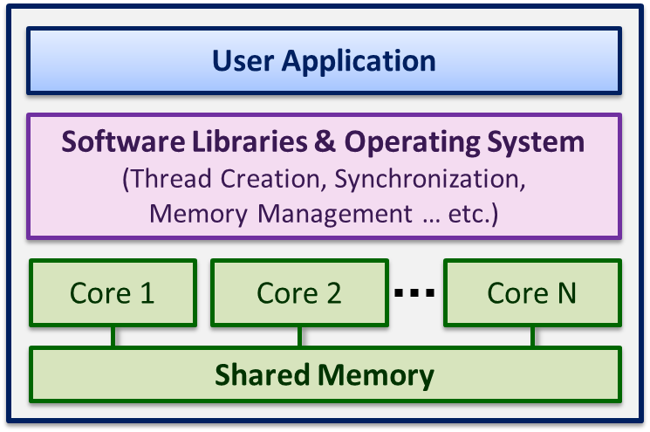
Synchronization Services: Memory Barrier
In Processor: software through-memory barriers
via shared memory & locks
void barrier(num_threads_const, lock_addr, eflag_addr,
lflag_addr, ecounter_addr, lcounter_addr)
{
while (*eflag_addr);
lock(lock_addr);
(*ecounter_addr)++;
if ((*ecounter_addr) == num_thread_const){
(*eflag_addr) = 0;
(*lflag_addr) = 1;
}
unlock(lock_addr);
while (*lflag_addr);
lock(lock_addr);
(*lcounter_addr)++;
if ((*lcounter_addr) == num_thread_const){
(*lcounter_addr) = 0;
(*ecounter_addr) = 0;
(*eflag_addr) = 1;
(*lflag_addr) = 0;
}
unlock(lock_addr);
}

Slide 28
Synchronization Services: Memory Barrier
In Processor: software through-memory barriers
via shared memory & locks
In FPGA:
void barrier()
{
send(isDone);
while (receive(allDone));
}
Suppose clients A & B need to synchronize
Client A
Client B
Client C
isDone
barrierInit
isDone
A
Synchronization Client
Synchronization Client
Synchronization Client
B
Synchronization Controller
allDone
barrierInit
Mask
A
B
C

Slide 29
Synchronization Services: Memory Barrier
In Processor: software through-memory barriers
via shared memory & locks
In FPGA:
outside of shared memory
Performance Comparison:
System | Barriers per Second | Normalized Throughput
LEAP Barrier Service | 7352076 | 342
Hardware Lock Barrier via Coherent Scratchpad | 85088 | 4
Spin-Lock Mutex-Enabled Cache* | 21510 | 1
* V. Mirian and P. Chow, “Managing mutex variables in a cache-coherent shared-memory system for FPGAs,” in FPT, 2012.

Slide 30
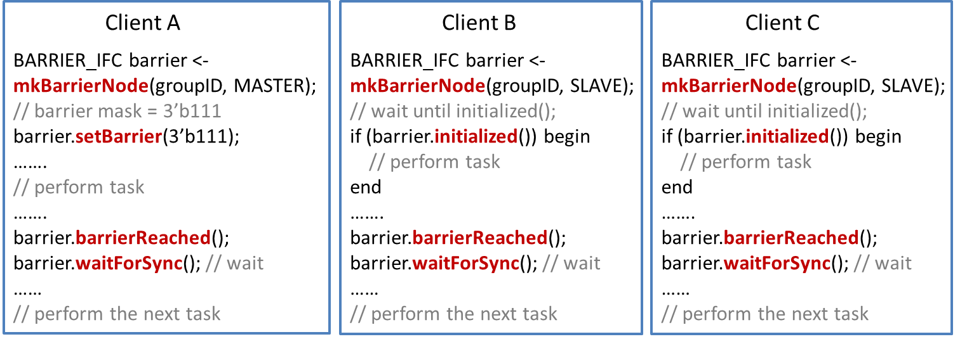
LEAP Barrier Usage
interface BARRIER_IFC;
method Bool initialized();
method void setBarrier(t_BARRIER barrier);
method void barrierReached();
method void waitForSync() if (all nodes have reached the barrier);
endinterface

Slide 31
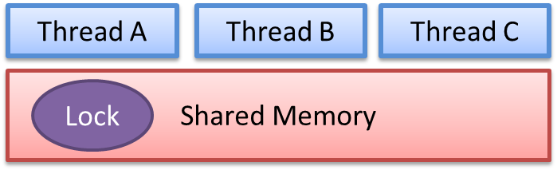
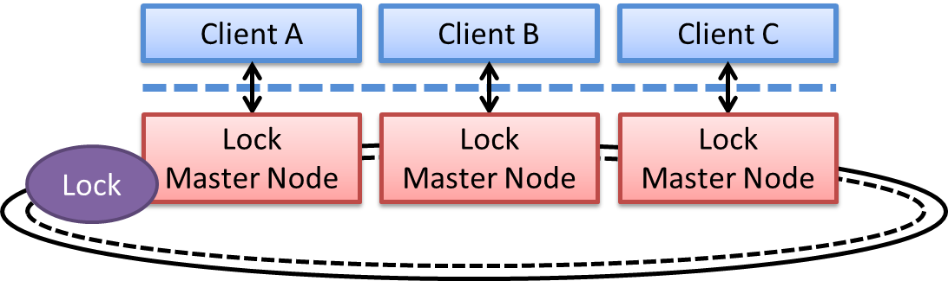
Synchronization Services: Lock
Processor:
through-memory locks
Performance Comparison (Shared Queue Test) :
LEAP lock primitive:
hardware locks
Primitive | Normalized Performance
Global Arbiter | 2.19
LEAP Hardware Lock | 1.82
Through-Memory Software Lock | 1

Slide 32
LEAP Lock Usage
interface LOCK_IFC#(type t_LOCK_ID);
method void acquireLockReq(t_LOCK_ID id);
method t_LOCK_ID lockResp() if (it receives lock); method void releaseLock(t_LOCK_ID id);
endinterface
Client A
Client B
Client C
LOCK_IFC#(Bit#(1)) lock <-
mkLockNode(groupID, MASTER);
lock.acquireLockReq(0);
if (lock.lockResp() == 0) // wait
begin
…….
// perform task
…….
end
lock.releaseLock();
LOCK_IFC#(Bit#(1)) lock <-
mkLockNode(groupID, SLAVE);
lock.acquireLockReq(0);
if (lock.lockResp() == 0) // wait
begin
…….
// perform task
…….
end
lock.releaseLock();
LOCK_IFC#(Bit#(1)) lock <-
mkLockNode(groupID, SLAVE);
lock.acquireLockReq(0);
if (lock.lockResp() == 0) // wait
begin
…….
// perform task
…….
end
lock.releaseLock();

Slide 33
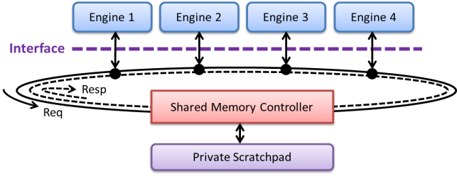
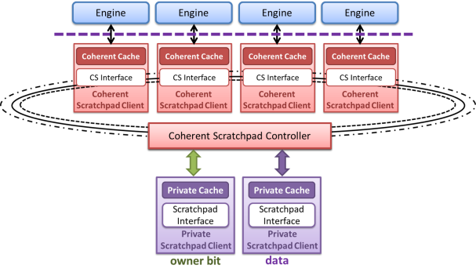
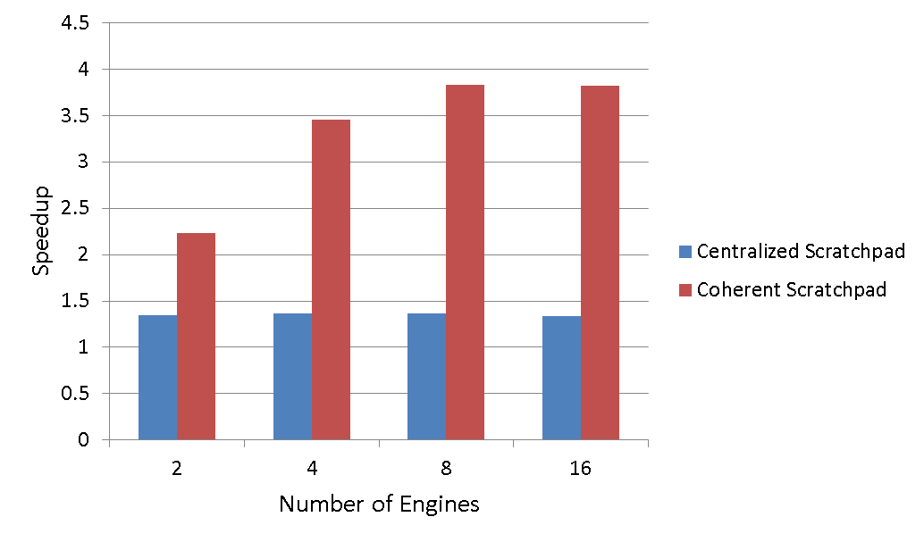
Performance on 2D Heat Transfer
Centralized Scratchpad
Coherent Scratchpad
N
M
FPGA: Xilinx VC707 Frame Size: 512x512
Coherent Cache Size: 8KB
Pixel Size: 8bit

