Slide 1
LEAP Tutorial: HLS Kernel and LEAP Memory Automatic Integration
Michael Adler†, Kermin E. Fleming†,
Hsin-Jung Yang‡, and Felix Winterstein§
† Intel Corporation
‡ Massachusetts Institute of Technology
§ European Space Agency
September 1st, FPL 2015

Slide 2
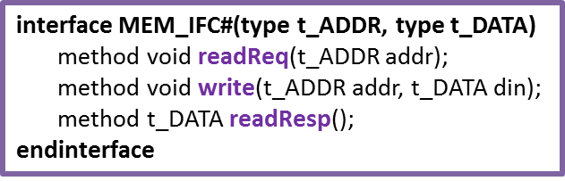
Integrating HLS kernel with LEAP Memory
Engine
HLS Kernel
Memory Interface
Bus Interface
ap_bus/axi_bus
LEAP
Scratchpad
Memory Interface Adapter
interface MEM_IFC#(type t_ADDR, type t_DATA)
method void readReq(t_ADDR addr);
method void write(t_ADDR addr, t_DATA din);
method t_DATA readResp();
endinterface
Memory Interface
LEAP
Scratchpad

Slide 3
Integrating HLS Kernel with LEAP Memory
Bus Interfaces:
ap_bus, axi_bus
Automatically generated wrappers
Extract information of bus interfaces exposed from HLS kernels
Instantiate memory interface adapters (bus interface <-> memory interface conversion modules)
Generate LEAP-based program model
FIFO Interface for non-memory communication
Support ap_fifo for transferring messages between HLS kernel and LEAP platform

Slide 4
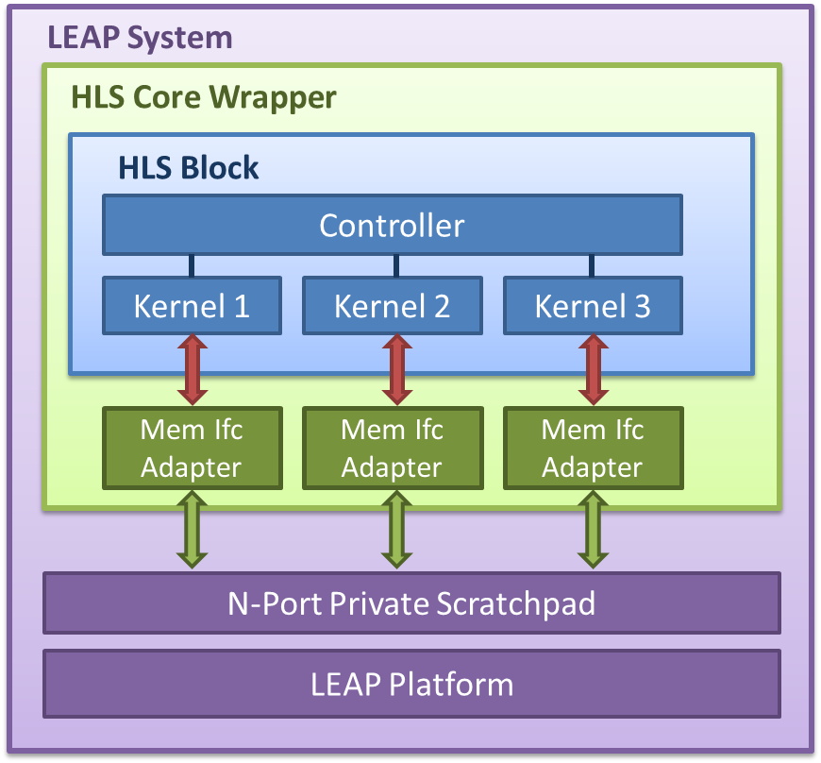
Integration Flow
HLS and LEAP tool flow integration (Current support)
C program
HLS Kernel Generation
Verilog Kernels
HLS Wrapper Generation
LEAP Compilation
FPGA/Simulation Program

Slide 5
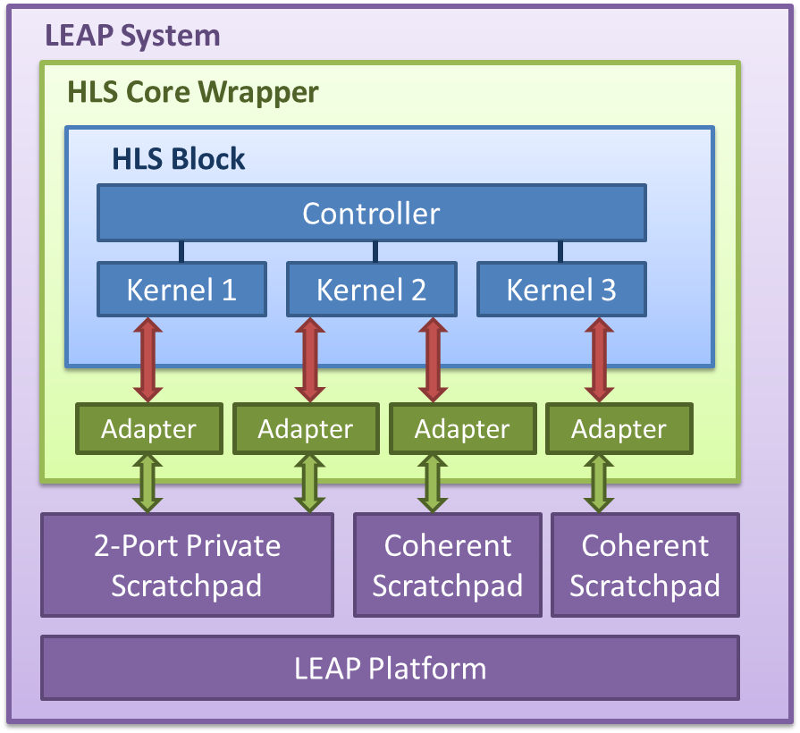
Integration Flow
HLS and LEAP tool flow integration (Ideal)
Memory Info (name, type)
C program
HLS Kernel Generation
Verilog Kernels
HLS Wrapper Generation
LEAP Compilation
FPGA/Simulation Program

Slide 6
Example: hls_mem_perf
Issue a sequence of reads/writes to memory based on instruction sent from host (software)
Instruction: working set, stride, iterations, read/write/finish
Hardware prints out execution latency and number of errors (if any)
Example code:
~/tutorial/src/leap-examples/modules/apps/examples/hls_mem_perf/

Slide 7
Example: hls_mem_perf
HLS kernel code
File: ~/tutorial/src/leap-examples/modules/apps/examples/ hls_mem_perf/hls_src/c_src/design/hls_mem_perf.cpp
void hls_mem_perf(volatile DataType *mem0, volatile InstType *inst, volatile int *result) {
#pragma HLS INTERFACE ap_bus port=mem0
#pragma HLS INTERFACE ap_fifo port=inst
#pragma HLS INTERFACE ap_fifo port=result
bool is_done = false;
while (!is_done){
cmd = inst[test]; // receive instruction
if (write_command){
for (int iter = 0; iter < iterations; iter++){
mem0[addr] = val; // write to memory
... // increase address
}
result[test] = error; // send back error number
}
...
}
}

Slide 8
Example: hls_mem_perf
LEAP System (leap-hls-mem-test.bsv)
HLS Core Wrapper (mkHlsCore in hls-core-bsv-wrapper.bsv)
HLS Kernel
ap_bus
mem0
ap_fifo
inst
ap_fifo
result
HlsApBus Memory Connection
Connection Receiver Name: hls_fifo_inst
Connection Sender Name: hls_fifo_result
Private Scratchpad
Connection Sender Name: hls_fifo_inst
Connection Receiver Name: hls_fifo_result
LEAP Platform

Slide 9
Example: hls_mem_perf
ap-fifo connection
File: ~/tutorial/src/leap-examples/modules/apps/examples/ hls_mem_perf/leap_model/leap-hls-mem-test.bsv
// Instantiate the connection sender to transfer test instructions
CONNECTION_SEND#(Bit#(`HLS_AP_IN_FIFO0_DATA_BITS)) instQ <-
mkConnectionSend("hls_fifo_inst_V");
// Send an instruction to the HLS kernel
rule sendTestCmd (state == STATE_TEST);
instQ.send(pack(CommandType{ workingSet: unpack(cmd.workingSet),
stride: unpack(cmd.stride),
iterations: unpack(cmd.iterations),
command: unpack(cmd.command) }));
endrule

Slide 10
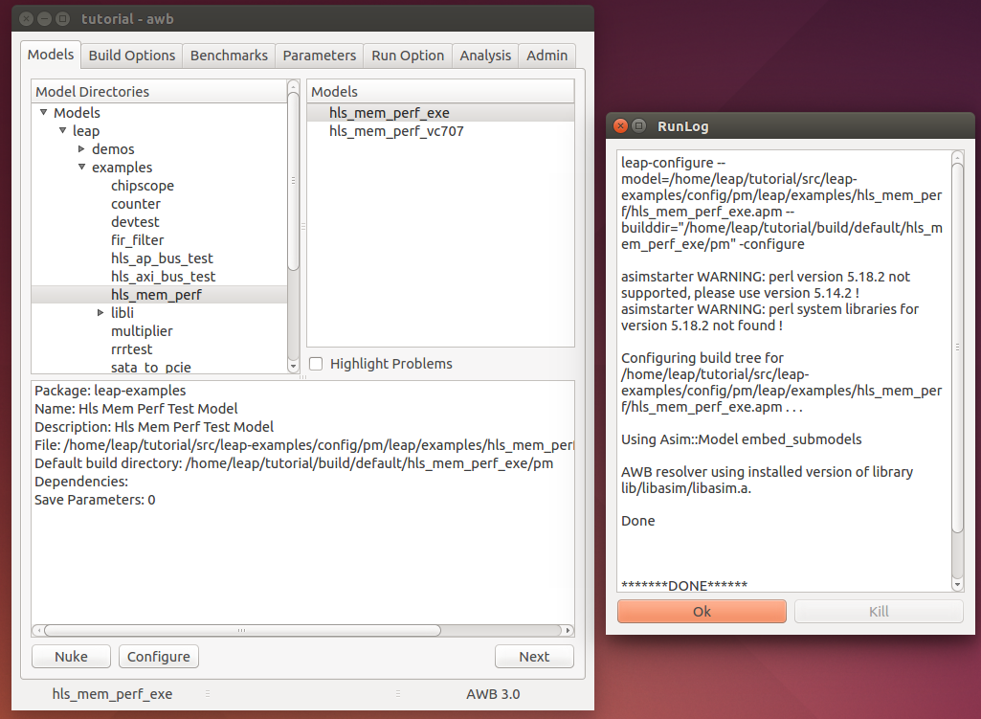
Example: hls_mem_perf
Configure model

Slide 11
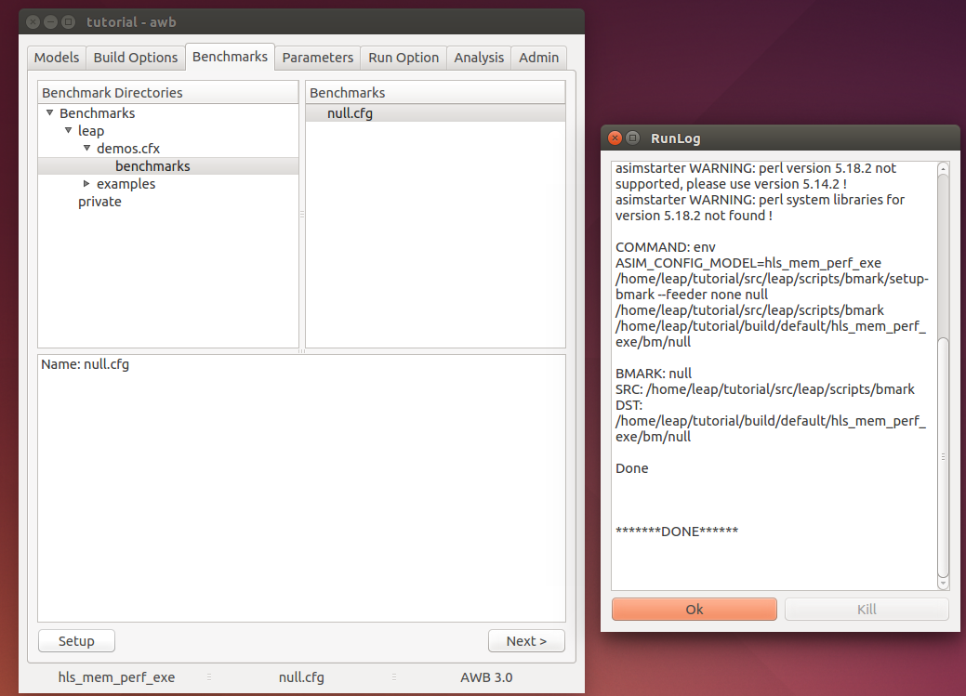
Example: hls_mem_perf
Setup benchmark

Slide 12
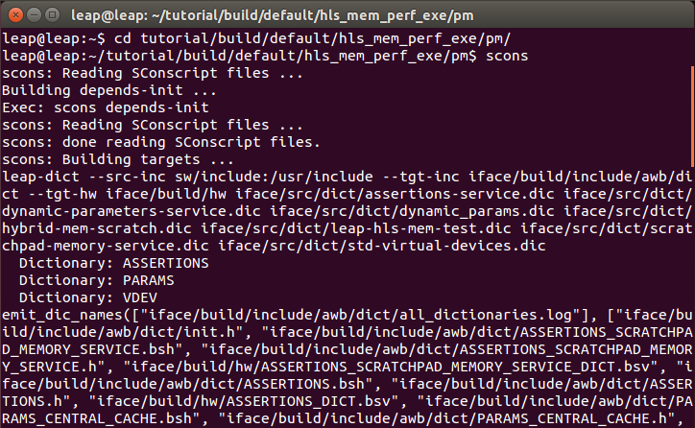
Example: hls_mem_perf
Build model
Type ‘scons’ in the ‘pm’ directory

Slide 13
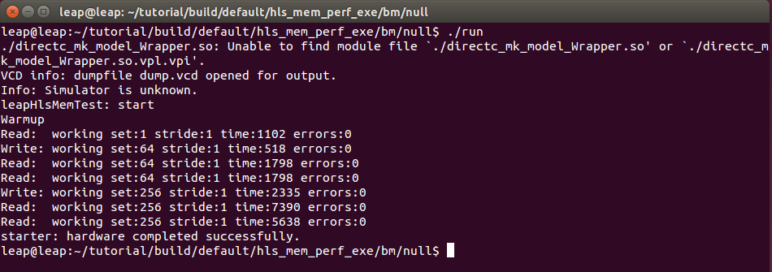
Example: hls_mem_perf
Run
Check cache stats from the stats file
LEAP_scratchpad_memory_0_SCRATCH_LOAD_HIT,"Scratchpad load hits",512
LEAP_scratchpad_memory_0_SCRATCH_LOAD_MISS,"Scratchpad load misses",513

Slide 14
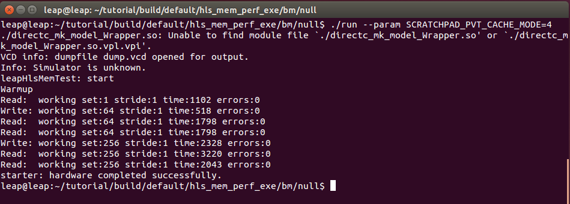
Example: hls_mem_perf
Run with prefetching turned on
./run –param SCRATCHPAD_PVT_CACHE_MODE=4
Check cache stats from the stats file
LEAP_scratchpad_memory_0_SCRATCH_LOAD_HIT,"Scratchpad load hits",978
LEAP_scratchpad_memory_0_SCRATCH_LOAD_MISS,"Scratchpad load misses",47

Slide 15
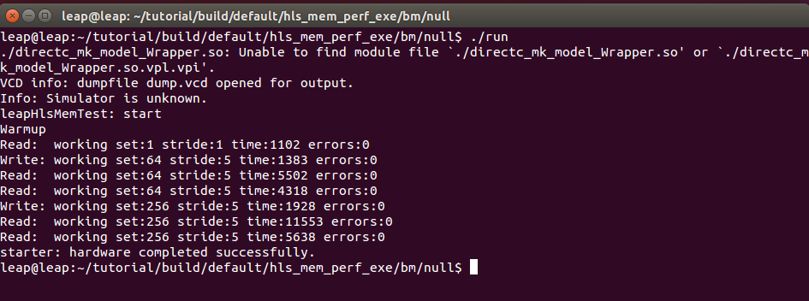
Example: hls_mem_perf
Change stride in software
pm/sw/model/connected_application/connected-application-test.cpp
Recompile software
scons sw
Rerun program

