Slide 1
LEAP Tutorial: Installation
Kermin Fleming Michael Adler

Slide 2
Getting Started
Two requirements:
VirtualBox, virtualization software
Pre-installed LEAP virtual machine:
https://github.com/LEAP-FPGA/leap-documentation/wiki/VirtualBoxImages
These are supplied on the Tutorial Flash Drive

Slide 3
Installation Steps
Confirm that VT-x is enabled in BIOS
Enabled by default on modern Macs
On Windows 8 check Task Manager->Performance->CPU and ensure that virtualization says enabled in bottom-right column
Otherwise, check BIOS
Install appropriate virtual box to your machine from provided USB stick
Import the virtual box image LEAPTutorial.ova
Once imported
Adjust system resources to suit your laptop
Boot the virtual machine

Slide 4
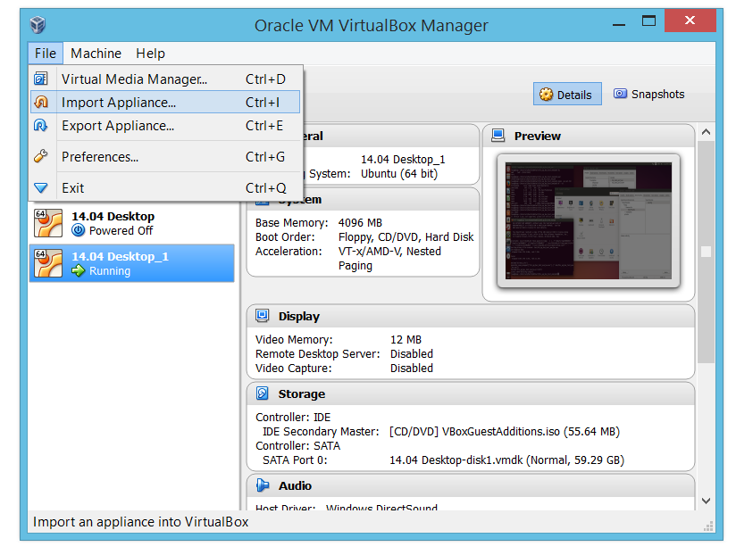
Importing Virtual Machine

Slide 5
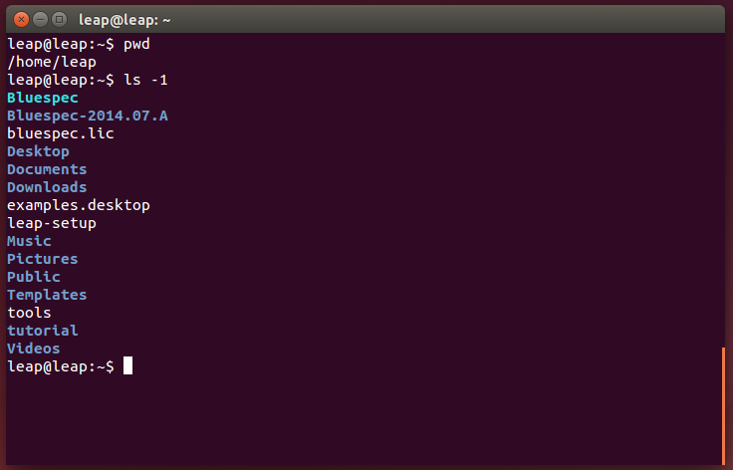
Getting Started
Logging in:
User: leap
Password: leap
Environment
Bluespec installation
Environment setup script
Tutorial AWB workspace

Slide 6
Licensing
Bluespec has provided node-locked VM licenses
Licenses expire December 31st 2015
Generally, free renewal for academic use
Contact support@bluespec.com for details
Compiling LEAP programs for FPGA
Requires tool vendor licenses
Support for ISE, Vivado, Quartus II, and Synplify are available

