Slide 1
The LEAP FPGA Operating System
Kermin Fleming
Michael Adler

Slide 2






A Bit of History
LEAP: Latency-insensitive Environment for Application Programming
Development of LEAP began ~7 years ago
Intel: FPGA-based performance models (HAsim)
Michael Adler, Joel Emer, Angshuman Parashar, Michael Pellauer
MIT: Wireless transceivers and other IP blocks
Open source (BSD License)
Growing community:

Slide 3
What is General Purpose Computing?
Not the ISA (x86, ARM, Power…)
Not the operating system (Unix, Windows, CP/M)
General purpose computing is programmability
Enables even novice programmers to build powerful programs

Slide 4
Where Does Programmability Come From?
User Program
Programming languages
Both high- and low-level
Services with consistent interfaces (e.g. POSIX)
Memory management (malloc, mmap)
Message formatting and printing (stdio)
Communication channels (pipes, TCP/IP)
Kernel abstraction
Consistent driver interfaces hide device hardware variations
Virtual memory eliminates machine-specific memory management
printf(“hello world”);
libc libraries
Kernel
Devices

Slide 5
Imagine I give you a CPU with a new ISA and I/O devices.
Do you:
Write your application and drivers in assembly language?
Write an LLVM backend and port Linux?

Slide 6
FPGAs aren’t general purpose!
Why? We usually pick option A!
Driver interfaces are platform-specific (wires).
Building blocks are low level:
Memories provided only as drivers
I/O provided as raw channels
Driver interface and timing details leak into user code.
Standard programming languages are very low level
Achieving option B requires an operating environment.

Slide 7
Hello World on Processor
main() { printf(“Hello world!\n”);
}
Notes:
User expects:
* Universal: works on any OS because LIBC provides a common API independent of the kernel interface
- User space buffering and memory management
- User program shares address space with I/O library
* Trap to kernel when needed with automatic memory management
* Automatic binding of file handle to some device
- Disk file system
- Network socket

Slide 8
Hello World on FPGA?
$write(“Hello world!\n”);
Notes:
User expects:
Same as C (inside software simulators)
Nothing on hardware!

Slide 9
Hello World on FPGA
(Excerpt from 300 page Xilinx 7 Series PCIe Manual)
AAAAAAAAAAAAAAAAAH!
All the software programmers resigned in protest

Slide 10
Hello World in LEAP
module [CONNECTED_MODULE] mkConnectedApplication ();
STDIO#(Bit#(32)) stdio <- mkStdIO();
let msg <- getGlobalStringUID("Hello, World!\n");
Reg#(STATE) state <- mkReg(STATE_start);
rule hello (state == STATE_start); stdio.printf(msg, List::nil);
state <= STATE_finish; endrule
endmodule
Notes:
An entire LEAP application.
What is not pictured is the virtual platform that sends the start message, receives the finish signal and provides the STDIO library. This is just like standard programming, which wraps main() in crt0 and provides libc.

Slide 11
What do we get from operating environments?
Programmers no longer need to focus on infrastructure
Greatly reduced design time, simplified designs
Advances are shared by all programs
New memory systems, scheduling policies, etc.
Wide portability
Enabled by common interfaces
What about HLS, OpenCL, etc.?
Promising languages, lots of productivity, etc.
Java and C++ don’t implement OS kernels
All programming environments benefit from a shared OS

Slide 12
Requirements of any operating environment
Allow application to expose high-level needs
Memory, communication, devices
Operating system responsible for satisfying these needs
Maintain the expressivity of programs
Programmers should decide how to express programs, not OS
Satisfy these requirements with light-weight, user-friendly interfaces
Notes:
Consequences of providing these functinoalities

Slide 13
Latency-insensitive Channels: The core LEAP Abstraction

Slide 14
How do user programs and OS interface in software?
User-OS interaction usually involves manipulations through
Function calls
Memory and register!
Very natural for von Neumann machines
Details of machine are hidden through abstraction layers
User: function call
OS: hardware abstraction layer
User Program
printf(“hello world”);
libc libraries
Kernel
Devices
How can we achieve a similar layering in FPGAs?
Notes:
This is a natural mechanism for von Neumann machines

Slide 15
Memory is Not a Good Base Abstraction for FPGAs
Spatial, distributed architecture
Computational structures are small, dedicated
Most algorithms follow pipelines
Memory sharing is possible, but expensive
Costs time, area, or both

Slide 16
Communication: A Natural Abstraction for FPGAs
FPGA
mkA
mkB
mkC
Inter-module communication by defined protocol
Usually FIFO-like
Nearly all HW designs use this methodology
What if we abstract this communication?
Notes:
Look at 8/9 transition
Recently, latency-insensitive design has become popular as a way to implement hardware. In LI design, programs are separated into modules which communicate solely by way of latency insensitive channels. These channels are implemented as simple hardware FIFOs. Designs are written so that computation only occurs when data is available in ingress FIFOS or when there is space for output in egress FIFOs. LI designs enjoy many benefits including improved modular composition and simplified design space exploration.

Slide 17
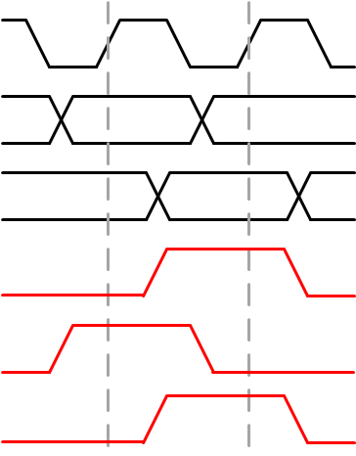
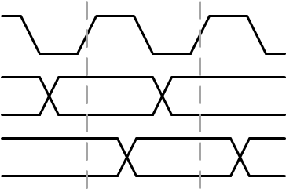
Abstracting Communication: From Register to FIFO
Communications have two components:
Payload (message contents)
Timing
When wires have payloads
When payload ownership is transferred
Systolic Pipeline
Latency-Insensitive Pipeline
Clock
Clock
Data In
D0
Not Full
Not Empty
Data Out
D0
Enq
Deq
Not Empty
Data In
Data Out
Registers
Enq
FIFO
Deq

Slide 18
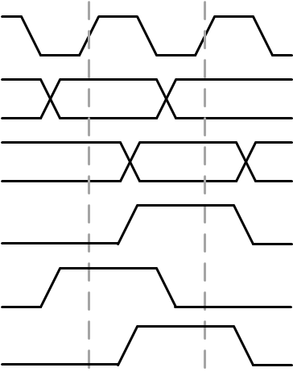
But the FIFO isn’t quite enough
Latency-Insensitive Pipeline
Clock
Clock
Not Full
Not Empty
Data In
D0
Enq
Deq
Data Out
D0
Data
Data
Not Empty
FIFO
Enq
Deq
FIFOs do a good job of decoupling FPGA programs
But not sufficiently abstract
Programmer may really require specific latency and buffering
Need to add a little more abstraction

Slide 19
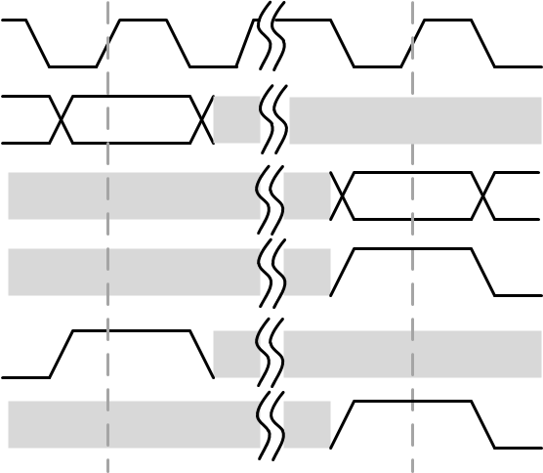
Latency-Insensitive Channels: The Core LEAP Abstraction
Clock
Clock
Data In
D0
D0
Not Full
Not Empty
Physical
Transport
Data Out
D0
D0
Send
Recv
Enq
Deq
Not Empty
Data
Data
Send
Enq
Latency-Insensitive Pipeline
Latency-Insensitive Channel
Recv
Deq
What if I abstract the notion of communication?
Introduce new RTL primitive: Latency-insensitive Channel
Channel has send/receive, flow controlled interface
Guaranteed FIFO delivery
But no explicit notion of implementation
LEAP picks implementation to suit program needs

Slide 20
Abstract Communications: What does it buy us?
Programmers see a simple, consistent interface to the operating environment
LI Channels strongly resemble existing hardware constructs
User program decoupled from devices, ensuring portability

Slide 21
Abstract communications: Heterogeneous platforms
Software can be viewed as a very slow channel endpoint
FPGA
CPU
mkRecv(“toFPGA”)
mkSend(“toFPGA”)
User
IP
User
Software
mkSend(“fromFPGA”)
mkRecv(“fromFPGA”)

Slide 22
Abstract Communication Abstracts Devices
Developer/user program need not comprehend physical device
Or implement a complex stack
Devices managed by LEAP, ensuring portability
Communication Thread
mkSend(“toFPGA”)
user code
Soft Service Paring
Channel Marshalling
Used Counts
Header
CPU
FPGA
CPU
Inter-Device
PHY
FPGA
Driver Thread
mkRecv(“toFPGA”)

Slide 23
Partitioning LI Channels Across FPGAs
FPGA0
FPGA
mkA
mkB
Control
Fetch
Decode
Exe
FPGA1
Fetch
Decode
Exe
mkC
Abstract communication permit LEAP to automatically partition any design.
Notes:
From our perspective, the important property of LI designs is that they do not care long it takes for data to propagate through the FIFOs. This allows us to solve many of the problems of existing multifpga tools: we no longer need to maintain a global notion of clock; in some sense data communication naturally synchronizes the design. Leveraging this property, it is logically straightforward to partition LI designs among FPGAs: we simply implement FIFOs across the FIFO boundaries. So now we’re done, right?

Slide 24
Abstract Communication Enables Automated Multi-FPGA Compilation
mkRecv(“toFPGA0”)
Recv B
Recv C
Recv B
Recv C
Channel Demarshalling
User programs need not comprehend execution on same device!
Recv A
Recv B
Recv B
Recv C
Recv A
Recv B
Recv A
Recv B
FIFO 0
Channel VC Buffering
AM
FIFO 0
Used Counts
Tail Ptr
FIFO 1
FIFO 2
FIFO 3
AM
FIFO 0
FIFO 1
FIFO 2
FIFO 3
Used Counts
Tail Ptr
AM
FIFO 1
FIFO 2
FIFO 3
Used Counts
Tail Ptr
Head Ptr
Free Counts
Head Ptr
Free Counts
Head Ptr
Free Counts
Lane Demerging
CRC
Deserialize/Reliability
Physical Interconnect
FIFO 0
Serialize/Reliability
AM
FIFO 1
FIFO 2
FIFO 3
CRC
Lane Merging
FPGA0
FPGA1
Channel Arbitration
Recv B
Recv C
Recv B
Recv C
Recv B
Recv C
Recv A
Recv B
Recv A
Recv B
Recv A
Recv B
Channel Marshalling
mkSend(“toFPGA0”)

Slide 25
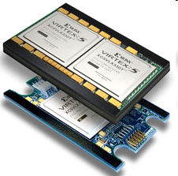
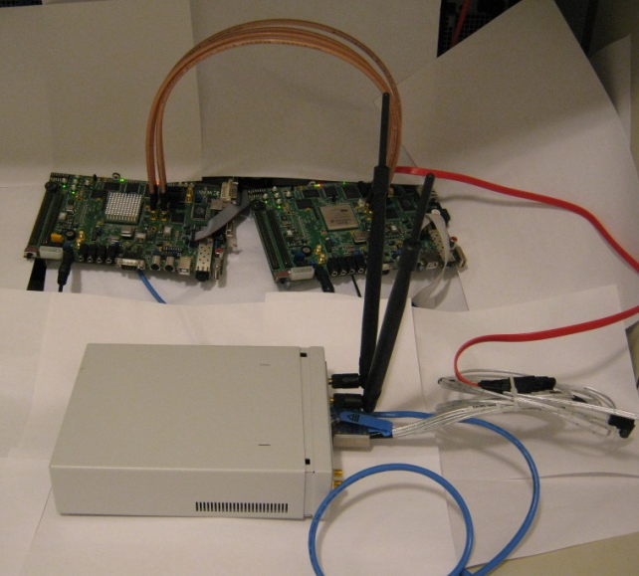
Multiple Expectations
Multiple FPGAs Mean More Resources
Larger Designs – up to 10x!
Faster Implementation – even superlinear!
Notes:
A single FPGA is sufficient for simulation. However, if the simulation is partitioned between FPGAs, it can be much faster, in part because improved access to FPGA resources permits much high clock frequencies. Here, improved clock frequency results in a super linear speed up, in some cases. Also, partitioned simulation has another advantage: fast compile times.

Slide 26
Communications: A Fundamental Service
Latency-insensitive channels enable any development environment
No assumption about program source, so long as LI channels are used
Operating systems still run assembly
Potential for common interface among programming languages
Verilog/VHDL, Bluespec
HLS compilers
Software: C, C++

Slide 27
LEAP Service Libraries: Making the FPGA Programmable

Slide 28
Service Libraries
Communications is the fundamental kernel layer
But programmers also benefit from services libraries
Operating systems usually ship with many useful libraries

Slide 29
What I really want is to write code
STDIO#(Bit#(64)) stdio <- mkStdIO();
let msgDone <- getGlobalStringUID("heat: done cycle: %016ld, test cycle count: %016ld\n");
rule sendDone (state == STATE_finished); stdio.printf(msgDone, list2(zeroExtend(cycleCnt), zeroExtend(cycleCnt-initCycleCnt))); state <= STATE_exit; endrule
Don’t want to understand how library works

Slide 30
Services: Processor vs. FPGA
 | Processor | FPGA
Implementation | Instructions in library | Spatially distributed
Invocation | Call an address | Message over wires
Data Transfer | Global Memory | Message over wires
LEAP services take a client-server architecture
Conveniently layered on LI Channels
Composition enables rapid development of sophisticated libraries

Slide 31
STDIO: A Service Library in FPGA
FPGA
CPU
STDIO
Service
Software STDIO
…
Response 0
Response n
Request 0
Request n
User Program
LI Channels
let msg <- getGlobalStringUID("Hello, World!\n");
stdio.printf(msg, List::Nil);
But what if application needs more than one client?
Software can share a single library code
Spatial nature of FPGAs requires services to be distributed

Slide 32
A Scalable Service Architecture
FPGA
CPU
Global STDIO
Software STDIO
Local STDIO
Local STDIO
…
…
Response 0
Response n
Response 0
Response n
Request 0
Request n
Request 0
Request n
Client 0
Client 1
Distributed services are transparent to user program
Notes:
Unlike software where a single library can be shared, in spatial architecture we need to instantiate multiple clients

Slide 33
LEAP Scratchpads: Abstracting Memory on the FPGA

Slide 34
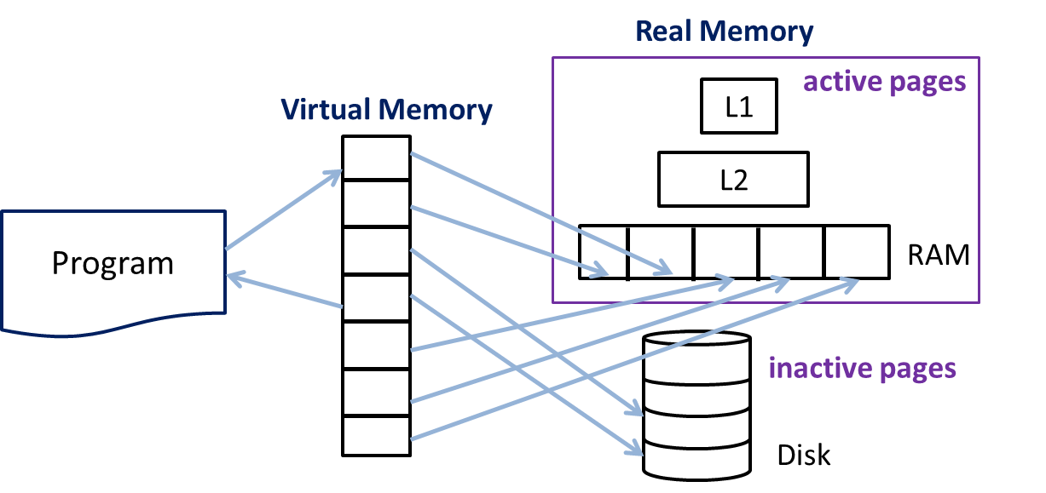
What do processors do?
int * array = (int*)malloc(M*N*2*sizeof(int));
d1 = array[a1];
array[a2] = d2;
Simple Program
Complex Memory Management
Ex: cache hierarchy, address translation,
page swapping….

Slide 35
Interfacing to Memory in FPGAs
What should a memory service provide?
Interface familiar to FPGA programmers
High flexibility
Arbitrary data types
“Virtually unlimited” address space
Access to memory resources like DRAM

Slide 36
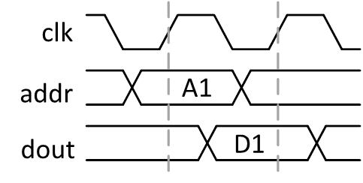
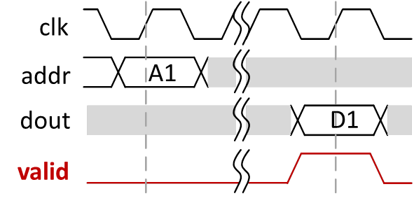
LEAP Scratchpads: A Memory Abstraction for FPGAs
Client
Client
Client
addr
Interface
din
dout
RAM
Block
RAM
Block
RAM
Block
LEAP
Scratchpad
LEAP
Scratchpad
LEAP
Scratchpad
valid
wen
interface MEM_IFC#(type t_ADDR, type t_DATA)
method void readReq(t_ADDR addr);
method void write(t_ADDR addr, t_DATA din);
// dout is available at the next cycle of readReq
method t_DATA readResp() if (readReq fired previous cycle);
endinterface
interface MEM_IFC#(type t_ADDR, type t_DATA)
method void readReq(t_ADDR addr);
method void write(t_ADDR addr, t_DATA din);
// dout is available when response is ready
method t_DATA readResp() if (valid == True);
endinterface
But, LEAP interface are be latency-insensitive!
Result: Freedom to vary memory implementations
Cache hierarchies, virtual memory, prefetching, etc.

Slide 37
LEAP Scratchpads: Automatic Cache Hierarchy
Processor
FPGA
Client
Client
Client
Application
Private Cache
Private Cache
Private Cache
Scratchpad Client
Scratchpad Client
Scratchpad Client
L1 Cache
Scratchpad
Interface
Scratchpad
Interface
Scratchpad
Interface
Scratchpad Master Node
L2 Cache
Scratchpad Controller
Central Cache
(on board DRAM)
CPU
Host Memory
Memory
LEAP Scratchpads layered on LI Channels

Slide 38
Great! Memory! But what if I need to share?
LEAP scratchpads are private
Sharing must be handled by client
General purpose systems provide facilities for shared programming
Coherence, Consistency, Locks, Barriers
Especially necessary for HPC applications

Slide 39
LEAP Coherent Scratchpads
FPGA 0
FPGA 1
FPGA
Engine
Engine
Engine
Engine
Coherent Scratchpad Client
Coherent Scratchpad Client
Coherent Scratchpad Client
Coherent Scratchpad Client
Coherent Scratchpad Controller
Coherent Scratchpad Rings
Central Cache (on board DRAM)
Host Memory
Wow! Abstraction enables strong composition!
Coherent Scratchpads are a composition of LEAP services

Slide 40
More Resources Available
FPGA 0
FPGA 1
Engine
Engine
Engine
Engine
Coherent Scratchpad Client
Coherent Scratchpad Client
Coherent Scratchpad Client
Coherent Scratchpad Client
Coherent Scratchpad Controller
Coherent Scratchpad Rings
Central Cache (on board DRAM)
Central Cache (on board DRAM)
Host Memory

Slide 41
Leave No Resource Unutilized!
FPGA 0
FPGA 1
Engine
Engine
Engine
Engine
Coherent Scratchpad Client
Coherent Scratchpad Client
Coherent Scratchpad Client
Coherent Scratchpad Client
Local Client Rings
Local Client Rings
Coherent Scratchpad Controller
Coherent Scratchpad Controller
Coherence Controller Rings
Controller
Central Cache
(DRAM)
Central Cache
(DRAM)
Scratchpad Controller Rings
Host Memory
Lots of complexity, but user program remains the same

Slide 42
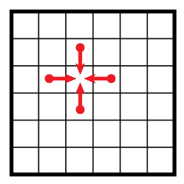
Heat Performance on Dual FPGA
N
Goodness →
M
FPGA: Xilinx VC707 Coherent Cache Size: 8KB
Pixel Size: 8bit
Performance a consequence of:
Raw memory bandwidth
Increased buffering in memory hierarchy

Slide 43
Current Research: Place and Route of Latency-insensitive Designs

Slide 44
Place and Route takes forever…
How many people build DRAM/PCIE controller every day?
10+ hour build times cause software developers to flee in panic
Two strategies for dealing with large problems
Divide and conquer
Avoid re-conquest when possible
Problem:
Frequency quality depends on tool correctly placing objects

Slide 45
Leverage LI Channels!
LI Channels are a convenient way to partition designs
E.g. multiple FPGA implementation
No frequency impact
Expose modules to backend tools through area groups
Classic floorplanning
Area groups can be independently implemented
Use distance information to implement channels
Pick number of buffers according to distance
Optimally route chains
FPGA
mkB
mkC
mkA
LEAP Driver Code

Slide 46
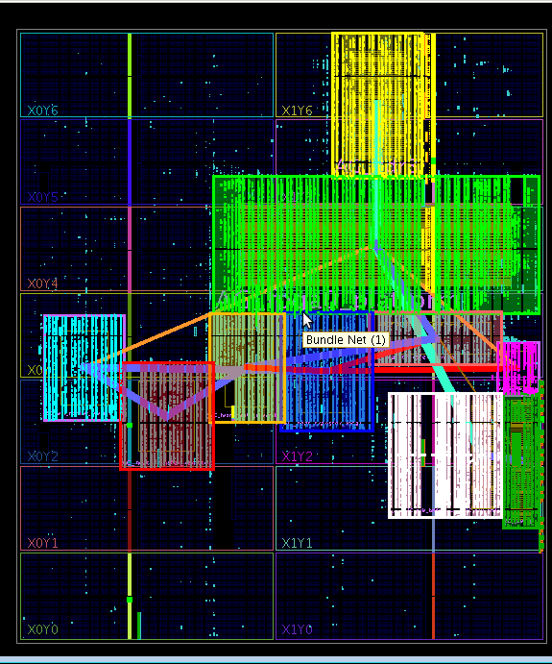
Place and Route of Heat
L2 Cache
Device Drivers
Coherence Directory
LEAP Service Code
Coherent Heat Processing Engines

Slide 47
Post-PAR results
Placement | LUT | Reg | BRAM | Slice
Baseline | 34433 | 28956 | 23 | 13141
User-placed | 34682 | 28956 | 23 | 12657
Full-placed | 36434 | 28956 | 23 | 10604
Fully integrated into LEAP’s compilation flow
Extremely preliminary results
Good reduction in slice usage
LUT usage goes up due to route-through
Currently evaluating impact on frequency

Slide 48
Conclusion
FPGAs must adopt principles from general purpose computing
Operating environments enable programmers to focus on algorithms
As opposed to spending significant time developing platforms
LEAP seeks to bring these design principles to FPGAs
Latency-insensitive channels are a fundamental abstraction for FPGAs
Channel abstraction enables strong composition of LEAP’s services
LEAP is open-source (BSD-license)
Code: http://asim.csail.mit.edu/redmine/projects/leap/

Slide 49
Questions?

Slide 50
Extra Slides

