Slide 1
LEAP: Simplifying the construction of FPGA-based processor models
Michael Adler
Elliott Fleming
Michael Pellauer
Joel Emer

Slide 2
FPGAs are hard to use
o_O
:(
;_;
+_+
T_T
@_@
T__T
-_-;;
Complex, poorly documented physical interfaces
Limited debugging interfaces
Lack of programming abstraction
The goal of LEAP is to make FPGAs easier to use
Slow tools with incomprehensible error messages
Notes:
/needs a transition here
I believe in FPGAs as a driver of processing performance in the future. However, FPGAs are and remain difficult to use. Parallel programming itself is difficult, but even this is not the chief issue in using FPGAs. There are many aspects of design peculiar to FPGAs which are quite difficult. Among them, using device resources, debugging, dealing with discrepancies in the behavior of simulation and the FPGA. When I started working with FPGAs, this was the only I’ve been working lately with a few younger graduate students. Here are a few emoticons that they have used to describe their experiences in working with FPGAs in the last few days . Note that there’s a regional dialect. Korean and Chinese emoticons use different numbers of underscores. Clearly, they’re suffering. The goal of this thesis is to make FPGAs easier to use.

Slide 3





What is LEAP?
Similar to an operating system, but with stronger compilation support
Useful for applications many applications, including processor modeling
User base in industry and academia

Slide 4
Hello World in C
int main (int argc, char* argv[])
{
printf(“Hello, world!\n”);
return 0;
}
What actions are taken by the system when compiling/executing this code?

Slide 5
Hello World in LEAP
module [CONNECTED_MODULE] mkConnectedApplication (); STDIO#(Bit#(32)) stdio <- mkStdIO(); Reg#(STATE) state <- mkReg(STATE_start); let msg <- getGlobalStringUID("Hello, world!\n”); rule hello (state == STATE_start); stdio.printf(msg, List::nil); state <= STATE_finish; endrule
endmodule
This code is a complete LEAP program

Slide 6
What is LEAP?
LEAP = LINC-based Environment for Application Programming
Flexible inter-module communication paradigm
Connections that provide latency-insensitive communications
A general memory paradigm
Arbitrarily sized memory spaces (private or shared)
System libraries, like STDIO, built on top of these abstractions

Slide 7
Communications In LEAP
Communications in FPGAs are a major headache
Many interesting FPGA accelerators, including HAsim, require processor assistance
FPGA-external communication is major headache
FPGA users consistently reinvent drivers (PCIE, GigE, SERDES, …) and bake these drivers into their designs
Painful debugging ensues
LEAP decouple logical and physical communications using latency-insensitive channels
Simple portable communication between FPGA and CPU or multiple FPGAs…
Notes:
Flow is still not right here.

Slide 8
What if a Model Doesn’t Fit on an FPGA?
FPGA
Optimize
Use bigger FPGA
Use multiple FPGAs
Partition
Map
Network
Fetch
Decode
I-Cache
Execute
Memory
D- Cache
Communications module
FPGA
Local
Commit
Notes:
Manual and automatic are not high level points
As we implement these algorithms for FPGA, it may be the case that an interesting design does not fit on the FPGA. For example, we may build a complex, next generation baseband or a large processor simulator. When this happens, we have a few choices. We can try to optimize the design or we can buy a bigger FPGA. However, for some designs we will ultimately have to use multiple FPGAs. Ultimately, this means solving three problems, which any multiple FPGA compiler must solve: partitioning the design somehow, mapping it to multiple FPGAs, and the synthesizing some communications network. In solving these problems, we have two choices. We can, of course, manually construct a multiple FPGA implementation. But just compounds the already painful FPGA design experience. Alternatively we can construct a tool that will solve the three problems for us.

Slide 9
Latency-Insensitive Design: A Higher Semantic
FPGA
Control Partition
Timing Partition
Control
Fetch
Decode
Exe
Fetch
Decode
Exe
Functional Partition
Inter-module communication by latency insensitive channels
Changing the timing behavior of a module does not affect functional correctness of the program
Many HW designs use this methodology
Improved modularity
Simplified design-space exploration
Implemented with guarded FIFOs in current RTLs
Notes:
Look at 8/9 transition
Recently, latency-insensitive design has become popular as a way to implement hardware. In LI design, programs are separated into modules which communicate solely by way of latency insensitive channels. These channels are implemented as simple hardware FIFOs. Designs are written so that computation only occurs when data is available in ingress FIFOS or when there is space for output in egress FIFOs. LI designs enjoy many benefits including improved modular composition and simplified design space exploration.

Slide 10
Latency-Insensitive Design: A Higher Semantic
FPGA0
FPGA
Control Partition
Timing Partition
Control
Fetch
Decode
Exe
FPGA1
Fetch
Decode
Exe
Functional Partition
Because behavior of LI channels does not affect functional correctness, no inter-FPGA synchronization is required.
Notes:
From our perspective, the important property of LI designs is that they do not care long it takes for data to propagate through the FIFOs. This allows us to solve many of the problems of existing multifpga tools: we no longer need to maintain a global notion of clock; in some sense data communication naturally synchronizes the design. Leveraging this property, it is logically straightforward to partition LI designs among FPGAs: we simply implement FIFOs across the FIFO boundaries. So now we’re done, right?

Slide 11
Latency-Insensitive Design: A Higher Semantic
FPGA
Control Partition
Timing Partition
Control
Fetch
Decode
Exe
Fetch
Decode
Exe
Functional Partition
There are many FIFOs in the design
It may not be safe to modify some of them
Compilers see only wires and registers
Reasoning about cycle accuracy is difficult
But the programmer knows about the LI property…
Notes:
Well, not so fast. The difficulty in latency-insensitive design, from a compiler’s perspective, is that it is impossible to reason about. To the compiler, an LI FIFO is a bunch of registers and gates with fixed behavior, and there may be many FIFOs in the design. Even inserting one cycle into the design may break it. In general, proving that it is safe to modify the cycle-over-cycle behavior of a design is not possible.

Slide 12
A Syntax for LI Design
Programmer needs to differentiate LI channels from normal FIFOs
Latency-Insensitive Send/Recv endpoints
Implementation chosen by compiler
FIFO order
Guaranteed delivery
Explicit programmer contract
Unspecified buffering & unspecified latency
Programmer responsible for correct annotation
module mkTimeP;
Send#(Inst) send <- mkSend(“Decode”);
endmodule
mkTimeP
RTL
mkFuncP
RTL
module mkFuncP;
Recv#(Inst) recv <- mkRecv(“Decode”);
endmodule
Easy to use – often a textual substitution!
Notes:
To solve this problem, we introduce a syntax for explicitly declaring latency-insensitive FIFOs. Here, programmers write down send and receive endpoints, which are matched by name. The compiler is free to choose whatever implementation that it would like between the endpoints. When instantiating the latency insensitive primitive, the programmer agrees to a specific contract: he will write his program in such a way that it can tolerate unspecified buffering and latency. The programmer is solely responsible for maintaining this guarantee.

Slide 13
HAsim: Design Scaling
Good →
Notes:
Let’s look at how HAsim performs when we scale to multiple FPGAs. The first thing to notice is that HAsim scales to 121 cores on two FPGAs. This superlinear scaling occurs because Hasim is time-multiplexed, and so only the state elements must be replicated. Here we measure performance in aggregate MIPS, the number of instructions executed by the simulated cores in aggregate. The cores run a mixture of SPEC marks. Multiple FPGAs actually improve the performance of HAsim beyond a single FPGA, if the number of simulated cores is large enough, and the performance is not worse than 40% of a single FPGA.

Slide 14
Scratchpads: The LEAP memory abstraction
module memIfc(
mem_ifc
);
bram m0(mem_ifc[0]);
bram m1(mem_ifc[1]);
…
endmodule
Like communications, memory is fundamental to programs
HAsim has big memory needs
How is memory specified in RTL?
What if we don’t have enough memory on board?
Added in DRAM mechanically
What if DRAM still isn’t enough?
And what if we don’t have DRAM?
module memIfc( mem_ifc,
dram_ifc
);
dram d0(dram_ifc);
dram2bram db0(dram_ifc, mem_ifc[0], bram0)
bram b0 (bram0)
dram2bram db1(dram_ifc, mem_ifc[1], bram1)
bram b1(bram1)
…
endmodule

Slide 15
Scratchpads: A generic memory abstraction
How should a memory interface look?
Consider malloc
Goal: preserve simple interface
How should we implement?
Compiler manages resources and plumbing
Caches, DRAM, and virtual memory all transparent
interface Scratchpad#(addr_t,
data_t);
readReq(addr_t addr);
data_t readResp();
write(addr_t addr,
data_t data);
endinterface
Unlimited Address Space
Arbitrary Data Size
Latency Insensitive

Slide 16
Scratchpads: Single FPGA
A
Client
Client
Client
Client
On-board Memory
Off-board I/O
Central
Cache
Host Memory
Interface
Unlimited Address Space
Arbitrary number of clients
Fast, Local Cache
Notes:
What happens when we scale to multiple FPGAs? In this case, we gain access to more resources, and memory interfaces are tied to the local on-board memories. Since we use LI channels to describe the implementation of the memory service, client memories on a remote FPGA can also be linked to remote cache resources, providing a correct, if slower implementation on those FPGAs which do not have a memory resource.

Slide 17
Scratchpads: Performance
Local Cache
Central Cache
Host Memory

Slide 18
Scratchpads: More FPGAs, more resources
On-board Memory
A
Central Cache
Remote Access to Resources
Scalable support for multiple chip level resources
Automatic routing to nearest cache
Client
Inter-FPGA Router
C
B
Client
Client
Client
Inter-FPGA Router
On-board Memory
Client
Central Cache

Slide 19
LEAP: Libraries that simplify the use of FPGAs
Memory and communication are fundamental to programs
Libraries simplify programming
LEAP libraries provide several basic functionalities
RTL: FIFOs, memories, caches
System services: configuration, STDIO, statistics, debugging
Portability thru abstraction
All libraries and services use abstraction layers
Each FPGA platform provides some implementation of these layers
Panel
Debug
Stats
LEAP
Libraries
Asserts
Scratchpad
Central
Cache
Starter
STDIO
Params
Marshalling
Virtual Channel Multiplexing
FPGA Physical Devices
FPGA

Slide 20
Building on abstractions: STDIO Service
stdio.printf(msg,List::nil);
User
Module
STDIO
Node
User
Module
printf()
User
Module
STDIO
Node
STDIO
Node
LINC network
STDIO Service
STDIO Service
Marshalling
Marshalling
Virtual Channel Multiplexing
Virtual Channel Multiplexing
FPGA Physical Devices
Kernel Driver
FPGA
CPU

Slide 21
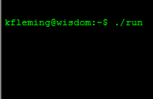
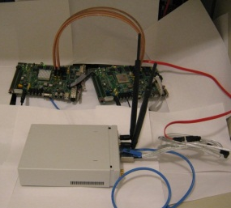
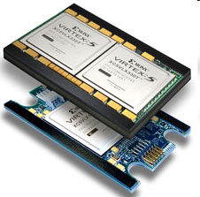
Portability: Leveraging abstraction
stdio.printf(msg,List::nil);
User
Module
STDIO
Node
User
Module
printf()
User
Module
STDIO
Node
STDIO
Node
STDIO Service
STDIO Service
Marshaling
Marshaling
Virtual Channel Multiplexing
Virtual Channel Multplexing
Simulation Physical Devices
ACP Physical Devices
Simulation Driver
XUPV5 Kernel Driver
XUPV5 Physical Devices
ACP Kernel Driver
FPGA
CPU
Simulator
void channelToHost(long long data);

Slide 22
Conclusion
LEAP enables FPGA programmers to focus on programming
Simple primitives for communication and memory eliminate many FPGA-related headaches
Platform abstraction permits portability among FPGA platforms
Automatic partitioning of designs across FPGAs
LEAP provides powerful system libraries, enhancing productivity
Debugging FPGAs by printf ☺

Slide 23
Questions?

Slide 24
AWB: Managing hardware and building systems

Slide 25
Describing complex systems
User
Module
LEAP simplifies the programmer interface to the FPGA
Changing FPGA targets is as simple as plug-n-play
But managing code for the FPGA is complicated
Each FPGA requires a platform-specific set of files
`ifdef quickly falls over
LEAP relies on the AWB code management infrastructure to provide these functionalities
STDIO
Node
User
Module
User
Module
STDIO
Node
STDIO
Node
STDIO Service
Marshaling
Virtual Channel Multiplexing
FPGA Physical Devices
FPGA

Slide 26
What is AWB?
An set of abstractions that enables the plug and play of modules to facilitate design
A suite of tools to support rapid modular construction and analysis of designs
GUI and command line interfaces
Released under GPL (specific projects/models may not be)

Slide 27
Why Modularity?
Speed of development
Well thought out interfaces => better design
Cooperative development
Sharing components between projects
Improved robustness through reuse
Facilitates design trade-offs, e.g., speed/complexity
Design space experimentation w/o code bloat
Factorial development and evaluation
Notes:
Encourages isomorphism to design by enforcing hierarchical representation of the model.

Slide 28
AWB Projects
AWB
Asim
Alpha
LEAP
HASIM
Airblue
H.264
EV8
EV9
X86
Secret
…
802.11
Softrate
Alpha
Secret
…
…
…

Slide 29
AWB Glossary
Packages (codebases) - .pack files:
are stored in repositories and checked out, or
are referenced locally on a system
become part of a users local workspaces
are versioned
can be grouped into sets called bundles
which can be checked out together
contain modules, models (projects) and benchmarks

Slide 30
AWB Glossary
Models (projects) - .apm files:
are a description of a hierarchy of modules
are turned into a build directory tree via a configuration step
Benchmarks - .cfg files:
are a description of a run of a design
are turned into a run directory tree via a setup step

Slide 31
AWB Glossary
Workspaces
are a place to work on awb-based projects
can contain multiple packages
can contain multiple build directories,
which can contain multiple benchmark runs
http://asim.csail.mit.edu/redmine/projects/awb/wiki/Glossary

Slide 32
What is the ROI for so much mechanism?
The layer of abstraction brings distributed modules and tools under one umbrella
Distinct packages may be independently developed, maintained and access controlled
Bundles simplify creation of projects that are composed of code from different packages and allow base lining those projects with a specific code revision
A unified model (project) representation facilitates creation of alternative designs (and build procedures)
A standardized module representation facilitates code swapability, reuse and creation of reusable build procedures.
Workspaces organize the simultaneous use of multiple packages and multiple projects over multiple benchmarks.

Slide 33
AWB Operation Example
Repositories
Workspace

Slide 34
AWB module details
Modules represent the unit of “swapability” in source code
Each module is defined in an .awb file
Textual %name and %description of the module
List of the %source files that comprise the module’s code
E.g., C, C++, BSV, Makefiles or Scons files.
Modules also %provide an AWB type (different from C++ type)
E.g., branch_predictor, fetch, decode, execute, cache
Modules can %require modules of specific AWB types
E.g., cache may require a pre_fetcher and different prefetch schemes would provide the same AWB type “pre_fetcher”
Modules can describe %parameters the user can vary
Parameters can be static (compile time) or dynamic (run time)
Notes:
Source code may be a build procedure….

Slide 35
Module Configuration – Example .awb File
%name APE Unit Tester
%desc APE – The AWB Plugin Exerciser
%attributes ape test
%provides system
%requires feeder ape_driver isa
%source –-public ape.h
%source –-private ape.cpp ape-util.cpp
%param MAX_INST_BUF_SZ 1024 “Number of instr buffer entries”
%param --global MAX_IDLE_CYCLES 256 “Maximum number of idle cycles”
http://asim.csail.mit.edu/redmine/projects/awb/wiki/Awb_file

Slide 36
Modules
Multiple modules may have the same awb type, but must have unique %names.
If two modules provide the same awb type then this is an assertion that they can be swapped for one another and that the result will be a coherent set of code that will successfully build.

Slide 37
From Modules to Models
A model (project) is an interesting configuration selected by the user:
All parameter values are set (unset ones use their default)
All “requires” choices are made between alternative modules
Stored in a .apm file
Created using apm-edit GUI

Slide 38
Example Module Hierarchy
S
C
M
N
F
D
R
X
C
W
B
Notes:
Fundamental components – module
Hierarchical
Specifies a type of module

Slide 39
Simple Example: Module Selection
S
B
C
M
N
B
F
D
R
X
C
W
B
B
B
B
Notes:
Can select a specific implementation of a module

Slide 40
Complete Example: Module Selection
S
S
B
C
C
M
M
N
N
B
F
F
D
D
R
R
X
X
C
C
W
W
B
B
B
B

Slide 41
Default Choices via Attributes
S
B
C
M
N
B
F
D
R
X
X
C
W
B
B
B

Slide 42
Workspace Structure
<workspace-name>/
awb.config - configuration file for this workspace
src/ - area for checked out packages
<package-A>/
<package-B>/...
build/ - area where models are built and run <project-A>/...
pm/ - source build tree
obj/ - object tree of built objects
src/ - source tree (links to module sources)
<model> - built executable of model
Makefile - synthesized Makefile
bm/ - area where benchmarks are run
<benchmark-A>/...
run/ - area where experiments/regressions run
http://asim.csail.mit.edu/redmine/projects/awb/wiki/Glossary#Workspace
Notes:
“build” area is managed asim tools. The areas inside a package are more user controlled.

Slide 43
Awb.config file format
[Global]
VERSION=1.4
Class=Asim::Workspace
[Vars]
shared=/usr/share/asim/packages
[Paths]
# Directory containing actual benchmarks
BENCHMARKDIR=/usr/share/asim/benchmarks
# Path where we search for ASIM files
SEARCHPATH=src/leap:…:${shared}/awb/HEAD
[Build]
# Make flags for all model builds
MAKEFLAGS=
Options for many tools that can be inserted in awb.config can be obtained via –options switch, e.g.,
% awb-run –options
[awb-run]
BUILD=1
BUILD_ALL=0
BUILD_DISTCC=0
…
Search for options proceeds from:
<workspace>/awb.config
~/.asim/asimrc
<prefix>/etc/asim/asimrc
http://asim.csail.mit.edu/redmine/projects/awb/wiki/Awbconfig

Slide 44
Repositories
The CVS, SVN, or GIT repositories described in: 1) ~/.asim/repositories.d/<package-name>.pack 2) <prefix>/etc/asim/repositories.d/<package-name>.pack 3) <prefix>/etc/asim/asim.pack
Check out with command:
% awb-shell checkout package <pkg-name>[/<version>]
Get updates with command:
% awb-shell update package <pkg-name>|all
Commit changes with command:
% awb-shell commit package <pkg-name>|all
http://asim.csail.mit.edu/redmine/projects/awb/wiki/AWB_example_setup_command_line
Notes:
Prerequisites
– cvs “login” to repository for anonymous access
- ssh key setup…

Slide 45
Package Structure Details
<package-name>/
admin/ - awb-managed administrative files
config/
pm/ - model configurations …/…/<model-A>.apm …/…/<model-B>.apm
bm/ - benchmark configurations …/…/<benchmark-A>.cfg …/…/<benchmark-B>.cfg
modules/ - modules
…/…/<module-A>/ <module-A>.awb - module description <module-A>.h - module source <module-A>.cpp
<module-A>.bsv
<miscelaneous>/ - package specific directories
http://asim.csail.mit.edu/redmine/projects/awb/wiki/Glossary#Package

Slide 46
Manipulating the Search Path
Automatic:
Checking out/using a package adds it to the path by default
Semi-automatic
Run command:
% awb-shell add package <directory>
Manual
Edit awb.config

Slide 47
Model Build
Since a model is created from a pool of modules, the build paradigm adds a new step to “configure” a model source tree from that pool of modules.
Therefore a workspace has:
A “source” area with a pool of module sources where users add modules and make changes to existing modules…
A “build” area for “configured” models that is managed almost entirely by the awb infrastructure…filled with build trees populated with links to the actual source files and synthesized source files.
Note: the actual tool used to do the configure is determined by the ‘type’ of the model.
Notes:
Within the directory of a particular model in the build area you see essentially a normal source tree.
Source area also has configuration files for configuring models and describing benchmarks.

Slide 48
Model Configurations
Found in: config/pm/.../<model>.apm
Contains:
module hierarchy
module parameters
To perform the configure a project, cd into your workspace and type:
% awb

Slide 49
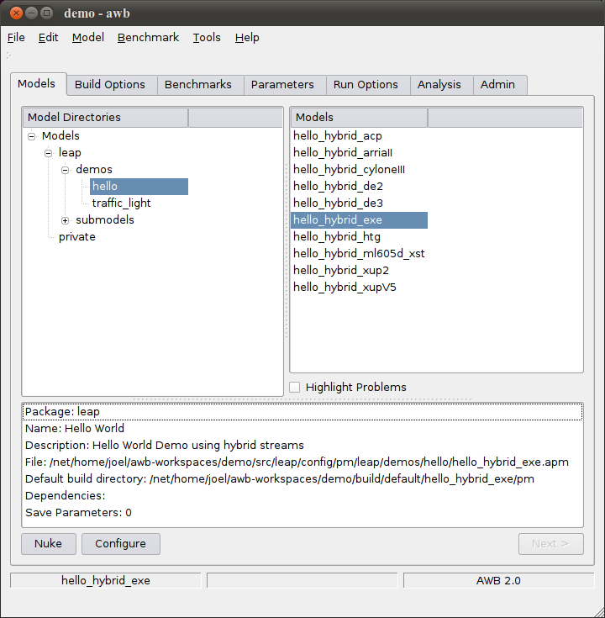
AWB- GUI
The ‘configure’ button invokes the proper configure tool as determined by the model type. (See apm-edit for details)

Slide 50
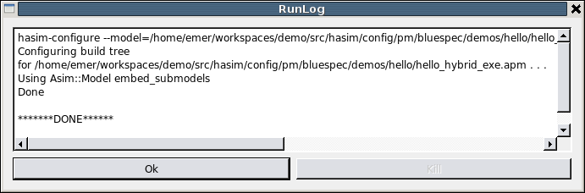
AWB- GUI
Runlog shows the command line tool invoked. Should have been leap-configure, which creates a build directory.

Slide 51
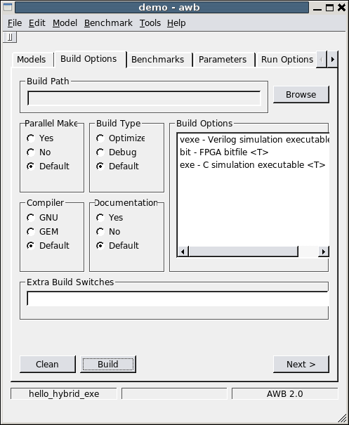
AWB- GUI
The ‘build’ button invokes ‘make’ (or ‘scons’) in the build tree created by the configure script.

Slide 52
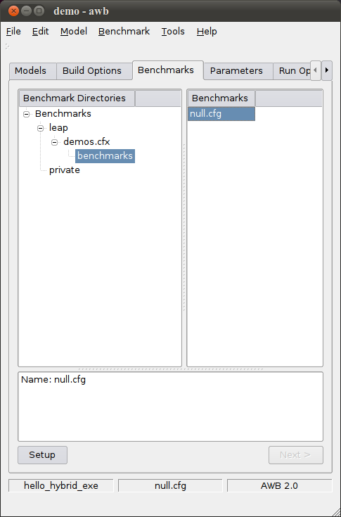
AWB- GUI
The ‘setup’ button invokes the proper benchmark setup tool as determined by the model type. (See apm-edit for details)

Slide 53
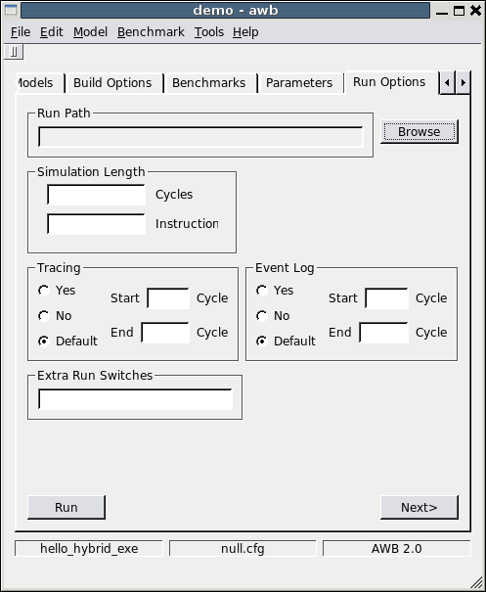
AWB- GUI
The ‘run’ button invokes the ./run script in the benchmark directory created by the benchmark setup script.

Slide 54
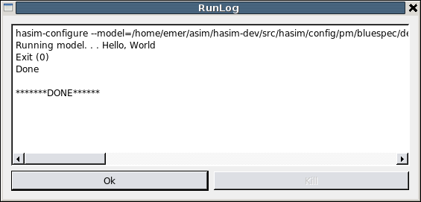
AWB- GUI
http://asim.csail.mit.edu/redmine/projects/awb/wiki/AWB_example_build_GUI

Slide 55
Awb-shell
% awb-shell
awb> configure model <model>
awb> build model
awb> setup benchmark <benchmark>
awb> run benchmark
awb> quit
Example:
<model> = config/pm/leap/demos/hello/hello_hybrid_exe.apm <benchmark> = config/bm/leap/demos.cfx/benchmarks/null.cfg
http://asim.csail.mit.edu/redmine/projects/awb/wiki/AWB_example_build_command_line

Slide 56
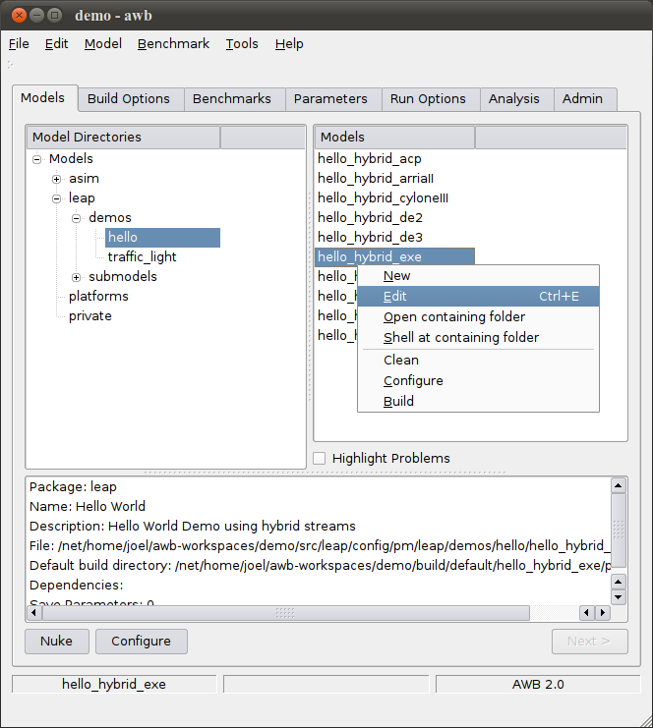
Apm-edit - GUI

Slide 57
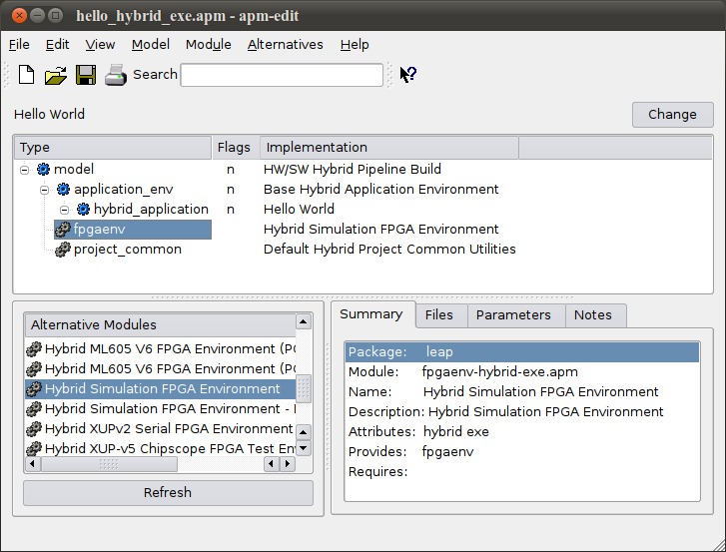
Apm-edit - GUI
Alternative module operation – replace module in tree with module or submodel
Module properties operations - edit module, open shell in module’s source directory.
Notes:
Operations – replace module in tree, edit module, open shell in module’s source directory.

Slide 58
Spare Slides

Slide 59
Hello World on a FPGA
Host Processor
FPGA Board
CPU/Memory
FPGA Chip
Software
Application
Inputs
FPGA
Application
Outputs
Memory
Block RAM
On-board RAM
Channel
Channel
FPGA code written in Bluespec
Physical
Logical
Notes:
Platform Assumptions
Hybrid host system with an FPGA and a CPU
Hybrid application with an FPGA and a software component
Application invoked from software
Parameters sent from software to FPGA
FPGA output sent to software that displays it on stdout

Slide 60
Solving the FPGA via Abstraction
Implement a Channel
Identify and multiplex multiple client modules
LEAP Abstraction: Channel IO
Make the Channel more useful
Chunk and marshal typed messages
Syntactic sugar
LEAP Abstraction: Remote Request Response (RRR)
Build high-level Services
LEAP Abstraction: Soft Services

Slide 61
Solving Problems via Abstraction
Implement a Channel
Identify and multiplex multiple client modules
LEAP Abstraction: Channel IO
Make the Channel more useful
Chunk and marshal typed messages
Syntactic sugar
LEAP Abstraction: Remote Request Response (RRR)
Build high-level Services
LEAP Abstraction: Soft Services

Slide 62
LEAP Abstraction Layers: Channel IO
Channel 0
Channel 1
Channel 1
Channel 0
Channel IO
Channel IO
FPGA Platform Physical Devices
Kernel Driver
FPGA
CPU

Slide 63
Solving Problems via Abstraction
Implement a Channel
Identify and multiplex multiple client modules
LEAP Abstraction: Channel IO
Make the Channel more useful
Chunk and marshal typed messages
Syntactic sugar
LEAP Abstraction: Remote Request Response (RRR)
Build high-level Services
LEAP Abstraction: Soft Services
[ Parashar et. al., WARP 2008 ]

Slide 64
RRR Specification Language
// ----------------------------------------
// create a new service called ISA_EMULATOR
// ----------------------------------------
service ISA_EMULATOR
{
// --------------------------------
// declare services provided by CPU
// --------------------------------
server CPU <- FPGA;
{
method UpdateRegister(in REG_INDEX, in REG_VALUE);
method Emulate(in INST_INFO, out INST_ADDR);
};
// ---------------------------------
// declare services provided by FPGA
// ---------------------------------
server FPGA <- CPU;
{
method SyncRegister(in REG_INDEX, in REG_VALUE);
};
};

Slide 65
LEAP Abstraction Layers: RRR
Channel IO
Channel IO
FPGA Platform Physical Devices
Kernel Driver
FPGA
CPU

Slide 66
LEAP Abstraction Layers: RRR
RRR
specification
files
Client Stub
Server Stub
Channel IO
Channel IO
FPGA Platform Physical Devices
Kernel Driver
FPGA
CPU

Slide 67
LEAP Abstraction Layers: RRR
ClientStubs.ISA_EMULATOR iemu;
...
...
iemu.UpdateRegister.Request(
REG_R27, regFile[REG_R27]);
...
...
iemu.Emulate.Request(inst);
...
...
tgtPC <- iemu.Emulate.Response();
ISA_EMULATOR::UpdateRegister(
REG_INDEX i,
REG_VALUE v)
{
regFile[i] = v;
}
ISA_EMULATOR::Emulate(
INST_INFO inst)
{
// emulate the instruction
return target_PC;
}
User Code
User Code
Client Stub
Server Stub
Channel IO
Channel IO
FPGA Platform Physical Devices
Kernel Driver
FPGA
CPU

Slide 68
LEAP Abstraction Layers: RRR
User Application
Stub
Stub
Stub
Stub
Stub
Stub
Channel IO
Channel IO
FPGA Platform Physical Devices
Kernel Driver
FPGA
CPU

Slide 69

Modularity in FPGA Accelerators
Airblue 802.11g
PHY
Debug Out
RX Pipeline
TX Pipeline
PCIe
Error Correction
A bug!
Add debugging logic
Route to Debug Out
BCJR
Viterbi
SOVA

Slide 70
The Modularity Problem
Airblue 80211.g
PHY
Debug Out
RX Pipeline
TX Pipeline
PCIe
Error Correction
A bug!
Add debugging logic
Route to Debug Out
Branch
Pred
BCJR
How many modules change?
Alternatives can worsen problem
What if alternatives give different insight?
Worst case: work grows multiplicatively
Notes:
Verilog OOMRs not satisfactory
Break the modular abstraction
Requires “Debug Out” to have knowledge of CPU, Front End, etc
SystemVerilog IFCs only partial solution

Slide 71
LEAP Abstraction: Soft Connections
debugConn = mkSend(“debug_info”);
.
if (bad_thing_happened && debugConn.notFull)
debugConn.send(interesting_info);
Airblue 802.11g
PHY
Debug Out
recv( )
“debug_info”
RX Pipeline
TX Pipeline
PCIe
connFromPHY = mkRecv(“debug_info”);
.
if (connFromPHY.notEmpty) {
pcie.xfer(connFromPHY.first);
connFromPHY.deq();
}
Error Correction
Added during compilation
BCJR
send( )
“debug_info”
Create channel between BCJR and Debug
Identify endpoints with text string
Have HDL compiler make the connection
Connection acts like a queue (guarded output FIFO)
[ Pellauer et. al., DAC 2009 ]

Slide 72
Solving Problems via Abstraction
Implement a Channel
Identify and multiplex multiple client modules
LEAP Abstraction: Channel IO
Make the Channel more useful
Chunk and marshal typed messages
Syntactic sugar
LEAP Abstraction: Remote Request Response (RRR)
Build high-level Services
LEAP Abstraction: Virtual Services and Devices

Slide 73
LEAP Abstraction Layers: Services
Panel
Debug
Stats
Panel
Debug
Stats
Platform
Services
Asserts
Scratchpad
Central
Cache
Asserts
Scratchpad
Starter
STDIO
Params
Starter
STDIO
Params
Stub
Stub
Stub
Stub
Stub
Stub
Channel IO
Channel IO
FPGA Platform Physical Devices
Kernel Driver
FPGA
CPU

