Slide 1

Summary of telomere analysis to date
Kyle M. Douglass
August 12, 2014

Slide 2
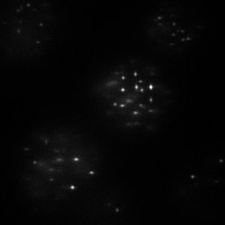
Do the telomeres display different sizes when subjected to different treatments?
How large are the telomeres?
How many molecules comprise each structure?
What are the shapes of the structures?
By how much do the above quantities vary?
10 µm
Widefield image of telomeres

Slide 3
Background information on telomeres
Telomeres were imaged in fixed cells and subjected to two different treatments, resulting in one group containing longer telomeres than the other.
L group: 10 – 30 kbp
S group: 4 – 10 kbp
Three different slides of each group were imaged on the Nikon super-resolution microscope in the BIOP using a cylindrical lens for 3D imaging.
DNA-FISH was performed to label the telomeres with labels that were 18 bp long.
The fluorophore was Cy5.
Datasets were comprised of drift-corrected x-, y-, and z-coordinates of all localizations in an image.
Localizations in which a molecule was on for ten consecutive frames or more were discarded before we received the dataset.

Slide 4
How can we assess the size of a cluster of points?
Measure moments of the distribution of localizations within the cluster
Draw shape around the localizations and measure volume of that shape
Count number of localizations in a cluster

Slide 5
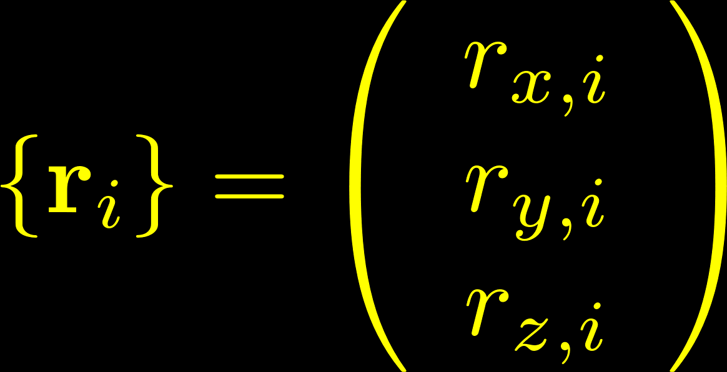
Information about the telomeres is represented by probability distributions.
All localizations are represented by a set of random vectors in 3-space.
z
y
x
r_{i} determined by
Uncertainty in the measurement process
Uncertainty in labeling efficiency
The underlying telomere structure
Raw data: a set of points in 3D
Notes:
Be clear that this treatment is for a single telomere, and we sample multiple telomeres.

Slide 6
Hypothesis tests are performed on moments of the localization distributions.
The distributions of r_{x}, r_{y}, and r_{z} tell us how the points are arranged within each telomere.
A super-resolution experiment is a random sample from these underlying distributions.
The moments of the distributions contain the information on the size and shape of each cluster.
Notes:
Why test against the moments?

Slide 7
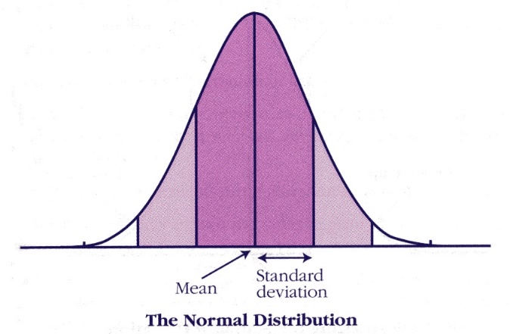
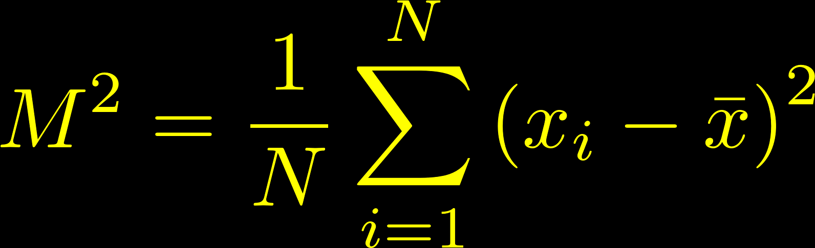
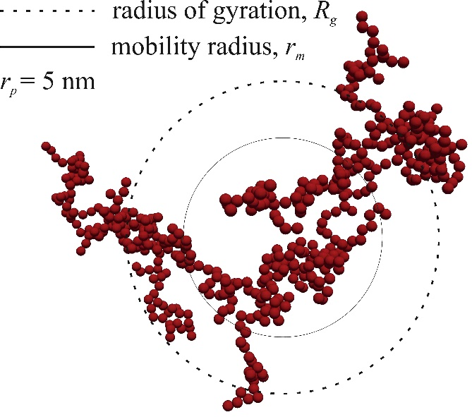
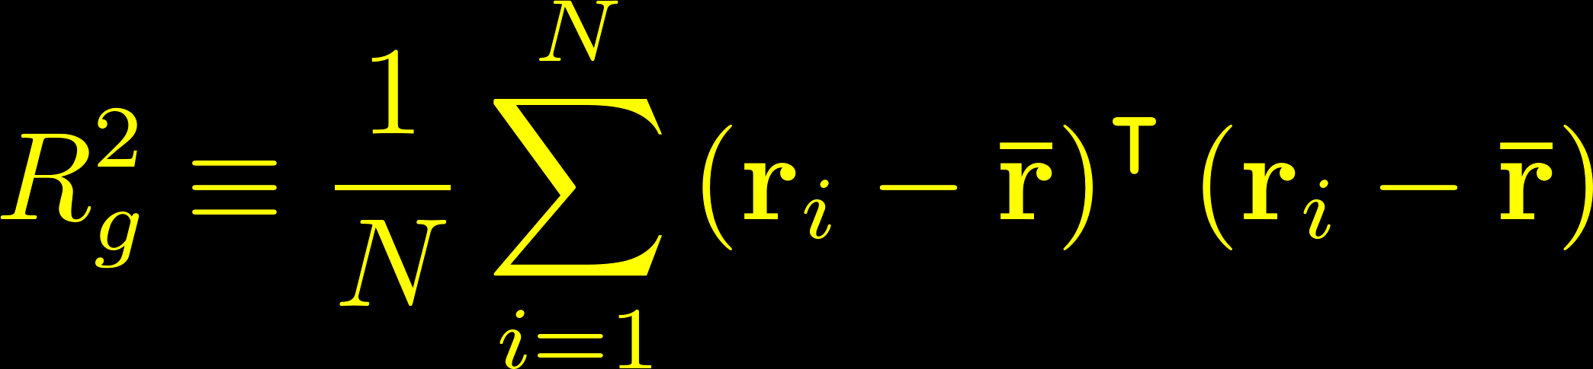
The variance of the points within a cluster is a measure of its size.
The second central moment of a distribution matches our physical intuition about size.
http://cnx.org/content/m16870/1.1/
In polymer physics, the sum of the mean square distances of the monomer units from the average position in x, y, and z is known as the radius of gyration.

Slide 8
Summary so far…
We want to learn about the size and shape of the telomeres.
The telomeres are represented by sets of points in 3D with randomly distributed values for their coordinates.
The probability distributions of the coordinate values are determined by measurement uncertainties and the telomere structures.
More specifically, the moments of the probability distributions provide information on the size and shape of the telomeres.
The moments are derived from randomly sampling the underlying distributions and are therefore subject to noise.
z
y
x

Slide 9
How else can we assess the size of a cluster of points?
Measure moments of the distribution of localizations within the cluster
Draw shape around the localizations and measure volume of that shape
Count number of localizations in a cluster

Slide 10

Determining the volume of a polyhedron defined by a set of randomly distributed points in R³.
Geometry review
A shape (or set) is convex if for any two points that are part of the shape, the whole connecting line segment is also part of the shape.
Convex
Not convex
The convex hull of a set of points is the smallest convex set that contains all the points.
The convex hull should “over-estimate” the volume filled by the points.

Slide 11
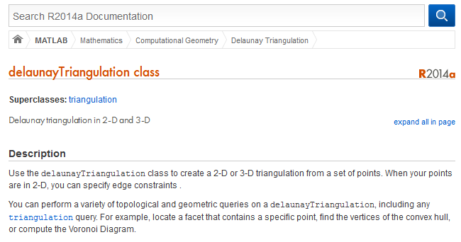
How to find the complex hull of a cluster and its volume
(Answer: smart people have already done it for us)
The convex hull should “over-estimate” the volume filled by the points.

Slide 12
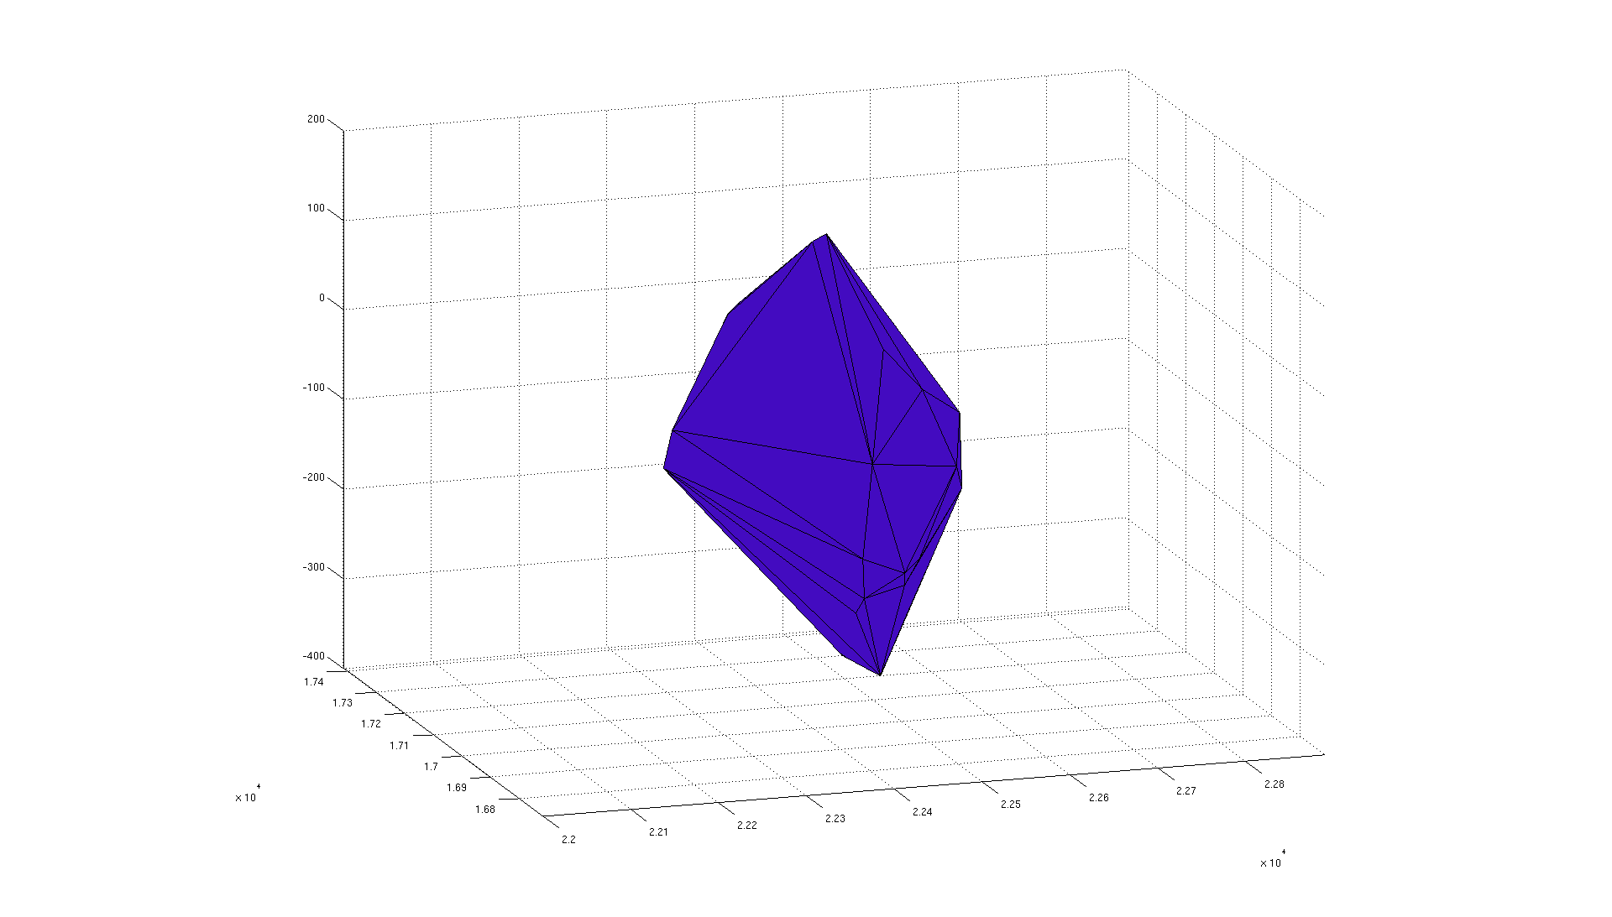
Here’s what one looks like…

Slide 13
How else can we assess the size of a cluster of points?
Measure moments of the distribution of localizations within the cluster
Draw shape around the localizations and measure volume of that shape
Count number of localizations in a cluster
For the time being, we’ll count each fluorophore as a distinct molecule, but in the future this will have to change…

Slide 14
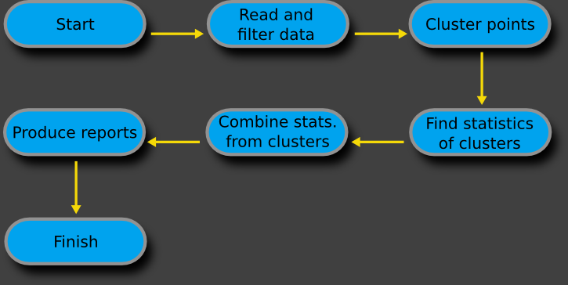
Algorithm for analyzing the telomere data

Slide 15
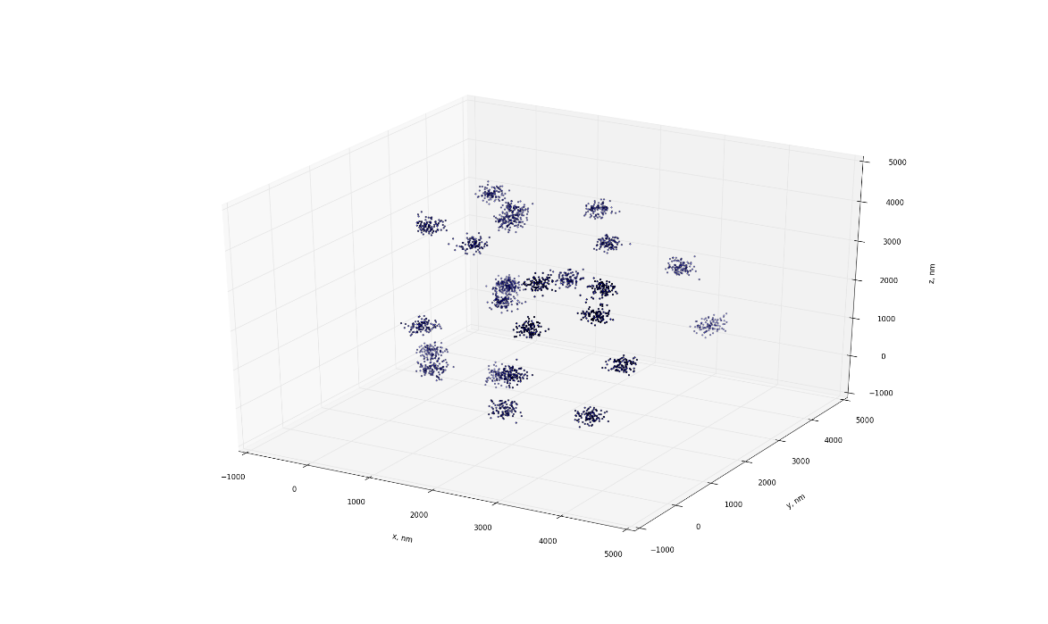
First we’ll test the analysis against a known dataset.
25 clusters uniformly randomly distributed in a 3D space 40 microns X 40 microns X 1 micron
100 points per cluster
Each point is normally distributed about a cluster center with a standard deviation of 100 nm
(This picture is actually in a 4 X 4 X 4 micron space; it’s easier to visualize the clusters like this.)

Slide 16
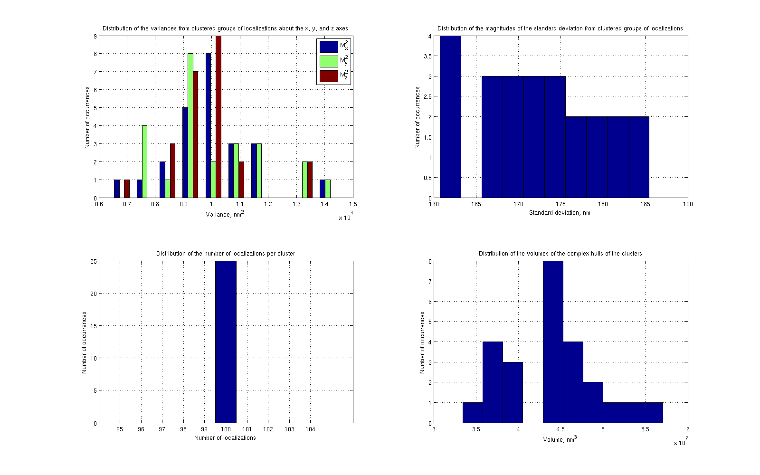
Square root of R_{g}²

Slide 17
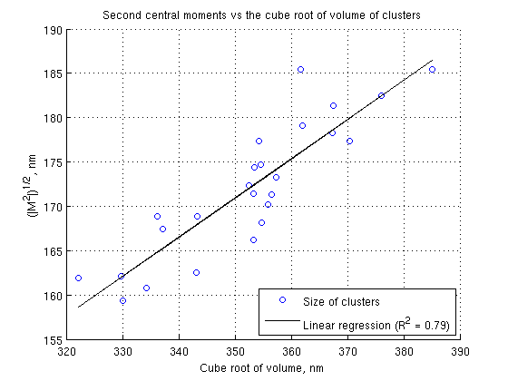
The second moment and the complex hull volume match our intuition of volume.
Square root of R_{g}²

Slide 18
Now onto the telomere data…
Two datasets, labeled L (long) and S (short)
3D localizations acquired using Nikon astigmatic microscope in the BIOP and Cy5 as a label
~10 FOV’s taken on three different slides for L and S datasets
2424 identifiable clusters in the L data set; 1405 clusters in the S dataset

Slide 19
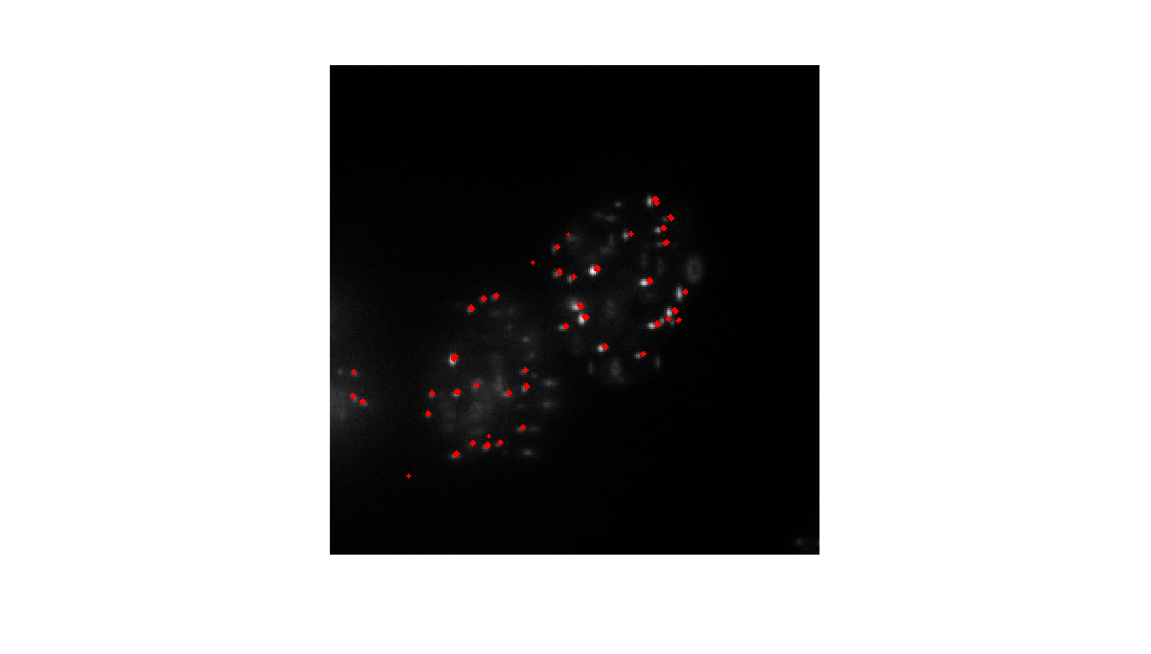
DBSCAN clustering captures most molecules, but some anomalous clusters appear.

Slide 20
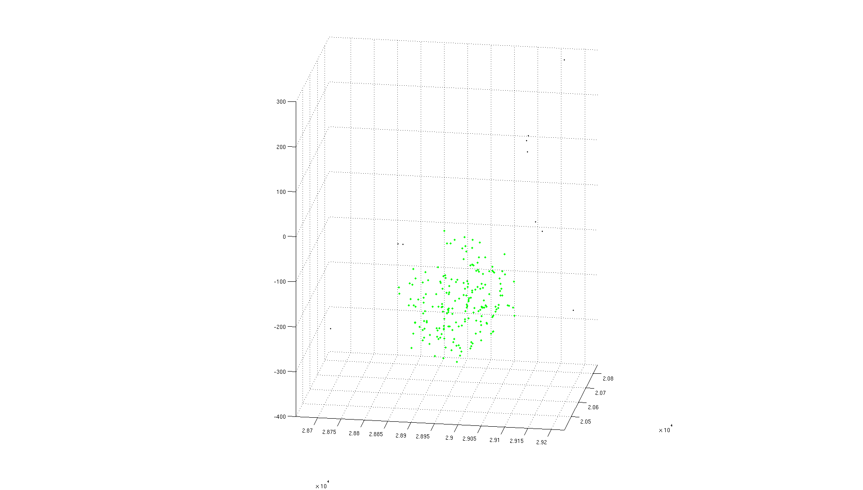
DBSCAN identifies most localizations within a cluster.

Slide 21
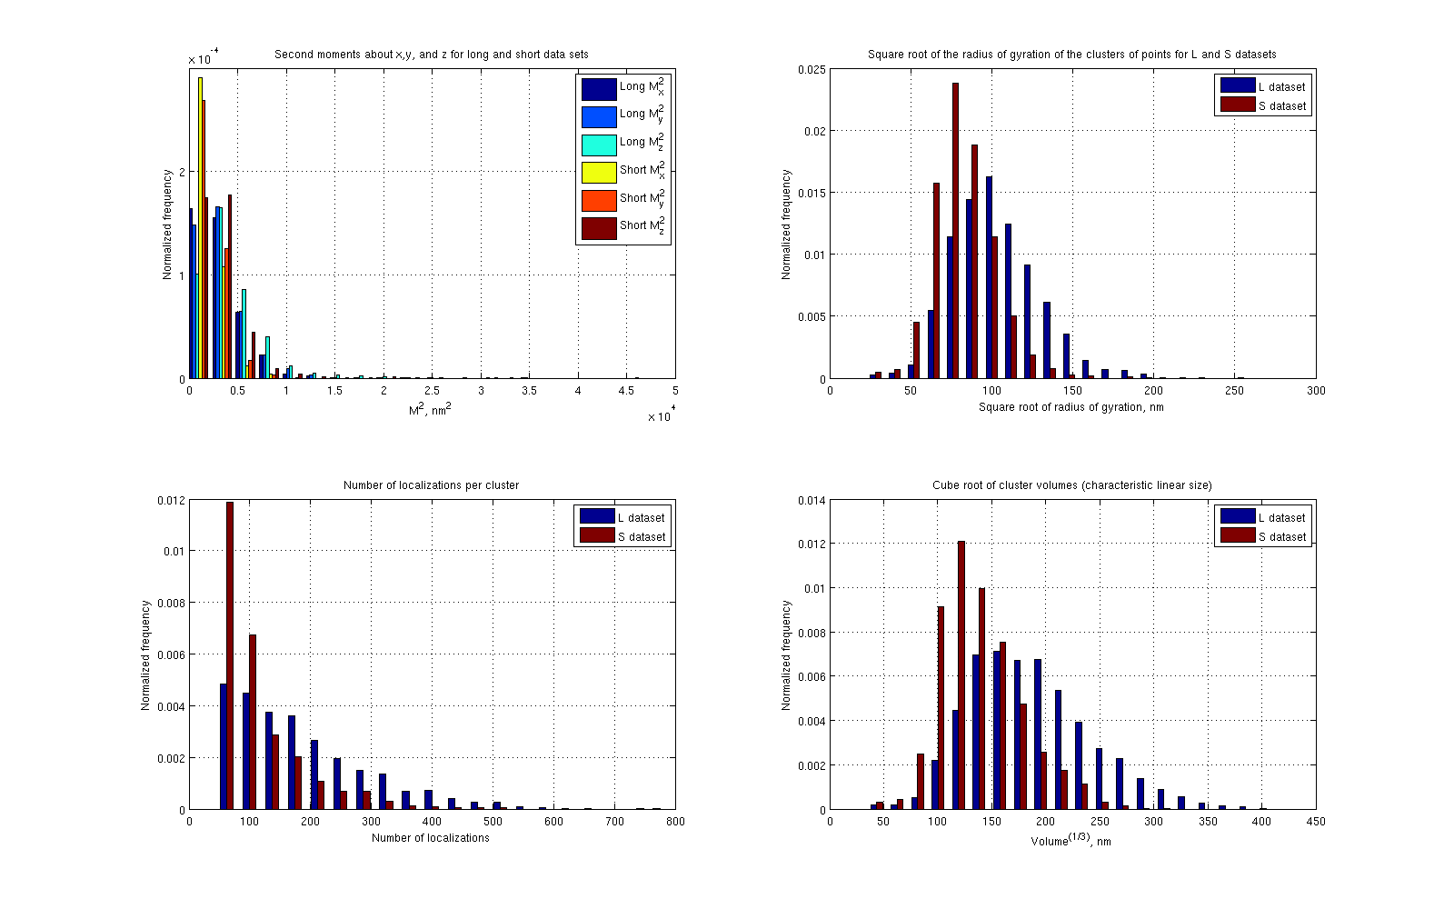
N_{L} = 2424
N_{S} = 1405
Mean(L) = 106 nm, Std(L) = 27 nm
Mean(S) = 85 nm, Std(S) = 19 nm
Mean(L) = 191, Std(L) = 111
Mean(S) = 119, Std(S) = 74
Mean(L) = 190 nm, Std(L) = 56 nm
Mean(S) = 142 nm, Std(S) = 38 nm

Slide 22
First impressions
The L dataset telomeres fill more space than the S dataset telomeres by both measures (second moments and volume of complex hull)
The L dataset telomeres contain more localizations than the S dataset telomeres (remember each localization was counted as a distinct molecule)
The clusters are slightly larger in the z-direction, which is likely due to a poorer localization precision along the optic axis.

Slide 23
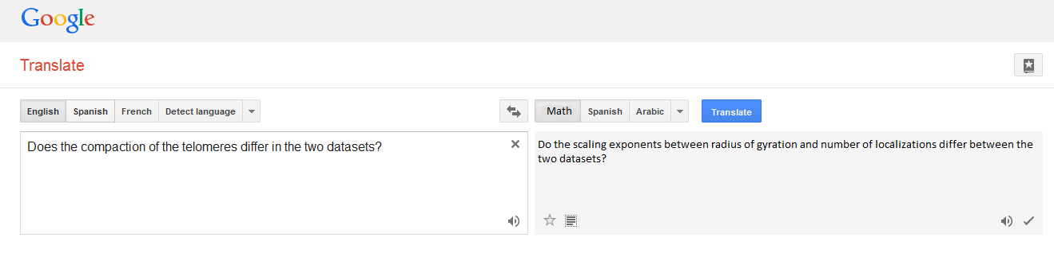
Does the compaction of the telomeres differ in the two datasets?

Slide 24

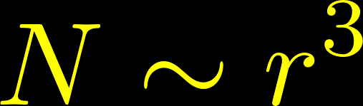
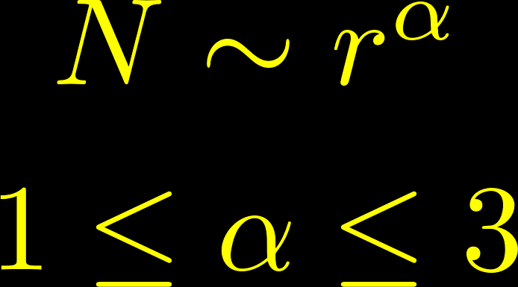
First let’s understand the scaling laws for polymer structures.
Structure
Scaling
Unfolded polymer in 3D
…
…
Uniformly randomly distributed monomers in 3D
Folded polymer in 3D
…
…

Slide 25
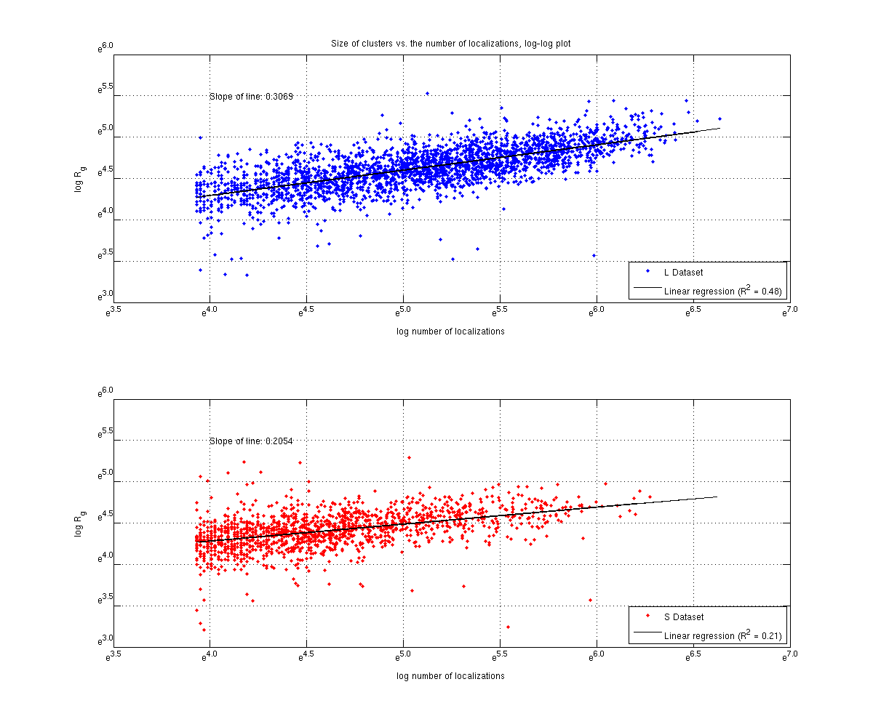
???

Slide 26
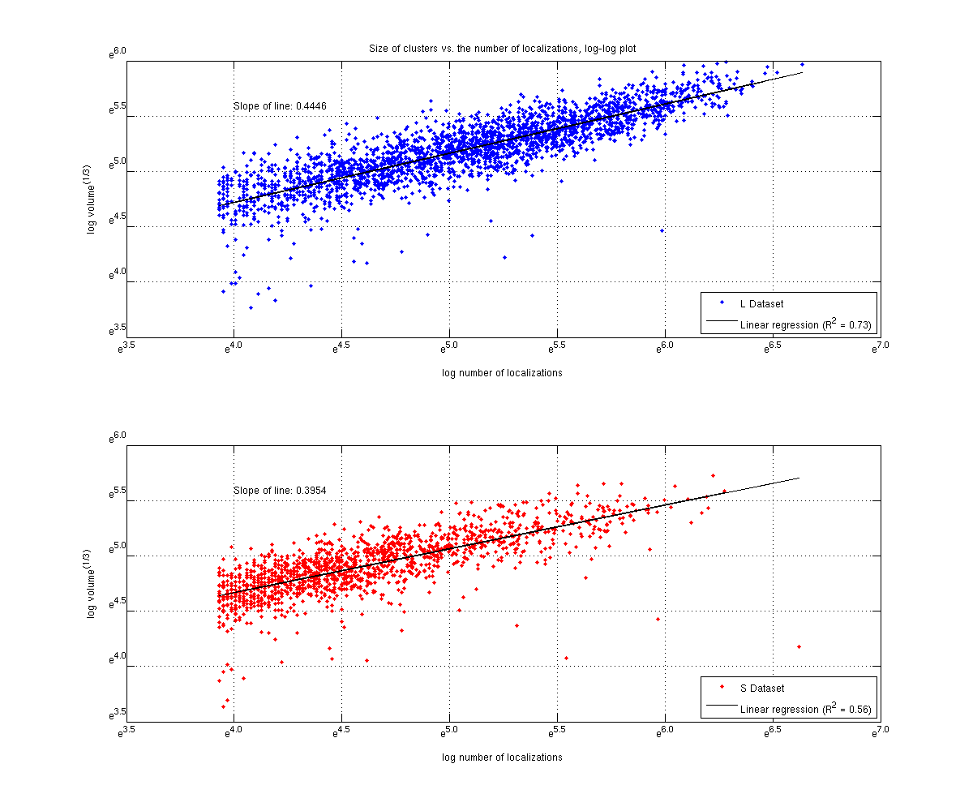

Slide 27
Data from new experiments
1. SmchD1 KD experiment:
data in 2 folders: folder 29_07_2014_HelaS_L_SmchD1_KD_FISH and folder
30_07_2014_HelaS_L_SmchD1_KD_FISH
What we did: transfected Hela S and L with:
control: pSuper
sh1 for SmchD1: pLVP041
sh2 for SmchD1: pLVP042
The cells are selected for the sh-plasmid for 4 days with antibiotics. For this experiment we did 1 transfection and stained 2 slides by FISH for each transfection (1 slide/condition is analyzed on the 29_07_2014; the 2 slide on the 30_07_2014: both slides are coming from the same transfection, i.e. same KD efficiency; we used the same buffer for both acquisitions). In each folder you will find sorted by condition: the .nd2 STORM files and the whitefield files .jp2. There is 1 folder for each data that contains all the molecule lists .txt sorted by condition.
2. LRif1 KD experiment:
data in folder 05_08_2014_HelaL_LRif1_KD_FISH
What I did: transfected Hela L with:
control: siGFP
siLRif1: si1LRif1
siLRif1: si6LRif1
These are siRNA transfection, i.e. the cells are not selected for a KD.
Transfection 48h.
For this experiment I did 2 transfections for each condition and stained 1 slide/transfection, i.e. 2 independent transfections for each
condition. In each folder you will find sorted by condition: the .nd2 STORM files
and the whitefield files .jp2. There is 1 folder for each date that contains all the molecule lists .txt sorted by condition.
For both experiments we took 15 pictures à 10000 frames/slide, i.e. 30
pictures/condition.
Alex took always 1 picture (this is nb_16) in the folder 30_07_2014 for
the SmchD1 experiment with 30000 frames.

Slide 28
SmchD1 Experiment
2014-07-29
 | pSuper |  |  | pLVP041 |  |  | pLVP042
 | Number | Mean R_{g} (nm) | Std. (nm) | Number | Mean R_{g} (nm) | Std. (nm) | Number | Mean R_{g} (nm) | Std. (nm)
L | 386 | 108 | 26 | 381 | 88 | 25 | 465 | 99 | 29
S | 331 | 83 | 23 | 246 | 80 | 24 | 334 | 86 | 21
2014-07-30
 | pSuper |  |  | pLVP041 |  |  | pLVP042
 | Number | Mean R_{g} (nm) | Std. (nm) | Number | Mean R_{g} (nm) | Std. (nm) | Number | Mean R_{g} (nm) | Std. (nm)
L | 383 | 108 | 28 | 355 | 105 | 27 | 486 | 105 | 30
S | 373 | 85 | 20 | 368 | 84 | 22 | 363 | 82 | 19

Slide 29
SmchD1 Experiment (cont.)
2014-07-29
Log-log slopes (outliers included)
 | pSuper | pLVP041 | pLVP042
L | 0.3626 | 0.3992 | 0.3905
S | 0.3893 | 0.3534 | 0.3077
2014-07-30
Log-log slopes
(outliers included)
 | pSuper | pLVP041 | pLVP042
L | 0.3634 | 0.3132 | 0.3761
S | 0.1911ª | 0.2960 | 0.3632
a – linear fit is notably bad

Slide 30
LRif1 KD Experiment (cont.)
2014-08-05
 | siGFP |  |  | si6LRif1 |  |  | si6LRif1
 | Number | Mean R_{g} (nm) | Std. (nm) | Number | Mean R_{g} (nm) | SD R_{g} (nm) | Number | Mean R_{g} (nm) | Std. (nm)
Trans. 1 | 427 | 112 | 26 | 559 | 110 | 27 | 498 | 104 | 26
Trans. 2 | 409 | 112 | 29 | 612 | 97 | 24 | 504 | 102 | 26

Slide 31
LRif1 KD Experiment
2014-08-05
 | siGFP | si1LRif1 | si6LRif1
Trans. 1 | 0.3742 | 0.3095 | 0.3519
Trans. 2 | 0.3684 | 0.3413 | 0.3669

Slide 32
TrF2 Knockdown Experiments
Removing TrF2 should cause a noticeable increase in the size of telomeres since it’s a key component of the Shelterin complex that “packs” the telomeres.

Slide 33
TrF2 KD
2014-08-11
Log-log slopes (outliers rejected)
 | pSuper | pLVP041 | pLVP042 | TrF2
L | 0.3624 | 0.3755 | 0.3752 | 0.3145
S | 0.2673 | 0.3018 | 0.3462 | X
2014-08-13
Log-log slopes
(outliers rejected)
 | pSuper | pLVP041 | pLVP042 | TrF2
L | 0.2589ª | 0.3582 | 0.2988 | 0.3242
S | 0.3825 | 0.4500 | 0.3590 | 0.3683
a – Noise draws slope slightly downwards

Slide 34
Extras

Slide 35
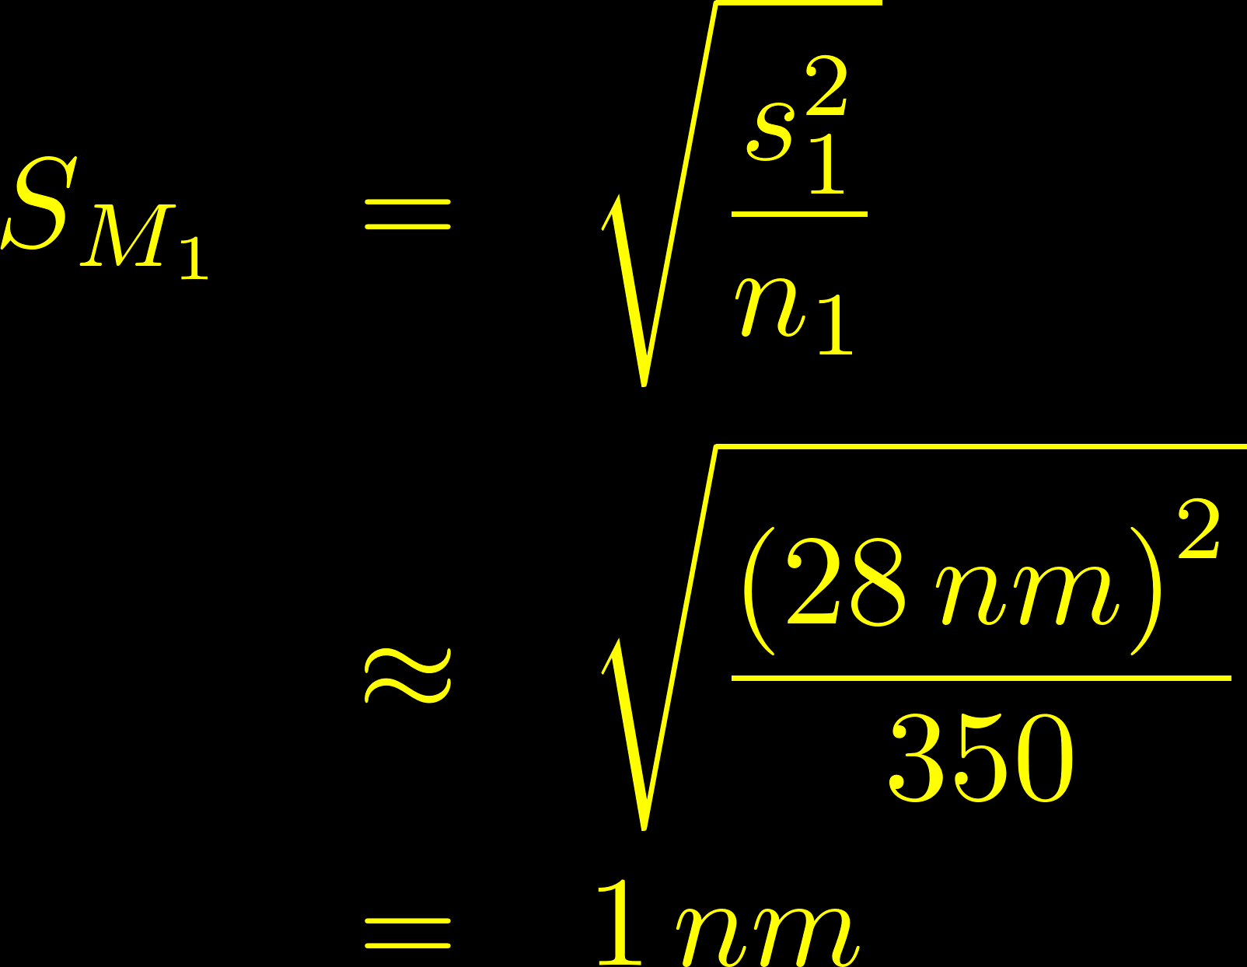
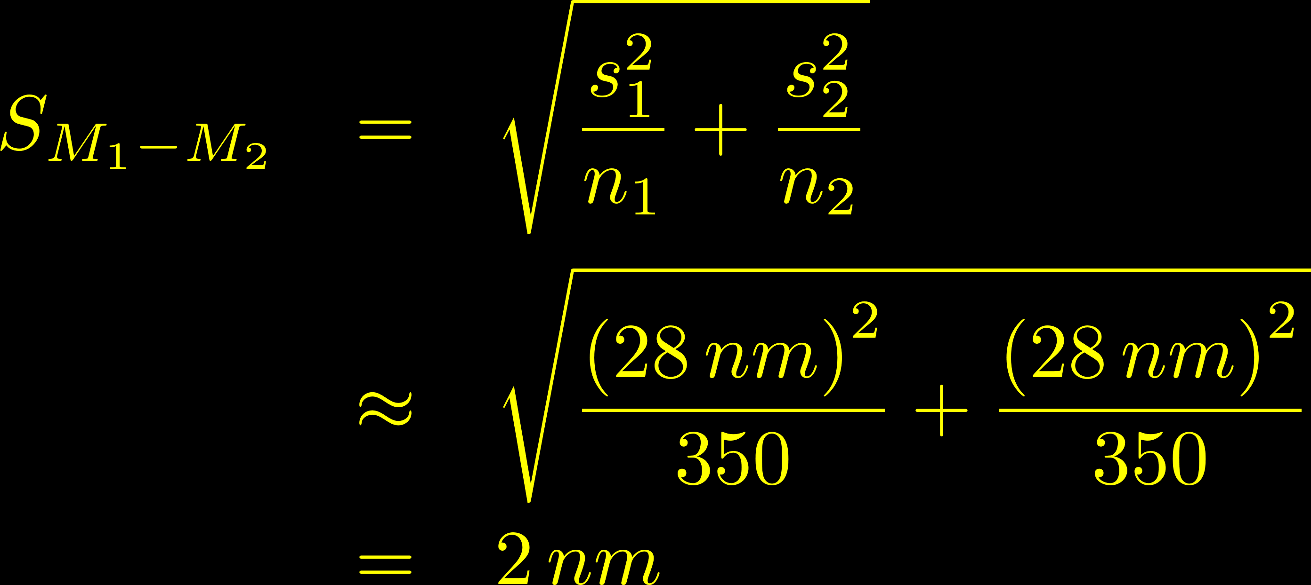
What are typical values for the standard errors here?
Standard error
of the difference between means
Standard error of the mean

