Slide 1
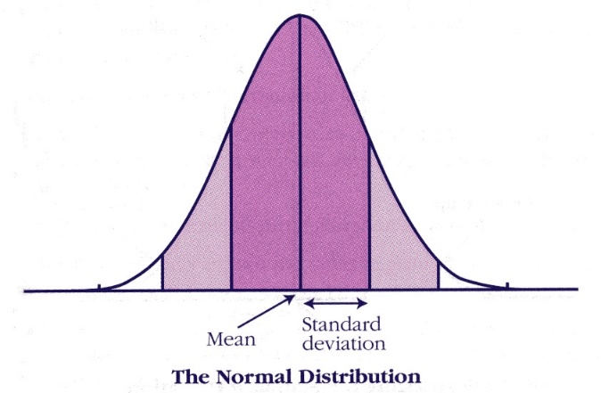
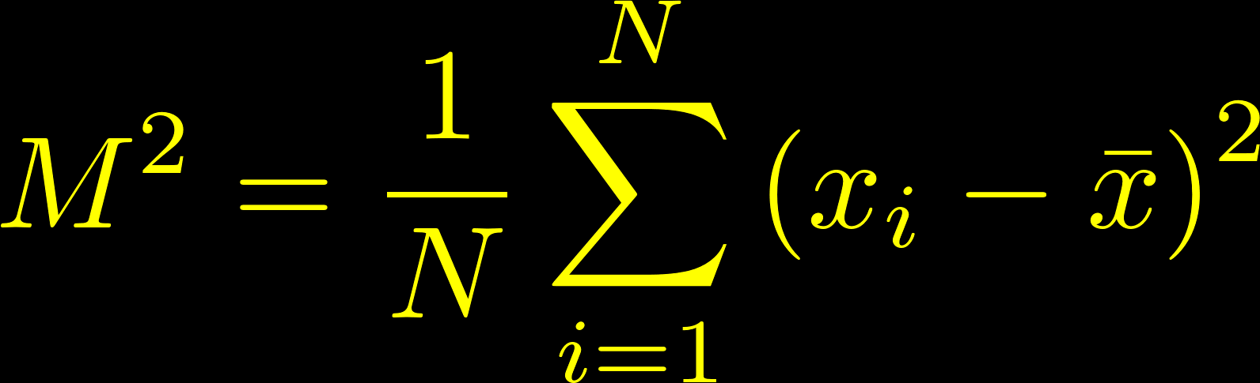
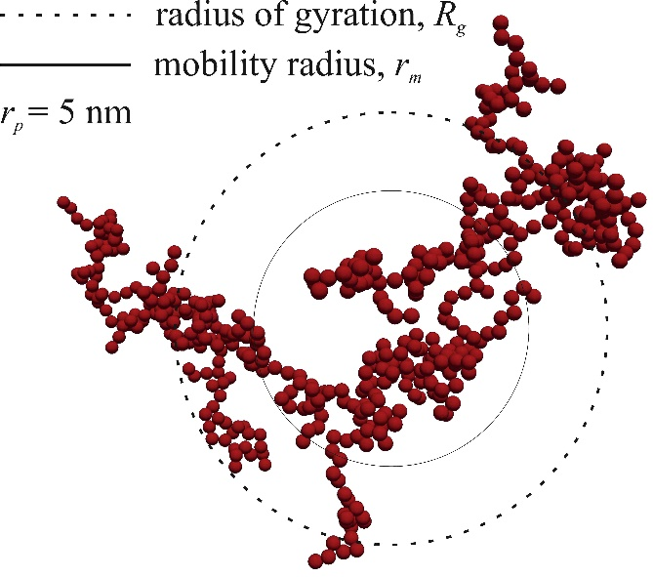
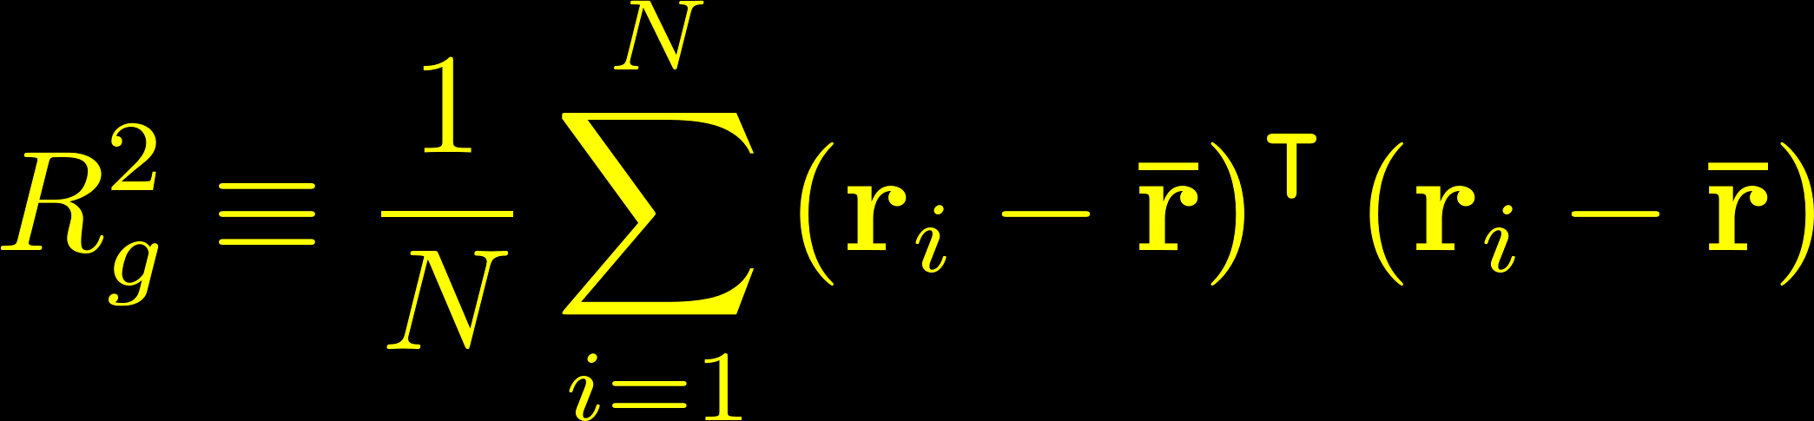
The variance of the points within a cluster is a measure of its size.
The second central moment of a distribution matches our physical intuition about size.
http://cnx.org/content/m16870/1.1/
In polymer physics, the sum of the mean square distances of the monomer units from the average position in x, y, and z is known as the
radius of gyration.
http://www3.aiche.org/proceedings/content/Annual-2011/images/Paper_233003_abstract_6042_0.jpg

Slide 2
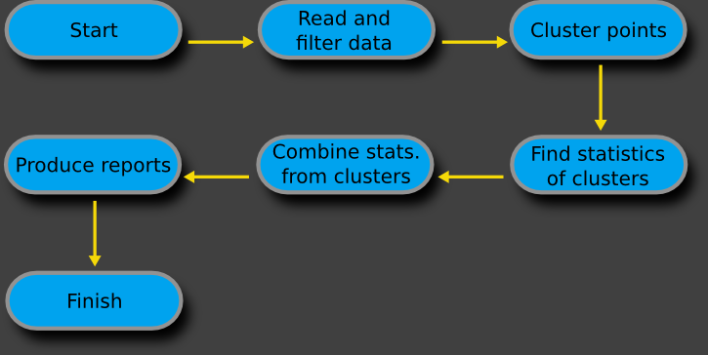
Algorithm for analyzing the telomere data

Slide 3
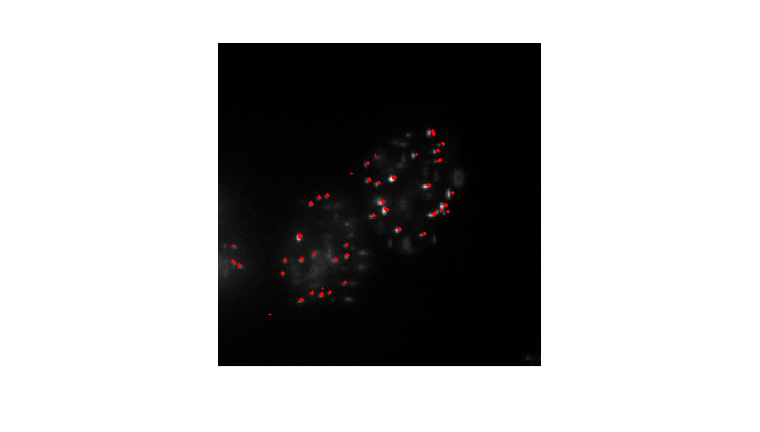
DBSCAN clustering captures most molecules and groups them accordingly.

Slide 4
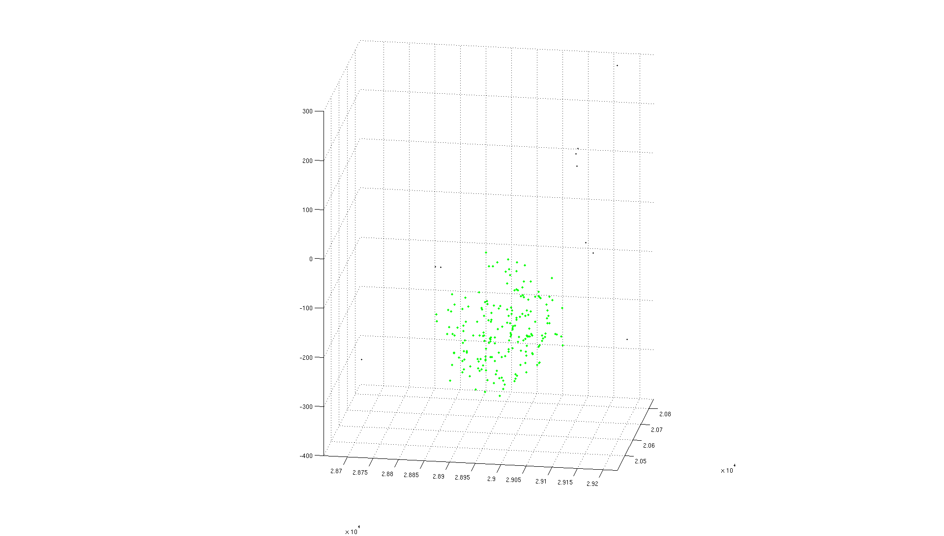
A single cluster, a.k.a. telomere, looks like this:

Slide 5
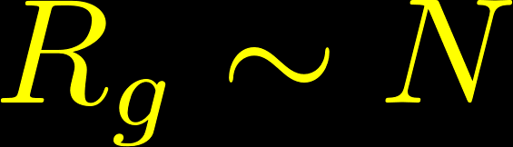
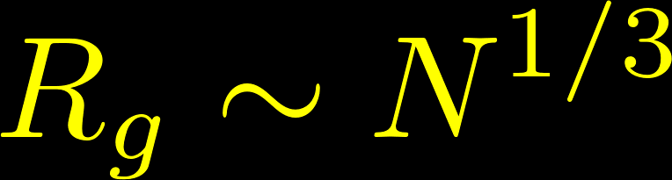
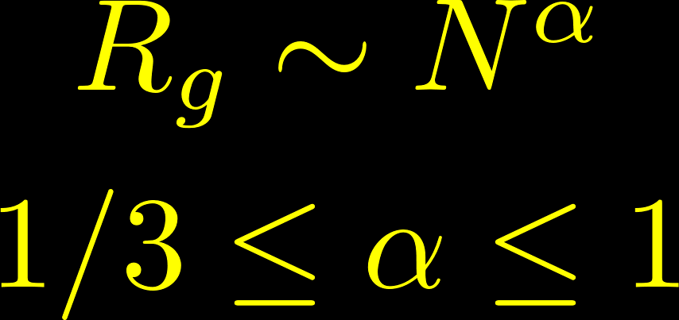
Scaling laws for ball and chain polymer models.
Structure
Scaling
Unfolded polymer in 3D
…
…
Uniformly randomly distributed monomers in 3D
Folded polymer in 3D
…
…

Slide 6
Flory-Huggins Mean Field Theory for Polymers in Solution
For a homopolymer (a single chain with the same type of monomer) in solvent, the lower and upper bounds on the scaling exponent are ν = 1/3 and ν = 3/5 respectively. The first corresponds to a fully compacted polymer due to hydrophobic interactions with the solvent, whereas the second corresponds to a polymer that’s not fully compact and randomly curled and bent due to hydrophilic interactions between the solvent and monomers. This could be called the ‘wet noodle’ state.
We have a polymer (the telomere) whose structure is partly dictated by a number of proteins like the shelterin complex and histones. Therefore, the radius of gyration might be expected to scale with monomer number with a scaling exponent somewhere between the 1/3 and 3/5.

Slide 7
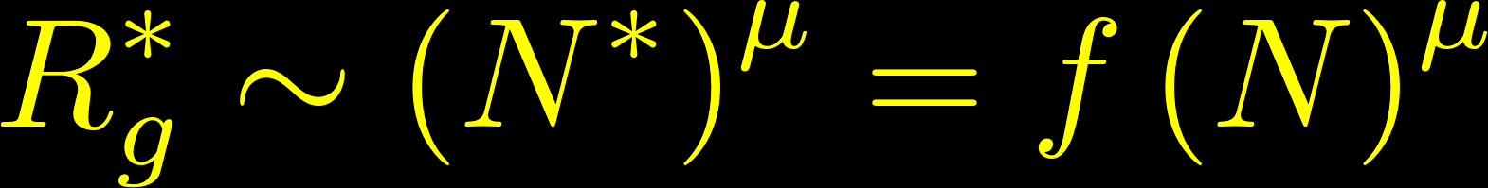
We measure number of localizations, not the number of monomers.
In super-resolution microscopy, the ‘monomers’ are the human telomere nucleotide repeat sequences. These sequences are randomly labeled with fluorescent molecules and recorded one a time.
The number of fluorescent molecules recorded in a telomere does not equal the total number of repeat sequences within the telomere. Furthermore, the average number of labeled sequences may be a nonlinear function of the number of sequences.
Let N* = the number of measured fluorophores in a cluster and N = the actual number of repeat sequences in the cluster. N* is a general function of N and Rg* is the measured radius of gyration. Rg is the real radius of gyration of the cluster.
In other words, our measured radius of gyration scales with an exponent that depends on both the telomere compaction and the labeling efficiency as a function of the number of repeat sequences.

Slide 8
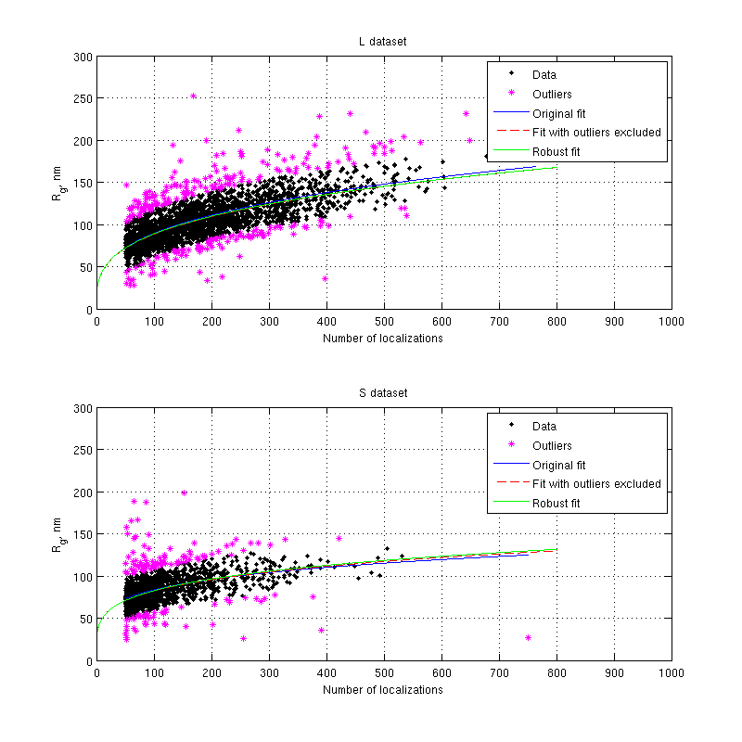


Examples
Original HelaL and HelaS data with three different fits for scaling exponents.
Errors are 95% confidence intervals on fit parameters.
Fits are to power law y = A x^{μ} where μ is the scaling exponent.

Slide 9
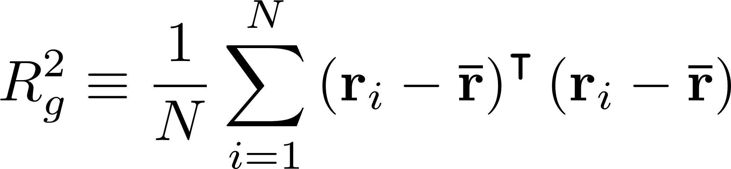
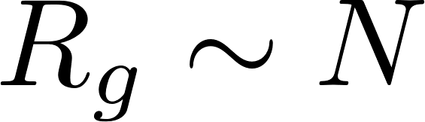
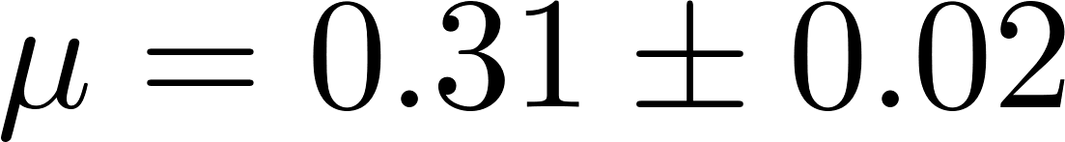
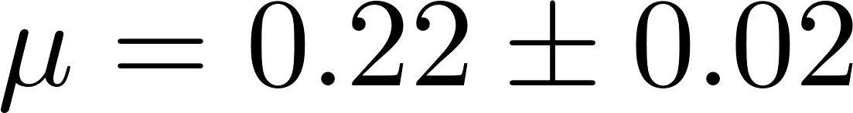
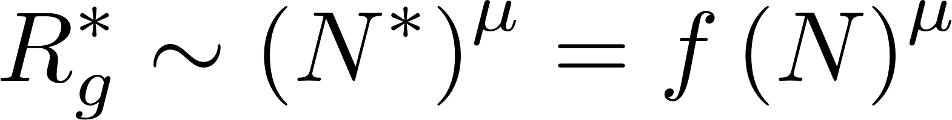
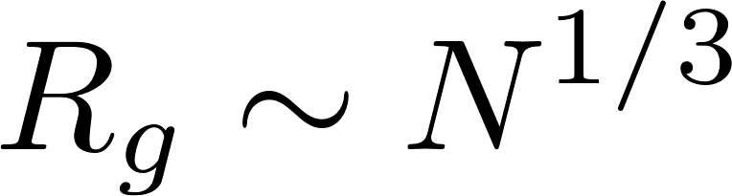
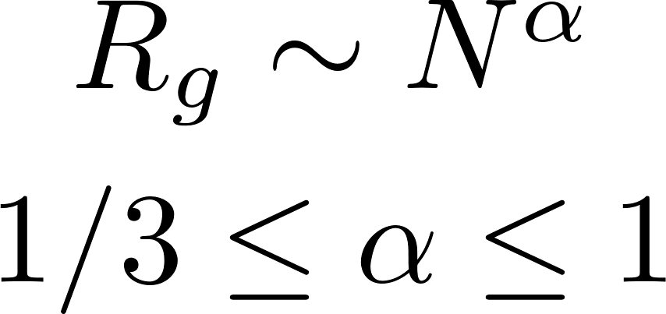
Equations in black

