Slide 2
Questions to address
Do SmchD1 knockdown Hela cells display changes in telomere size or compaction?
Do TRF1 or TRF2 knockdown cells display changes in telomere size or compaction?
What happens to telomere size/compaction in double SmchD1 and TRF2 knockdowns?
What happens to telomere size/compaction in double TRF1 and TRF2 knockdowns?
Passes Mann-Whitney Median Comparison for different medians
(p- value noted)
Notes:
These are human chromosomes with labeled telomere caps.

Slide 3
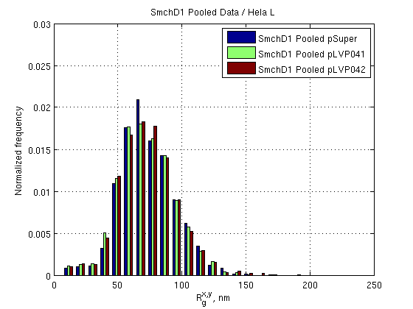
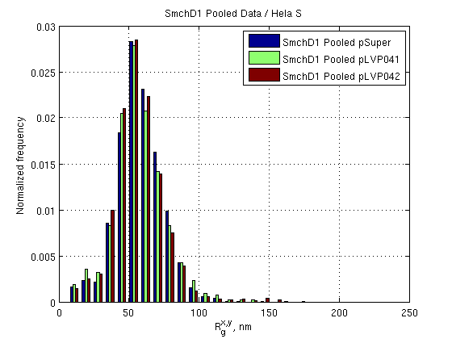
SmchD1 knockdown
p = 0. 02
p = 10⁻⁴
N = 2876
N = 2546
N = 2854
N = 2828
N = 1848
N = 2766

Slide 4
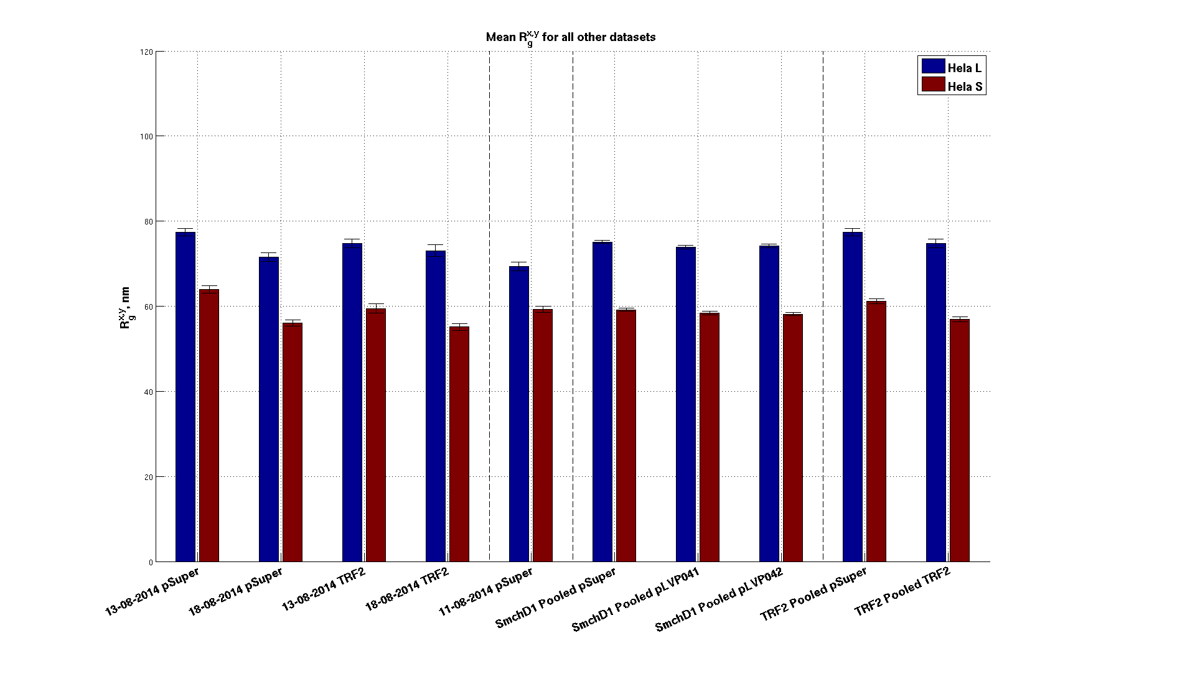
SmchD1 knockdown – mean values

Slide 5
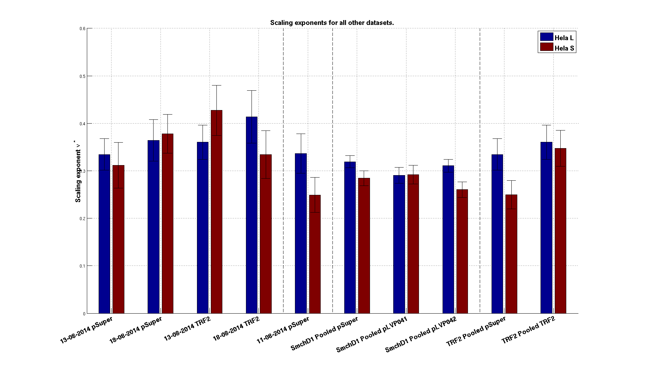
SmchD1 knockdown – scaling

Slide 6
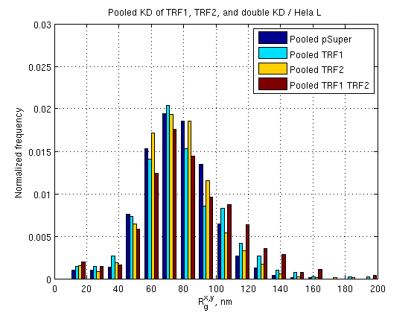
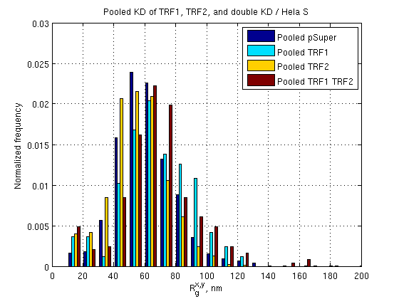
TRF1 and TRF2 single knockdowns; TRF1 TRF2 double knockdowns
N =
N =
986
499
829
365
1777
249
1202
168

Slide 7
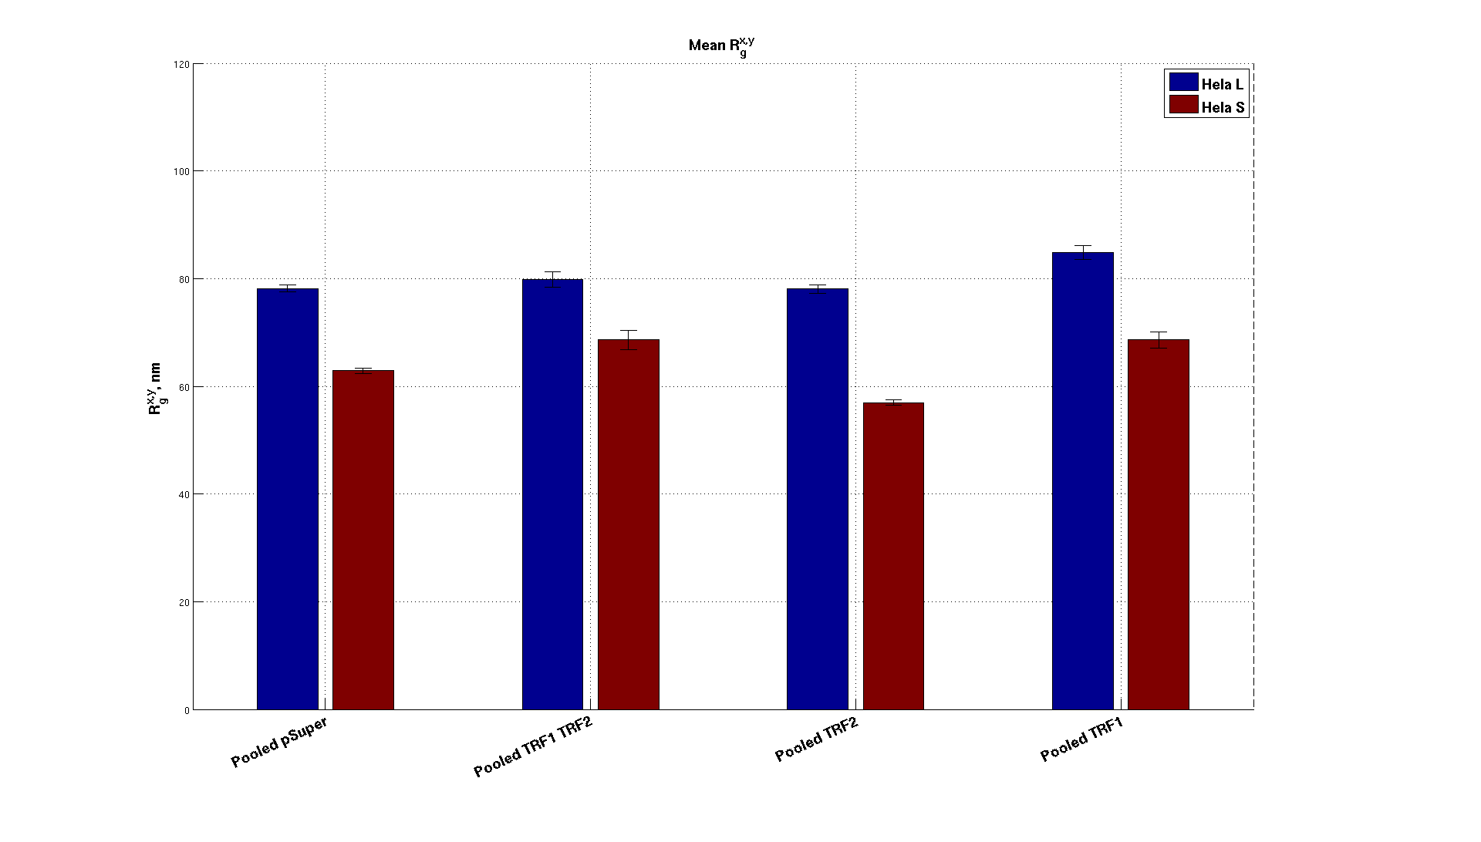
TRF1 and TRF2 single knockdowns; TRF1 TRF2 double knockdowns

Slide 8
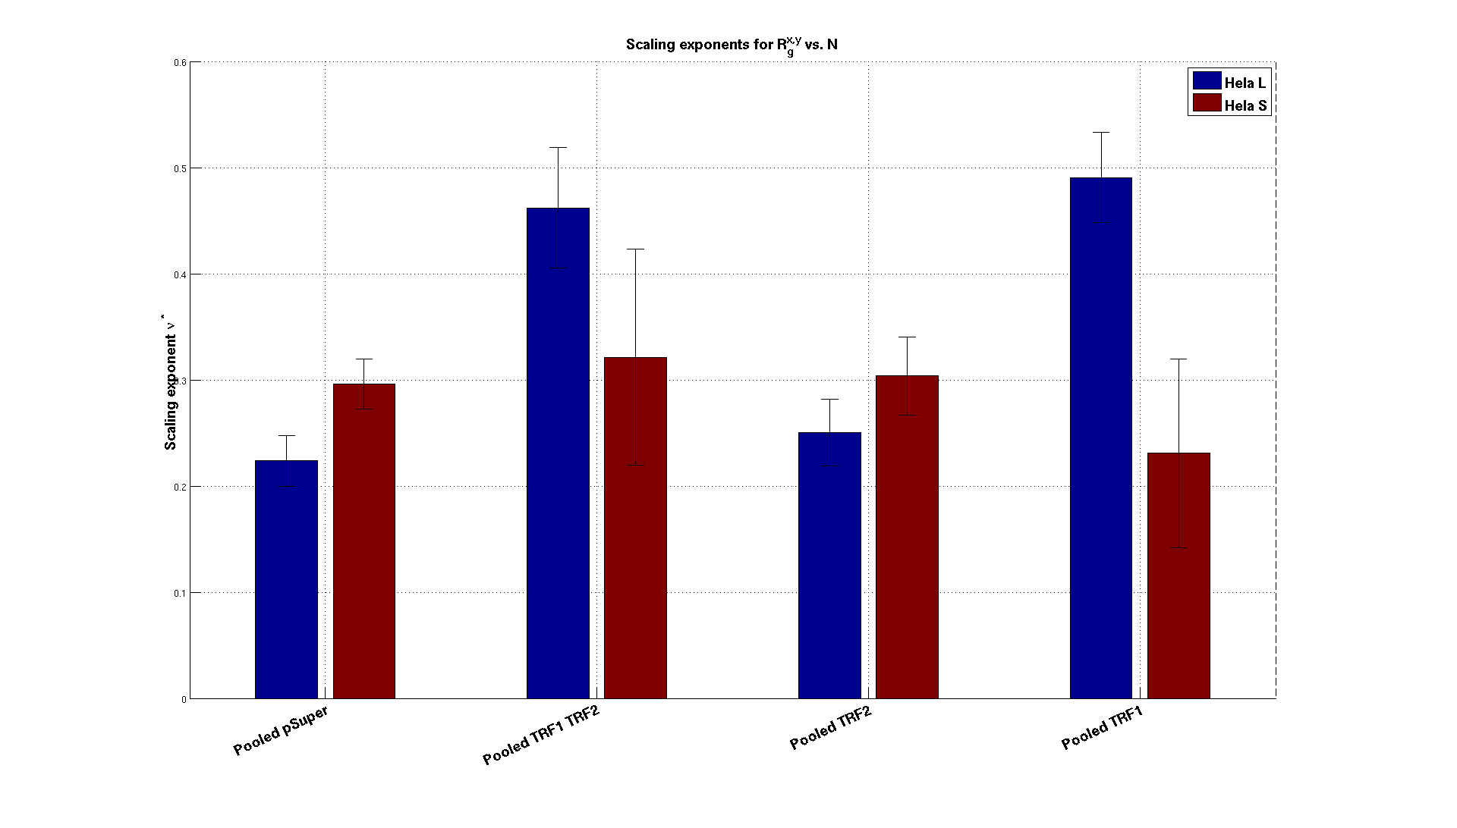
TRF1 and TRF2 single knockdowns; TRF1 TRF2 double knockdowns

Slide 9
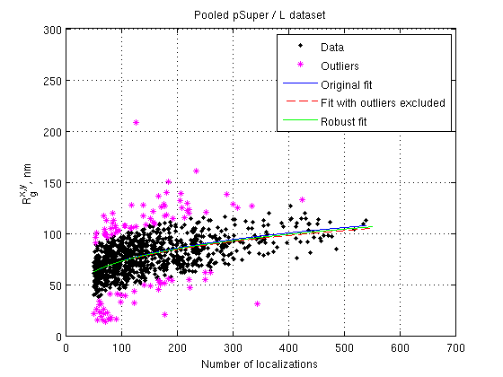
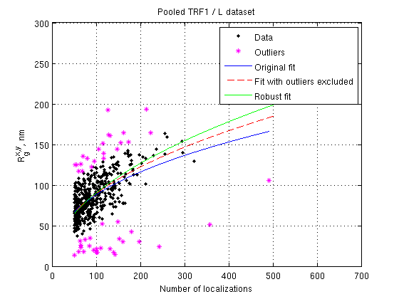
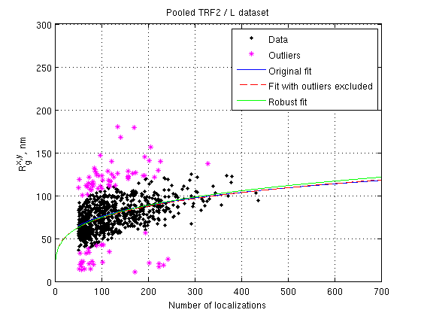
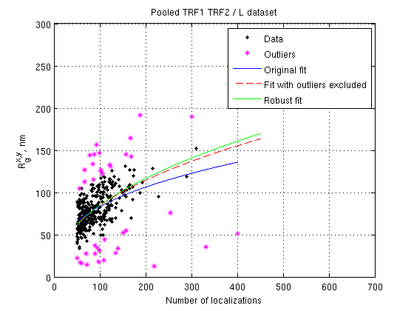
TRF1 and TRF2 single knockdowns; TRF1 TRF2 double knockdowns

Slide 10
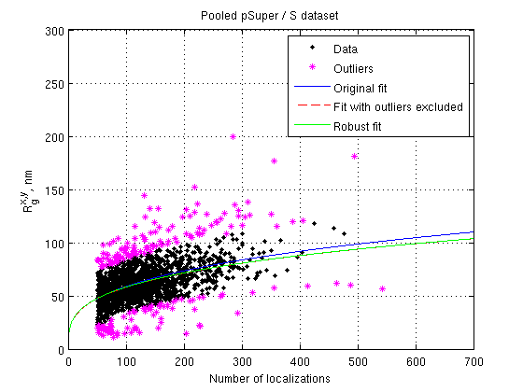
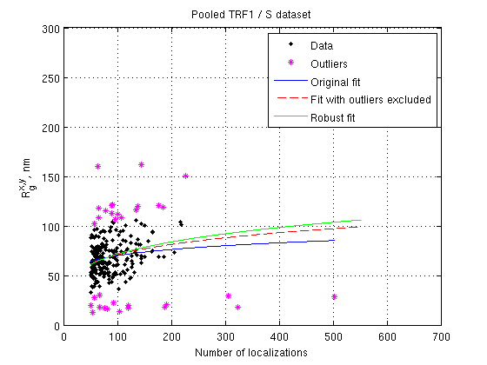
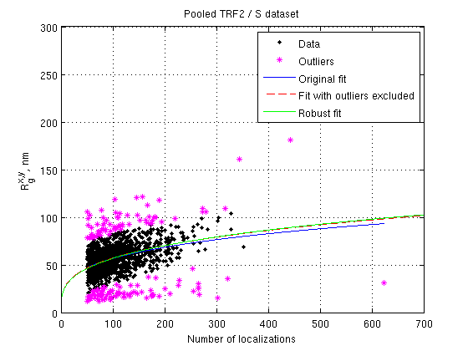
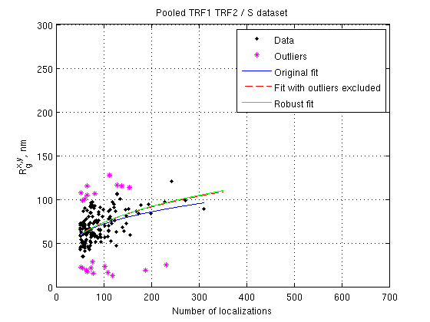
TRF1 and TRF2 single knockdowns; TRF1 TRF2 double knockdowns

Slide 11
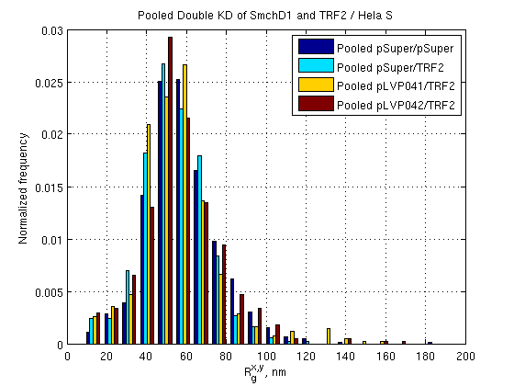
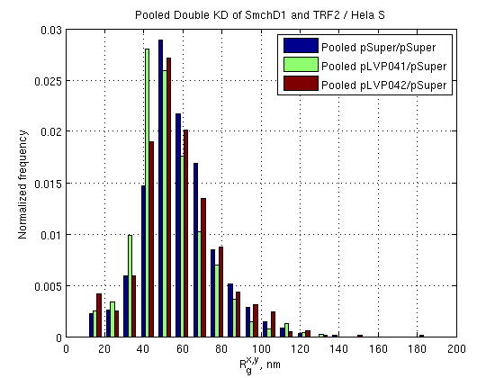
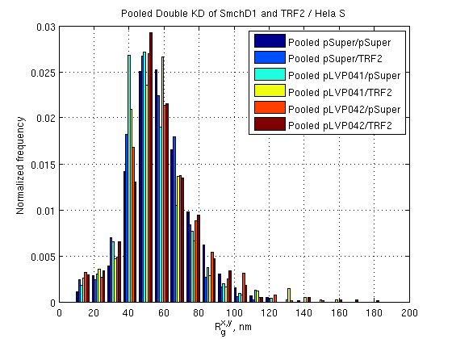
SmchD1 and TRF2 double knockdown
N =
703
543
624
471
757
493
P – values (test against pSuper/pSuper)
pSuper/TRF2 : 1 x 10⁻⁴
pLVP041/pSuper: 2 x 10⁻⁹
pLVP041/TRF2: 5 x 10⁻⁴
pLVP042/pSuper: 0.07
pLVP042/TRF2: 0.03

Slide 12
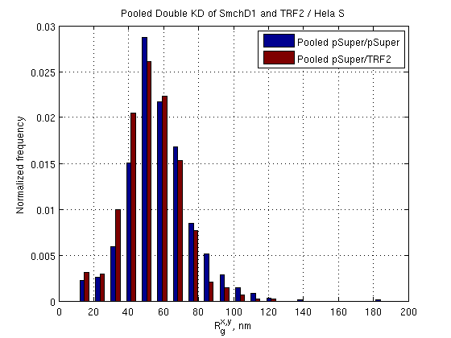
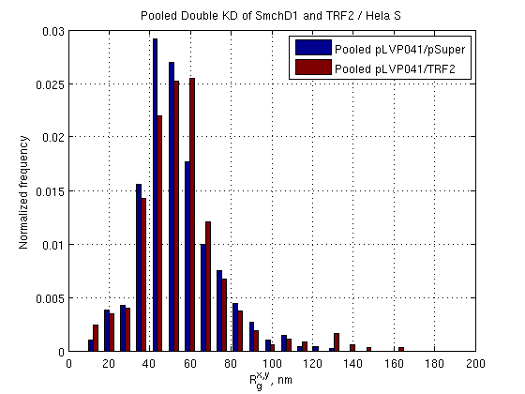
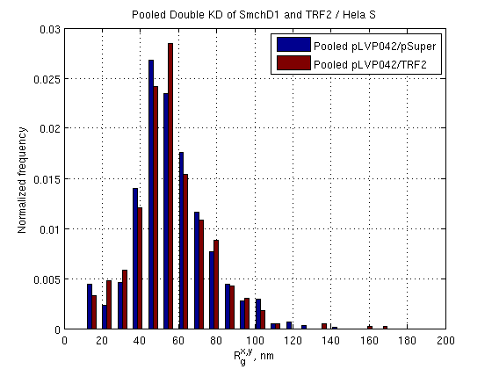
SmchD1 and TRF2 double knockdown
p = 10⁻⁴
N = 703
N = 543
N = 624
N = 471
N = 757
N = 493

Slide 13
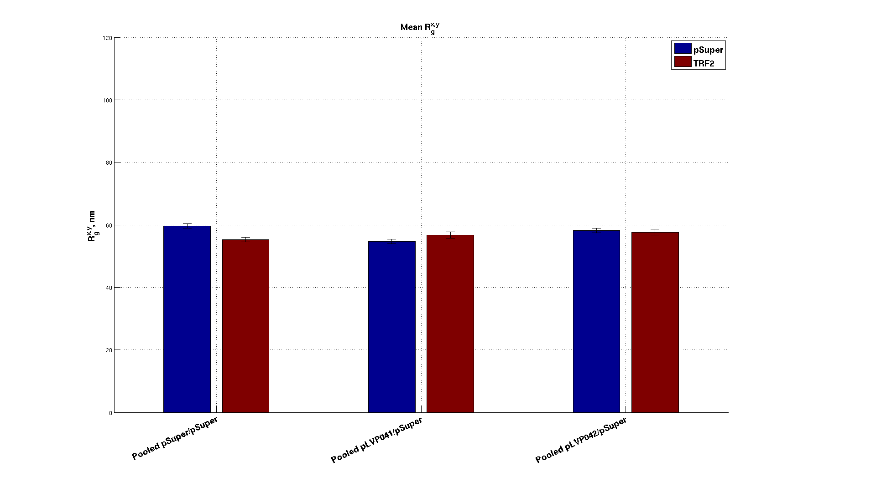
SmchD1 and TRF2 double knockdown Mean R_{g}’s

Slide 14
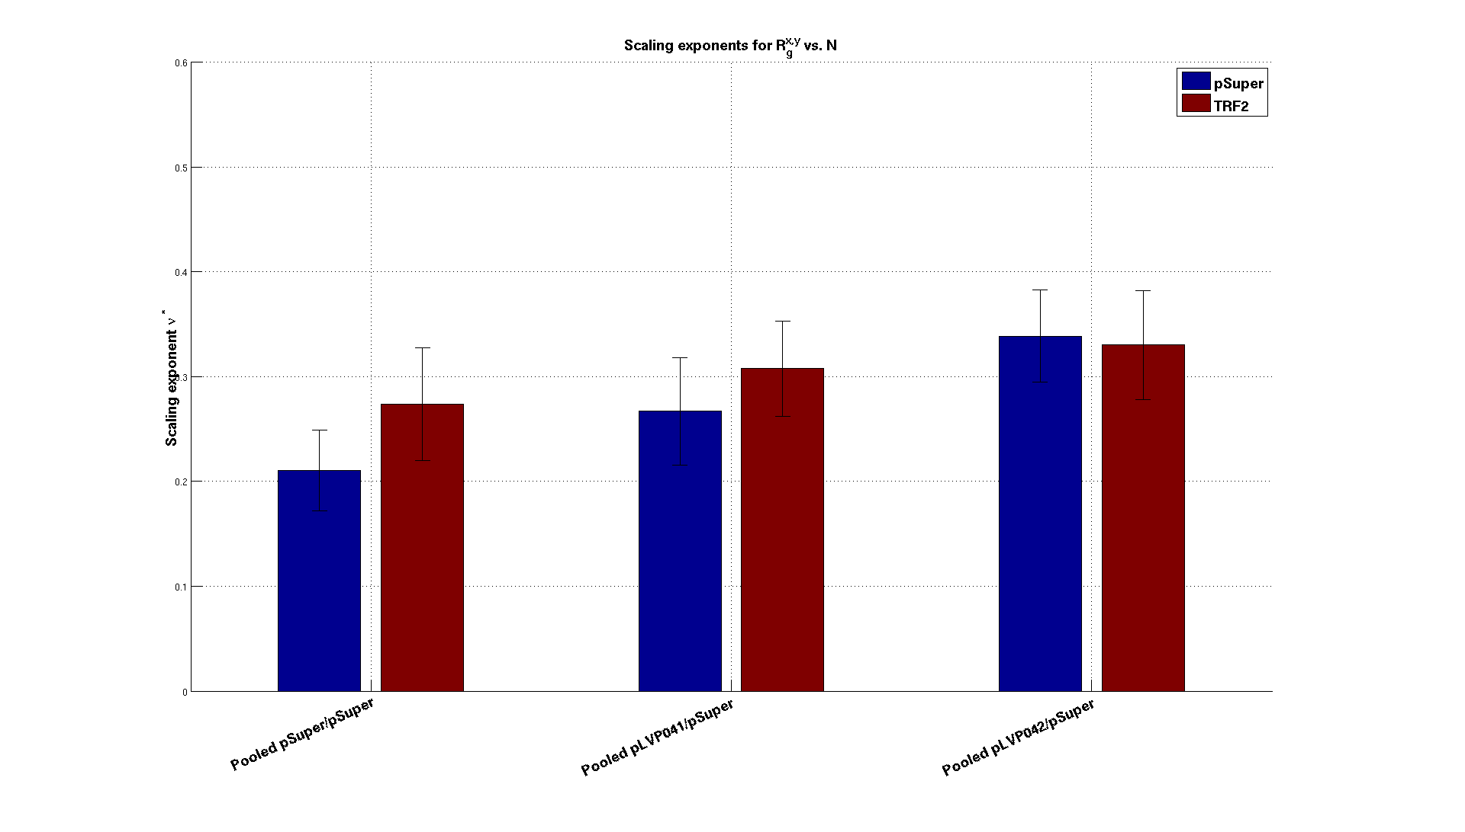
SmchD1 and TRF2 double knockdown Scaling

Slide 15
Talk from Wednesday, 15-10-2014

Slide 16
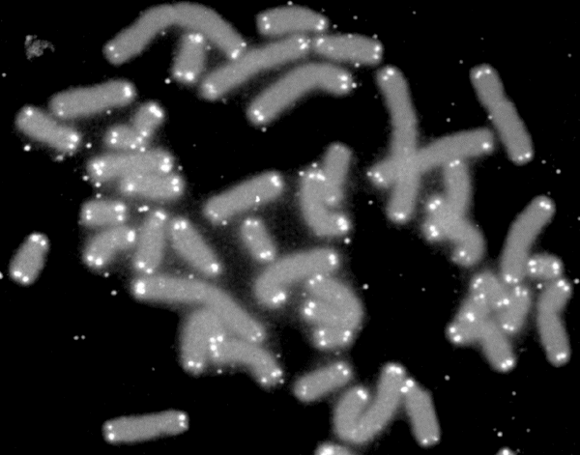
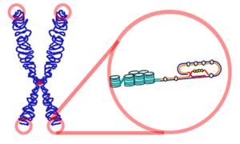
Telomeres are nucleotide repeats at each end of a chromatid.
http://commons.wikimedia.org/wiki/File:Telomere.png
By U.S. Department of Energy Human Genome Program.SierraSciSPA at en.wikipedia [Public domain or Public domain], from Wikimedia Commons
Found in most eukaryotes
Protect chromosomes from deterioration & fusion
Capped by a protein complex known as shelterin
Play a significant role in the prevention of cancer
In humans: TTAGGG
Notes:
These are human chromosomes with labeled telomere caps.

Slide 17
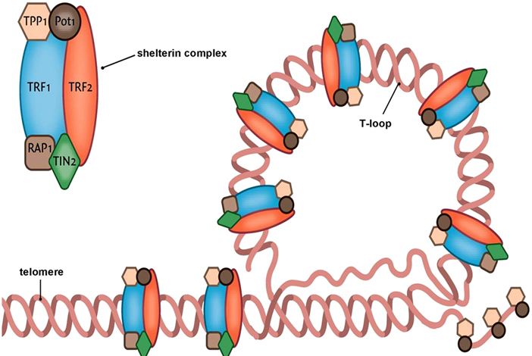
Telomeres are packaged with the shelterin complex of proteins.
https://www.bioscience.org/2010/v15/af/3604/fig2.jpg
Notes:
These are human chromosomes with labeled telomere caps.

Slide 18
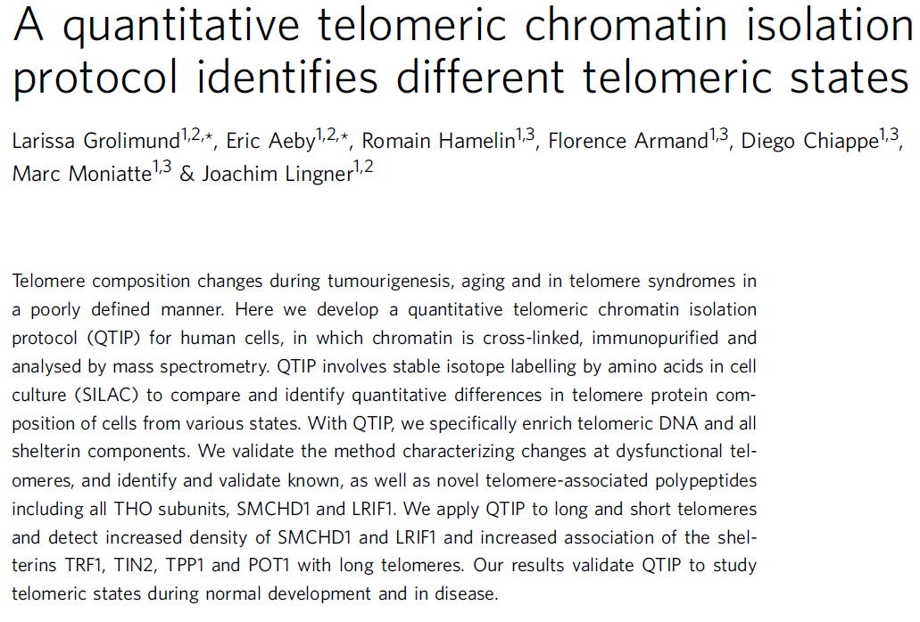
SMCHD1 is a protein associated with both telomeres and inactive X chromosomes.
Nature Communications
4, 2848 (2013)
Nature Structural and Molecular Biology
20, 566 (2013)
Notes:
These are human chromosomes with labeled telomere caps.

Slide 19
Hypotheses
Is SMCHD1 involved in telomere compaction as it is in inactive X chromosome compaction?
If so, how much less compact is a telomere in the absence of SMCHD1?

Slide 20
Hypotheses
Is SMCHD1 involved in telomere compaction as it is in inactive X chromosome compaction?
If so, how much less compact is a telomere in the absence of SMCHD1?
Telomeres are small structures (~10 kb) inside the dense nucleus
→ Use super-resolution fluorescence microscopy

Slide 21
Hypotheses
Is SMCHD1 involved in telomere compaction as it is in inactive X chromosome compaction?
If so, how much less compact is a telomere in the absence of SMCHD1?
Telomeres are small structures (~10 kb) inside the dense nucleus
→ Use super-resolution fluorescence microscopy
and other questions that have evolved from the original one…
How can we quantitatively assess the size of and compaction of fluorescently-labeled DNA in super-resolution microscopy data?
What are the limits on the level of detail in chromatin structure that can be measured with SR fluorescence localization microscopy?

Slide 22
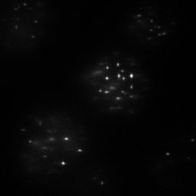
BIOP Nikon STORM microscope
DNA FISH with Cy5 and 18 bp labels
Astigmatism for z-localization
~15 fields of view containing about 4 cells each of each cell type.
Group localizations into clusters corresponding to telomeres using DBSCAN
Automatically compute size and statistics of all clusters
10 µm
Widefield image of telomeres

Slide 23
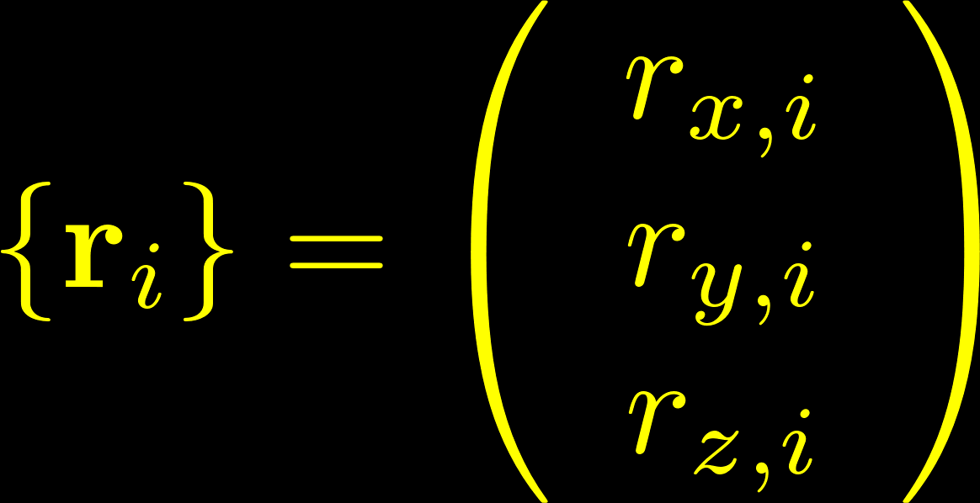
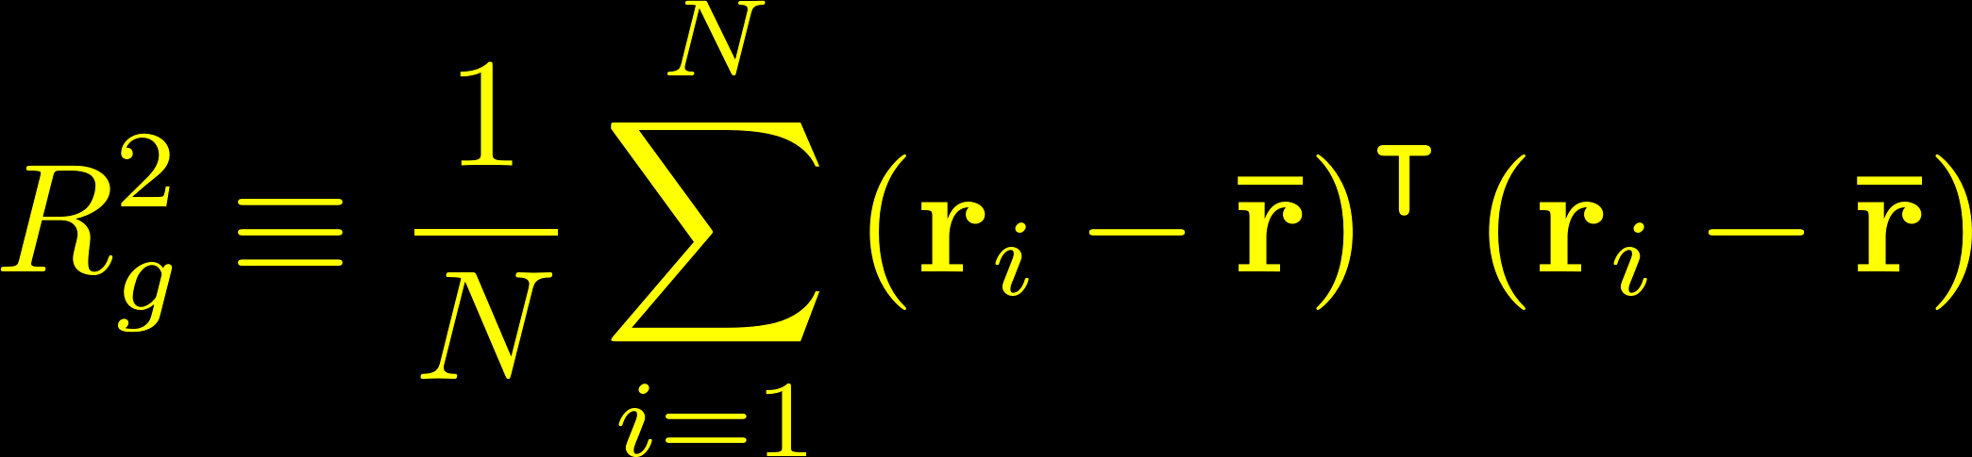
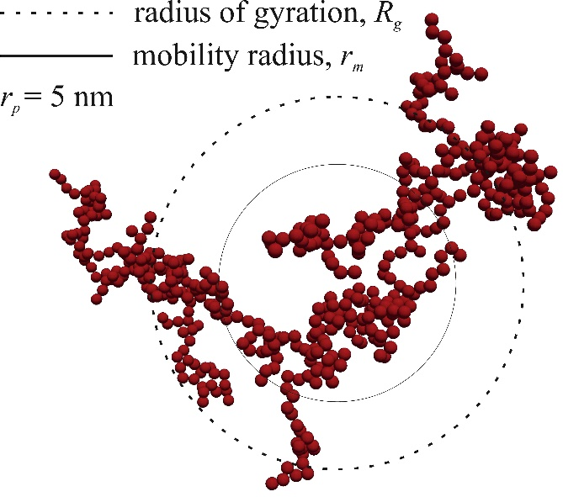
The radius of gyration is a good measure of telomere size.
z
y
x
Clusters of localizations at each telomere
Other statistics
Number of localizations / cluster
Volume of complex hull
http://www3.aiche.org/proceedings/Abstract.aspx?PaperID=233003

Slide 24
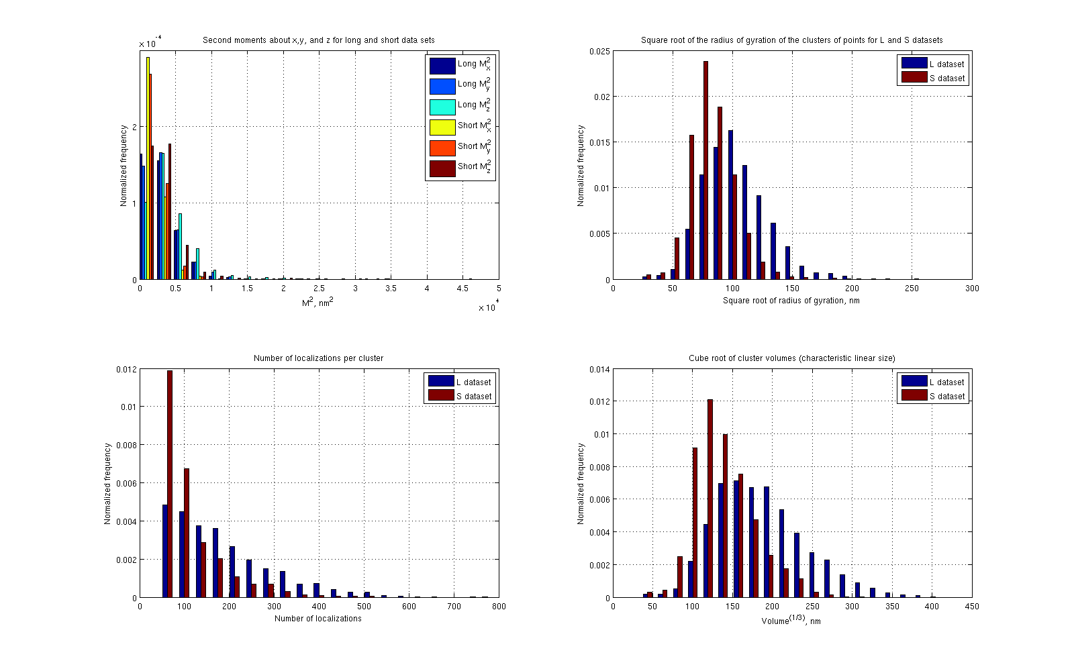
N_{L} = 2424
N_{S} = 1405
Mean(L) = 106 nm, Std(L) = 27 nm
Mean(S) = 85 nm, Std(S) = 19 nm
R_{g}
Mean(L) = 191, Std(L) = 111
Mean(S) = 119, Std(S) = 74
Mean(L) = 190 nm, Std(L) = 56 nm
Mean(S) = 142 nm, Std(S) = 38 nm

Slide 25
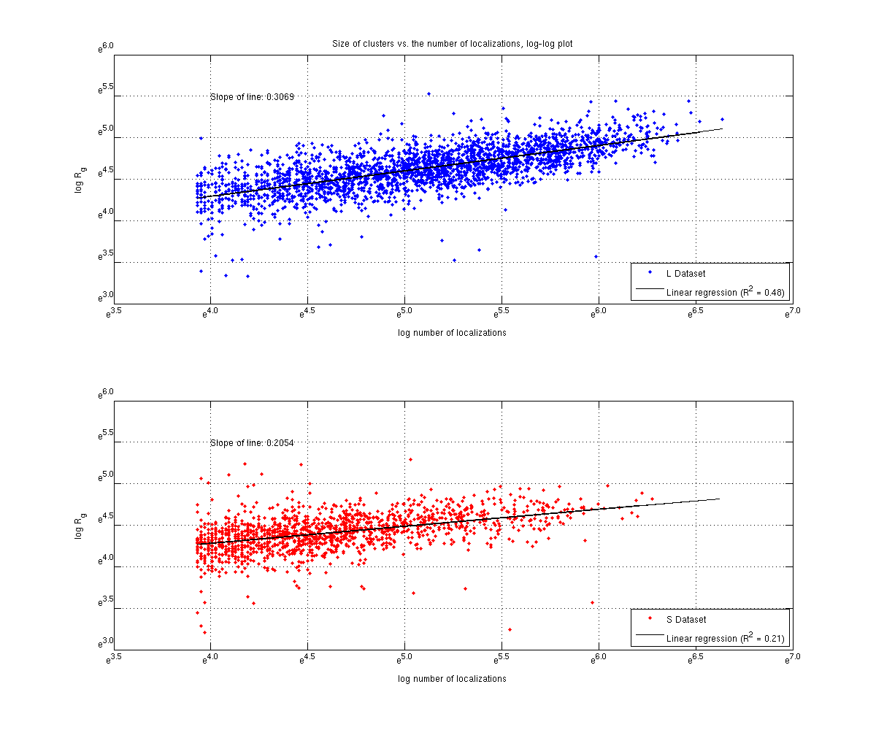
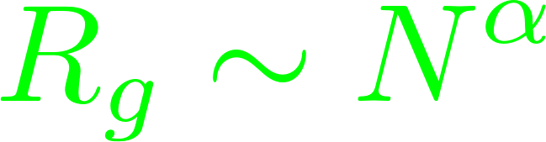
???

Slide 26
Summary of the previous results
We developed a workflow for assessing telomere size and compaction.
The average telomere R_{g} for Hela L was 106 nm; for Hela S it was 85 nm.
The scaling behavior of R_{g} with the number of localizations did not match any known polymer models.

Slide 27
Summary of the previous results
We developed a workflow for assessing telomere size and compaction.
The average telomere R_{g} for Hela L was 106 nm; for Hela S it was 85 nm.
The scaling behavior of R_{g} with the number of localizations did not match any known polymer models.
Coming up…
Look at the effects of SMCHD1, and TRF2 knockdowns
Make estimations of what we should have expected to see in the first place
Attempt a better fit procedure on the R_{g} vs. N scaling data, and when it still produces anomalous results, suggest an explanation

Slide 28
What happens to telomere size when SMCHD1 and TRF2 are knocked down?

Slide 29
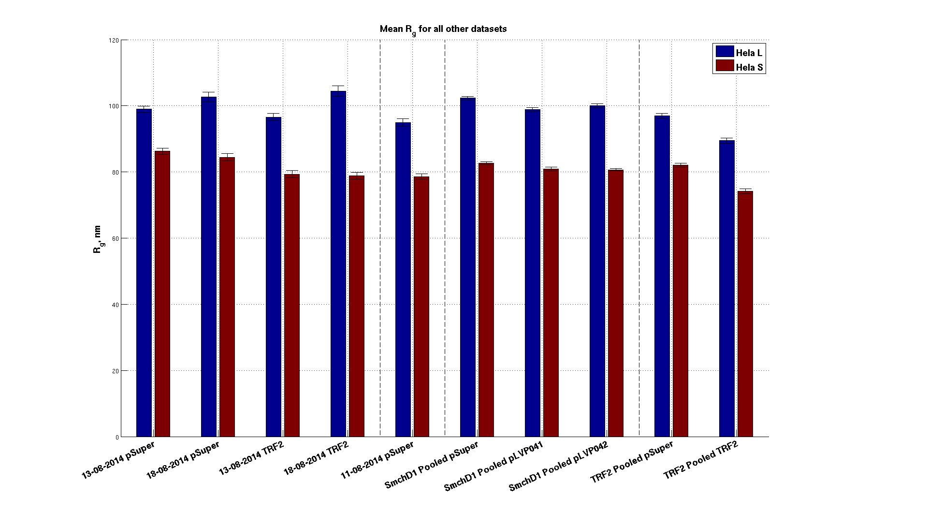
Controls

Slide 30
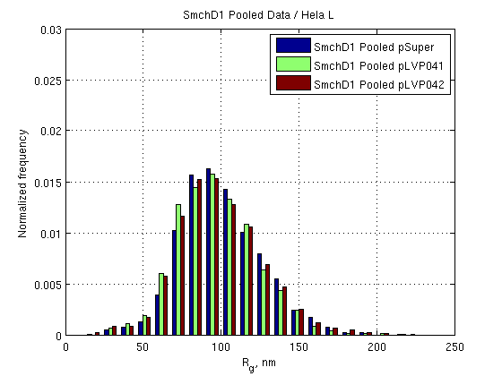
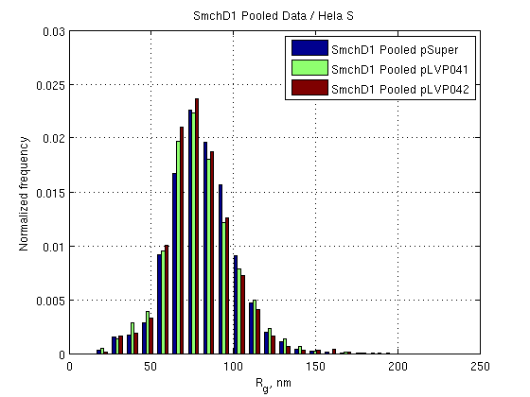
SMCHD1 Knockdown
N = 2445
N = 2206
N = 2532
N = 2478
N = 1641
N = 2494
 | Hela L | Hela S
control / pLVP041 | < .0001 | 0.0093
control / pLVP042 | 0.0023 | 0.0006
pLVP041 / pLVP042 | 0.1220 | 0.7114
p-values

Slide 31
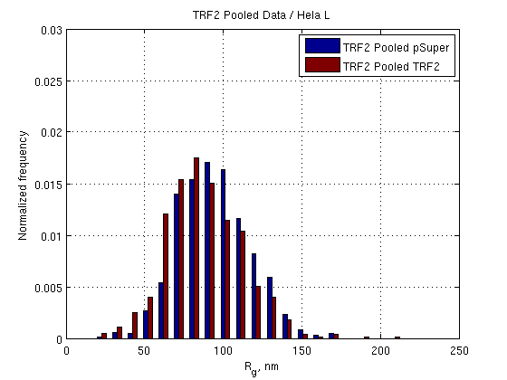
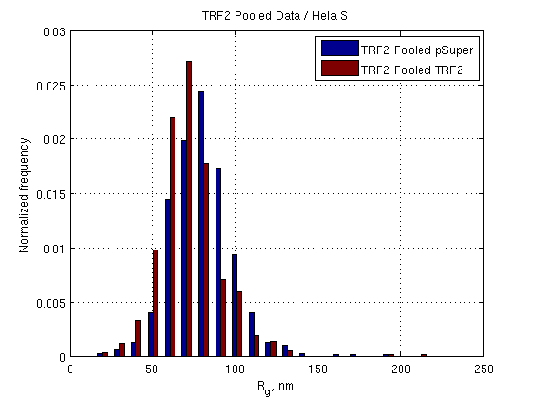
TRF2 Knockdown
N = 881
N = 861
N = 857
N = 666
(p-values are less 1 X 10⁻¹⁰)
But…

Slide 32
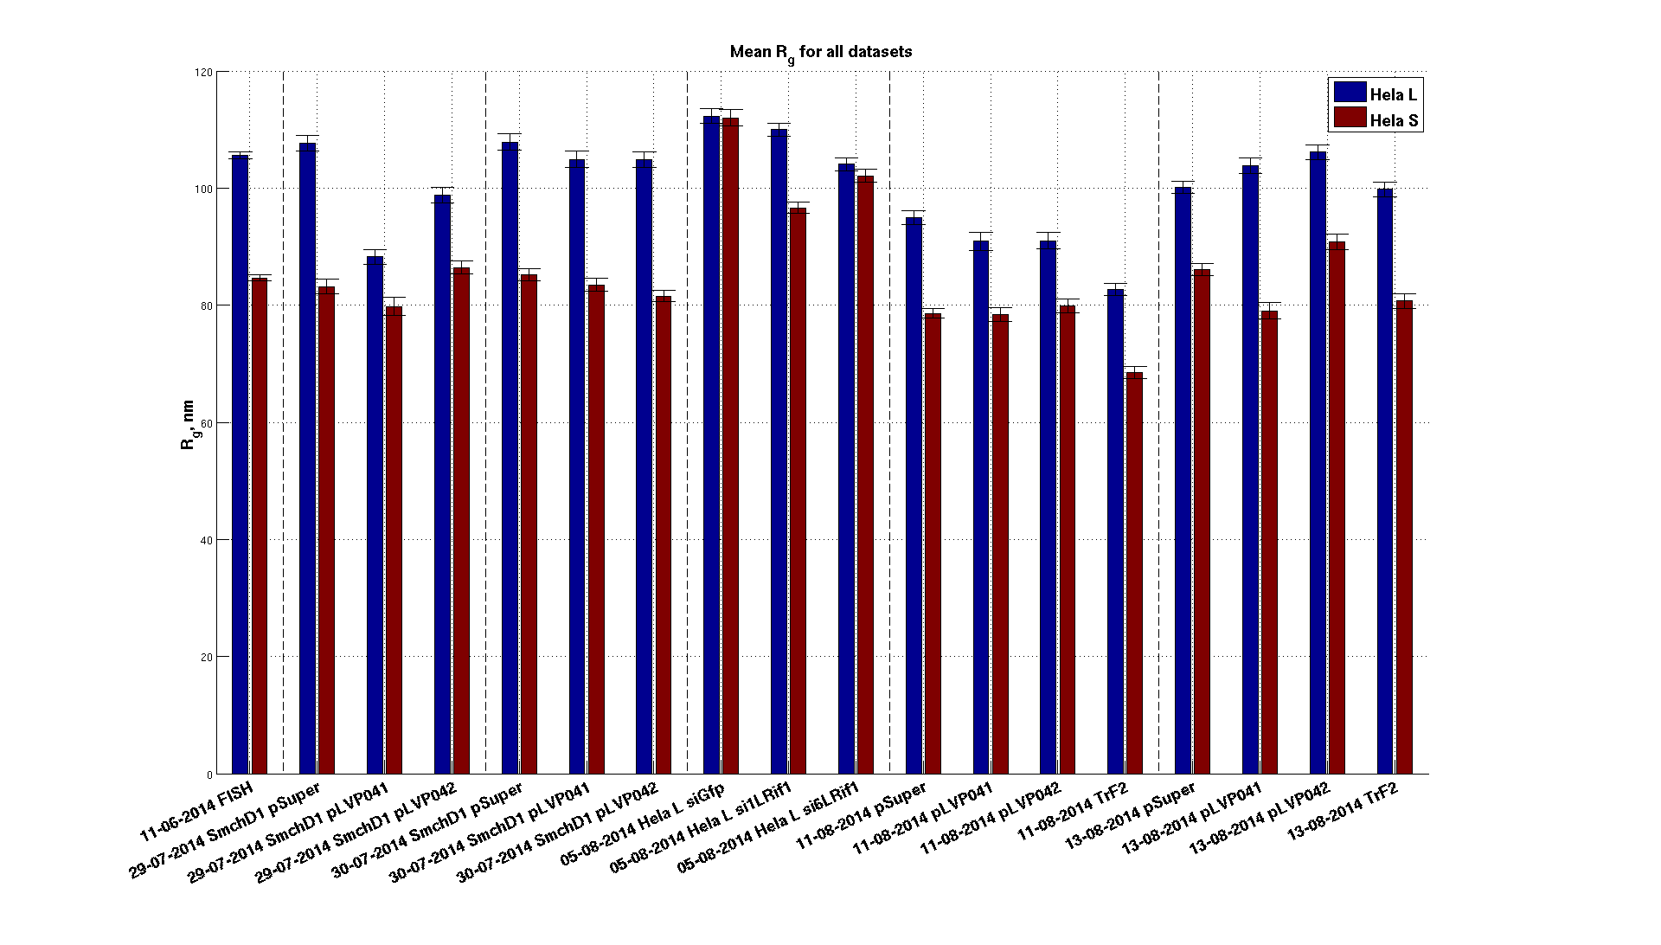
The individual TRF2 KD datasets have very different means.

Slide 33
We could not show that SMCHD1 or TRF2 knockdowns cause a large change in overall telomere size.
… but SMCHD1 knockouts did cause statistically significant shrinking of both mean values for L and S telomere radii of gyration.
Mean R_{g}
 | Hela L | Hela S
control | 102.4 | 82.6
pLVP042 | 98.9 | 80.9
pLVP042 | 100.1 | 80.7
p-values
 | Hela L | Hela S
control / pLVP041 | < .0001 | 0.0093
control / pLVP042 | 0.0023 | 0.0006
pLVP041 / pLVP042 | 0.1220 | 0.7114

Slide 34
What sort of changes should we have seen in the first place?

Slide 35
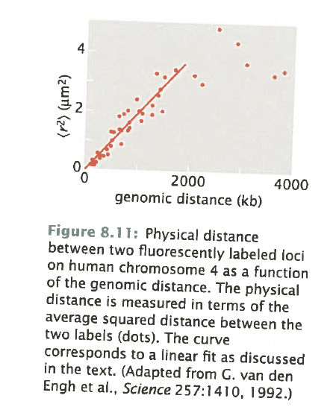
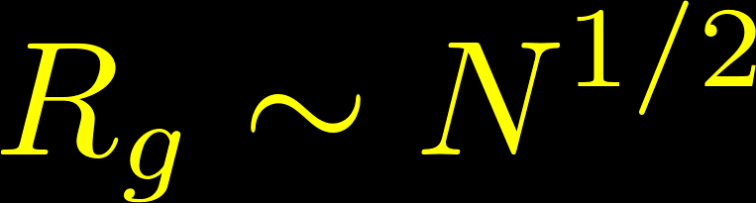
What should we have expected in the first place?
Crowding effects
100 kb – 1000 kb scales
freely-jointed chain model
Telomeres are 10 – 25 kb long.
Models for other length scales
10 Mb and higher → fractal globules
100 bp → 10 nm and 30 nm fibers
Phillips, Physical Biology of the Cell, 2nd Ed.

Slide 36
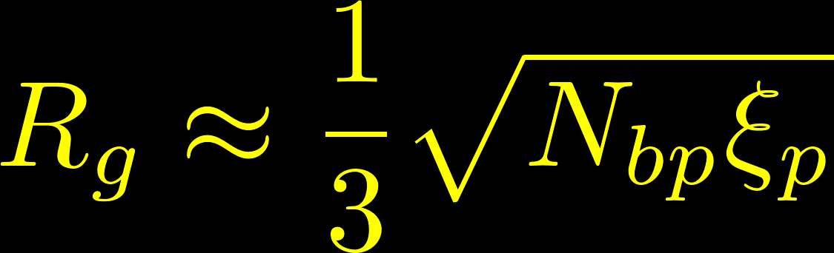


What should we have expected in the first place?
The radius of gyration of the freely-jointed chain grows with the number of base pairs like:
Assuming a persistence length of DNA of 50 nm and using N_{L,bp} = 25,000 and N_{S,bp} = 10,000 from Southern blots, we get
Hela L
Hela S

Slide 37
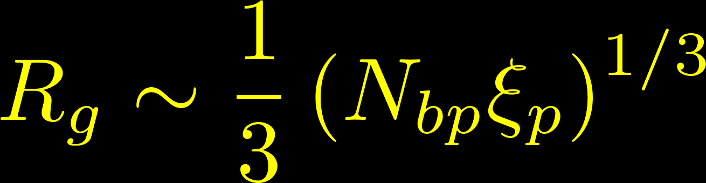


What should we have expected in the first place?
The radius of gyration of the freely-jointed chain grows with the number of base pairs like:
Assuming a persistence length of DNA of 50 nm and using N_{L,bp} = 25,000 and N_{S,bp} = 10,000 from Southern blots, we get
Hela L
Hela S
On the other hand, we can estimate what a fully-compacted polymer should look like by using the Flory-Huggins theory and assuming the prefactor also scales with the same exponent:
Hela L
Hela S

Slide 38
The measured data suggests the telomeres are more compact than the FJC, but not fully compacted.
Full compaction
Hela L
(measured)
Hela S
(Freely-jointed chain)
Hela L
(Freely-jointed chain)
Hela S
(measured)
R_{g}
~40 nm
95 nm
150 nm
205 nm
260 nm
315 nm
370 nm

Slide 39

The measured data suggests the telomeres are more compact than the FJC, but not fully compacted.
Full compaction
Hela L
(measured)
Hela S
(Freely-jointed chain)
Hela L
(Freely-jointed chain)
Hela S
(measured)
R_{g}
~40 nm
95 nm
150 nm
205 nm
260 nm
315 nm
370 nm
0.3
0.4
0.5
Approximate scaling exponents

Slide 40
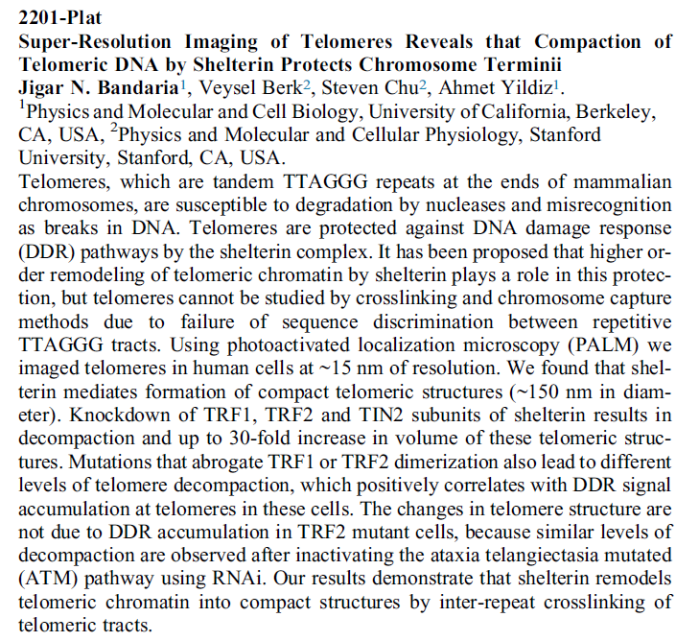
Researchers in California have observed a 30-fold change in volume.
(But this is literally everything I could find about the work.)
30-fold increase in volume =
~3-fold increase in R_{g}
This would bring the observed R_{g}’s into agreement with the FJC.
Do all three TRF1, TRF2, and TIN2 need to be knocked down?
Decompaction seems possible to observe, but we didn’t observe it.
Bandaria et al., Biophysical Journal, 106, 435a (2014)
http://www.cell.com/biophysj/pdf/S0006-3495%2813%2903710-7.pdf

Slide 41

http://writetribe.com/wp-content/uploads/2014/04/art-353-learning-300x0.jpg

Slide 42
We have more information than just the mean values…
Scaling is a measure of compaction

Slide 43
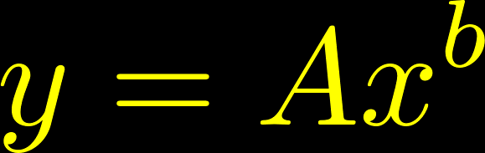
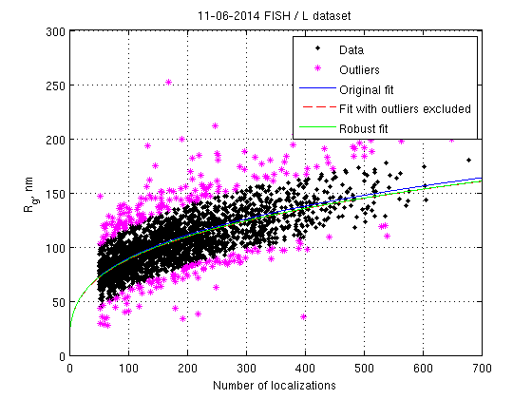
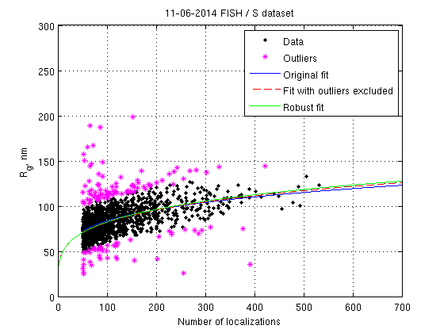
Changing the fit procedure does not change the scaling exponents by much.
Fit model
α = 0.22
α = 0.30
(Remember that for full compaction α = 0.33)

Slide 44
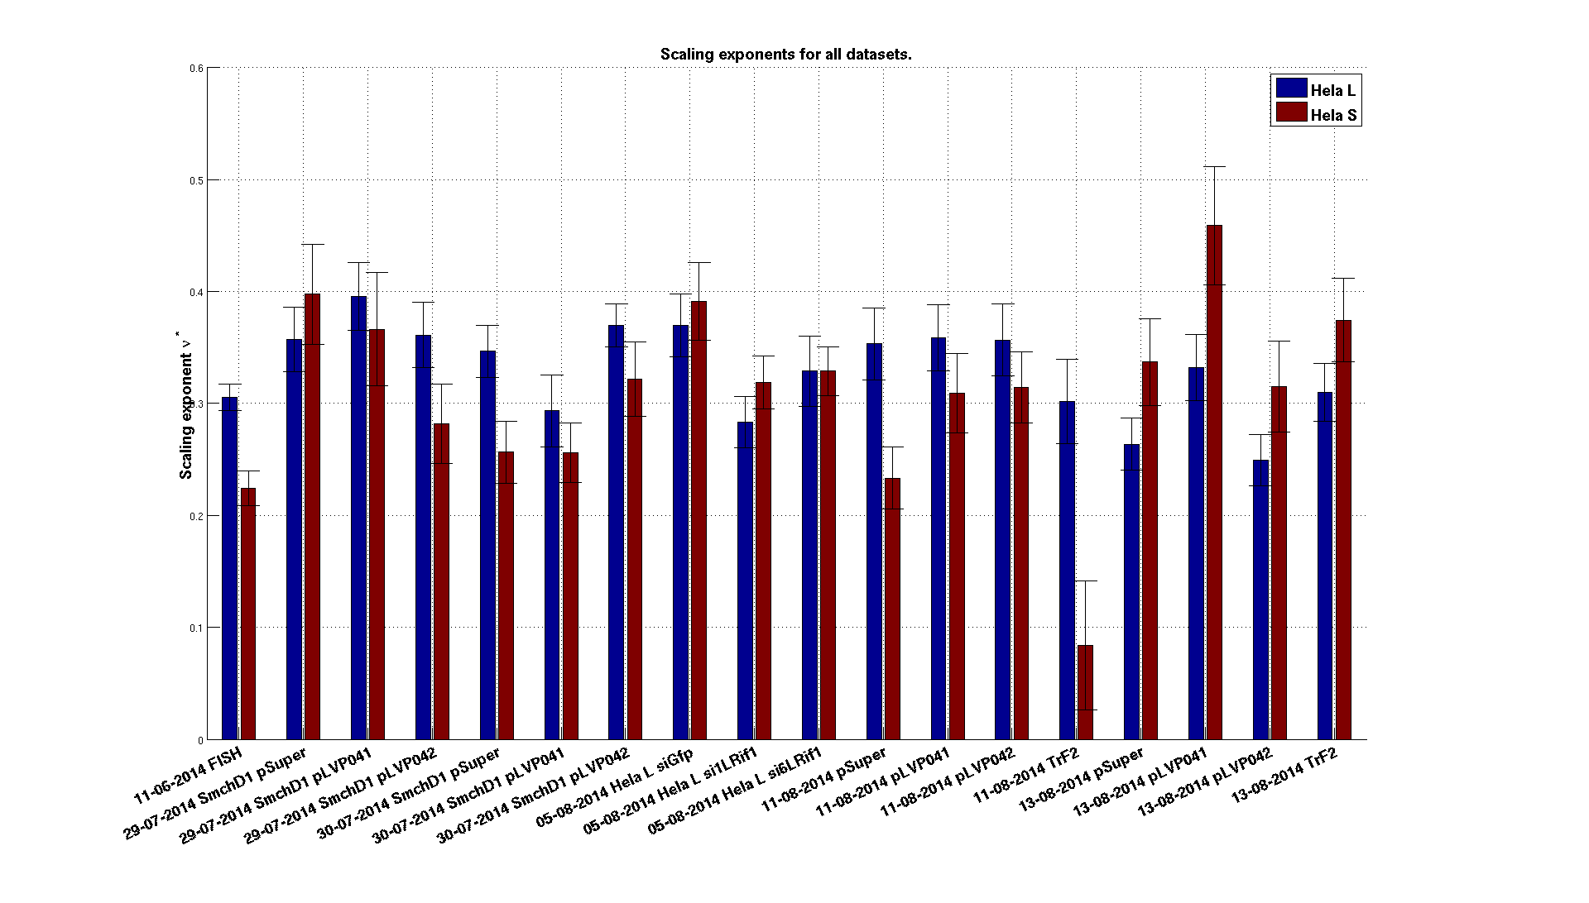
Assessing the scaling exponent requires A LOT of telomeres.
N ~ 1000
(three slides, 15 images from each slide)
± 0.03
Error bars : 95% confidence intervals on fit parameter values

Slide 45
Assessing the scaling exponent requires A LOT of telomeres.
N ~ 400
(1 slide, ~15 images from each slide)
± 0.05
Error bars : 95% confidence intervals on fit parameter values

Slide 46

Pooling datasets helps reduce the uncertainty.
But we don’t yet have a model to explain them…

Slide 47

So why are the scaling exponents always so low, especially for Hela S cells?

Slide 48

So why are the scaling exponents always so low, especially for Hela S cells?
Find the radius of gyration of this structure.
r
-4
-3
-2
-1
0
1
2
3
4

Slide 49

So why are the scaling exponents always so low, especially for Hela S cells?
Find the radius of gyration of this structure.
r
-4
-3
-2
-1
0
1
2
3
4

Slide 50
So why are the scaling exponents always so low, especially for Hela S cells?
Find the radius of gyration of this structure.
r
-4
-3
-2
-1
0
1
2
3
4
And how about this one?
-4
-3
-2
-1
0
1
2
3
4

Slide 51

So why are the scaling exponents always so low, especially for Hela S cells?
Find the radius of gyration of this structure.
So what are the rebels hiding from me?
r
-4
-3
-2
-1
0
1
2
3
4
And how about this one?
-4
-3
-2
-1
0
1
2
3
4

Slide 52

The act of measurement in SR bumps the real molecule positions in random directions.
Actual molecule positions
Measured molecule positions
Generate a uniformly distributed collection of points and bump each point randomly according to a multimodal Gaussian distribution.
The standard deviation of the Gaussian is 10 nm in X and Y and 50 nm in Z.

Slide 53


The radius of gyration is positively biased by a non-zero localization precision.
Smaller clusters are more biased towards larger sizes than larger clusters.
Localization precision in X and Y
1000 clusters of uniformly and randomly distributed points
100 points / cluster
50 nm Z precision

Slide 54


We can first test this hypothesis by fitting to the transverse radius of gyration.
α = 0.32
α = 0.25
Mean 3D R_{g}: 103 nm
Old mean 3D R_{g}: 106 nm
Old α: 0.31
Mean 3D R_{g}: 77 nm
Old mean 3D R_{g}: 85 nm
Old α: 0.22

Slide 55
Summary
We found no large change in Hela telomere sizes when either SMCHD1 or TRF2 (a key shelterin component) were knocked down

Slide 56
Summary
We found no large change in Hela telomere sizes when either SMCHD1 or TRF2 (a key shelterin component) were knocked down
We would expect to see a noticeable change in telomere size when key shelterin components are knocked down based on polymer modeling and one obscure super-resolution study

Slide 57
Summary
We found no large change in Hela telomere sizes when either SMCHD1 or TRF2 (a key shelterin component) were knocked down
We would expect to see a noticeable change in telomere size when key shelterin components are knocked down based on polymer modeling and one obscure super-resolution study
The scaling of radius of gyration with the number of labels should tell us an absolute measure of telomere compaction and variation than looking at average size alone, but the limitations of super-resolution imaging bias the size measurements

Slide 58
Future Plans
Short term
Correct the data for non-zero localization precisions
Investigate whether over-counting biases the number of localizations (correcting for over-counting will also cause an increase in the scaling exponent relative to what we’ve observed)
Observe some large change in size by knocking down other shelterin components, such as TRF1 and TIN2 in addition to TRF2
Long term
Quantitatively assess decompaction from various shelterin protein knockdowns
Assess whether the distribution of sizes of telomeres affects their function
Explore whether labeling artifacts are present (i.e. whether labels only attach to surface of telomeres)

Slide 60
Background information on telomeres
Telomeres were imaged in fixed Hela cells. One culture of cells, known as Hela L, had longer telomeres than the other, known as Hela S. The cultures were imaged separately.
L group: 10 – 30 kbp
S group: 4 – 10 kbp
Three different slides of each group were imaged on the Nikon super-resolution microscope in the BIOP using a cylindrical lens for 3D imaging.
DNA-FISH was performed to label the telomeres with labels that were 18 bp long.
The fluorophore was Cy5.
Datasets were comprised of drift-corrected x-, y-, and z-coordinates of all localizations in an image.
Localizations in which a molecule was on for ten consecutive frames or more were discarded before we received the dataset.

Slide 61
How can we assess the size of a cluster of points?
Measure moments of the distribution of localizations within the cluster
Draw shape around the localizations and measure volume of that shape
Count number of localizations in a cluster

Slide 62
Information about the telomeres is represented by probability distributions.
All localizations are represented by a set of random vectors in 3-space.
z
y
x
r_{i} determined by
Uncertainty in the measurement process
Uncertainty in labeling efficiency
The underlying telomere structure
Raw data: a set of points in 3D
Notes:
Be clear that this treatment is for a single telomere, and we sample multiple telomeres.

Slide 63
Hypothesis tests are performed on moments of the localization distributions.
The distributions of r_{x}, r_{y}, and r_{z} tell us how the points are arranged within each telomere.
A super-resolution experiment is a random sample from these underlying distributions.
The moments of the distributions contain the information on the size and shape of each cluster.
Notes:
Why test against the moments?

Slide 64


The variance of the points within a cluster is a measure of its size.
The second central moment of a distribution matches our physical intuition about size.
http://cnx.org/content/m16870/1.1/
In polymer physics, the sum of the mean square distances of the monomer units from the average position in x, y, and z is known as the radius of gyration.

Slide 65





Higher-order moments contain shape information.
Important note
Higher order moments are more difficult to determine in the presence of noise.
http://mvpprograms.com/help/images/Skewness_PosNegPict.jpg
http://mvpprograms.com/help/images/KurtosisPict.jpg

Slide 66

A quick aside: the spectrum of moments completely determines a distribution.
The moment-generating function of a random variable X with a continuous probability density function f(x) is
where n is the n’th moment of f(x).
In the presence of noise, computing some of the moments gives us at least some knowledge of the distributions we’re trying to determine.
Notes:
So what?
Noise means we can’t precisely determine the distribution, but we can determine some parts to a high accuracy.

Slide 67
Summary so far…
We want to learn about the size and shape of the telomeres.
The telomeres are represented by sets of points in 3D with randomly distributed values for their coordinates.
The probability distributions of the coordinate values are determined by measurement uncertainties and the telomere structures.
More specifically, the moments of the probability distributions provide information on the size and shape of the telomeres.
The moments are derived from randomly sampling the underlying distributions and are therefore subject to noise.
z
y
x

Slide 68
How else can we assess the size of a cluster of points?
Measure moments of the distribution of localizations within the cluster
Draw shape around the localizations and measure volume of that shape
Count number of localizations in a cluster

Slide 69

Determining the volume of a polyhedron defined by a set of randomly distributed points in R³.
Geometry review
A shape (or set) is convex if for any two points that are part of the shape, the whole connecting line segment is also part of the shape.
Convex
Not convex
The convex hull of a set of points is the smallest convex set that contains all the points.
The convex hull should “over-estimate” the volume filled by the points.

Slide 70

How to find the complex hull of a cluster and its volume
(Answer: smart people have already done it for us)
The convex hull should “over-estimate” the volume filled by the points.

Slide 71

Here’s what one looks like…

Slide 72
How else can we assess the size of a cluster of points?
Measure moments of the distribution of localizations within the cluster
Draw shape around the localizations and measure volume of that shape
Count number of localizations in a cluster
For the time being, we’ll count each fluorophore as a distinct molecule, but in the future this will have to change…

Slide 73

Algorithm for analyzing the telomere data

Slide 74

First we’ll test the analysis against a known dataset.
25 clusters uniformly randomly distributed in a 3D space 40 microns X 40 microns X 1 micron
100 points per cluster
Each point is normally distributed about a cluster center with a standard deviation of 100 nm
(This picture is actually in a 4 X 4 X 4 micron space; it’s easier to visualize the clusters like this.)

Slide 75

Square root of R_{g}²

Slide 76

The second moment and the complex hull volume match our intuition of volume.
Square root of R_{g}²

Slide 77
Now onto the telomere data…
Two datasets, labeled L (long) and S (short)
3D localizations acquired using Nikon astigmatic microscope in the BIOP and Cy5 as a label
~10 FOV’s taken on three different slides for L and S datasets
2424 identifiable clusters in the L data set; 1405 clusters in the S dataset

Slide 78

DBSCAN clustering captures most molecules, but some anomalous clusters appear.

Slide 79

DBSCAN identifies most localizations within a cluster.

Slide 80
N_{L} = 2424
N_{S} = 1405
Mean(L) = 106 nm, Std(L) = 27 nm
Mean(S) = 85 nm, Std(S) = 19 nm
Mean(L) = 191, Std(L) = 111
Mean(S) = 119, Std(S) = 74
Mean(L) = 190 nm, Std(L) = 56 nm
Mean(S) = 142 nm, Std(S) = 38 nm

Slide 81
First impressions
The L dataset telomeres fill more space than the S dataset telomeres by both measures (second moments and volume of complex hull)
The L dataset telomeres contain more localizations than the S dataset telomeres (remember each localization was counted as a distinct molecule)
The clusters are slightly larger in the z-direction, which is likely due to a poorer localization precision along the optic axis.

Slide 82

Does the compaction of the telomeres differ in the two datasets?

Slide 83



First let’s understand the scaling laws for polymer structures.
Structure
Scaling
Unfolded polymer in 3D
…
…
Uniformly randomly distributed monomers in 3D
Folded polymer in 3D
…
…

Slide 84
???

Slide 85


Slide 86
What more should be done?
What’s the best way to measure compaction? Box counting / sandbox plots?
Implement a fluorescence deadtime to decrease the effects of over counting
Implement a manual layer for false cluster rejection
Test the conclusions against variability in the DBSCAN parameters
Hypothesis testing on the distributions (e.g. are the second moments different?)
Explore the possibility of deriving information from higher order moments (Might be useful for studying compaction)

Slide 87
Summary
We’ve established a statistical method to assess the size and distribution of clusters of localizations.
The method is capable of determining size differences in labeled chromatin.
We’re currently not certain how best to measure compaction of the telomeres.
Over-counting of fluorophores is likely skewing our results, especially with regard to telomere compaction.

