Slide 1
Introduction
Telomeres are nucleotide repeats at the end of each chromatid.
In humans, the repeat sequence is TTAGGG.
Found in most eukaryotes
Protect chromosomes from deterioration and fusion
Packaged by a protein complex known as shelterin
Play a significant role in the prevention of cancer
Hypothesis
Shelterin maintains chromosome integrity by tightly packing telomeric DNA.
Telomeres are therefore more condensed than the rest of the chromatin fiber.

Slide 2
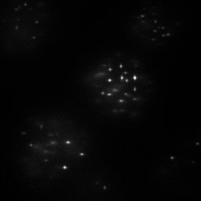
Experiment
We use super-resolution flourescence micrscopy to visualize telomeres with 10 nm localization precision.
Telomeres are labeled with DNA-FISH using 18 bp labels and Cy5 fluorescent dye
Between 1000 and 2000 telomeres are imaged in each experiment
Computationally determine telomere locations in all images using density-based clustering
For each cluster (telomere), compute the radius of gyration of the point localizations
Create the distributions of gyration radii, labeling density, and estimated volume for each cluster
How does super-resolution fluorescence microscopy work?
Use high laser powers and engineered photophysics to activate a sparse subset of fluorophores at a time
Take ~10,000 images with different subsets of fluorophores activated in each image
Computationally determine the centers of each recorded fluorophore in every image with a precision of ~10 nm
Combine the resulting point localizations into a final, super-resolved image

Slide 3
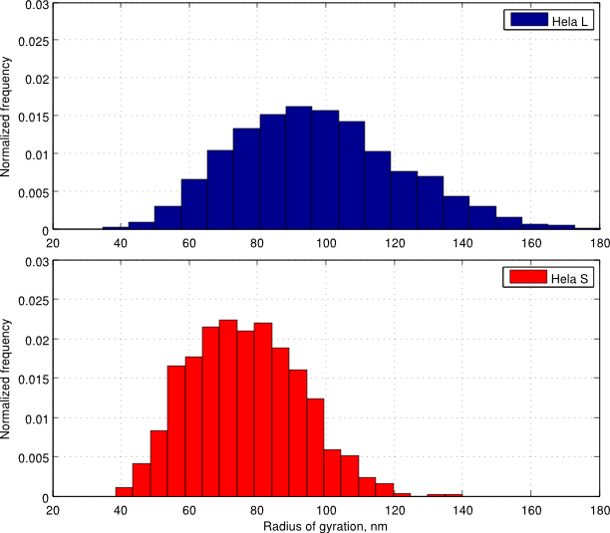
Analysis
A wormlike chain is described by two structural parameters:
Lp – persistence length
c – packing density
The radius of gyration describes the worm-like chain. It's mean square value is Rg2= f(lp, c, N)
N, mean, std
Radius of gyration data combined with Southern blot information allows for a MLE estimation of polymer model parameters
<INCLUDE SOUTHERN BLOT?>

Slide 4
Conclusions
The shorter genomic length of Hela S telomeres (~10 kbp) correlates with a smaller telomere gyration radius than Hela L telomeres (~25 kbp).
Labeling artifacts pose difficulties for interpreting telomere compaction in terms of a polymer model.
TO BE FURTHER ESTABLISHED

