Slide 1
Deep Learning for CIFAR-10 Image Classification
Exploring Convolutional Neural Networks (CNNs) and Transfer Learning
September 8, 2024

Slide 2
Project Overview
CIFAR-10 Image Classification using CNN and Transfer Learning
Objective: Classify images from CIFAR-10 into 10 categories using deep learning.
Dataset: 60,000 images (32x32) across 10 categories (airplane, car, bird, etc.).

Slide 3

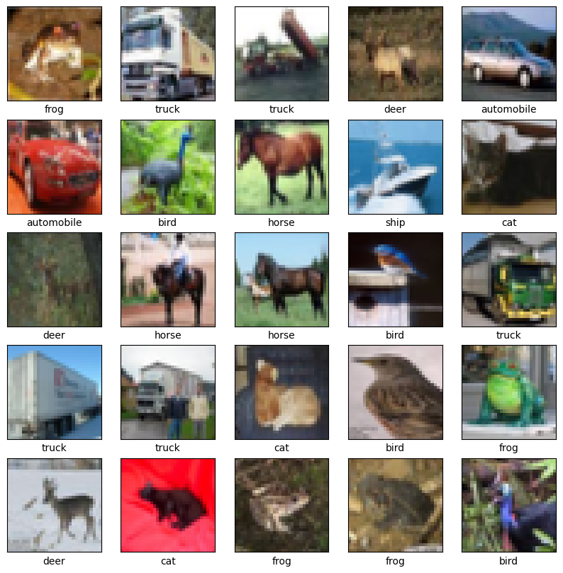
Problem Statement
Challenge: Accurately classify low-resolution images with high variability.
Goal: Build a model that generalizes well, achieving high accuracy on unseen images.

Slide 4
ML Approach
CNN Architecture: Multiple convolutional layers with batch normalization and dropout.
Transfer Learning: Pre-trained models (ResNet18, Xception) to improve classification accuracy.
Techniques: Data normalization, Image augmentation (horizontal flipping), Hyperparameter tuning (Grid Search).

Slide 5
Exploratory Data Analysis (EDA)
Class Distribution: Balanced across the 10 categories.
Image Characteristics: RGB channels, pixel intensity distributions.
Visualization: PCA and t-SNE for class separation, Edge detection using Canny.

Slide 6
Exploratory Data Analysis (EDA) Example training images

Slide 7
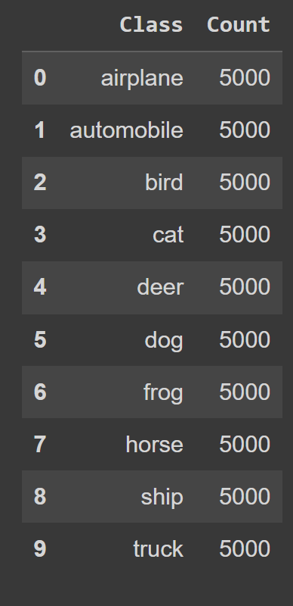
Exploratory Data Analysis (EDA) Training data: 10 classes Balanced at 5000 images each

Slide 8
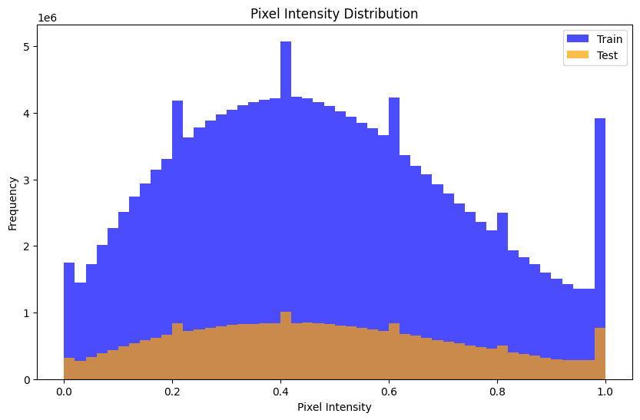
Exploratory Data Analysis (EDA) Pixel Intensity Distribution

Slide 9
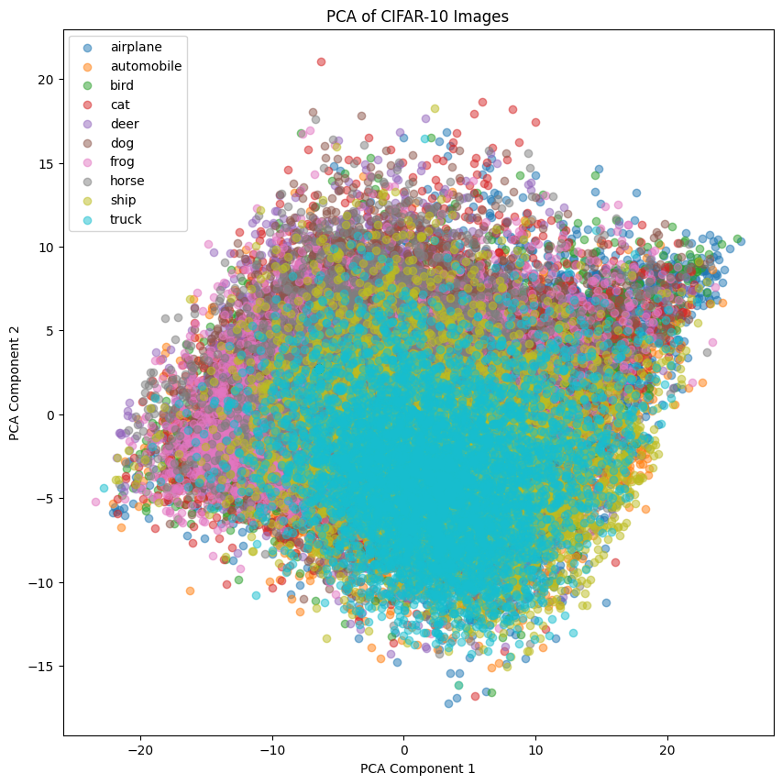
Exploratory Data Analysis (EDA) PCA

Slide 10
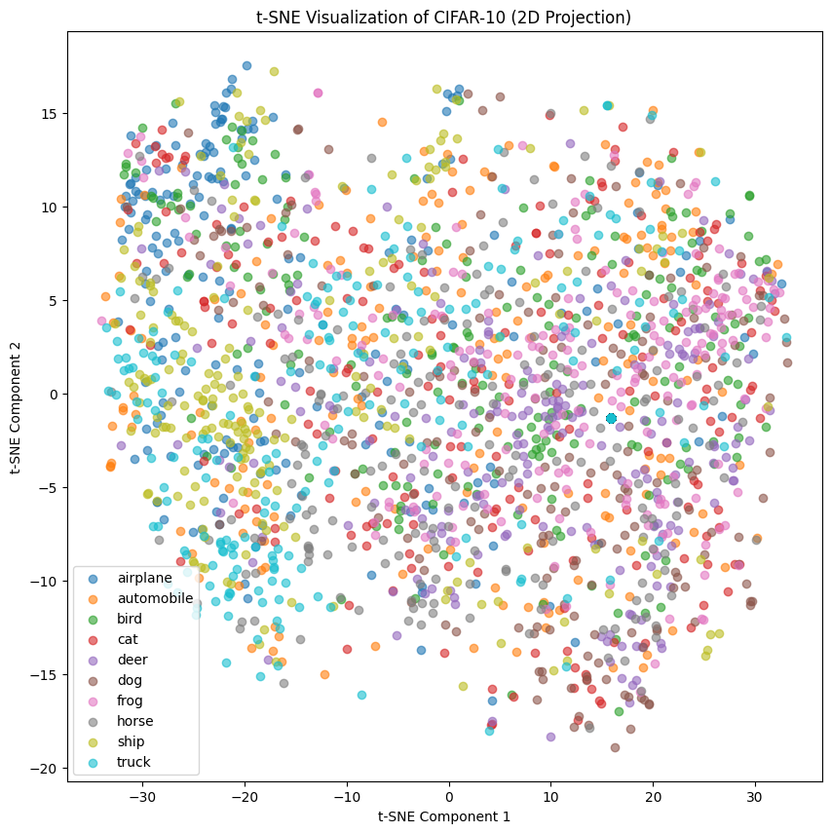
Exploratory Data Analysis (EDA) t-SNE

Slide 11
Model Architecture
CNN Model: Convolutional layers, Batch normalization, Dropout to prevent overfitting.
Transfer Learning: Fine-tuned Xception and ResNet18.

Slide 12
Training Results
CNN Performance: Best overall Test accuracy of 82.5%.
Xception Performance: After tuning, achieved ~80% test accuracy.
ResNet50: Lower performance (38.13%) on CIFAR-10.

Slide 13
Visualization of Model Performance
Accuracy & Loss Curves: Training and validation accuracy indicate overfitting.

Slide 14
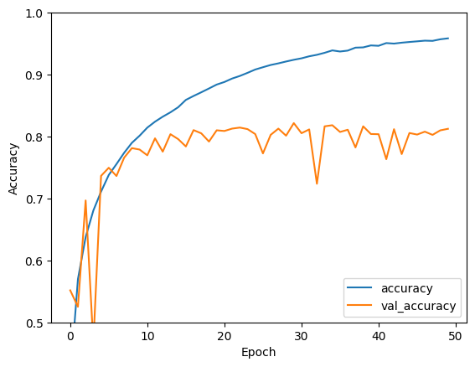
Training Results
CNN with 5 convolutional layers, 50 epochs

Slide 15
CNN Model Architecture Summary
Input Layer:
Shape: (32, 32, 3) RGB image
Convolutional Blocks (x5):
Conv2D: Detects image patterns (32-256 filters)
BatchNormalization: Stabilizes training
MaxPooling (2x2): Reduces dimensions
Dropout (25%): Prevents overfitting
GlobalAveragePooling2D:
Converts feature maps to a 1D vector
Dense Layers:
Dense (64 units, ReLU): Learns complex patterns
Dropout (50%): Regularization
Dense (10 units): Output layer for classification
Compilation:
Optimizer: Adam
Loss: SparseCategoricalCrossentropy
Metric: Accuracy
Training Results:
Accuracy: Training vs Validation
Test Accuracy: Final accuracy

Slide 16
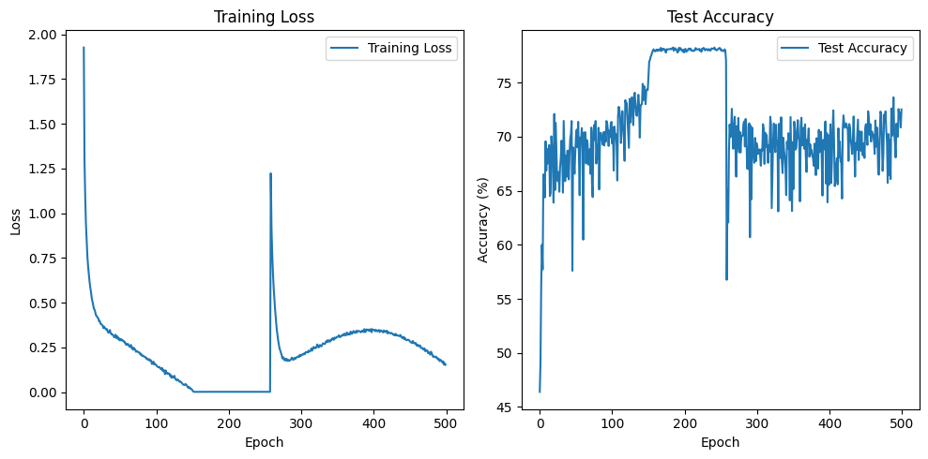
Training Results
CNN with Random Horizontal Flip, 500 epochs

Slide 17
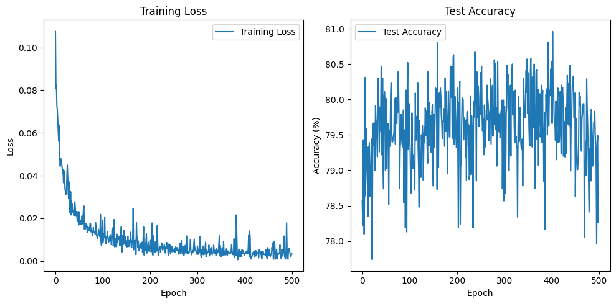
Training Results
Xception (pretrained) with best hyper parameters, 500 epochs

Slide 18
Optimization & Hyperparameter Tuning
Hyperparameters: Learning rate, batch size, optimizer choice.
Grid Search: Tested different combinations to maximize accuracy.

Slide 19
Optimization & Hyperparameter Tuning
Ran each of these 4 pretrained models:
ResNet50 and ResNet18
EfficientNetB0
InceptionV3
Xception

Slide 20
Optimization & Hyperparameter Tuning
Hyperparameter grid – best parameters found in bold below for pretrained Xception
lrs = [0.001, 0.01, 0.1]
momentums = [0.8, 0.9]
weight_decays = [0, 1e-4]
batch_sizes = [64, 128]
optimizers = ['SGD', 'Adam']

Slide 21
Conclusion
Key Takeaways: CNNs are effective for image classification.
Transfer learning with Xception shows promising results.
Future Work: More data augmentation, regularization, deeper models.

Slide 22
Project Links:
GitHub Link: https://github.com/LEBLAPI1/ImageClassifier-CNN-ResNet-Xception/
Notebook Link (Google Colab): https://colab.research.google.com/drive/1muNErLFUuOIqb1wMnoUJ_zdv6eGhyTuW?usp=sharing
Data set:
https://www.tensorflow.org/datasets/catalog/cifar10

