Slide 1
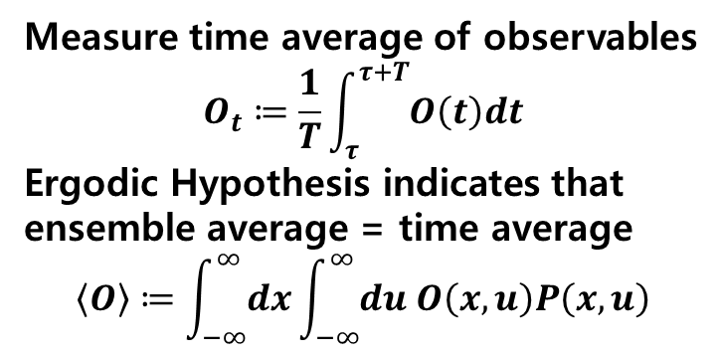
Dynamics according to Langevin equation
Iteration = 10,000 + 100,000, delta t = 0.001
Measure time average of observables
$$O_{t}≔\frac{1}{T}\int_{τ}^{τ+T}{O\left(t\right)dt}$$
Ergodic Hypothesis indicates that
ensemble average = time average
$$\left\langle O\right\rangle ≔\int_{−∞}^{∞}{dx}\int_{−∞}^{∞}{du O\left(x,u\right)P\left(x,u\right)}$$
Ensemble size
= Sample size
= 250,000
Random initialization of
Particle position and noise
Remove initial effect
= 10,000 iteration
Collect data (= particle position)
= 100,000 iteration

