Slide 1
Appendix
LEE, SungBin

Slide 2
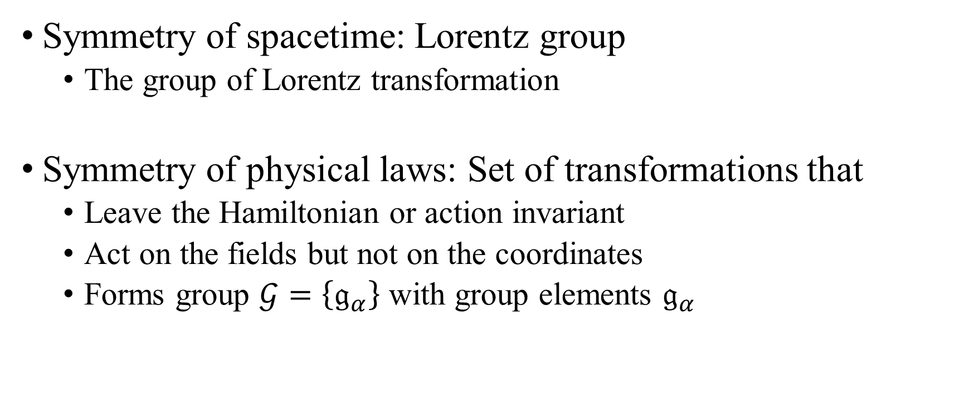
Basic group theory and Lie algebra
Symmetry of spacetime: Lorentz group
The group of Lorentz transformation
Symmetry of physical laws: Set of transformations that
Leave the Hamiltonian or action invariant
Act on the fields but not on the coordinates
Forms group $𝒢=\left\{𝔤_{α}\right\}$ with group elements $𝔤_{α}$

Slide 3
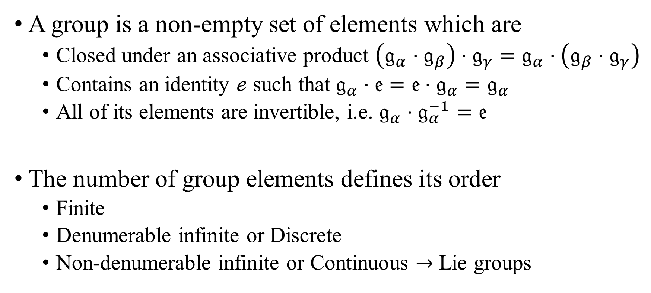
Basic group theory and Lie algebra
A group is a non-empty set of elements which are
Closed under an associative product $\left(𝔤_{α}⋅𝔤_{β}\right)⋅𝔤_{γ}=𝔤_{α}⋅\left(𝔤_{β}⋅𝔤_{γ}\right)$
Contains an identity $ℯ$ such that $𝔤_{α}⋅𝔢=𝔢⋅𝔤_{α}=𝔤_{α}$
All of its elements are invertible, i.e. $𝔤_{α}⋅𝔤_{α}^{−1}=𝔢$
The number of group elements defines its order
Finite
Denumerable infinite or Discrete
Non-denumerable infinite or Continuous $→$ Lie groups

Slide 4
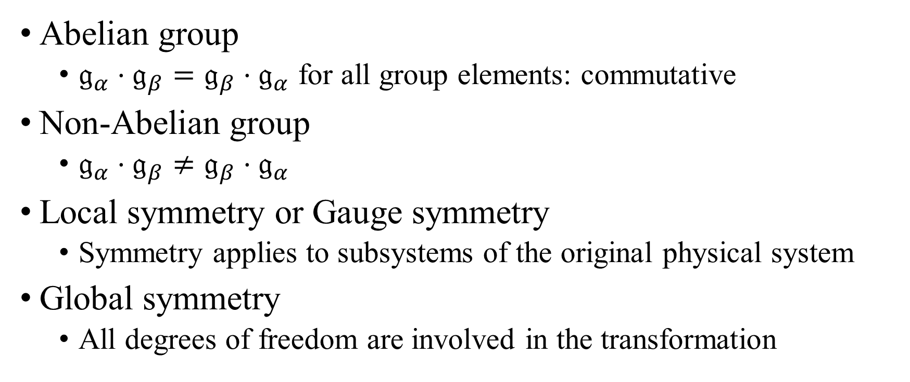
Basic group theory and Lie algebra
Abelian group
$𝔤_{α}⋅𝔤_{β}=𝔤_{β}⋅𝔤_{α}$ for all group elements: commutative
Non-Abelian group
$𝔤_{α}⋅𝔤_{β}≠𝔤_{β}⋅𝔤_{α}$
Local symmetry or Gauge symmetry
Symmetry applies to subsystems of the original physical system
Global symmetry
All degrees of freedom are involved in the transformation

Slide 5
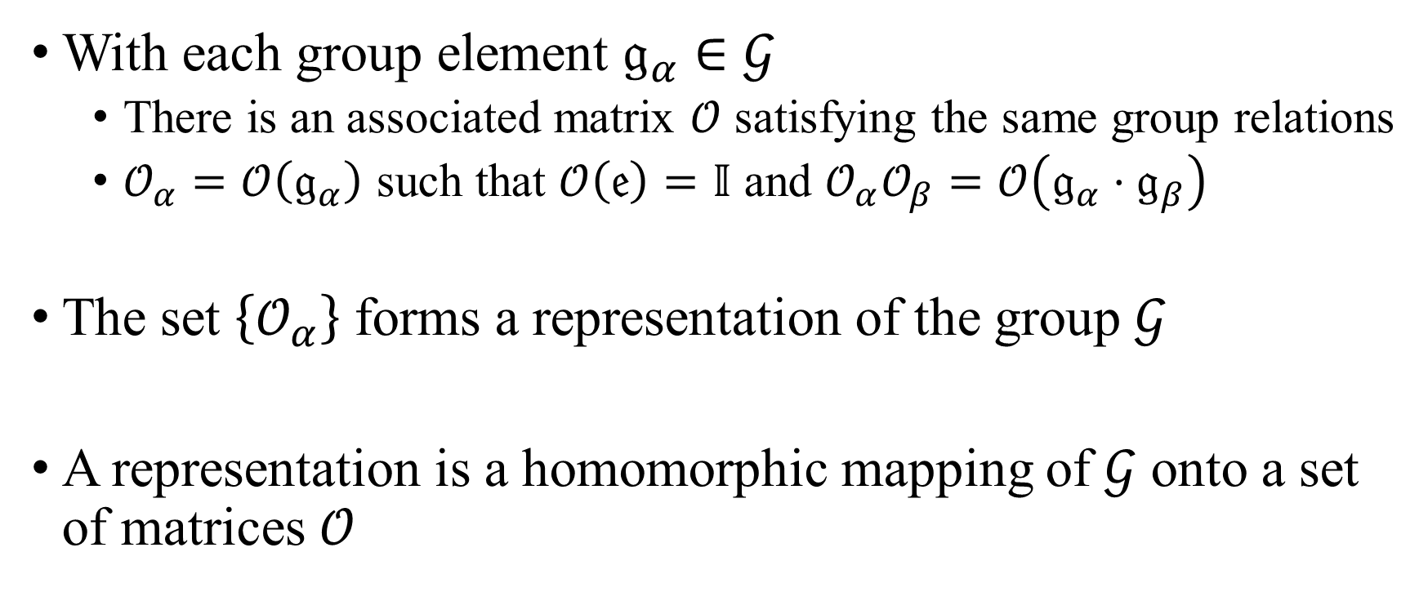
Basic group theory and Lie algebra
With each group element $𝔤_{α}∈𝒢$
There is an associated matrix $𝒪$ satisfying the same group relations
$𝒪_{α}=𝒪\left(𝔤_{α}\right)$ such that $𝒪\left(𝔢\right)=𝕀$ and $𝒪_{α}𝒪_{β}=𝒪\left(𝔤_{α}⋅𝔤_{β}\right)$
The set $\left\{𝒪_{α}\right\}$ forms a representation of the group $𝒢$
A representation is a homomorphic mapping of $𝒢$ onto a set of matrices $𝒪$

Slide 6
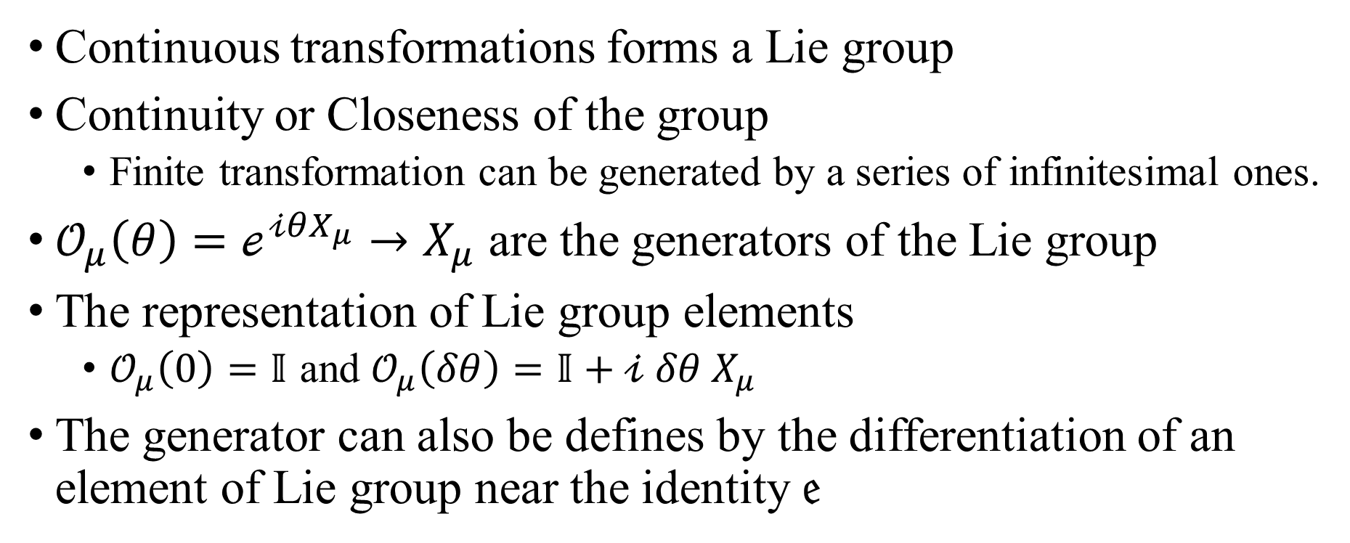
Basic group theory and Lie algebra
Continuous transformations forms a Lie group
Continuity or Closeness of the group
Finite transformation can be generated by a series of infinitesimal ones.
$𝒪_{μ}\left(θ\right)=ℯ^{𝒾θX_{μ}}→X_{μ}$ are the generators of the Lie group
The representation of Lie group elements
$𝒪_{μ}\left(0\right)=𝕀$ and $𝒪_{μ}\left(δθ\right)=𝕀+𝒾 δθ X_{μ}$
The generator can also be defines by the differentiation of an element of Lie group near the identity $𝔢$

Slide 7
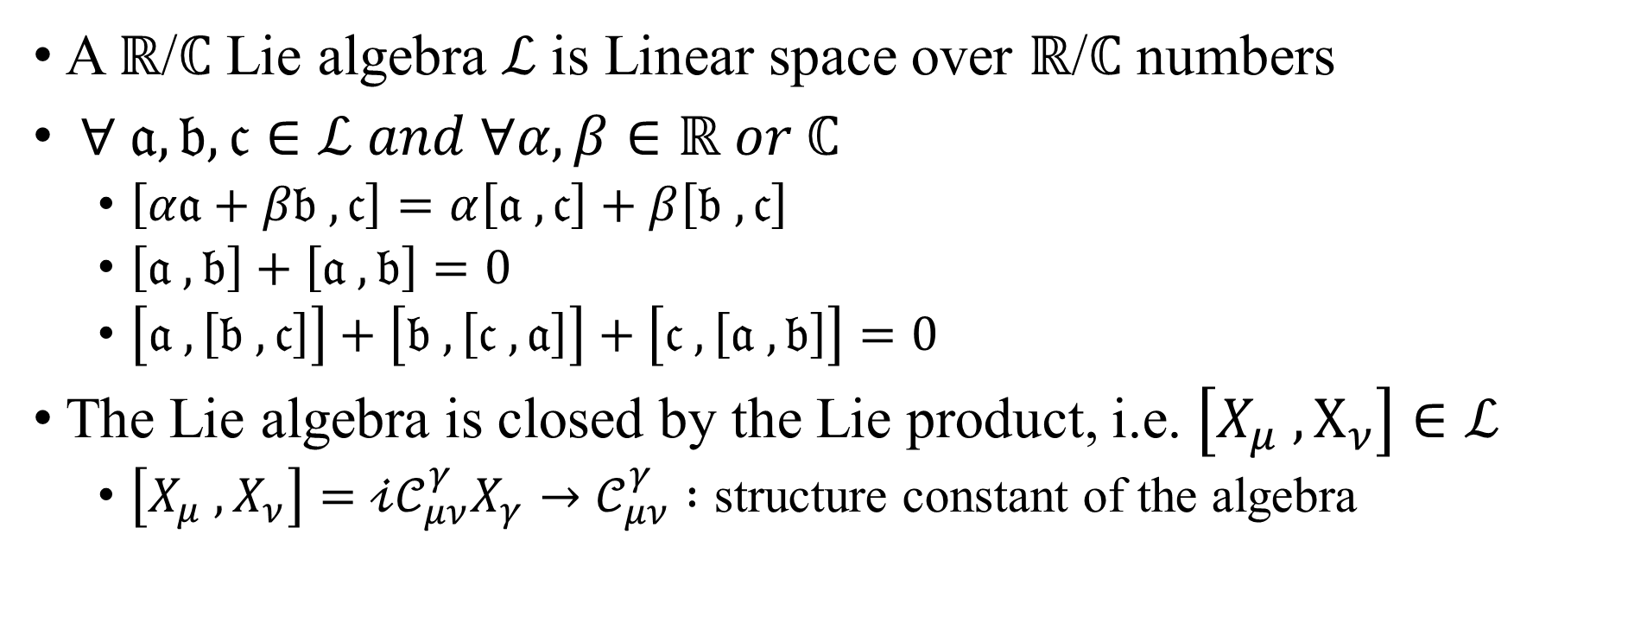
Basic group theory and Lie algebra
A $ℝ$/$ℂ$ Lie algebra $ℒ$ is Linear space over $ℝ$/$ℂ$ numbers
$∀ 𝔞, 𝔟, 𝔠∈ℒ and ∀α, β∈ℝ or ℂ$
$\left[α𝔞+β𝔟 ,𝔠\right]=α\left[𝔞 ,𝔠\right]+β\left[𝔟 ,𝔠\right]$
$\left[𝔞 ,𝔟\right]+\left[𝔞 ,𝔟\right]=0$
$\left[𝔞 ,\left[𝔟 ,𝔠\right]\right]+\left[𝔟 ,\left[𝔠 ,𝔞\right]\right]+\left[𝔠 ,\left[𝔞 ,𝔟\right]\right]=0$
The Lie algebra is closed by the Lie product, i.e. $\left[X_{μ} ,X_{ν}\right]∈ℒ$
$\left[X_{μ} ,X_{ν}\right]=𝒾𝒞_{μν}^{γ}X_{γ}→𝒞_{μν}^{γ} :$ structure constant of the algebra

Slide 8
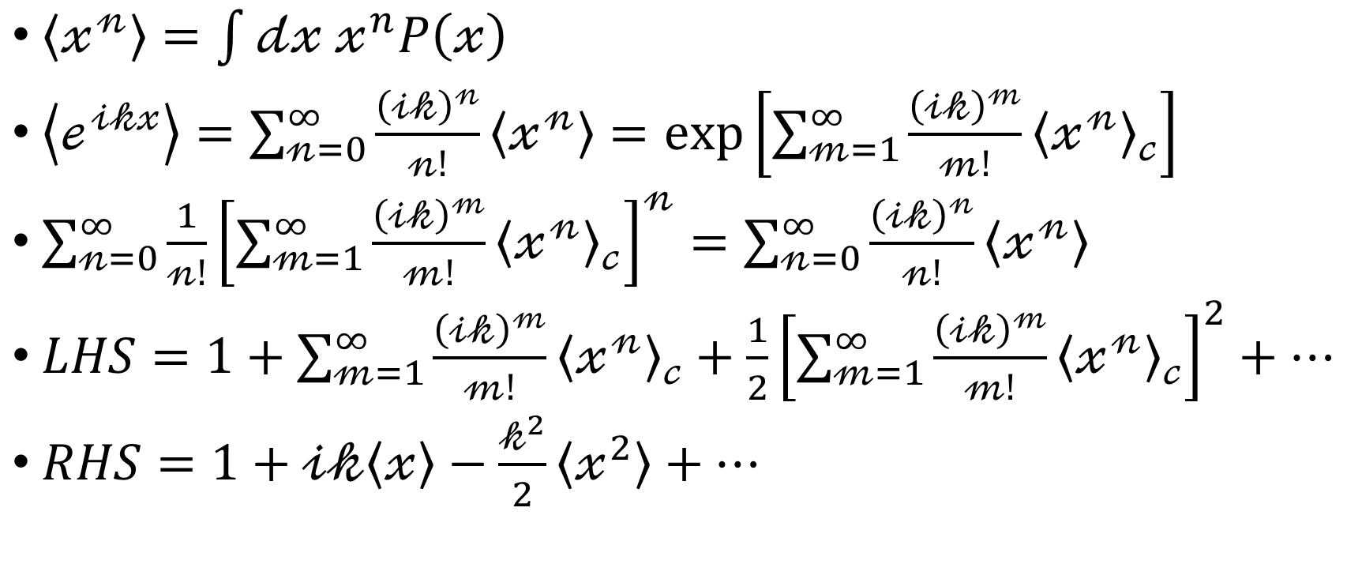
Cumulants
$\left\langle 𝓍^{𝓃}\right\rangle =\int{𝒹𝓍 𝓍^{n}P\left(𝓍\right)}$
$\left\langle ℯ^{𝒾𝓀𝓍}\right\rangle =\sum_{𝓃=0}^{∞}{\frac{{\left(𝒾𝓀\right)}^{𝓃}}{𝓃!}\left\langle 𝓍^{𝓃}\right\rangle }=\exp\left[\sum_{𝓂=1}^{∞}{\frac{{\left(𝒾𝓀\right)}^{𝓂}}{𝓂!}{\left\langle 𝓍^{𝓃}\right\rangle }_{𝒸}}\right]$
$\sum_{𝓃=0}^{∞}{\frac{1}{𝓃!}{\left[\sum_{𝓂=1}^{∞}{\frac{{\left(𝒾𝓀\right)}^{𝓂}}{𝓂!}{\left\langle 𝓍^{𝓃}\right\rangle }_{𝒸}}\right]}^{𝓃}}=\sum_{𝓃=0}^{∞}{\frac{{\left(𝒾𝓀\right)}^{𝓃}}{𝓃!}\left\langle 𝓍^{𝓃}\right\rangle }$
$LHS=1+\sum_{𝓂=1}^{∞}{\frac{{\left(𝒾𝓀\right)}^{𝓂}}{𝓂!}{\left\langle 𝓍^{𝓃}\right\rangle }_{𝒸}}+\frac{1}{2}{\left[\sum_{𝓂=1}^{∞}{\frac{{\left(𝒾𝓀\right)}^{𝓂}}{𝓂!}{\left\langle 𝓍^{𝓃}\right\rangle }_{𝒸}}\right]}^{2}+…$
$RHS=1+𝒾𝓀\left\langle 𝓍\right\rangle −\frac{𝓀^{2}}{2}\left\langle 𝓍^{2}\right\rangle +…$

Slide 9
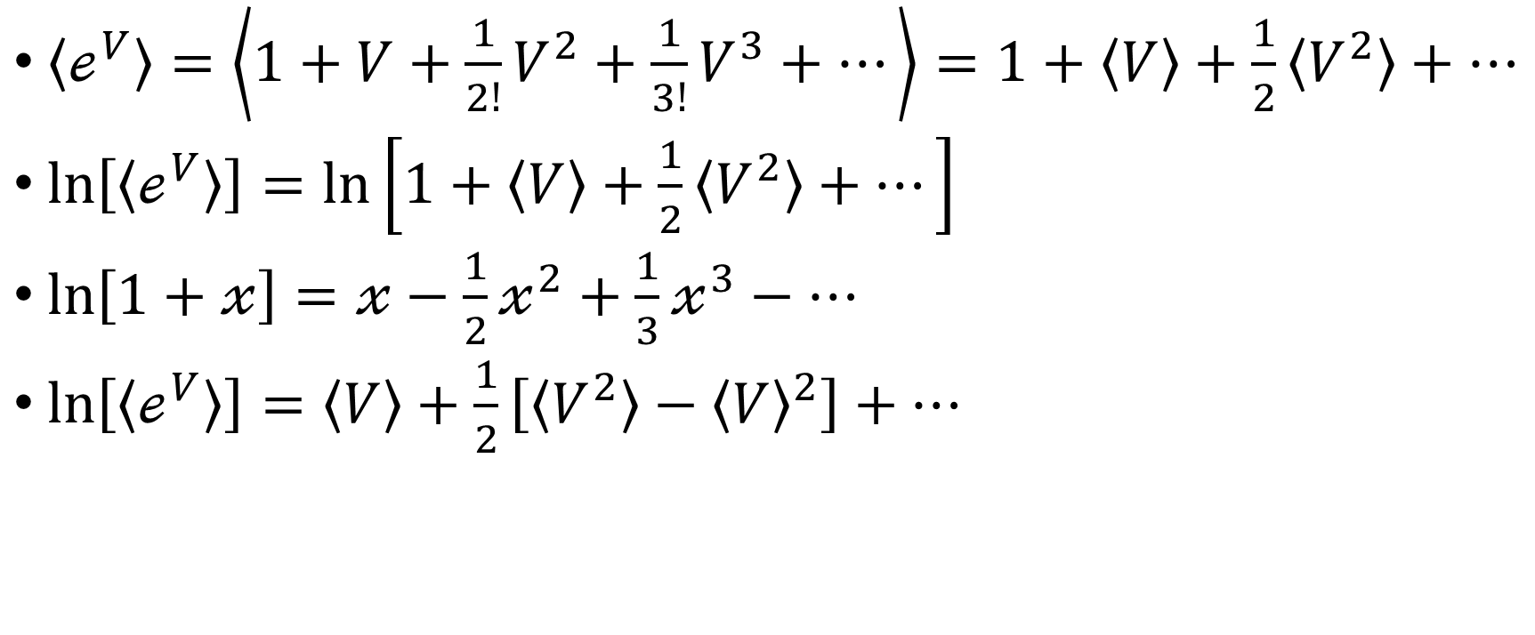
Cumulants
$\left\langle ℯ^{V}\right\rangle =\left\langle 1+V+\frac{1}{2!}V^{2}+\frac{1}{3!}V^{3}+…\right\rangle =1+\left\langle V\right\rangle +\frac{1}{2}\left\langle V^{2}\right\rangle +…$
$\ln\left[\left\langle ℯ^{V}\right\rangle \right]=\ln\left[1+\left\langle V\right\rangle +\frac{1}{2}\left\langle V^{2}\right\rangle +…\right]$
$\ln\left[1+𝓍\right]=𝓍−\frac{1}{2}𝓍^{2}+\frac{1}{3}𝓍^{3}−…$
$\ln\left[\left\langle ℯ^{V}\right\rangle \right]=\left\langle V\right\rangle +\frac{1}{2}\left[\left\langle V^{2}\right\rangle −{\left\langle V\right\rangle }^{2}\right]+…$

Slide 10
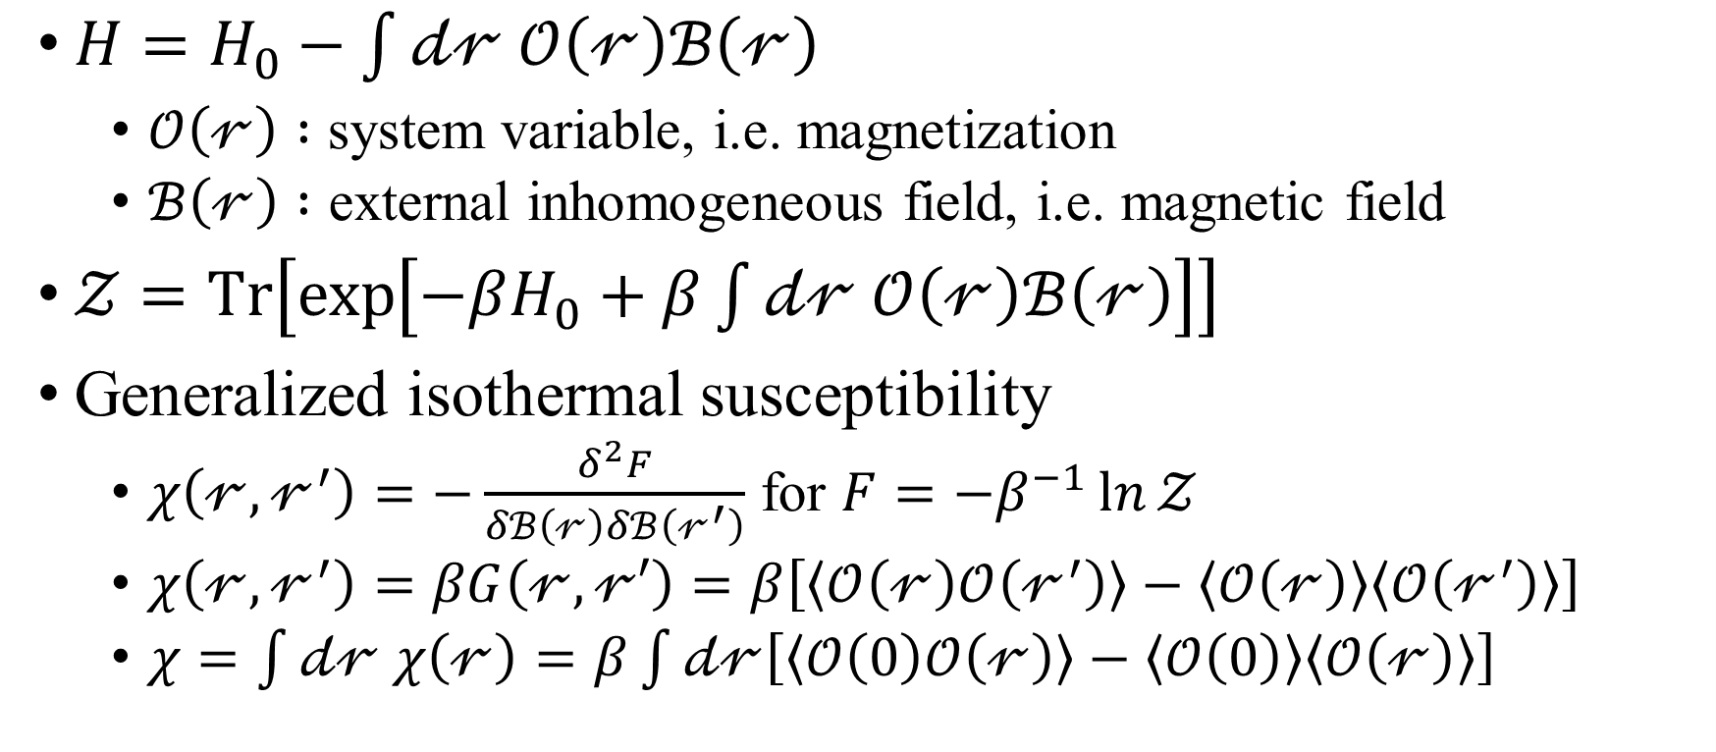
Fluctuation-dissipation theorem
$H=H_{0}−\int{𝒹𝓇 𝒪\left(𝓇\right)ℬ\left(𝓇\right)}$
$𝒪\left(𝓇\right) :$ system variable, i.e. magnetization
$ℬ\left(𝓇\right) :$ external inhomogeneous field, i.e. magnetic field
$𝒵=Tr\left[\exp\left[−βH_{0}+β\int{𝒹𝓇 𝒪\left(𝓇\right)ℬ\left(𝓇\right)}\right]\right]$
Generalized isothermal susceptibility
$χ\left(𝓇,𝓇^{′}\right)=−\frac{δ^{2}F}{δℬ\left(𝓇\right)δℬ\left(𝓇^{′}\right)}$ for $F=−β^{−1}\ln{𝒵}$
$χ\left(𝓇,𝓇^{′}\right)=βG\left(𝓇,𝓇′\right)=β\left[\left\langle 𝒪\left(𝓇\right)𝒪\left(𝓇^{′}\right)\right\rangle −\left\langle 𝒪\left(𝓇\right)\right\rangle \left\langle 𝒪\left(𝓇^{′}\right)\right\rangle \right]$
$χ=\int{𝒹𝓇 χ\left(𝓇\right)}=β\int{𝒹𝓇\left[\left\langle 𝒪\left(0\right)𝒪\left(𝓇\right)\right\rangle −\left\langle 𝒪\left(0\right)\right\rangle \left\langle 𝒪\left(𝓇\right)\right\rangle \right]}$

