Slide 1
Hamiltonian
LEE SungBin

Slide 2

Ising Model
$H=−𝒥\sum_{\left\langle 𝒾,𝒿\right\rangle }{σ_{𝒾}σ_{𝒿}}−𝒽\sum_{𝒾}{σ_{𝒾}}$
$σ_{𝒾}=± 1$
Ising spin = Representation of the $ℤ_{2}$ group

Slide 3
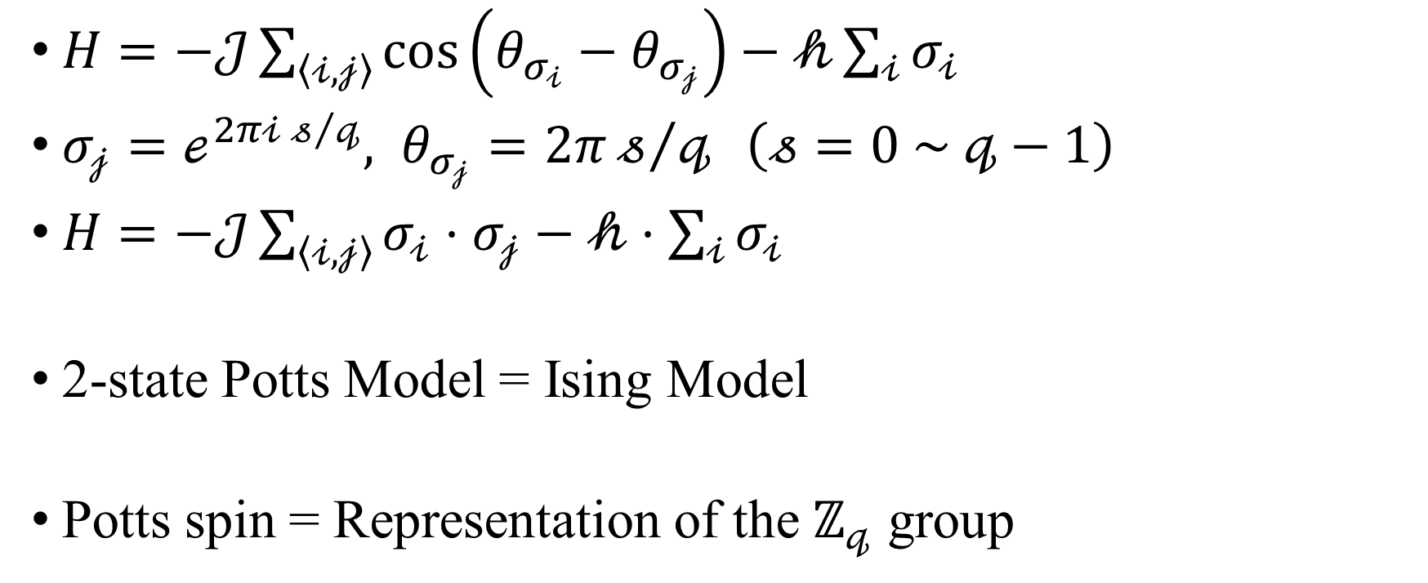
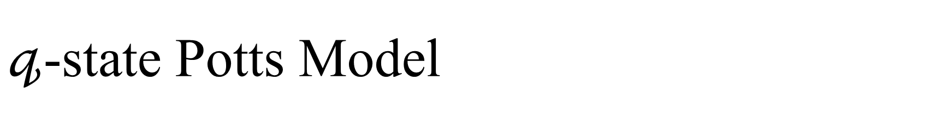
$𝓆$-state Potts Model
$H=−𝒥\sum_{\left\langle 𝒾,𝒿\right\rangle }{\cos\left(θ_{σ_{𝒾}}−θ_{σ_{𝒿}}\right)}−𝒽\sum_{𝒾}{σ_{𝒾}}$
$σ_{𝒿}=ℯ^{2π𝒾 𝓈/𝓆}, θ_{σ_{𝒿}}=2π𝓈/𝓆 \left(𝓈=0 \sim 𝓆−1\right)$
$H=−𝒥\sum_{\left\langle 𝒾,𝒿\right\rangle }{σ_{𝒾}⋅σ_{𝒿}}−𝒽⋅\sum_{𝒾}{σ_{𝒾}}$
2-state Potts Model = Ising Model
Potts spin = Representation of the $ℤ_{𝓆}$ group

Slide 4
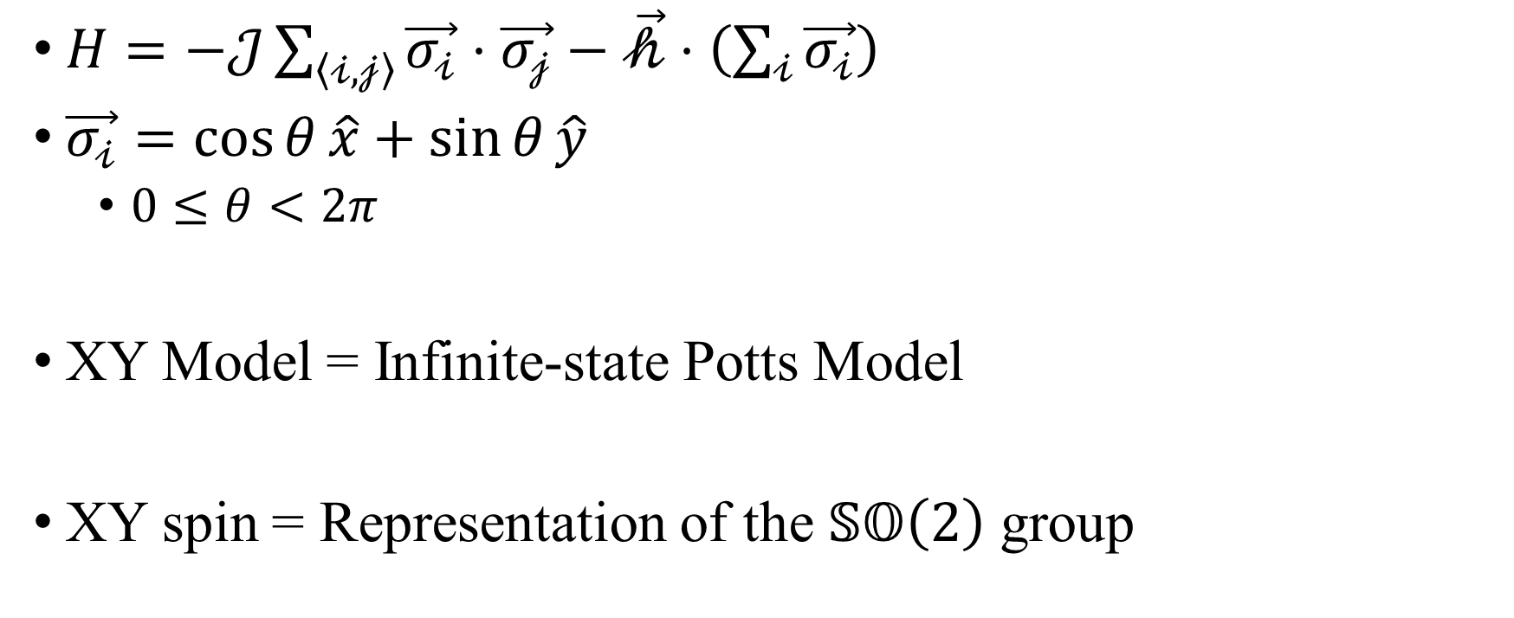
XY Model
$H=−𝒥\sum_{\left\langle 𝒾, 𝒿\right\rangle }{\vec{σ_{𝒾}}⋅\vec{σ_{𝒿}}}−\vec{𝒽}⋅\left(\sum_{𝒾}{\vec{σ_{𝒾}}}\right)$
$\vec{σ_{𝒾}}=\cos{θ}\hat{x}+\sin{θ}\hat{y}$
$0≤θ<2π$
XY Model = Infinite-state Potts Model
XY spin = Representation of the $𝕊𝕆\left(2\right)$ group

Slide 5
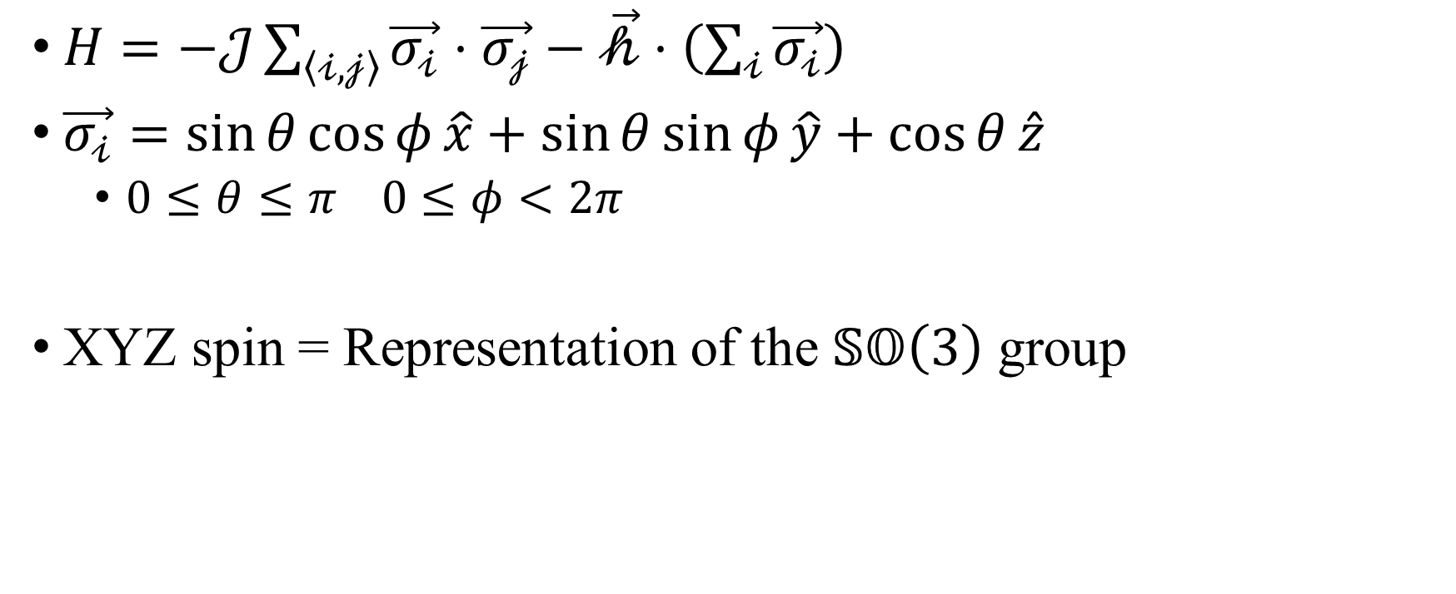
XYZ Model (Heisenberg)
$H=−𝒥\sum_{\left\langle 𝒾, 𝒿\right\rangle }{\vec{σ_{𝒾}}⋅\vec{σ_{𝒿}}}−\vec{𝒽}⋅\left(\sum_{𝒾}{\vec{σ_{𝒾}}}\right)$
$\vec{σ_{𝒾}}=\sin{θ}\cos{φ}\hat{x}+\sin{θ}\sin{φ}\hat{y}+\cos{θ}\hat{z}$
$0≤θ≤π 0≤φ<2π$
XYZ spin = Representation of the $𝕊𝕆\left(3\right)$ group

Slide 6
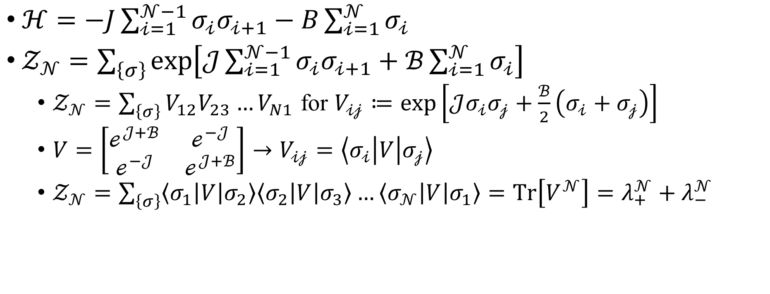
Transfer Matrix
$ℋ=−J\sum_{𝒾=1}^{𝒩−1}{σ_{𝒾}σ_{𝒾+1}}−B\sum_{𝒾=1}^{𝒩}{σ_{𝒾}}$
$𝒵_{𝒩}=\sum_{\left\{σ\right\}}{\exp\left[𝒥\sum_{𝒾=1}^{𝒩−1}{σ_{𝒾}σ_{𝒾+1}}+ℬ\sum_{𝒾=1}^{𝒩}{σ_{𝒾}}\right]}$
$𝒵_{𝒩}=\sum_{\left\{σ\right\}}{V_{12}V_{23}…V_{N1}}$ for $V_{𝒾𝒿}≔\exp\left[𝒥σ_{𝒾}σ_{𝒿}+\frac{ℬ}{2}\left(σ_{𝒾}+σ_{𝒿}\right)\right]$
$V=\left[\begin{matrix}ℯ^{𝒥+ℬ} & ℯ^{−𝒥} \\ ℯ^{−𝒥} & ℯ^{𝒥+ℬ}\end{matrix}\right]→V_{𝒾𝒿}=\left\langle σ_{𝒾} | V | σ_{𝒿}\right\rangle$
$𝒵_{𝒩}=\sum_{\left\{σ\right\}}{\left\langle σ_{1} | V | σ_{2}\right\rangle \left\langle σ_{2} | V | σ_{3}\right\rangle …\left\langle σ_{𝒩} | V | σ_{1}\right\rangle }=Tr\left[V^{𝒩}\right]=λ_{+}^{𝒩}+λ_{−}^{𝒩}$

Slide 7
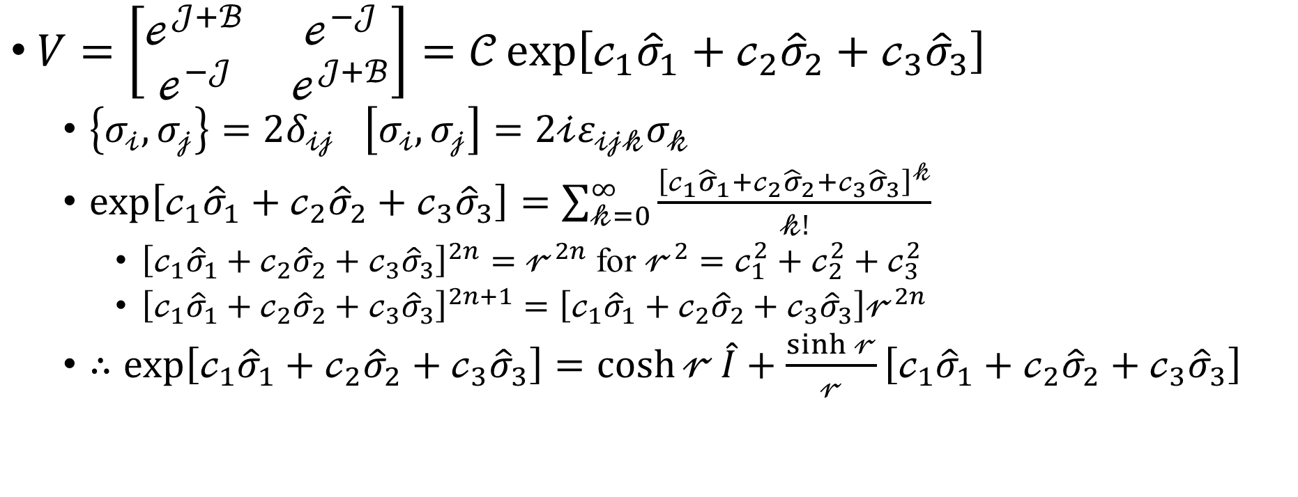
Quantum Hamiltonian
$V=\left[\begin{matrix}ℯ^{𝒥+ℬ} & ℯ^{−𝒥} \\ ℯ^{−𝒥} & ℯ^{𝒥+ℬ}\end{matrix}\right]=𝒞\exp\left[𝒸_{1}{\hat{σ}}_{1}+𝒸_{2}{\hat{σ}}_{2}+𝒸_{3}{\hat{σ}}_{3}\right]$
$\left\{σ_{𝒾},σ_{𝒿}\right\}=2δ_{𝒾𝒿} \left[σ_{𝒾},σ_{𝒿}\right]=2𝒾ε_{𝒾𝒿𝓀}σ_{𝓀}$
$\exp\left[𝒸_{1}{\hat{σ}}_{1}+𝒸_{2}{\hat{σ}}_{2}+𝒸_{3}{\hat{σ}}_{3}\right]=\sum_{𝓀=0}^{∞}{\frac{{\left[𝒸_{1}{\hat{σ}}_{1}+𝒸_{2}{\hat{σ}}_{2}+𝒸_{3}{\hat{σ}}_{3}\right]}^{𝓀}}{𝓀!}}$
${\left[𝒸_{1}{\hat{σ}}_{1}+𝒸_{2}{\hat{σ}}_{2}+𝒸_{3}{\hat{σ}}_{3}\right]}^{2n}=𝓇^{2n}$ for $𝓇^{2}=𝒸_{1}^{2}+𝒸_{2}^{2}+𝒸_{3}^{2}$
${\left[𝒸_{1}{\hat{σ}}_{1}+𝒸_{2}{\hat{σ}}_{2}+𝒸_{3}{\hat{σ}}_{3}\right]}^{2n+1}=\left[𝒸_{1}{\hat{σ}}_{1}+𝒸_{2}{\hat{σ}}_{2}+𝒸_{3}{\hat{σ}}_{3}\right]𝓇^{2n}$
$∴\exp\left[𝒸_{1}{\hat{σ}}_{1}+𝒸_{2}{\hat{σ}}_{2}+𝒸_{3}{\hat{σ}}_{3}\right]=\cosh{𝓇}\hat{I}+\frac{\sinh{𝓇}}{𝓇}\left[𝒸_{1}{\hat{σ}}_{1}+𝒸_{2}{\hat{σ}}_{2}+𝒸_{3}{\hat{σ}}_{3}\right]$

Slide 8
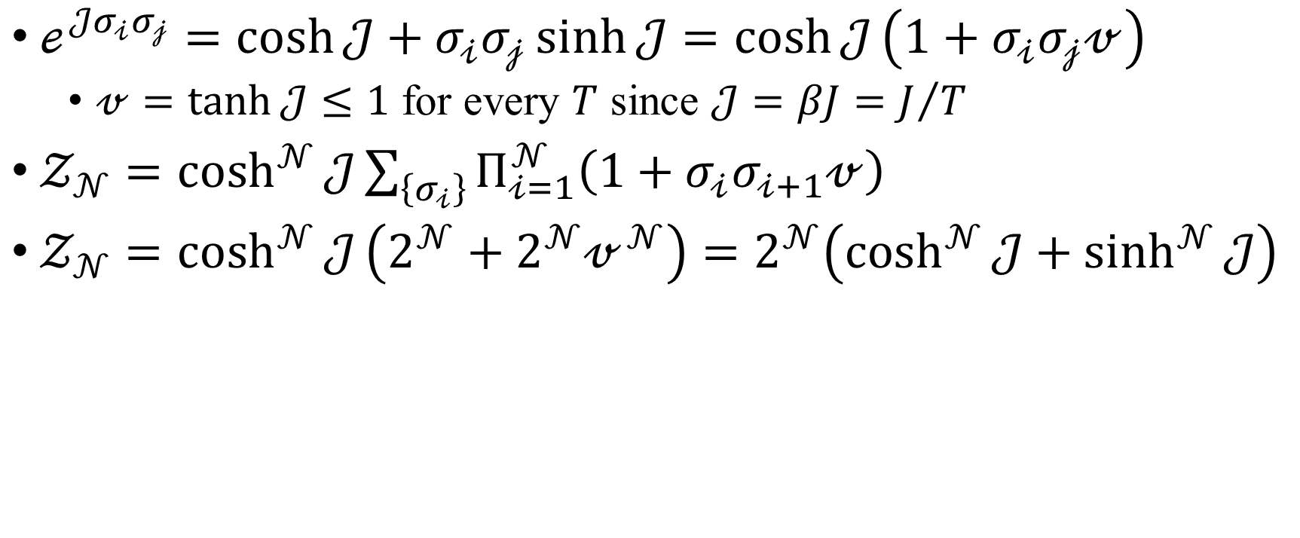
Series Expansion
$ℯ^{𝒥σ_{𝒾}σ_{𝒿}}=\cosh{𝒥}+σ_{𝒾}σ_{𝒿}\sinh{𝒥}=\cosh{𝒥}\left(1+σ_{𝒾}σ_{𝒿}𝓋\right)$
$𝓋=\tanh{𝒥}≤1$ for every $T$ since $𝒥=βJ=J/T$
$𝒵_{𝒩}=\cosh^{𝒩}{𝒥}\sum_{\left\{σ_{𝒾}\right\}}{Π_{𝒾=1}^{𝒩}\left(1+σ_{𝒾}σ_{𝒾+1}𝓋\right)}$
$𝒵_{𝒩}=\cosh^{𝒩}{𝒥}\left(2^{𝒩}+2^{𝒩}𝓋^{𝒩}\right)=2^{𝒩}\left(\cosh^{𝒩}{𝒥}+\sinh^{𝒩}{𝒥}\right)$

