Slide 1
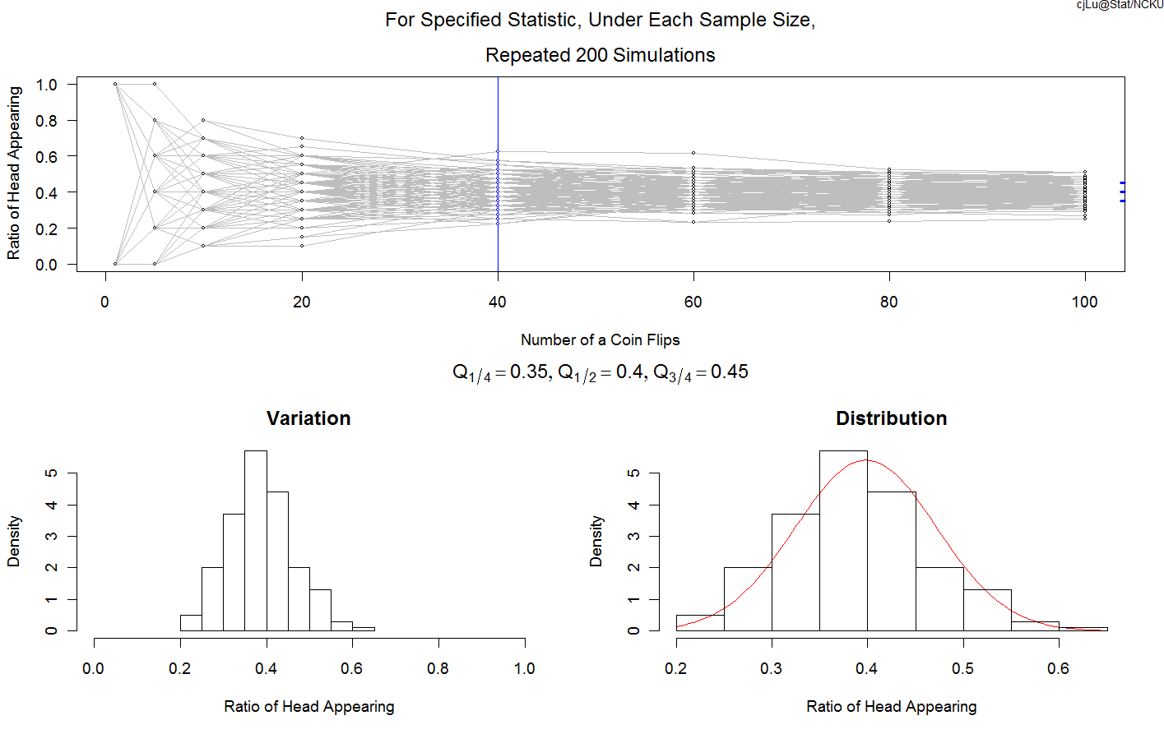
Teaching Basic Statistics with R:
An Introduction to Interactive Packages
Shuen-Lin Jeng
National Cheng Kung University

Slide 2
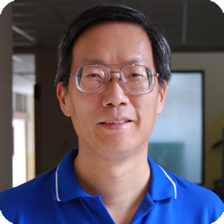
Outline
Teaching the basic Statistics
  Law of Large Numbers
  Central Limit Theorem
The R interactive packages
  LargeSample
  LargeSampleV2.1
  http://sites.google.com/site/cjosephlu2/
C. Joseph Lu
Associate Professor
National Cheng Kung University

Slide 3
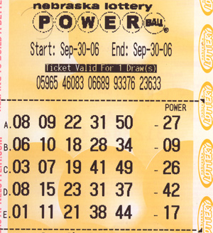
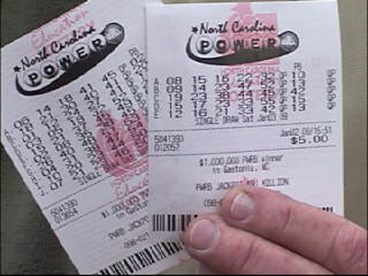
An probability / statistics event seen in daily lives

Slide 4
Questions
Could the past number frequency help for winning the Jackpot?
If the lottery is “fair”, should the frequency of each number be getting closer after years?
ANS: By the Law of Large Numbers
Does the lottery favor or not favor to certain numbers? Is the lottery “fair”?
ANS: By the Central Limit Theorem

Slide 5
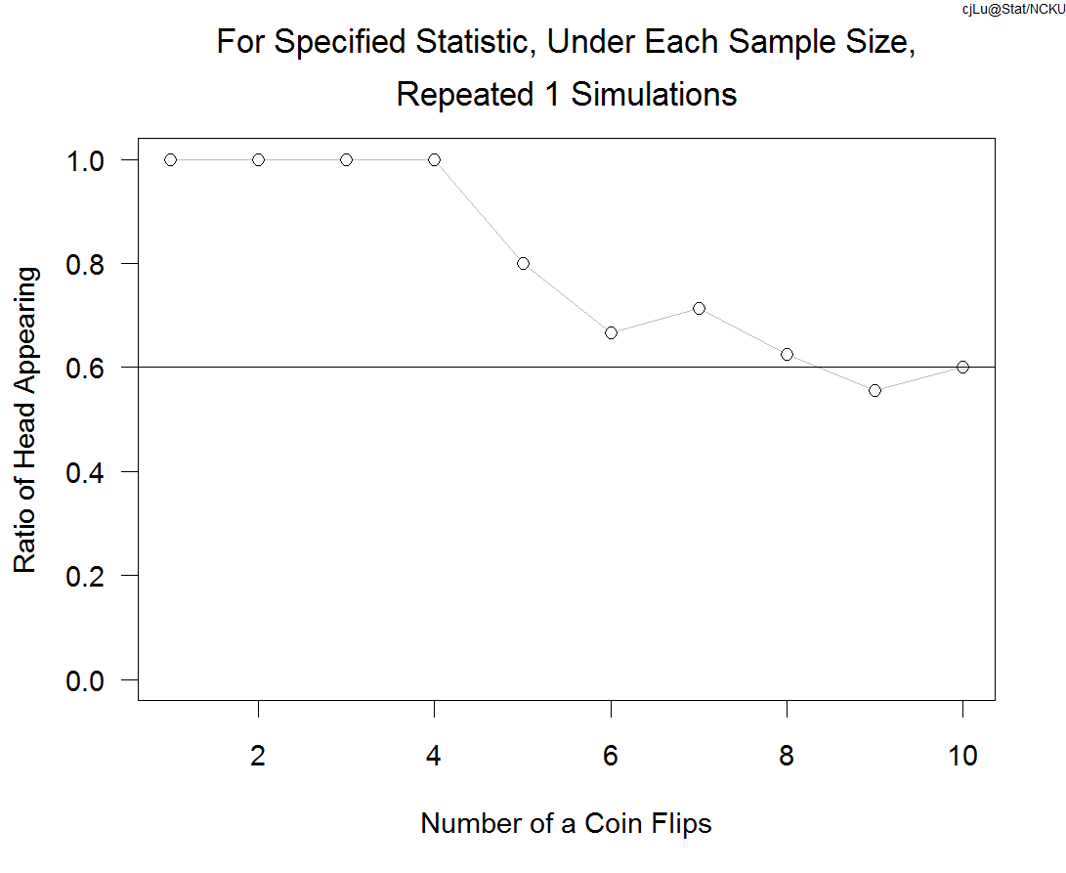
Simplify the question: Is the coin fair?
Toss a coin 1 to 10 times and calculate the ratio of head appearing

Slide 6
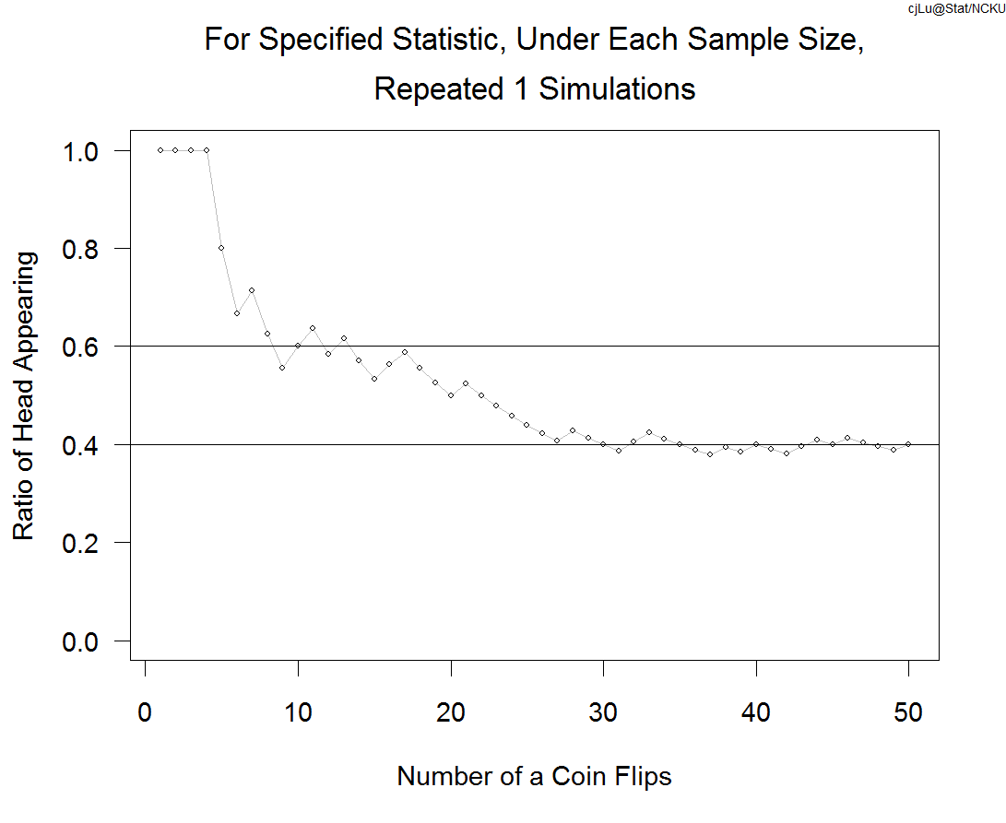
Keep tossing to 50 times

Slide 7
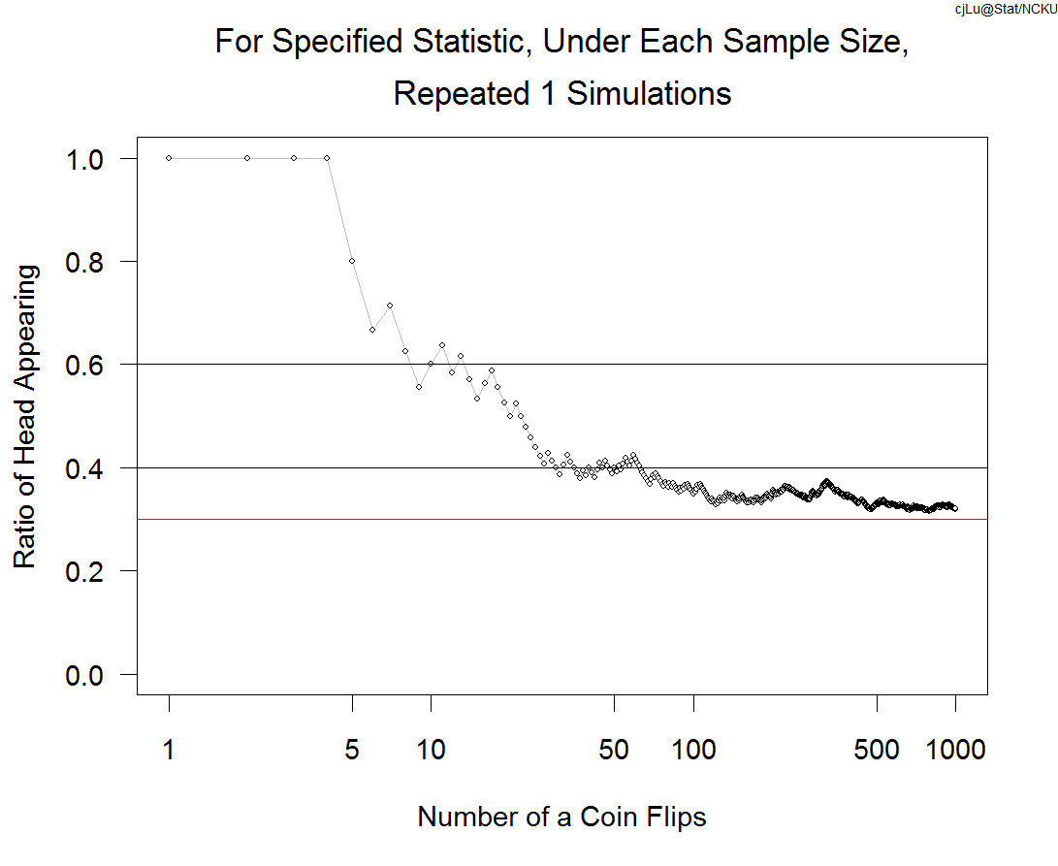
Keep Tossing to 1000 Times

Slide 8
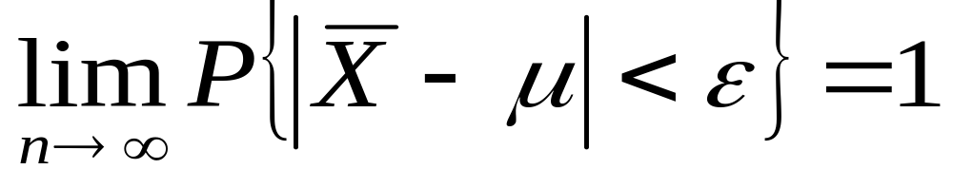
The Law of Large Numbers
Bernoulli (1713) “The Art of Guessing” proved that for X1 … Xn independent and binomial distributed B(1,μ)，then for all ε > 0
Actually the result holds for independent identical distributed random variables with finite expectation.
Loosely speaking, for the sample collected under a repeating manner, the sample mean will be close to the population mean when the sample size is large.

Slide 9
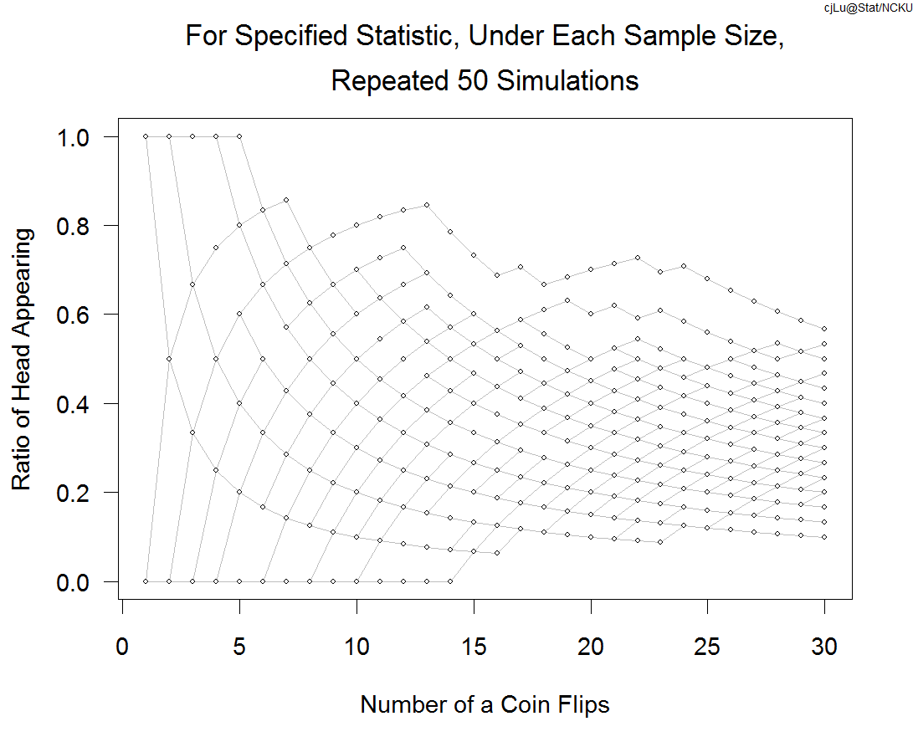
How large？Toss 30 times？
Simulations to see the size effect.

Slide 10
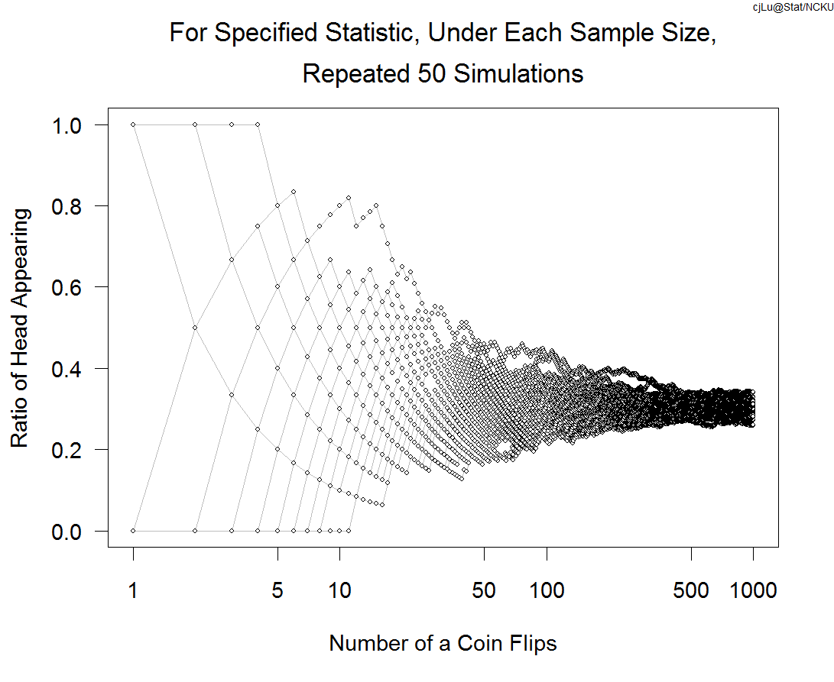
50 Simulations. Each tossing 1000times
We may conclude that it is not a fair coin

Slide 11
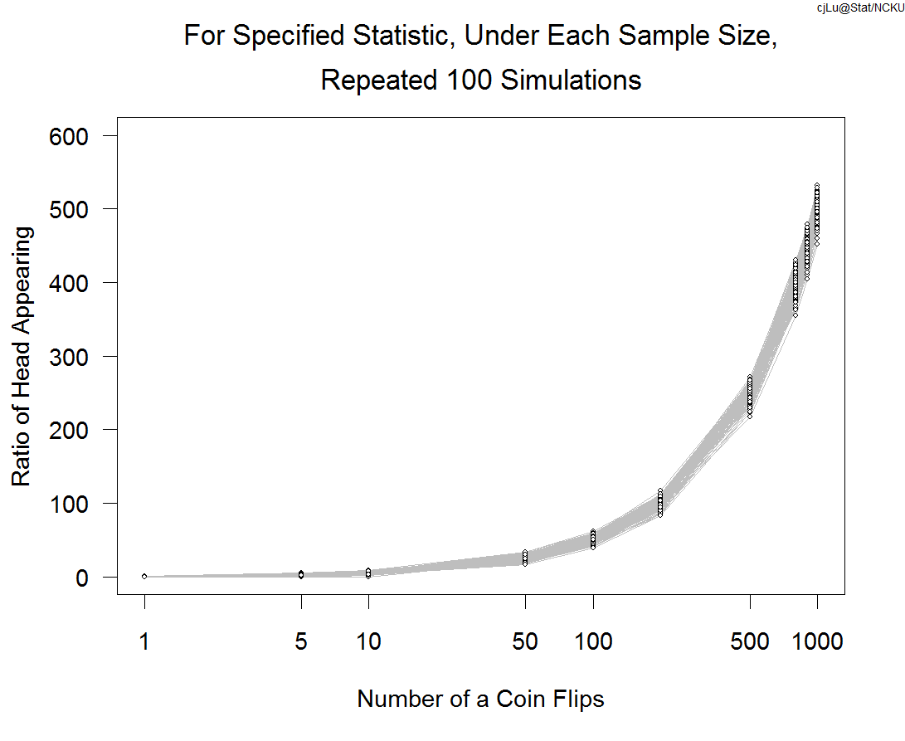
For a fair coin，will the frequency be closer to 0.5n？Simulate 100 times

Slide 12
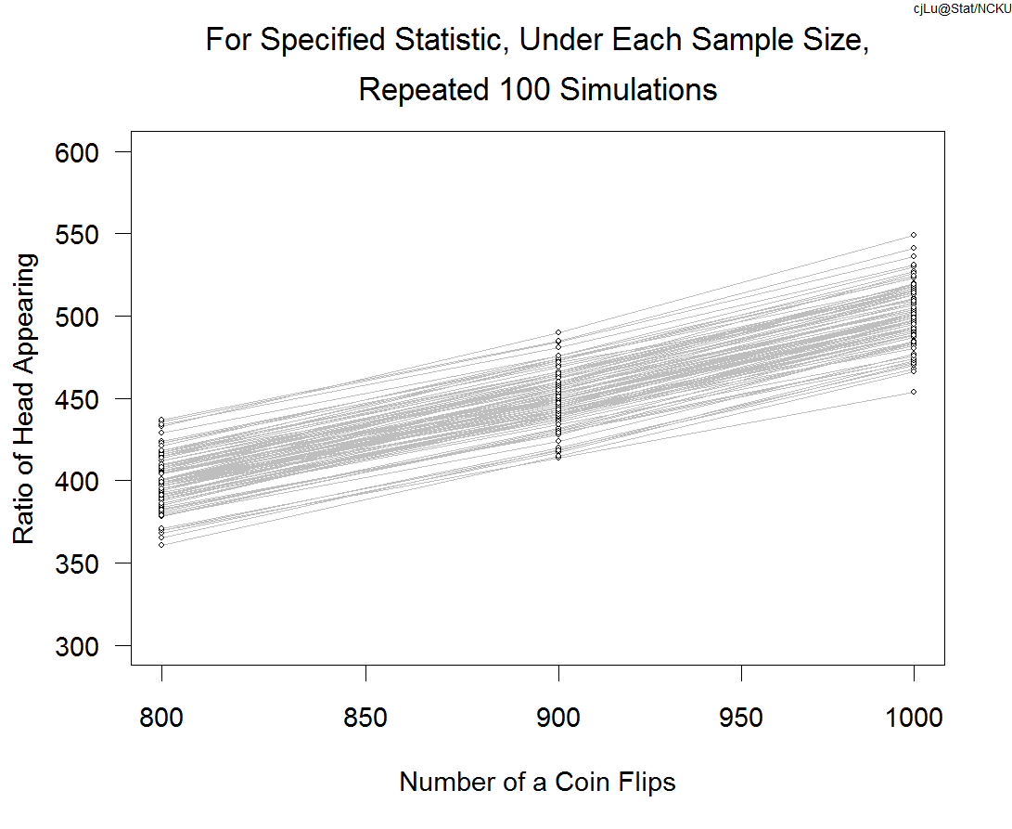
A closer look

Slide 13
Question
If the lottery is “fair”, should the frequency of each number be getting closer after years of the games?
Answer: not necessary true.
The law of large numbers claims that for a fair experiment, the sample mean (ratio of head count) will closer to the expected value (population mean).
So the frequencies may or may not be getting closer.

Slide 14
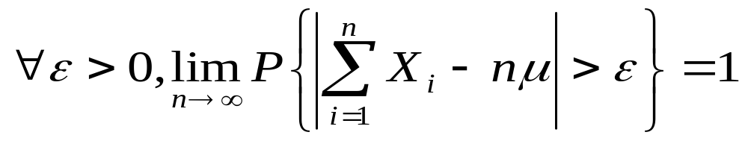
Actually
In the long run, the probability that we see the
frequency far away from the mean number
is 1!

Slide 15
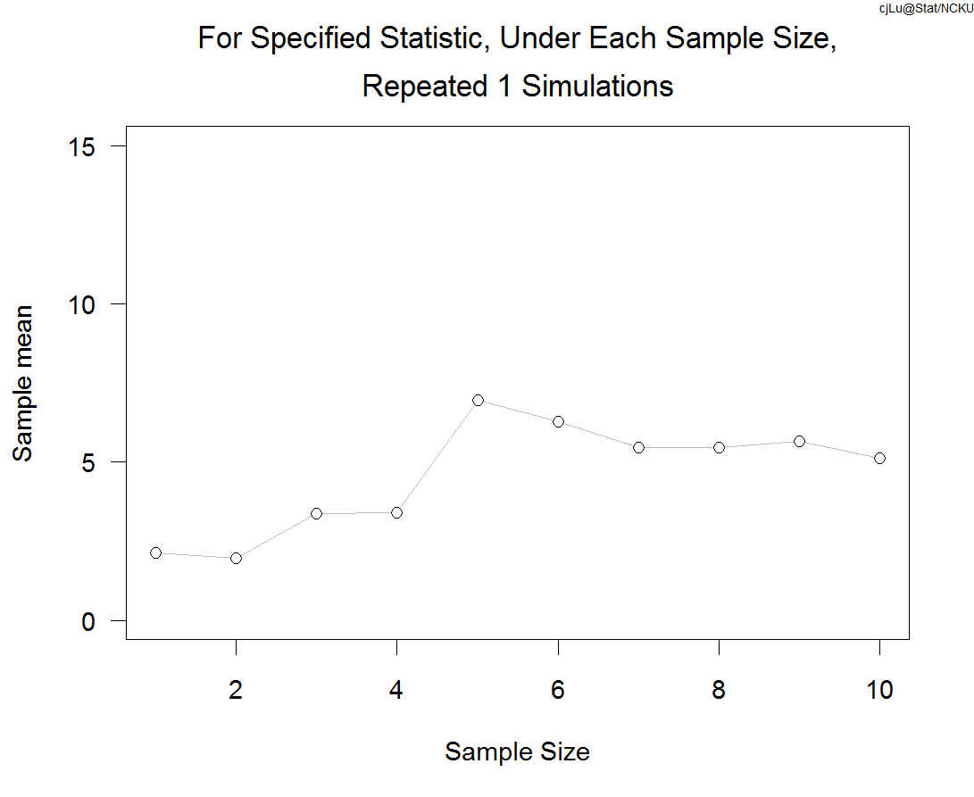
Mice under certain dosage of a treatment.
The average life in weeks？

Slide 16
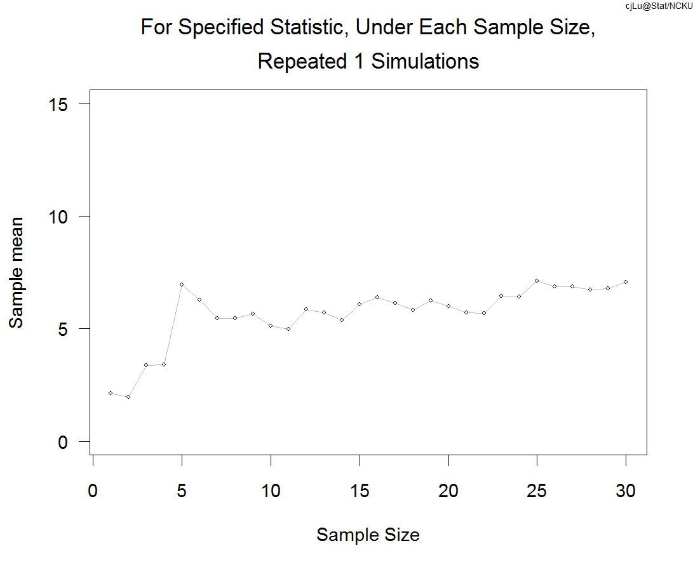
Increases sample size to 30 mice

Slide 17
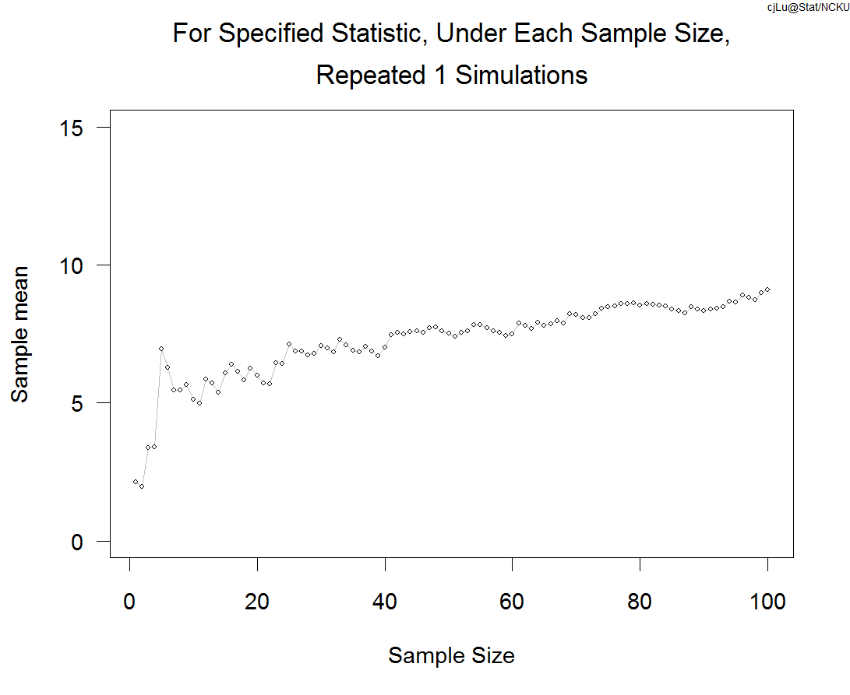
Increases sample size to 100 mice (Money?).
What is the sampling distribution of the average life?

Slide 18
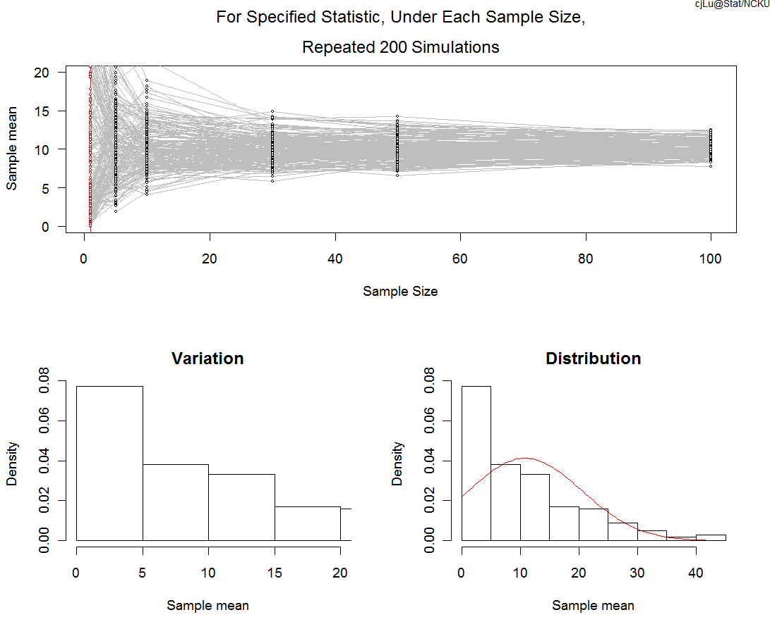
Sampling dist. of sample mean: simulation 200 times.
Suppose population form exponential(rate=0.1)(mean=10)

Slide 19
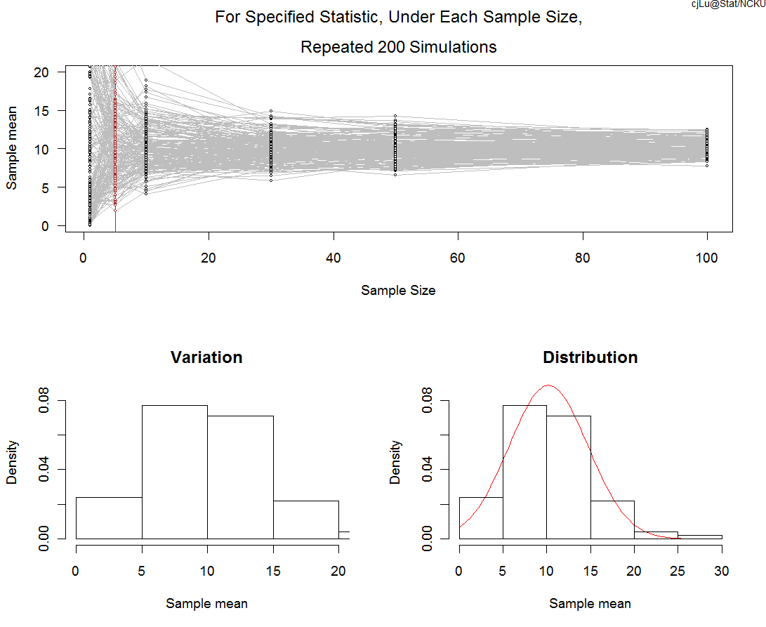
Look at the sampling distribution with sample size 5

Slide 20
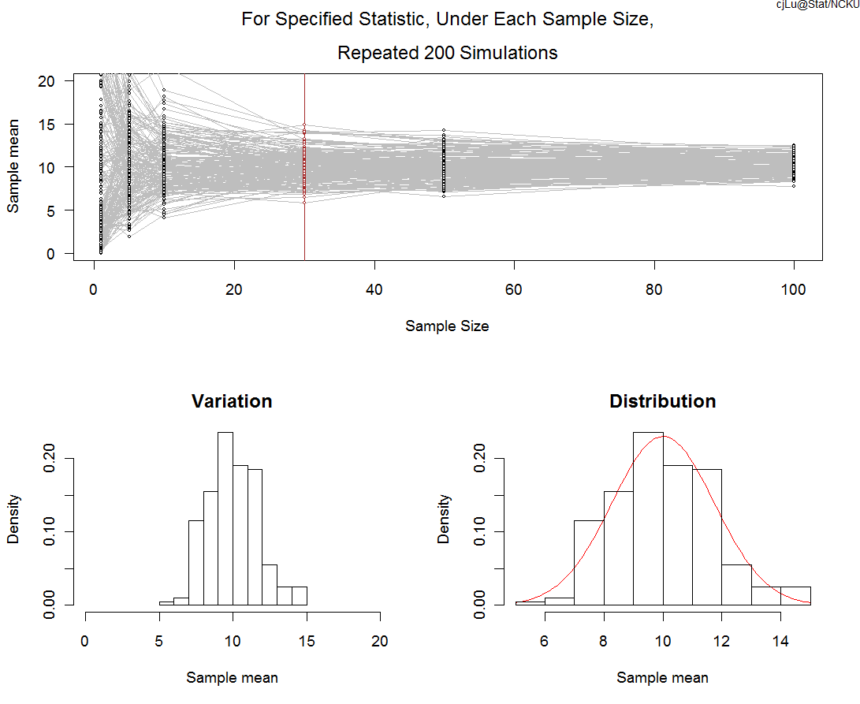
Look at the sampling distribution with sample size 30

Slide 21
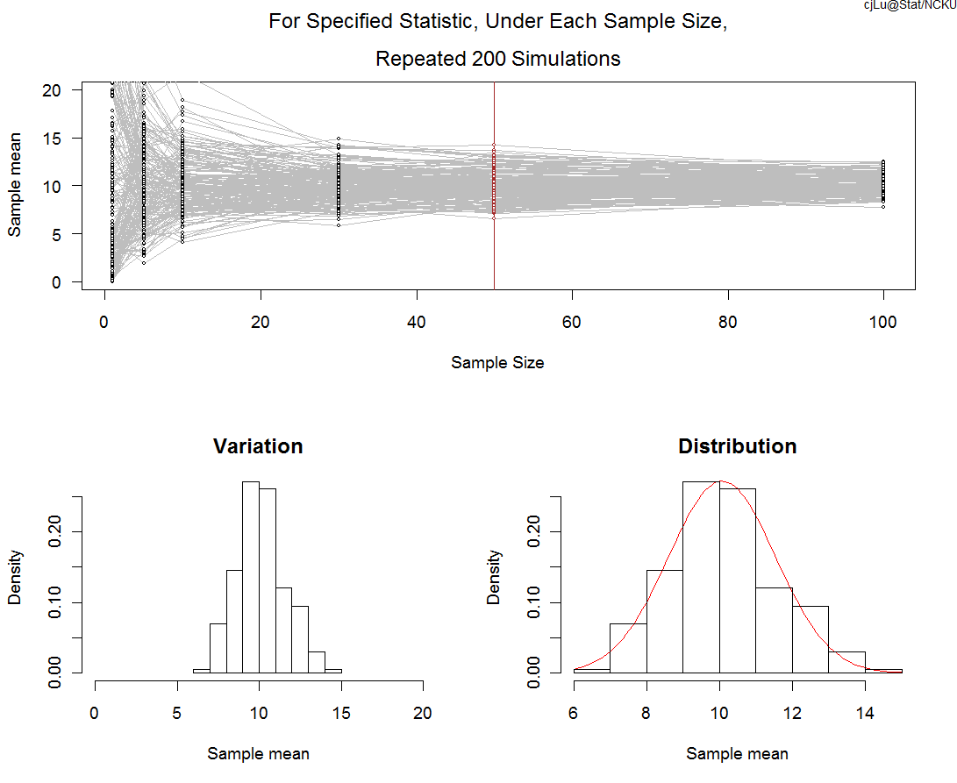
Look at the sampling distribution with sample size 50

Slide 22
The Central Limit Theorem
Lindeberg Central Limit Theorem :
If a sequence of independent random variables has zero means and finite variances (may different), and distribution functions satisfying Lindeberg condition, then the distribution functions of the normalized sums tend to the standard normal. (Probability Theory, Yuan Shih Chow, Henry Teicher, 1988)
Lindeberg condition? Light tail condition

Slide 23
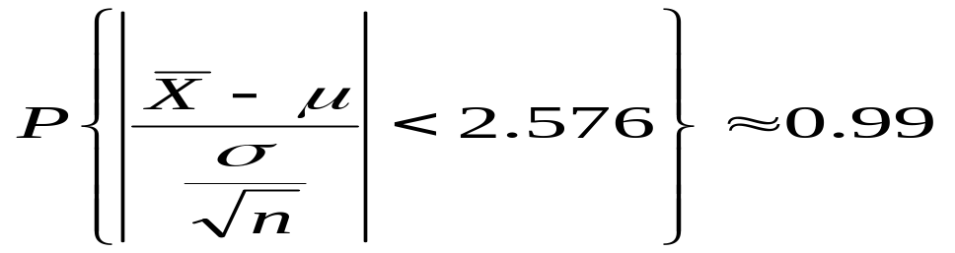
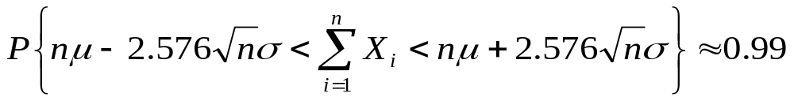
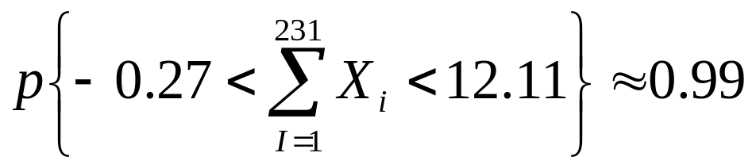
The Central Limit Theorem
When sample size is large,
That is
For the power ball number μ=ｐ=1/39, σ=sqrt(p(1-p))
，n=231

Slide 24
Lottery Numbers
Does the lottery favor or not favor to certain numbers? Is the lottery “fair”?
ANS：
  By CLT, under the assumption of fair game, the reasonable range can be approximated.
  The range can also be calculated by Binomial distribution.
  In the case with numbers far beyond the reasonable range after a long period of games, we will suspect the fairness of the game.

Slide 25
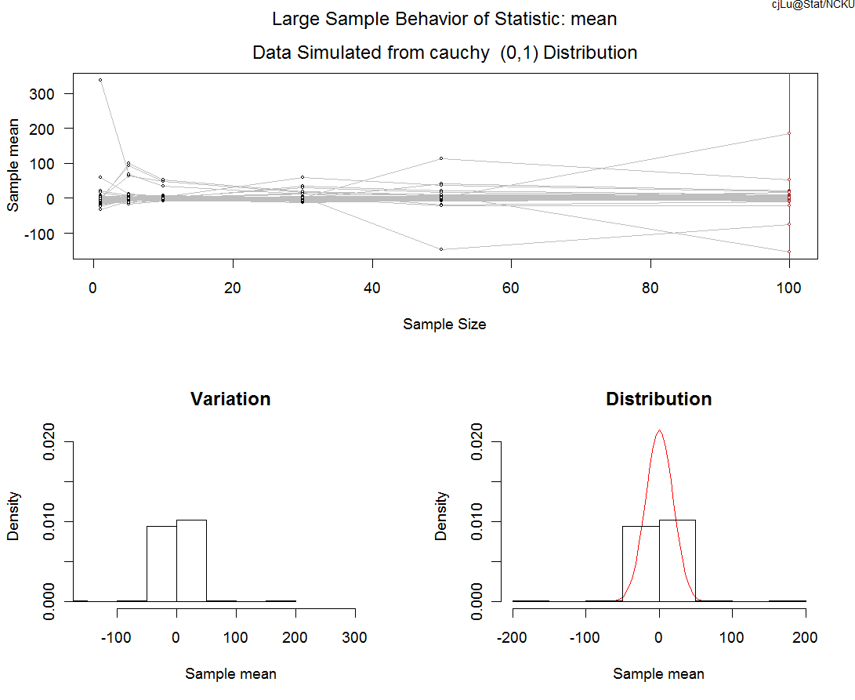
Will the sampling dist. of sample mean always goes to normal?
Population Cauchy(0,1), 200 simulations

Slide 26
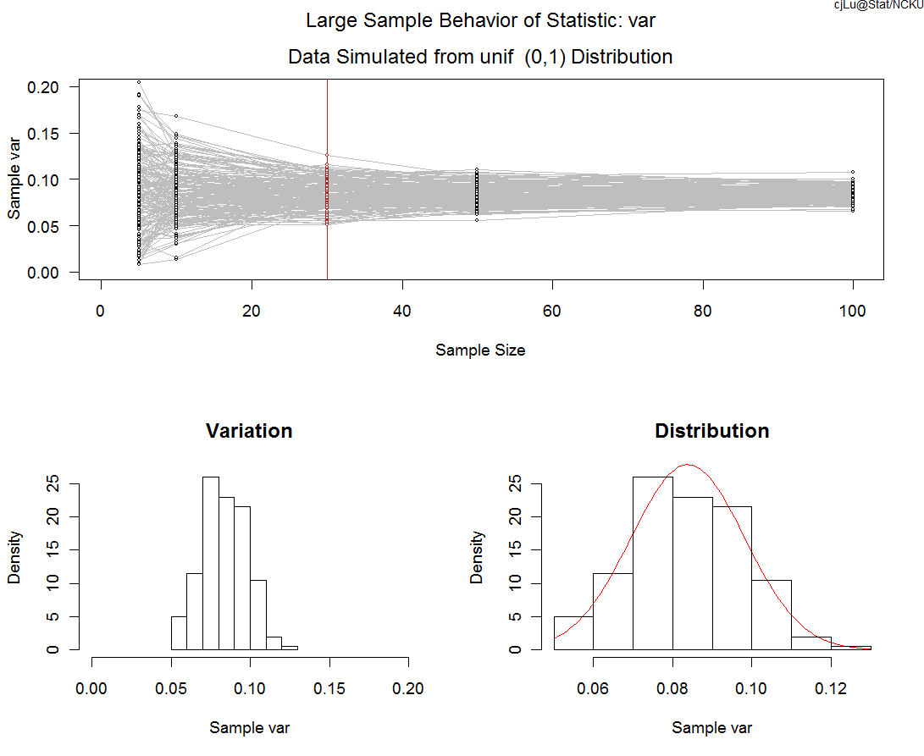
Sampling dist. of sample variance
Population U(0,1) , Sample size 30

Slide 27
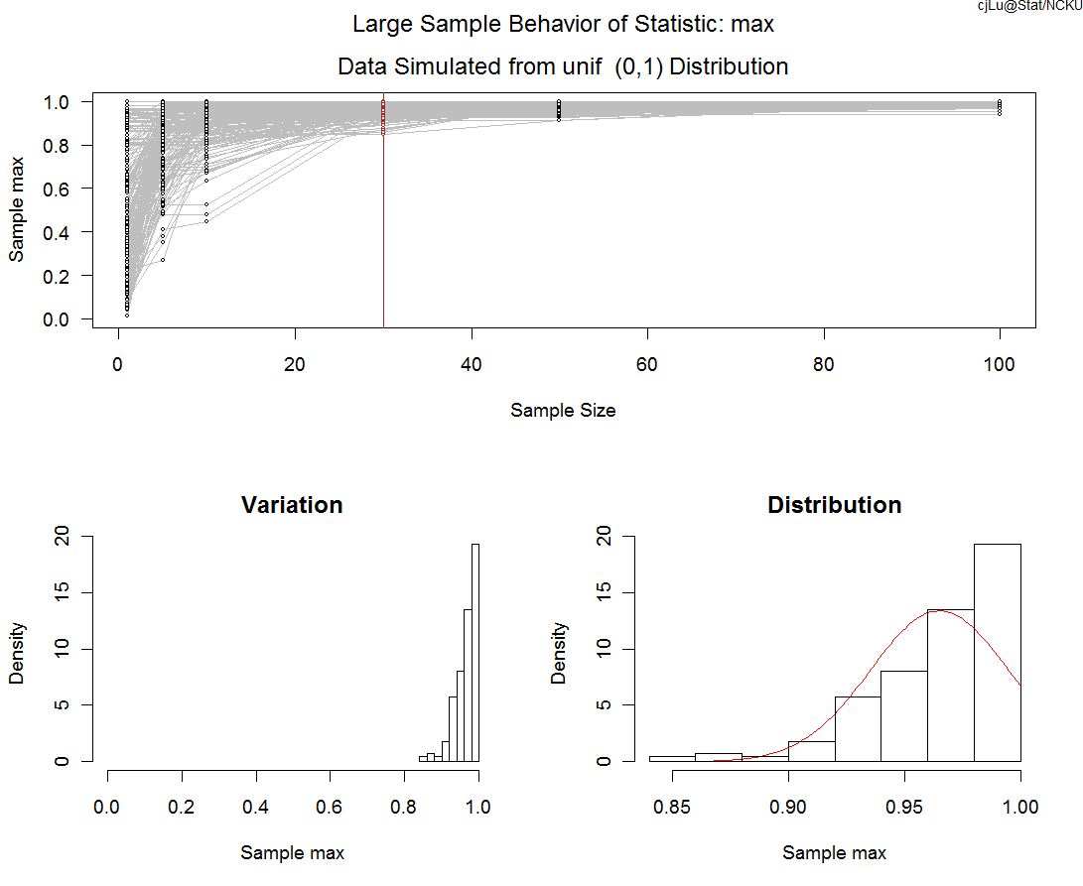
Sampling dist. of sample maximum
Population U(0,1), Sample size 30

Slide 28
How about the censored data?
  LargeSampleV2.1
  Single right censoring
  Random right censoring
  Estimation of mean and median by Kaplan-Meier estimator of survival function
    KMmean and KMmedian

Slide 29
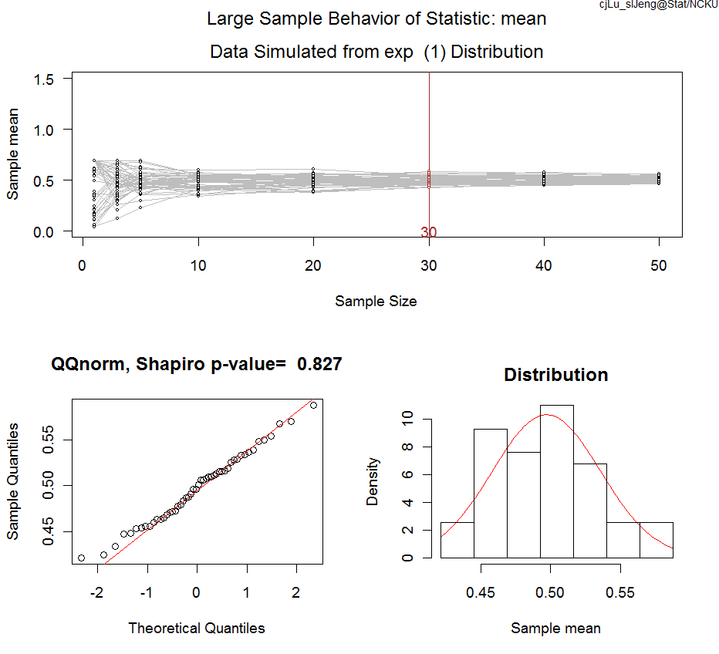
50% right censoring from Exp(1)
Sample distribution of sample mean

Slide 30
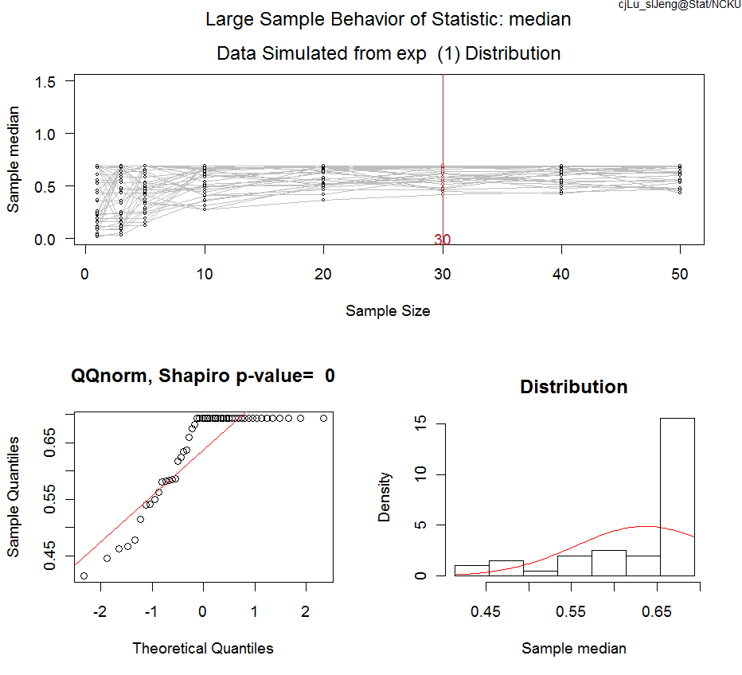
50% right censoring from Exp(1)
Sample distribution of sample median

Slide 31
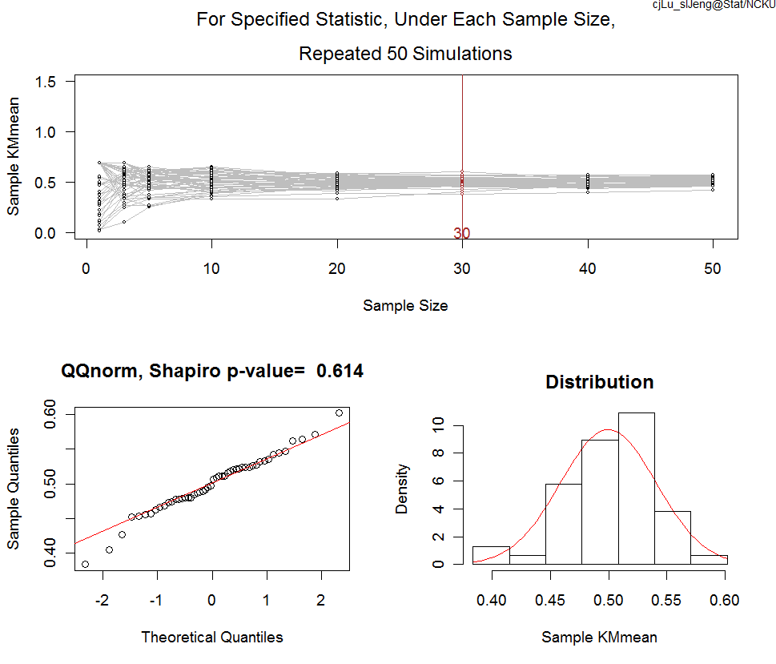
50% right censoring from Exp(1)
Sample distribution of sample mean from Kaplan-Meier survival estimation

Slide 32
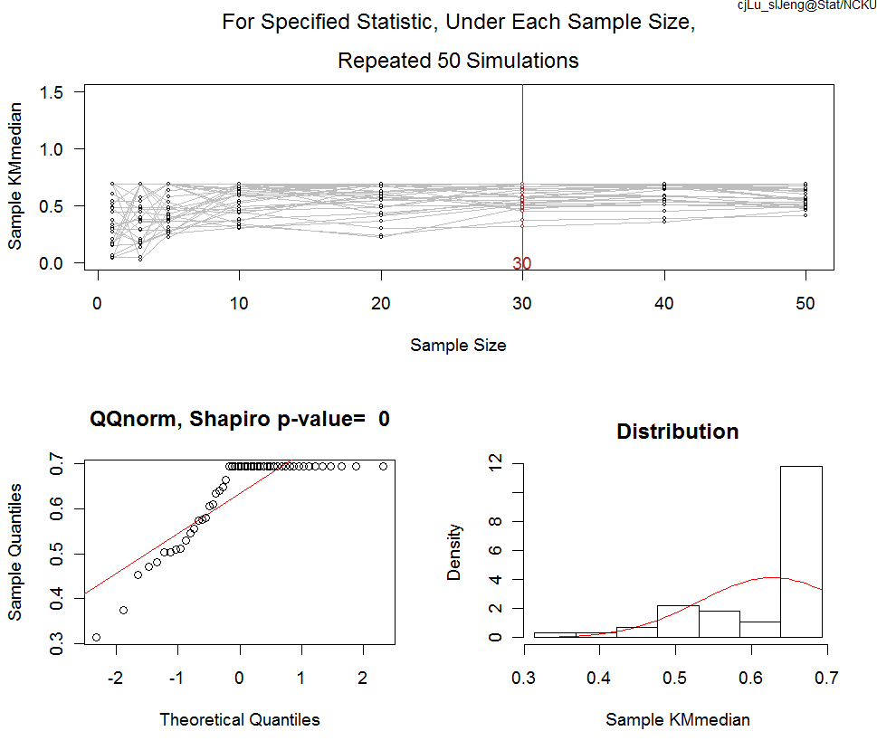
50% right censoring from Exp(1)
Sample distribution of sample median from Kaplan-Meier survival estimation

Slide 33
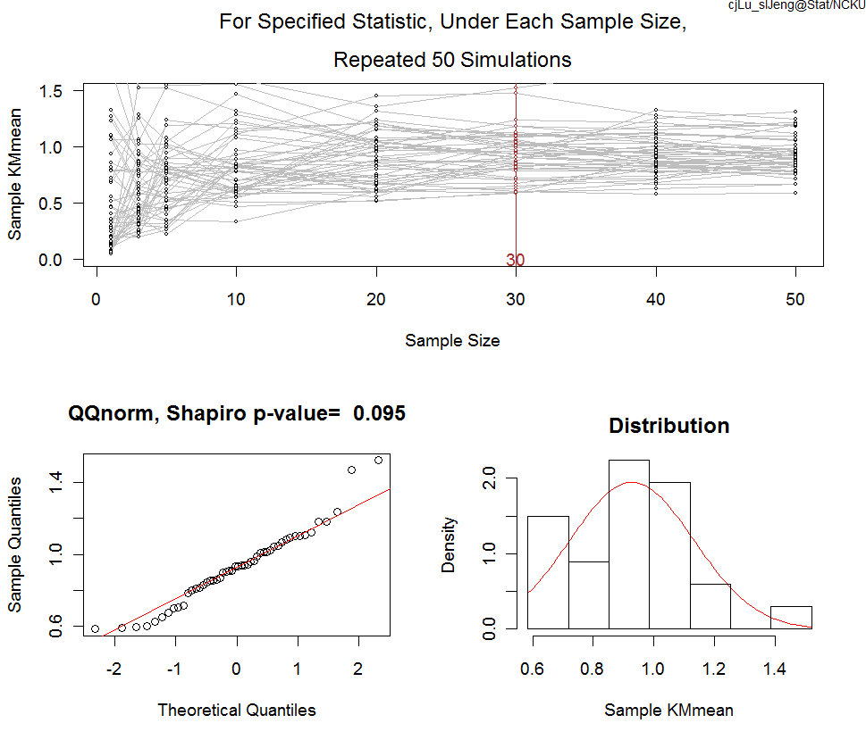
Exp(1) with random right censoring from Exp(1)
Sample distribution of sample median from Kaplan-Meier survival estimation

Slide 34
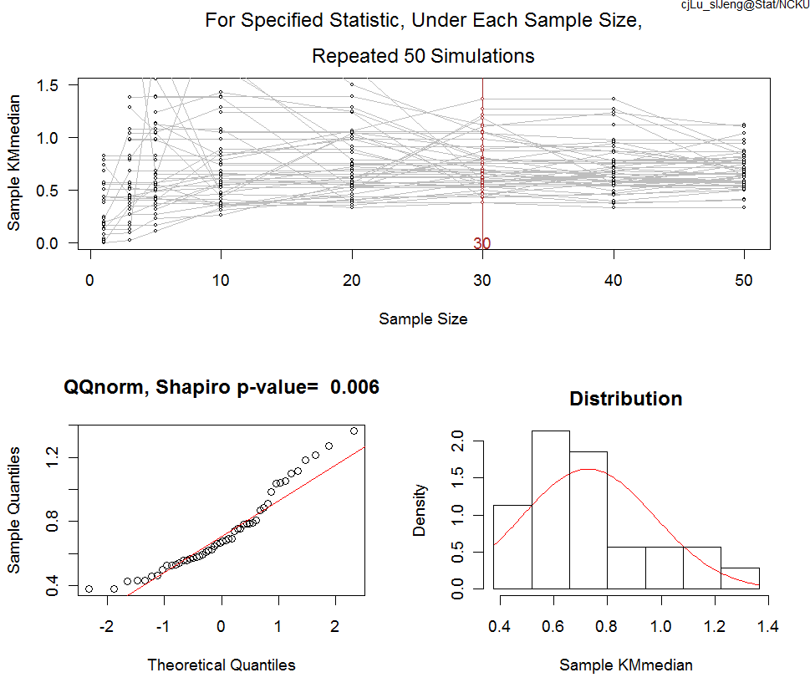
Exp(1) with random right censoring from Exp(1)
Sample distribution of sample median from Kaplan-Meier survival estimation

