Slide 1
Django Auth
Example

Slide 2

Software Architecture
Web
frontend
Web
backend
http://127.0.0.1:1985/web/
Port 可以自己訂
Auth frontend
Auth backend
http://127.0.0.1:1984/account/login
User Database
Tracker

Slide 3






Django auth introduction
The Django authentication system handles both authentication and authorization.
The auth system consists of:
User
Group
Permission
Password hasing
Form
Backend system
Notes:
Django 身份驗證系統處理身份驗證和授權。
認證系統包括：
使用者
權限：二進位是/否標誌指定使用者是否可以執行特定任務
群組：一種將標籤和權限應用於多個使用者的通用方法。
可設定的密碼雜湊系統
用於登入使用者或限制內容的表單和檢視工具
帳號密碼後端系統
The Django authentication system handles both authentication and authorization.
The auth system consists of:
Users
Permissions: Binary yes/no flags designating whether a use may perform a certain task
Groups: A generic way of applying labels and permissions to more than one user.
A configurable password hashing system
Forms and view tools for logging in users, or restricting content
A pluggable backend system

Slide 4
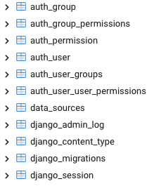
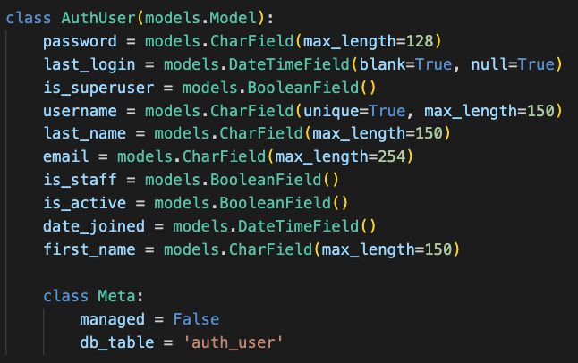

Django database table
example: AuthUser
migrate
models.py
User database
Django backend
Notes:
轉移

Slide 5
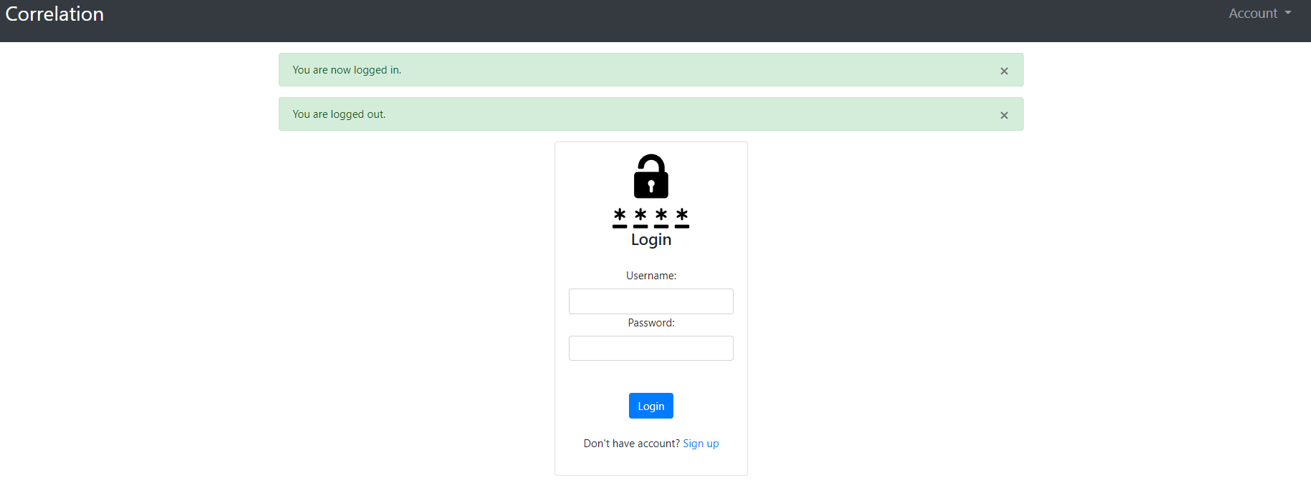
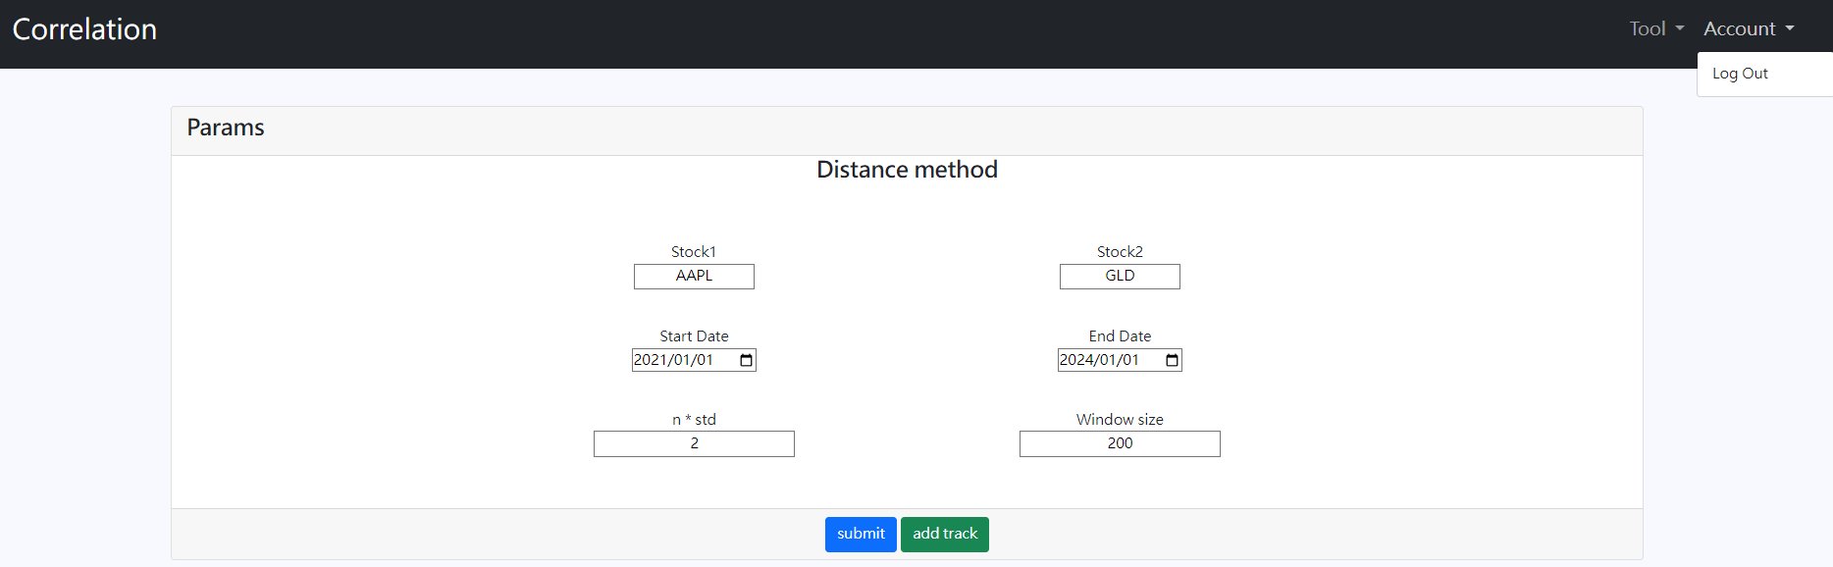
Django session
http://140.116.214.156:1984/account/login
登入後保持會話窗口
http://140.116.214.156:1985/correlation/
Notes:
Django session 是一種用來在 Web 應用程式中跟蹤用戶狀態的機制。
當用戶訪問網站時，Web 應用程式可以為每個用戶創建一個獨立的 session 對象，並在後續的請求中使用這個對象來存儲和檢索用戶相關的數據。
總的來說，Django session 是一個有助於保持用戶狀態和數據的工具，使得 Web 應用程式能夠更好地處理用戶之間的連續性

Slide 6
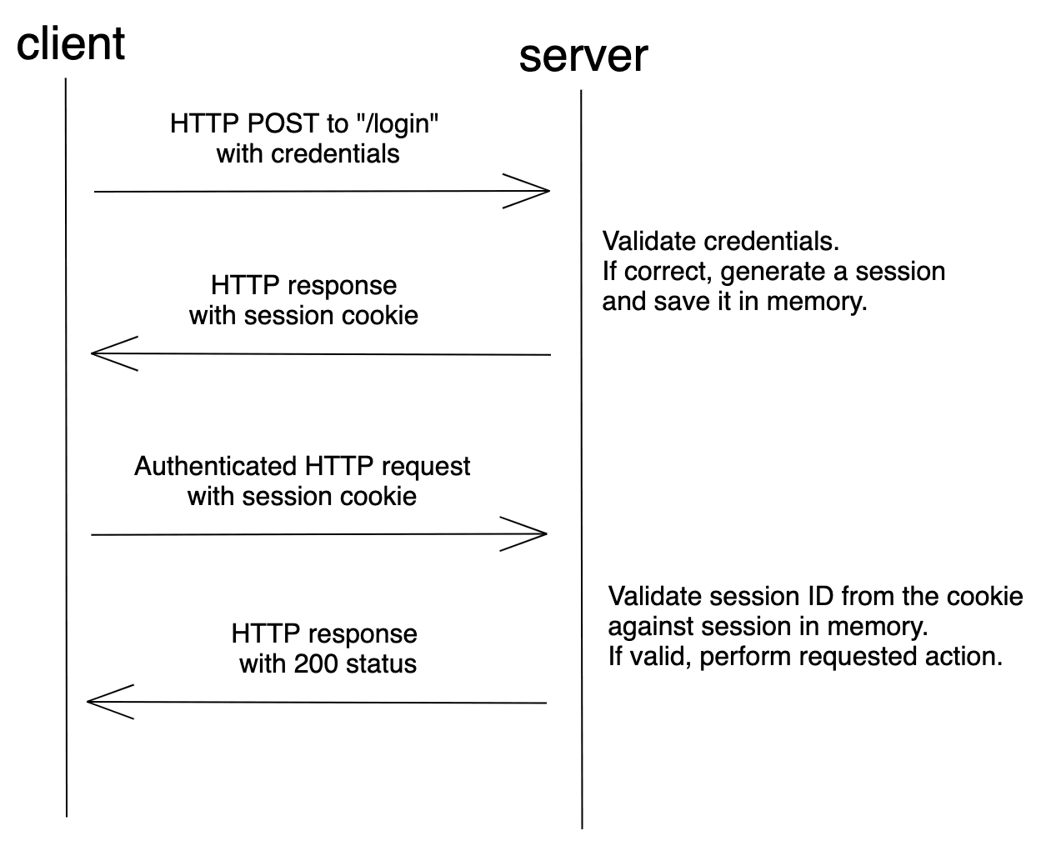
Django auth sequence

Slide 7
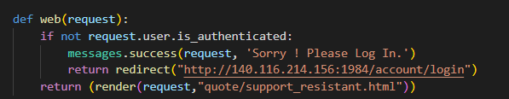
Django middleware
request.session
request.user
How to implement in Django?
client
server

Slide 8
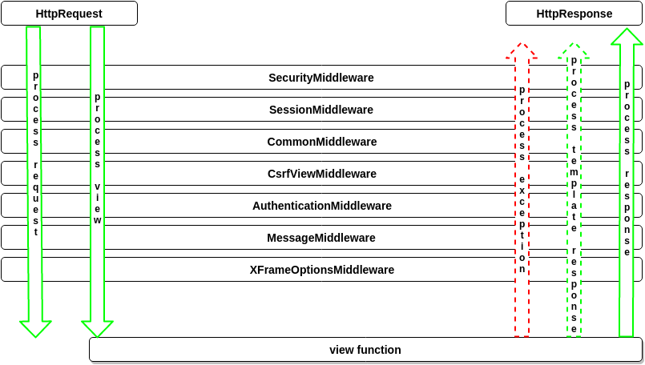
Django middleware
Notes:
middleware在中間先做點一些事情，可以節省django的資源、也可以做安全性認證或者配合如cache方法等優化。 若想修改request，例如被傳送到view中的HttpRequest。
或者你想修改view返回的Httpresponse，或者想在view執行之前做一些操作，這些都可以通過middleware實現。

Slide 9
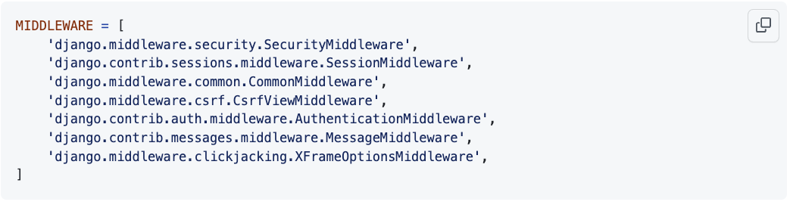
Django middleware settings.py

Slide 10
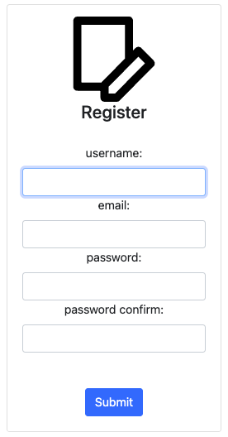
Website
http://140.116.214.156:1985/correlation/
http://140.116.214.156:1984/account/logout
沒登入會被擋 轉址到Authentication server強制登入
Authentication server login page
Authentication server register page
http://140.116.214.156:1984/account/login
http://140.116.214.156:1984/account/register

Slide 11
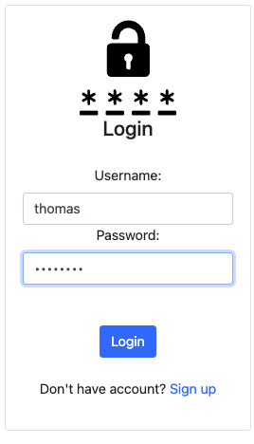
Authentication
http://140.116.214.156:1984/account/login
http://140.116.214.156:1985/correlation/
login successful
user: anonymous->thomas
Notes:
Anonymous : 匿名的

Slide 12
Website
http://140.116.214.156:1984/account/logout
What information can be obtained???
User
E-mail

Slide 13
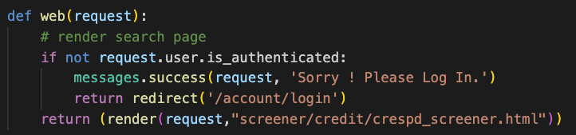
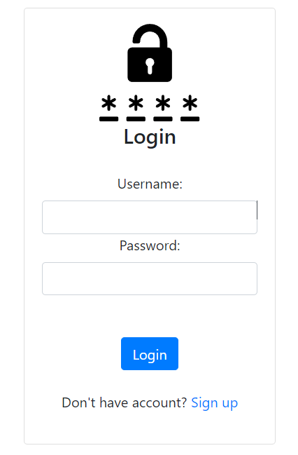

Software architecture
User database
redirect
Authentication server
Web server
Confirm
login / register page
Notes:
創立新的Database

Slide 14
Authentication session-base
User database
兩個Server SECRET_KEY 必須相同!
SECRET_KEY in Django usage:
Signing serialised data e.g. JSON documents.
Unique tokens for a user session, password reset request, messages, etc.
Prevention of cross-site or replay attacks by adding and then expecting unique values for the request.
Generating a unique salt for hash functions.
redirect
Authentication server
Web server
ref to:
https://docs.djangoproject.com/en/4.1/ref/settings/#std:setting-SECRET_KEY
https://docs.djangoproject.com/en/4.1/topics/signing/
login / register page
Notes:
Django 中的 SECRET_KEY 用法：簽署序列化資料例如 JSON 文件。
使用者會話、密碼重設請求、訊息等的唯一 token。

Slide 15
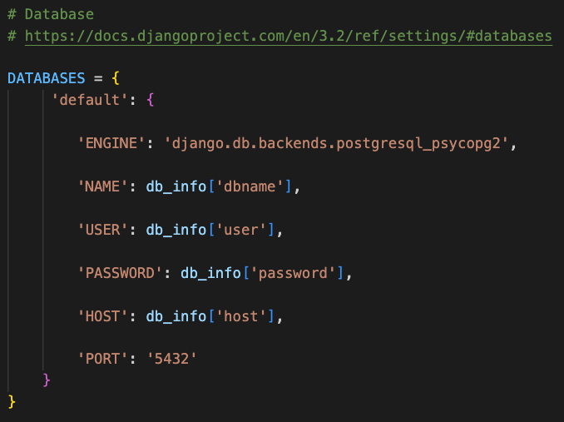
Authentication SECRET_KEY
settings.py
兩個Server SECRET_KEY 必須相同
需連接相同Database

Slide 16
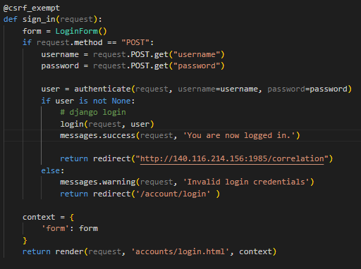
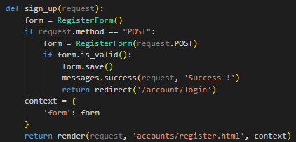
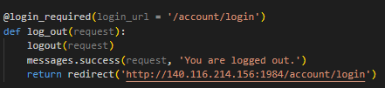
Sequence
redirect
login / logout / register
web server
authentication server
function sign_in
function sign_up
function logout
accounts/account/views.py
accounts/account/views.py
accounts/account/views.py

Slide 17
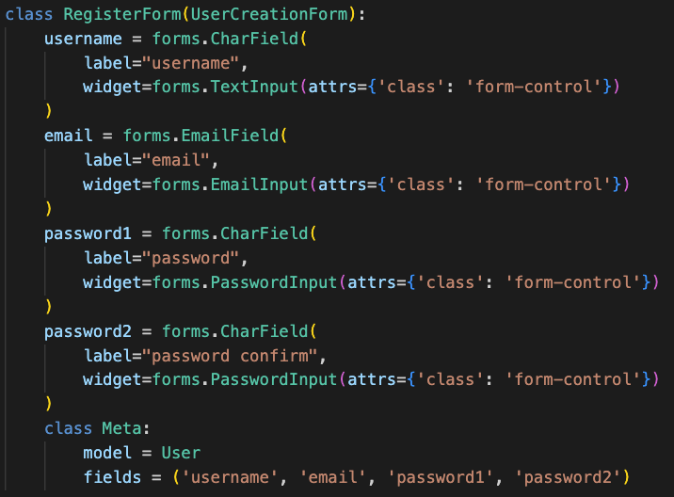
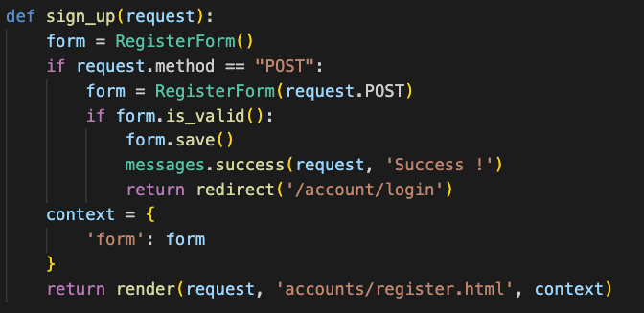
Authentication form
sign up function
Djagno built-in

Slide 18
PostgreSQL install
Window :
https://ticyyang.medium.com/sql-%E5%AE%89%E8%A3%9Dpostgresql-6040002d1317
Linux:
https://www.youtube.com/watch?v=UGfteFq_6Co
MacOS:
https://www.youtube.com/watch?v=2P5guvvqP5Y
https://www.youtube.com/watch?v=fy-42clnbmc

