Slide 1
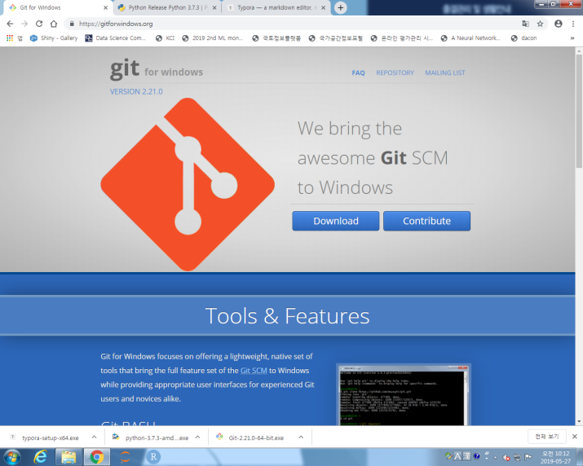
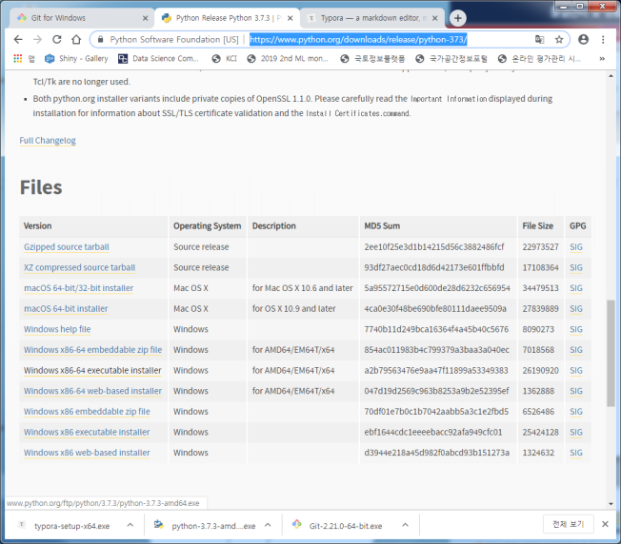
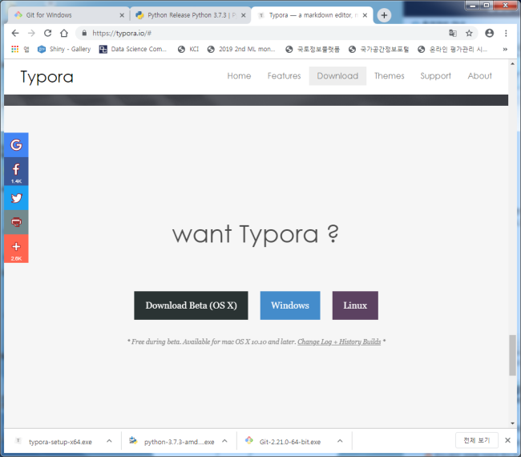
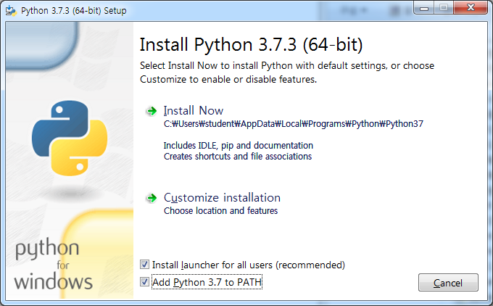
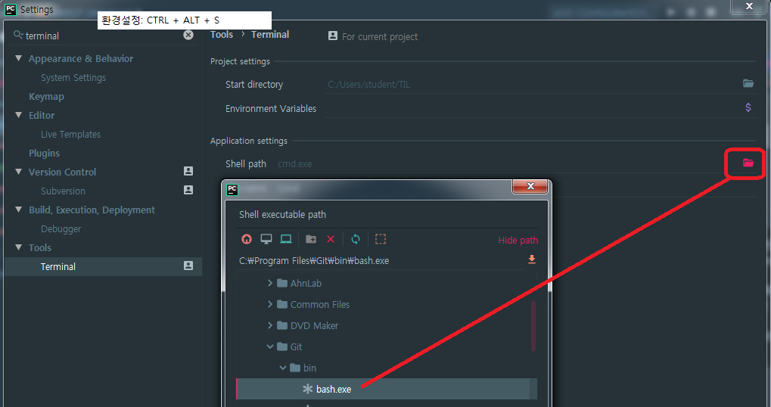
[개발환경 셋팅] https://gitforwindows.org/ https://www.python.org/downloads/release/python-373/ https://typora.io/#windows
GitHub
Python3.7
Typora
Pycharm Git 연결

