Slide 1

Git Pro(3)
Dept. Korea University Sejong Campus
Major: Future Mobility(Autonomous Driving)
Name: Jubin Lee

Slide 2

Storage Manual of Git

Slide 3

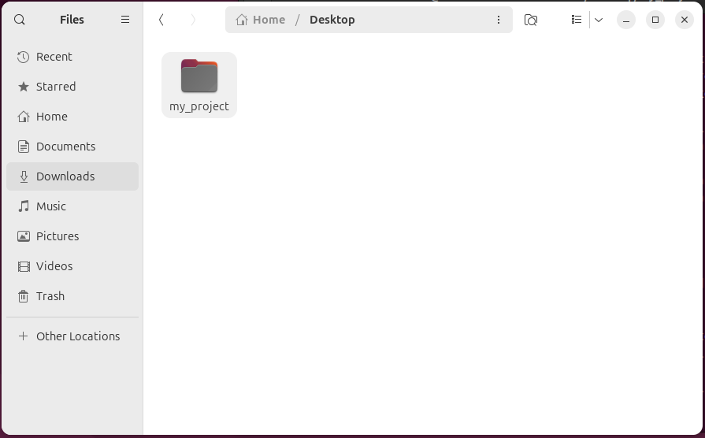
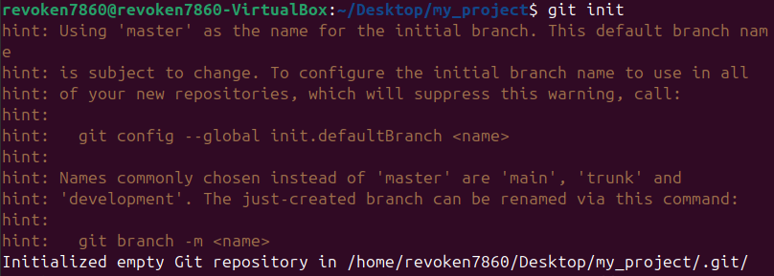
Setting
Make Directory
Move Directory
Create .Git File

Slide 4
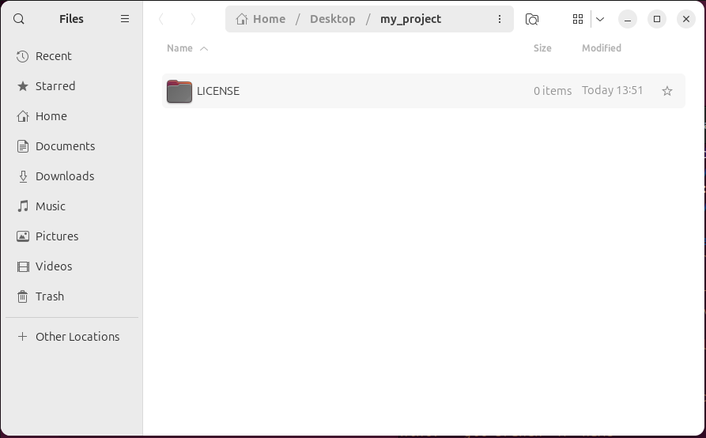
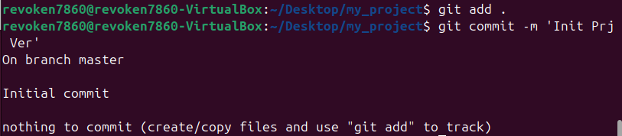
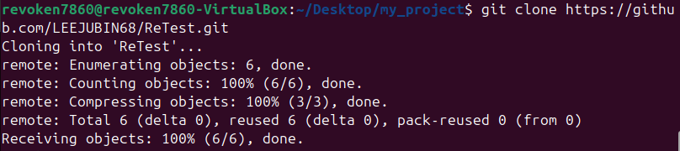
Setting
Make Directory in Folder
Add All Directory
Execute Commit
Execute Clone

Slide 5

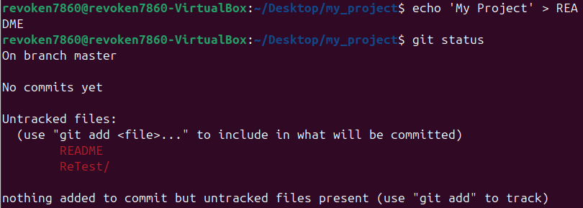
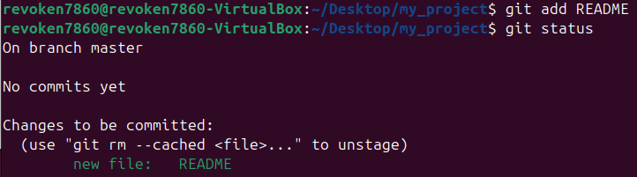
Setting
Check Status
Make File
Fail to Make File
Add File Again
Check Status Again

Slide 6
Reference
Create Storage: Git - Git 저장소 만들기

