Slide 1

Community Service Project on Flood Guard: Safeguarding Communities Against Flooding
Presented by Batch B2
1. K. Mounika(22481A1288) 2. M. Leela Devi(23485A1213)
3. K. Geethika(22481A1281) 4. J. Love Kumar(23485A1211)
Under the Guidance of
Dr. D. N. V. S. L. S. Indira
Professor & HOD
Department of Information Technology
SESHADRI RAO GUDLAVALLERU ENGINEERING COLLEGE
(An Autonomous Institute with Permanent Affiliation to JNTUK, Kakinada)
Seshadri Rao Knowledge Village, Gudlavalleru – 521356, Andhra Pradesh

Slide 2
OUTLINE
Abstract
Introduction
Problem statement & Objectives
Existing System
Limitations
Proposed System
List the problems to be solved
Complete action plan for the implementation of the proposed method.

Slide 3
Abstract :
The project "Flood Guard: Safeguarding Communities Against Flooding" utilizes a combination of climatic data and geographic information to predict and prevent users from flood events.
Flood Guard aims to provide an effective and efficient solution for flood detection and prevention.
The ultimate goal of this project is to enhance flood preparedness and response, reducing the potential damage and saving lives.

Slide 4
Introduction:
Natural disasters such as earthquakes, floods, drought, cyclones and tsunami are the various threats to human life and property.
Floods are among the most recurring natural disasters and damaging natural disasters, causing huge destruction to infrastructure, leading to various losses
As we know, stopping of natural disaster occurrences can't be done, but we can prevent and predict whether a flood may occur or not, so people can overcome the problems that will occur during a flood

Slide 5
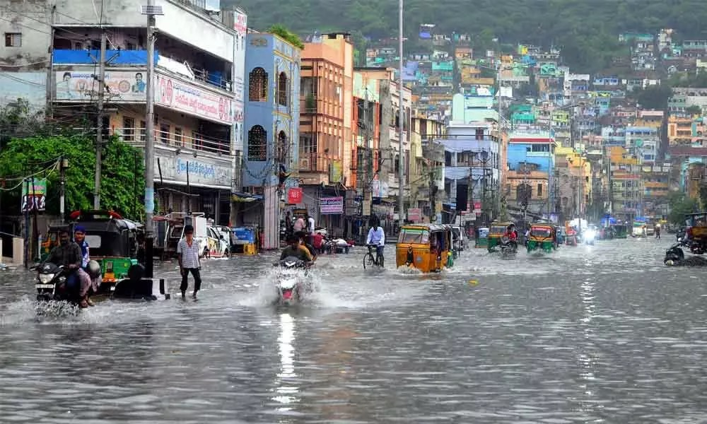
Introduction:
According to research, the major point is that most people don't know when the floods will occur to take the basic precautions to overcome huge infrastructure loss and human loss.

Slide 6
Problem Statement:
The primary challenge is the lack of accessible, localized, timely flood detection systems that can inform and educate communities about potential flood risks .The system should be easy to use, visually appealing, accessible to both authorities and the general public.
Objectives :
The main objectives to be fulfilled are:
To predict, prevent, and increase awareness about floods using climatic and geographic data, enhancing preparedness and response to flood events..
To educate communities on effective flood prevention measures.
Enhanced community preparedness and awareness for flood events through localized detection.

Slide 7
Existing System
The present system scenario is as follows:
1.Flood Monitoring Systems : These systems use sensors placed in rivers, streams, and other water bodies to monitor water levels, flow rates, and rainfall.
2. Mobile-Based Alert Systems : Mobile alert systems use SMS, apps, or other communication technologies to deliver flood warnings to individuals in real-time
3. Satellite and Remote Sensing Systems : Satellite-based flood monitoring systems use remote sensing technology to detect and predict floods. These systems analyze data on rainfall, soil moisture, and water levels to provide flood forecasts.

Slide 8
Limitations:
Manual Data Collection: Some systems rely on manual data collection, which can delay detection and response.
Generic Alerts: These systems often provide generalized alerts that may not be specific to the user's location, leading to either over-warning or under-warning.
Delay in Data Processing and high cost: Processing satellite data to provide real-time information can be slow, which is critical in fast-developing flood situations.
Implementing and maintaining satellite-based systems can be expensive

Slide 9
Proposed System: a) Problems to be solved:
Community Awareness and Education : Create informative content, including images, videos, and articles, to raise awareness about floods and their impact. Use the About page to share this information.
Localized Flood Warnings: The system will provide real-time flood risk assessments based on climatic conditions linked to the user’s specific location (village and pin code). This will allow for quicker and more accurate warnings.
Emergency Response: The system will enable quicker decision-making by providing timely alerts, allowing emergency services and residents to take swift action.

Slide 10
b) Implementation Process:
Defining specific app needs.
Planning app’s look and structure.
Designing an user-friendly interface.
Building app using flutter environment using dart language.
Collecting and adding the resources.
Making sure that app works well on Android phones.
Promoting for the app through live interaction with community

Slide 11
Setting Up the Development Environment Install Flutter SDK: Download, extract, and configure the Flutter SDK.
Install Android Command-Line Tools: Set up Android Studio and SDK components.
Configure Android Emulator: Install emulator tools, create an AVD, and run the emulator.
Verify Setup: Use flutter doctor to confirm all tools are installed correctly.
Creating the Flutter Project Initialize Project:
Create a new Flutter project (flutter create floodguard).
Add Dependencies: Include packages like http, geolocator, and provider.
Set Up API Access: Register with OpenWeatherMap, obtain an API key, and configure it for real-time data.
Developing the App's UI Design Key Screens: Build pages for Welcome, Flood Detection, Precautions, and Prevention.
Enhance Visual Appeal: Add logos, icons, background images, and consistent styling themes.

Slide 12
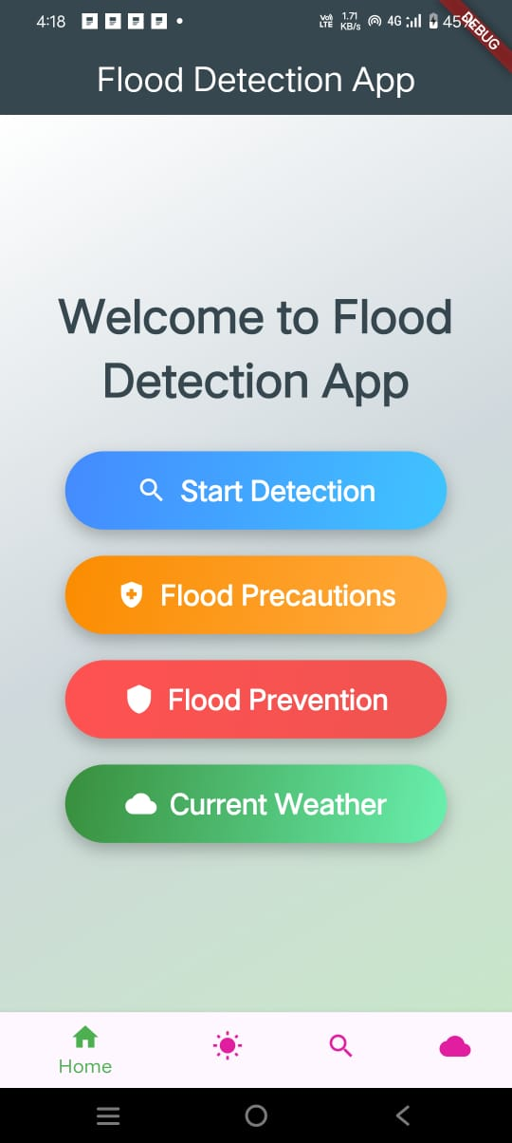
Implement Features: Display real-time weather data.Predict flood risks using historical and climatic data.
Provide safety tips for flood preparedness.
Testing on Emulator Run and Test: Use flutter run to test app functionality on an emulator.
Fix Bugs: Resolve UI issues, crashes, and optimize performance for various screen sizes.
Deploying to a Physical Device Enable Developer Mode: Activate USB debugging on the Android device.
Install the App: Connect the device, use flutter install to deploy, and perform final tests.
Final Verification: Ensure smooth navigation, accurate data, and real-time updates.

Slide 13
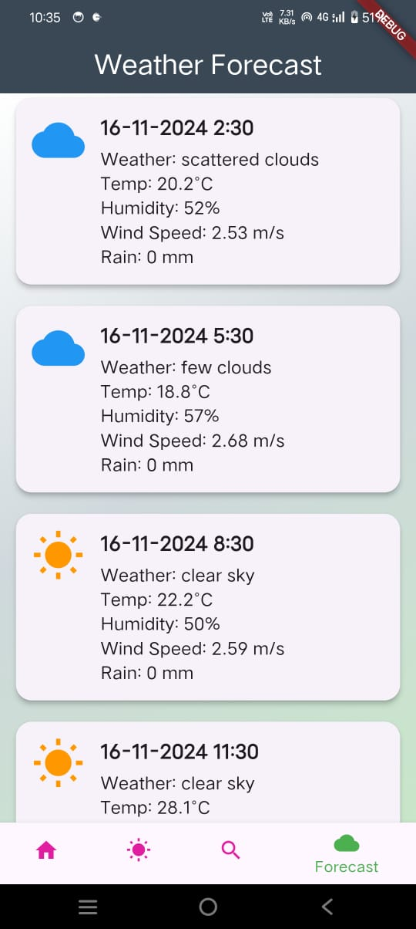
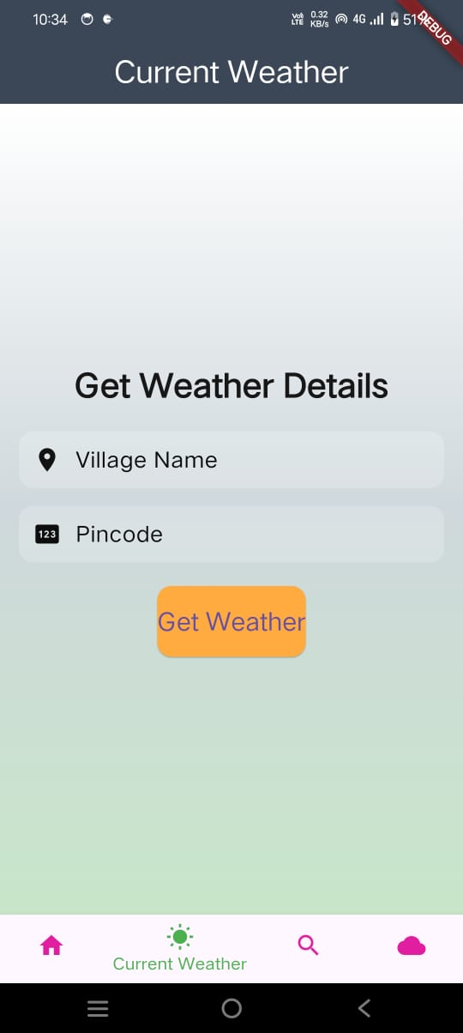
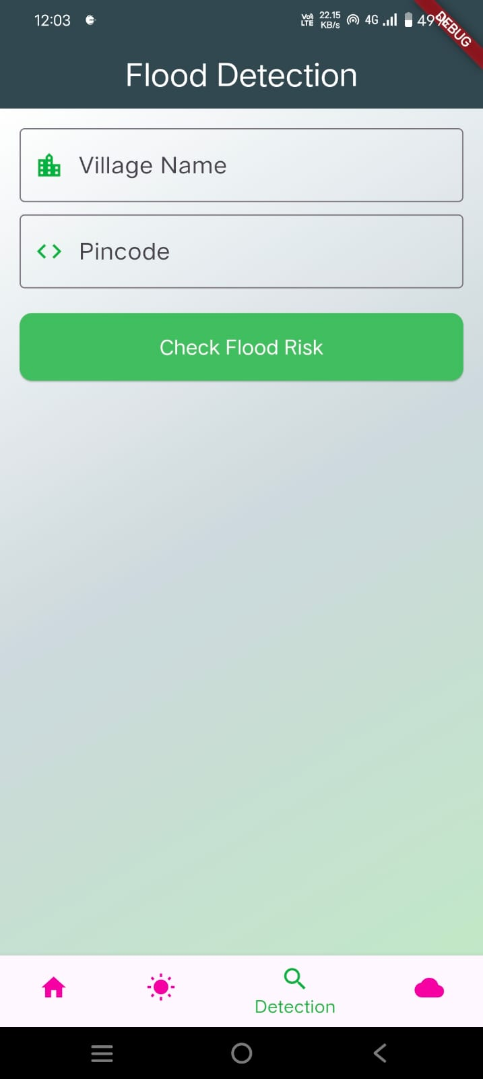

Slide 14
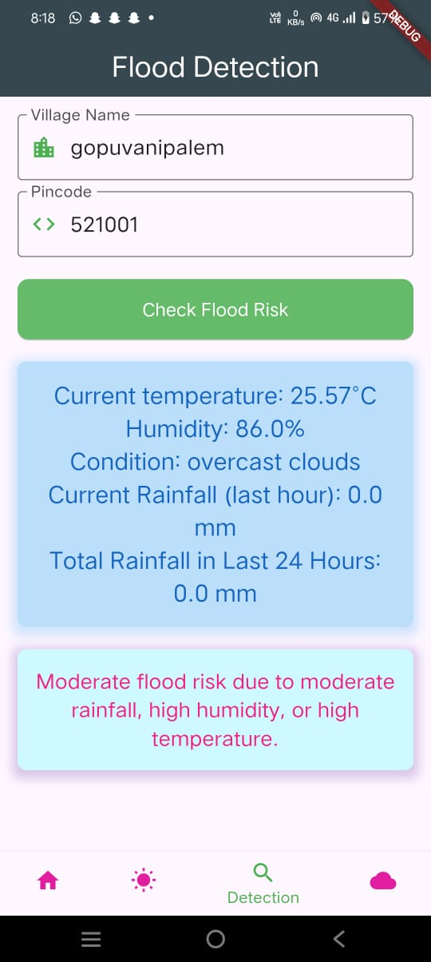
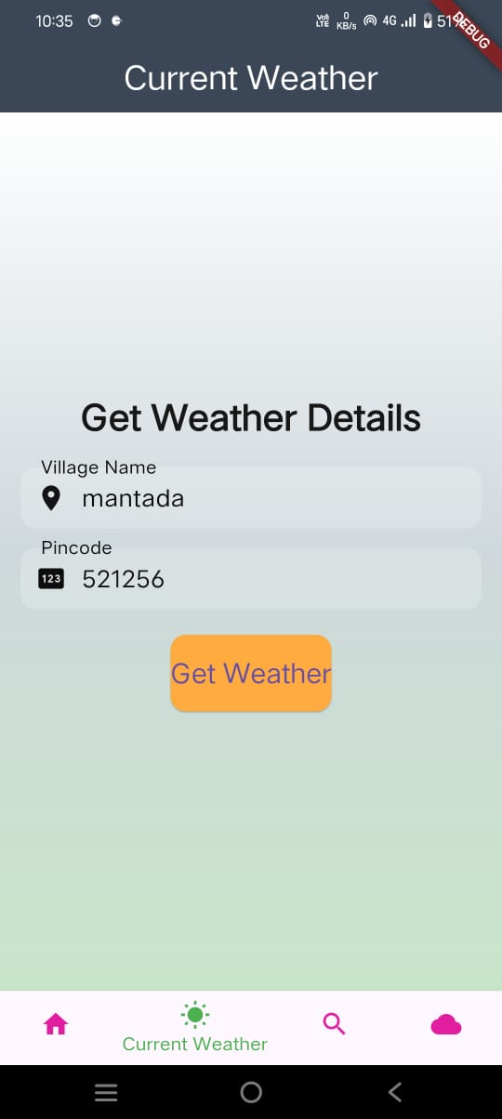
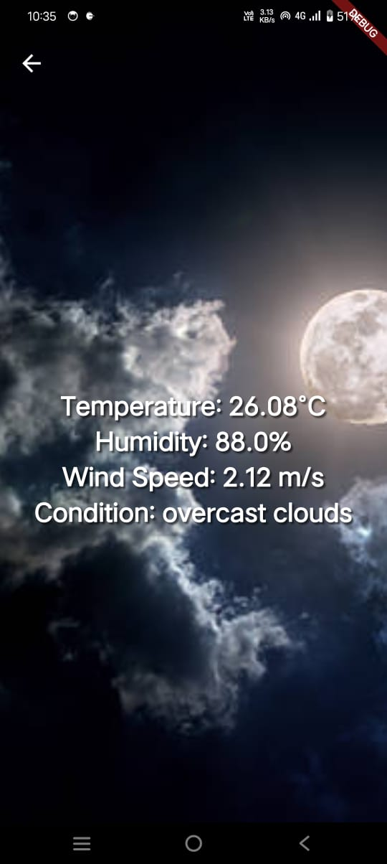

Slide 15
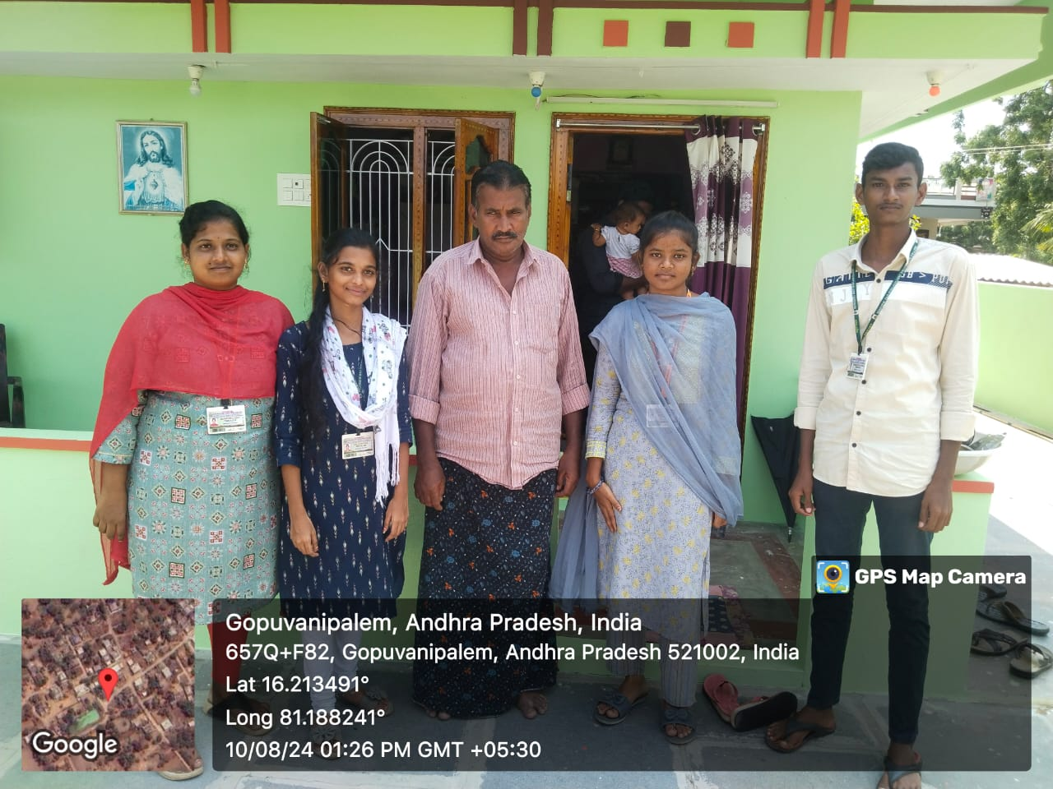
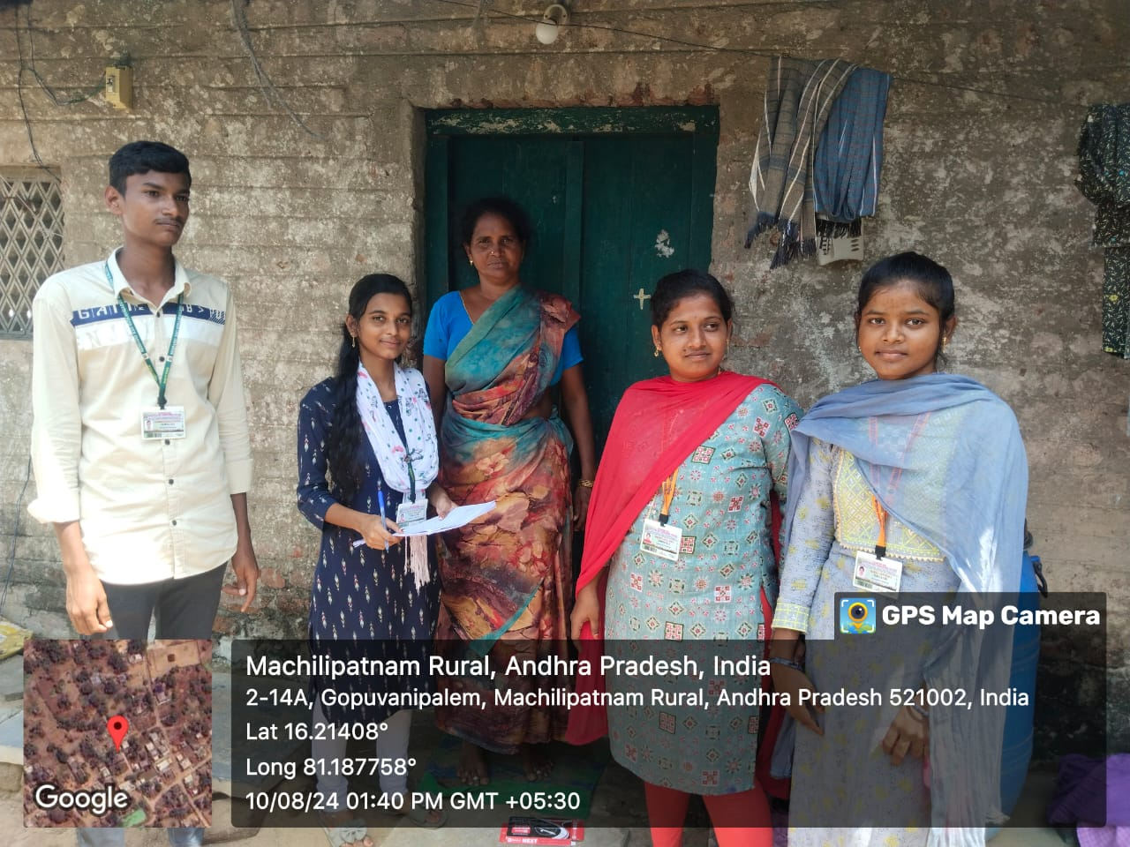

Slide 16


