Slide 1
Data Power User Group
Agenda (prepared by Jagadish Vemugunta – Technical Architect at Availity)
Data Power Architecture patterns
Data Power Service Level Monitoring (SLM) and Peering
Feedback from users on the interested topics

Slide 2
Data Power Architecture patterns
Data Power Role in an enterprise
Hardware appliance
Inbuilt hardened security
Wire speed performance (~ 20 times faster than software based applications)
Multi protocol support
XML centric. Starting from 7.0 , java script is supported
Any-to-any transform ( can work great with web sphere transformation extender)
Notes:
Could be exclusively used as the security gateway in the DMZ
XML Denial-of-Service (XDoS) attack
Can reject large payloads. These are all out-of-box support from the device

Slide 3
Data Power Architecture patterns
Data Power product line
WebSphere DataPower B2B Appliance XB62: provides business-to-business (B2B) connectivity for applications including cloud and mobile. The gateway consolidates B2B trading partner connectivity and transaction management.
WebSphere DataPower Integration Appliance XI50: provides security and integration gateway capabilities in convenient form factors for blade and IBM System z environments.
WebSphere DataPower Integration Appliance XI52: a security and integration gateway appliance built for simplified deployment and hardened security, bridging multiple protocols and performing conversions at wire speed.
WebSphere DataPower Integration Appliance XI52 Virtual Edition: a purpose-built, virtual appliance that delivers rapid data transformations for cloud and mobile applications.
WebSphere DataPower Service Gateway XG45: a lightweight platform that provides rapid cloud and mobile services deployments, governance and integration. It also serves as an edge-of-network security gateway.
WebSphere DataPower Service Gateway XG45 Virtual Edition: a purpose-built, virtual appliance. It delivers rapid cloud and mobile services deployments, governance, light-weight integration and edge of network security gateway.
WebSphere DataPower XC10 Appliance: a caching platform that supports data-oriented, distributed caching scenarios with little or no changes to existing applications.

Slide 4
Data Power Architecture patterns
Deployment topology

Slide 5
Data Power Architecture patterns
Data Power Services
Multi-protocol gateway
Web Service Proxy
XML firewall
Web application firewall
XSL Accelerator (Proxy)

Slide 6
Data Power Architecture patterns
Services offered on each appliance
Core Services offered | Data Power appliances | Typical usage scenarios
Multi-protocol gateway | XS40, XI50, XI52 | Bridge request and response protocol differences. Multiple transports in and out.
WS-Proxy | XS40, XI50 , XI52 | Process WSDL described services.
XML firewall | XS40, XI50 , XI52 | Send and receive XML traffic over HTTP to and from XML-based applications.
Web application firewall | XS40, XI50 , XI52 | Protect heritage XML, SOAP, and B2B messages, non WSDL based Web services and non Web service applications.
XSL accelerator | XA35 | Optimize XML/XSLT transformations.

Slide 7
Data Power Architecture patterns
Configuration architecture

Slide 8
Data Power Architecture patterns
Typical Multi-Protocol use case

Slide 9
Data Power Architecture patterns
Web Service proxy policy model

Slide 10
Data Power Architecture patterns
Web Service proxy conformance policy
Setting a conformance policy object validates incoming requests against back-end server responses against the WS-I Basic Profile and WS-I Basic Security Profile standards.
The highlights of the key constraints imposed by the profile are:
Precludes the use of SOAP encoding
Requires the use of HTTP binding for SOAP
Requires the use of the HTTP 500 status response for SOAP fault messages
Requires the use of the HTTP POST method
Requires the use of WSDL1.1 to describe the interface of a Web service
Requires the use of rpc/literal or document/literal forms of the WSDL SOAP binding
Precludes the use of solicit-response and notification-style operations
Requires the use of WSDL SOAP binding extension with HTTP as the required transport
Requires the use of WSDL1.1 descriptions for UDDI Model elements representing a Web service

Slide 11
SLM Peering
Service Level Monitoring
SLM stands for service level monitoring, and is the primary means within Data Power to do things like throttling and shaping incoming message traffic based on some configured criteria

Slide 12
SLM Peering
SLM multicast peering
A new configuration option for SLM peering that uses IP multicast packets as its means
of communications.
Customers who require very accurate SLM enforcement when using SLM peering, or
use SLM peering with high incoming data rates.
SLM peering can achieve global connection pool across the cluster of Data Power servers. SLM peering allows multiple data power boxes to be grouped together which is referred to as peer group and each peer in the group is referred as an identical SLM policy.

Slide 13
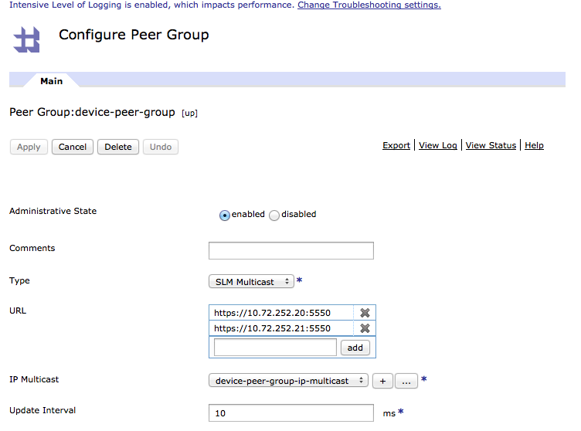
SLM Peering
SLM multicast peering

Slide 14
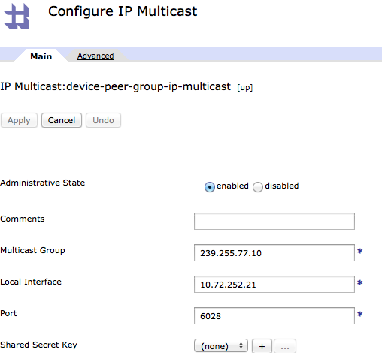
SLM Peering
IP multicast

Slide 15
SLM Peering
Troubleshooting
Known limitations
– The local interfaces used for the IP multicast traffic between the peers must be in the
same subnet. The IP multicast interfaces are connected on a dedicated subnet.
Troubleshooting
– The IP multicast status provider will show whether the multicast packets successfully
reach each peer in the peer group. The presence of sent/received NAKs or lost packets
indicates either a network problem that should be resolved, or a poor configuration of the IP multicast objects. All peers within the peer group must have the identical SLM/peer/IP multicast configuration (except for the local interface of the IP multicast object).

