Slide 1
IBM DataPower Gateway Overview & What’s New in V7.5.2
Ozair Sheikh, Senior Product Manager, API Connect & Gateways
Arif Siddiqui, Program Director, API Connect & Gateways
Sep 30, 2016

Slide 2
Agenda
DataPower Gateway Overview
DataPower Operations Dashboard
Recent Releases
What’s New in DataPower Gateway V7.5.2

Slide 3

DataPower Gateways …
SECURE API, Mobile, Web, Cloud, SOA, and B2B Workloads
INTEGRATE Systems of Engagement with Systems of Record
CONTROL & MANAGE Traffic and Service Level Agreements
OPTIMIZE Data Delivery and User Experiences
CONSOLIDATE & Simplify Infrastructure Footprint
IBM DataPower Gateways provide a low startup cost,
helping clients increase ROI and reduce TCO with
specialized, consumable, dedicated gateways that
combine superior performance and hardened security in Docker container, Linux application, virtual machine, and physical appliance form factors
Notes:
2

Slide 4






Secure, control & accelerate Today’s Digital workloads
Mobile
Simplify mobile security with single, purpose-built gateway; control mobile traffic and accelerate delivery
SOA
Secure, integrate, control & manage SOA workloads in the DMZ and Trusted zones
Cloud
Deploy in multiple hypervisor, cloud environments and enable hybrid & inter cloud connectivity
API
Easily secure, control, publish, monitor & manage your APIs
Web Simplify web security with single, purpose-built gateway; control traffic and accelerate delivery for intranet and internet web applications
B2B
Extend Connectivity & Integration beyond the enterprise with DMZ-ready B2B edge capabilities

Slide 5
Centralize, offload and simplify critical functions
Before DataPower Gateway
After DataPower Gateway
Consumer
Secure
Integrate
Consumer
Control
Optimize
Consumer
Consumer
Notes:
4

Slide 6









Common Use Cases
IBM DataPower Gateways are the industry-leading
Security & Integration gateways that help provide security, integration, control and optimized access to a full range of API, Mobile, Web, Cloud, SOA, & B2B workloads
Internet
DMZ
Trusted Zone
Internal LoB App
Web
App Server or Service
Mobile, IoT
Trading Partners
ESB / Middleware
1 API Gateway
2 Mobile Gateway
3 Web Gateway
4 B2B Partner Gateway
5 API & SOA Gateway
6 ESB / Integration Gateway
7 Internal Security Enforcement
8 Legacy Integration
System Z

Slide 7

Single Gateway for API & Mobile policy enforcement
TH
GS
www
DataPower Gateway
IN
Cloud
High performance gateway to secure, control & accelerate traffic across API, mobile, web, and cloud
MobileFirst Platform Foundation
DataPower
Essential mobile backend services pre-integrated with advanced safeguards, management and analytics
MobileFirst Foundation
API Connect
Create, Run, Manage & Secure new or existing APIs and Microservices in a hybrid deployment with Node.js and Java to power modern digital applications
API Connect
Use one or all of these components together based on project needs

Slide 8
Single, modular & extensible Gateway platform
B2B Module
B2B DMZ gateway
EDIINT AS1,AS2,AS3,AS4,ebXML
Partner profile management
B2B transaction viewer
Any-to-Any message transformation
Database connectivity
TIBCO EMS
Module
Integrate with TIBCO EMS messaging middleware
Support for queues & topics
Load balancing & fault-tolerance
ISAM Proxy Module
User access control, session management, web SSO enforcement
Advanced mobile security: mobile SSO, context-based access, one-time password, multi-factor authn
Application Optimization
Module
Frontend self-balancing
Backend intelligent load distribution
Session affinity
z Sysplex Distributor integration
Integration
Module
Any-to-Any message transformation
Database connectivity
Mainframe IMS connectivity
IBM DataPower Gateway (Base)
Secure
Authentication, authorization
Security token translation
Service / API virtualization
Threat protection
Message schema validation
Message filtering
Message digital signature
Message encryption
AV scanning integration
Integrate
Transport protocol bridging
Any-to-any message transformation
Message enrichment
Database connectivity
Mainframe connectivity
B2B partner connectivity
Hybrid cloud connectivity
Control & Manage
Quota & rate enforcement
Content-based routing
Message accounting
B2B partner management
Integration w/ governance, management & monitoring platforms including IBM API Connect & WSRR for policy enforcement
Optimize & Offload
HTTP/2
SSL / TLS offload
Hardware accelerated crypto*
JSON, XML offload
JavaScript, JSONiq, XSLT, XQuery acceleration
Local response caching
Distributed caching with WXS
Backend load balancing
Notes:
Physical Gateway
2U rack mount appliance using latest generation hardware platform
Two base editions: Non-HSM and HSM (FIPS 140-2 Level 3 certified)
Each software module is licensed separately
Virtual Edition
Three editions: Developer, Non-Production, Production
Developer includes all software modules at no additional cost, except TIBCO EMS
Non-Production includes all software modules at no additional cost, except TIBCO EMS & ISAM Proxy
Production: Each software module is licensed separately
All software modules are field upgradeable
Hardware crypto accelerated operations are provided on the physical gateway appliance through built-in cryptography accelerator card

Slide 9



Available Form Factors: Deploy Anywhere
IBM Provided
Physical
Virtual**
Linux**
Docker**
Gateway Image
Gateway Image
Gateway Image
Gateway Image
Signed & Encrypted Gateway Stack
Signed & Encrypted Gateway Stack
Signed & Encrypted Gateway Stack
Gateway Stack
IBM Optimized Application Layer
IBM Optimized Embedded OS
IBM Optimized Embedded OS
IBM Optimized Application Layer
Docker
Hardware
Hypervisor¹
Operating System²
Operating System
Trusted Platform Module
Hardware Security Module
Hardware
Hardware / Hypervisor
Hardware / Hypervisor
Crypto Acceleration
All in one solution (HW / SW)
* Physical security
* Drop-in deployment & mgmt
* Performance including HW
crypto acceleration
* DMZ drop-in
Embedded HSM option (FIPS 140-2 certified)
Software solution (Virtual machine)
* User responsible for providing &
securing HW and Hypervisor
Flexible deployment
Flexible resource allocations
Software solution (Application)
* User responsible for providing
& securing HW, Hypervisor, OS
Public & private Cloud deployments
Rapid scale up/down
First class Cloud citizen
Physical server deployment
Software solution (Container)
* User responsible for providing
& securing HW, Hypervisor, OS
Docker optimized image
* Apply your DevOps tools &
processes
* Use Docker Volumes & Docker
Build to manage gateway config
¹ Supported on VMware & Citrix XenServer hypervisors.
² Supported via RHEL & Ubuntu operating systems anywhere, including bare-metal physical servers, hypervisors (Hyper-V, KVM, VMware, XenServer) and cloud platforms (Amazon EC2, Microsoft Azure, IBM SoftLayer, Cloud Foundry, OpenShift, others).
** “Once deployed, it’s DataPower Gateway”
** ”Available in Production, Non-prod & Developer edition on X86_64”
Available free of charge for Development use: https://hub.docker.com/r/ibmcom/datapower/

Slide 10
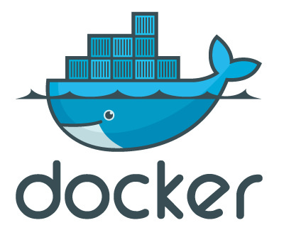



Virtual Edition Benefits
Seamless configuration migration
Easily move configuration between form factors
Deployment flexibility and elasticity
“Right size” the deployment, quickly deploy where needed & rapidly scale
Workload isolation
Projects can use their own instances
Unbounded memory scalability
Memory can be added to instances without additional licensing
Low cost for Dev & Test environments
Developers & Non-Production versions include add-on software modules at no additional charge
Free disaster recovery
Warm or cold backup without additional licenses when licensed for Production
Flexible licensing and entitlement
Sub-capacity licensing
Monthly licensing option
Entitlement to future product versions at no additional charge with active maintenance (S&S)
Notes:
Existing customers can take advantage of new releases and upgrade to new versions with an active Subscription & Support account with IBM

Slide 11
How DataPower Gateways are unique?
Purpose-Built, Secure Gateway
Non-blocking event-driven I/O architecture
Architecture similar to Nginx & Node.js
Continued enhancements since 2002
Parsers & compilers for JSON & XML processing written from ground-up with several patents
Secure and optimized JavaScript runtime called GatewayScript
Purpose-built, secure gateway image (all form factors)
Single self-contained, signed & encrypted secure gateway image without external software dependencies
No arbitrary software
Security exposure minimized due to smaller vulnerability surface (few user-exposed and 3rd party components)
High assurance, “locked-down” configuration
Optimized, embedded operation system
Physical security (physical appliance only)
Sealed, tamper-evident case
No usable USB, VGA, other ports
Customized intrusion detection switch
Trusted Platform Module
Encrypted flash drive
Cryptographic acceleration card
Optional FIPS 140-2 level 3 certified Hardware Security Module
Enterprise grade security requires a secure platform

Slide 12
Simple & Secure Architecture
How is DataPower Gateway different? Purpose-built, secure gateway platform
Complete gateway platform delivered as hardened image
Guiding philosophy is to centralize common security, traffic management, mediation, acceleration functions and optimize them in a security-hardened gateway stack delivered in Docker container, Linux application, Virtual machine and Physical appliance form factors
DataPower Gateways
(Secure & Easy to Manage)
Commodity Gateways
(In-Secure & Hard to Manage)
config
config
config
config
config
config
Proprietary Software
JVM
HTTP Server
App Server
database
config
DataPower Gateway Platform
Digitally Signed and Encrypted
Image
libxml
glibc
JSP Engine
Linux Daemons
config
Full Linux OS
(including shells and user accounts)
IBM Optimized Embedded Operating Environment
Display Ports
Bootable CDROM Drive
Bootable USB Ports
Crypto Acceleration
Flash
Memory
Hardware
Hardware

Slide 13
GatewayScriptTM: Secure & optimized JavaScript runtime
JavaScript-based gateway runtime which simplifies configuration for developers and provides an easier development paradigm for API, Mobile, Web, & IoT
Security
Transaction isolation to prevent memory-based attacks
Code injection protection to prevent security exposures from malicious code
Performance
Highly optimized JavaScript compiler
Built on intellectual capital and expertise from 10+ years securing and optimizing parsing/compiler technology

Slide 14

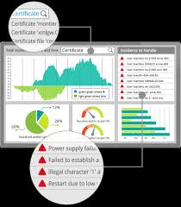
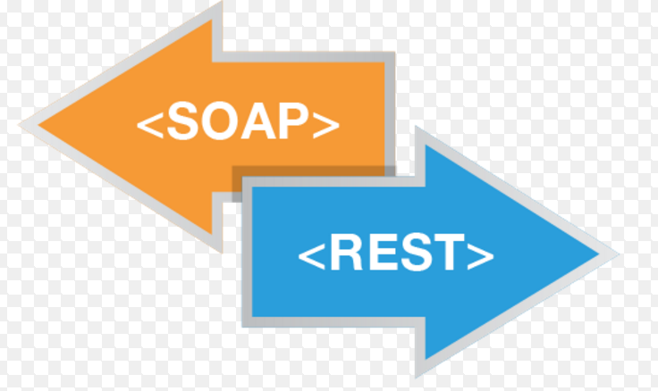

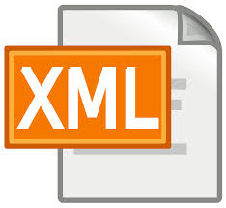





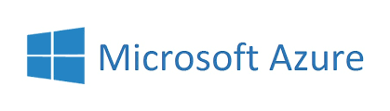



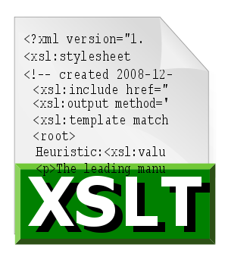


DataPower Gateways ….
Developer, Enterprise & DevOps Friendly
API,Mobile,Cloud,B2B
Built-in security, traffic mgmt, mediation, acceleration
Operations Dashboard
Purpose-built, Secure Gateway
Deploy Anywhere
Flexible & Extensible

Slide 15




DataPower Gateways
Over 15 years of innovation & 2000 global installations
Government
Insurance
Agencies and ministries
Defense and security organizations
Crown corporations
Used by 95% of top global insurances firms
SaaS providers, ASPs, regulators, etc.
Banking
Many, many, more
Majority of the big US and European banks
All of the big 5 Canadian banks
Numerous regional banks and credit unions
Healthcare
Retailers
Utilities, Power, Oil and Gas
Telecom
Airlines
Others

Slide 16






DataPower’ing IBM Bluemix!!!
Did you know?
DataPower has been trusted to be the exclusive gateway for Bluemix, IBM’s global Platform as a Service
Mobile client
Internet
Security
Control
Filtering
Content-Based Routing
Load balancing
Monitoring and Logging
Bluemix Tooling
App
External Services
App
App
App
Service
Service
Application Manager
Service
Service
VM
Open Stack

Slide 17
DataPower Gateway V7.5.2: Supported standards & protocols
Data format & language
JavaScript
JSON
JSON Schema
REST, SOAP 1.1, 1.2
WSDL 1.1
XML 1.0
XML Schema 1.0
XPath 1.0, XPath 2.0 (XQuery only)
XSLT 1.0
XQuery 1.0, JSONiq
Security policy enforcement
OAuth 2.0, OpenID Connect, Social Login
JWE, JWS, JWT, JWK
SAML 1.0/1.1/2.0, SAML Tkn Profile, SAML queries
XACML 2.0
Kerberos (including S4U2Self, S4U2Proxy)
SPNEGO
RADIUS, RSA SecurID OTP using RADIUS
LDAP versions 2 and 3
Lightweight Third-Party Authentication
Microsoft Active Directory
FIPS 140-2 Level 3 (w/ optional HSM)
FIPS 140-2 Level 1 (w/ certified crypto module)
SAF & IBM RACF® integration with z/OS
Internet Content Adaptation Protocol
W3C XML Encryption
W3C XML Signature
S/MIME encryption and digital signature
WS-Security 1.0, 1.1
WS-I Basic Security Profile 1.0, 1.1
WS-SecurityPolicy
WS-SecureConversation 1.3
Transport & connectivity
HTTP, HTTP/2, HTTPS, WebSocket Proxy
FTP, FTPS, SFTP
WebSphere MQ
WebSphere MQ File Transfer Edition
TIBCO EMS
WebSphere Java Message Service
IBM IMS Connect, & IMS Callout
NFS
AS1, AS2, AS3, AS4, ebMS 2.0, CPPA 2.0, POP, SMTP (B2B Module)
DB2, Microsoft SQL Server, Oracle, Sybase, IMS
Transport Layer Security
TLS versions 1.0, 1.1, and 1.2
SSL versions 2 and 3
SNI, PFS, ECC Ciphers
Public key infrastructure (PKI)
RSA, 3DES, DES, AES, SHA, X.509, CRLs, OCSP
PKCS#1, PKCS#5, PKCS#7, PKCS#8, PKCS#10, PKCS#12
XKMS for integration with Tivoli Security Policy Manager (TSPM)
Management
Simple Network Management Protocol
SYSLOG
IPv4, IPv6
Web services
WS-I Basic Profile 1.0, 1.1
WS-I Simple SOAP Basic Profile
WS-Policy Framework
WS-Policy 1.2, 1.5
WS-Trust 1.3
WS-Addressing
WS-Enumeration
WS-Eventing
WS-Notification
Web Services Distributed Management
WS-Management
WS-I Attachments Profile
SOAP Attachment Feature 1.2
SOAP with Attachments (SwA)
Direct Internet Message Encapsulation
Multipurpose Internet Mail Extensions
XML-binary Optimized Packaging (XOP)
Message Transmission Optimization Mechanism (MTOM)
WS-MediationPolicy (IBM standard)
Universal Description, Discovery, and Integration (UDDI versions 2 and 3), UDDI version 3 subscription
WebSphere Service Registry and Repository (WSRR)
Link to Product Documentation

Slide 18
See slide deck for Common Use Cases: slideshare.net/ibmdatapower/data-power-common-use-cases

Slide 19
Agenda
DataPower Gateway Overview
DataPower Operations Dashboard
Recent Releases
What’s New in DataPower Gateway V7.5.2

Slide 20
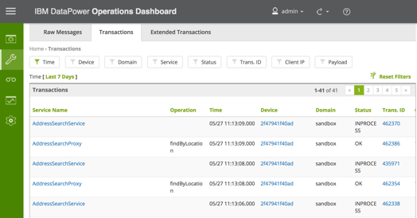
DataPower Operations Dashboard Overview
Released May 2016
Smart Insights, visibility & troubleshooting for DataPower Gateways
Provides advanced operations console for real-time visibility of transactions and centralized operations to enable quicker problem determination and operational resiliency
Overview: youtube.com/watch?v=I3Y7RwpP2ns
Details: youtube.com/watch?v=6NJJjaW8Z7U
Documentation: ibm.com/support/docview.wss?uid=swg21984708

Slide 21
DataPower Operations Dashboard Features
Centralized, customizable console with self-service capabilities for developers
Real-time and Historical Transaction Troubleshooting including full text search
Quickly and easily drill-down, assess, and react to real-time or historical cross-gateway transactions down to the detailed logs and payloads
Dashboards, Statistics, Reports, and more
Real-time visibility of DataPower gateway operations and performance as well as historical analysis, statistics, scheduled and ad-hoc reports, and more
Non-intrusive, Completely Asynchronous, Highly Scalable
Seamlessly integrates with existing DataPower gateways to provide vital feedback without affecting transaction latency and irrespective of the number of gateways being monitored

Slide 22
Agenda
DataPower Gateway Overview
DataPower Operations Dashboard
Recent Releases
What’s New in DataPower Gateway V7.5.2

Slide 23

Released
Jun 2016
7.5.1
Cloud
Red Hat Enterprise Linux (RHEL) deployment support on Microsoft Azure
Smaller Docker image sizes for flexible delivery
API
OAuth distributed token management support (API Connect only)
Fine-tuned caching in a AAA security policy
Platform
Fixed-length TCP/IP integration for backend services
Optimized connectivity with HTTP 2.0 support

Slide 24







Released
Mar 2016
7.5
New Cloud Offerings
Built-in Policies on IBM API Connect
Run DataPower as an Red Hat Enterprise Linux (RHEL) application on cloud platforms (Amazon/SoftLayer) for easier management using cloud management tools
Create
Run
New API gateway policies for IBM API CONNECT to enable quick delivery of gateway capabilities without any custom policy authoring or coding
Secure
Manage
Deployment Flexibility using Docker
Enhanced API Security
Flexible user authentication for Single Sign-On (SSO) to Web, mobile and API workloads using social (eg. Google) or enterprise identities based on OpenID Connect
Deploy DataPower as a Docker container for enhanced portability, scalability and environment provisioning
Network HSM Integration
New Modernized User Experience
Integrate with Gemalto (formerly Safenet) network HSM to provide secure key management and offload of crypto operations in cloud and virtual environments.
Modernized user experience to reduce complexity and allow quicker creation of gateway services

Slide 25






Released
Jun 2015
7.2
Secure. Integrate. Control. Optimize.
New Cloud Offerings
Enhanced Mobile and API security
Deploy DataPower Gateways on Amazon EC2, Microsoft Azure and SoftLayer CCI to provide enhanced cloud elasticity for cloud workloads
Increased mobile and API security for protecting mission-critical transactions with JSON Encryption, JSON Signature, JSON Key, and JSON Token
Secure Gateway for Bluemix
GatewayScript Enhancements
GS
Enhanced hybrid cloud integration to securely connect between IBM Bluemix applications and on-premise services protected using DataPower Gateways
Easily transform between XML and JSON messages to quickly integrate System of Records data sources with Systems of Engagement interfaces
Robust Platform Security
Easier DevOps with new REST API
Protect mission-critical applications from security vulnerabilities with enhanced TLS protocol support using Elliptic Curve Cryptography, Server Name Indication, and Perfect Forward Secrecy
New REST-based management API to build deployment and automation scripts, enabling easier devops for continuous software delivery and quicker problem resolution
Notes:
Amazon EC2, Microsoft Azure and IBM Softlayer CCI support for increased deployment flexibility on public cloud environments
Enhanced hybrid cloud integration using Secure Gateway service to securely connect between IBM Bluemix applications and on-premise services secured using DataPower Gateways
Stronger cloud and on-premise security with support for Elliptic Curve Cryptography (ECC), Server Name Indication (SNI), and Perfect Forward Secrecy (PFS) to protect against malicious protocol attacks
Mobile security enhancements for securing access to REST services using JSON Web Encryption (JWE), JSON Web Signature (JWS), JSON Web Key (JWK) and JSON Web Token (JWT)
Easier integration between Systems of Engagement and System of Record solutions with XML support using GatewayScript, JavaScript-based runtime.
New management API based on a REST architecture for managing DataPower configuration, enabling easier DevOps.
Increased transactional reliability with enhanced IMS database support
Distributed caching support with IBM WebSphere eXtreme Scale 8.6+

Slide 26
Agenda
DataPower Gateway Overview
DataPower Operations Dashboard
Recent Releases
What’s New in DataPower Gateway V7.5.2

Slide 27
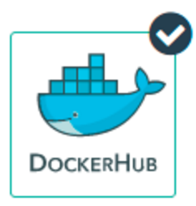


Released
Sep, 2016
7.5.2
Enhanced Docker Image
Deploy Anywhere on Linux
Optimized DataPower Gateway Docker image provides smaller footprint, enhanced security, & DevOps support
Install and run DataPower Gateway on Red Hat Enterprise Linux or Ubuntu in any environment including bare-metal, virtual & cloud platforms
Available on Docker Hub
No-Charge Edition for Developers
Download & deploy DataPower Gateway directly from Docker Hub for enhanced productivity, see https://hub.docker.com/r/ibmcom/datapower/
Evaluate, demonstrate, develop and unit test DataPower Gateway configuration free for charge, see https://hub.docker.com/r/ibmcom/datapower/
Enhanced B2B Integration with AS4
New Modernized User Experience
Support for AS4 one-way message exchange pattern in the B2B module enables users to meet government & industry mandates
Modernized user experience to reduce complexity & allow quicker creation of gateway services, now available as the default UI
http://www.ibm.com/support/knowledgecenter/SS9H2Y_7.5.0/com.ibm.dp.doc/whats_new_7.5.2.html

Slide 28
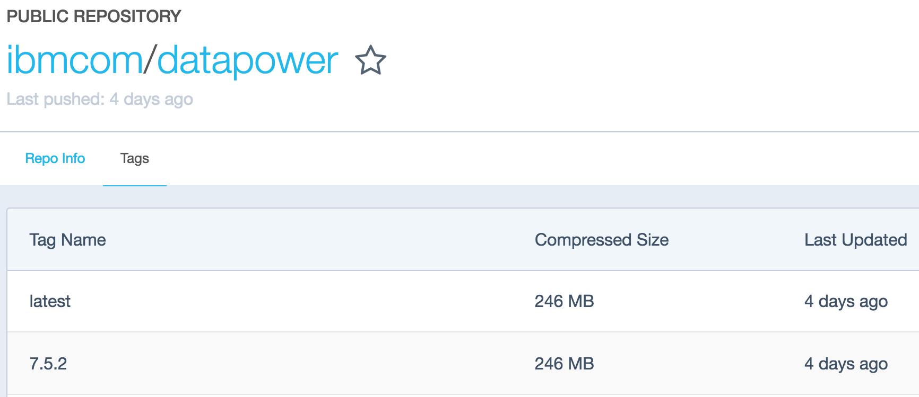
Enhanced Docker Image
Deploy DataPower Gateway anywhere using Docker containers on x86_64 including
Bare-metal physical servers
Virtual platforms: VMware, XenServer, Hyper-V, KVM, others
Cloud platforms: Amazon EC2, Microsoft Azure, IBM SoftLayer, Cloud Foundry, OpenShift, others
Smaller footprint: 250MB download size (from Docker Hub), less than 1GB running size, running in less than 10 seconds!
Enhanced security: Run without root privileges
https://hub.docker.com/r/ibmcom/datapower/
DevOps support
Project and file-based management for deploying configuration from source control in a continuous delivery manner
Interactive command-line experience to quickly perform common gateway tasks
DevOps support to quickly bootstrap new installable images into a running container

Slide 29
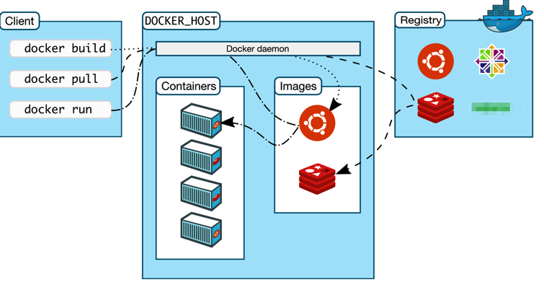
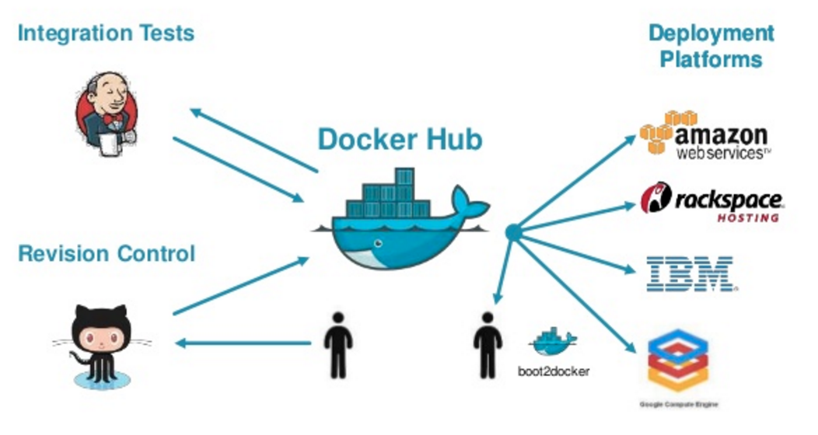
Deploy Anywhere using Docker containers
Deploy DataPower Gateway Docker container on any X86_64 Docker platform
Perform regular Docker tasks (build, pull, and run) on Docker supported hosts
Pull DataPower gateway images from Docker private registries
Higher density to run multiple concurrent DataPower gateway instances on a single machine

Slide 30
Deploy Anywhere on Linux
Deploy DataPower Gateway anywhere on Red Hat Enterprise Linux or Ubuntu Linux natively on x86_64 including
Bare-metal physical servers
Virtual platforms: VMware, XenServer, Hyper-V, KVM, others
Cloud platforms: Amazon EC2, Microsoft Azure, IBM SoftLayer, Cloud Foundry, OpenShift, others
DataPower Gateway
DataPower Gateway
Linux Operating System
Linux Operating System
Hypervisor
Hardware
Hardware
Bare-metal Physical server
Virtual or Cloud platform

Slide 31
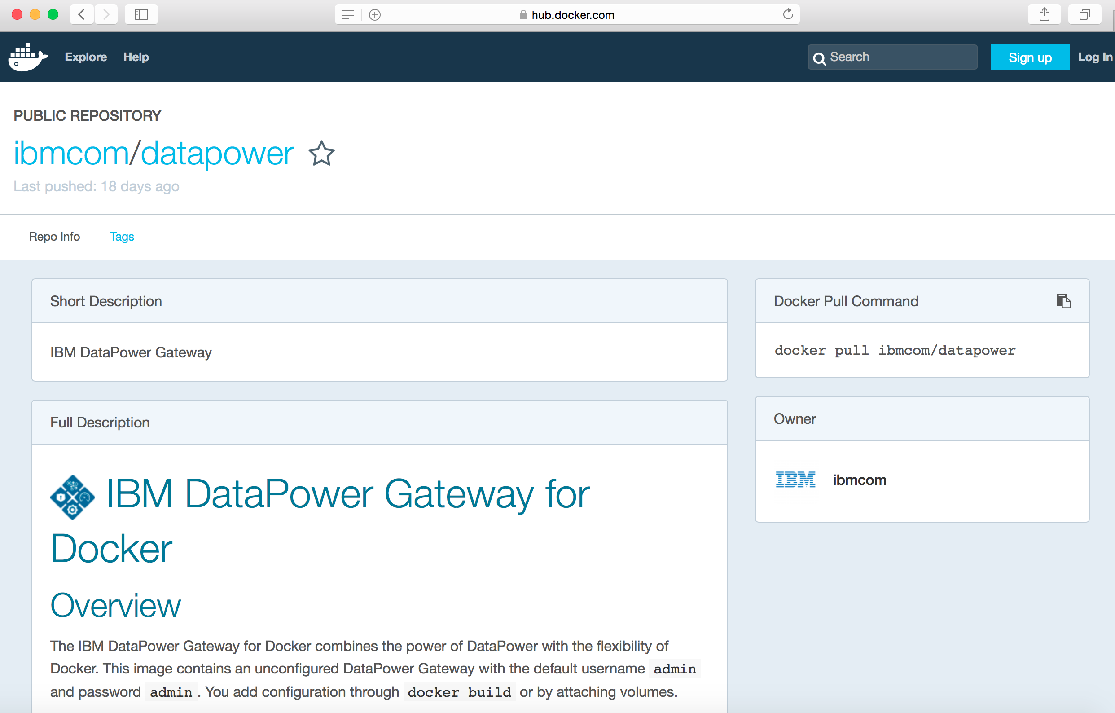
No-charge Edition for Development
DataPower Gateway available at no charge without IBM support for Developers
Evaluate, demonstrate, develop & unit test without cost
Restricted to development and unit testing, no expiry period
Download & deploy directly from Docker Hub!
Supports Docker for Mac and Docker for Windows
https://hub.docker.com/r/ibmcom/datapower/
Develop and unit test gateway configuration using the no-charge download from Docker Hub and convert it to paid offerings for formal IBM support and deployment in test, staging, production via license activation from IBM Passport Advantage® without starting over with a new image
Low-cost, single-user license w/ IBM support
DataPower Gateway Virtual Edition for Developers
DataPower Gateway for Developer (No Charge)
Deployment in test, quality assurance, benchmarking, staging environments
DataPower Gateway Virtual Edition for Non-Production
Deployment in production environments
DataPower Gateway Virtual Edition for Production

Slide 32
Enhanced B2B Integration: AS4 One-way Message Exchange Pattern
B2B module now includes support for AS4 protocol One-way Message Exchange Pattern (MEP)
AS4 is an open standard for secure and payload-independent exchange of business-to-business documents by using Web Services
Supports one-way push and one-way pull message exchange pattern
AS4 protocol is a requirement due to government & industry mandates, common in Europe, Australia and New Zealand
INTERNET
DMZ
TRUSTED ZONE
Trading Partners
AS4
One-way MEP
B2Bi
B2B Partner Gateway

Slide 33
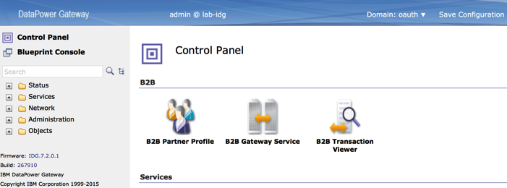
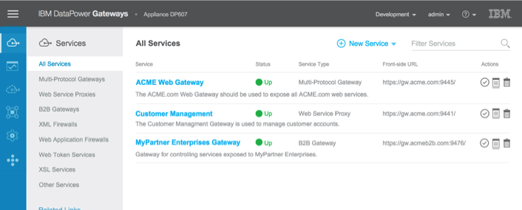
New Modernized User Experience
Modernized look and feel with updated theme and simplified navigation experience
Current
New

Slide 34
Other enhancements (1 .. 2)
Accelerate DevOps & increase platform resiliency
Flexibility to store cryptographic material in the local: directory, plus ability to securely store local user account and password in exported configuration, enable 100% self-contained configuration export for easier DevOps
Dynamically configure transaction timeouts in a gateway policy based on transactional context or environmental issues to optimize response times and resource usage
Dynamically specify caching policies on a per transaction basis in a gateway policy based on message content
View certificate details using RMI and SOAP management interface for easier certificate management
Quickly troubleshoot SSL related issues with enhanced SSL debugging using session key logging

Slide 35
Other enhancements (2 .. 2)
Enhanced security, control API workload
Fine-grained caching control of authentication and authorization failures to provide enhanced environment resiliency
New Quota Enforcement (ratelimit) API to identify and count the number of concurrent transactions that are simultaneously processed
Invoke Processing Policy Rules programmatically using GatewayScript
Convert any asynchronous callback pattern into a synchronous one with virtually no performance penalty with the new fibers module in GatewayScript
Authenticate requests using a SAML response assertion
Set cipher suites for SSH connections when acting as a SFTP client or SFTP server
Support for IBM Transformation Extender v9.0.1
Support for IBM Security Access Manager v9.0.1

Slide 36
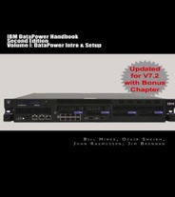
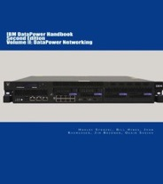
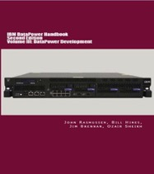
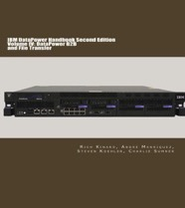



DataPower Handbook, Second Edition, Volume I, II, III, IV
Known as the ‘bible’ of DataPower planning, implementation, and usage.
New content to cover new products/features, including 9006/7.2!
Volume 1 consists of DataPower Intro, Setup Guide, Common Use Cases, Deployment Checklist, new Preface and three invaluable new appendices for physical and virtual gateways.
Volume II is an in-depth coverage of DataPower networking topics, including VLAN, link aggregation, high availability.
Volume III is an in-depth coverage of DataPower development, including XSLT, EXSLT, JavaScript/GatewayScript, JSON, JSONiq, XQuery, binary/secondary data formats, and development tools.
Volume IV covers DataPower B2B processing and file transfer, including relevance of B2B in today’s API driven world.
Available in softcover and e-book formats
Notes:
Available today on Amazon:
IBM WebSphere DataPower SOA Appliance Handbooks: 2nd Edition: Volume I: DataPower Intro & Setup http://amzn.to/1IjrEBb 2nd Edition Volume II: DataPower Networking http://amzn.to/1Ijrzh3
2nd Edition Volume III: DataPower Development http://amzn.to/1JJszf4 2nd Edition Volume IV: DataPower B2B and File Transfer http://amzn.to/1O6HNuC Amazon.com worldwide & Amazon Kindle
KindleMatch – buy hardcopy & get ebook for US$2.99
Kinde Unlimited, Kindle lending

Slide 37





Where can I learn more about IBM DataPower Gateway?
Overview Video
youtube.com/watch?v=RqT3f_TmSMM
Product Page
ibm.com/software/products/en/datapower-gateway
Developer Center & Playground
developer.ibm.com/datapower/
Product Documentation
ibm.com/support/knowledgecenter/SS9H2Y
Videos
youtube.com/channel/UCV2_-gdea5LM58S-E3WCqew
Slide Decks
http://slideshare.net/ibmdatapower
GitHub Repository
github.com/ibm-datapower/
Twitter
twitter.com/IBMGateways
LinkedIn
Private user group ‘IBM DataPower Gateway’
linkedin.com/groups?gid=4820454
User Forum
ibm.biz/dpuserforum

