Slide 1

BS23124 — DATA MINING AND DATA WAREHOUSING
A Decision Support System for Johor Property Price Estimation Using Data Mining
Mini Project Presentation
Team: Lee Wen Xin · Jaff Go · Chew See Yuan
Notes:
Introduce the project title, course code, and team.
1

Slide 2
01 / PROBLEM & MOTIVATION
Buyers face the largest information gap in the property market
Buying a house is one of the largest financial decisions an ordinary person makes.
“
Developers and investors already have valuation tools and transaction data at their disposal.
For a house with these characteristics, what is a reasonable price — and is the asking price high, fair, or low?
Ordinary buyers face the greatest information asymmetry.
Notes:
Frame the information asymmetry problem buyers face versus developers and investors.
2

Slide 3
02 / BACKGROUND & RELATED WORK
Tree-based ensembles are the established approach for automated valuation
Automated Valuation Models (AVM) are an established machine-learning application; tree-based ensembles like Random Forest are the standard choice.
Oh, Hang & Wang (2024)
Ho, Tang & Wong (2021)
Kuala Lumpur — terrace houses
Hong Kong — ~40,000 transactions
Random Forest was the strongest model, R² = 0.74–0.75 — somewhat higher, consistent with their larger, pre-filtered dataset.
Richer features (floor, orientation, transport distance) produced a substantially higher R² — feature availability sets the accuracy ceiling.
Notes:
Position AVMs and RF as an established approach; cite two studies and note what drives accuracy differences.
3

Slide 4

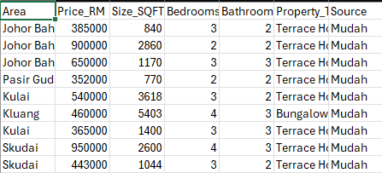
03 / DATA SOURCES
Three sources combined into one raw dataset
Mudah.my
Kaggle
PropertyGuru
Scraped listings
Public dataset
Scraped listings
Source | Raw rows | Districts covered
Mudah.my | 1,968 | 13
Kaggle (public dataset) | 1,013 | 13
PropertyGuru | 127 | 5
Total (raw, pre-cleaning) | 3,108 | 18 (after consolidation)
3,108
raw rows collected
18
districts spanned
Notes:
Describe the three data sources and the resulting raw dataset size.
4

Slide 5
04 / DATA CLEANING
Four issues shaped the cleaning pipeline
1
Location recovery — 395 rows mislabeled as “Johor” (a state, not a district) → 392 recovered from the address field.
2
Region consolidation — 226 fragmented location labels merged into 18 core districts.
3
Outlier handling — built-up area contained impossible values (one row at 213,939 sqft) → invalid range filtered.
4
Duplicate removal & leakage-safe split — 597 fully duplicate rows found (~19%). Random splitting would leak duplicates across train/test, so we switched to GroupShuffleSplit grouped by property characteristics.
Now automated & reproducible: build_database.py scripts items 1 and 3 (district mapping + 200-10,000 sqft outlier/median-impute check) with logged before/after counts on every run - re-running it against this dataset finds 0 further anomalies, confirming the original manual clean-up was complete.
Notes:
Walk through the four cleaning issues; item four is the key methodological contribution.
5

Slide 6
05 / MODELING APPROACH
Three models, five features
Linear Regression
Decision Tree
Random Forest
Baseline model
Overfits easily
Ensemble — resists overfitting
FINAL FEATURE SET
District
Property type
Built-up area
Bedrooms
Bathrooms
Tenure was dropped — missing in over 90% of scraped records.
Notes:
Introduce the three candidate models and the final feature set, noting tenure was dropped.
6

Slide 7
06 / SYSTEM ARCHITECTURE
A relational store behind a three-page decision tool
DATABASE — SQLITE
How can a buyer determine if their offer is Overpriced, Fair, or Underpriced?
→ Solved by: the Price Check page
master_property
transactions
decision_log
Three related tables, linked by house_id.
How are properties distributed geographically across the 18 districts of Johor?
→ Solved by: the Data Dashboard's geographic map
APPLICATION — STREAMLIT
Price Check
Prediction, price range, and verdict
[ PLACEHOLDER: TERMINAL / ARCHITECTURE SCREENSHOT ]
What hidden "If-Then" rules and bundling patterns exist within the property market?
→ Solved by: the Hidden Patterns / Apriori page
Data Dashboard
Descriptive statistics
Hidden Patterns
How do we honestly communicate model uncertainty to users when data features are imperfect?
→ Solved by: the ±15% honest-uncertainty range design
Apriori — 250 rules mined, 65 predict price band (lift up to 3.25×)
Notes:
Explain the database schema and the two Streamlit app pages.
7

Slide 8
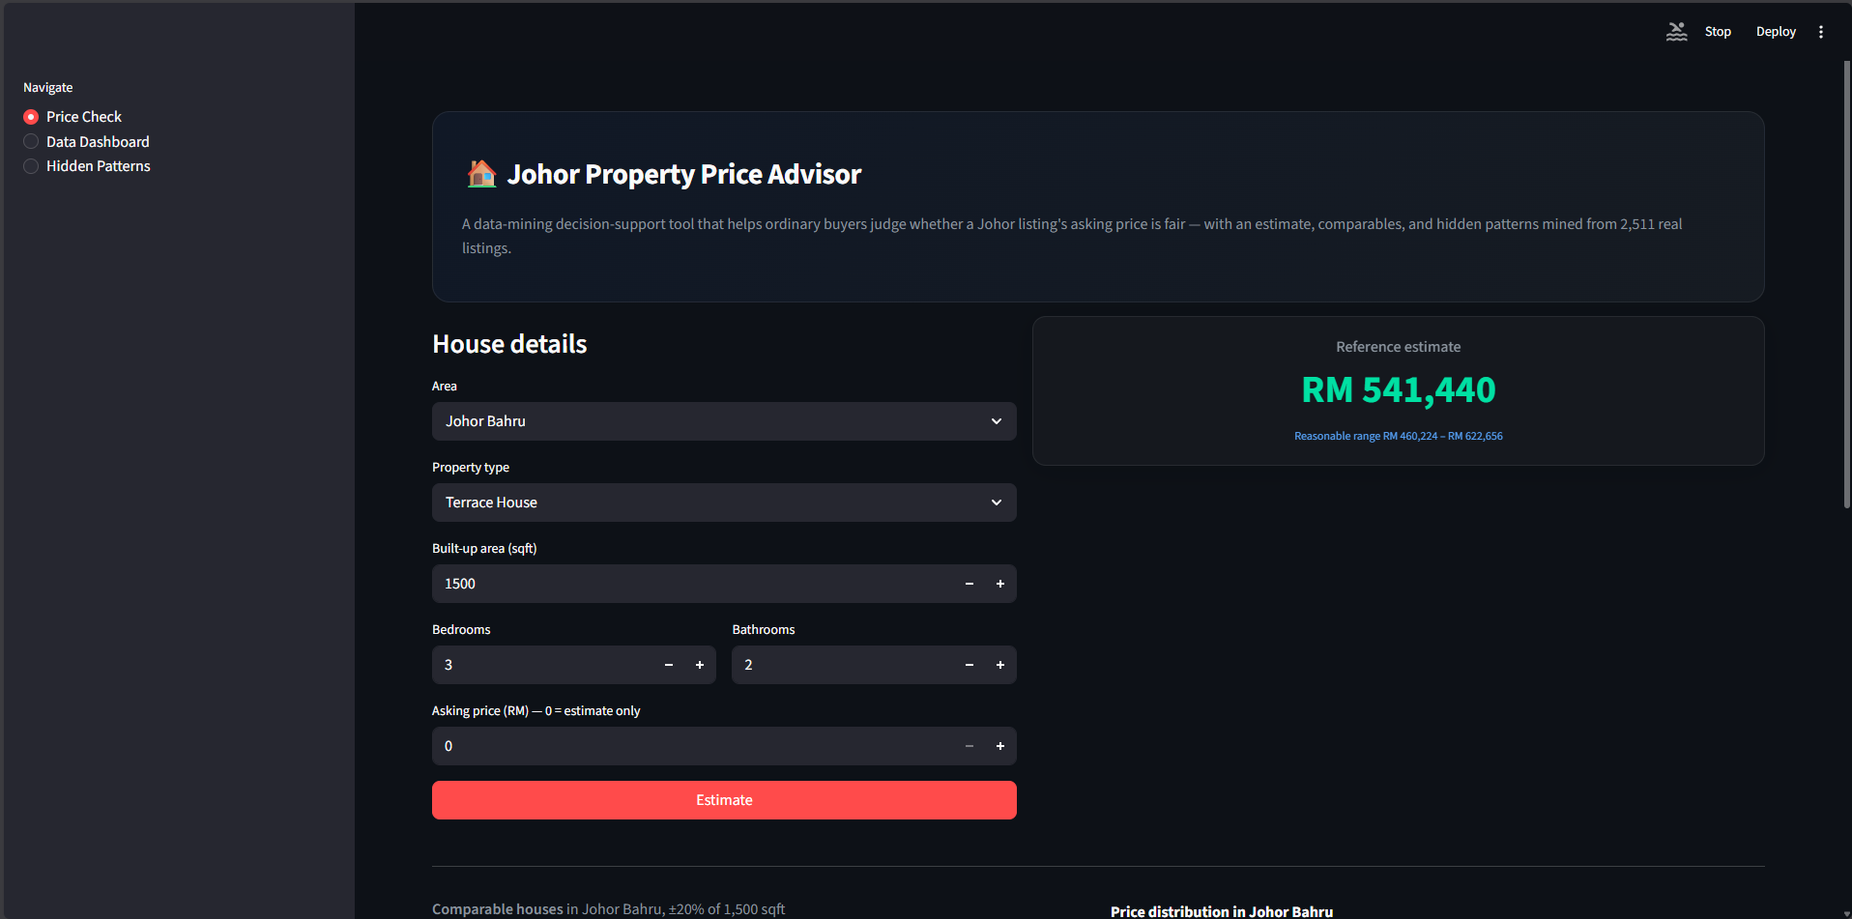
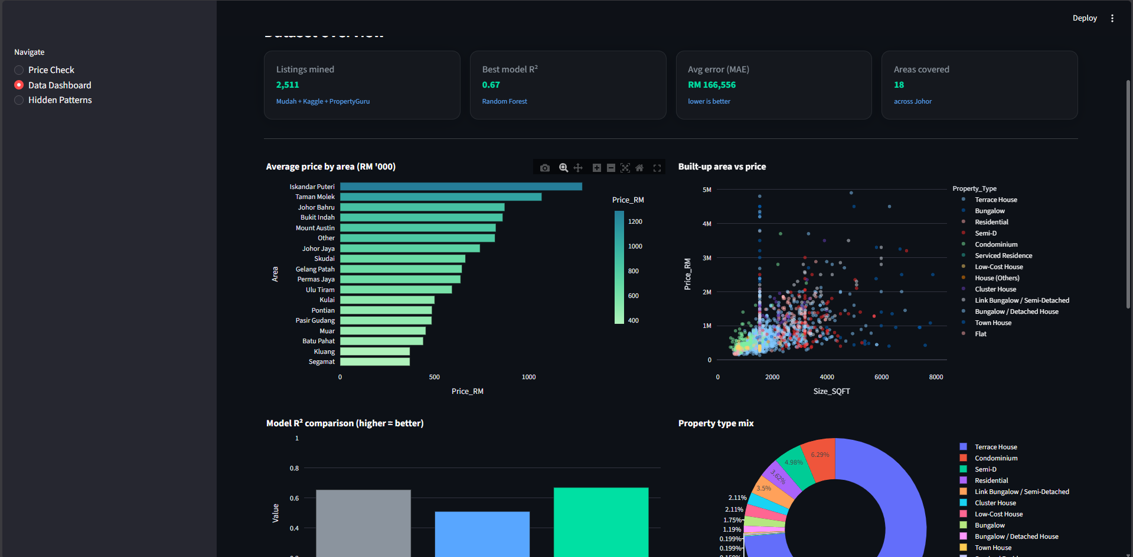
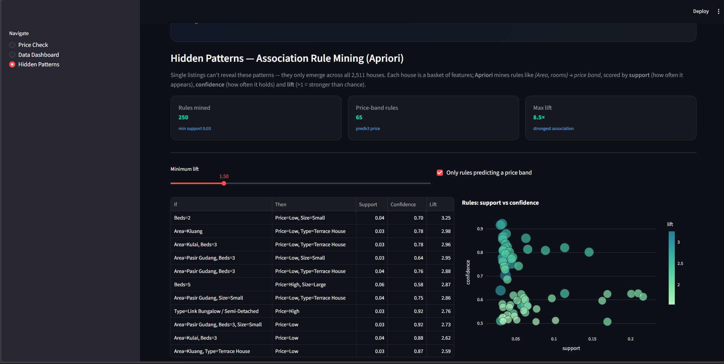
07 / SYSTEM DEMO
Three pages, one decision workflow
[ PLACEHOLDER SCREENSHOT ]
[ PLACEHOLDER SCREENSHOT ]
[ PLACEHOLDER SCREENSHOT ]
Price Check page (gauge chart)
Data Dashboard
Hidden Patterns / Apriori page
Notes:
Walk through screenshots of the three application pages.
8

Slide 9
08 / MODEL COMPARISON RESULTS
Random Forest gives the best fit and lowest error
Model
R²
RMSE (RM)
MAE (RM)
Linear Regression
0.656
305,589
182,367
Decision Tree
0.511
364,235
185,119
Random Forest (selected)
0.671
298,614
166,556
Notes:
Present the comparison table; Random Forest is the selected model.
9

Slide 10
09 / BENCHMARKING AGAINST LITERATURE
Our result sits inside the published range
Our result
0.671
Oh, Hang & Wang (2024) — KL terrace houses
0.74–0.75
Two independent datasets both land in the 0.65–0.75 range using basic listing-level features — this is the normal ceiling for this feature set, not a flaw in our data or model.
Notes:
Compare our R-squared against two published studies; explain the shared ceiling.
10

Slide 11
10 / FINDING — FEATURE IMPORTANCE
Bathrooms is a proxy for scale, not an independent driver
Bathrooms initially showed dominant importance (~0.67) — counter-intuitive, since location was expected to matter more.
CORRELATION WITH BATHROOMS
Bathrooms acts as a proxy for overall property scale, not an independent price driver: multicollinearity was producing misleading feature importance.
Bedrooms
0.80
Built-up area
0.62
Notes:
Explain the counter-intuitive bathrooms finding and the multicollinearity investigation.
11

Slide 12
11 / LIMITATIONS
Two limitations bound how far these results generalize
Missing features
Selection bias
Error is largely driven by features not present in the data: age, renovation, orientation, and parking.
Listing prices exceed transacted prices; the model may overestimate rural or older properties.
Root cause: asking price is the seller/developer's opening offer, shaped by marketing and financing strategy - not the supply-demand equilibrium price. The model captures what sellers ask, not market-clearing dynamics.
First-pass check: mapping listings to Johor's 10 official districts and merging 2024 income data (75% coverage), Johor Bahru's median price is 5.8x the district's median annual income - the least affordable district in the sample, vs. 4.1x in Segamat.
Notes:
Discuss missing features and selection bias as the two main limitations.
12

Slide 13
12 / FUTURE WORK
Four directions to extend this work
Scrape detail pages for age, renovation, and tenure.
Incorporate real transacted prices (NAPIC / List.my).
Flag low-sample-area estimates as less reliable.
Explore model ensembling — validate against the current baseline rather than assume improvement.
Notes:
Outline four directions for future work.
13

Slide 14
13 / CONCLUSION
A working decision support system for Johor property prices
Its value lies not in a high R² figure, but in honest uncertainty communication and analytical rigor.
Thank you — Questions?
Notes:
Close by restating the project's value: rigor and honest uncertainty, not a headline metric. Invite questions.
14

