Slide 1
DATA ANALYTICS PROJECT — BDS23114
Predictive Modeling of
FIFA World Cup Match Outcomes
A machine learning approach to predicting — and explaining — why one team beats another
Lee Wen Xin
Student ID: BIT-B2201F-2505004
Lecturer: Dr. Ng Choon Ching • May 2026 Semester

Slide 2
Project objective
Football looks random on the surface — but across thousands of matches, clear patterns emerge.
1
Predict
2
Explain
the outcome of a match — Win, Draw, or Loss — from the home team's perspective.
why one team beats another, using interpretable pre-match strength indicators.
Research questions
1
Can match outcomes be predicted more accurately than a naive baseline?
2
Which factors explain a win, and how much does each contribute?
3
Do these factors generalise to World Cup matches, including the 2022 tournament?
BDS23114 Data Analytics • Predictive Modeling of FIFA World Cup Match Outcomes
2

Slide 3
The dataset
International Football Results, 1872–2026 — Kaggle (martj42) + FIFA World Cup All Dataset (abhijitdahatonde)
49,490
8
154
4
matches
raw columns
years of history
supporting files
Outcome balance (home team's perspective)
Home win
49.0% (24,253)
Away win
28.3% (13,981)
Draw
22.7% (11,255)
The home team wins more often — this sets the baseline any model must beat.
BDS23114 Data Analytics • Predictive Modeling of FIFA World Cup Match Outcomes
3

Slide 4
Data cleaning & preparation
Every step documented and justified — not just applied.
1
Chronological order
2
Duplicates
Date converted to datetime, sorted ascending — required so every engineered feature uses only past information.
1 exact duplicate fixture (same date, teams, score) identified and removed.
3
Outliers kept, justified
4
Target encoding
Extreme scorelines (e.g. 31–0) are real historical results, not errors — kept, but Elo/form features are robust to single blow-outs.
Result derived from goal difference (Win / Draw / Loss) plus a numeric Result_Code for correlation analysis.
BDS23114 Data Analytics • Predictive Modeling of FIFA World Cup Match Outcomes
4

Slide 5
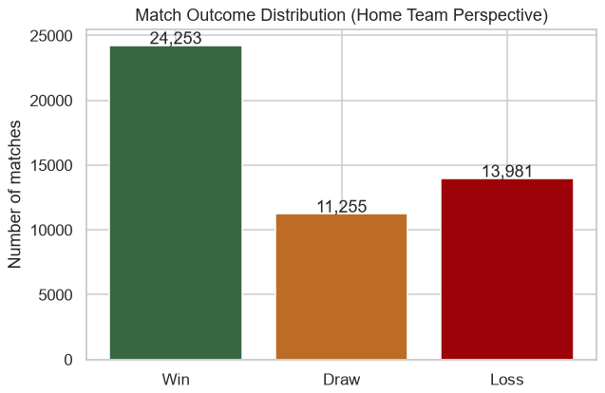
EDA — who wins, and where
50.7%
home win rate at own stadium, vs 44.2% at a neutral venue
Mean total goals / match: 2.94 (median 3, SD 2.10)
Home advantage is real, but modest — the first quantitative evidence that it shouldn't be overweighted in later modelling.
BDS23114 Data Analytics • Predictive Modeling of FIFA World Cup Match Outcomes
5

Slide 6
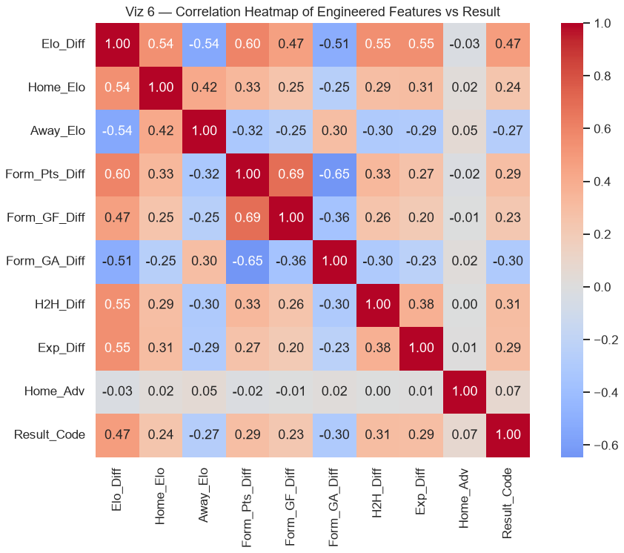
EDA — what correlates with the result
Elo_Diff
correlates with the result more strongly than any other engineered feature (r = 0.47) — the first sign that team strength will dominate the model.
Used for feature selection: every engineered feature earns its place in the model by showing a real relationship with the outcome, not just intuition.
BDS23114 Data Analytics • Predictive Modeling of FIFA World Cup Match Outcomes
6

Slide 7
Feature engineering — turning outcomes into explanations
Raw columns only record what happened. These features capture each team's strength BEFORE kick-off — all computed chronologically and time-shifted to prevent data leakage.
Elo rating
A running skill score updated after every match, weighted by goal margin. The single clearest measure of relative strength.
1
Recent form
Difference in average points, goals scored, and goals conceded over each team's previous 5 matches.
2
Head-to-head
The home team's historical win rate against this specific opponent, before the match.
3
Home advantage & experience
Whether the home team plays at its own stadium, and how many matches each side has played to date.
4
BDS23114 Data Analytics • Predictive Modeling of FIFA World Cup Match Outcomes
7

Slide 8
Modelling approach
Chronological split — not random
Train — first 80% of matches
Test — most recent 20%
A random split would leak future matches into training and inflate the score — chronological order avoids this.
Three models compared
Logistic Regression
Random Forest
Gradient Boosting
Transparent coefficients — shows direction of effect
Tuned with GridSearchCV over time-series CV
Advanced ensemble comparison
Baseline to beat: always predict the majority class (Win) — 47.6% accuracy
BDS23114 Data Analytics • Predictive Modeling of FIFA World Cup Match Outcomes
8

Slide 9
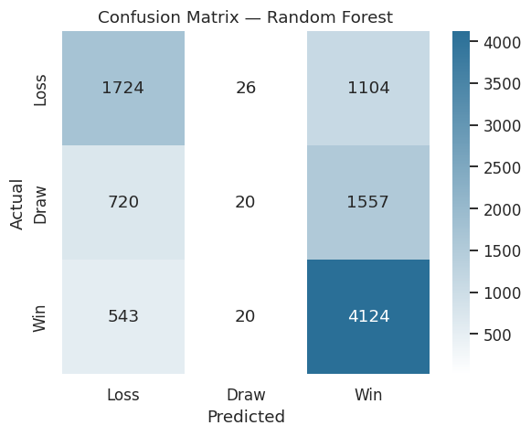
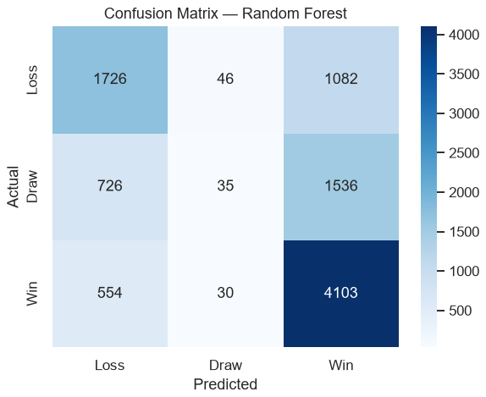
Results — all three beat the baseline
Model | Accuracy | Precision | Recall | F1 (macro)
Baseline (predict Win) | 0.476 | – | – | –
Logistic Regression | 0.598 | 0.539 | 0.497 | 0.441
Random Forest | 0.597 | 0.510 | 0.499 | 0.443
Gradient Boosting | 0.594 | 0.483 | 0.497 | 0.447
Random Forest selected: all three models are within 0.006 macro-F1 of each other (not a meaningful gap on one split) — Random Forest is chosen for its native feature importances, used to explain why teams win.
Confusion matrix — Random Forest
BDS23114 Data Analytics • Predictive Modeling of FIFA World Cup Match Outcomes
9

Slide 10
Being honest about the model's weak spot
Accuracy (0.596) looks solid — macro-F1 (0.443) tells the real story.
Class | Precision | Recall | F1
Win | 0.61 | 0.88 | 0.72
Loss | 0.58 | 0.61 | 0.59
Draw | 0.34 | 0.01 | 0.02
Remedies for the next iteration
1
class_weight="balanced" penalise misclassifying draws more heavily — cheapest next step
2
Resampling SMOTE oversampling of draws, or undersampling Win/Loss
1%
Draw recall — only ~23 of 2,297 actual draws correctly identified. A class-imbalance effect: predicting “not a draw” is the model's lower-risk strategy.
3
Ordinal reframing Loss < Draw < Win respects the natural ordering of outcomes
BDS23114 Data Analytics • Predictive Modeling of FIFA World Cup Match Outcomes
10

Slide 11
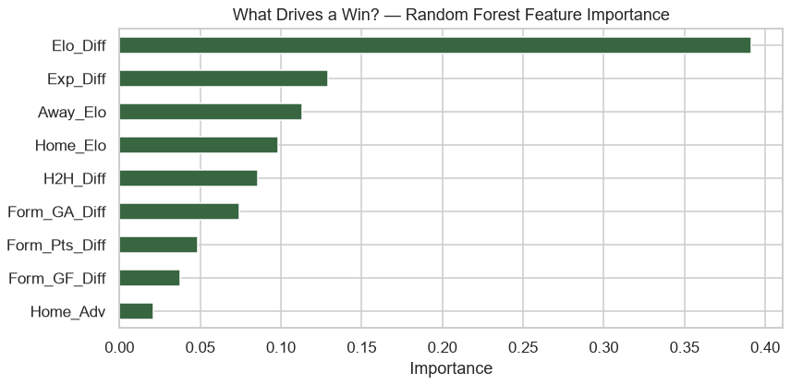
Why teams win
Answered three ways: Random Forest importance, Logistic Regression direction, permutation importance — all agree.
1
Strength gap dominates
Elo difference is overwhelmingly the top factor — football is largely a contest of accumulated quality.
2
Defence beats attack
A lower recent goals-conceded average raises win probability more than a higher goals-scored average.
3
Home advantage: real, but small
Confirms the EDA finding — easily outweighed by a large strength gap.
Random Forest feature importance
BDS23114 Data Analytics • Predictive Modeling of FIFA World Cup Match Outcomes
11

Slide 12
Applying it: the 2022 World Cup
Feeding the trained model 2022 group-stage fixtures — which carry no scores — as a live end-to-end check.
Home | Away | Prediction | Home win prob.
Argentina | Saudi Arabia | Home win | 0.825
Qatar | Ecuador | Away win | 0.135
Germany | Japan | Home win | 0.488
Morocco | Croatia | Home win | 0.480
An honest caveat
The dataset is a continuously-updated snapshot through July 2026 — so each team's Elo reflects current strength, not their strength in November 2022.
This demonstrates the pipeline runs end-to-end on unseen fixtures — it is not a true retrospective forecast. A faithful backtest (pre-2022 data only) is listed under future work.
BDS23114 Data Analytics • Predictive Modeling of FIFA World Cup Match Outcomes
12

Slide 13
The fix: a live, unplayed match
France v Spain — 2026 World Cup semifinal, predicted 12 July, kick-off 14 July. Genuinely unknown when this number was generated.
Elo rating
Why this fixes Section 12's problem
France 2087.0
Spain 2127.9
Last 5 results
The 2022 example used 2026-dated Elo to “predict” a 2022 match — the model already knew the future. This prediction was made before its match was played: nothing about the outcome existed yet.
France W W W W W
Spain W D W W W
Head-to-head (38 meetings)
France 13 wins
Spain 18 wins · 7 draws
Model output (draw redistributed into an advancement estimate)
Still an honest caveat
France advances
44.3%
The dataset snapshot is dated 2 July — it doesn't yet include the Round of 16 / Quarter-final results (4–11 July). The prediction is slightly stale, not leaked — the opposite failure mode, and one that self-corrects on refresh.
Spain advances
55.7%
BDS23114 Data Analytics • Predictive Modeling of FIFA World Cup Match Outcomes
13

Slide 14
Insights & recommendations
Analysts & pundits
Rank teams by a properly-updated Elo rating before a tournament — it captures most of what predicts results, far simpler than tracking dozens of stats.
1
Team management
Prioritise defensive consistency. Reducing goals conceded yields a larger win-probability gain than increasing goals scored.
2
Organisers & hosts
Don't over-rely on host-nation advantage. It's genuine but modest, and won't overturn a large strength gap.
3
BDS23114 Data Analytics • Predictive Modeling of FIFA World Cup Match Outcomes
14

Slide 15
Limitations & future work
Limitations
Future work
Draws are hard to predict — a known challenge in football modelling
Player-level features (FIFA ratings, market values, injury/suspension news) - the clearest remaining gap, since match importance and rest days are already tested and added
No squad-level data — injuries, line-ups, red cards are absent
Class-imbalance handling for draws + ordinal target reframing
Elo cold start — newer national teams begin mis-rated at 1500
A faithful 2022 backtest using only pre-November-2022 data
Interactive Streamlit dashboard with per-match feature contributions — built as this project's bonus feature
BDS23114 Data Analytics • Predictive Modeling of FIFA World Cup Match Outcomes
15

Slide 16
Now, let's see it live
Streamlit dashboard — same Elo + form pipeline as the notebook, containerised with Docker
1
Lopsided match Brazil vs Qatar — high home win probability, read live from the app
2
The “Why” panel Elo gap, recent form, and home advantage laid out as the reasoning behind the prediction
3
The headline moment France vs Spain, home venue OFF — the same live semifinal call from Slide 13, made before it was played
4
A close match Argentina vs France — probabilities tighten up; the model is appropriately less certain
5
Feature importance Across 39,000+ training matches, strength gap dominates, then form and defence
BDS23114 Data Analytics • Predictive Modeling of FIFA World Cup Match Outcomes
BDS23114 Data Analytics • Predictive Modeling of FIFA World Cup Match Outcomes
16

Slide 17
Thank you
Questions?
Dataset:
Kaggle — International Football Results (martj42) + FIFA World Cup All Dataset (abhijitdahatonde)
Code:
GitHub repository — notebook, dashboard, Docker setup

