Slide 1

DATA SCIENCE
Predicting customer buying behaviour

Slide 2
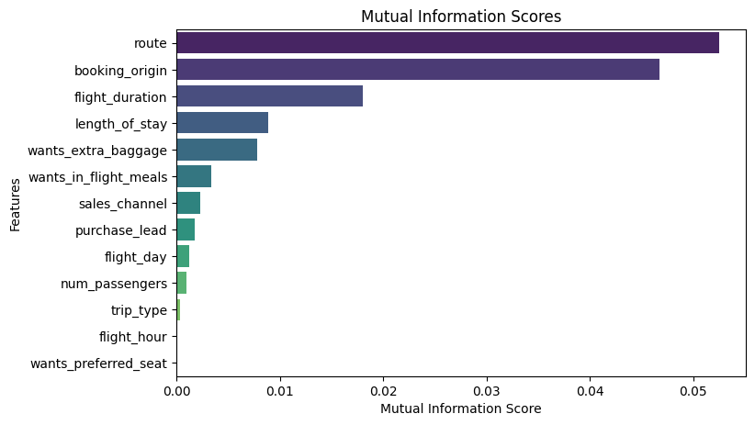
Analysis of Booking Completion Prediction
Top 5 Most Important Features
Based on feature importance analysis, the five most influential variables were:
Route (MI Score: 0.052)
Booking Origin (MI Score: 0.047)
flight_duration (MI Score: 0.018)
length_of_stay (MI Score: 0.008)
Wants_extra_baggage (MI Score 0.007782)=

Slide 3
Performance Metrics
Methods Used
We tested two classification models:
Random Forest Classifier: Accuracy = 85.09%, AUC Score = 0.5578
Logistic Regression: 70.01%, AUC Score = 0.7218
Conclusion & Recommendations
The top features should be prioritized for marketing and pricing strategies.
The improved AUC score in Logistic Regression suggests that this model may be more effective for classification in this dataset

