Slide 1
STAT5003 • ASSIGNMENT 2
From model accuracy
to species coverage
FrogID contextual species ranking under geographic validation
18
242,600
5
target species
complete-case events
model families
Group W11G03 • University of Sydney

Slide 2
PROBLEM & SCOPE
A shortlist, not an acoustic classifier
Inputs
Prediction
Not claimed
Seasonal timing, environmental conditions, elevation and—when using M4—latitude/longitude.
An ordered shortlist of 18 frog species. Correct rank matters, not just the first guess.
No frog-call audio analysis; no population abundance, definitive identification or conservation-grade decisions.
Decision question: which model stays useful when geography and species frequency change?
STAT5003 / W11G03 • Context-based FrogID species ranking
02

Slide 3
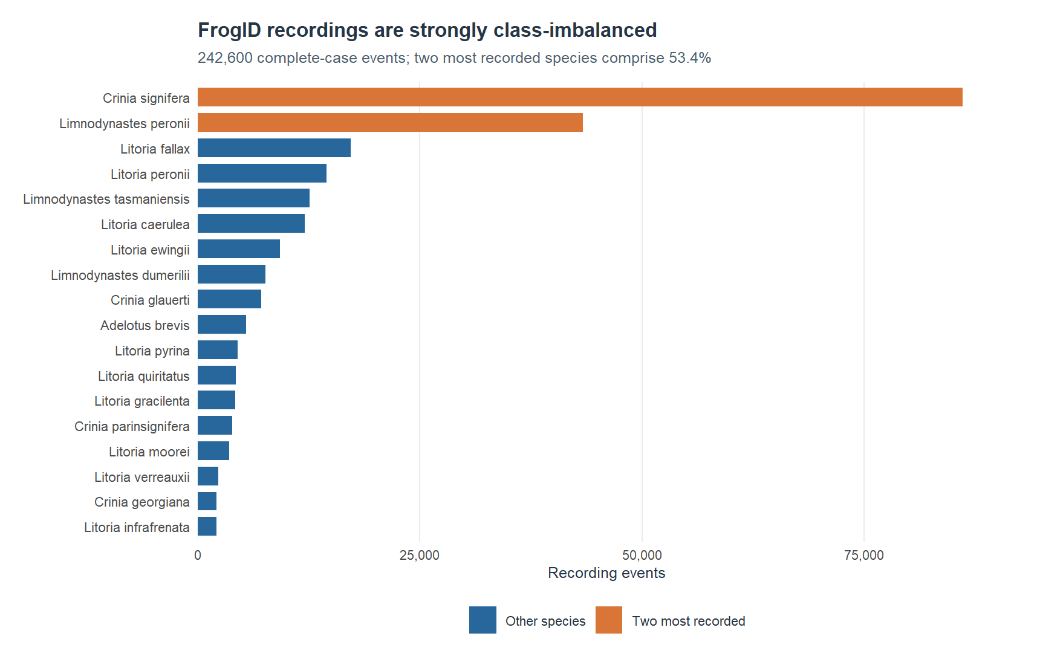
EDA → METRIC CHOICE
Class imbalance can conceal missed species
53.4%
Recordings from the top two species
≈41:1
Largest versus smallest class frequency
Macro-F1 assigns equal weight to all 18 species.
Raw accuracy alone would reward majority-species predictions.
STAT5003 / W11G03 • Context-based FrogID species ranking
03

Slide 4
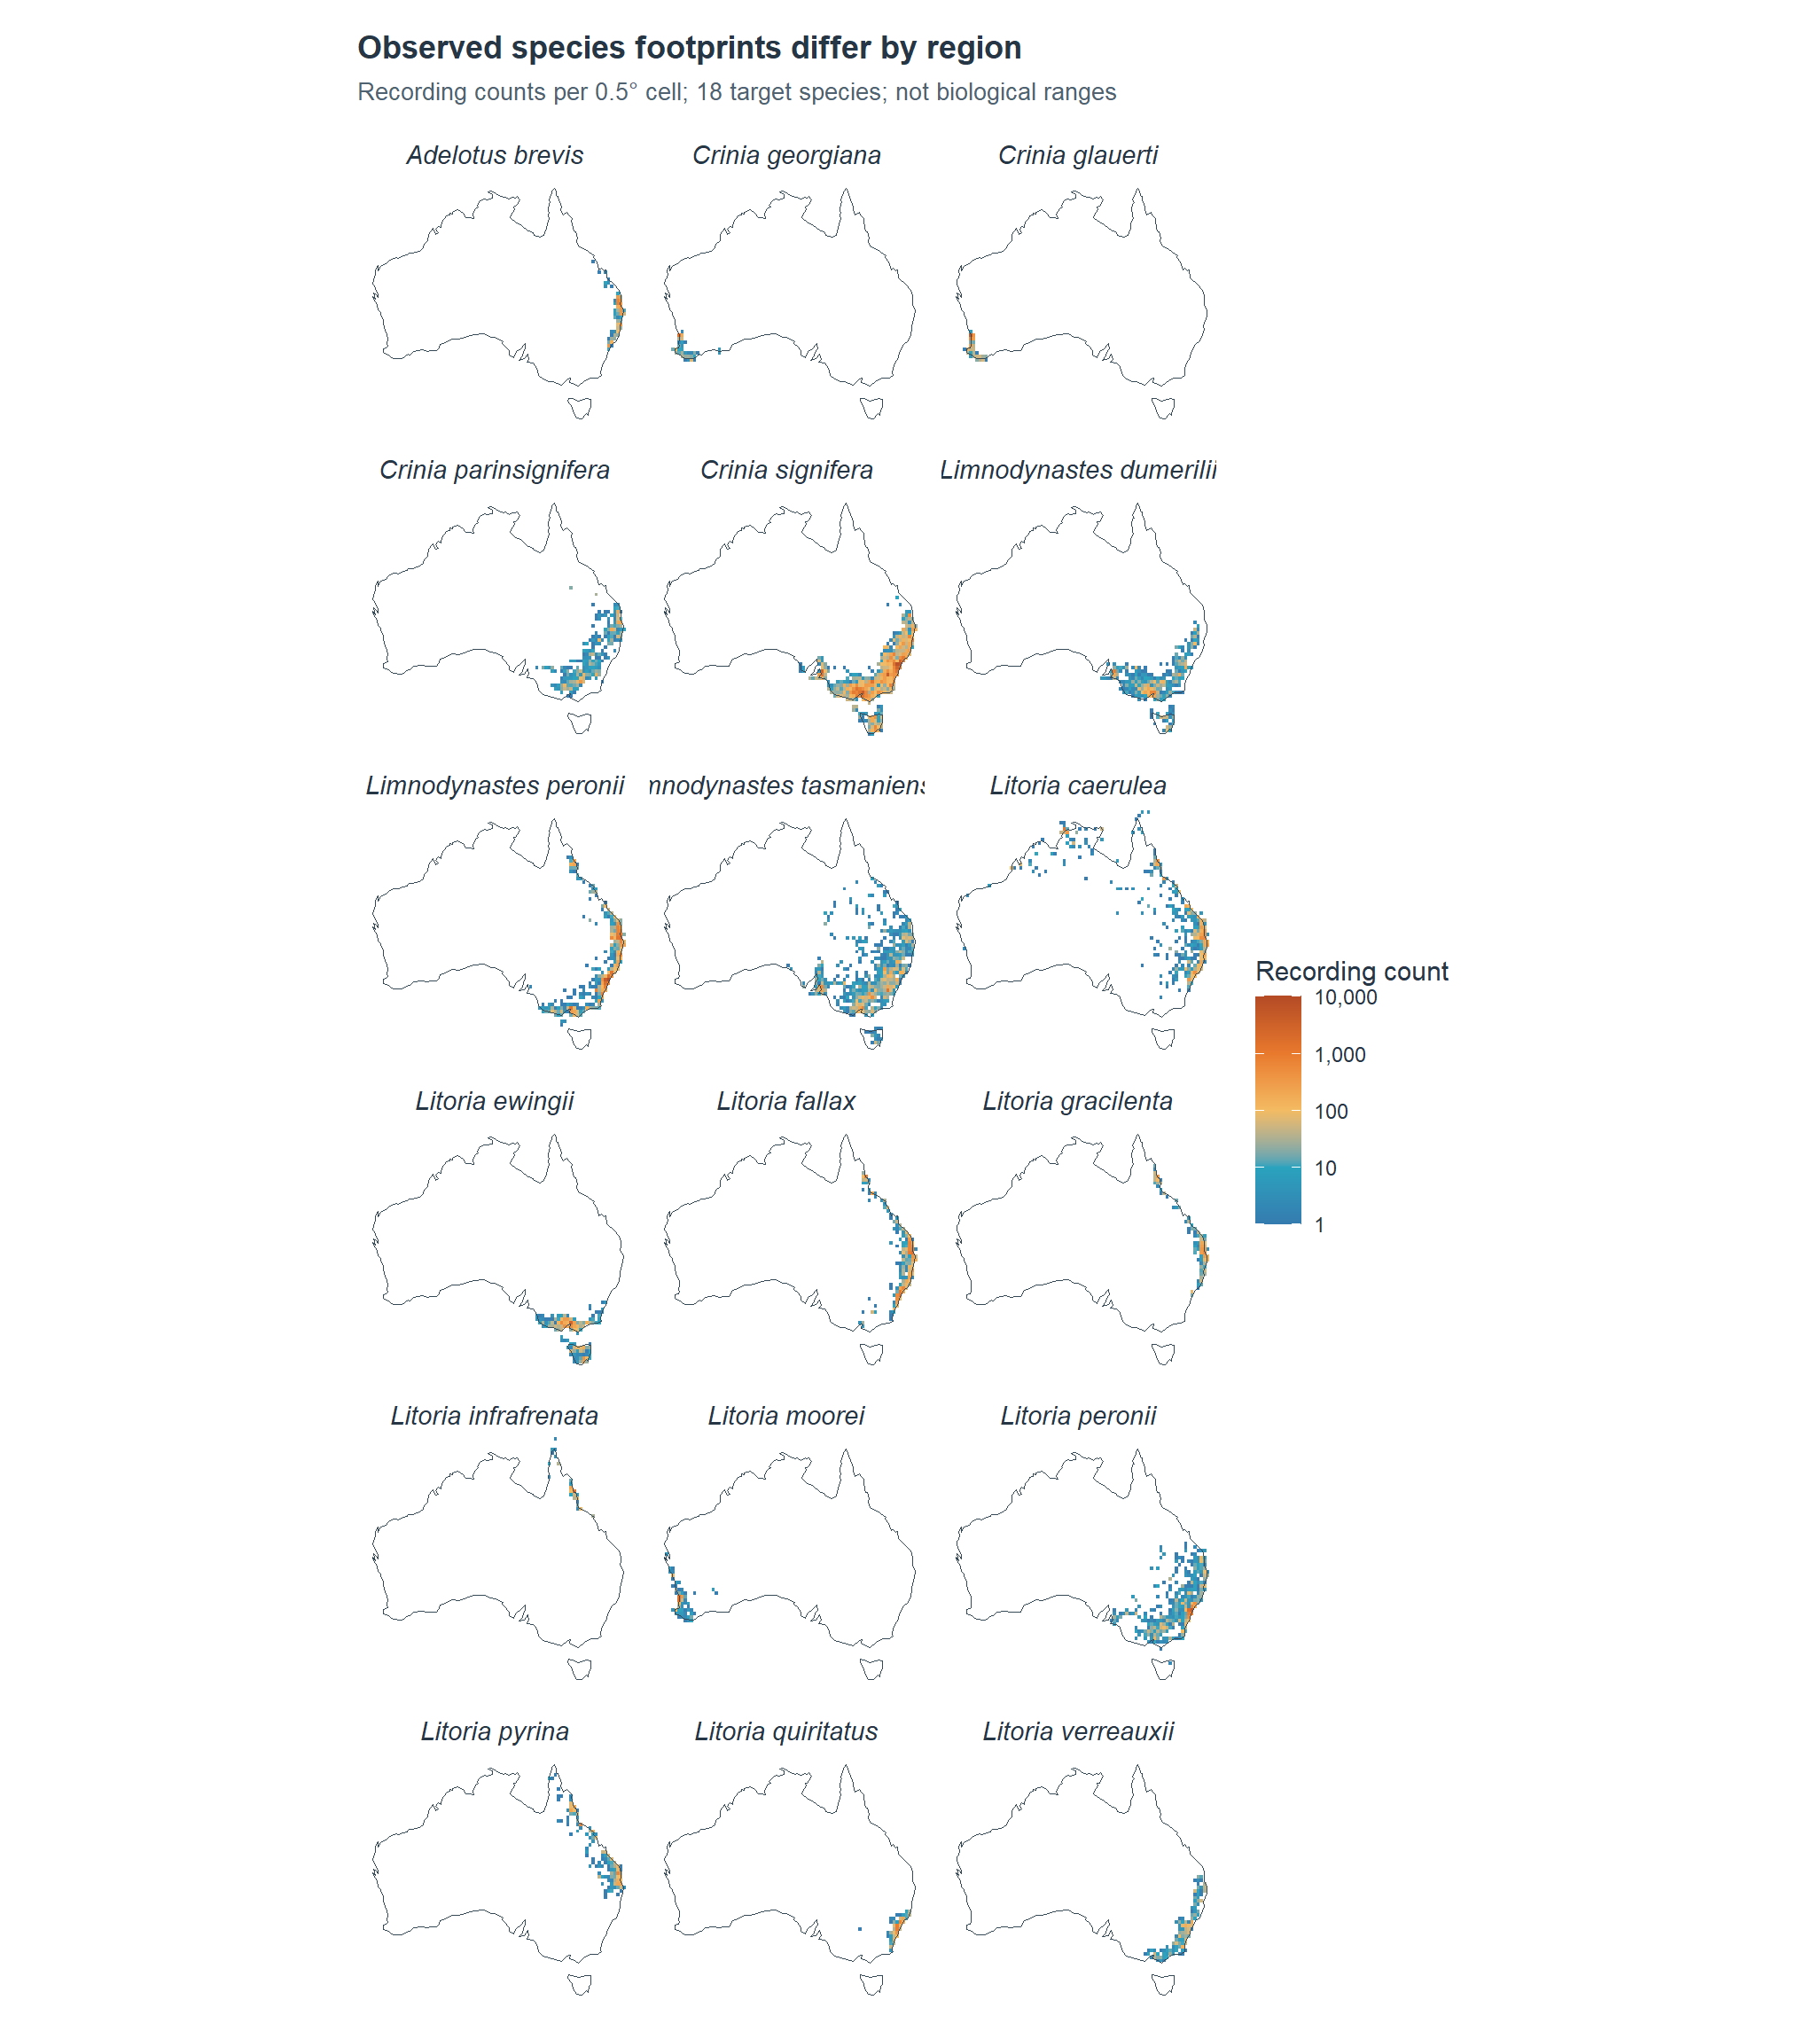
EDA → GEOGRAPHIC EVIDENCE
Recorded species occupy different places
Selected coarse-footprint panels from the complete 18-species figure
Distinct footprints
Observed recording locations vary sharply between species.
Evaluation risk
Random folds can contain nearby locations on both sides of a split.
Interpretation
These are citizen-science recording footprints—not true biological ranges.
STAT5003 / W11G03 • Context-based FrogID species ranking
04

Slide 5
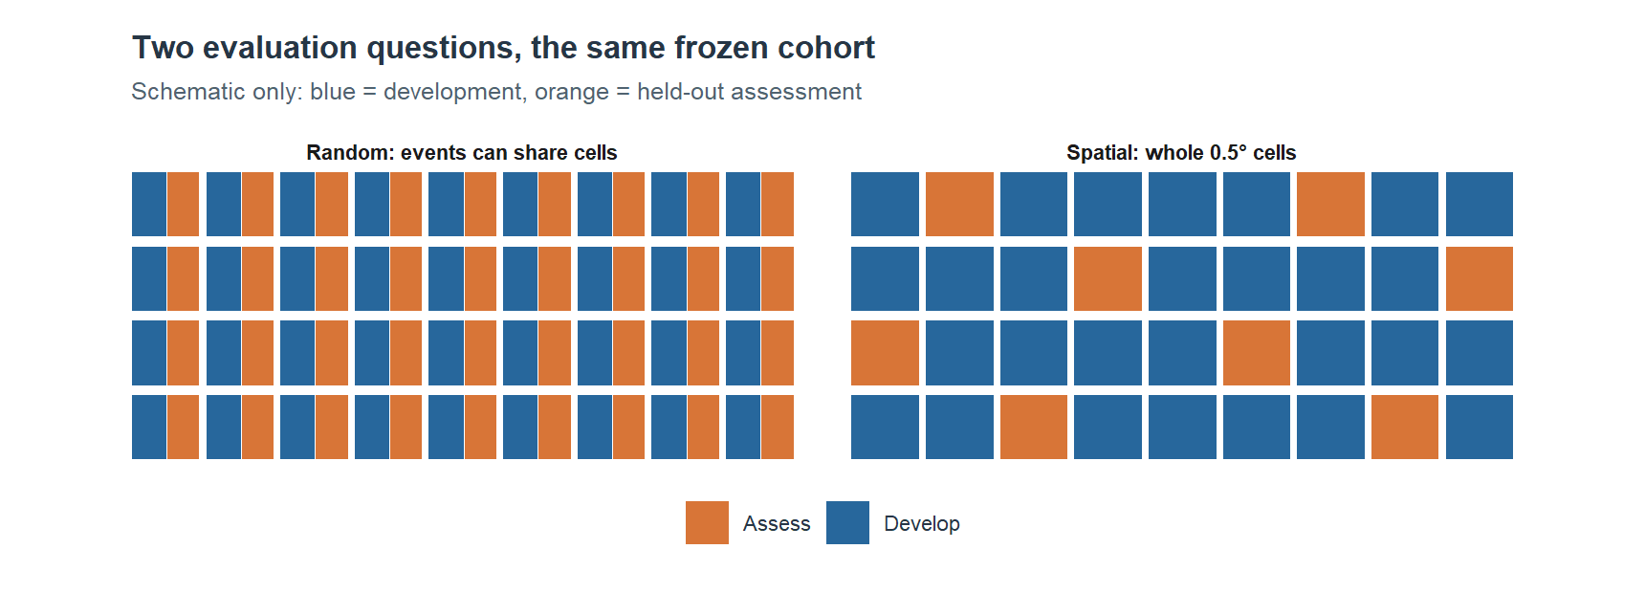
VALIDATION DESIGN
Random and spatial tests answer different questions
Random folds
Spatial folds
Predict recordings from familiar sampled areas.
Hold out entire 0.5° cells; ask about unseen cells.
Three frozen outer folds each; inner fit/tune partition matches the outer splitting regime.
STAT5003 / W11G03 • Context-based FrogID species ranking
05

Slide 6
FEATURE DESIGN
We progressively tested what information matters
M0
0
Species-prevalence baseline
BASELINE
M1
4
Cyclic calendar terms
EARLY SCREEN
M2
25
Season + 19 BIO + monthly normals
EARLY SCREEN
M3
26
M2 + elevation
FULL COMPARISON
M4
28
M3 + latitude / longitude
FULL COMPARISON
Full five-family benchmark compares M3 vs M4: what do explicit coordinates add?
STAT5003 / W11G03 • Context-based FrogID species ranking
06

Slide 7
MODELLING & TUNING
Five model families test different assumptions
MODEL
INDUCTIVE BIAS
TUNED CONTROLS
EDA MOTIVATION
Elastic-net
Linear effects with penalisation
α: 0 / 0.5 / 1; λ: up to 30
Correlated climate predictors
PCA-LDA
Compressed linear boundaries
95% variance PCs; +2 / +4
Covariance stability
PCA-kNN
Local neighbourhood voting
k = 7 / 21 / 51; PCs +0 / +2
Locality vs smoothing
Random Forest
Bootstrap nonlinear ensemble
200 trees; mtry 5/10; nodes 5/20
Robust interactions / sparse classes
XGBoost
Regularised boosting
depth 3/6; η .07/.15; child 2/8
Complexity vs overfitting
Hyperparameters selected only on inner tuning data; final outer-fold assessment remains held out.
STAT5003 / W11G03 • Context-based FrogID species ranking
07

Slide 8
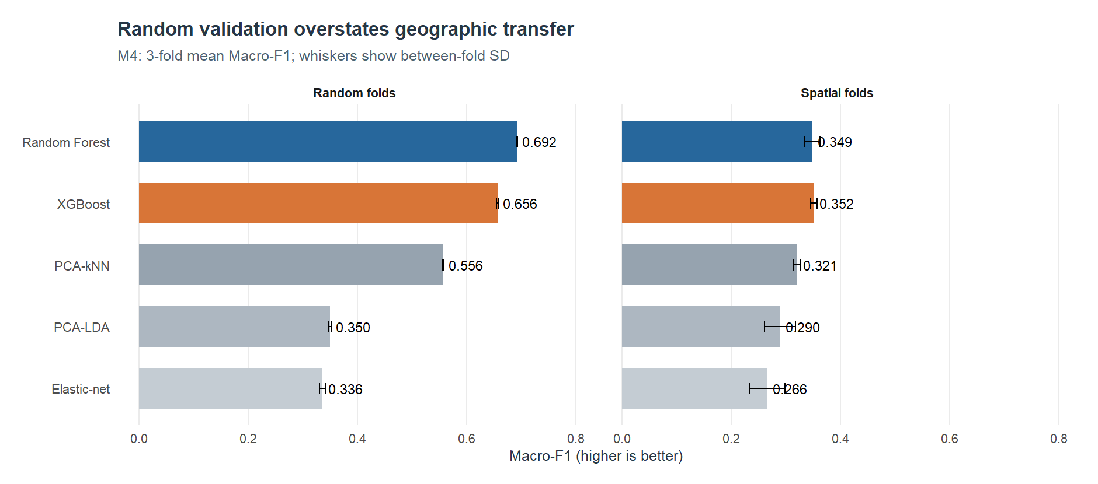
PRIMARY COMPARISON
Random folds are optimistic about geography
RF: 0.692 → 0.349 • XGBoost: 0.656 → 0.352 (random → spatial Macro-F1)
STAT5003 / W11G03 • Context-based FrogID species ranking
08

Slide 9
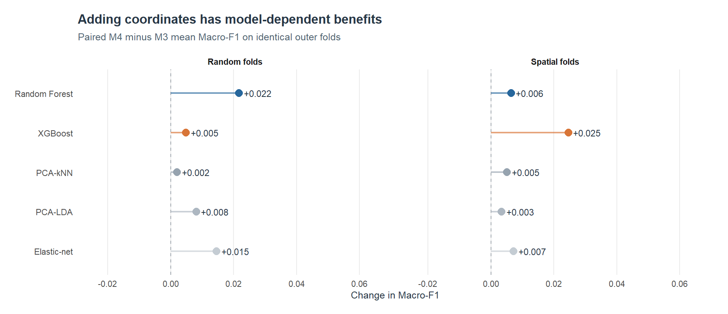
M3 VS M4
Coordinates help, but do not remove geographic shift
Spatial Macro-F1 gain: XGBoost +0.025; Random Forest +0.006.
STAT5003 / W11G03 • Context-based FrogID species ranking
09

Slide 10
MODEL SELECTION
A 0.003-point lead is not the whole decision
M4 spatial assessment
SPATIAL MACRO-F1
TOP-1 ACCURACY
TOP-3 ACCURACY
XGB
0.352
XGB
53.3%
XGB
85.8%
0.349
52.5%
85.5%
RF
RF
RF
We therefore inspected which species each model struggled to recover.
STAT5003 / W11G03 • Context-based FrogID species ranking
10

Slide 11
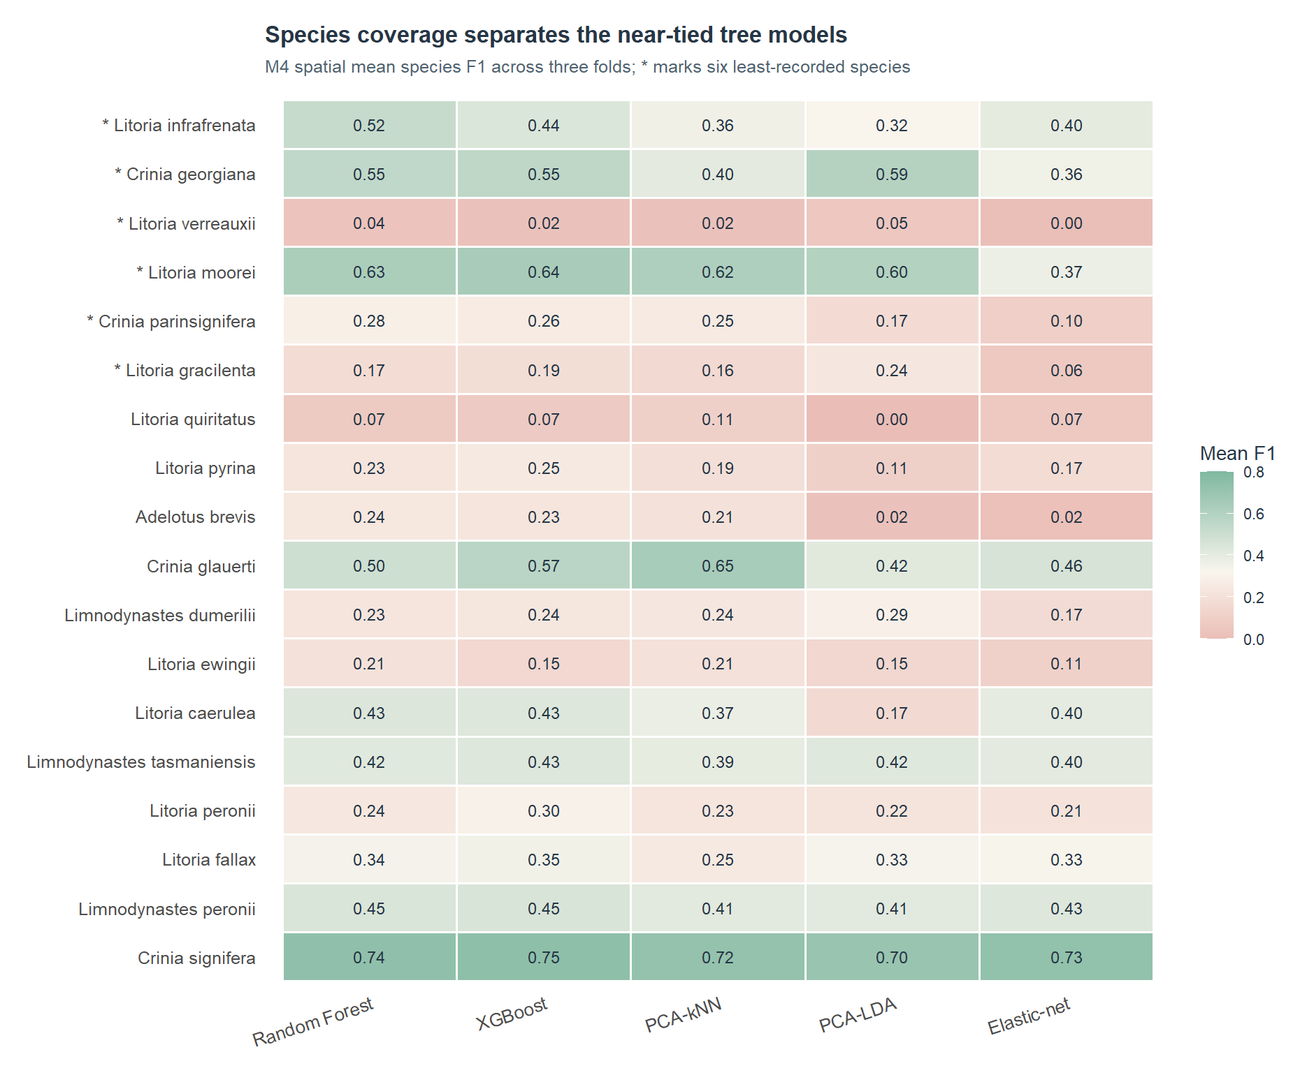
SPECIES-EQUITY AUDIT
Random Forest better covers less-recorded species
0.401
0.365
RF rare-six mean recall
XGB rare-six mean recall
0.775
0.740
RF rare-six Top-3 recall
XGB rare-six Top-3 recall
RF improves the coverage floor, but neither model is reliable for every class.
STAT5003 / W11G03 • Context-based FrogID species ranking
11

Slide 12
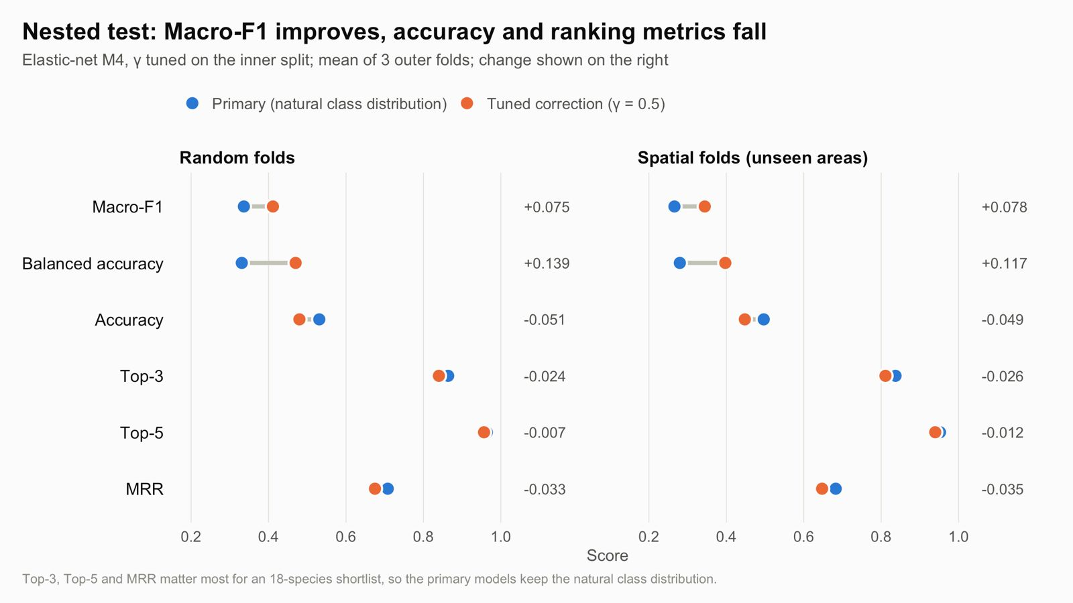
IMBALANCE SENSITIVITY
Improving Macro-F1 is not a free ranking gain
Nested elastic-net prevalence correction; not oversampling or SMOTE
Spatial: Macro-F1 +0.078 • Top-3 −0.026 • MRR −0.035
STAT5003 / W11G03 • Context-based FrogID species ranking
12

Slide 13
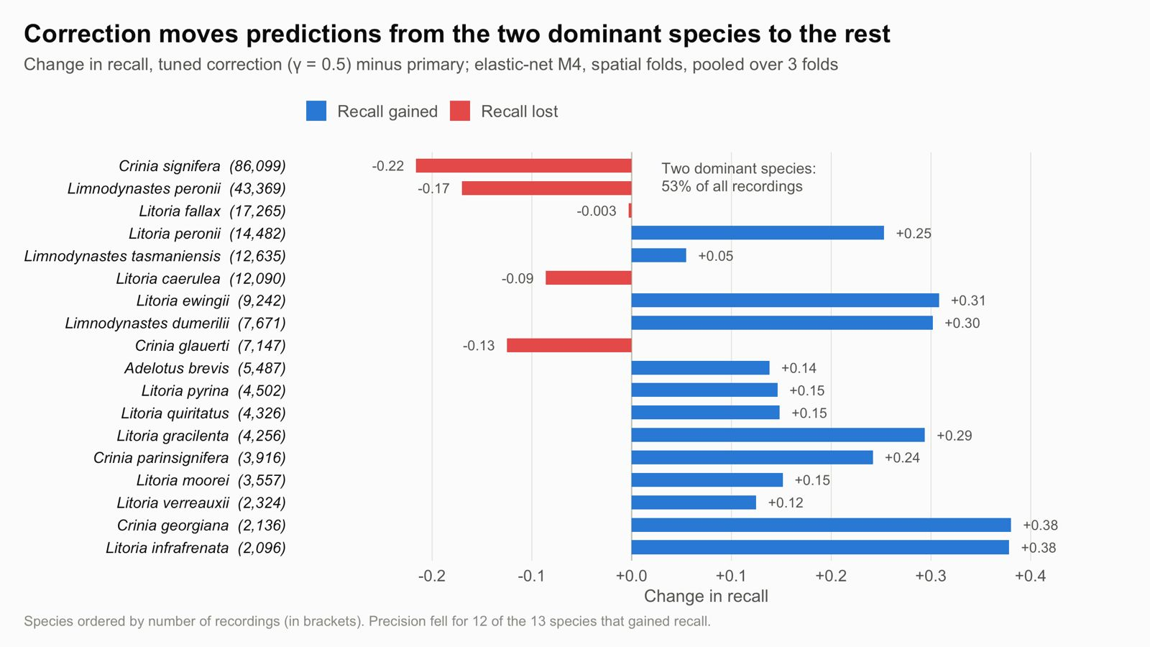
WHY THE AUDIT MATTERED
The trade-off shifts recall across species
Evidence from this sensitivity test motivated a later species-level model-selection audit.
STAT5003 / W11G03 • Context-based FrogID species ranking
13

Slide 14
DECISION & LIMITATIONS
Final recommendation: Random Forest M4
Random Forest
Critical limits
Spatial folds do not isolate neighbouring cells. Sparse classes remain weak. The inputs are context—not audio—and cannot justify autonomous conservation decisions.
Selected for stronger uncommon-species coverage in a near-tie.
Strength
Trade-off
More balanced recovery of the least-recorded species.
XGBoost narrowly leads average spatial Macro-F1.
Takeaway: evaluate geographic transfer and species-level errors before choosing a model.
STAT5003 / W11G03 • Context-based FrogID species ranking
14

