Slide 1
RESEARCH AND INNOVATION: HOW RESEARCH OUTCOMES REACH FARMERS AND MARKET PLACE
Presentation at the International Conference & Expo on Research Innovations in Agriculture; at the Nigerian Institute of International Affairs, Victoria Island, Lagos, on October 24, 2019.
By
Prof. Lucia Omobolanle OGUNSUMI
Institute of Agricultural Research Training, Obafemi Awolowo University, Ibadan, Nigeria
+2348037173993; lucyogunsumi2011@gmail.com; loogunsumi@iart.gov.ng
www.loogunsumi.agr.ng

Slide 2
Contents of Discussion
Brief introduction and objectives of the paper
Extension New Approaches
Paradigms of agricultural extension
Agricultural Extension Planning Process
Research Outcomes: On-Station /Farm Trials
Research- Extension Farmers Linkage
Conclusion

Slide 3
Introduction
Agriculture is a diverse, dynamic and vital land use in agreement with nature that provides countless economic and environmental benefits to a community
Agricultural extension is the application of scientific research and new knowledge to agricultural practices through farmer education
The field of 'extension' now encompasses a wider range of communication and learning activities organized for rural people by educators from different disciplines, including agriculture, agricultural marketing, health, and business studies

Slide 4
It is a significant social innovation, an important force in agricultural change, which has been created and recreated, adapted and developed over the centuries
Its evolution extends over nearly four thousand years, although its modem forms are largely a product of the past two centuries

Slide 5
Conference objectives
To attract government attention and funding for Agriculture Research Institutes.
To commercialize research findings and innovations in Agriculture.
To showcase and identify innovations in optimizing Agriculture for sustainable development while attracting investors.
To facilitate opportunities for networking and collaboration with renowned leaders in the industry.

Slide 6
Paper’s Objective
This paper aims to open up several ways through which the different outcomes of scientific research reach farmers and the market place.

Slide 7
Extension New Approaches
Recent advances have given opportunity for improvements in the way farmers grow, store, transport, distribute, and consume food
These advances can reach farmers through several means
To train and impart skill to Farmers/others for value chain development and sustainability in agro-industry

Slide 8
How?
Establishment of agro enterprises
partnership between farmers and researchers
This is because, agricultural knowledge and research are essential
Farmers are at the centre of the innovation processes
These need to be incorporated in order to achieve the goal of reaching and impacting the desired beneficiaries

Slide 9
How?
The use of information technology. Extension workers have used ICT tools like mobile phones, radio, television and also internet to expand their reach to rural farmers
These tools have been harnesses to communicate vital information to farmer
Extension officers have also helped to accelerate technology transfer

Slide 10
How?
Extension officers help to facilitate the adoption of technologies and their adaptation to local conditions
They also serve as bridges between the researchers developing research systems and the famers who may not be able to articulate their problems or constraints
The Training and Visit model of extension was a means to reach farmers promoted by the World Bank

Slide 11
How?
It entails having a single line of command, with several levels of field and supervisory staff; in-house technical expertise, whereby subject matter specialists are to provide training to staff and tackle technical issues reported by field staff
Farmer Field School Model
Through group interactions, attendees sharpen their decision making abilities and are empowered by learning leadership, communication and management skill

Slide 12
Summary of Approaches
Diverse top-down extension: After independence, commodity-based extension services emerged from the remnants of the colonial system, with production targets established as part of five-year development plans. In addition, various schemes were initiated to meet the needs of small farmers, with support from foreign donors
Unified top-down extension: During the 1970s and 1980s, the Training and Visit system (T&V) was introduced by the World Bank. Existing organizations were merged into a single national service. Regular messages were delivered to groups of farmers, promoting the adoption of "Green Revolution" technologies

Slide 13
Summary of Approaches
Diverse bottom-up extension: When World Bank funding came to an end, the T&V system collapsed in many countries, leaving behind a patchwork of programs and projects funded from various other sources. The decline of central planning, combined with a growing concern for sustainability and equity, has resulted in participatory methods gradually replacing top-down approaches

Slide 14
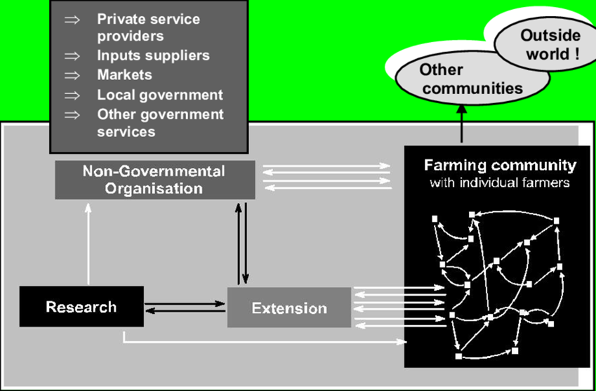
Fig. 1: Research Extension –Research Outcomes Actors

Slide 16
Paradigms of Agricultural Extension
Technology transfer (persuasive + paternalistic): This paradigm was prevalent in colonial times and reappeared in the 1970s and 1980s when the "Training and Visit" system was established across Asia
Technology transfer involves a top-down approach that delivers specific recommendations to farmers about the practices they should adopt.
Advisory work (persuasive + participatory): This paradigm can be seen today where government organizations or private consulting companies respond to farmers' inquiries with technical prescriptions
It also takes the form of projects managed by donor agencies and NGOs that use participatory approaches to promote predetermined packages of technology.

Slide 17
Paradigms of Agricultural Extension
Human resource development (educational + paternalistic): This paradigm dominated the earliest days of extension in Europe and North America, when universities gave training to rural people who were too poor to attend full-time courses
It continues today in the outreach activities of colleges around the world.
Top-down teaching methods are employed, but students are expected to make their own decisions about how to use the knowledge they acquire.
Facilitation for empowerment (educational + participatory): This paradigm involves methods such as experiential learning and farmer-to-farmer exchanges
Knowledge is gained through interactive processes and the participants are encouraged to make their own decisions.
The best known examples in Asia are projects that use Farmer Field Schools (FFS) or participatory technology development

Slide 18
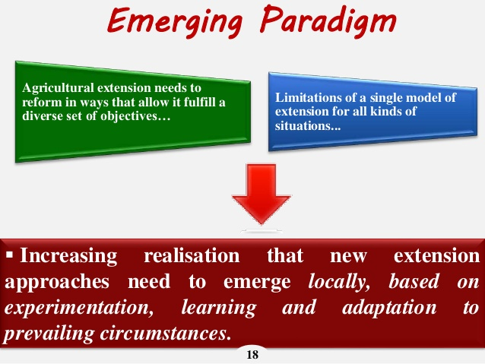
Emerging Paradigm

Slide 19
Agricultural Extension Planning Process
Fig. 5: Programme Planning Process Model (Adapted from Ani, 2007)

Slide 20
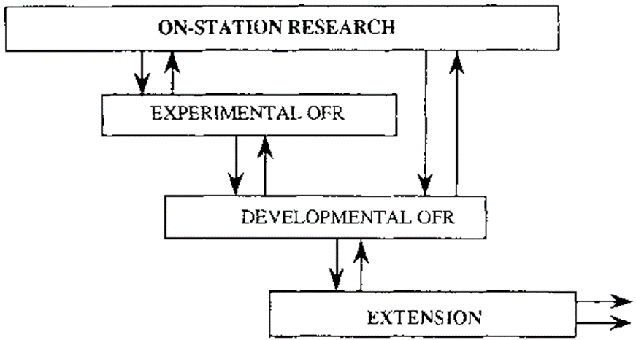
On- Station Trials

Slide 21
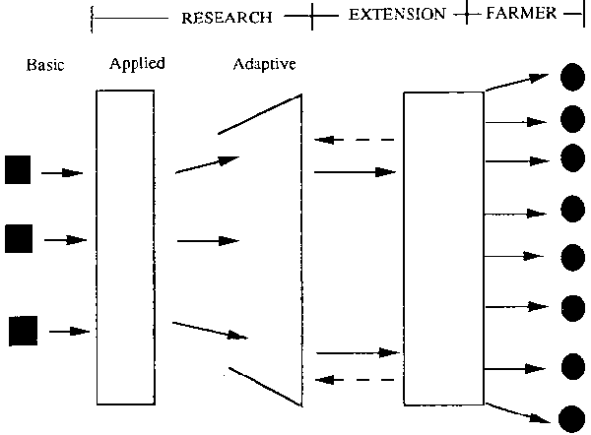
On- Farm Trials

Slide 22
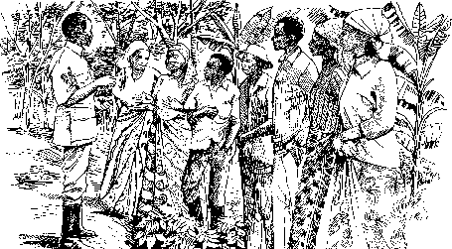
The involvement of extension agencies is essential during on-farm trials: Adapted from Atta-krah, 1987

Slide 23
Conclusion
However, if the farmer had a rationale for the modification, the researcher should look at the new system carefully, and discuss with the farmer the possible harms and benefits
The farmer may be modifying the system to better achieve his/her own objectives, while not harming crop productivity or long-term sustainability
Through this sort of interaction, researchable issues can emerge and suggest new directions for on-station and/or on-farm trial

Slide 24
Many Thanks for Listening

