Slide 1
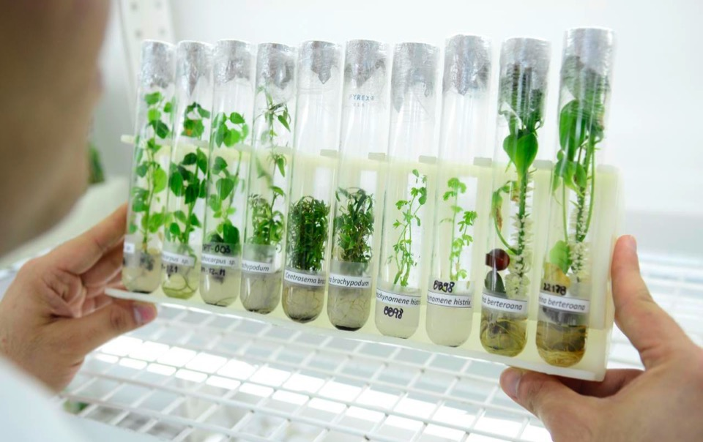
Breakthroughs & Innovations
in Agricultural Research
The IITA Model

Slide 2
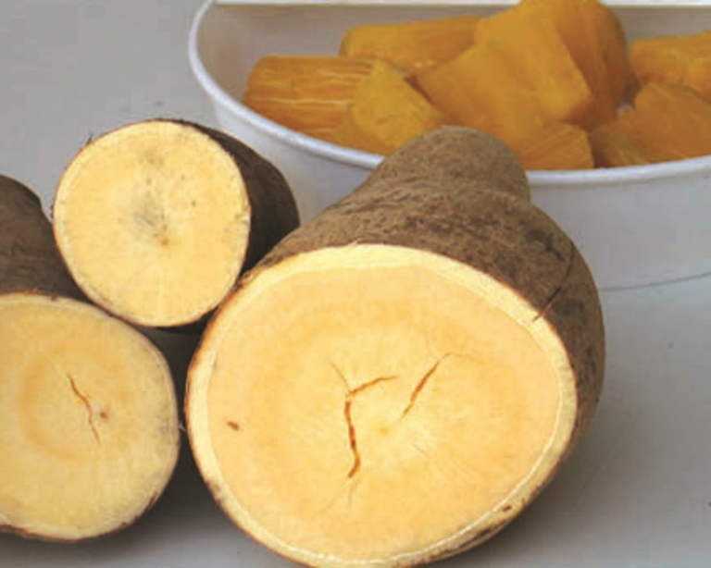
Who we are
We are a non-profit institution that generates agricultural innovations to meet Africa’s most pressing challenges of hunger, malnutrition, poverty, and natural resource degradation.
We work with various partners across sub-Saharan Africa, to improve livelihoods, enhance food and nutrition security, increase employment, and preserve natural resource integrity.
We are a member of CGIAR, a global agriculture research partnership for a food secure future.

Slide 3
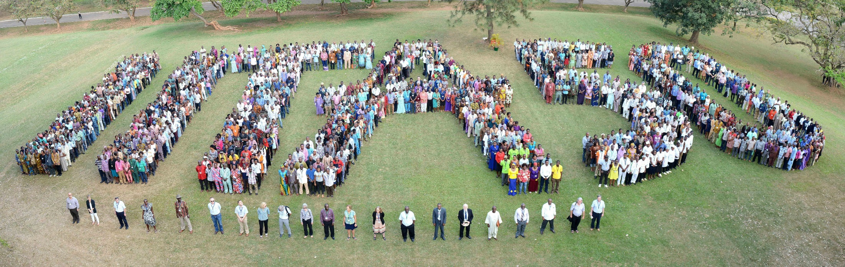
Goals
IITA aims to:
Increase food security
Reduce rural poverty
Reduce the prevalence of undernutrition
Introduce sustainable natural resource management

Slide 4
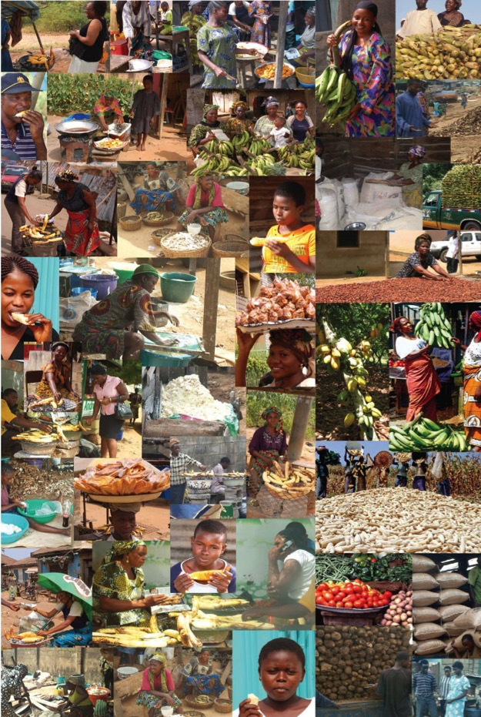
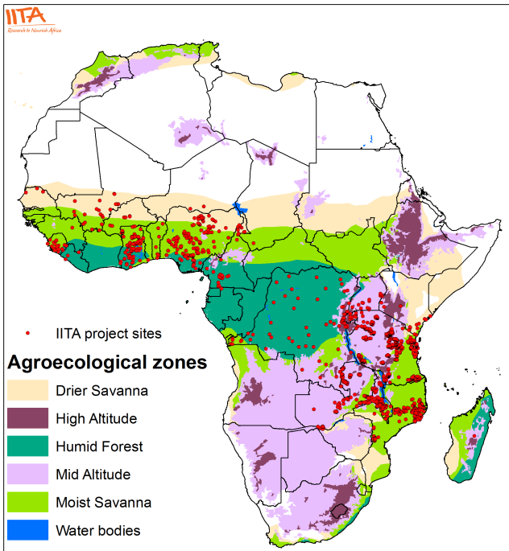
What we do
We work with public and private sector partners to Transform African Agriculture
IITA project sites

Slide 5
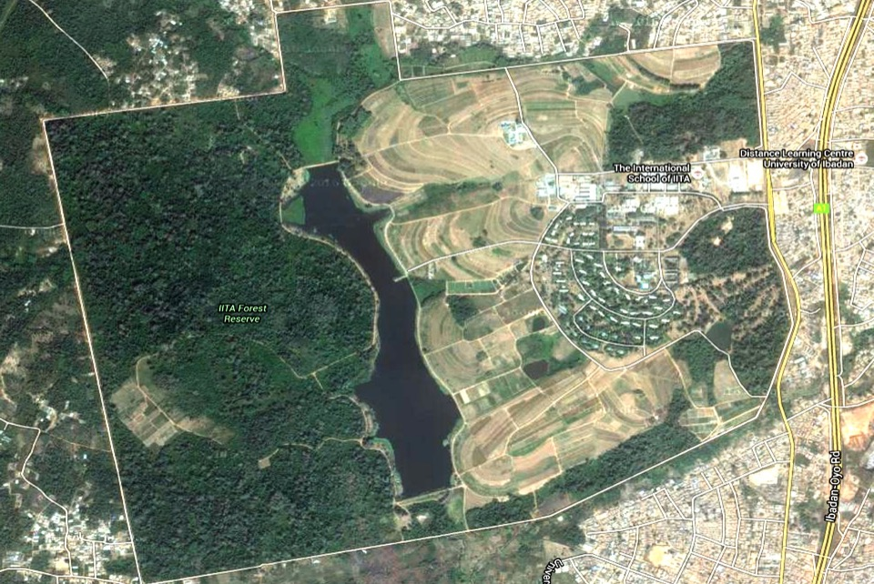
IITA Campus, Ibadan

Slide 6
Research
Product
Commercialization

Slide 7
We research, discover problems,
and build solutions
Genetics/
New varieties
Products
Service & Technologies
Products can be classified as tangible. You can touch them and commercialize as a unit. For example, Aflsasafe and Nodumax
IITA GoSeed handles commercialization of the improved varieties developed. This is to ensure that the best varieties get to farmers.
Varieties developed via IITA and other CGIAR centers or sources of genetics which will bring the farmer a benefit.
We have worked on developing improved varieties of crops such as maize, cassava, soybean, yam, cowpea, and banana.
Consultancy which uses Services, Technologies, and products developed by IITA.
Examples are
Soil analysis
Land classification
Bus. Plans for different crops and processing plants
Outgrower schemes

Slide 8
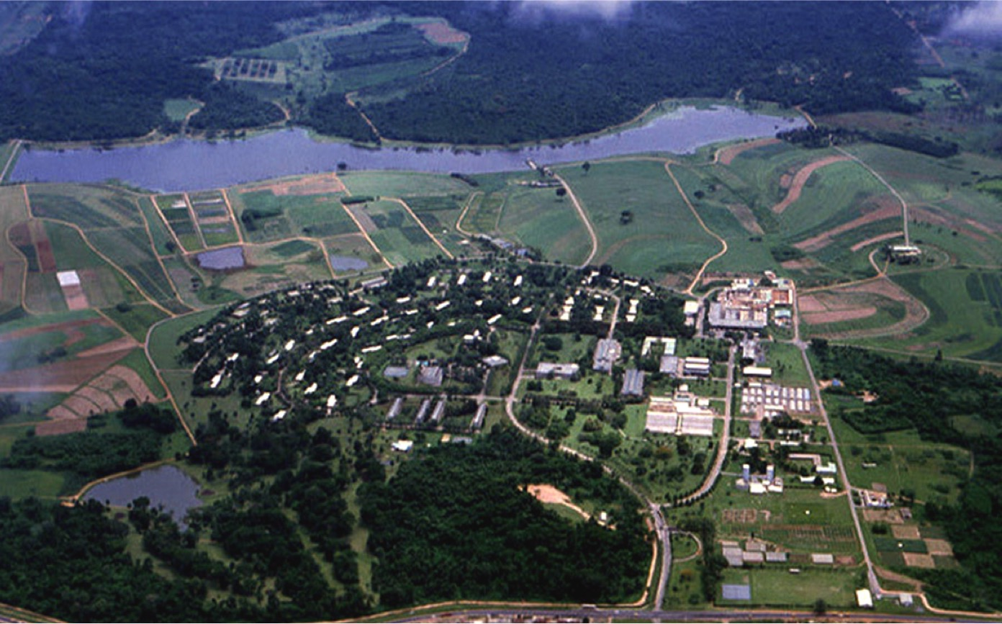
Business Incubation Platform
Bridge between research and dissemination
https://iitabip.org/

Slide 9
BIP Goals
  Disseminate new validated technologies which benefit the farmer. Bring those technologies into the market through a sustainable value chain model via Technology Transfer Agreements, JV’s or Business Development support
  Work through multistakeholder partnerships, Government, Private sector, local sub (Saharan) consultants, national institutions, NGOs, IITA and other CGIAR centers

Slide 10
BIP Goals
  Create jobs with decent work conditions and income (focus on youth & women)
    Professional education (theoretical and practical)
    Youth outgrower schemes with the latest validated technologies
      Seeds and Good Agricultural Practices
      Mechanization
      Precision agriculture & digital support
    Aggregation via outgrowers and guaranteed uptake by processor.
      Aggregation via youth outgrowers (no middleman involvement)
      Guaranteed uptake and price
  Generate income to make the
  Business Incubation Platform sustainable
Fund research & incubation

Slide 11
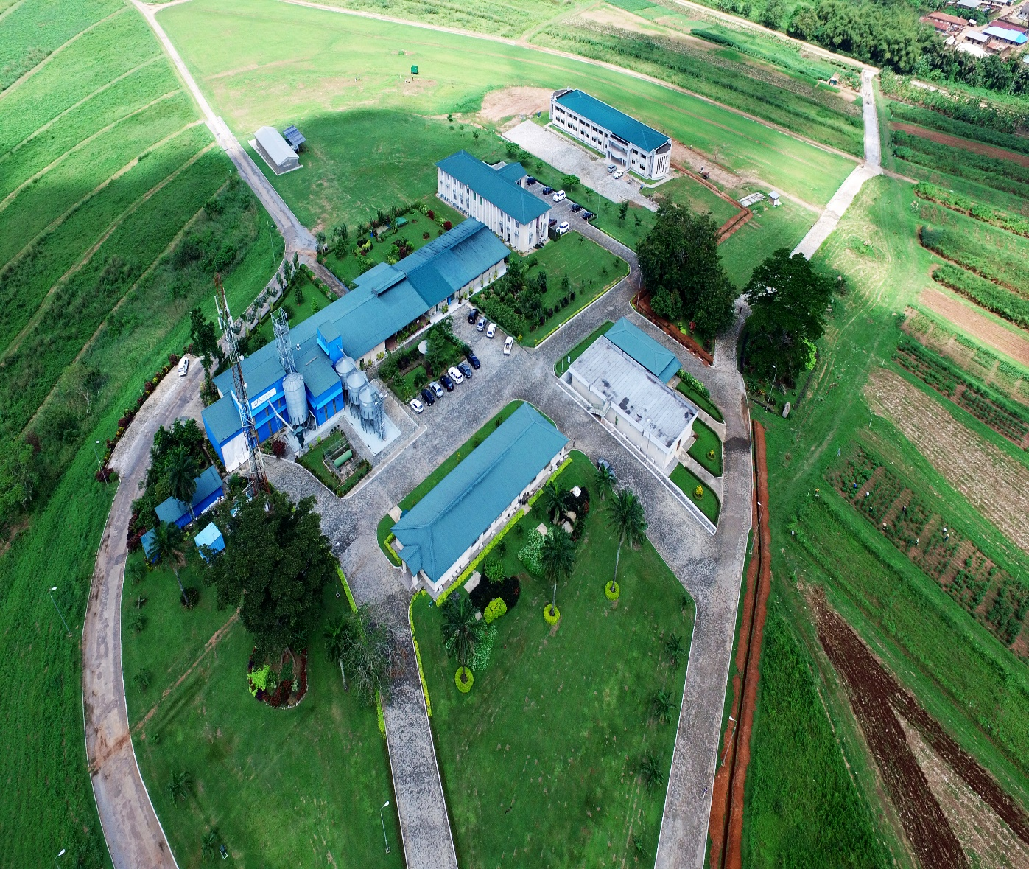
BIP overview
Frederick
Schreurs
CEO IITA BIP

Slide 12

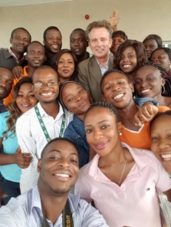
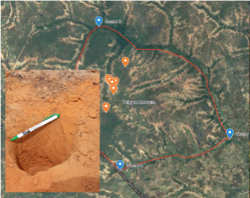
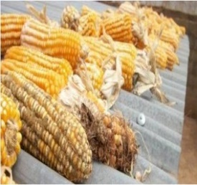
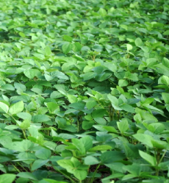
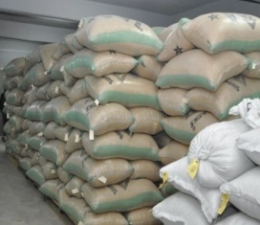
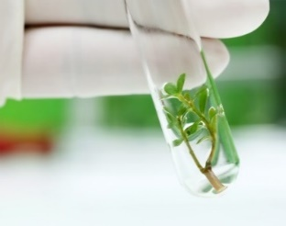
Products & Services Developed from our research
Funding Investors
New Products &Technologies IITA
BIP
Agriserve
NoduMax
GoSeeds
Tissue culture
Aflasafe
Soil fertility & Consultancy
Youth production projects
Out- grower & consultant project

Slide 13

Launching
First e-Commerce Platform
for Breeder & Foundation Seeds in Nigeria

Slide 14

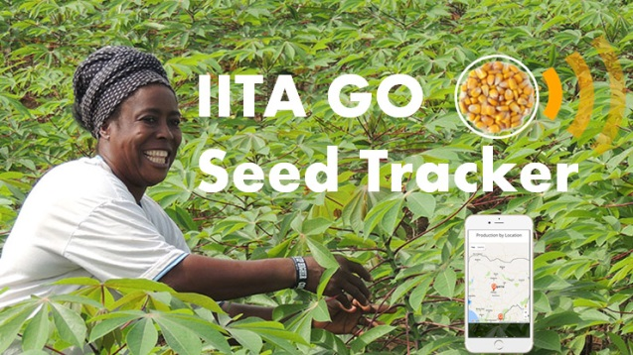
GoSeed Inventory &
Seed Data Management System
Inventory management
Seed tracking (M&E)
Seed trade
Decision support
https://iitabip.org/GoSeedTracker
Based on Seed TrackerTM Web Application
Hosted on IITA-GoSeed website
In-house tool for planning, real time tracking of field status and seed inventory management
Online trade enquiry (map-based seed and trade information)
Data archival & other tailored features

Slide 15
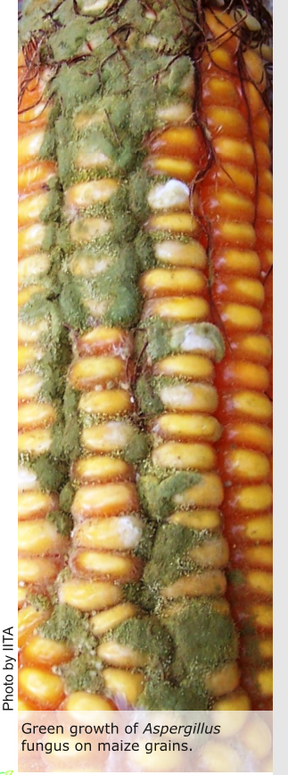
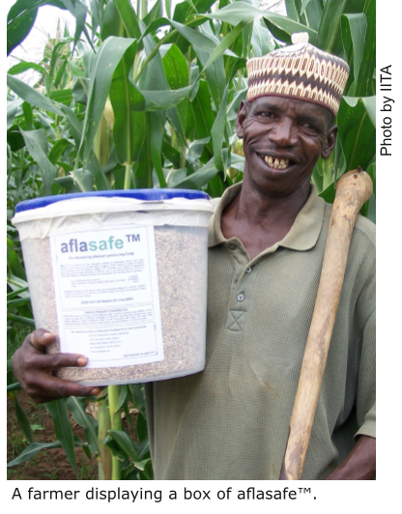
Aflasafe to Combat Aflatoxin in Maize

Slide 16
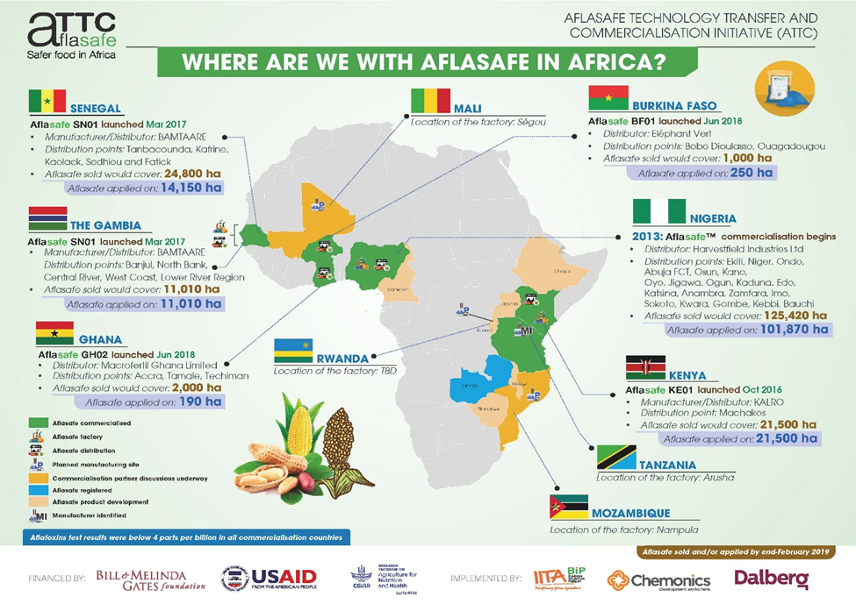
Aflasafe to Combat Aflatoxin in Maize

Slide 17

Nodumax
Helps soybean crops to better access Nitrogen
An inoculant that boosts the yield of soybean by 30-40%

Slide 18
AgriServe Business – From providing technical expertise to support investment decisions, technical backstopping of farming operations to management of mechanized farm and youth outgrower schemes
AgriServe
Conduct feasibility study, competitiveness of greenfield projects, farm & business plan
Providing technical advice to support strategic investment decisions, establishing and improving backward linkages
Design outgrower scheme,
organize producers network, increase production - restore productivity
Involve agripreneurs to earn $5,000 - $12,000 annually
AgriServe

Slide 19
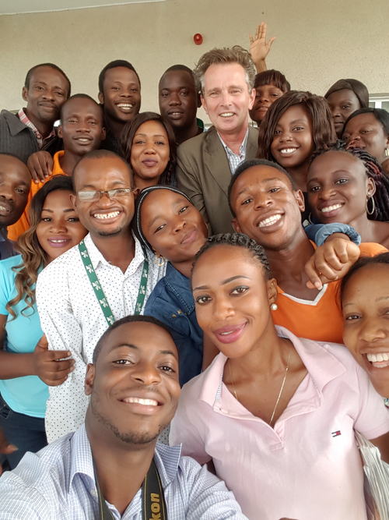
Contact us
For partnerships and cooperation,
contact BIP CEO
Frederick Schreurs
f.schreurs@cgiar.org

