Slide 1
Introduction to Machine Learning Classifiers Using Phishing Website Detection Project

Slide 2
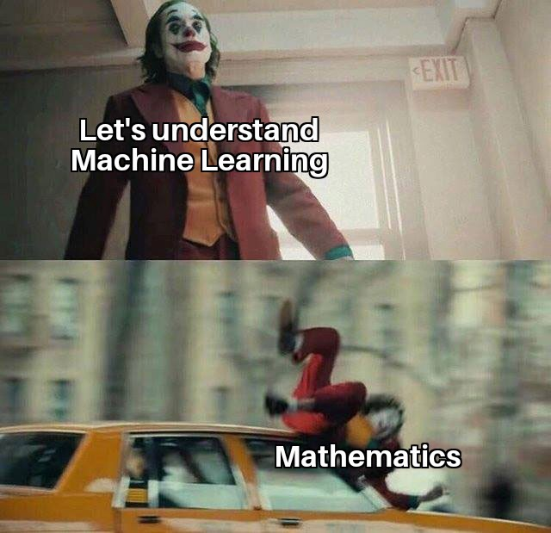
Introduction
This is what machine learning feels like to a lot of beginners and not having rich background in mathematics discourages them to get into machine learning.
In this session I will try to remove this block that prohibits a lot of people from entering the field, we will learn how a particular classifier basically works and then directly apply it into a dataset.
Because I believe that the best way to learn is to do.

Slide 3
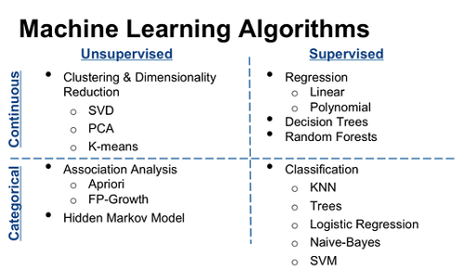

Slide 4

Logistic Regression
Basic Equation for Logistic Regression:
In layman's terms Logistic Regression takes data as n-Dimensional input (x1,x2…xn) and applies weights to it (β1, β2…. βn) while also adding the bias term (β0), giving us a linear relation between inputs and the required label.
This linear equation is then passed through an activation function (here we consider sigmoid function), which then returns a value between 0 and 1.
We then proceed to set a cut-off point, say 0.5, this means that any values obtained from the sigmoid function larger 0.5 are classified into the 1 class, and values less than 0.5 are classified to the 0 class.

Slide 5
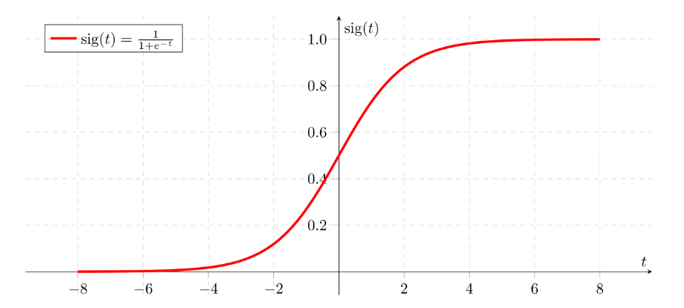
Sigmoid function

Slide 6
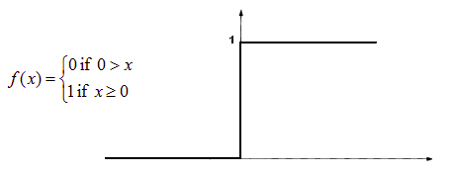
Binary Step Function
Another activation function available to us is the binary step function, generally Sigmoid function is preferred over Binary Step function.
Note: There are many other activation functions including ReLU, Leaky Relu,Hyperbolic Tangent, etc. and it completely depends on your data and what you’re predicting to choose between them.

Slide 7
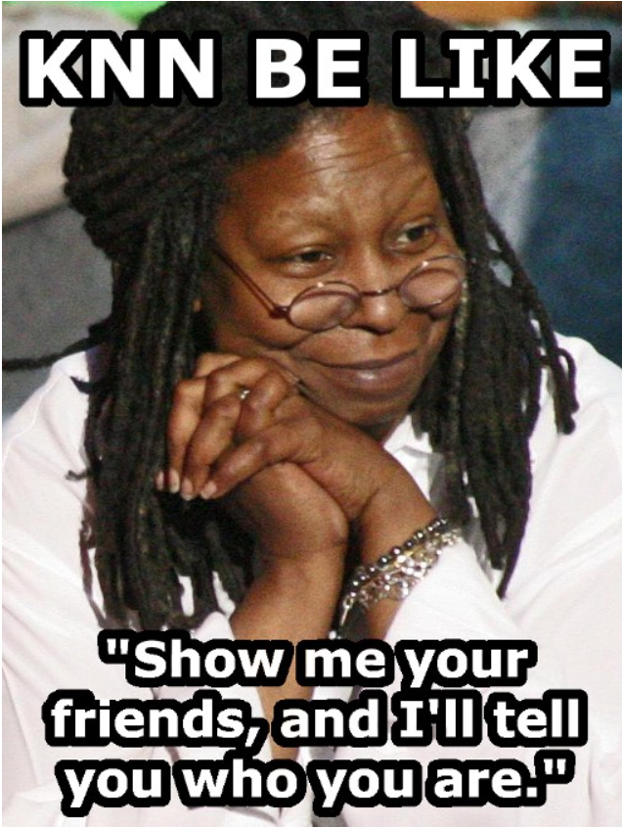
K-Nearest Neighbours(KNN)
This is the lamest and easiest explanation of K-Nearest Neighbours I could find on the internet.

Slide 8
KNN Continued…
The most important parameter that a KNN model expects from you is n_neighbours(suppose n_neighbours=5), then for the point to be classified it finds Euclidian distance to every other point in training set.
From these is selects the 5 nearest neighbours and then weighs which class is majority and then classifies the test point into majority class.

Slide 9
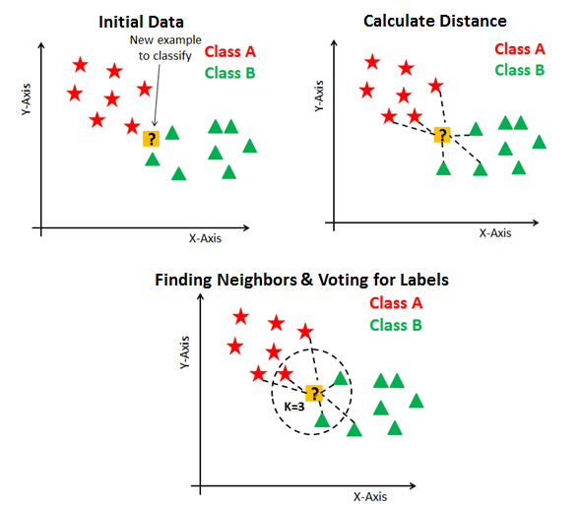
Diagrammatic representation of steps followed by KNN

Slide 10
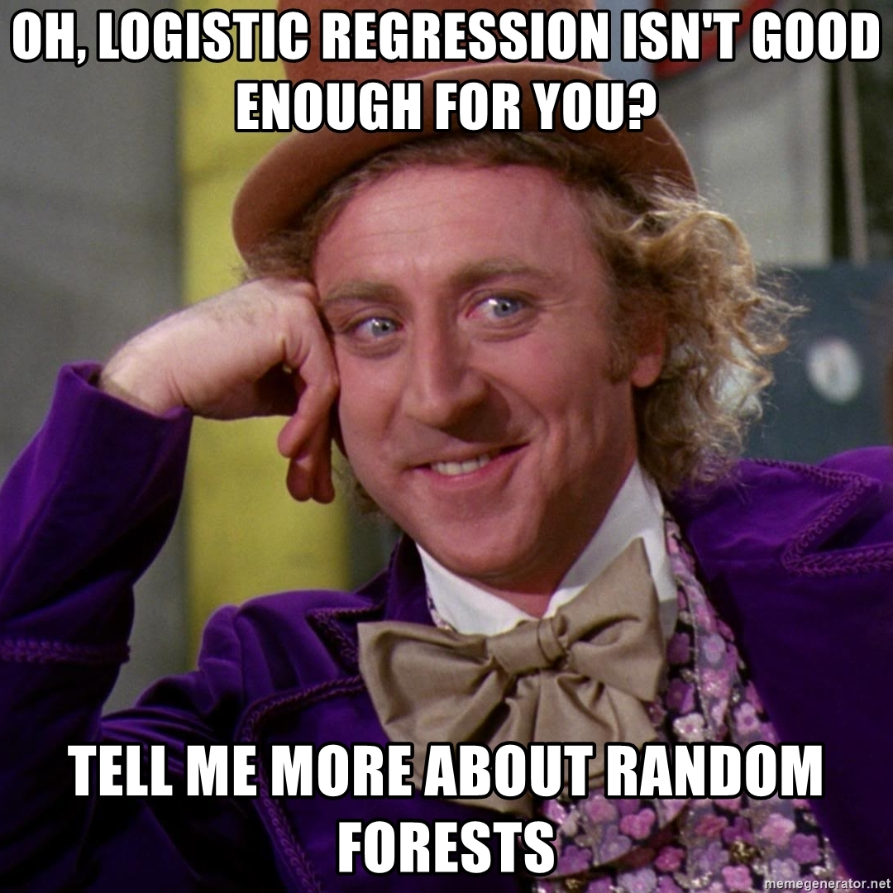

Slide 11
Decision tree
A decision tree is a flowchart-like structure in which each internal node represents a “test” on an attribute (e.g. whether a coin flip comes up heads or tails), each branch represents the outcome of the test, and each leaf node represents a class label (decision taken after computing all attributes). The paths from root to leaf represent classification rules.
Tree based learning algorithms are considered to be one of the best and mostly used supervised learning methods. Tree based methods empower predictive models with high accuracy, stability and ease of interpretation. Unlike linear models, they map non-linear relationships quite well. They are adaptable at solving any kind of problem at hand.

Slide 12
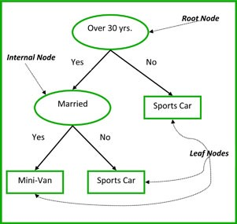
For example lets consider a basic tree which predicts whether a person has a minivan or a sports car.

Slide 13
Random forest classifier
Data science provides a plethora of classification algorithms such as logistic regression, support vector machine, naive Bayes classifier, and decision trees. But near the top of the classifier hierarchy is the random forest classifier.
Random forests are bagged decision tree models that split on a subset of features on each split.
What this basically means is that decision trees are taken and the principles of bootstrapping are applied to create bagged trees.
Bagging, or bootstrap aggregating, is where we create bagged trees by creating X number of decision trees that is trained on X bootstrapped training sets. The final predicted value is the average value of all our X decision trees. One single decision tree has high variance (tends to overfit), so by bagging or combining many weak learners into strong learners, we are averaging away the variance. It’s a majority vote!

Slide 14
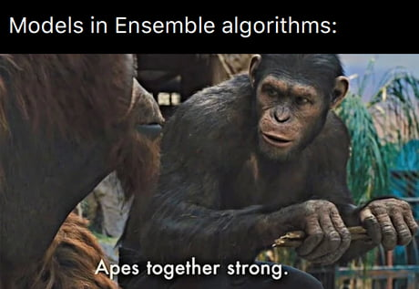
This is basically how Random forest classifiers work

Slide 15
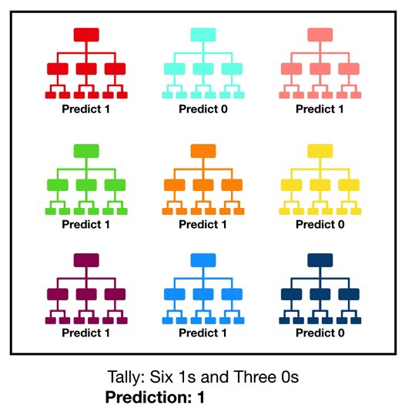

Slide 16
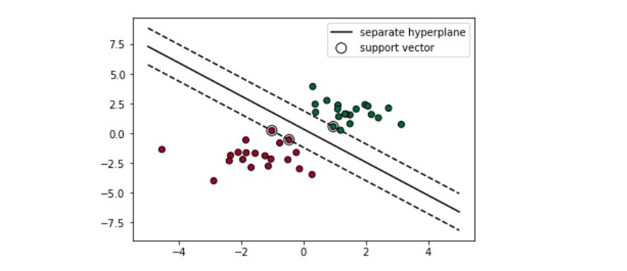
Support vector classifier
What a Support Vector Machine does is find the decision boundary to separate different classes and maximize the margin.
Margins are the (perpendicular) distances between the line and those dots closest to the line.

Slide 17
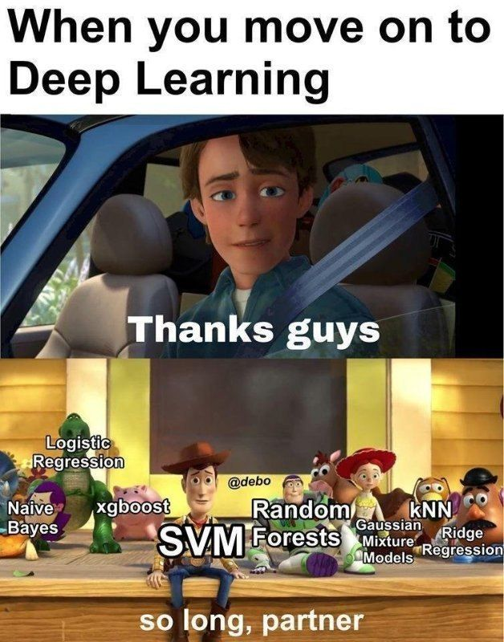

Slide 18
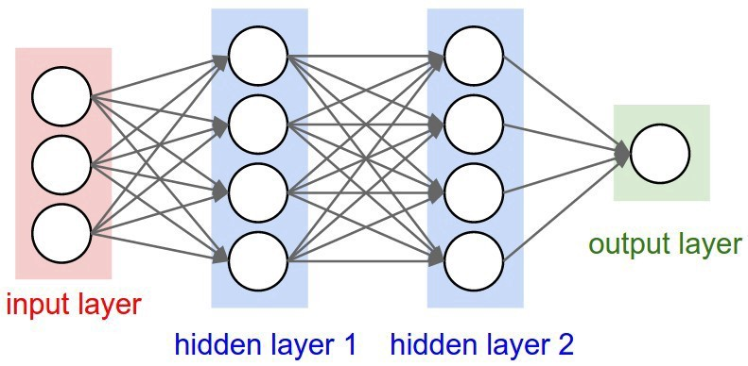
Deep learning and neural networks
Generally speaking, deep learning is a machine learning method that takes in an input X, and uses it to predict an output of Y. As an example, given the stock prices of the past week as input, my deep learning algorithm will try to predict the stock price of the next day.
Deep Learning Algorithms use something called a neural network to find associations between a set of inputs and outputs. The basic structure is seen below:

Slide 19
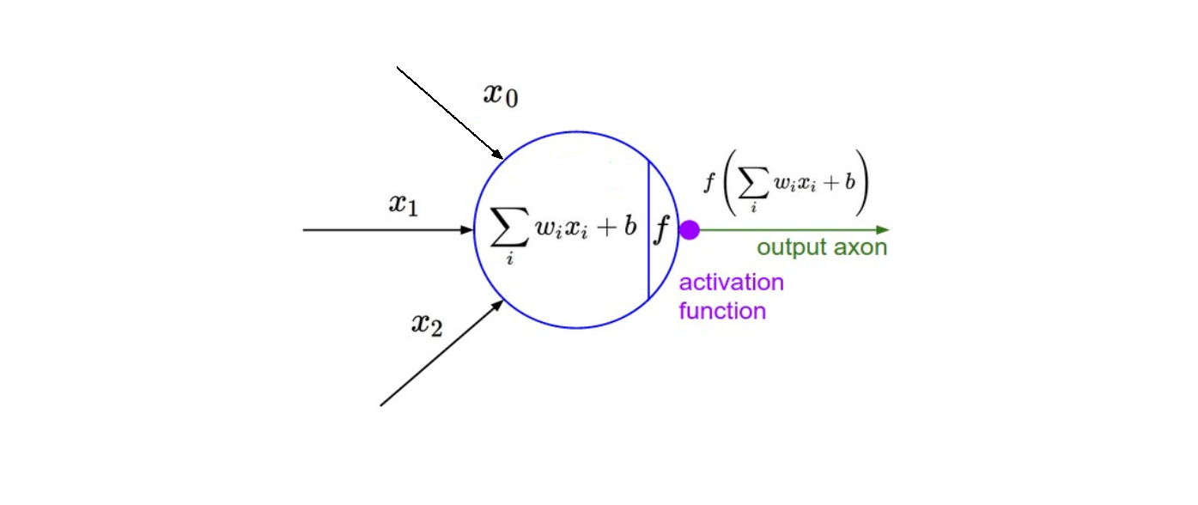
A neural network is composed of input, hidden, and output layers — all of which are composed of “nodes”. Input layers take in a numerical representation of data (e.g. images with pixel specs), output layers output predictions, while hidden layers are correlated with most of the computation.

Slide 20

Further reading
There is nowhere better to start learning than Andrew Ng’s Coursera courses from introduction into machine learning.
You can also look at Jose Portilla’s course on Udemy.
Deep Learning with Python Book by François Chollet is another great reading material.

Slide 21
Contact
This webinar was brought to you by Deepak Kumar Jha
Feel free to contact me with any queries, doubts and everything else:
Mail: deepakkumarjha178531@gmail.com
Text/WhatsApp: 9943898886
LinkedIn: https://www.linkedin.com/in/deepak-kumar-jha-bb2049182/
Instagram: deepak._.jha_
Thank you for sticking around till the end.

