Slide 1

Project Title -Seasonal Agriculture Performance Analysis
Presented By: Mohith R
Department: Artificial Intelligence and Data Science
College: Chettinad College of Engineering and Technology
AICTE STU ID : STU6937e094eb00e1765269652

Slide 2

PROBLEM STATEMENT
Agricultural activities are influenced by seasonal variations in rainfall, temperature, humidity, soil conditions, resource availability, and farming practices. These variations often lead to differences in crop productivity, resource utilization, and economic performance.
Although agricultural data contains valuable information, seasonal patterns and relationships are not always apparent from raw records alone.
This project focuses on analyzing agricultural data collected across different seasons to identify meaningful trends, variations, and relationships that affect agricultural performance. The study aims to transform raw data into actionable insights that support better understanding of seasonal agricultural behavior.

Slide 3
Project Description
The Seasonal Agriculture Performance Analysis project examines agricultural activities across different seasons using data analytics techniques.
The analysis begins with understanding the dataset and assessing data quality through preprocessing and cleaning. Exploratory Data Analysis (EDA) is then performed to investigate seasonal variations in crop production, environmental conditions, resource utilization, and economic outcomes.
The project focuses on:
Understanding seasonal agricultural trends
Comparing performance across seasons
Examining environmental influences
Evaluating resource utilization
Analyzing revenue and profit patterns
Identifying significant relationships within the data
The outcome of the project is a set of data-driven insights and recommendations derived from observed patterns in the dataset.

Slide 4

WHO ARE THE END USERS?
Farmers
Seasonal insights can help farmers better understand crop performance under different environmental conditions and support planning decisions.
Agricultural Researchers
The analysis provides a structured view of seasonal agricultural patterns and relationships that can support further research.
Government and Policy Makers
The findings can assist in agricultural planning, resource allocation, and the development of seasonal support initiatives.
Agribusiness Organizations
Understanding seasonal productivity and profitability patterns can support operational and strategic decision-making.
Educational Institutions
The project serves as a practical example of applying data analytics techniques to a real-world agricultural problem.

Slide 5

Technology Used
Python,
Pandas,
NumPy,
Matplotlib,
Seaborn,
Plotly,
SciPy,
Jupyter Notebook,
Google Colab

Slide 6
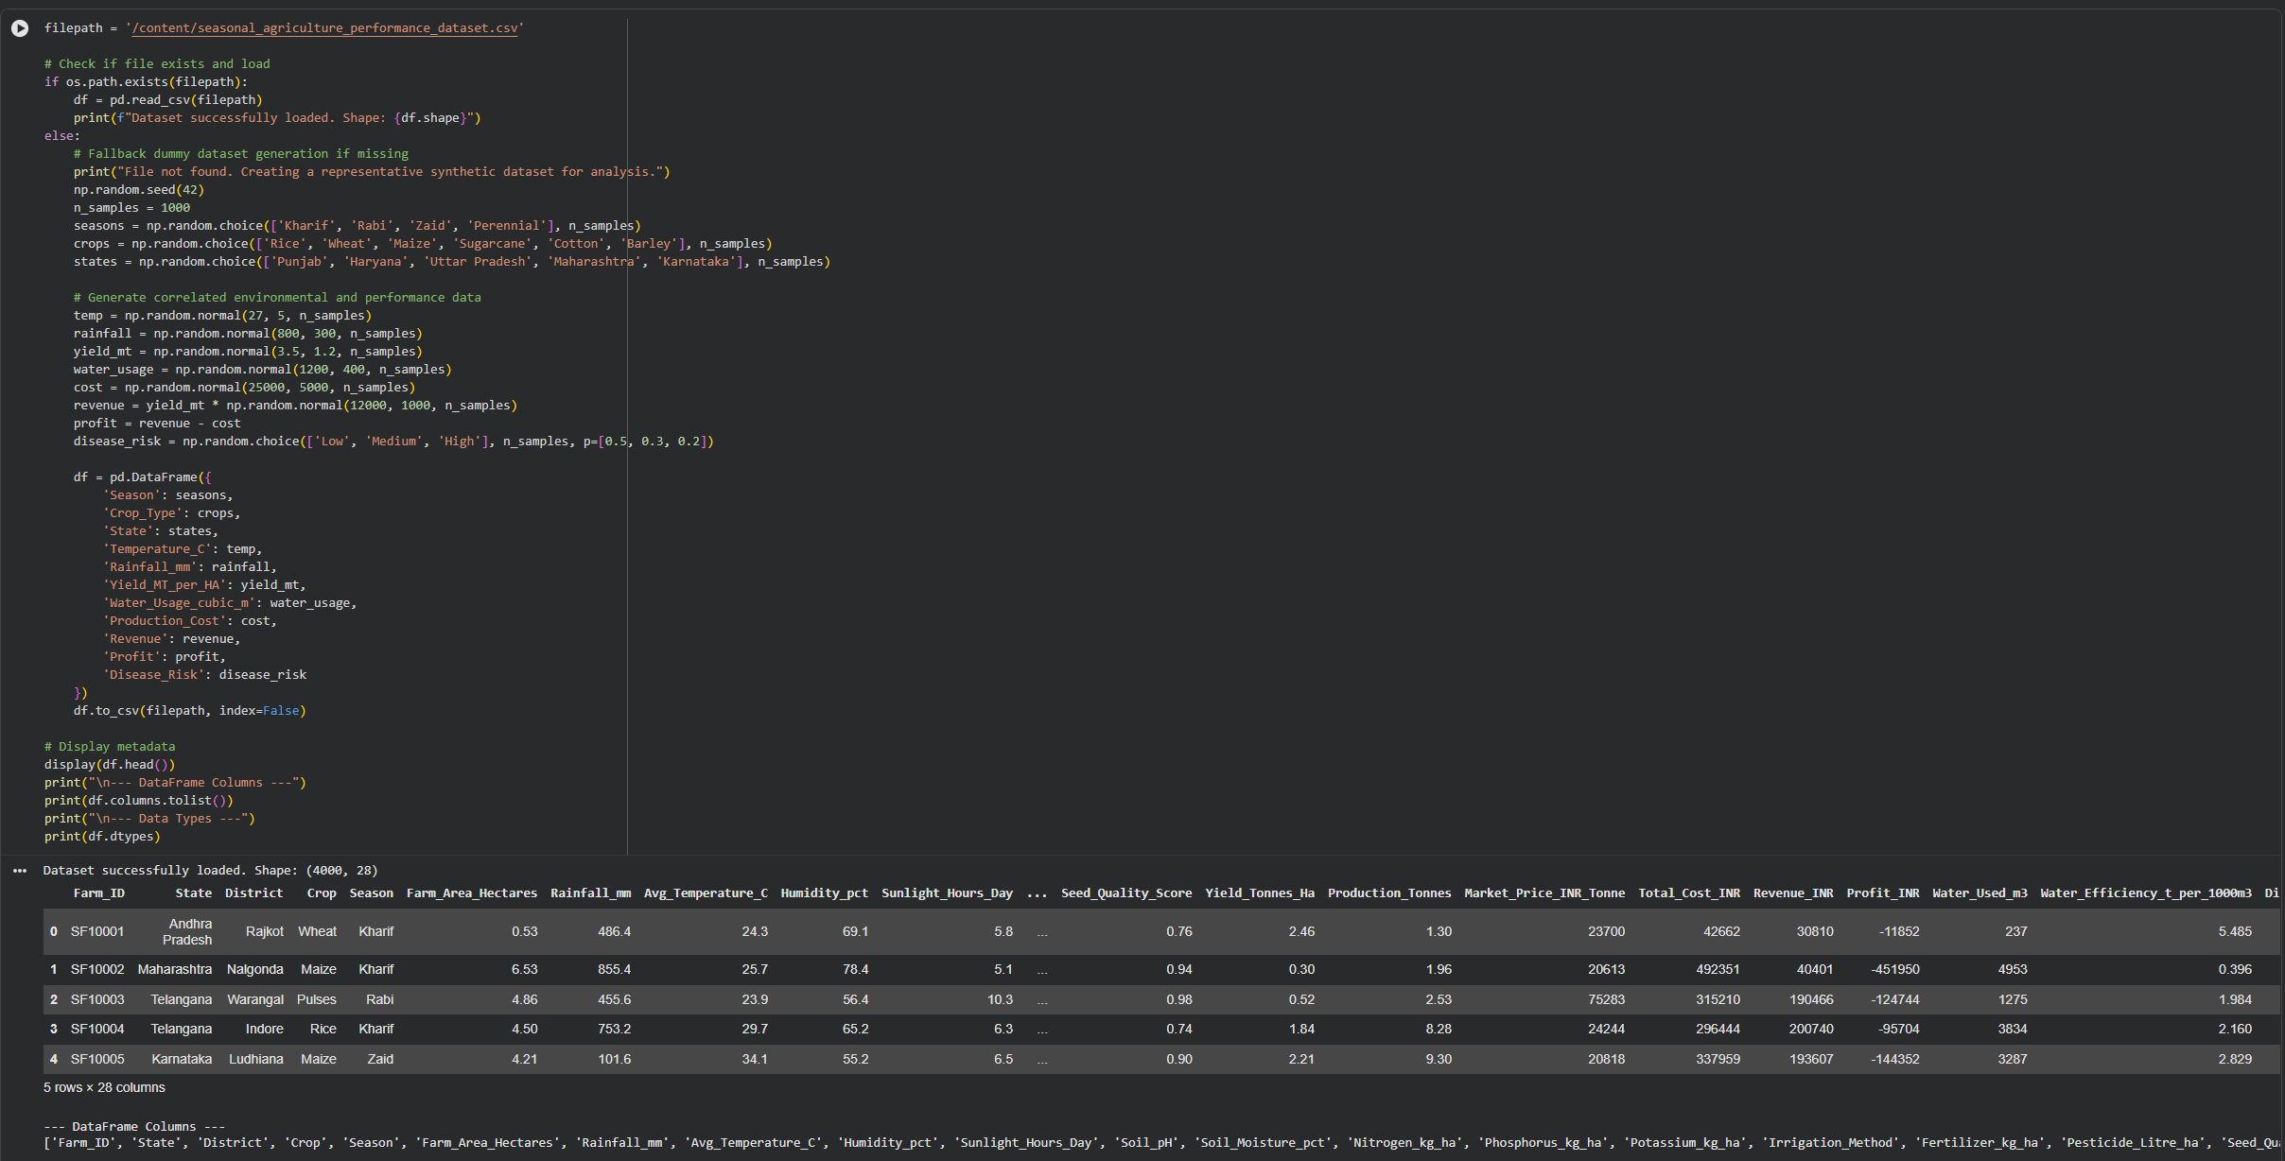
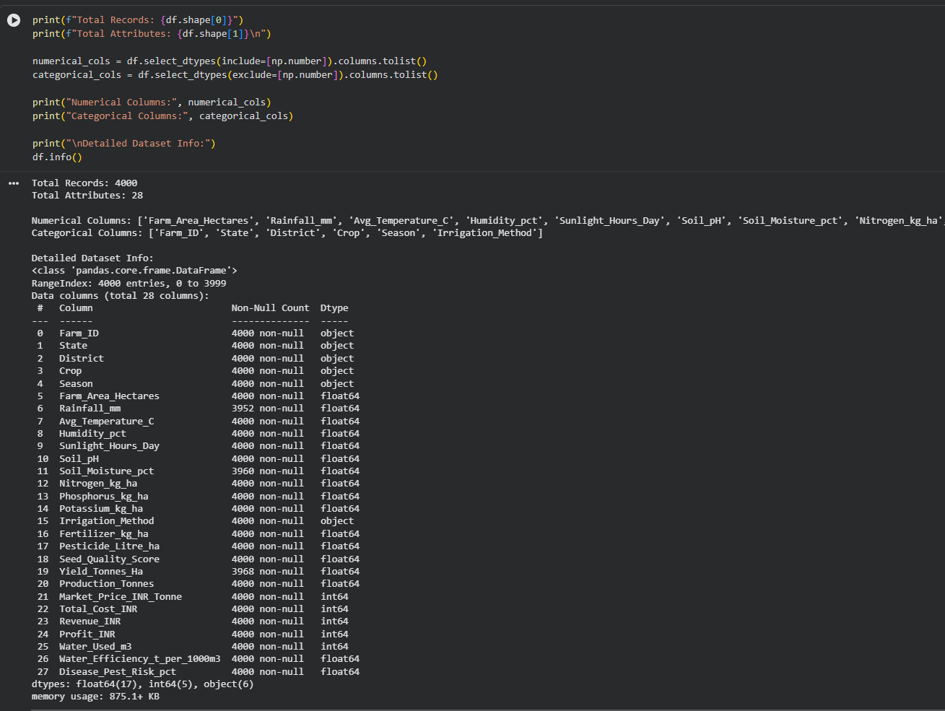
RESULTS
Dataset Understanding and Preparation

Slide 7
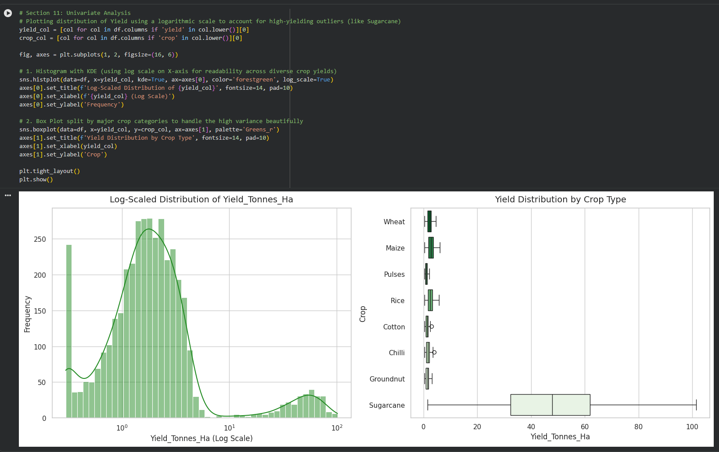
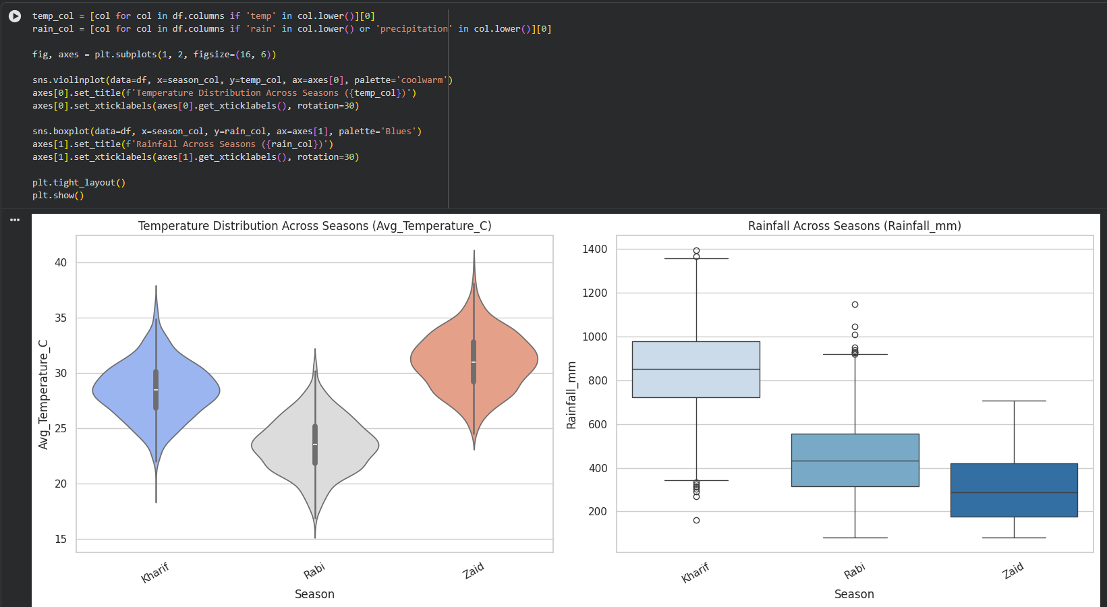
RESULTS
Seasonal Performance Analysis

Slide 8
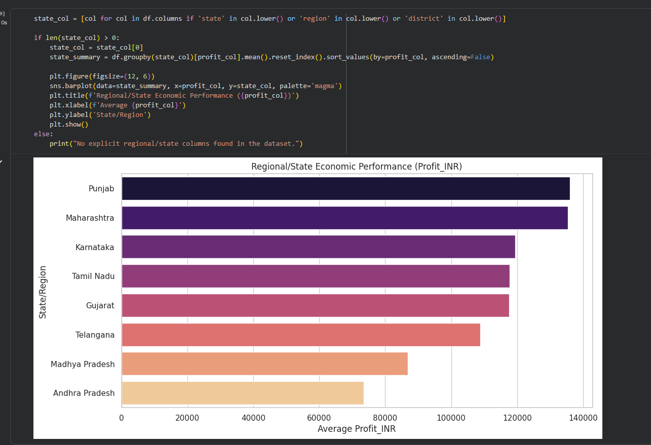
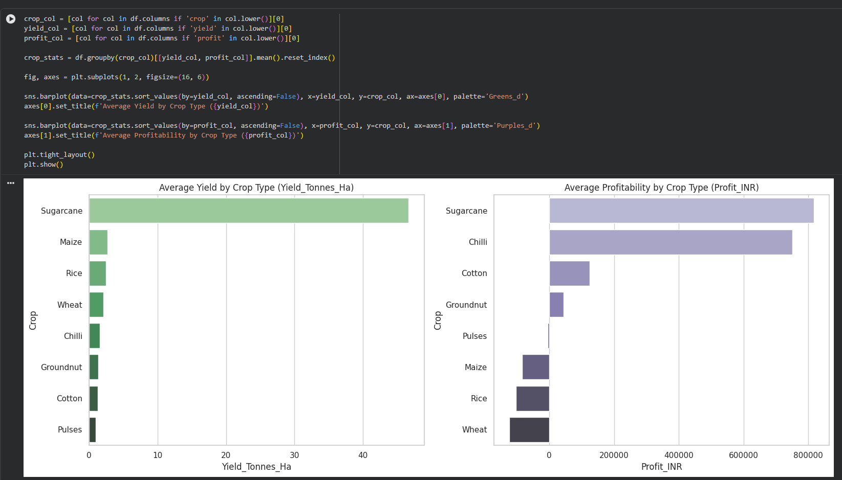
RESULTS
Crop and Environmental Analysis

Slide 9
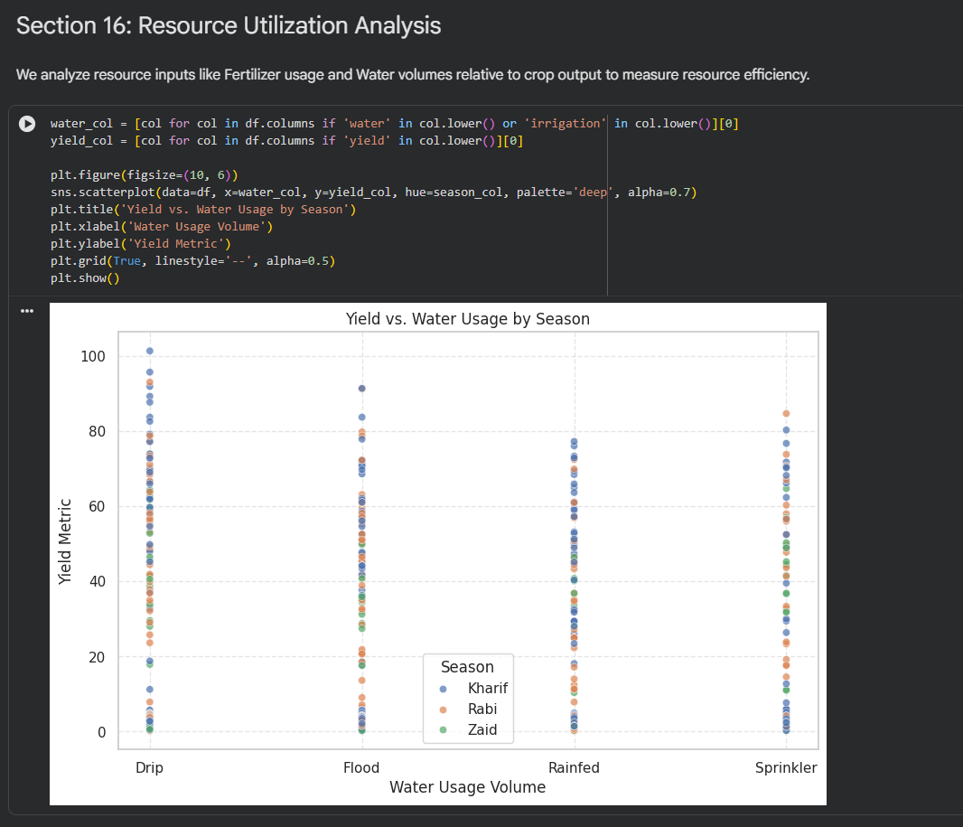
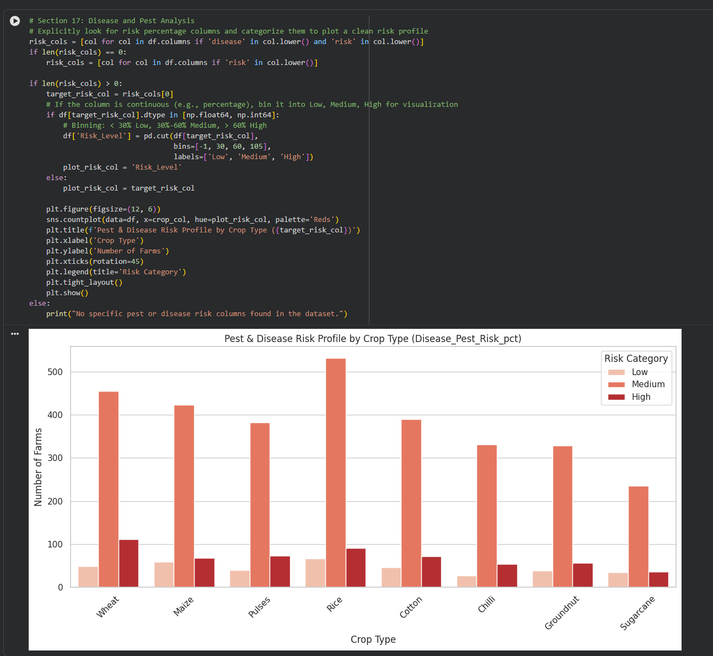
RESULTS
Statistical Analysis and Insights

Slide 10
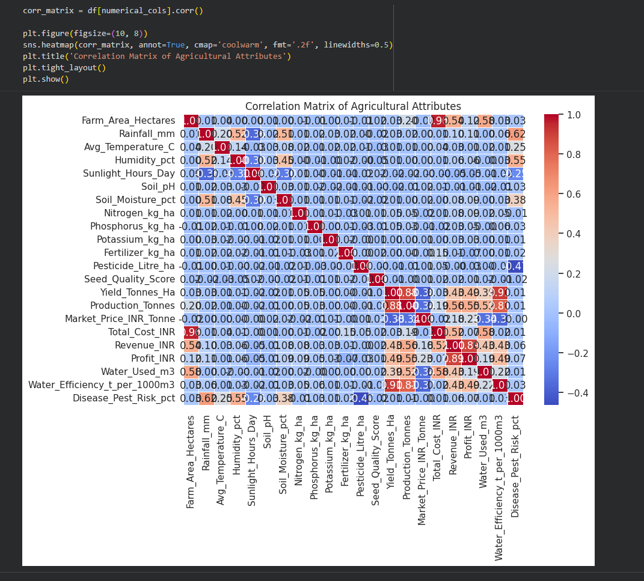
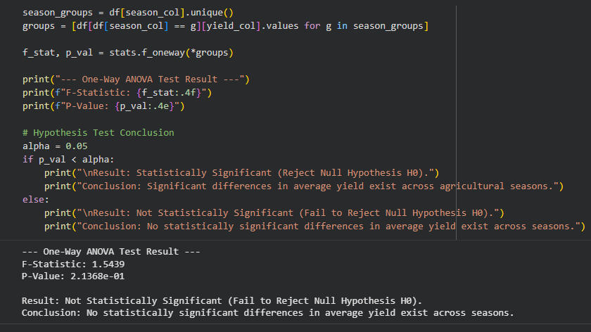
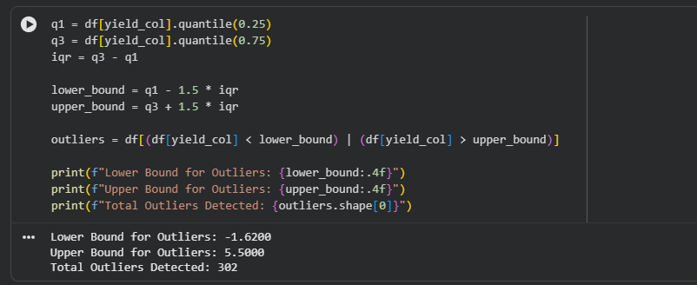
RESULTS

Slide 11
Future scope
The current project focuses on descriptive and comparative analysis of seasonal agricultural performance.
Future enhancements may include:
Predictive Analytics
Crop Yield Prediction
Revenue Forecasting
Profit Forecasting
Machine Learning Applications
Crop Recommendation Systems
Seasonal Risk Prediction Models
Interactive Analytics
Real-Time Dashboards
Web-Based Visualization Platforms
Decision Support Systems
Data-Driven Agricultural Planning
Resource Optimization Frameworks
These enhancements could extend the project from analytical reporting to intelligent decision support.

Slide 12
GitHub Link
https://github.com/LEGIONM3/Seasonal-Agriculture-Performance-Analysis

Slide 13
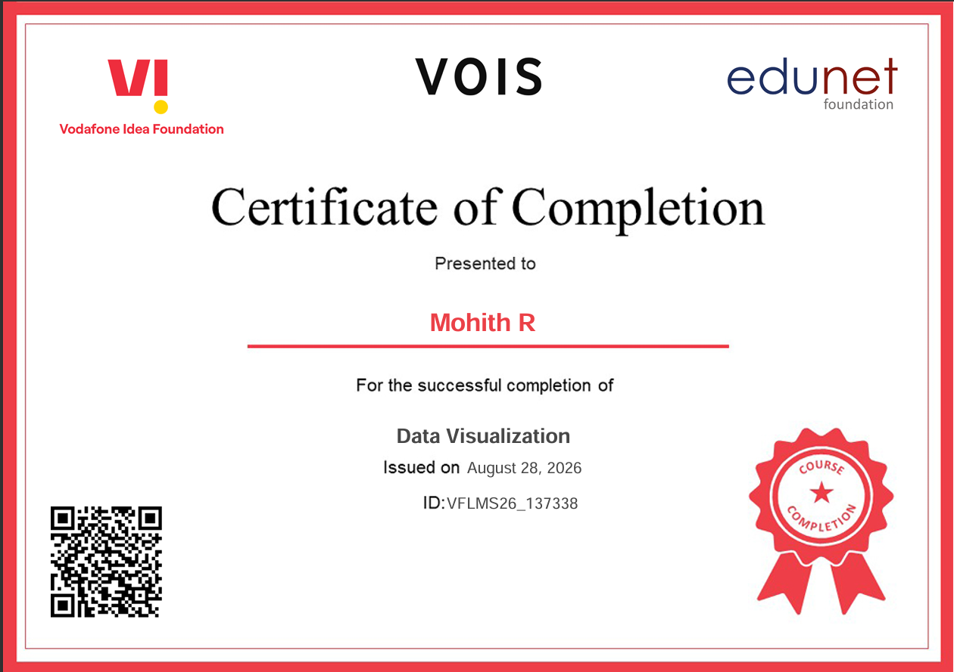
VOIS Course completion certificate -
Course name- Data Visualization

Slide 14
Thank you
This project demonstrates the application of data analytics techniques to understand seasonal agricultural performance and derive meaningful insights from real-world data.
The study highlights the importance of data-driven approaches in understanding agricultural trends, improving resource utilization, and supporting informed decision-making.
Presented By:
Mohith R
.

