Slide 1
Commenting code
BY SANJAY AND ARVIND SESHAN

Slide 2
Lesson Objectives
Learn how to comment code
Learn the importance of commenting code
Learn what makes useful comments

Slide 3
Why bother with comments?
Comments in code help the author of the code remember what they were trying to accomplish.
You can use them to record the goals or pseudocode for the code.
It makes it easier to debug
You could use it to take notes on values
More importantly, comments allow someone other than the author of the code to understand the program.
Get into the habit of adding comments to your code

Slide 4
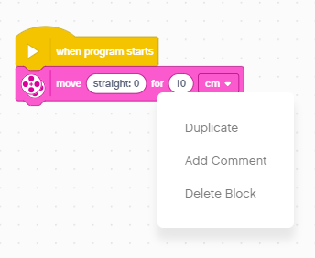
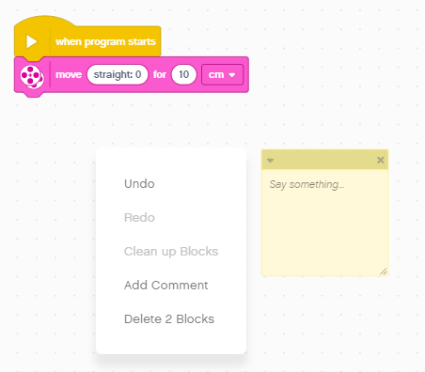
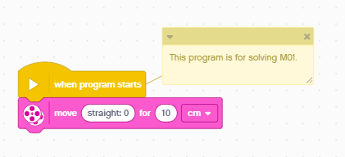
Adding Comments
Right click on any block to add a Comment
You can also right click anywhere on the Programming Canvas to create a Comment box
Type your comments and resize and move the box as needed

Slide 5
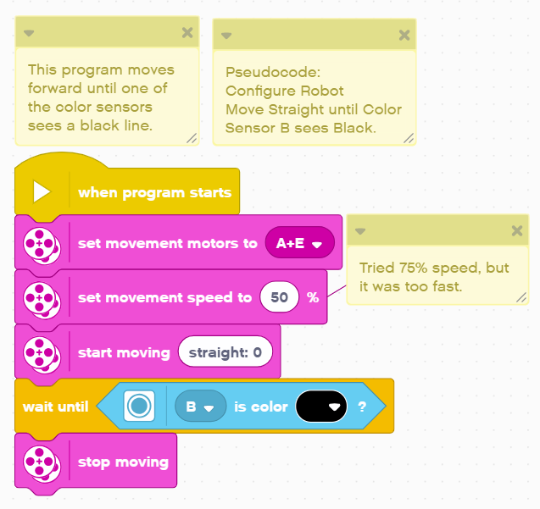
What are useful comments?
Make comments count: Comments should not repeat the contents of the block.
Comments can be used to summarize the code/document the pseudocode you wrote
Comments can be used to document values you are trying out in the code
Note: In our lessons, we do not use comment blocks only because it makes it harder for our collaborators to translate. Instead, we used text boxes in PowerPoint.

Slide 6
CREDITS
This lesson was created by Sanjay Seshan and Arvind Seshan for Prime Lessons
More lessons are available at www.primelessons.org
This work is licensed under a Creative Commons Attribution-NonCommercial-ShareAlike 4.0 International License.

