Slide 1
INTRODUCTION TO MICROPYTHON
BY ARVIND SESHAN

Slide 2
Lesson Objectives
Learn some basics

Slide 3
WHAT IS PYTHON?
Python is a text-based coding language
Commonly used even in first year program courses at university-level

Slide 4
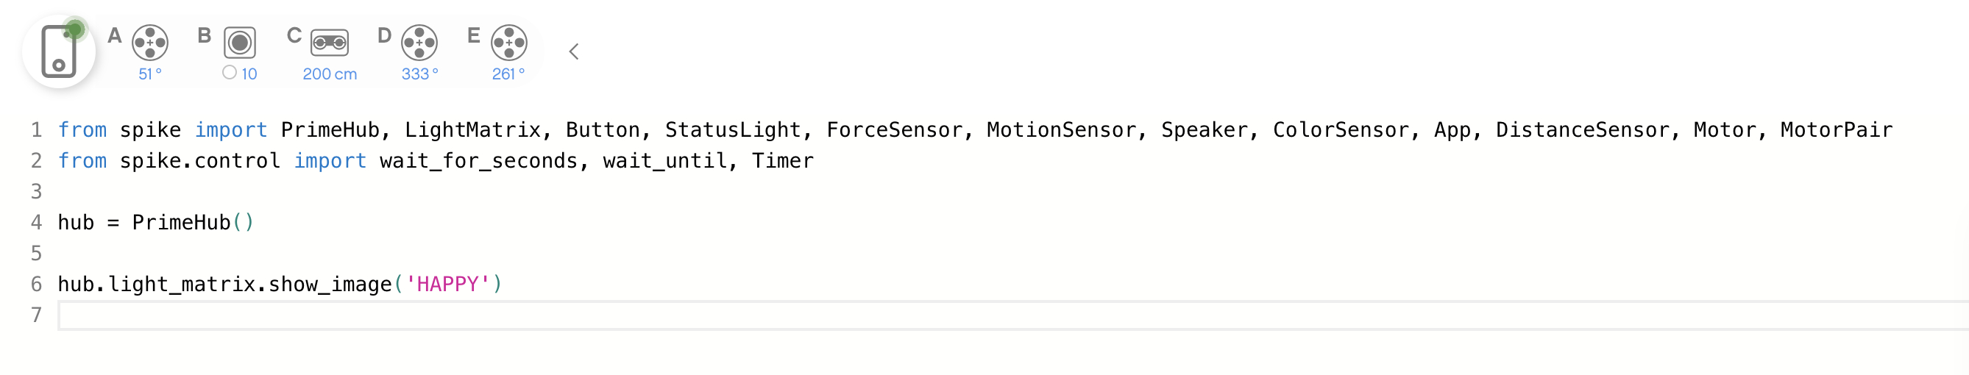
IMPORTING LIBRARIES
For SPIKE PRIME, you will need to include the library for your hardware components (e.g., motors, Hub, sensors) in every program
The imported libraries should appear once at the beginning of the .py file
There are the available libraries for you to import: App, Hub. Light Matrix. Buttons, Speaker, Brick Status Light, Motion Sensor, Distance Sensor, Color Sensor, Force Sensor, Motor, Motor Pair, Operators
You will notice that all these libraries are imported into your code by default.

Slide 5
INDENTATION/FORMATTING
In Python capitalization, spaces, and indenting matter

Slide 6
INitialization
To use any hardware (Hub, motors or sensors), you must initialize them:
hub = PrimeHub()
force = ForceSensor('E')

Slide 7
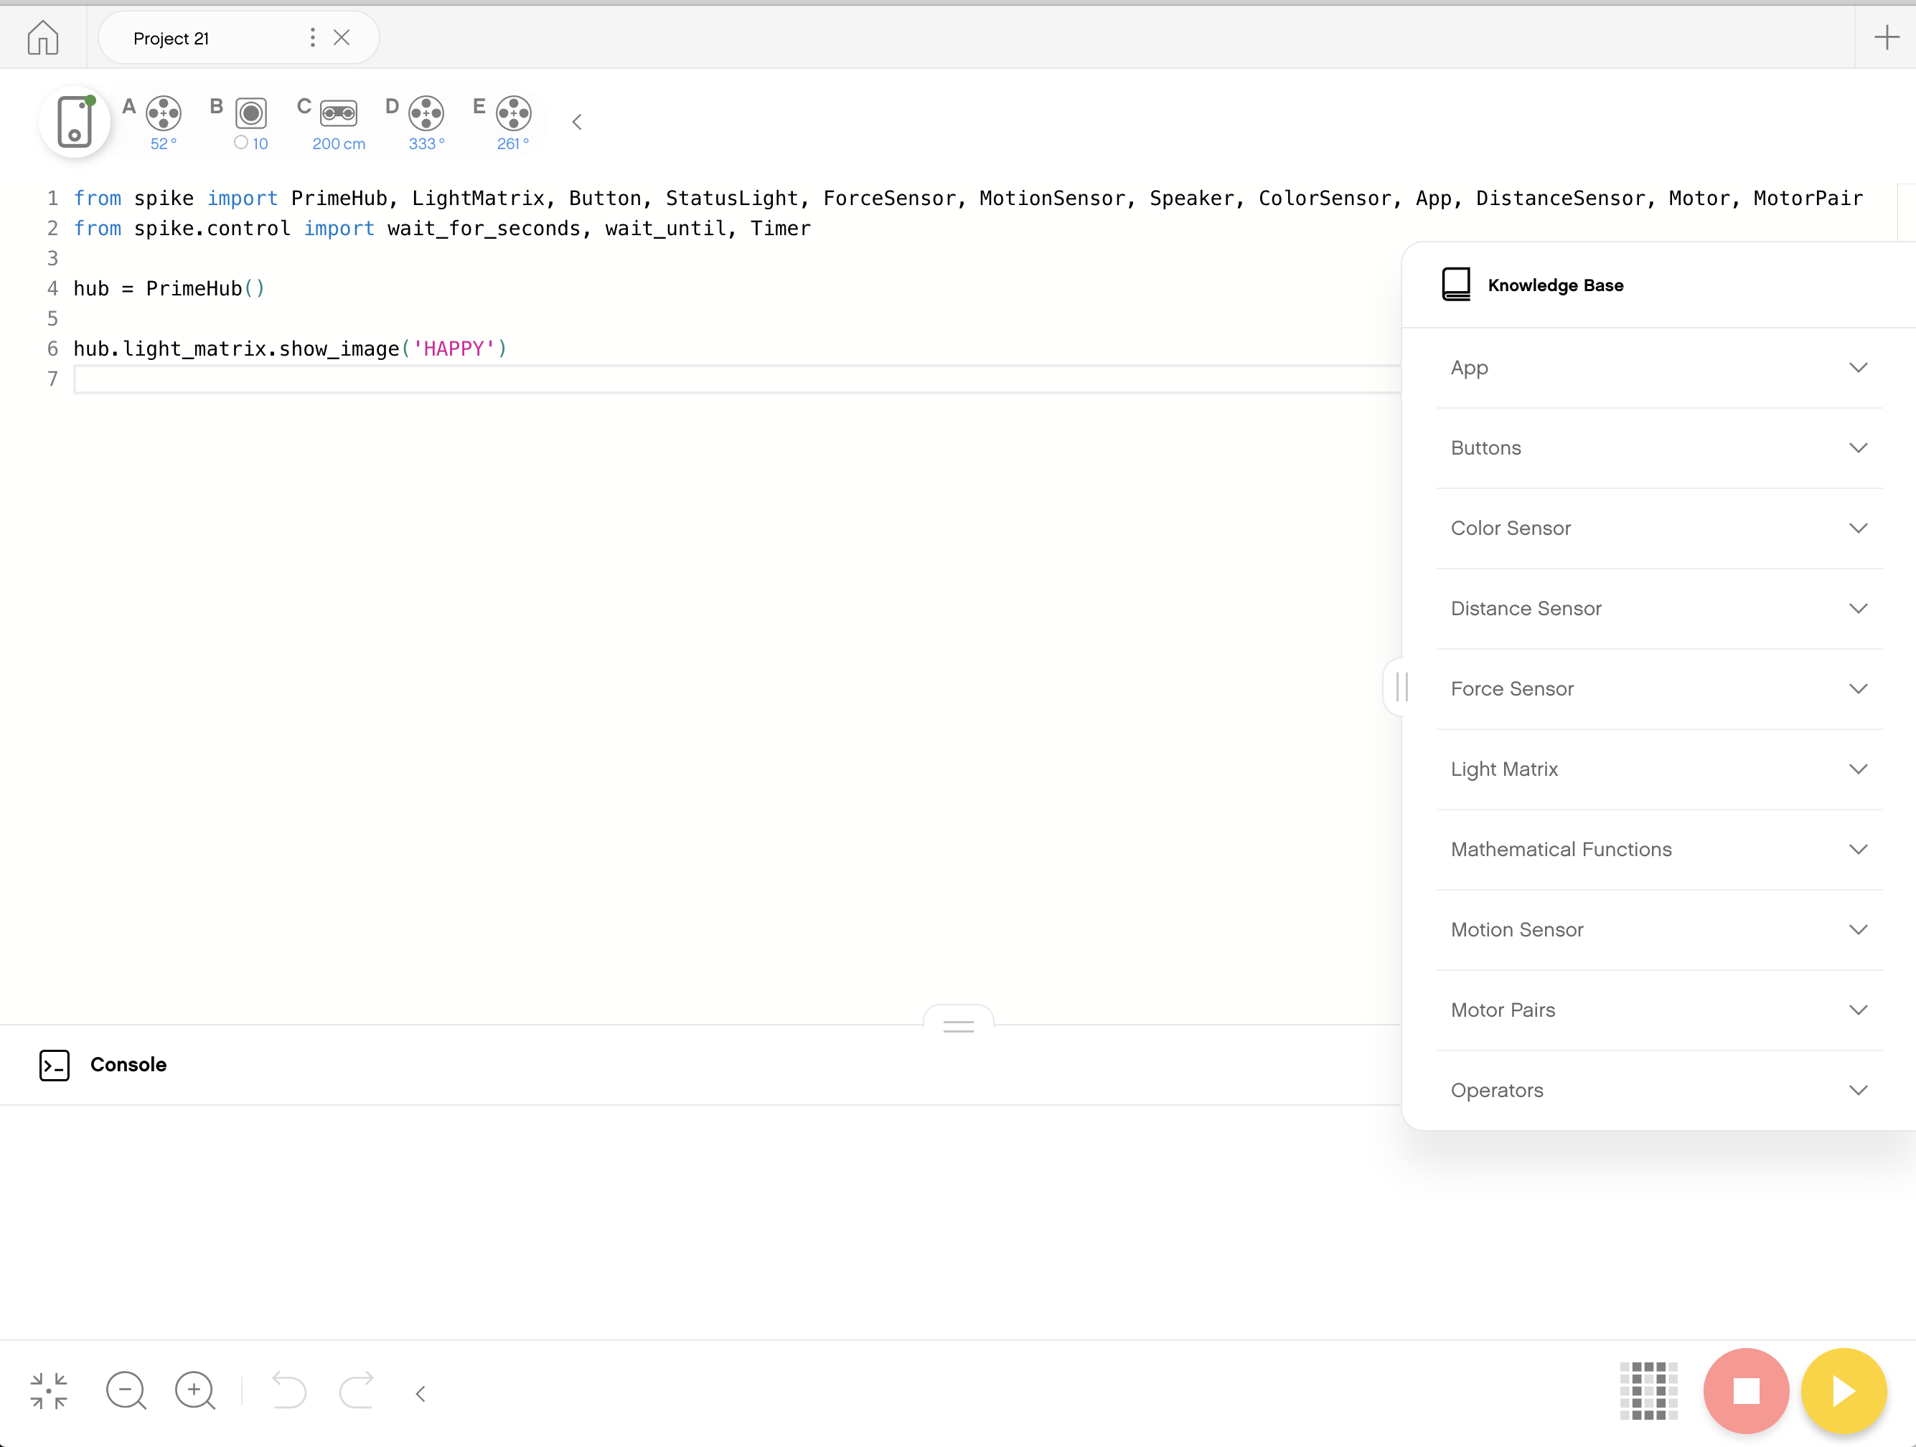
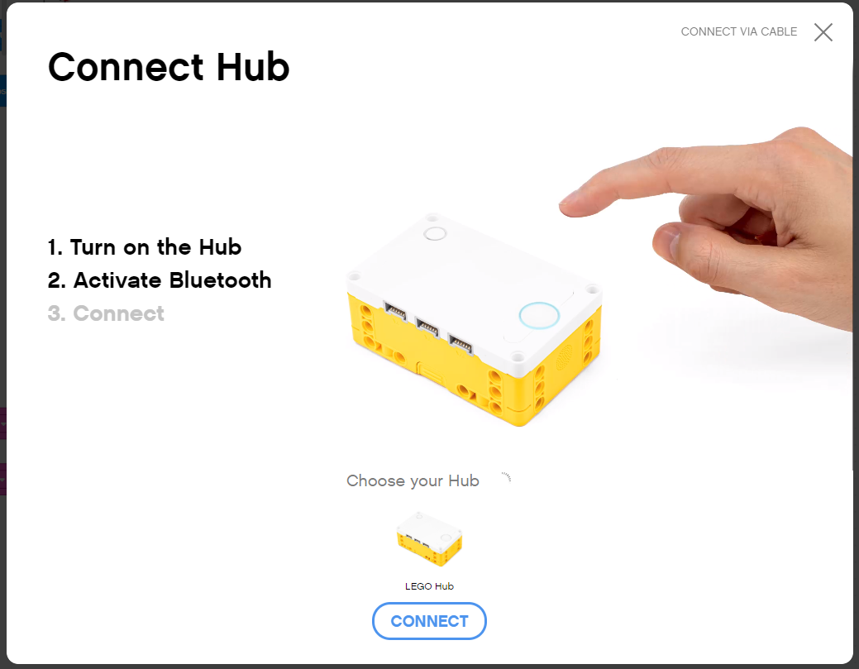
You must be Connected to hub
To view any sensor data, you must first be connected to the Hub

Slide 8
Sensor values on Project page
Once connected to the Hub, Sensor and Motor Values are visible on the top of each Project page

Slide 9
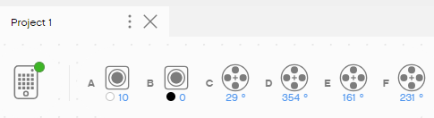
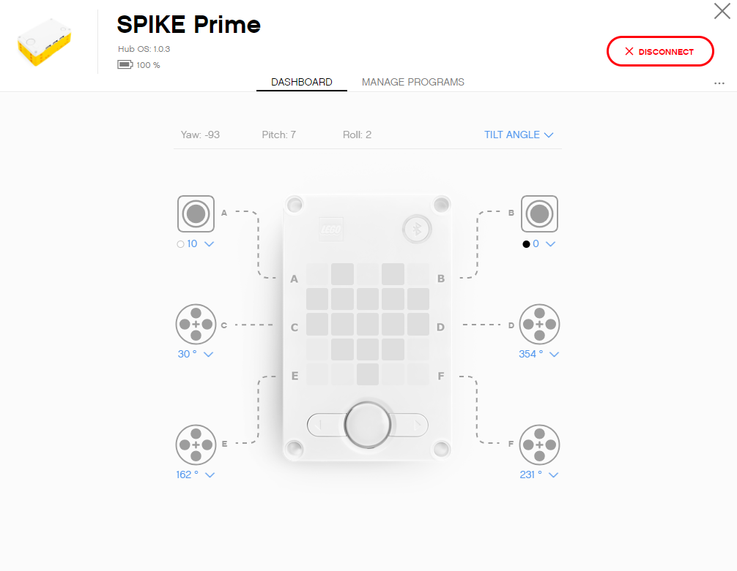
Sensor values on DASHBOARD
Clicking on the SPIKE Prime Hub Icon takes you to the Hub Dashboard where you can see more sensor data

Slide 10
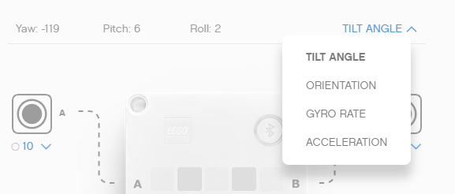
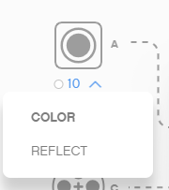
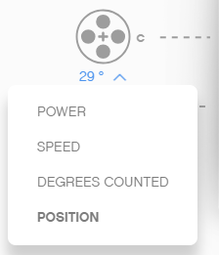
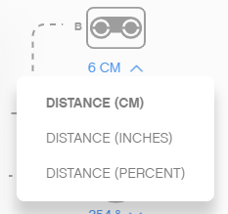
More sensor data on the dashboard
From the Hub Dashboard, you can also see a lot of additional information about each sensor and motor you have connected to the hub
Select the mode using the down arrow
You can also see values for the built-in gyro sensor
Gyro Sensor
Color Sensor
Force Sensor
Distance Sensor

Slide 11
Sensor data is powerful
Sensor data can help you program better and also help you debug your code
As you go through the rest of our lessons, you will use this feature often.
As you complete each challenge, think about how knowing sensor data might help you.
The next page has many several examples to think about.

Slide 12
When can sensor data can help?
Reduce Guess-and-Check: I want my robot to turn a particular amount, but I am not sure how much to turn without guessing.
Debug Code: The robot does not follow the green line like I programmed it to do. Why not? What color does the robot think that green line is?
Check Builds: I built my robot with the Force sensor a little bit inside the robot. I am not sure that the Force sensor is getting pressed enough. How can I make sure the sensor is getting pressed?
Test Sensors: I told my robot to stop when the Distance sensor is 20cm away. But it seems to stop earlier. Is the sensor working correctly? How can I see what the Distance sensor sees?

Slide 13
CREDITS
This lesson was created by Arvind Seshan for SPIKE Prime Lessons
More lessons are available at www.primelessons.org
This work is licensed under a Creative Commons Attribution-NonCommercial-ShareAlike 4.0 International License.

