Slide 1
Acceleration
By Sanjay and Arvind Seshan

Slide 2
Lesson Objectives
Learn what acceleration means
Learn how and when to use accelerate
Learn how to use the Timer Block

Slide 3
Why Ramp Up
Acceleration is very helpful when running fast-paced programs
The speed steadily increases over time in a linear fashion
Usually, if the robot starts up with high speed, then there would be a small jerk in the beginning. The jerk may change the position of the robot.
With the acceleration, it would start up slowly and increase speed over time (see video on the right)

Slide 4
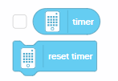
New Tool: Timer Block
The timer block is used to count time
It is found in the Blue sensor tab
1 timer is available You can use the reset timer block to reset a the timer back to 0 seconds
You can use the block to read the time since reset…
If you are a FIRST LEGO League Challenge team, you can use timers to track time or for the acceleration code in this lesson

Slide 5
Accelerate in 4 Easy Steps
1. Reset timer
2. In a loop, read the number of seconds passed and multiply the speed by 20. The 20 is the rate at which it speeds up and is measured in speed/second
3. Still in the loop, take the result of the multiplication and apply it to the move block.
4. Repeat the Loop for 5 seconds (duration)
Note that the final speed will be final speed = duration*rate which should be less than or equal to 100

Slide 6
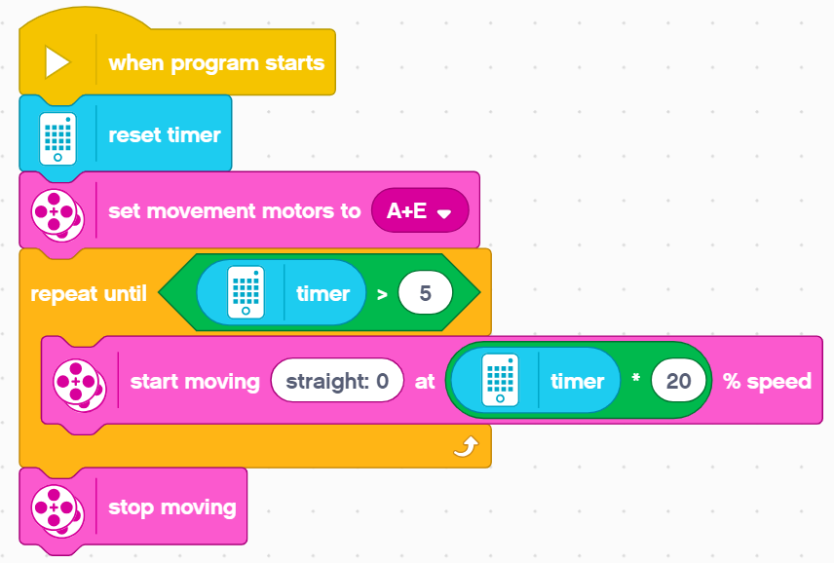
Acceleration code
Reset timer
Set movement motors
Accelerate over the course of 5 seconds

Slide 7
Acceleration Challenge
Step 1: Can you now make an acceleration program that takes 2 inputs (total duration of acceleration and how much speed you want the motor to accelerate per second)? Create a My Block.
Step 2: Accelerate your robot, then move until a black line.

Slide 8
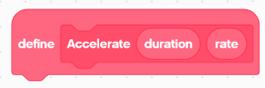
Making the My Block
Go to Make a My Block
Add 2 inputs: one for seconds (duration) and one for how quickly you want to accelerate (rate)
Seconds to ramp up
How quickly you want to ramp up

Slide 9
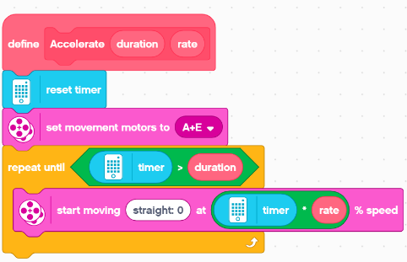
DEFINING THE MY Block
Drag the “duration” and “rate” operators into the correct locations

Slide 10
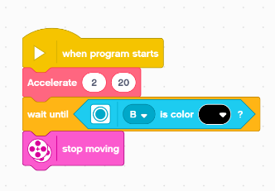
Challenge Solution
This program accelerates for 2 seconds to 40% speed and moves until the color sensor (on port B) sees a black line.

Slide 11
Next Steps
Think about what else you might be able to use a timer block for
Create a deceleration program now that you know how to create an acceleration program.

Slide 12
CREDITS
This lesson was created by Sanjay Seshan and Arvind Seshan for SPIKE Prime Lessons
More lessons are available at www.primelessons.org
This work is licensed under a Creative Commons Attribution-NonCommercial-ShareAlike 4.0 International License.

