Slide 1
Final Challenges
BY SANJAY AND ARVIND SESHAN

Slide 2
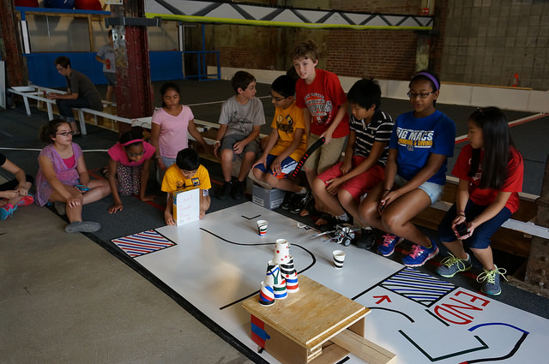
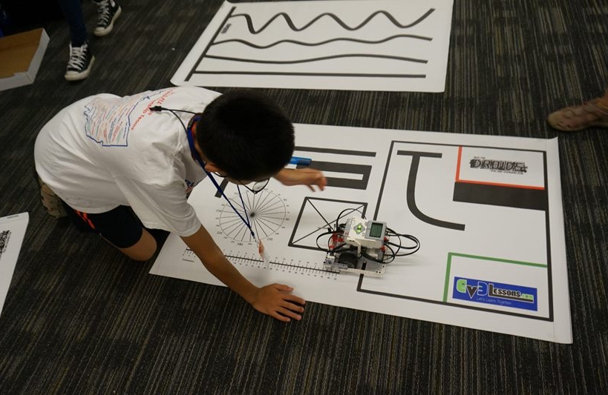
INSTRUCTIONS
The goal of these challenges is to combine everything the students have learnt so far: moving, turning and basic sensor usage
You can set up any challenge you want using colored electric tape on a white board (available at home improvement/hardware stores). You can also use large white poster paper on a hard floor.
Note that the electric tape colors do not match LEGO’s colors. So your sensors may have trouble reading those colors.
You can also use old FIRST LEGO League Mats for practice. They are sometimes available on eBay or other teams.

Slide 3
Challenge 1: MOVING STRAIGHT AND TURNING PRACTICE
HOME
Go out of Launch Area
Turn left into the passage
Turn right
Turn right and head to Home
LAUNCH AREA

Slide 4

Challenge 2: SENSOR USAGE PRACTICE
Solid North Wall
Home
Go out of Launch Area
Go up to the North wall and touch it.
Back up turn and navigate through the passage
Go to the “do not touch this wall”. Don’t touch it. (some light box that falls over when touched can be used here)
Turn and go to the West wall.
Turn and head to Home.
USE 2-3 SENSORS
Launch Area
Do Not Touch This Wall

Slide 5
Challenge 3: pick up item
Solid North Wall
Home
Go out of Launch Area
Go up to the North wall and touch it.
Back up turn and navigate through the passage
Capture/Pick up the cup along the way
Turn and go to the West wall.
Turn and head to Home.
Launch Area

Slide 6
STOP ON THE LINE
Program your robot to move forward and then stop exactly at the 3rd line.
Move forward until a black line
Repeat that action three times
Combine what you learnt in the Repeat Block, If-then Block, Color Sensor and Move Forward lessons

Slide 7
CREDITS
This lesson was created by Sanjay Seshan and Arvind Seshan for SPIKE Prime Lessons
More lessons are available at www.primelessons.org
This work is licensed under a Creative Commons Attribution-NonCommercial-ShareAlike 4.0 International License.

