Slide 1
IF Then Block
BY SANJAY AND ARVIND SESHAN

Slide 2
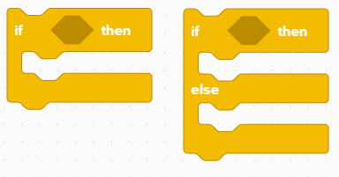
Lesson Objectives UPDATE!
Learn how to make your robot decide what to do out of different choices
Learn how to use an if-then Block

Slide 3
Repeating code
Asking the robot a question and doing something different based on the answer
Example:
Does the robot see a line? Or not?
Is the robot near the wall? Or not?
It is like a yes/no question

Slide 4

Challenge: Happy or Sad?
Write a program that changes the display based on if the Force Sensor is pressed or not pressed
If pressed, your SPIKE Prime is happy. Display a smiley face. On the LED Matrix.
If not pressed, SPIKE Prime is sad! Display a sad face.
You will need to use the Light Block, a Repeat Block, and an If-Else block
You will need to customize the Light Block to create a sad face
Extensions: Combine what you know and see if you can add a happy laugh when pressed and crying when you stop pressing the sensor. You may have to make some custom sounds.

Slide 5
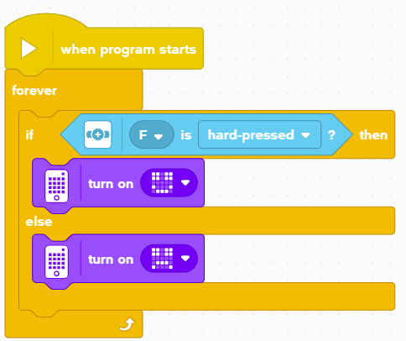
Challenge solution
Run the code forever
When the Force sensor is pressed hard, the LED Matrix shows a smiley
When you let go of the Force sensor, the LED Matrix shows a sad face

Slide 6
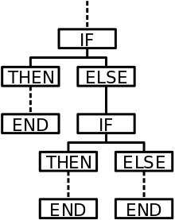
Taking it further
If-Else Blocks can be very powerful tools as you create more complex programs
Think about situations where you might want to nest more than one inside another

Slide 7
CREDITS
This lesson was created by Sanjay Seshan and Arvind Seshan for SPIKE Prime Lessons
More lessons are available at www.primelessons.org
This work is licensed under a Creative Commons Attribution-NonCommercial-ShareAlike 4.0 International License.

