Slide 1
installing software & Firmware
BY SANJAY AND ARVIND SESHAN

Slide 2
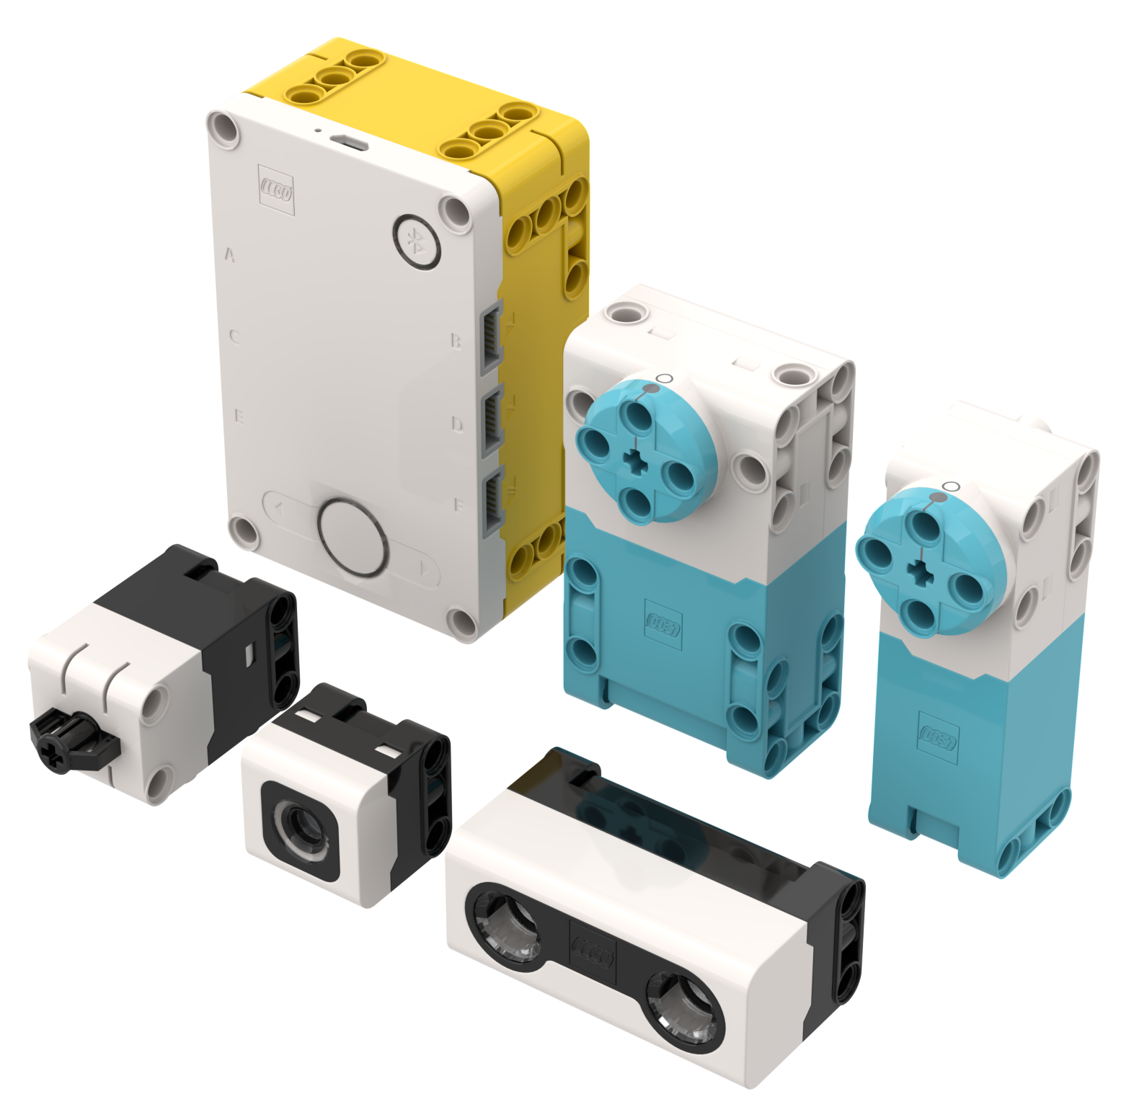
Lesson Objectives
Learn how to update SPIKE Prime

Slide 3
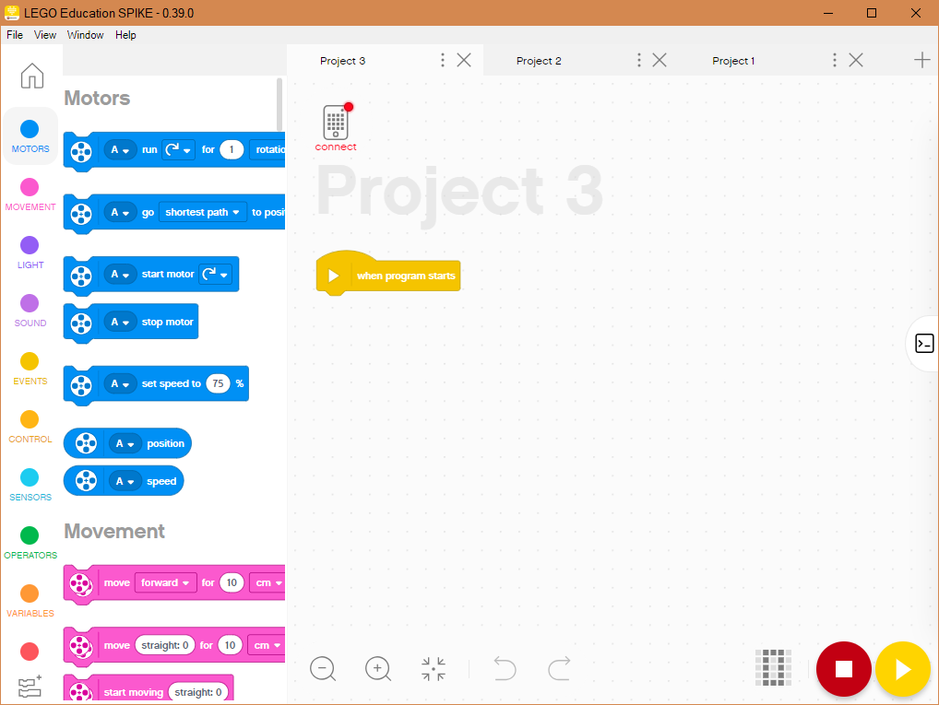
Connect to hub
Connect your SPIKE Prime to your computer using the USB Cable for OS Updates
The software will auto-connect to the brick if you are using USB
Note: If you are using the iOS, Android, or Chromebook version of the software, you may need to connect to your Hub using a computer the very first time to update the firmware on the Hub. Subsequent updates may be possible via Bluetooth. [This process may get updated.]

Slide 4
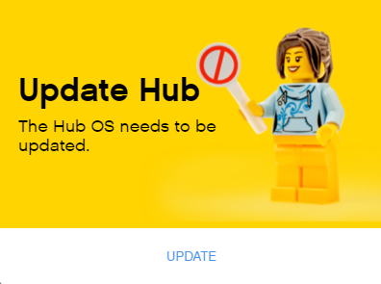
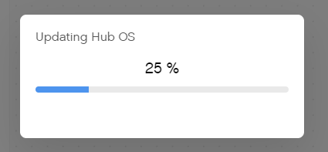
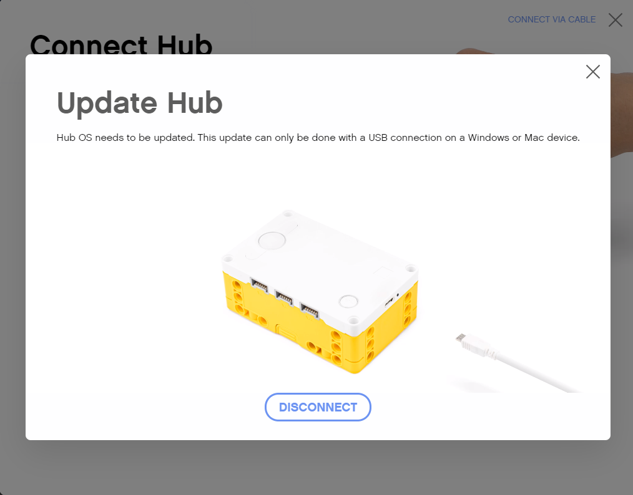
Updating the hub operating system
If there is an Update available, you will get a popup telling you to do so

Slide 5
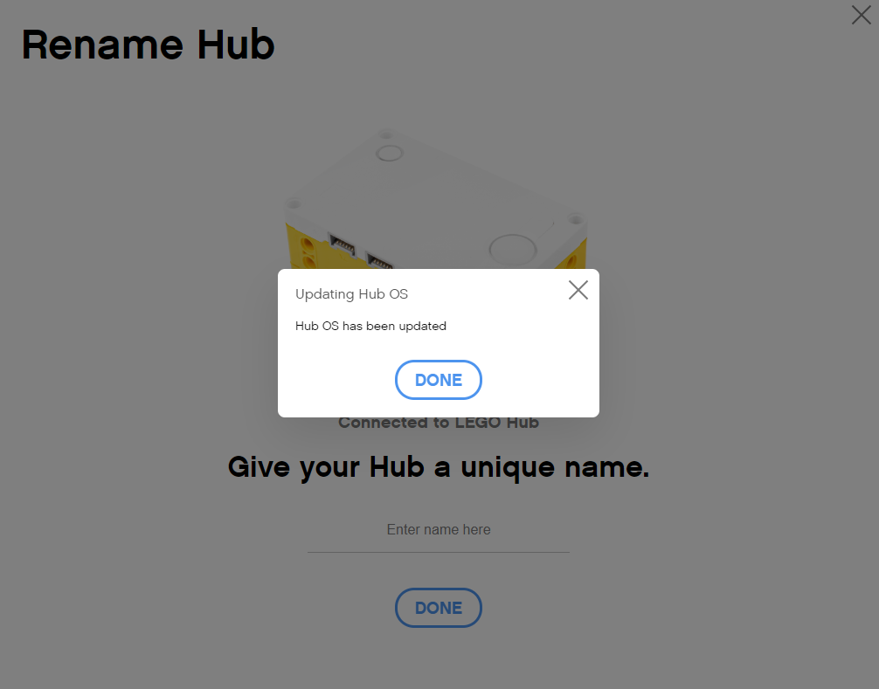
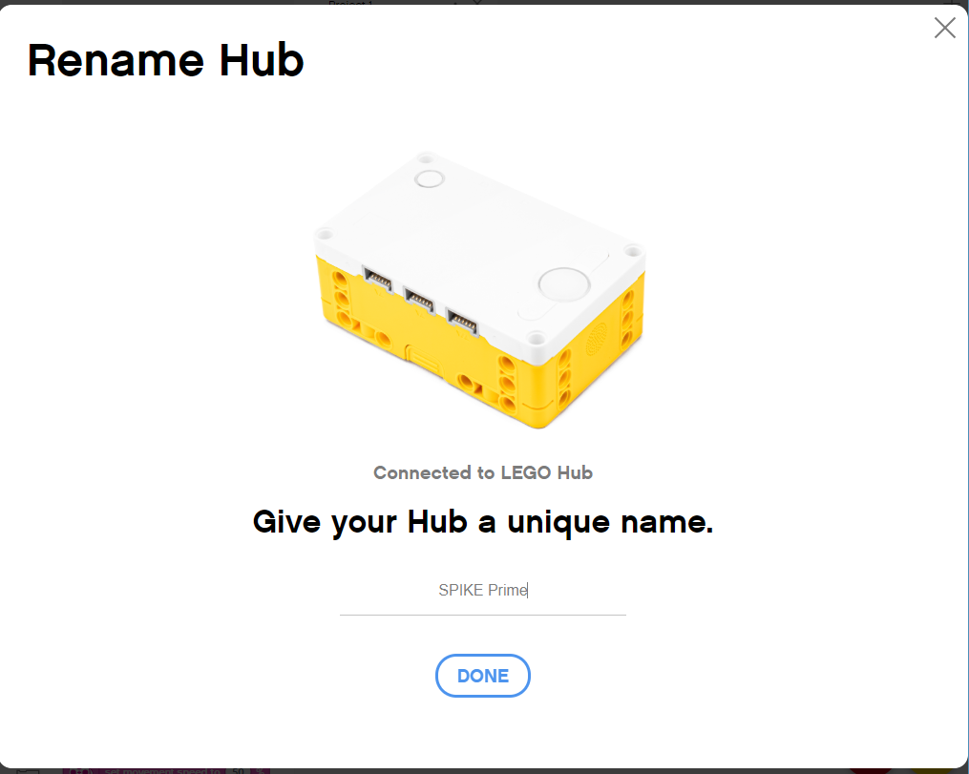
Renaming HUb
The first time you update your Hub OS, you will be prompted to rename your Hub

Slide 6
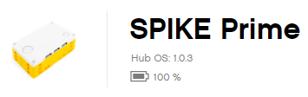
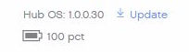
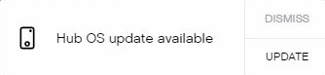
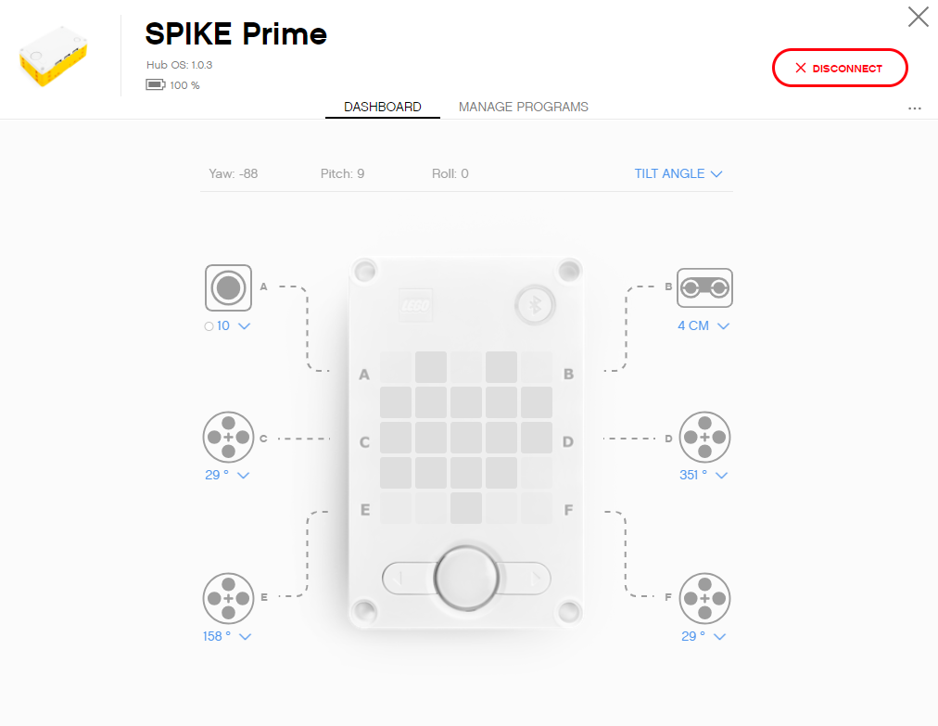
INSTALL LATEST HUB OS
When a new Hub OS is available a button labeled Update will appear next to the current Hub OS in the Hub Dashboard
You may also see a pop-up show up on the right side of the screen indicating a Hub OS update is available
Never disconnect the Hub while the update is in progress

Slide 7
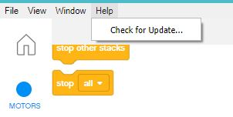
Install the latest Software
You can check for SPIKE Prime Software Updates from inside the App
Click on the Help Menu inside a Project and Check for Update

Slide 8
CREDITS
This lesson was created by Sanjay Seshan and Arvind Seshan for SPIKE Prime Lessons
More lessons are available at www.primelessons.org
This work is licensed under a Creative Commons Attribution-NonCommercial-ShareAlike 4.0 International License.

