Slide 1
RELIABILITY TECHNIQUES
BY SANJAY AND ARVIND SESHAN

Slide 2
Lesson Objectives
Learn how to make your robot more reliable
Learn about common problems you might face
Learn some possible solutions

Slide 3
Why discuss reliability?
While working on the Challenges lesson, you might have experienced frustration because the robot did not behave the same way or move as expected.
These types of frustrations are common in competitions such as FIRST LEGO League as well.
This lesson introduces the reliability issues faced by FIRST LEGO League teams. Many concepts are applicable to non-competition situations, but the terminology in the lesson and the main focus is for competition robots.
Visit FLLTutorials.com for a series of lessons on being more reliable in FIRST LEGO League.

Slide 4
Sources of Problems
Problem | Impact
Starting alignment varies from launch to launch | Each launch is different and missions sometimes do not work.
Robots do not travel straight for long or turn exactly the same amount | It is hard to predict the robot location exactly.
Errors accumulate as you travel | Long missions tend to fail. It is hard to do missions far from Launch/Home
Battery levels impact motor performance | Tweaks that work today fail tomorrow

Slide 5
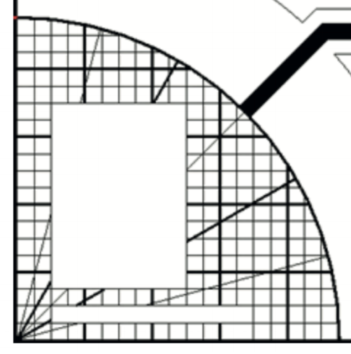
Starting Points in Launch are Critical
In FIRST LEGO League, teams need to figure out where to start in the launch area
Jigs: a LEGO ruler/wall that your robot can align against them in base (the red triangle is an example of a jig)
Same start each time: pick one spot and start there no matter what the mission for easy starts
Grid/Radial Lines: Use the grid lines to pick a starting spot for each run
Words: Launch has a FIRST LEGO League logo. You can use letters in the logo or the border for the image to line up
Even better…try to find a way to align the robot using other techniques (see slide 6)
Use a jig
Use grid lines or logo border

Slide 6
Errors Accumulate Over Time
By the time you get to the far side of the table, you are no longer in the right position
Solution: Repeat alignment techniques multiple times in a run for better reliability (see slide 7)
A
Mission Model 1
E
A
Mission Model 2
E

Slide 7
Where Are You on the Competition table?
These are common alignment strategies used:
Align on walls – deliberately back into a wall to straighten out
Square/Align on lines –If you are moving angled, you can straighten out whenever you see a line using two color sensors
Move until a line – travel until you find a line so you know where you are on the mat
Align on a mission model – Mission models that are stuck down with dual-lock can be used to align against
A
Back into walls
E
A
Square on a line
E
A
Align on a mission model
E
Mission Model

Slide 8
Other Factors in Reliability
Battery life
If you program your robot when the battery life is low, it won’t run the same when fully charged
Motors behave differently with low battery
But using sensors makes you not as dependent on battery
LEGO pieces come apart over time:
Squeeze in LEGO pieces in key areas before a run – the pegs get loose which means the sensors may not be in the same place as a previous run
Push wires in for sensors and motors. They come out!
Motors and sensors don’t always match:
Some teams test motors, sensors and wheels to make sure that they match
You will never get a perfect match so we recommend use other techniques and accept that they will be different

Slide 9
CREDITS
This lesson was created by Sanjay Seshan and Arvind Seshan for SPIKE Prime Lessons
More lessons are available at www.primelessons.org
This work is licensed under a Creative Commons Attribution-NonCommercial-ShareAlike 4.0 International License.

